Slide 1












CSC358: Principles of Computer Networks
Lecture 9 – Part 3: Web and HTTP
mobile network
4G
national or global ISP
Streaming
video
Skype
IP
local or regional ISP
home network
content
provider
network
HTTP
datacenter
network
Ethernet
TCP
enterprise
network
Erfan Meskar
Winter 2025, University of Toronto, Mississauga

Slide 2
Today’s Outline
Part 1:
Putting Things Together (review)
Part 2:
Socket Abstraction
Part 3:
The Web and HTTP
HTTP and improving its performance
Pipelined, Persistent, Caching
Part 4:
Transport Layer

Slide 3
The Web
World Wide Web (WWW): a distributed database of “pages” linked through Hypertext Transport Protocol (HTTP)
First HTTP implementation – 1990
Tim Berners-Lee at CERN
HTTP/0.9 – 1991
Simple GET command for the Web
HTTP/1.0 – 1992
Client/Server information, simple caching
HTTP/1.1 – 1996

Slide 4
Web Components
Web infrastructure:
Clients, servers and proxies
Web content:
Individual objects (files, etc.)
Web sites (coherent collection of objects)
Implementation
URL (Uniform Resource Locator): includes the location (address) of a resource
Protocol for exchanging content (main protocols are HTTP and HTTPS)

Slide 5
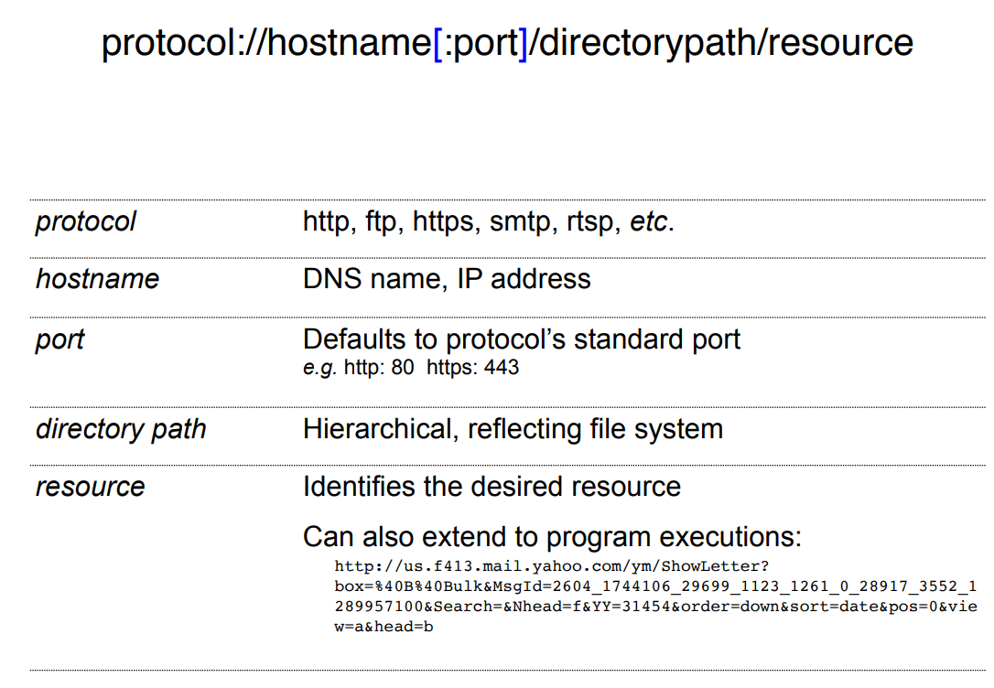
URL Syntax

Slide 6
Hyper Text Transfer Protocol (HTTP)
HTTP is the foundation of data communication on the Web.
It is a protocol that defines how Web browsers and Web servers communicate.
Key Features of HTTP
Client-server architecture
Server is “always on” and “well known”; Clients initiate contact to server
Request-Response Model – Clients send requests, and servers send responses.
Stateless – Each request is independent; the server does not remember previous requests.
Text-Based Protocol – Messages are human-readable (ASCII format) and consist of headers and body.
HTTP supports different methods, such as GET, POST, PUT, and DELETE for interacting with resources.
HTTP runs over TCP. Server listens for HTTP on well-known port 80. (A later secure version uses 443.)

Slide 7
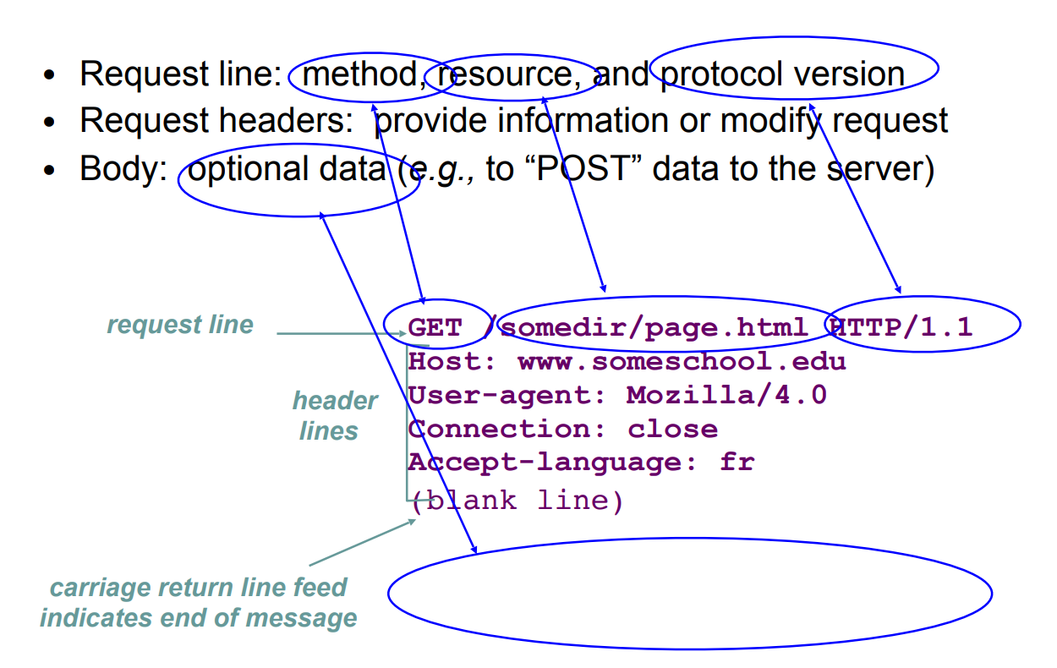
HTTP Request Message

Slide 8
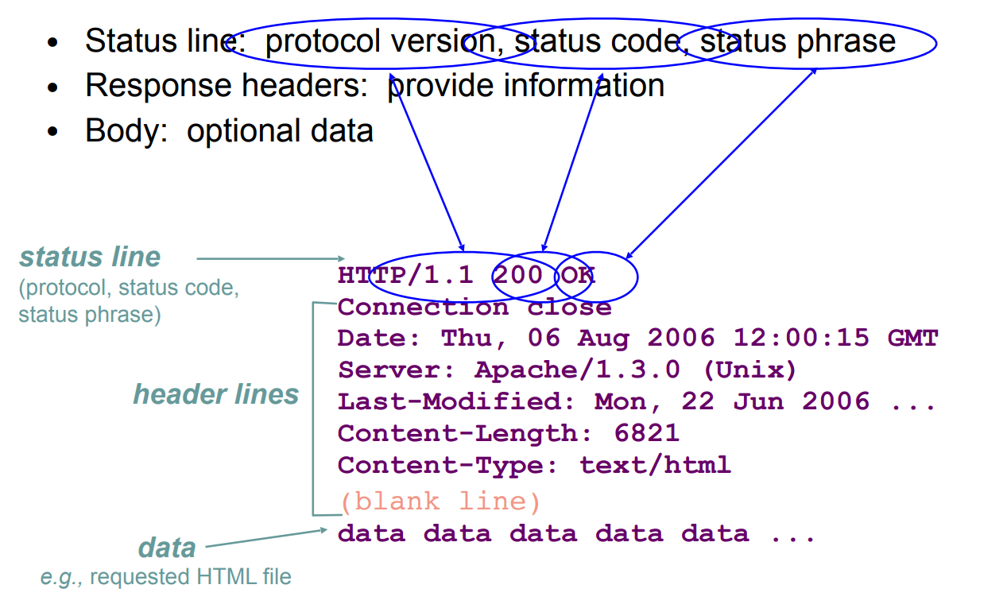
HTTP Response Message

Slide 9
HTTP is Stateless
HTTP is stateless. Each request-response is treated independently
Servers are not required to retain state for HTTP. Each HTTP request is independent; the server does not remember previous HTTP requests.
Pros: Improves scalability on the server-side
Failure handling is easier
Can handle higher rate of requests
Order of requests doesn’t matter (to HTTP)
Cons: Some applications need persistent state since they need to uniquely identify user or store temporary info
e.g., Shopping cart, user profiles, usage tracking, …
Question: How can we have a stateful communication over the stateless HTTP protocol?

Slide 10
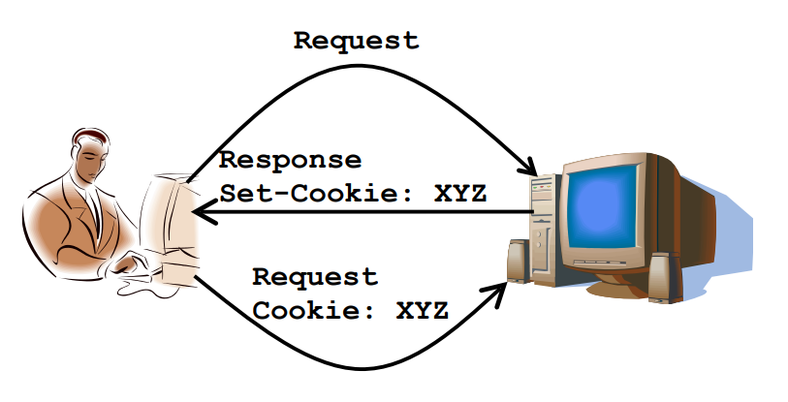
Stateful Communication on Stateless HTTP: Cookies
To have a stateful communication over HTTP, we need to have client-side state maintenance
HTTP cookie (also called cookie) is a small block of data created by a Web server and sent to the client
Client stores the cookies
i.e., client stores the state on behalf of server
Client sends state in future requests to the server
The server can then read the cookies and use their values (for example, to maintain a logged-in session or store user preferences).
Server responded and set the cookies

Slide 11
Today’s Outline
Part 1:
Putting Things Together (review)
Part 2:
Socket Abstraction
Part 3:
The Web and HTTP
HTTP and improving its performance
Persistent, Pipelined, Caching
Part 4:
Transport Layer

Slide 12
HTTP Performance Issues – multiple objects
Most Web pages have multiple objects
e.g., HTML file and a bunch of embedded images
How do you retrieve those objects?

Slide 13
HTTP Improvements: Persistent Connections
Naïve approach: non-persistent connections
Establish a new connections per object. The connection then will be terminated by the server after sending each response
Pros: The server does not need to maintain multiple open connections. This makes it more scalable.
Cons: This approach is not efficient. Each connection establishment requires 2RTTs
Client (random port)
GET /googlelogo.png HTTP/1.1
Server (port 80)
GET /googleicon.png HTTP/1.1

Slide 14
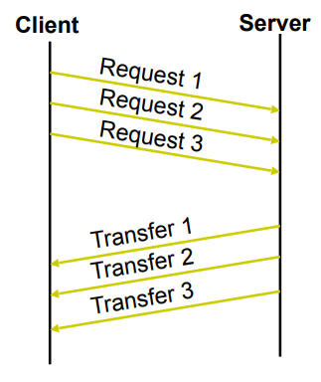
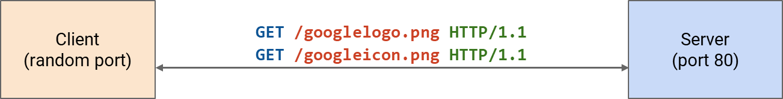
HTTP Improvements: Persistent Connections, cont’d
Smarter approach: Persistent connections
the connection between the client and the server remains open after the initial request/response pair
The connection remains open until either the client or the server decides to close it (using connection: close header or other mechanisms).
Cons: More efficient.
Less overhead: No need to repeatedly establish new connections for each resource.
Allow multiple requests to be pipelined.
Pros: The server must maintain more open connections.
In HTTP/1.1, persistent connections is the default behavior.

Slide 15
HTTP Performance Issues – same requests
It is quite common that many users request the same resource
How do we send them the common resource?

Slide 16
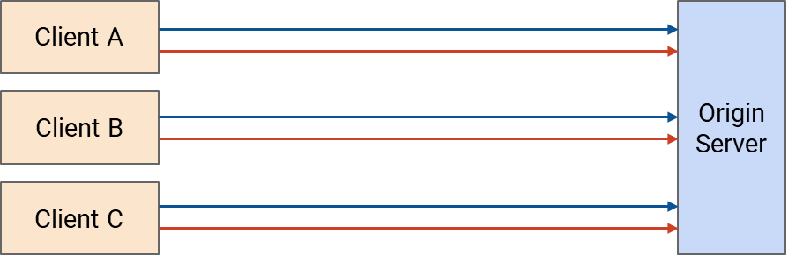
HTTP Improvements: Cache
Naïve approach: Every request goes to the origin server.
Three clients each request the same resource twice.
= first request
= second request

Slide 17
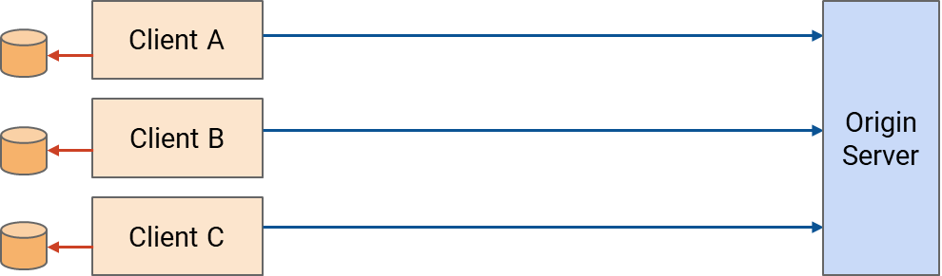
HTTP Improvements: Cache
Smarter approach: Use cache
We study two types of cache
Private cache
Proxy
Three clients each request the same resource twice.
= first request
Proxy Cache
Client A
Origin Server
= second request
Client B
Client C

Slide 18
HTTP Improvements: Cache
Private cache
Private caches are tied to a specific end client (e.g., in a user's browser).
When a user requests something for the second time, they can use the cache.
Three clients each request the same resource twice.
= first request
= second request

Slide 19
HTTP Improvements: Cache
Proxy cache
Proxy caches are in the network (not end host).
When a user requests something for the second time, they can use the cache. The first client's first request goes to the origin server.
All subsequent requests can be served by the proxy cache.
Proxy caches are operated by a third party (not the client or server).
Proxy Cache
Three clients each request the same resource twice.
Client A
Origin Server
Client B
= first request
= second request
Client C

Slide 20
HTTP Performance Improvements: Caching
One of the most active areas of research is how to effectively cache Web pages.
Benefits caching:
From the client’s perspective: A page that can be retrieved from a nearby cache can be displayed much more quickly
From the server’s perspective: Reduces the load on the server
From the network’s perspective: Reduces the load on the network

