Slide 1












CSC358: Principles of Computer Networks
Lecture 10 – Part 1: TCP Connection Establishing
mobile network
4G
national or global ISP
Streaming
video
Skype
IP
local or regional ISP
home network
content
provider
network
HTTP
datacenter
network
Ethernet
TCP
enterprise
network
Erfan Meskar
Winter 2025, University of Toronto, Mississauga

Slide 2
Today’s Outline
TCP: Reliability Over a Best-Effort Network
Providing a Byte-stream abstraction (We saw it last week)
Part 1: Providing a connection-oriented service
Provides a reliable communication with ARQ
Part 2: Flow Control with Sliding Window
Part 3: Retransmission Time-Out and Fast Retransmission

Slide 3
TCP Initial Sequence Number (ISN)
TCP uses a random number for ISN.
Why not just using ISN = 0 for all connection? It leads to some practical issue.
IP addresses and port numbers uniquely identify a connection. Eventually, though, these port numbers do get used again
There’s a small chance that an old packet is still in flight, and we had already stablished a new connection with the same IP addresses and port numbers.
When the old packet is delivered to the receiver, it mistakenly interpret the packet to coming from the new connection!
With ISN always set to 0, others can spoof your connection more easily (i.e., it makes it easier for them to guess your sequence numbers).
Random ISN helps addressing these issues:
Thus, TCP requires hosts to exchange ISNs when they establish a connection.

Slide 4
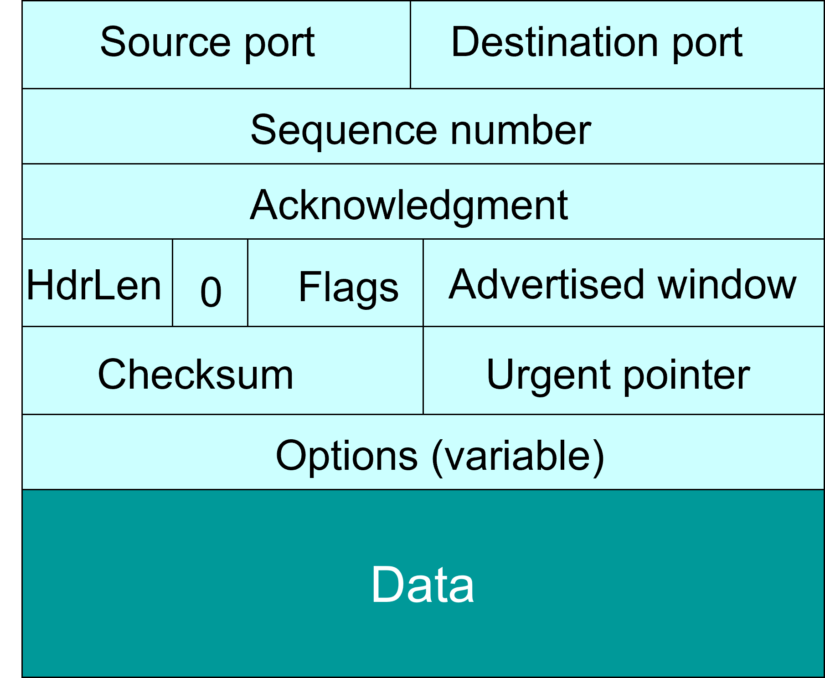
Establishing a TCP Connection, Step 1
TCP uses Three-Way Handshake to establish connection
Host A sends a SYN (open; “synchronize sequence numbers”) to host B
Host A tells Host B that it wants to stablish a connection.
Host A tells Host B what port number it uses.
It announces to Host B what is the ISN value that Host A uses in its sending buffer.
A
B
SYN
The number of words (i.e., 4 bytes) in the header
A’s port
B’s port
A’s ISN
(Irrelevant since ACK not set)
5
Advertised window
000000
URG=0
PSH=0
SYN=1
RST=0
FIN=0
ACK=0
Checksum
Urgent pointer
Options (variable)
Recall: TCP general packet structure

Slide 5
Establishing a TCP Connection, Step 2
TCP uses Three-Way Handshake to establish connection
Host B returns a SYN acknowledgment (SYN ACK)
Host B confirms that it is ready to establish a connection.
Host B announces to Host A what is the ISN value that Host B uses in its sending buffer.
It acknowledges that it is ready to receive byte number A’s ISN + 1
Upon receiving this packet, A can start sending data.
A
B
SYN
SYN ACK
B’s port
A’s port
B’s ISN
A’s ISN + 1
5
Advertised window
000000
PSH=0
SYN=1
RST=0
FIN=0
URG=0
ACK=1
Checksum
Urgent pointer
Options (variable)

Slide 6
Establishing a TCP Connection, Step 3
TCP uses Three-Way Handshake to establish connection
Host A sends an ACK to acknowledge the SYN ACK
It acknowledges that it is ready to receive byte number B’s ISN + 1
A
B
SYN
SYN ACK
ACK
A’s port
B’s port
A’s ISN
B’s ISN + 1
5
Advertised window
000000
URG=0
PSH=0
SYN=0
RST=0
FIN=0
ACK=1
Checksum
Urgent pointer
Options (variable)

Slide 7
Timing Diagram: 3-Way Handshaking
Passive Open
Active Open
Server
Client (initiator)
listen()
connect()
SYN, SeqNum = x
SYN + ACK, SeqNum = y, Ack = x + 1
ACK, Ack = y + 1

Slide 8
What If The SYN Packet Gets Lost?
Suppose that the SYN packet is lost inside the network, or server discards the packet (e.g., it’s too busy)
In both cases, no SYN-ACK arrives at the sender.
What should be done in such cases?
Sender sets a timer when sending out a SYN packet.
It waits for the receiving the SYN-ACK. If the timer expires before receiving the SYN-ACK, it retransmits the SYN packet.
How should the TCP sender set the timer?
Sender has no idea how far away the receiver is
Hard to guess a reasonable length of time to wait
According to RFCs 1122 & 2988, TCP uses a default of 3 seconds.
Some implementations instead use 6 seconds

Slide 9
SYN Loss and Web Downloads
User clicks on a hypertext link
Browser creates a socket and calls “socket.connect”
The “socket.connect” triggers the OS to transmit a SYN
If the SYN is lost, TCP must wait 3-6 seconds to retransmit the SYN packet.
3-6 seconds of delay can be very long for a user. Thus, user usually becomes impatient and clicks the hyperlink again, or click “reload”
i.e., user triggers an “abort” of the “connect”
Browser creates a new socket and another “connect”
Essentially, forces a faster send of a new SYN packet.
Sometimes very effective, and the page comes quickly!

Slide 10
Tearing Down the Connection
B
Closing (each end of) the connection
Finish (FIN) to close and receive remaining bytes
And other host sends a FIN ACK to acknowledge
Reset (RST) to close and not receive remaining bytes
We won’t study how FIN or RST procedure works in TCP.
For the sake of exam, you are only expected to know their differences that are described above.
ACK
SYN
SYN ACK
Data
ACK
FIN
ACK
FIN
ACK
A
time

