Slide 1












CSC358: Principles of Computer Networks
Lecture 10 – Part 2: TCP Flow Control
mobile network
4G
national or global ISP
Streaming
video
Skype
IP
local or regional ISP
home network
content
provider
network
HTTP
datacenter
network
Ethernet
TCP
enterprise
network
Erfan Meskar
Winter 2025, University of Toronto, Mississauga

Slide 2
Today’s Outline
TCP: Reliability Over a Best-Effort Network
Providing a Byte-stream abstraction (We saw it last week)
Part 1: Providing a connection-oriented service
Provides a reliable communication with ARQ
Part 2: Flow Control with Sliding Window
Part 3: Retransmission Time-Out and Fast Retransmission

Slide 3
Reliability with Automatic Repeat request (ARQ)
ACKs and timeouts are the main ingredients of any ARQ mechanism
Receiver sends ACK when it receives a packet
Sender waits for ACK and times out
Simplest ARQ mechanism is Stop and Wait
Send a packet, stop and wait until ACK arrives
But Stop and Wait ARQ is very inefficient …
Sender
Receiver
Packet
Timeout
ACK
Time

Slide 4
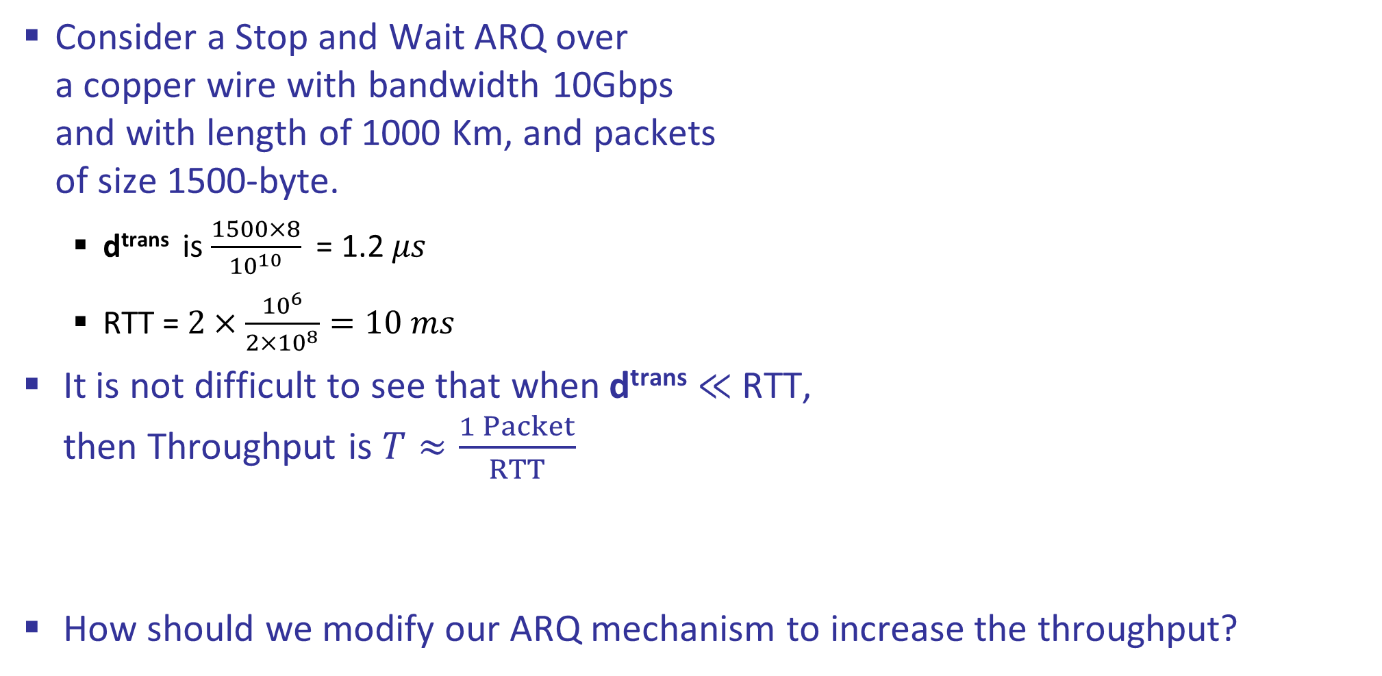
Stop & Wait ARQ is Inefficient
Consider a Stop and Wait ARQ over a copper wire with bandwidth 10Gbps and with length of 1000 Km, and packets of size 1500-byte.
$\text{d}\text{trans}$ is $\frac{1500×8}{{10}^{10}}$= 1.2 𝜇𝑠
RTT = $2×\frac{{10}^{6}}{2×{10}^{8}}=10 ms$
It is not difficult to see that when$\text{d}\text{trans}$ $≪$RTT, then Throughput is $T≈\frac{1 Packet}{RTT}$
How should we modify our ARQ mechanism to increase the throughput?
d^{trans}
DATA
RTT
ACK
Sender
Receiver

Slide 5
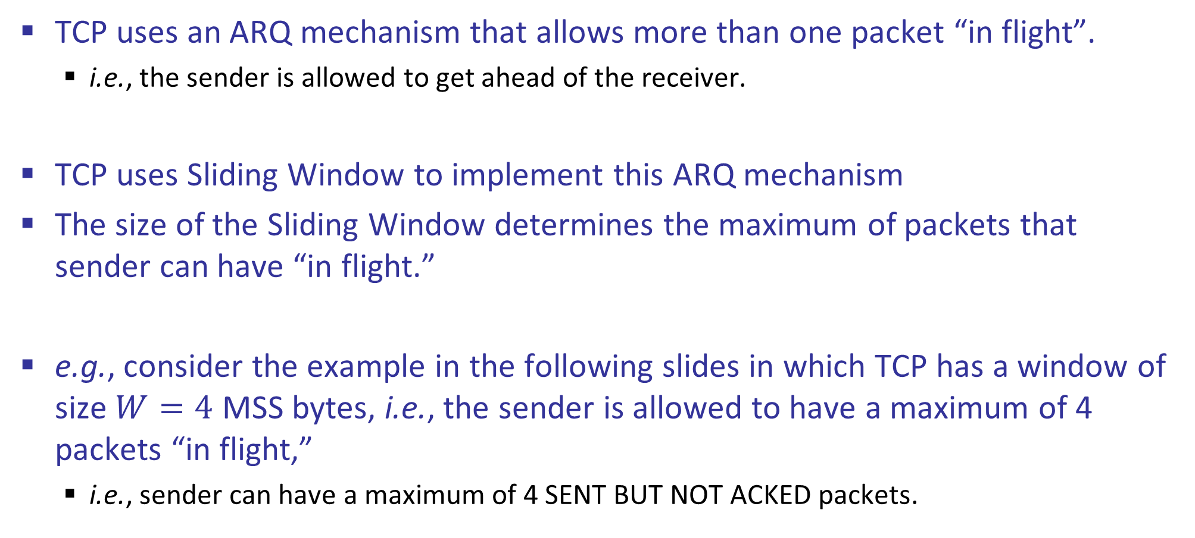
TCP Uses Sliding Window to Improve Throughput
TCP uses an ARQ mechanism that allows more than one packet “in flight”.
i.e., the sender is allowed to get ahead of the receiver.
TCP uses Sliding Window to implement this ARQ mechanism
The size of the Sliding Window determines the maximum of packets that sender can have “in flight.”
e.g., consider the example in the following slides in which TCP has a window of size $W=4$ MSS bytes, i.e., the sender is allowed to have a maximum of 4 packets “in flight,”
i.e., sender can have a maximum of 4 SENT BUT NOT ACKED packets.

Slide 6

TCP Uses Sliding Window ARQ
d^{trans}
Sender has 1 packet “in flight.”
Since $W = 4$ MSS bytes, it is allowed to send 3 more packets without waiting to receive ACK.
DATA
ACK
Sender
Receiver

Slide 7
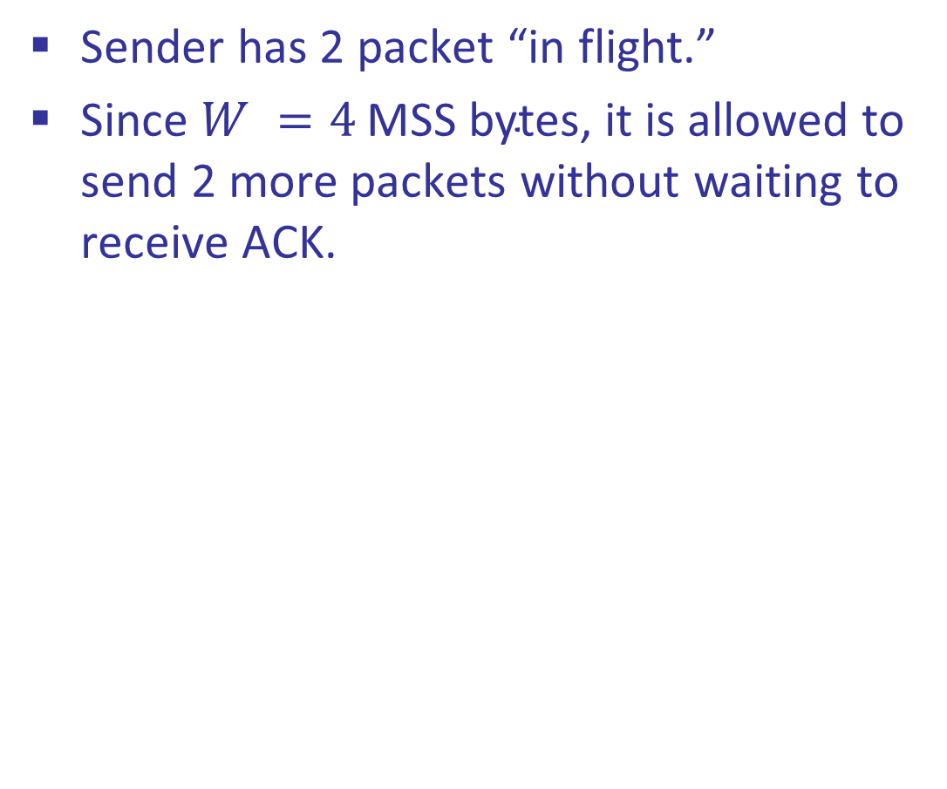
TCP Uses Sliding Window ARQ
d^{trans}
Sender has 2 packet “in flight.”
Since $W =4 \text{MSS} \text{bytes}$, it is allowed to send 2 more packets without waiting to receive ACK.
DATA
ACK
ACK
Sender
Receiver

Slide 8

TCP Uses Sliding Window ARQ
d^{trans}
Sender has 3 packet “in flight.”
Since $W =4 \text{MSS} \text{bytes}$, it is allowed to send 1 more packets without waiting to receive ACK.
DATA
ACK
ACK
ACK
Sender
Receiver

Slide 9
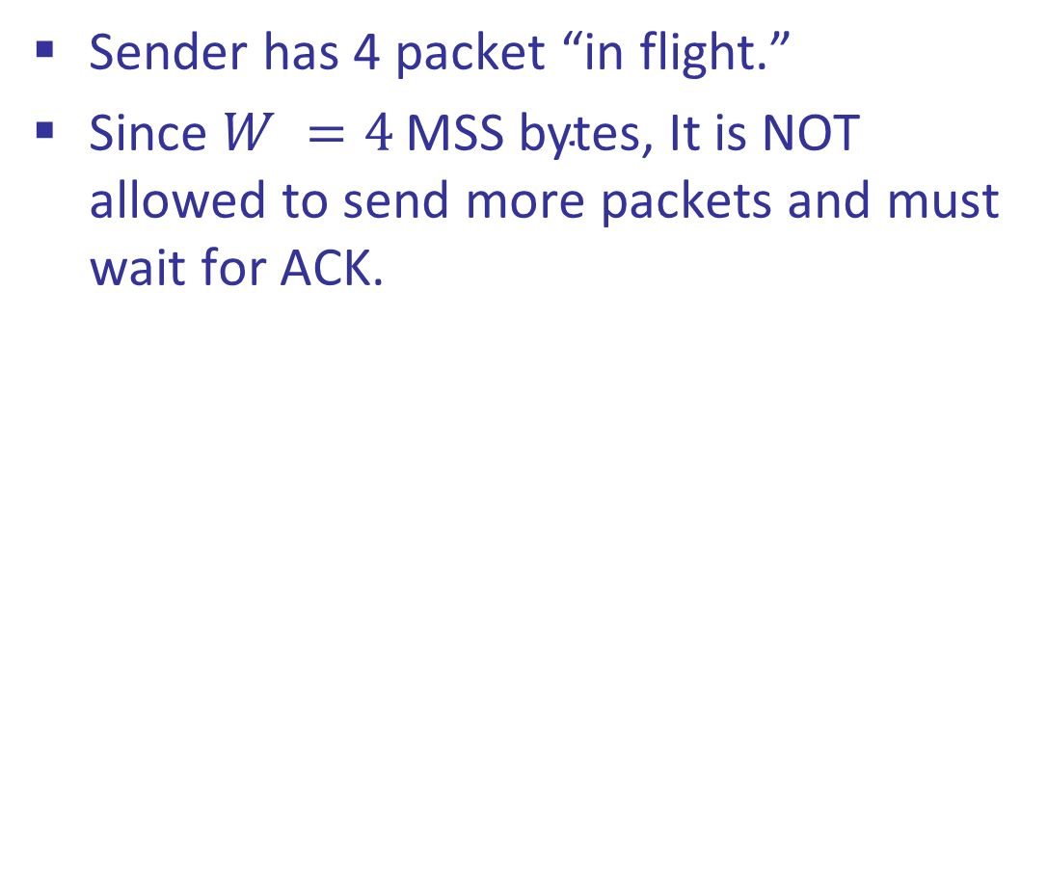
TCP Uses Sliding Window ARQ
d^{trans}
Sender has 4 packet “in flight.”
Since $W =4 \text{MSS} \text{bytes}$, It is NOT allowed to send more packets and must wait for ACK.
DATA
Sender
Receiver

Slide 10
TCP Uses Sliding Window ARQ
d^{trans}
It is NOT allowed to send more packets as it already has 4 packets “in flight.”
Keep waiting for ACK.
DATA
Sender
Receiver

Slide 11
TCP Uses Sliding Window ARQ
d^{trans}
Now that it received the ACK for one of its packets, it has only 3 packets “in flight.”
Thus, it is allowed to send one more packet.
DATA
RTT
Sender
Receiver

Slide 12

TCP Sliding Window and Throughput
d^{trans}
What is the Throughput now?
$T≈\frac{W}{RTT}$
DATA
RTT
Sender
Receiver

Slide 13
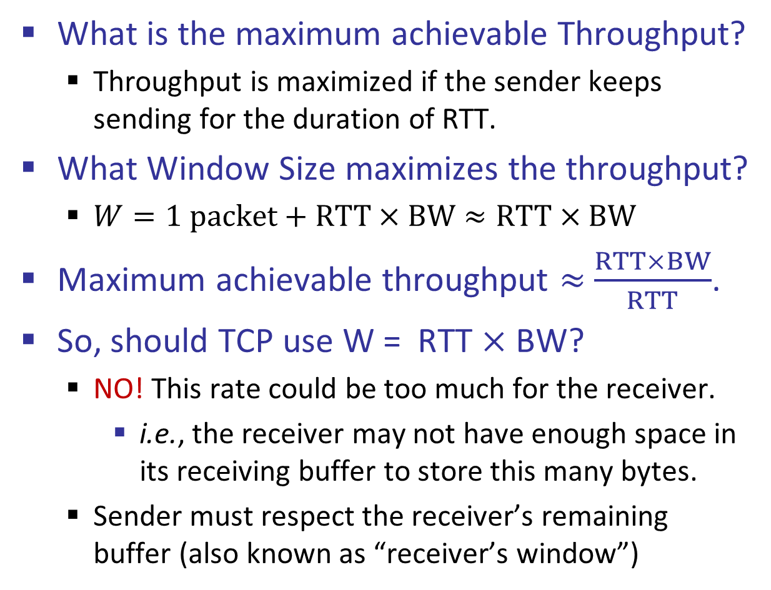
TCP Sliding Window and Throughput
What is the maximum achievable Throughput?
Throughput is maximized if the sender keeps sending for the duration of RTT.
What Window Size maximizes the throughput?
$W=1 packet+RTT×BW≈RTT×BW$
Maximum achievable throughput $≈$ $\frac{RTT×BW}{RTT}$.
So, should TCP use W = RTT $×$ BW?
NO! This rate could be too much for the receiver.
i.e., the receiver may not have enough space in its receiving buffer to store this many bytes.
Sender must respect the receiver’s remaining buffer (also known as “receiver’s window”)
d^{trans}
DATA
RTT
Sender
Receiver

Slide 14
Sender Should Respect Receiver’s Remaining Buffer
application process at receiver
Buffer size = 50 bytes
...
60
20
...
59
1
19
2
3
4
5
6
7
8
9
10
11
12
13
14
15
16
17
18
21
22
23
24
25
26
27
28
29
30
31
32
33
34
35
...
58
57
Received and processed (essentially this bytes are removed from the buffer)
Received but not processed
Sender should not overrun the receiver’s remaining buffer (a.k.a receiver’s window)
First unacked byte

Slide 15
Advertised Window (Flow Control)
Receiver uses an “Advertised Window” to prevent sender from overflowing its buffer
Receiver indicates available remaining buffer in ACKs
Sender limits number of bytes it can have in flight <= receiver’s window
source port
destination port
Sequence number
Acknowledgment number
Header length
Advertised window
000000
URG
PSH
SYN
RST
FIN
ACK
Counts in bytes
Counts in 4-bytes
Checksum
Urgent pointer
Options (variable)
Data

Slide 16
TCP Implementation of Sliding Window at Sender
TCP is implemented with bytes as the primary unit of data.
Window size is expressed in terms of number of bytes.
The window is a range of W contiguous bytes, starting at the first unacked byte.
Only these W bytes are allowed to be in flight.
The window slides right if and only if its leftmost bytes are acked.
Example: When 15–18 arrive, we can send 27–30.
Sending Buffer and Sliding Window
First unacked byte
1
2
3
4
5
6
7
8
9
10
11
12
13
14
15
16
17
18
19
20
21
22
23
24
25
26
27
28
29
30
31
32
33
...
...
...
Sent and acked
Window
W bytes
Not sent yet
First unacked byte
1
2
3
4
5
6
7
8
9
10
11
12
13
14
15
16
17
18
19
20
21
22
23
24
25
26
27
28
29
30
31
32
33
...
...
...
Sent and acked
Window
W bytes
Not sent yet

Slide 17
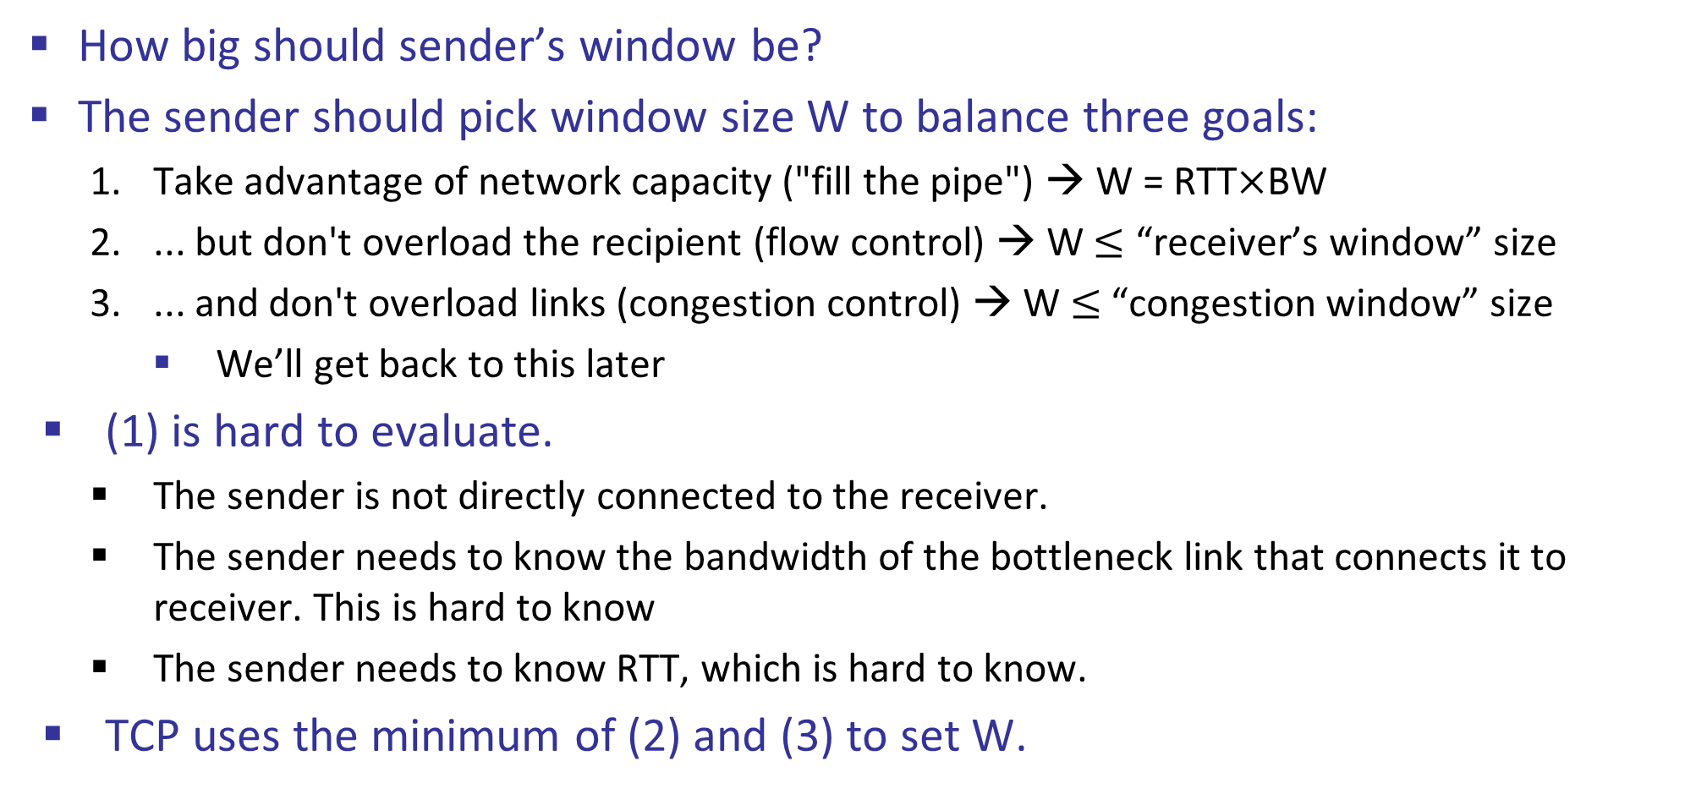
Setting Window Size
How big should sender’s window be?
The sender should pick window size W to balance three goals:
Take advantage of network capacity ("fill the pipe") → W = RTT$×$BW
... but don't overload the recipient (flow control) → W $≤$ “receiver’s window” size
... and don't overload links (congestion control) → W $≤$“congestion window” size
We’ll get back to this later
(1) is hard to evaluate.
The sender is not directly connected to the receiver.
The sender needs to know the bandwidth of the bottleneck link that connects it to receiver. This is hard to know
The sender needs to know RTT, which is hard to know.
TCP uses the minimum of (2) and (3) to set W.

