Slide 1












CSC358: Principles of Computer Networks
Lecture 10 – Part 3: TCP Retransmission
mobile network
4G
national or global ISP
Streaming
video
Skype
IP
local or regional ISP
home network
content
provider
network
HTTP
datacenter
network
Ethernet
TCP
enterprise
network
Erfan Meskar
Winter 2025, University of Toronto, Mississauga

Slide 2
Today’s Outline
TCP: Reliability Over a Best-Effort Network
Providing a Byte-stream abstraction (We saw it last week)
Part 1: Providing a connection-oriented service
Provides a reliable communication with ARQ
Part 2: Flow Control with Sliding Window
Part 3: Retransmission Time-Out and Fast Retransmission

Slide 3
So Far …
TCP provides:
A stream-of-bytes service
A connection-oriented service
To bring reliability, TCP:
Uses Sliding window algorithm (Flow Control)
TCP also needs to use Retransmission Time Out (RTO) to ensure reliability.
TCP detects loss when it sees a timeout and retransmits when time out expires.

Slide 4
How Should we Set Time Out Value?
Timeout
RTT
RTT
Timeout
Timeout too long → inefficient
Timeout too short → Unnecessary duplicate packets

Slide 5
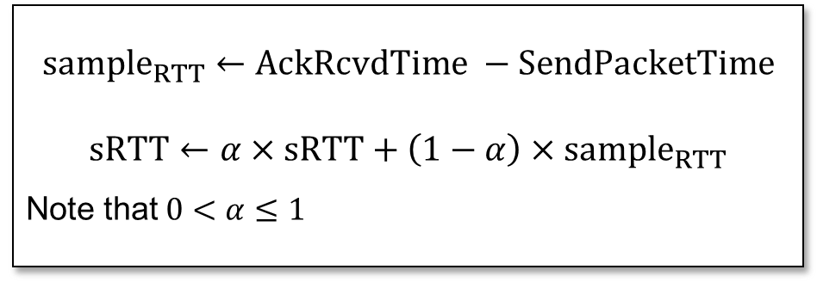

Setting Retransmission Timeout (RTO) with EWMA
Solution: make timeout proportional to RTT
But how do we measure RTT? RTT changes over time and is different for each packet.
Use Exponentially Weighted Moving Average (EWMA)
Whenever you send a new packet, measure how long it takes to receive its acknowledgment. This will give you a new sample for RTT.
Use these samples to get a smoothed estimate of the RTT.
$$sample_{RTT}$$
$$sample_{RTT}←AckRcvdTime −SendPacketTime$$
$$sRTT←α×sRTT+\left(1−α\right)×sample_{RTT}$$
Note that $0<α≤1$
sRTT
Time
sRTT = Smoothed RTT

Slide 6
Problem: Ambiguous Measurements
How do we differentiate between the real ACK, and ACK of the retransmitted packet?
Sender
Receiver
Sender
Receiver
Original Transmission
Original Transmission
SampleRTT
ACK
SampleRTT
Retransmission
Retransmission
ACK

Slide 7
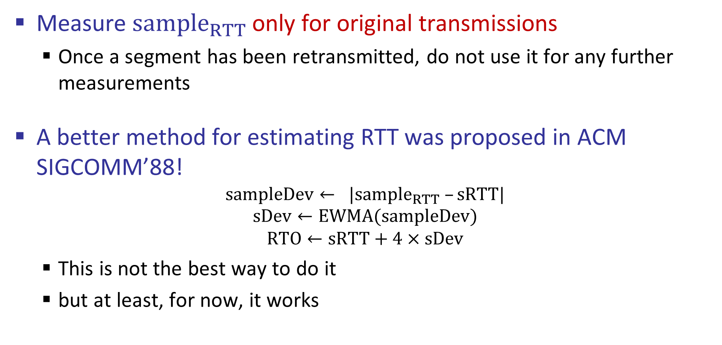
Retransmission Timeout (RTO)
Measure $sample_{RTT}$ only for original transmissions
Once a segment has been retransmitted, do not use it for any further measurements
A better method for estimating RTT was proposed in ACM SIGCOMM’88!
$$sampleDev← |sample_{RTT} –sRTT|$$
$$sDev←EWMA(sampleDev)$$
$$RTO←sRTT+4×sDev$$
This is not the best way to do it
but at least, for now, it works

Slide 8
Even Smarter Loss Detection: Fast Retransmission
So far, we detect loss by waiting for a timeout.
Sender sends packets with 100B and sequence no.:
Seq=100, Seq=200, Seq=300, Seq=400, Seq=500, Seq=600, Seq=700, Seq=800, Seq=900, …
Assume the fifth packet (sequence no. 500) is lost, but no others
Stream of ACKs will be:
ACK=200, ACK=300, ACK=400, ACK=500, ACK=500, ACK=500, ACK=500, …
Can we exploit this to retransmit fifth packet (even before timeout)?
“Duplicate ACKs” are a sign of an isolated loss
The lack of ACK progress means 500 hasn’t been delivered
Stream of ACKs means some packets are being delivered after packet with seq=500.
Therefore, could trigger resend upon receiving k duplicate ACKs
TCP uses k=3, i.e., “Triple Duplicate ACKs.”
This strategy is known as “Fast Retransmission” or “Triple Duplicate ACKs”
1st duplicate ACK
2nd duplicate ACK
3rd duplicate ACK

Slide 9
Effectiveness of Fast Retransmit
When does Fast Retransmission work best?
High likelihood of many packets in flight
Long data transfers, large window size, …
How about Web traffic? Does Fast Retransmission work well for Web traffic?
Most Web transfers are short (e.g., 10 packets)
So, often there aren’t many packets in flight
Making fast retransmit is less likely to “kick in”
Forcing users to click “reload” more often …

Slide 10
Putting Them Together: TCP
Stream-of-bytes service
Sends and receives a stream of bytes
Connection oriented
Explicit set-up and tear-down of TCP connection
Flow control
Prevent overflow of the receiver’s buffer space
Sliding windows
Reliable, in-order delivery
Detect Corruption: checksums
Detect loss/reordering: timers, sequence numbers, fast retransmission
Reliable delivery: acknowledgments and retransmissions

