Slide 1












CSC358: Principles of Computer Networks
Lecture 10 – Part 4: Basics of Congestion Control
mobile network
4G
national or global ISP
Streaming
video
Skype
IP
local or regional ISP
home network
content
provider
network
HTTP
datacenter
network
Ethernet
TCP
enterprise
network
Erfan Meskar
Winter 2025, University of Toronto, Mississauga

Slide 2
Today’s Lecture
Part 4: Principles of congestion control
Part 5: TCP congestion control
Part 6: Related TCP mechanisms
Nagle’s algorithm and delayed acknowledgments
Part 7: Network Address Translation (NAT)

Slide 3
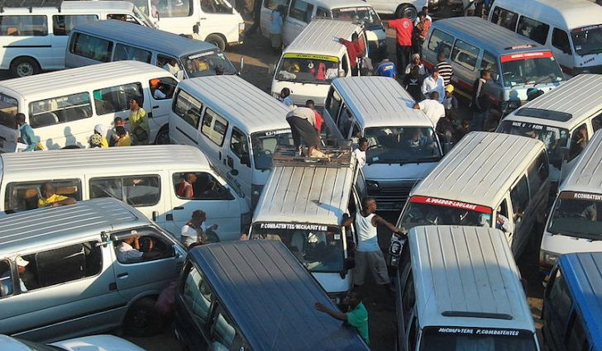
What is Congestion Collapse?
In mid-1980s, similar thing happened in Internet!
Network was fully utilized but no useful work was being done.
About 1000x throughput reduction
That incident showed us that flow control is not enough!

Slide 4
Statistical Multiplexing Leads to Congestion
Internet is based on packet switching
No BW reservation
Buffers are used to absorb transient load
If two packets arrive at a switch at the same time
Switch will transmit one and buffer/drop the other
Internet traffic is bursty
If many packets arrive close in time
the switch cannot keep up and it gets congested
causes packet delays and drops

Slide 5
Arguably Congestion is Good!
We use packet switching because it makes efficient use of the links.
Therefore, buffers in the routers are frequently occupied.
If buffers are always empty, delay is low, but our usage of the network is low
If buffers are always occupied, usage of the network is high, but delay is high
So, how much congestion is too much?
!
!

Slide 6
Congestion Collapse
Definition: Increase in network load results in a decrease of useful work done
Many possible causes
False retransmissions of packets still in flight
Classical congestion collapse
e.g., congestion collapses in 1980s
Undelivered packets
Packets consume resources and are dropped elsewhere in network

Slide 7
What Do We Want, Really?
We want high throughput and low delay
These two metrics are sometimes at odds
e.g., suppose you drive a link as hard as possible
… then, throughput will be high, but delay will be, too

Slide 8
Load, Delay, and Power*
Typical behavior of queuing
systems with random arrivals:
A simple metric of how well the
network is performing:
Average
Packet delay
Power
Load
Load
“optimal
load”
* This slide is out of the scope of the course. It is here for curious students who are interested in queueing theory
Goal: maximize power

Slide 9
We Want Fairness, As Well
Effective utilization is not the only goal
We also want to be fair to the various flows
But what the heck does that mean?
This is a serious question.
We need to define fairness. This is a hot research topic.
Who studies this? Philosophers, economists, computer scientists, Erfan, etc.
Simple definition: equal shares of the bandwidth
N flows that each get 1/N of the bandwidth?
But what if the flows traverse different paths?

Slide 10

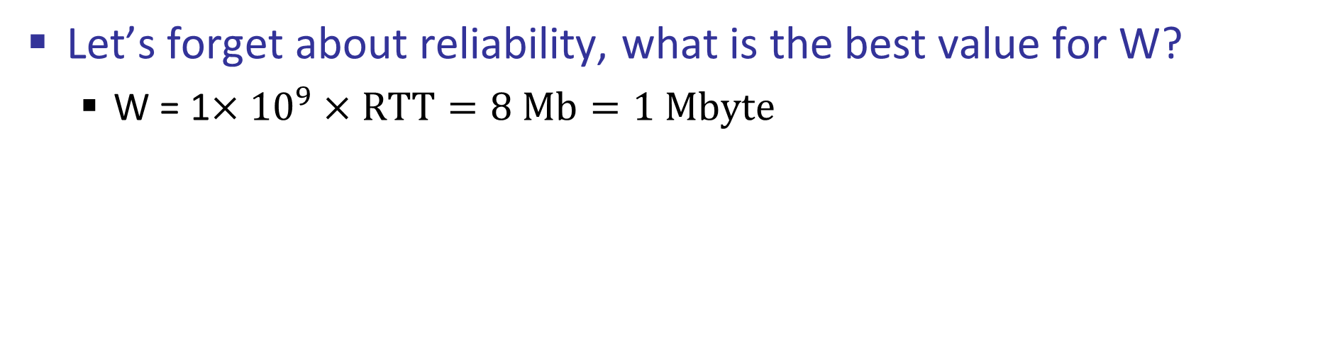
A Thought Experiment
W
1 Gbps
Sender
Delay: 4 ms
Let’s forget about reliability, what is the best value for W?
W = 1$×{10}^{9}×RTT=8 Mb=1 Mbyte$

Slide 11
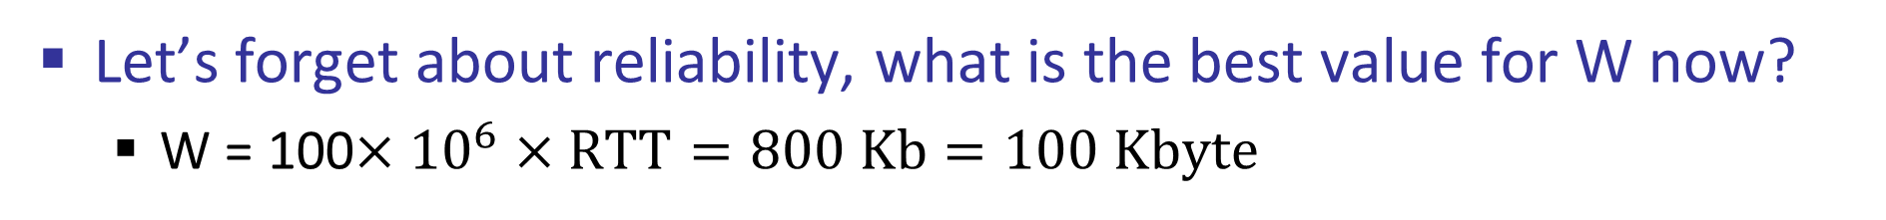
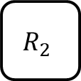
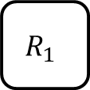
A Thought Experiment
W
1 Gbps
$$R_{1}$$
100 Mbps
$$R_{2}$$
1 Gbps
Sender
Delay: 4 ms
Let’s forget about reliability, what is the best value for W now?
W = 100$×{10}^{6}×RTT=800 Kb=100 Kbyte$

Slide 12
A Thought Experiment
W
Network
1Gbps
100Mbps
Sender
Delay: 10ms
What is the best sending rate, now?
We don’t know what’s going on inside the “Network.”
Who knows what the bottleneck BW is.

Slide 13

A Thought Experiment
W
Network
1Gbps
100Mbps
Sender
Receiver
Delay: 10ms
✓
How about now?!
We don’t know the bottleneck BW
We don’t know how many other users are there
But we should come up with an acceptable sending rate!

Slide 14
Congestion Control (CC) on the Internet is about …
Finding the congestion window (cwnd) size that maximizes your performance objective
I want Higher throughput
I want Lower delay
I want no lost packets
While being a good citizen
Be fair to others and respect them!
All that without having any prior knowledge of the network or other users!

Slide 15
Basics of Congestion Control: Probe
We need at least to know two things: RTT and bottleneck BW
How to find RTT?
Use sRTT estimations from older (like SYN) packets
How to find bottleneck link BW?
Trial and Error!
Start from a small number,
If everything is fine, increase your guess
If something is wrong (i.e., packet loss), decrease your guess
Important questions:
How much increase at each step?
How much decrease at each step?

Slide 16
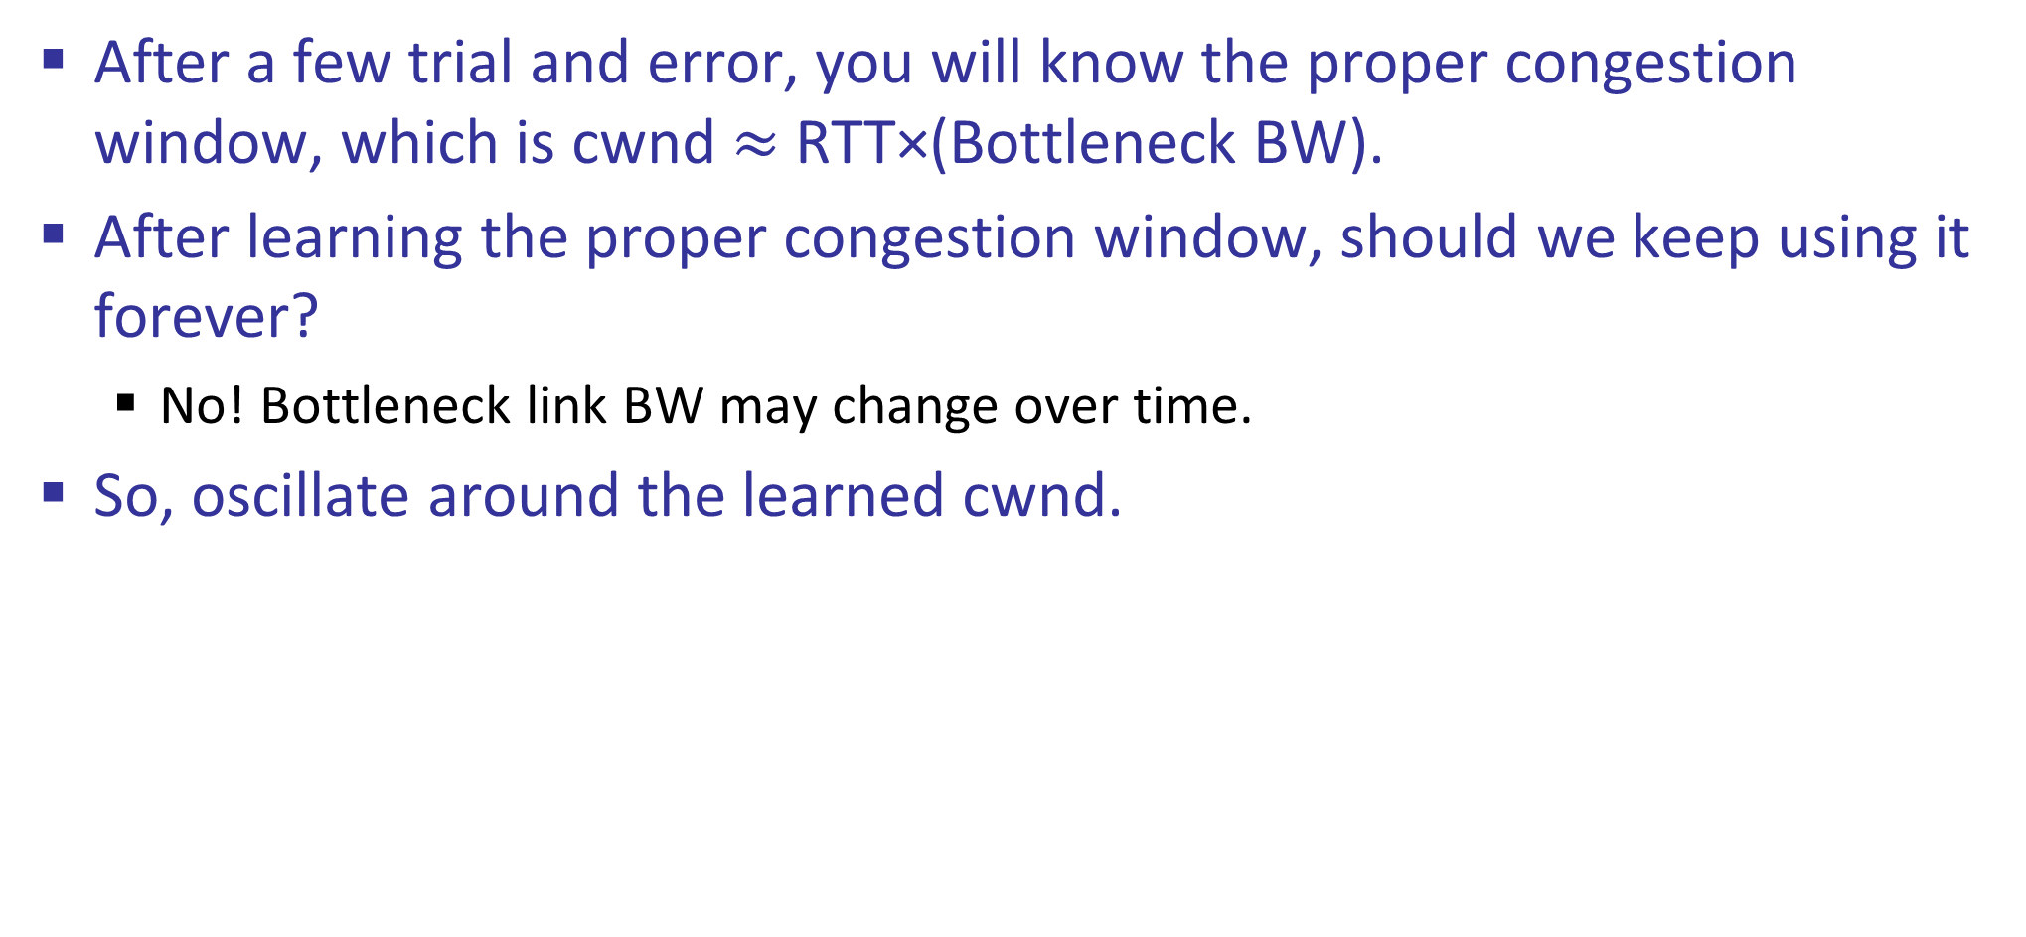
Basics of CC: Use Your Best Guess and Update
After a few trial and error, you will know the proper congestion window, which is cwnd $≈$ RTT×(Bottleneck BW).
After learning the proper congestion window, should we keep using it forever?
No! Bottleneck link BW may change over time.
So, oscillate around the learned cwnd.

Slide 17
Basics of CC: Fairness
What does it mean if you detect a packet loss?
Someone else is in the network?
Don’t hug the links forever!
Backoff and let others probe/use the network

Slide 18
Summary: Flow Control vs. Congestion Control
Flow control
Keeping one fast sender from overwhelming a slow receiver
Congestion control
Keep a set of senders from overloading the network
Different concepts, but similar mechanisms
TCP flow control: monitors receiver’s remaining buffer (receiver’s window)
TCP congestion control: monitors congestion window (cwnd)
TCP window W = min{cwnd, receiver’s window}

