Slide 1
IMAGE DATA FORMATS
Outline
    RGB image format and representation
    YUV image format and representation
    Grayscale
    Histograms

Slide 2
RGB COLOR SPACE
It is the most common format of image representation.
Each pixel is represented by three color channels: Red, Green, and Blue.
Typically stored in 3-channel matrices (CV_8UC3) where accessing is done through the data type cv::Vec3b.
Color intensity values are of type unsigned char (8-bit uchar) ranging from 0(darkest) to 255(brightest).

Slide 3
YUV COLOR SPACE
Popularly used in video image representation.
Color encoding system used in analog TV.
Bandwidth efficiency, as the luminance value of each pixel is prioritized over color information.
Sub-sampling into formats like YUV 444, YUV 422, YUV 420 etc.

Slide 4
Cntd...
In a YUV image, each pixel has three components (Y, U, V)
Y component represents the brightness information (grayscale image).
U and V components represent the color information.
Often stored in 3 channel matrices.

Slide 5
YUV 422
Image format with two channels
Each pixel contains y (intensity) value and either u(blue sensitivity) or v(red sensitivity) value
Highly efficient for broadcasting as low bandwidth required.

Slide 6


YUV Example
Original BGR Image
Retrived the Y(Grayscale values) only in single channel matrix

Slide 7
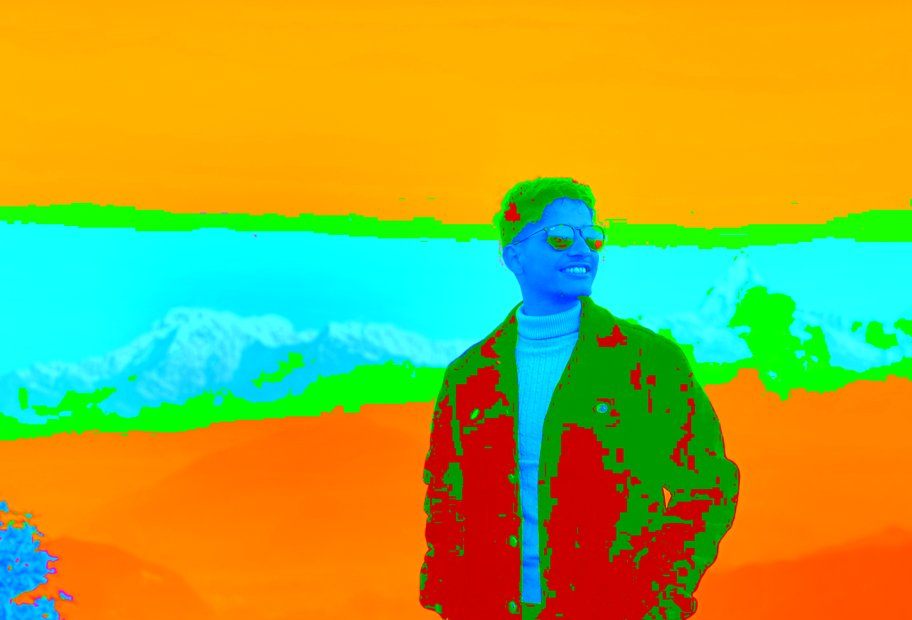
YUV 422 Example
Original BGR Image
Converted to YUV422 and back to BGR for display

Slide 8
Thresholding
Common Image Processing Technique for image segmentation and object detection
Binary Thresholding.
Adaptive Thresholding.

Slide 9
Binary Thresholding
Simple threshold technique that converts an image into a binary image.
A predefined threshold value is considered.
If the pixel intensity is above the threshold, it is set to the maximum value (e.g., 255).
If the pixel intensity is below the threshold, it is set to the minimum value (e.g., 0).

Slide 10
Adaptive Thresholding
An extension of binary thresholding that dynamically determines the threshold value for each pixel
Threshold value is based on the local image characteristics.
Techniques:
  Mean Adaptive thresholding.
  Gaussian Adaptive thresholding.

Slide 11
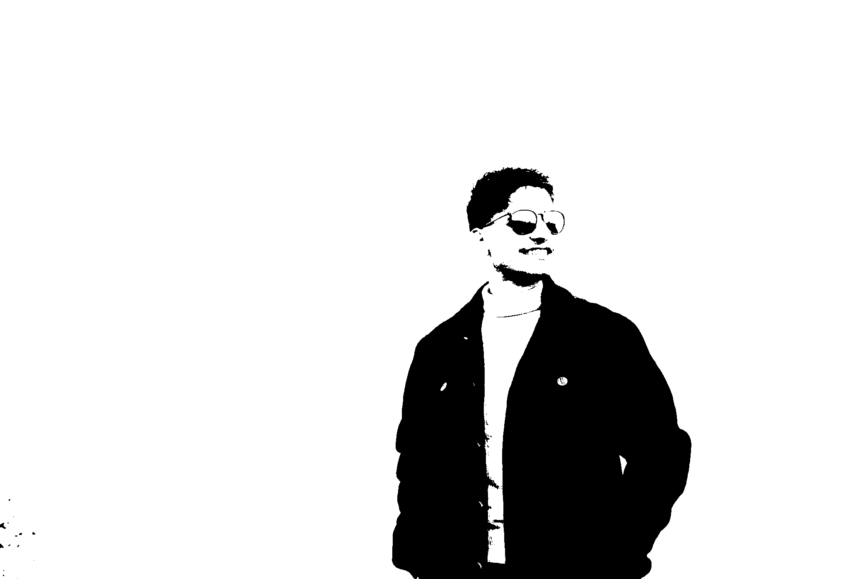
Example: Binary Thresholding
From custom static binThreshold() function
From cv::threshold() function

Slide 12
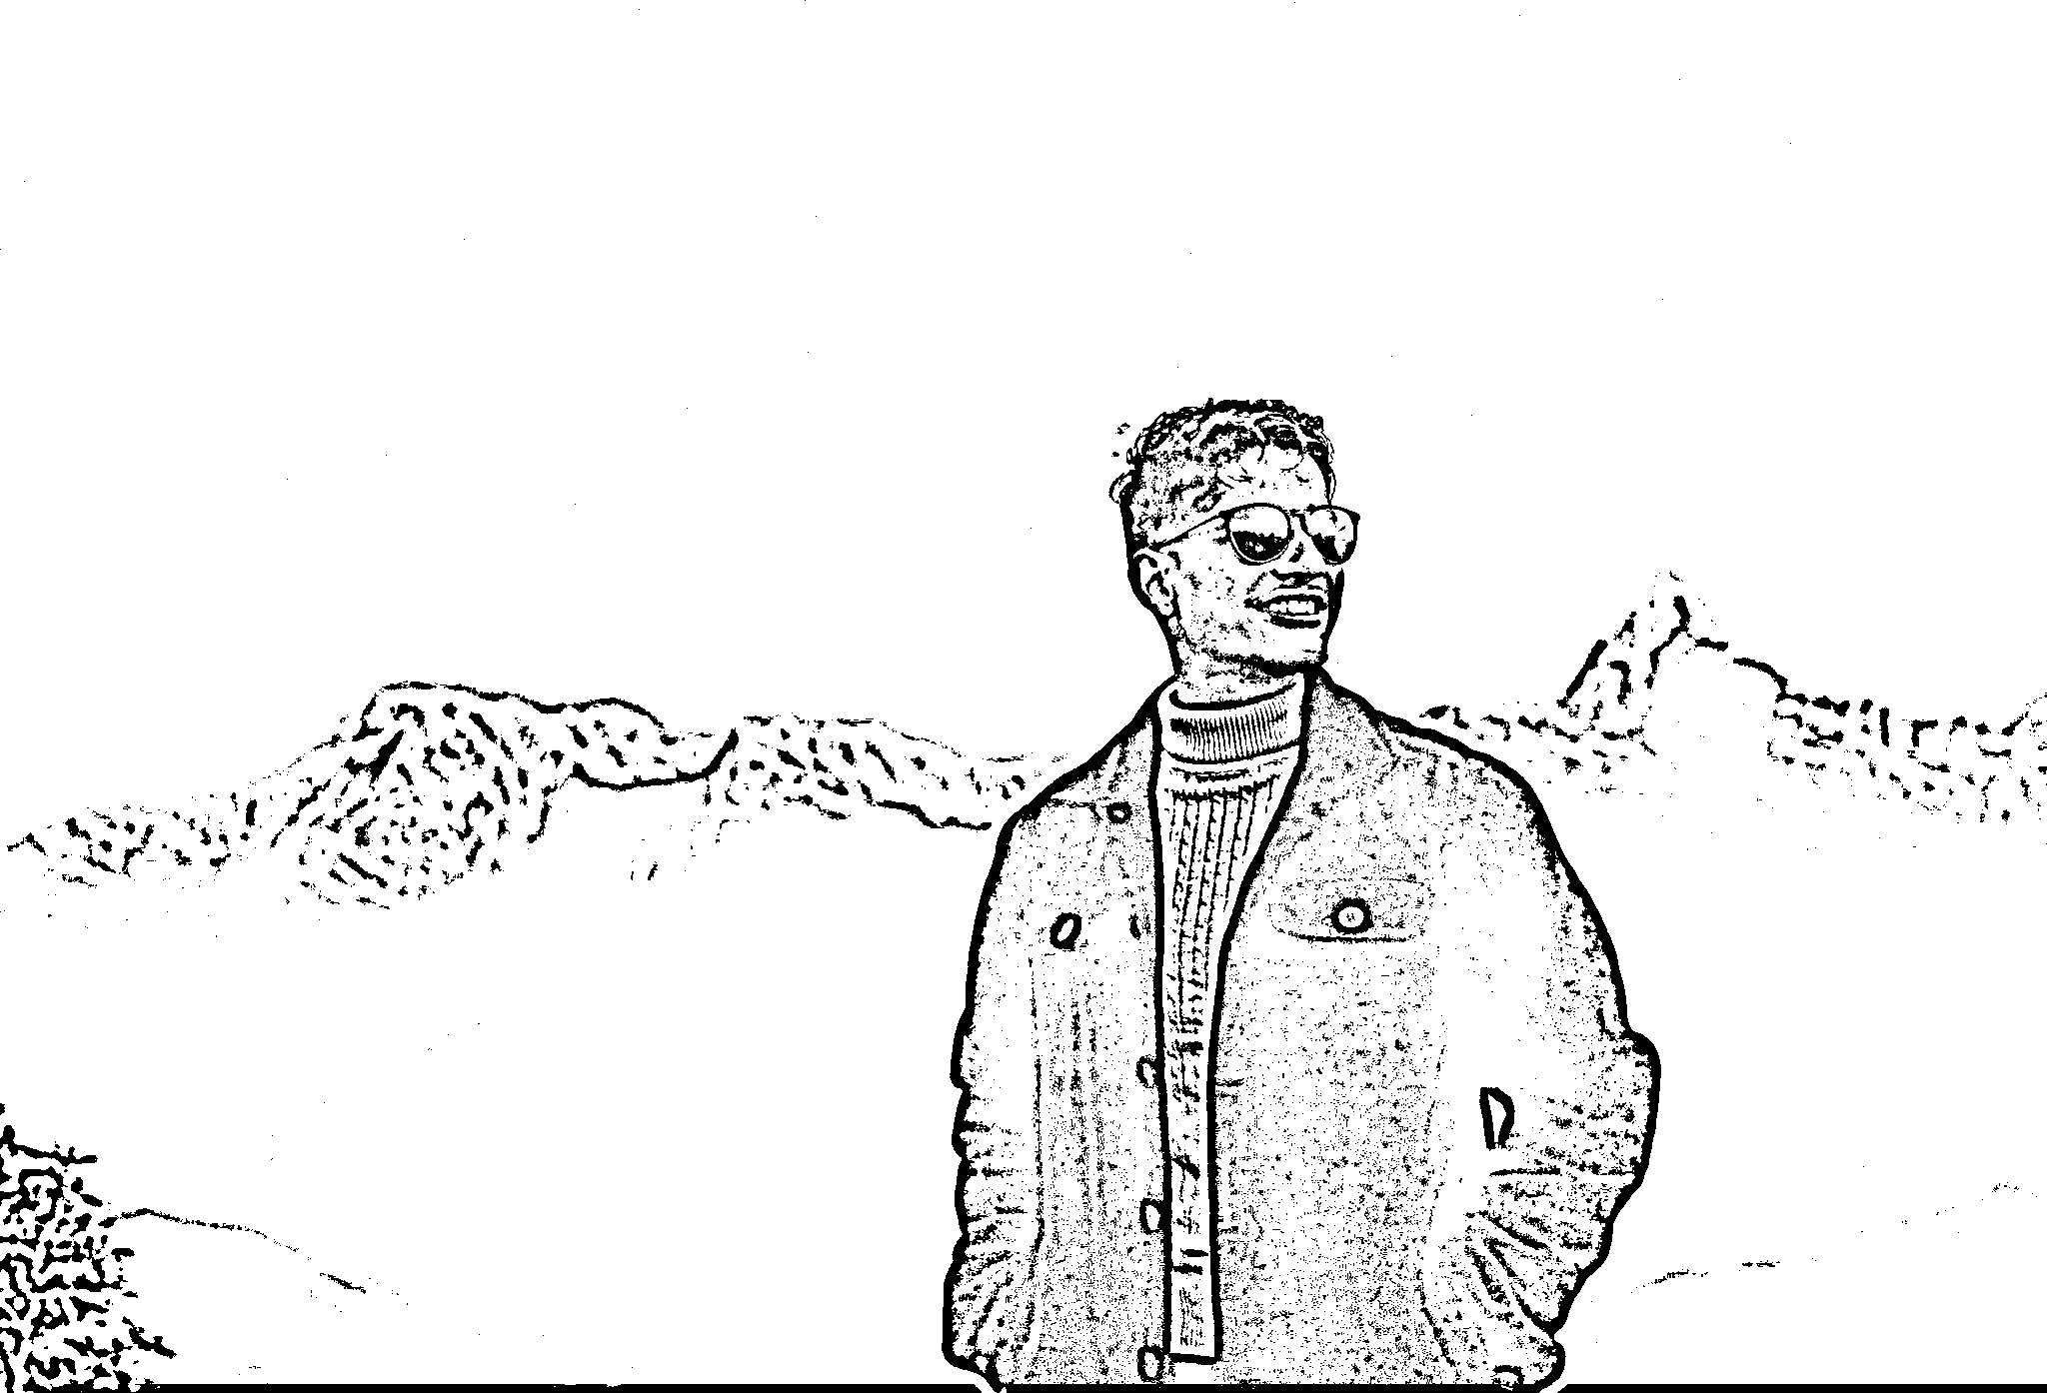
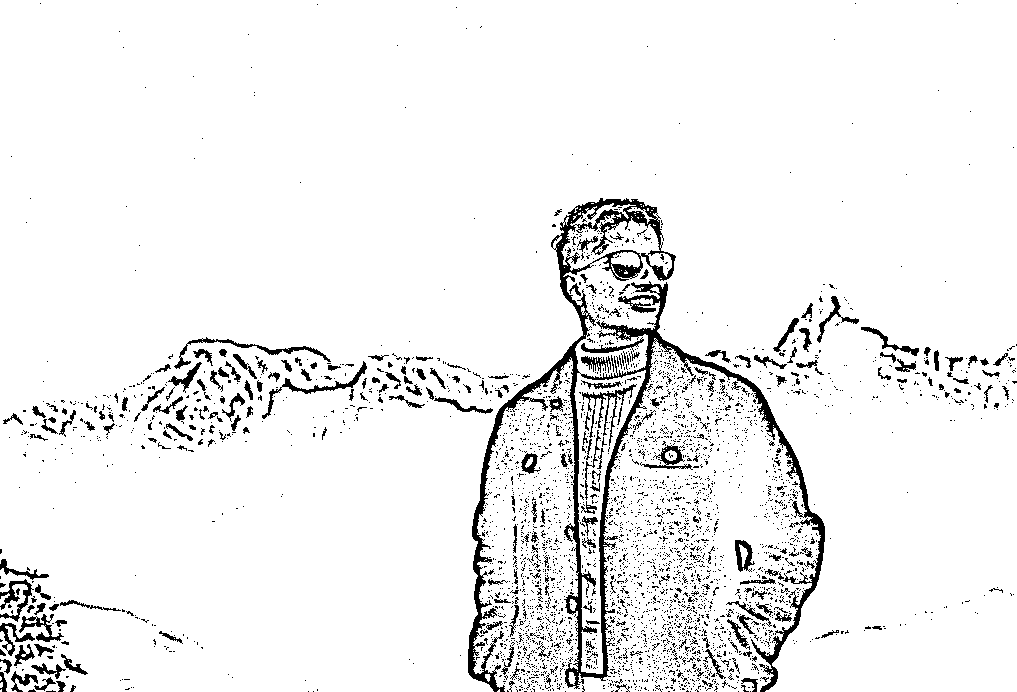
Example: Adaptive Thresholding
From cv::adaptiveThreshold() function
From custom static adThreshold() function

