Slide 1
Continuous Sensor Health Monitoring and
Risk/Capability-aware Graded MRM Supervision
for Fail-Safe Operation of Autonomous Vehicles
Taewook Eum
Sungkyunkwan University
Department of Electrical and Computer Engineering
Advisor: Prof. Tae Yong Kuc
1

Slide 2
Outline
• Background & Problem
• Related Work
• Proposed System: Health Monitoring & MRM Supervision
• Experimental Setup: 1,862-Case Closed Loop
• Results: Detection, Encounters, Causal Cap Effect
• Conclusion
2

Slide 3
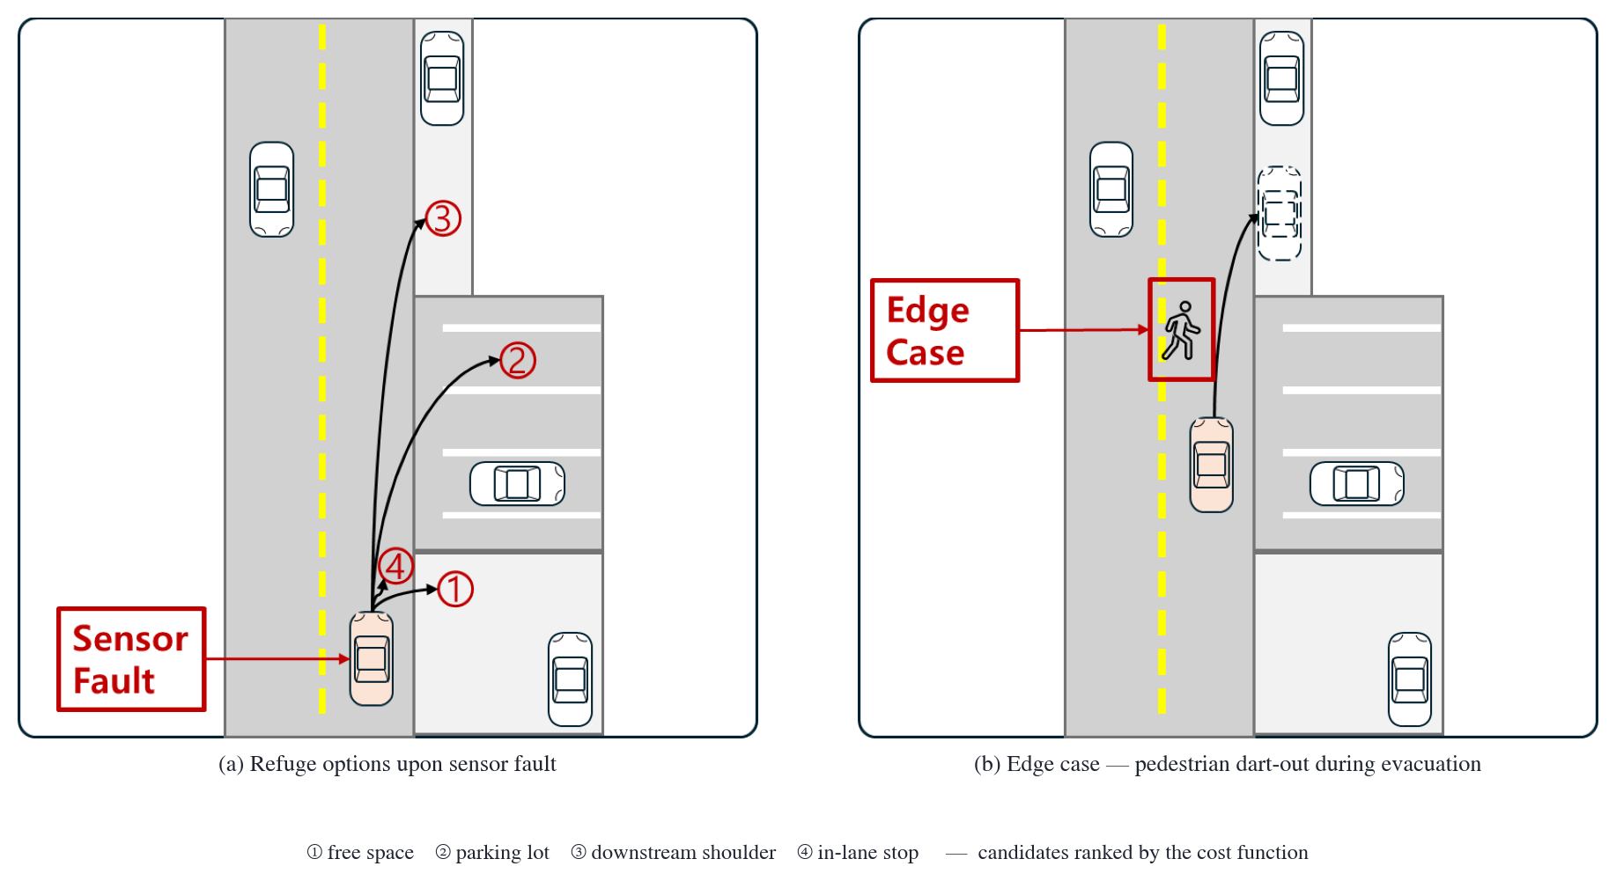
Background & Problem
• Level-4 autonomy must reach a minimal risk condition on its own — ISO 26262 FTTI; SOTIF (ISO 21448)
• Evaluated stock stack: in-lane stop only; faults unmonitored → 238–275 m blind driving
• Design axes: stop now? / how far? / how fast?
3

Slide 4
Related Work
• Adaptive-MRM studies presuppose the fault state (Xue 2018, Tang 2026)
– Selection by traffic TTC/THW
– Validation on representative scenarios
• This work: estimate faults online as a continuous health score
– Graded MRM selection + evacuation speed cap
– 1,862-case closed loop with verified collision verdicts
4

Slide 5
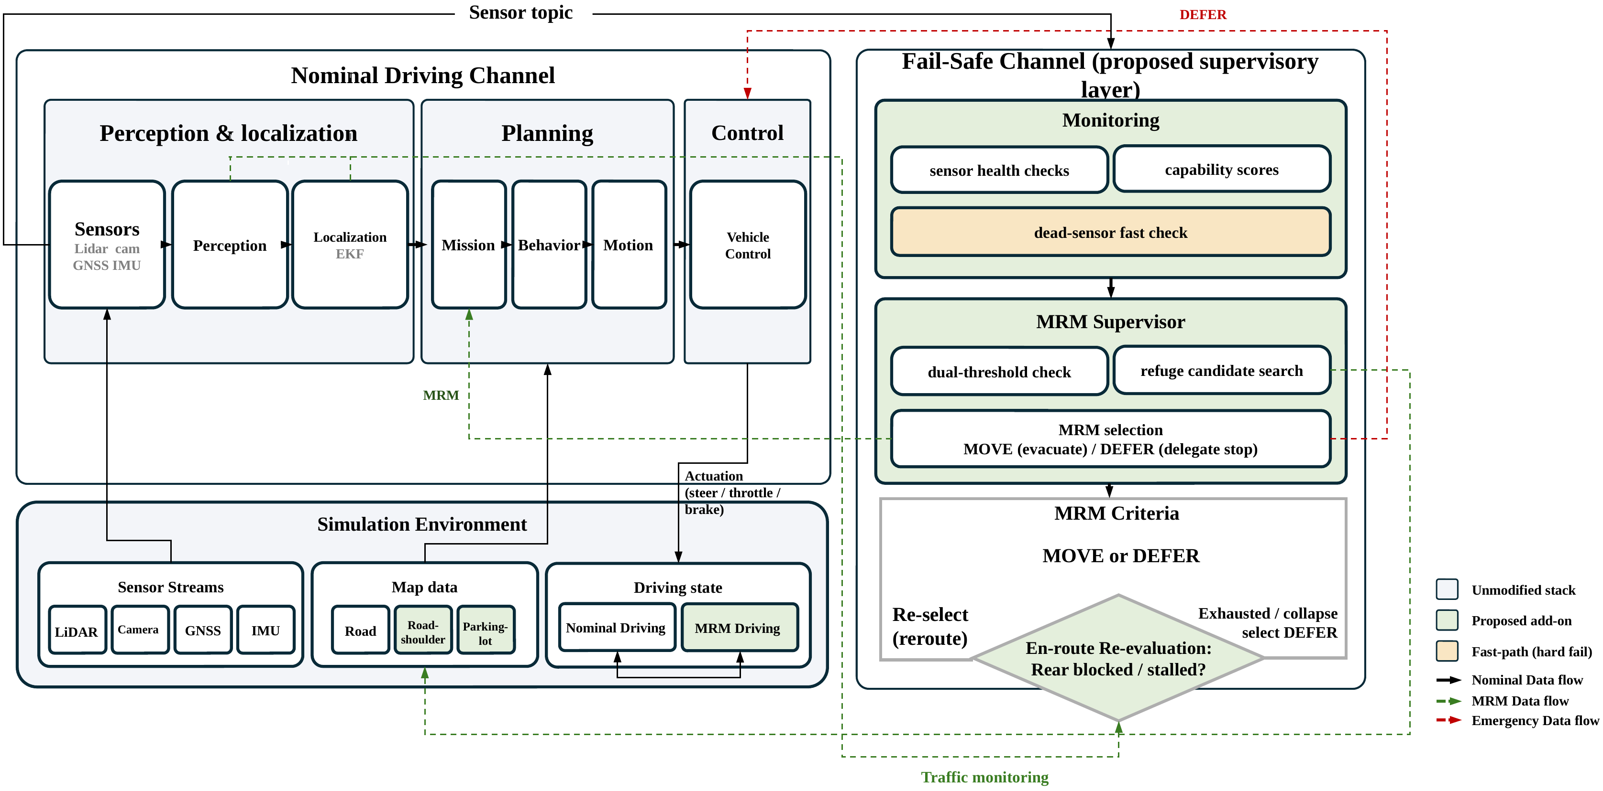
Proposed System
• Non-intrusive add-on: read-only monitoring, standard interfaces
• MOVE (reroute + speed cap) vs DEFER (delegate to stock stop)
5

Slide 6
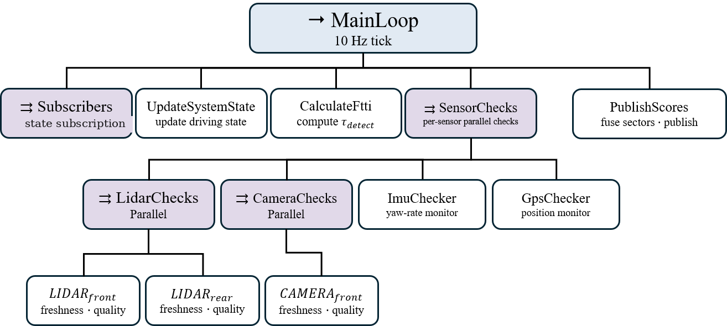
Continuous Health Scoring
• Freshness · quality · physics scores per sensor at 10 Hz (behavior tree)
• 8-sector fusion → health = min(perception, localization)
• Dual thresholds 0.7 / 0.3 → NORMAL / DEGRADED / CRITICAL
6

Slide 7
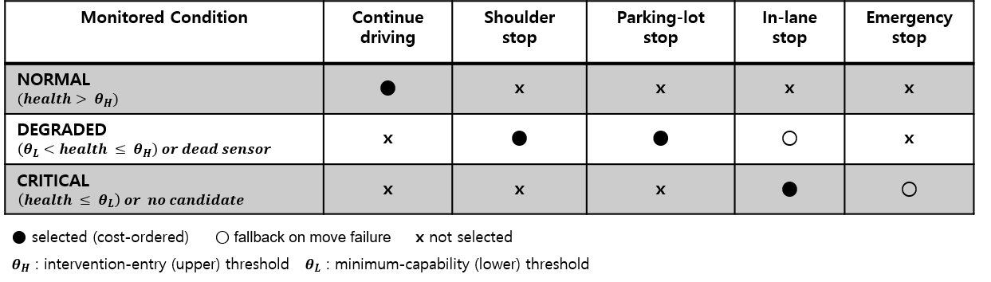
MRM Supervision & Speed Cap
• Refuge by cost: exposure time + traffic-light observability gate
• Speed cap 3.0 m/s from d = vτ + v²/2a (model bound ≈ 3.9 m/s)
• Hard fails: evidence-aware fast path decides within 1.5 s
7

Slide 8
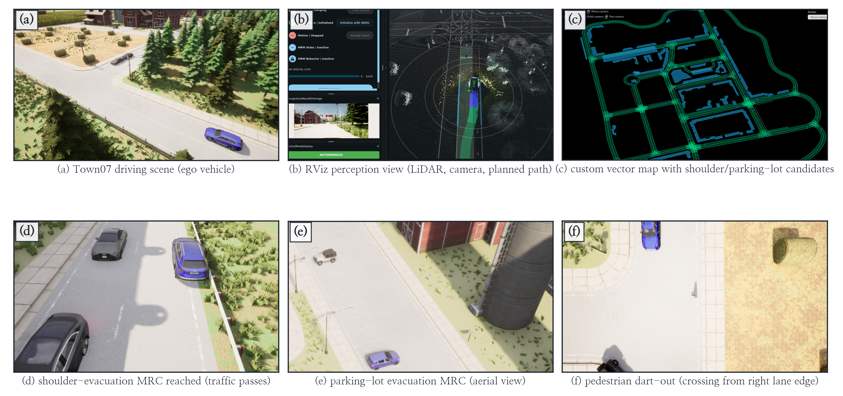
Experimental Setup
• CARLA 0.9.16 ↔ Autoware 0.39.0 closed loop (AWCL), Town07, 15 km/h
• 1,862 valid cases: fault × severity × traffic × method + encounters
• Full simulator restart every case — independence guaranteed
8

Slide 9
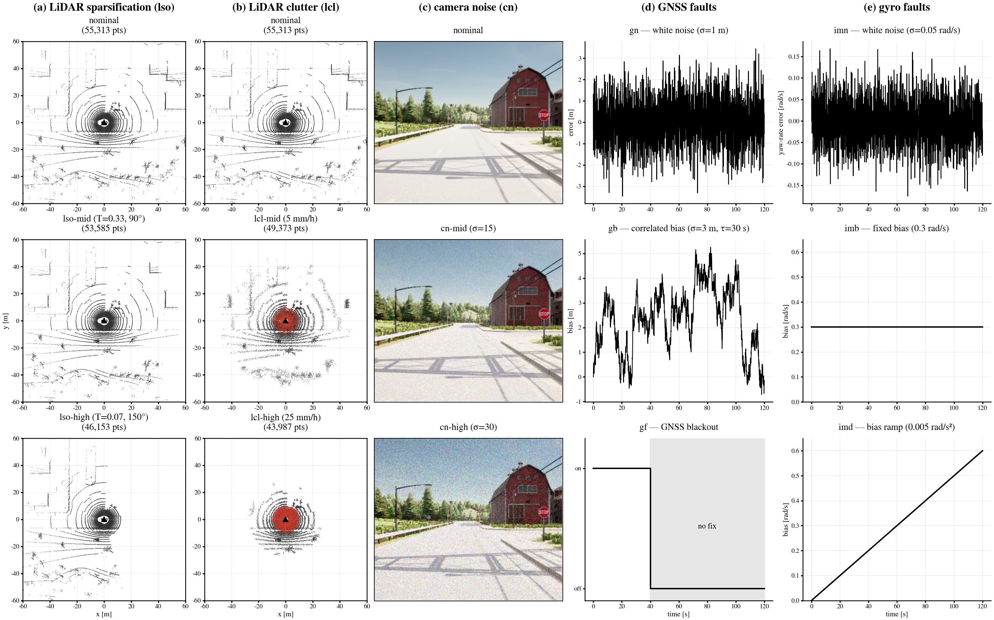
Fault Model & Verdict Reliability
• 11 physics-based fault types (LiDAR, camera, GNSS, IMU)
• Pedestrian collision sensor never fires in CARLA
• Dual verdict: ego ledger (RAW-HIT) + physics oracle
9

Slide 10
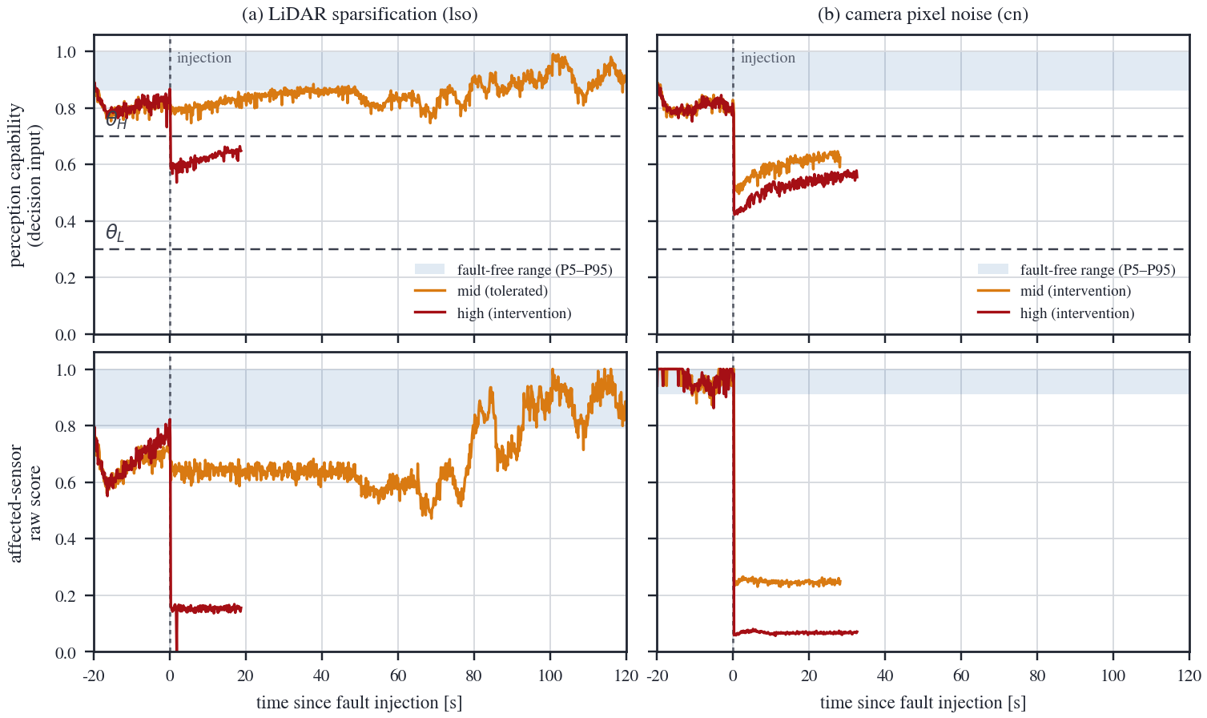
Results: Detection & Response
• Detection 96–100% (19/20 conditions); 0 false alarms / 45 runs
• Exposure 238–275 m → 11–58 m; hard-fail decision ≤ 1.20 s
• Health bands separate by severity → tolerate / evacuate / defer
10

Slide 11
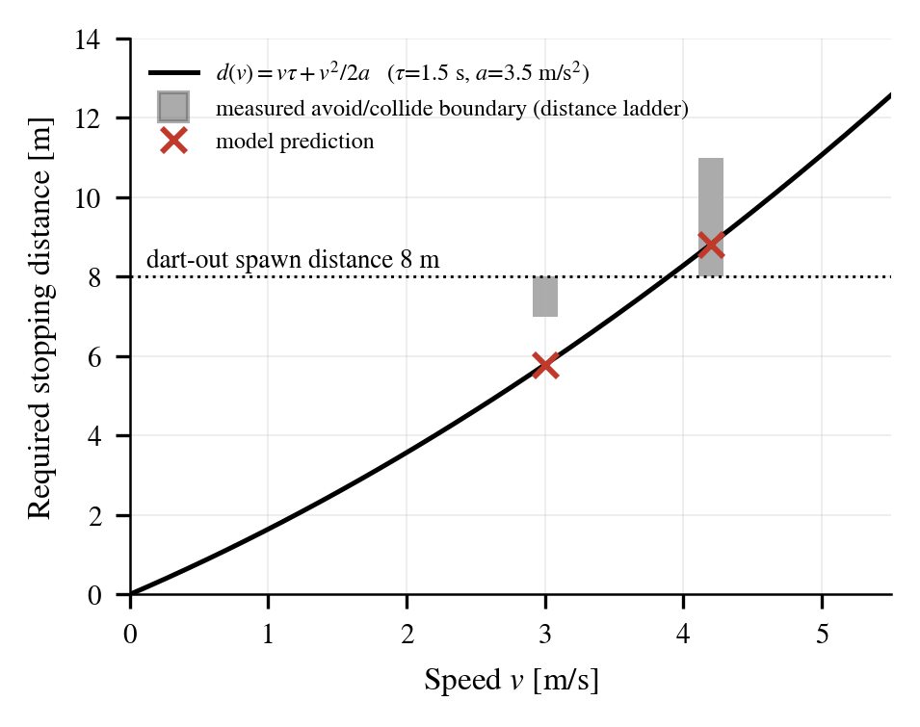
Results: Avoid/Collide Boundary
• Boundary: 8–11 m at 4.2 m/s (model 8.8 m); 7–8 m at 3.0 m/s
• 8 m dart-out: stock 10/10 collide vs settled cruise 8/8 avoid
• Transient encounters 2/2 collide → risk lives in the transient
11

Slide 12
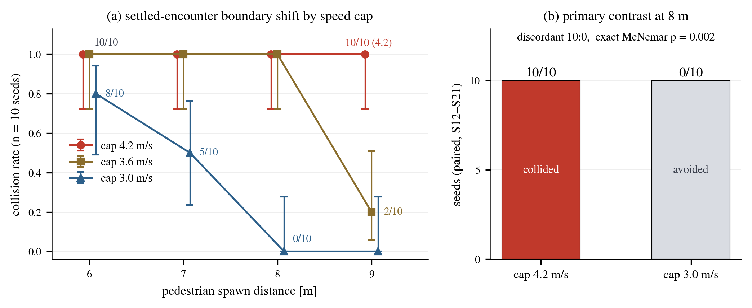
Results: Causal Cap Effect
• 120 pre-registered runs; settlement trigger — cap holds at encounter
• 8 m paired contrast: discordant 10:0, exact McNemar p = 0.002
• Boundary moves inward monotonically: beyond 9 m → about 7 m
12

Slide 13
Conclusion
• Graded fault response — health score + MRM supervision, 1,862 cases
• Stop vs evacuate: a temporal trade-off; risk lives in the transient
• Settled low speed shifts the boundary (10:0, p = 0.002)
• Reusable verdict methodology: ledger + physics oracle
• Future: high-speed ODD, adaptive baselines, real vehicle
13

