Slide 1
Zotero Workshop
by Samuel Mok (s.mok@utwente.nl)
Information Specialist
University of Twente
EEMCS & LISA

Slide 2
Information Specialist
?
Every faculty is supported by one or two information specialists, but you can contact any of us.
We are library staff who help students and researchers with information literacy, access to books/journals/etc, publishing research, citing sources, and more.
Always available to help, don’t hesitate to contact us! Information & contact info can be found on the library website,
www.utwente.nl/library

Slide 3
Today’s topic is
Zotero
A crash course to help you with:
installing and integrating with other software
effortlessly save and cite your sources
change settings to suit your need
adding plugins for specific use cases
comparing with alternatives
incorporating all of this in your research workflow
www.utwente.nl/library

Slide 4
is a reference manager
Zotero
“A bibliographic manager is software with which you can gather, store and organize your references” [1]
Maybe this is a bit obvious, but let’s talk about where and when you can use Zotero in your research process
[1] Reference managers. Leiden University Libraries - Leiden University.
https://www.library.universiteitleiden.nl/searching-sources/citation-managers

Slide 5







Research Cycle
Searching
UT Library
Starting point for all your research – don’t forget the guides and FindUT!
Aggregated databases
Broader search. Examples: Scopus, Web of science, Lens, Semantic Scholar
Specific databases
Full-text search and more detail. Examples: IEEE, ScienceDirect, NexisUni
Managing
Access to articles
Plugins & links: Lean Library, Unpaywall, UT network, Ezproxy, Open access
Saving articles
Reference manager: Zotero, Mendeley, Endnote
Install browser plugin for your reference manager to make citing really easy and effortless
Read, write, repeat
Notes
take notes and annotate papers, identify keywords, concepts
Cite
Integrate your reference manager with your text editor for easy and correct citations
Discover more
Use your current bibliography and insight to kickstart the next round of searching.
Go back to the start, but now also use tools like inciteful, pure suggest, etc to help you alongside keyword searches
www.utwente.nl/library
Notes:
Where does Zotero fit in here?
Click for each item:
Citing, obviously: you use it to reference your sources in your text editor and insert a bibliography.
You’ll need to add these sources, so you can of course store your sources in Zotero. Not only the metadata: you can add the item itself and any other files you want to keep with it, like a database or web-snapshot.
Notes can also be stored like all other files, and you can use the built-in notes function as well!
So far, not groundbreaking. Any other steps you can use it for? Well, yes:
4. You can let Zotero find the referenced items for you when you add them to your list. How? It uses the library service…
5. The library can be set as a provider for (meta)data, it will automatically download pdfs of articles and such if we have access, or look up more info on the item. Only by using the library then? No…
6. You can also add more search / item providers or use built-in ones to find your item!
That’s it then? Not quite..
7. Other tools also have plugins or can be added, so you can do almost your complete research cycle in Zotero and your Text editor! Not the best way to d, but can often save a lot of time and hassle.

Slide 6
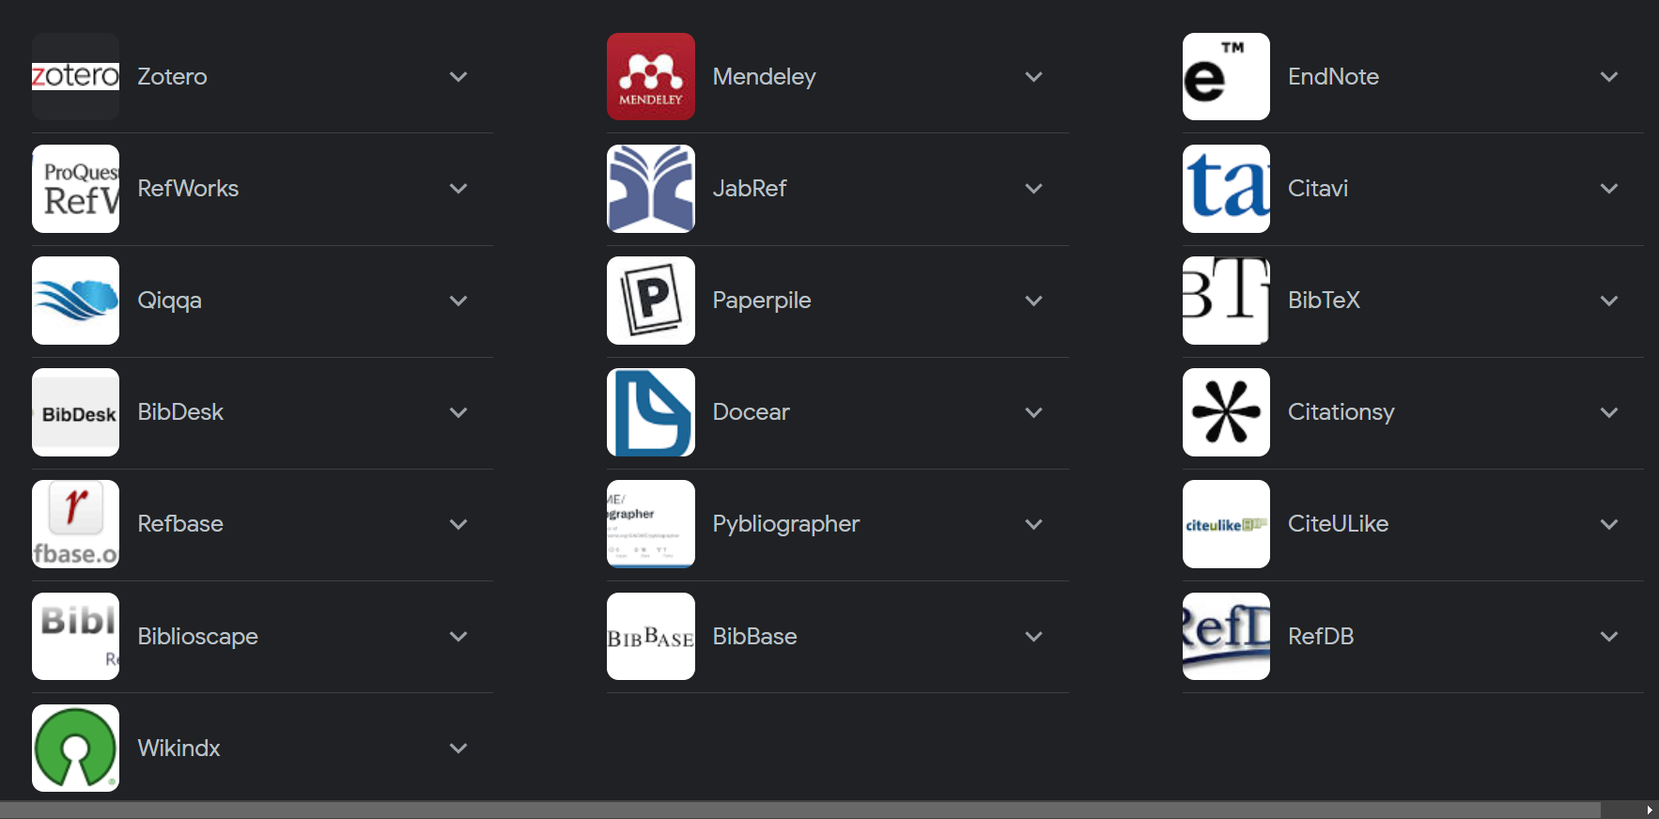
is one of many reference managers
Zotero
I’ll quickly compare the most used ones with Zotero to explain why I think it’s the best choice

Slide 7



Comparison most used reference managers
Description
Why pick this one?
My preferred manager. Free & open source. Can be customized to fit your needs.
You want full control of the software & data and like playing around with settings
You don’t mind a kinda dated UI
Decent 2nd choice. By Elsevier (Scopus). Easy to set up and use, barely any customization.
You want something that works out of the box & looks nice
You don’t have any niche requirements
Software with a long history. By Clarivate (Web of Science) Feels dated, is widely used.
You want the true old-school experience
You want to use a product licensed by the UT
www.utwente.nl/library

Slide 8
More details
Integrations
Cost
Links
Browser plugin: Yes, excellent
Word plugin: Yes, excellent
Overleaf plugin: Yes, excellent
Integrates with even more!
Free, pay for websync over 300MB. Can use own webdrive or cloud storage instead.
Software, browser & word plugin: www.zotero.org/download/
More plugins: https://www.zotero.org/support/plugins - Better BibTex is recommended if using LaTeX, see https://retorque.re/zotero-better-bibtex/
Browser plugin: Yes, excellent
Word plugin: Yes, OK
Overleaf plugin: Yes, OK
No other integrations
Free, UT has subscription for unlimited webstorage until end of 2023: sign up with utwente email.
https://www.mendeley.com/download-reference-manager/
Word: https://appsource.microsoft.com/en-US/product/office/wa104382081?exp=ubp8
Browser: https://www.mendeley.com/reference-management/web-importer
Browser plugin: Yes, bit clunky
Word plugin: Yes, OK
Overleaf plugin: No
No other integrations
Install from Notebook Service Centre (desktop app w/ license). Webstorage and browser plugin are separate
Browser plugin: https://click.endnote.com/
Install: https://www.nsc.utwente.nl/software/view/V2pOU2JtVkhOVEJaV0dOMlRYcFJla3g2UlRKUFJFbDVUbnByZVU1NlJUMD0/
www.utwente.nl/library

Slide 9
Installation & Setup
A demonstration of the basic tool + setup guide

Slide 10
Demo – basic usage
Let’s take a look at basic Zotero to see how it works and what it can do
Afterwards we’ll take a look at how to do a basic setup to use Zotero as shown

Slide 11
Links to the most important pages
https://www.zotero.org/ managers, make sure to download browser plugin as well; comes with Word plugin included
https://leanlibrary.com/download/ - browser plugin so you can automatically access articles even when outside UT network – integrates with Zotero (guide here)
https://www.overleaf.com/learn/how-to/How_to_link_your_Overleaf_account_to_Mendeley_and_Zotero
Integrate zotero with Overleaf
UT Library Service portal – UT’s official list of databases, guides, contact, get access, software, and more
Information tools– my personal overview of useful tools, databases and websites – use options to filter & categorize
www.utwente.nl/library

Slide 12
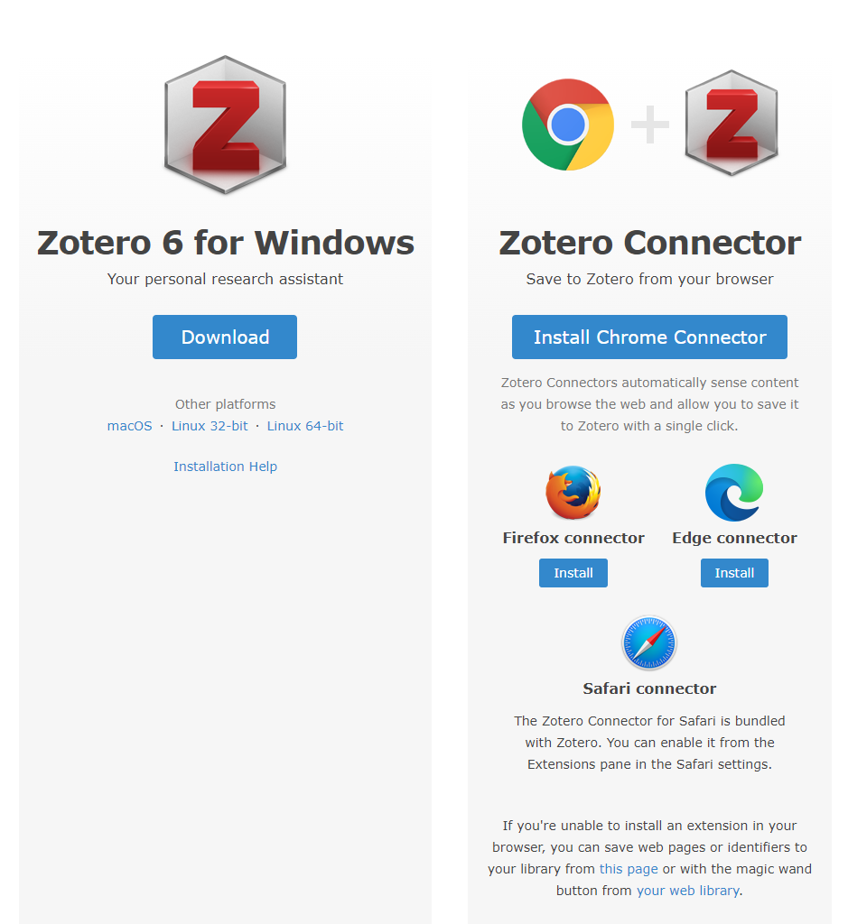
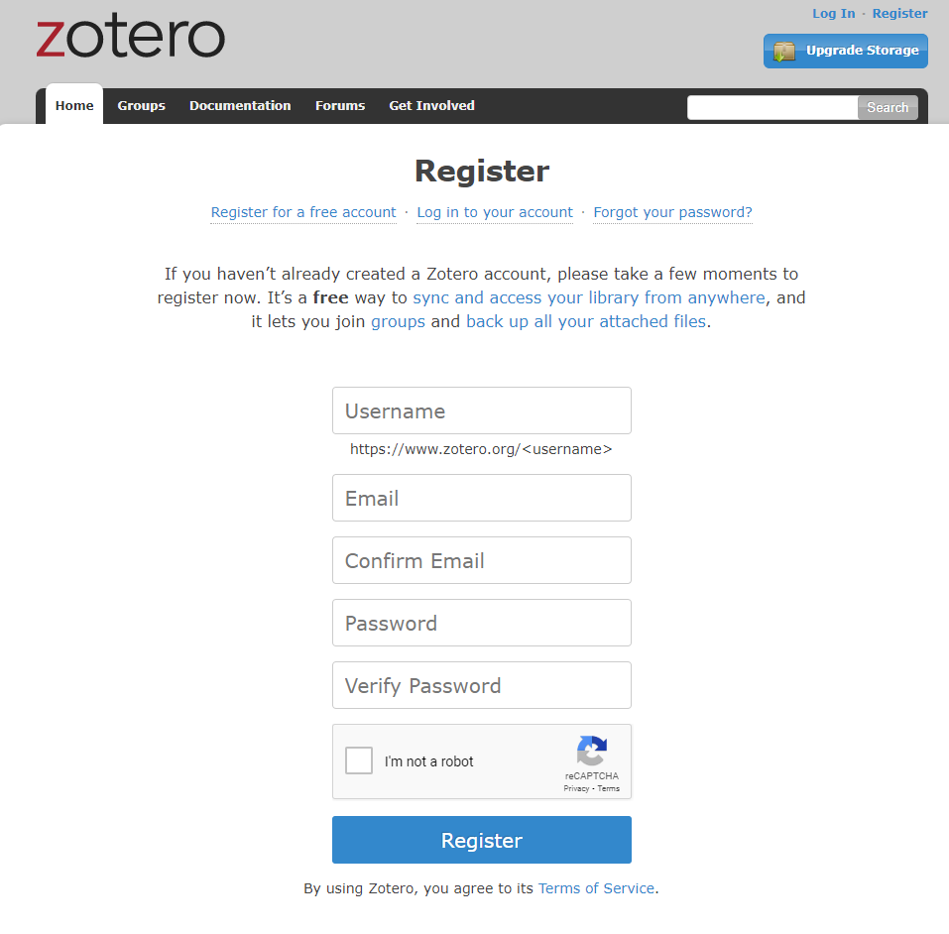
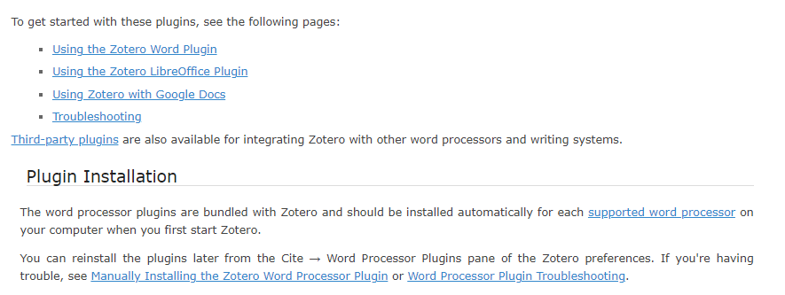
Install
https://www.zotero.org/download/ - download page
https://www.zotero.org/user/register/ - create account
https://www.zotero.org/support/word_processor_integration - integrate with text editors
https://www.zotero.org/support/installation - guide
www.utwente.nl/library

Slide 13
Setting it up yourself
We’re going to take a look at some settings to make sure Zotero is set up like we want.
Install Zotero first, start it up, and then follow the guide.

Slide 14
Steps
We have some stuff to set up:
Make a zotero account and link it
Choose how and where to store our files
Add the UT Library as provider
Check/setup the connections with browser and text editor
Setup group library

Slide 15
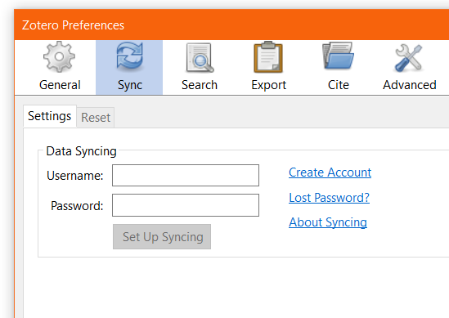
Zotero account
https://www.zotero.org/user/register Free, 300mb storage, more can be bought
You don’t need much storage: you only need to store metadata. Full text we’ll save somewhere else.
Registered? Then go to
edit -> preferences -> sync
to add your account

Slide 16
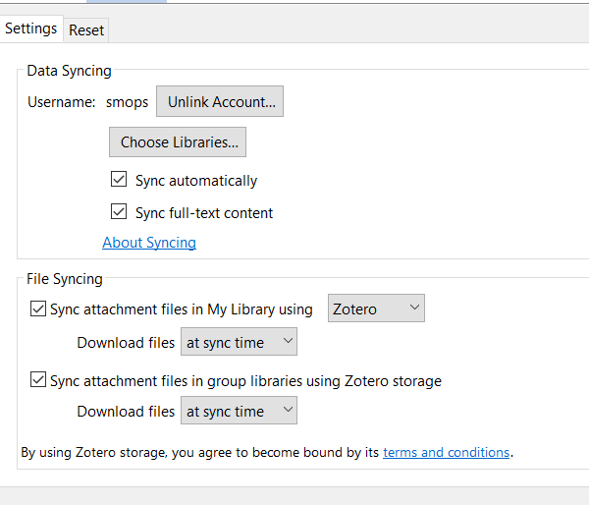
Syncing: setup (preferences -> sync after linking account)
Always sync with zotero.com to keep your library backed up and to enable group sharing!
Full-text / file-syncing is not necessary, you can store it in a cloud-storage folder using Zotfile: a plugin for zotero.

Slide 17
Zotero has loads of plugins you can install
Official list here
Essential plugins for basically everyone:
http://zotfile.com/ - way better storage of PDFs
https://retorque.re/zotero-better-bibtex/ - as backbone for lots of other plugins, and to better integrate with almost everything except Word
More on plugins later.

Slide 18
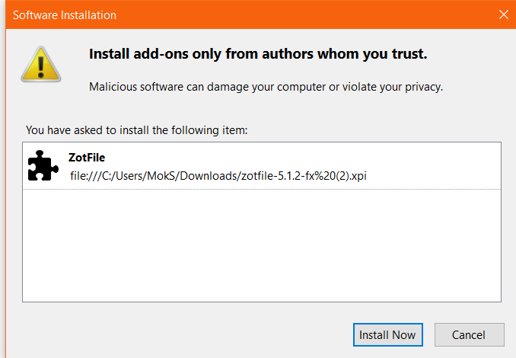
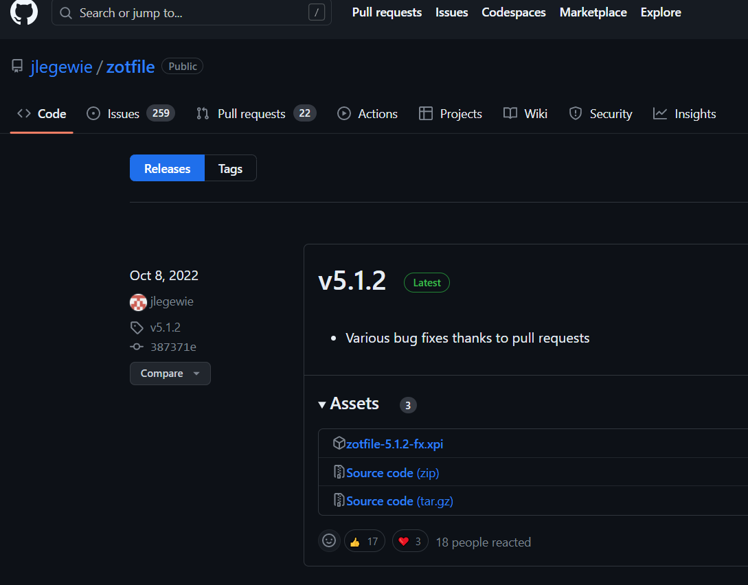
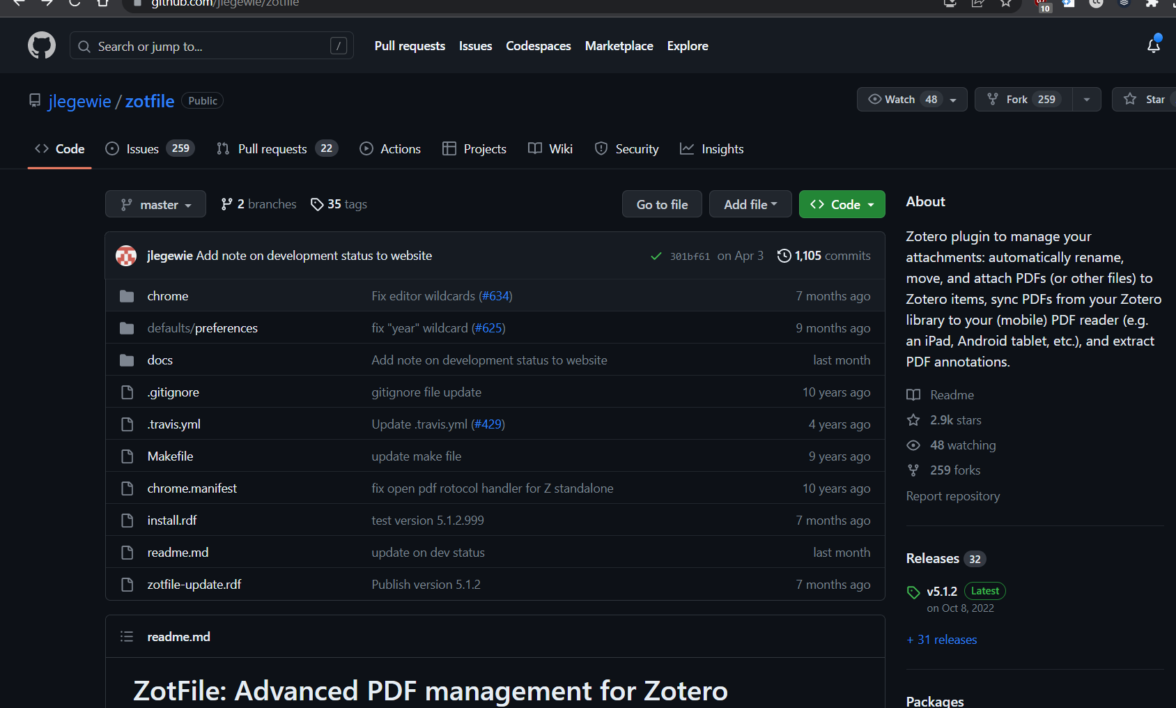
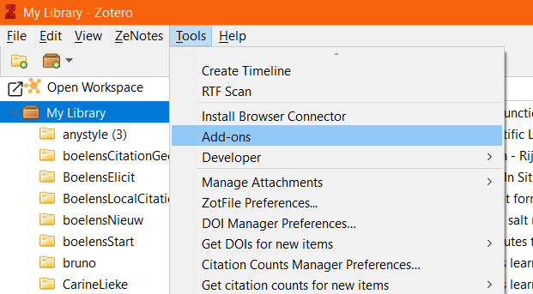
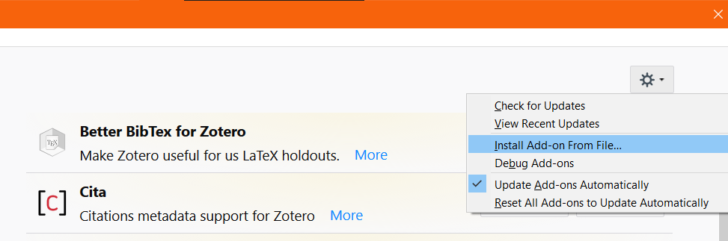
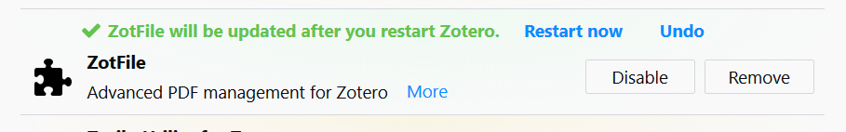


Install plugins
Essential plugin: Zotfile
First go to https://github.com/jlegewie/zotfile/releases, click “releases” and grab the file
Then the rest of the steps
Download .xpi file
Open Zotero
Click Tools -> Add-ons
Click the gear icon and select “Install add-on from file”
Browse to the .xpi file and select it
Wait 3 second and press “Install Now”
Maybe restart Zotero, depends on plugin

Slide 19
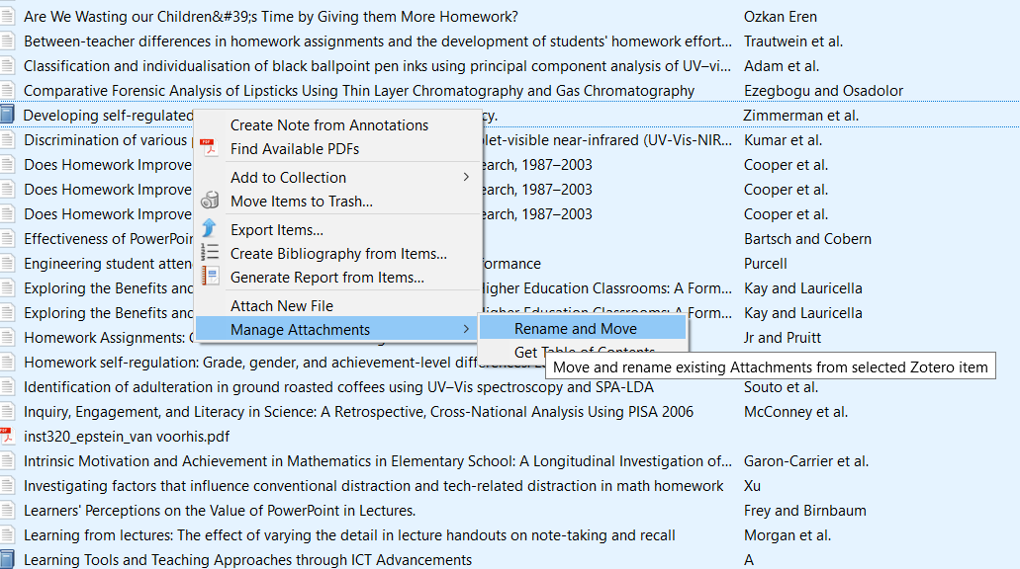
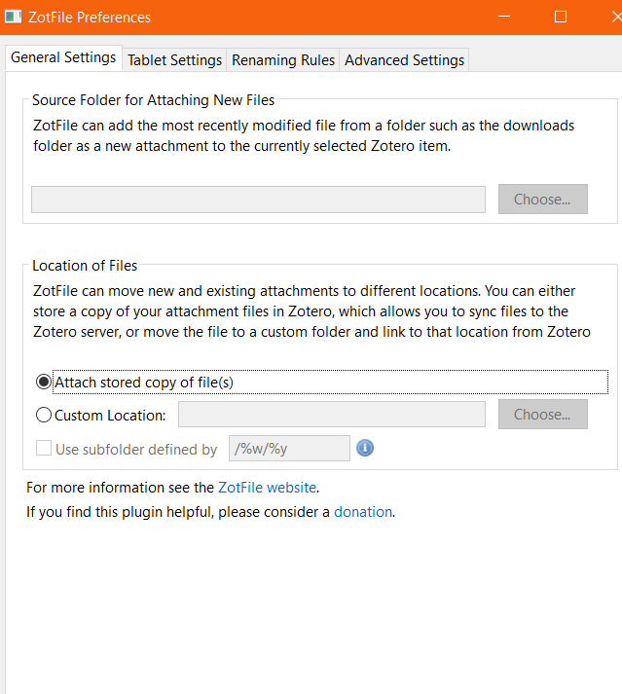
Syncing: Zotfile setup
Tools -> ZotFile preferences
Location of files -> custom location -> pick a cloud folder
Done! Zotfile will rename all pdfs and store them there.
You can do more with Zotfile, like easily sync with a tablet or extract pdf highlights as Zotero notes with links etc.
You can manually ask Zotfile to move pdfs with the right-click menu.

Slide 20
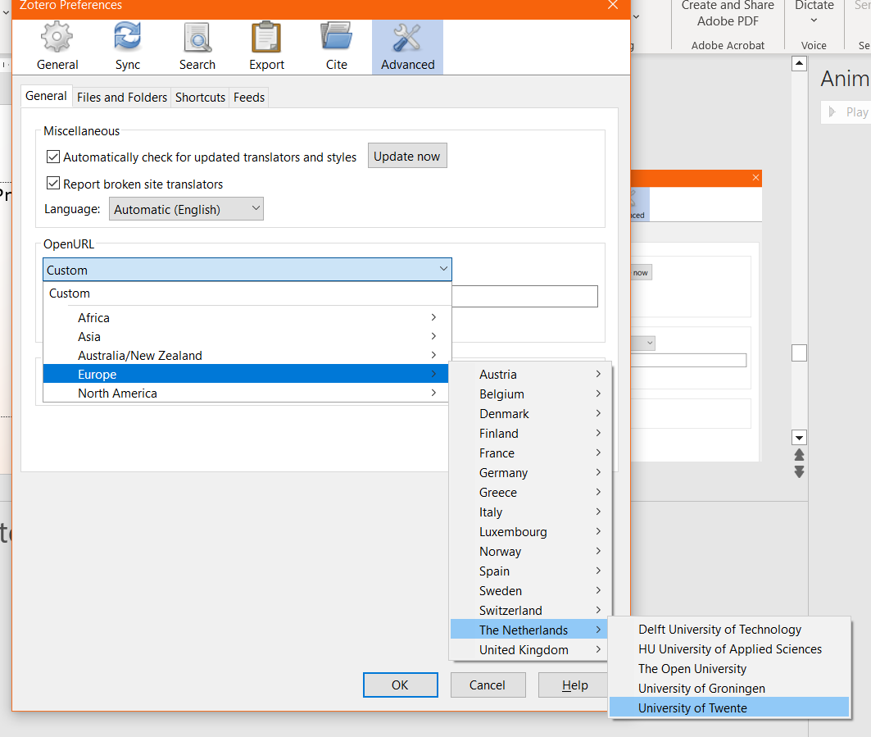
Connect with UT Library
Preferences -> advanced -> OpenURL
Select the UT as provider
This will make Zotero find PDFs and metadata through our collection.
You can also use it to look up items in your library to see if we have it in our collection..

Slide 21
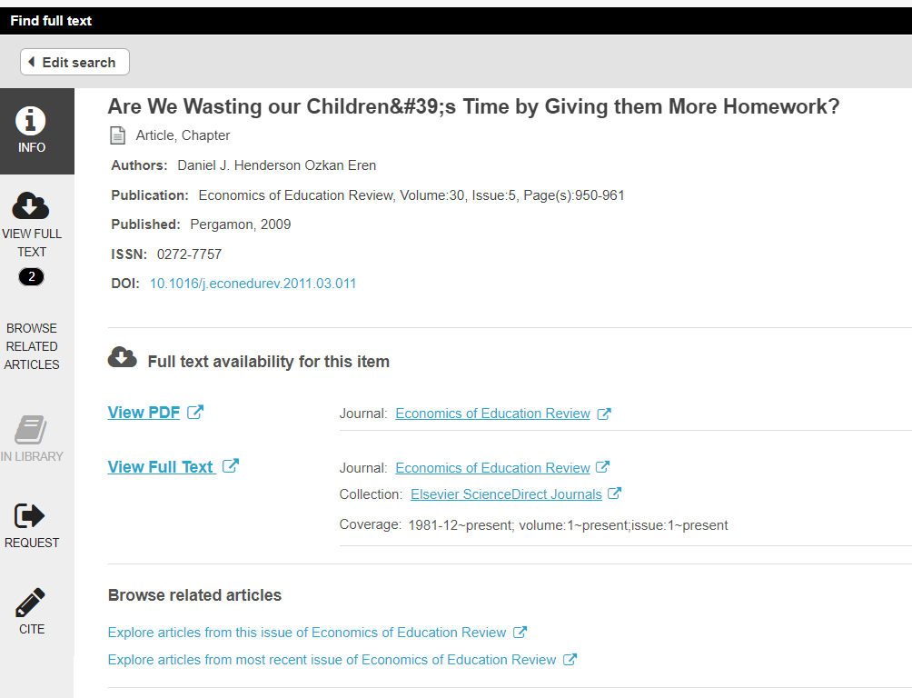
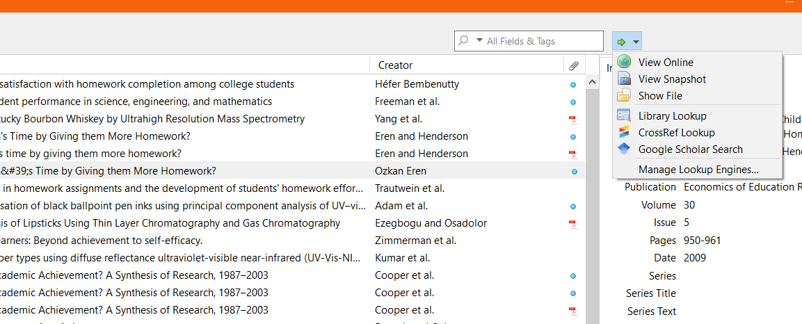
Find item in library or elsewhere
Select item(s) and use the green arrow in the top right to open in chosen database or elsewhere

Slide 22
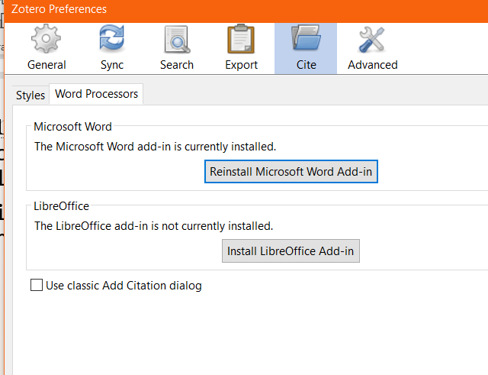
Connections
You can couple Zotero with Lean Library for access to articles using this guide
Integrating with word: edit -> preferences -> cite -> word processors -> install word add-in
Integrate with something else? Install Better BibTeX plugin first!
Guide for overleaf can be found on the official site, but if you want a better experience (or use LaTeX in a different way) there are guides available in the better BibTeX Manual: by using a cloud service or using a script with more functionality

Slide 23
Group work
You can make a group library to share your work with others (and certain software like Overleaf). You need to use your Zotero account do this is. Guide is here:
https://www.zotero.org/groups/
You can fully share an entire library. You’ll need to make a new library for each group: you can’t quickly share a subcollection directly from zotero.

Slide 24
Advanced usage
Zotero can do a lot more!

Slide 25
Demo – advanced usage
I’ll open up my real Zotero installation to show you what you can do with it.
Way too much to show and explain at once: if you want to play around with it just do so, see what works for you.

Slide 26
Plugin tips
Small additions but very useful: https://github.com/windingwind/zotero-pdf-preview https://github.com/eschnett/zotero-citationcounts https://github.com/bwiernik/zotero-shortdoi Nice integrations: https://github.com/scitedotai/scite-zotero-plugin https://github.com/inciteful-xyz/inciteful-zotero-plugin

Slide 27
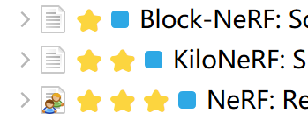
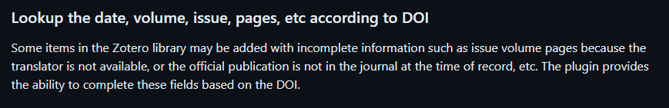
More plugins I’d recommend
https://github.com/windingwind/zotero-better-notes
https://github.com/windingwind/zotero-tag
https://github.com/MuiseDestiny/zotero-style
https://github.com/MuiseDestiny/zotero-citation
https://github.com/northword/zotero-format-metadata
https://github.com/tecosaur/LaTeX-Utilities - if using LaTeX and not Overleaf
https://github.com/topics/zotero to find more plugins

Slide 28





























Search tools
And did you know there is a whole world of other types of search tools out there?
Keyword search
You probably know (some) of these:
You can find a list with links & descriptions here: Information tools
Look at category Discovery and Search for these tools and more.
But did you know about these?
www.utwente.nl/library

Slide 29
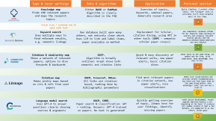
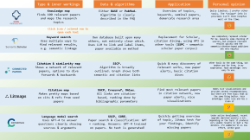
Search Tools – extra recommendations
You can find the main recommendations on the UT library site. The ones listed on this slide are (mostly) new, free, different, and, most importantly, very useful!
Two slides with more info on these tools can be found by clicking here:
www.semanticscholar.com
www.lens.org
Good alternative for google scholar. Semantic search, no Booleans and such, good recommendations in my experience
Great free alternative for scopus/WoS, with a more modern interface, better search tools, and often better results
inciteful.xyz
elicit.org
www.researchrabbit.ai
https://fabian-beck.github.io/pure-suggest/
Awesome way to quickly get lots of extremely relevant recommendations based on your current library.
With the Zotero plugin it’s literally 1 click to use!
Combine your library with keywords to quickly find the most relevant connected papers
Uses GPT-3.5 to find relevant papers and quickly extract crucial info
Like Inciteful and PURE suggest combined and on steroids, dive into a deep rabbit hole of recommendations and citations
www.utwente.nl/library

Slide 30


Type & inner workings
Data & algorithms
Application
Personal opinion
Knowledge map
finds 100 relevant papers and maps the research topics
Either BASE or PubMed. Algorithm is clearly described in the FAQ
Overview of topics, keywords, seminal papers, demarcate research area
Quite limited, I prefer other tools. The “unique” info it provides isn’t that helpful most of the time.
😐
Click icon / colored row to open each tool
Keyword search
Uses multiple ways to find relevant results, e.g. semantic linkage
Own database built upon many others, not entirely clear which. Uses LLM to link and label items, paper available on method
Replacement for Scholar, citation diving, using API in other tools (SSPC – semantic scholar paper corpus)
Has completely replaced scholar for me. Requires some checking of sources, but produces relevant results quickly and the semantic/citation-based additions are very helpful
😃
Citation & similarity map
Shows a network of relevant papers, options to dive forwards & backwards
SSCP.
Algorithm is broadly outlined. Graph shows both semantic and citation links
Quick & easy discovery of relevant works, new paper alerts, basic citation dives
Other tools do the same thing, but better and for free, in my experience. Main advantage: very easy to use.
😐
Citation map
Makes pretty maps based on cits & refs from seed papers
SSCP, Crossref, OAlex.
All links are citation-based, ranking done by bibliographic parameters
Find most relevant papers in citation network, new paper alerts, nice visualizations
Makes nice visualizations and provides decent recommendations, but there are free tools that do the same thing better. Main advantage: looks nice and has a clean UI
🤔
Language model search
Uses GPT-4 to answer questions clearly showing sources & arguments
SSCP, CORE.
Paper search & classification: GPT + ranking. Answers: GPT-4 trained on papers. No text is generated!
Quickly getting overview of topic, litmus test for your findings, identify missing papers
Under active development, recent upgrade improved quality a lot. Depending on the topic it produces very usable results in just a few minutes. I’d summarize it as low effort, little gain
🙂

Slide 31

Type & workings
Data & algorithms
Application
Personal opinion
Keyword search
Systematic search, just like Scopus or WoS.
OAlex, Crossref, CORE, PubMed
Only “addition”: linking preprints, patents, and scholarly works
Systematic searches with useful additional options, free alternative for scopus/WoS
Highly recommended to use in addition to Scopus/WoS, perhaps even replacing them
😃
Click icon / colored row to open each tool
Citation network
Crawls through the citation map of seed paper(s), displays results in many ways
OAlex, Crossref, OC, SSCP
Algorithms described in detail; source code openly available; SQL can be edited
Finding relevant literature in all ways except keyword searches, doing deep dives, systematic process
Very powerful while still being easy to use. Can be used very systematically. Indispensable tool in my view.
😍
Citation network
builds the entire citation network of seed paper(s) step by step
Lens database
All steps are clear, and all sub-results can be downloaded
Complete citation network mapping, systematic reviews, bibliographic mapping
If you want to get the complete network this tool does exactly that. Easy to use, number of papers quickly spirals out of control!
🙂
Recommender
Recommends papers based on seed paper(s) and keywords
OC, Crossref
Code 100% open source. Uses citations + relevance + keywords (in title) to rank results
Get useful recommendations, fill out bibliography. Easy to use for everyone, nice UI
Very useful tool, combining keywords and citation networks is unique (AFAIK). Easy to use and understand, even for beginners.
😃
Language model search
Uses GPT-3.5 to find papers that answer question, and extract details from papers.
SSCP
Algorithm is clearly described, but non-deterministic (all LLM based). All text is sourced from papers.
Find papers to start out with, fill out library, use as reading/scanning tool, etc
Can be very helpful but results vary based on topic/type of paper. Under active development, big update coming up that should improve functionality. Can save a lot of time.
🙂

Slide 32
Need help?
Can’t find your sources? Trouble with a tool? Reference manager isn’t working for you? No access to a critical article?
s.mok@utwente.nl
Just send me an email and I’ll help you! It helps if you provide some details in the question, and we can also plan a meeting if you need some more help.
You can of course also contact one of my colleagues, you can find us at utwente.nl/library.

