Slide 1

Deep Neural Network
(AIML ZG511)
Neha Vinayak
neha.vinayak@pilani.bits-pilani.ac.in
DNN Team, BITS Pilani

Slide 2
The author of this deck, Prof. Seetha Parameswaran, is gratefully acknowledging the authors who made their course materials freely available online.

Slide 3
Perceptron

Slide 4
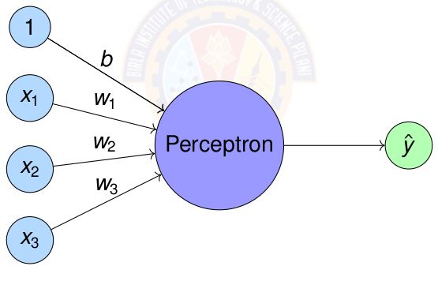
Perceptron
Perceptron = Simplest form of artificial neuron
Perceptron was introduced by Rosenblatt in 1958.
Notes:
Highlight that perceptron will have outputs as +1 and -1 always.

Slide 5
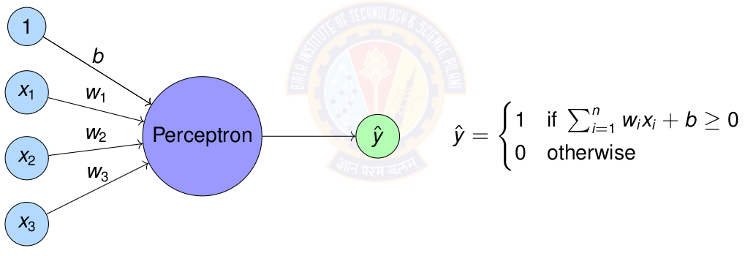
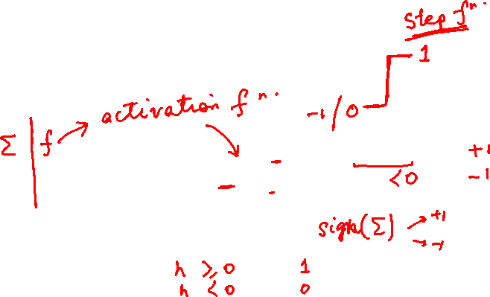
Perceptron
Perceptron = Simplest form of artificial neuron
Notes:
Highlight that perceptron will have outputs as +1 and -1 always.

Slide 6
Perceptron & Logic Gates

Slide 7
Representing Logic Gates using Perceptron
Any linear decision can be represented by a Boolean equation.
The quest is to find out how to represent the above using Perceptron.
For this we test whether each of the logic gates can be represented by a Perceptron.

Slide 8
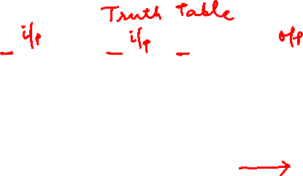
AND Logic Gate
Question:
How to represent AND gate using a perceptron?
What are the parameters for the AND perceptron?
Data is given below.
x1 | x2 | t (x1 and x2)
0 | 0 | 0
0 | 1 | 0
1 | 0 | 0
1 | 1 | 1

Slide 9
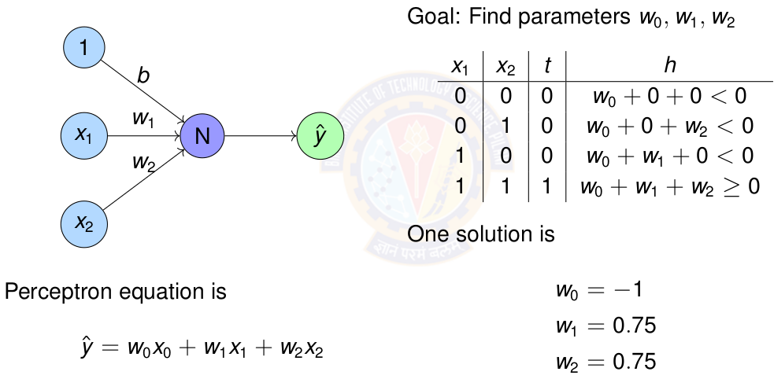
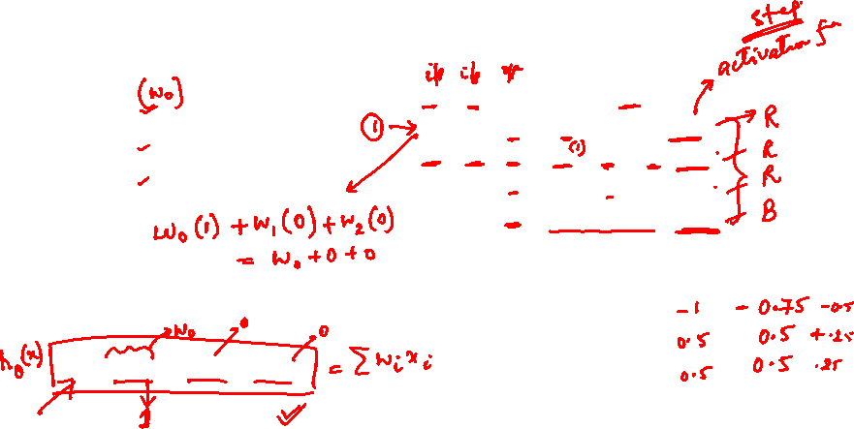
Perceptron for AND gate
Notes:
4 equations and 3 unknown. Easily solved using linear algebra.

Slide 10
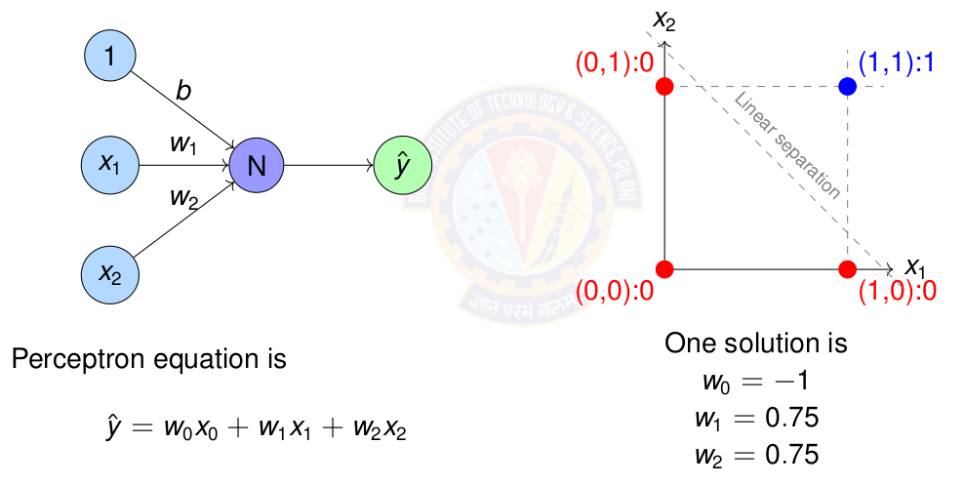
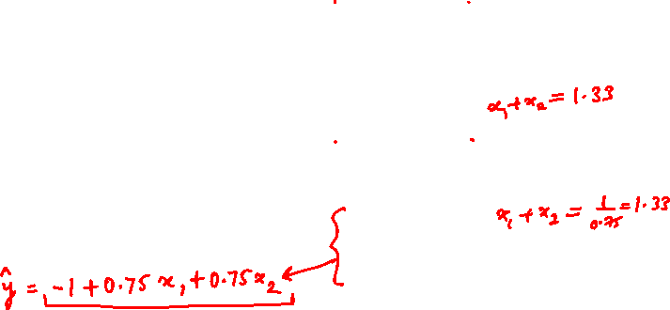
Perceptron for AND gate

Slide 11

OR Logic Gate
Question:
How to represent OR gate using a perceptron?
What are the parameters for the OR perceptron?
Data is given below.
x1 | x2 | t (x1 or x2)
0 | 0 | 0
0 | 1 | 1
1 | 0 | 1
1 | 1 | 1

Slide 12
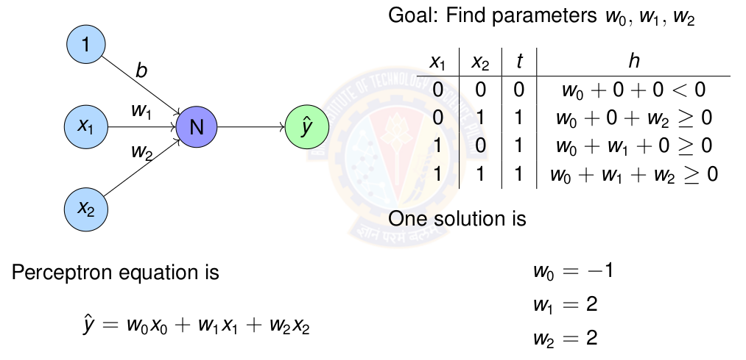
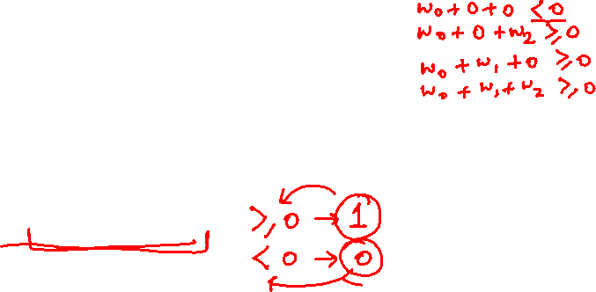
Perceptron for OR gate

Slide 13
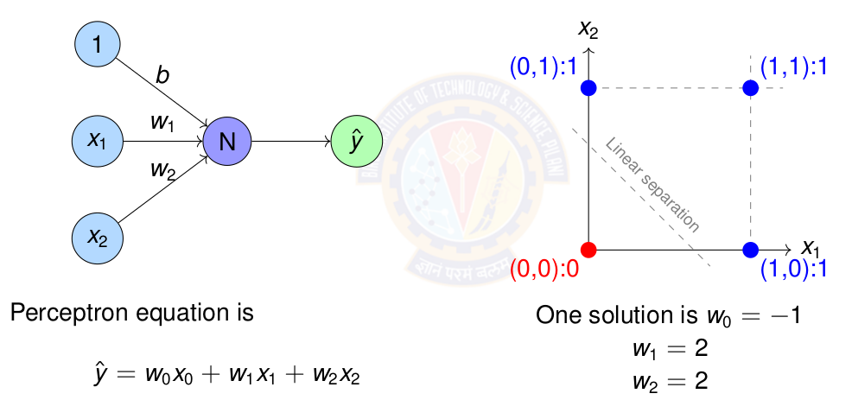
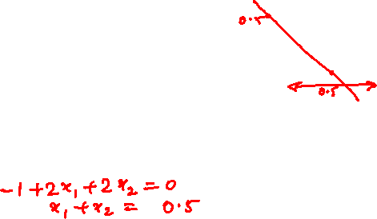
Perceptron for OR gate

Slide 14

Exercise
Represent OR gate using Perceptron. Compute the parameters of the perceptron.
Represent NOR gate using Perceptron. Compute the parameters of the perceptron.
Represent NAND gate using Perceptron. Compute the parameters of the perceptron.
Notes:
Give this as exercise for the students.

Slide 15
Perceptron Learning Algorithm

Slide 16
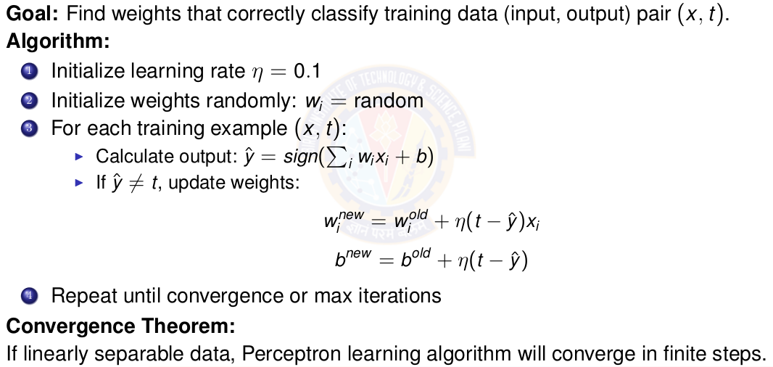
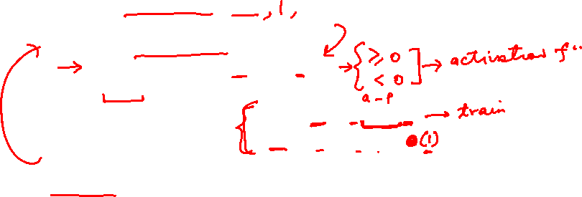
Perceptron Learning Algorithm
Notes:
Definition of learning rate is in next slide

Slide 17
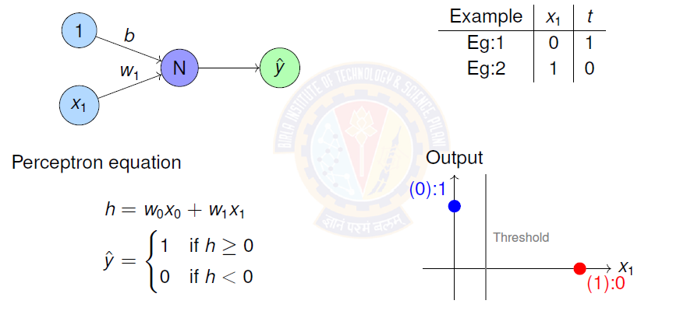
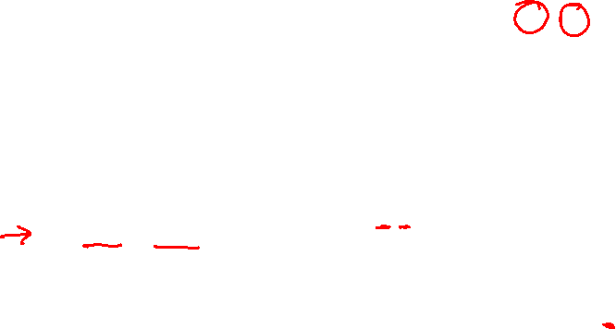
Perceptron Learning for NOT gate
Notes:
Definition of learning rate is in next slide

Slide 18
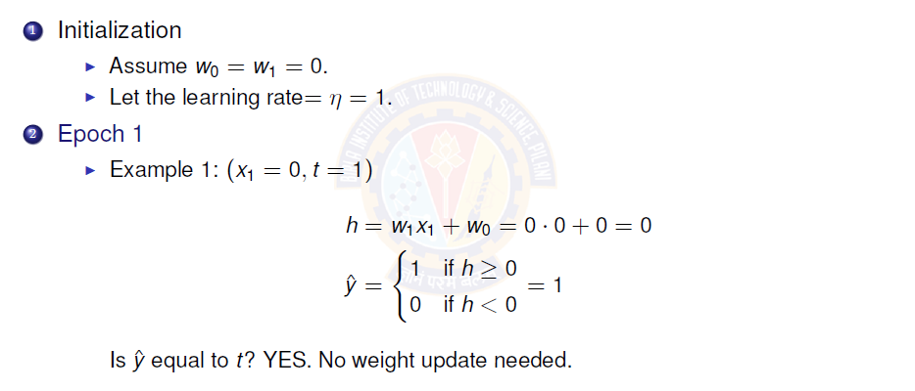
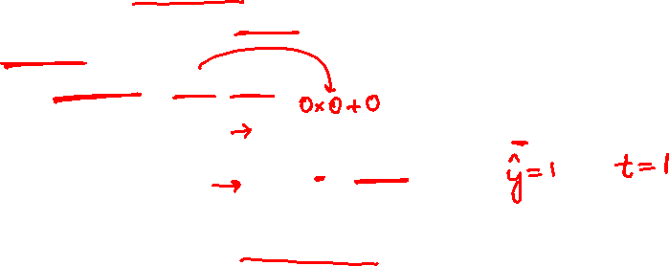
Perceptron Learning for NOT gate I
Notes:
Definition of learning rate is in next slide

Slide 19
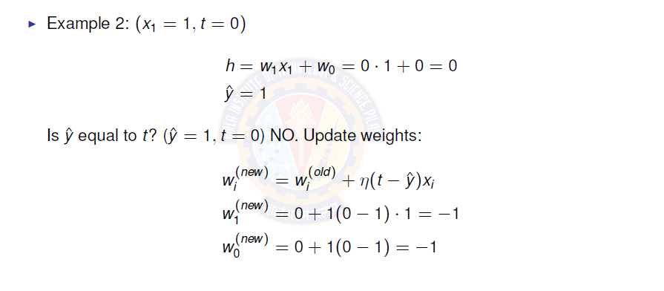
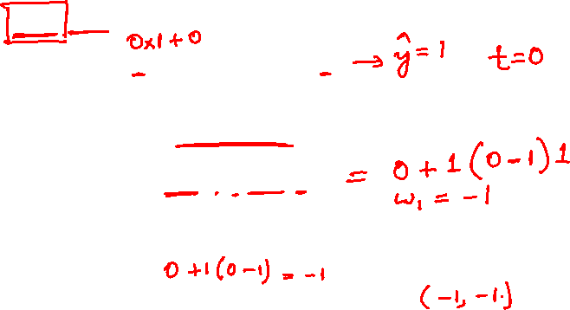
Perceptron Learning for NOT gate II
Notes:
Definition of learning rate is in next slide

Slide 20
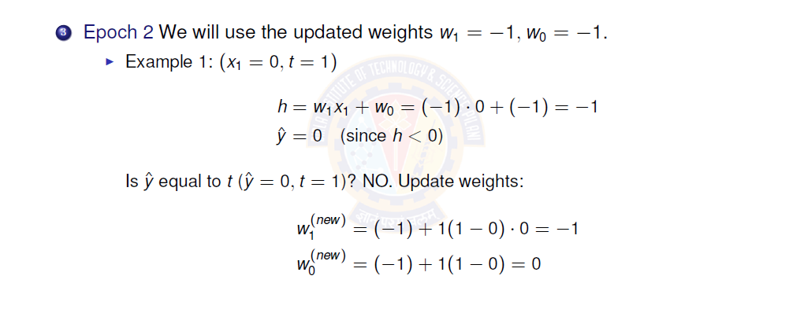
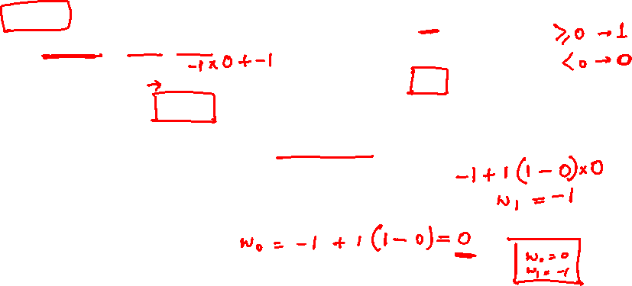
Perceptron Learning for NOT gate III
Notes:
Definition of learning rate is in next slide

Slide 21
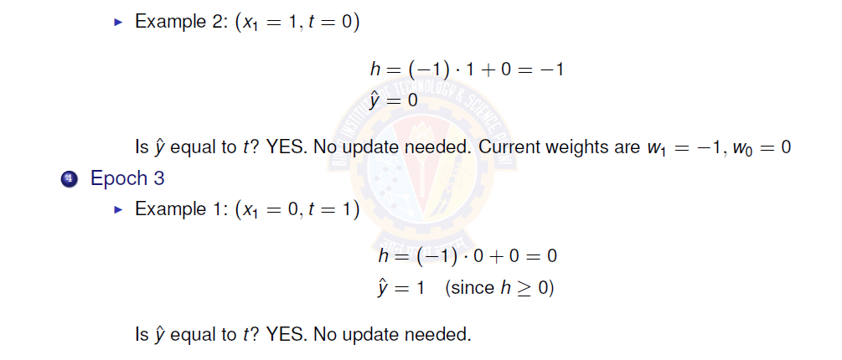
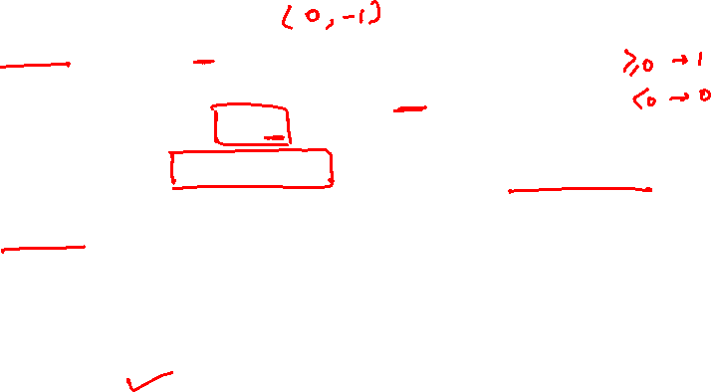
Perceptron Learning for NOT gate IV
Notes:
Definition of learning rate is in next slide

Slide 22
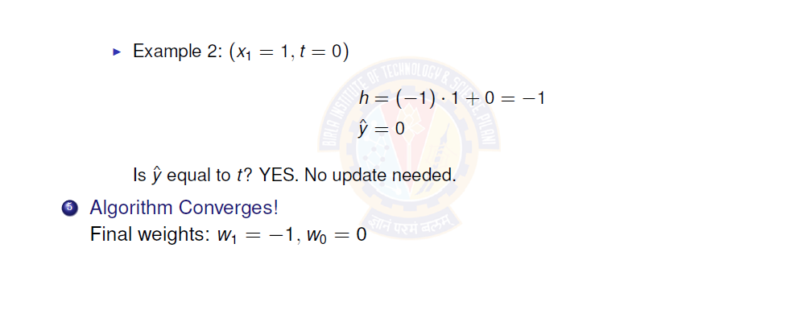
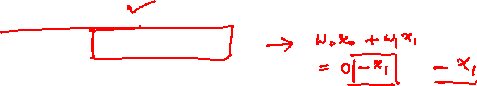
Perceptron Learning for NOT gate V
Notes:
Definition of learning rate is in next slide

Slide 23
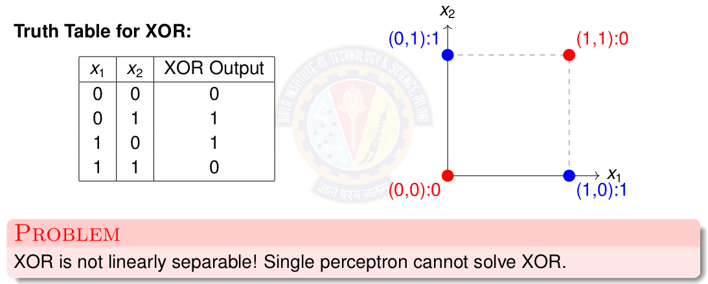
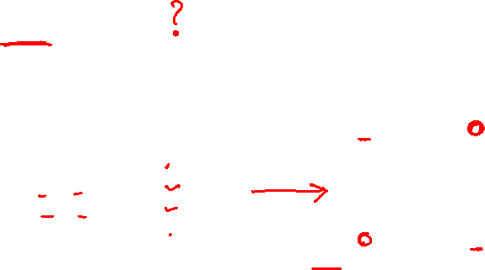
The XOR Problem
Notes:
Definition of learning rate is in next slide

Slide 24
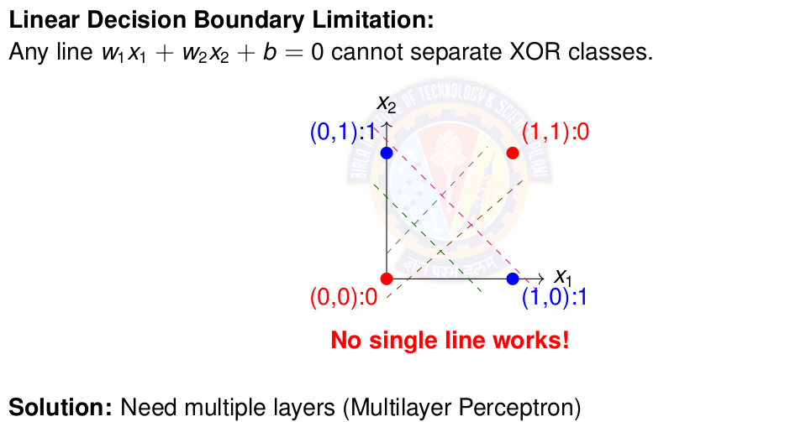

Why Single Perceptron Fails on XOR
Notes:
Definition of learning rate is in next slide

Slide 25
Linearly Separable Data

Slide 26
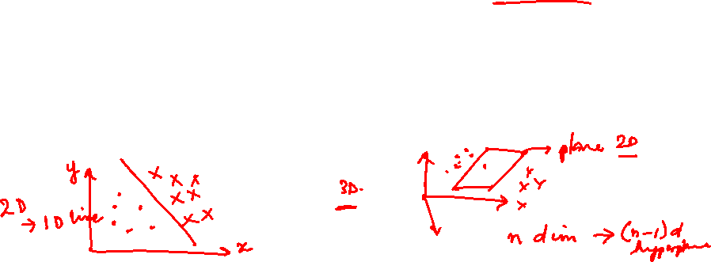
Linearly Separable Data
Two sets data points are separable in a n-dimensional space if they can be separated by an (n-1) dimensional hyperplane.
A straight line can be drawn to separate all the data examples belonging to class +1 from all the examples belonging to the class -1. Then the two-dimensional data are clearly linearly separable.
An infinite number of straight lines can be drawn to separate the class +1 from the class -1.
Notes:
Our aim to find the optimal decision boundary that can separate the classes.

Slide 27
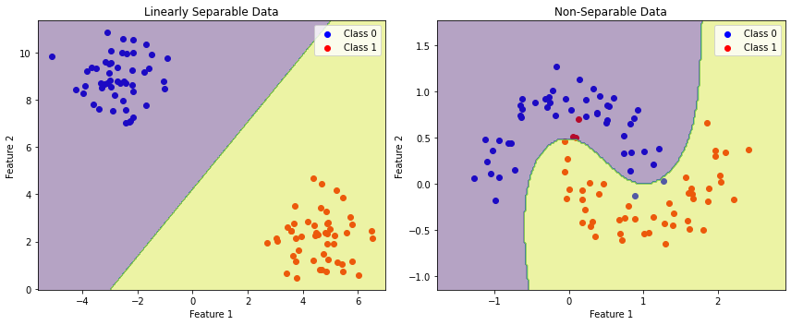

Linearly vs Non-Linearly Separable Data
Notes:
Our aim to find the optimal decision boundary that can separate the classes.

Slide 28

Perceptron for Linearly Separable Data
Data
  Truth tables or set of examples
Model
  Perceptron
  Inputs x are the features or columns
  Target output t is the required label
Objective Function
  Deviation of desired output or target t and the computed output ŷ
Learning Algorithm
  Perceptron Learning algorithm
Challenge
  How to learn these n + 1 parameters w₀ , w₁ . w₂ . . . w_{n} ?
Solution
  Use Perceptron learning algorithm.
Notes:
THe perceptron can take any number of inputs. Each input connection will have a weight associated with it. The aim is to find the values of these parameters that can draw a decision boundary that will separate the classes. The computation remind the same ie take the sign of the weighted sum and compute output response for each example.

Slide 29
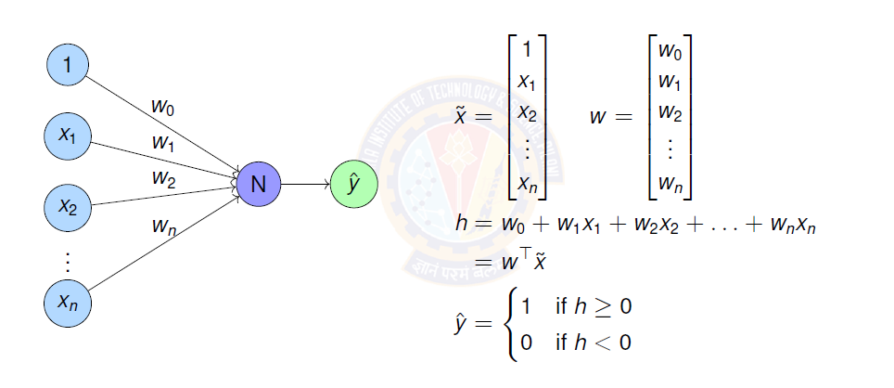
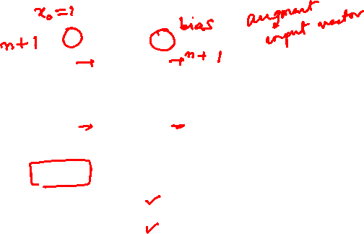
Perceptron for Linearly Separable Data
Notes:
THe perceptron can take any number of inputs. Each input connection will have a weight associated with it. The aim is to find the values of these parameters that can draw a decision boundary that will separate the classes. The computation remind the same ie take the sign of the weighted sum and compute output response for each example.

Slide 30
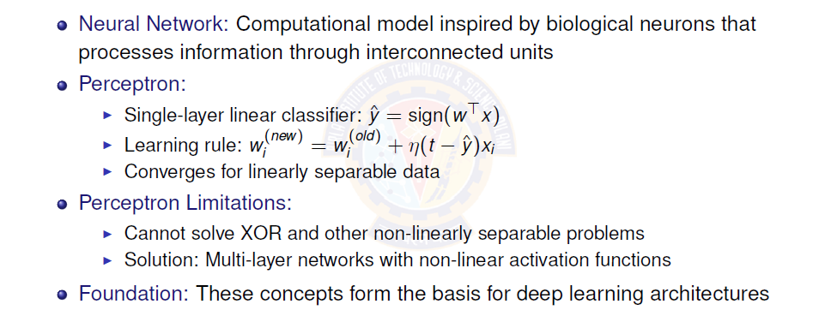
Key Concepts
Notes:
Give this as exercise for the students.

Slide 31
Practice Problems
Represent OR gate using Perceptron. Compute the parameters of the perceptron using perceptron learning algorithm.
Represent AND gate using Perceptron. Compute the parameters of the perceptron using perceptron learning algorithm.
Represent NOR gate using Perceptron. Compute the parameters of the perceptron using perceptron learning algorithm.
Represent NAND gate using Perceptron. Compute the parameters of the perceptron using perceptron learning algorithm.
Notes:
Give this as exercise for the students.

Slide 32
Perceptron Demo Python Code
https://colab.research.google.com/drive/1DUVcOoUIWhl8GQKc6AWR1wi0LaMeNkgD?usp=sharing
Student pl note:
The Python notebook is shared for anyone who has access to the link and the access is restricted to use BITS email id. So pl do not access from non-BITS email id and send requests for access.

Slide 33
References
Zhang et al. "Dive into Deep Learning" - Chapter 1 https://d2l.ai/
http://mlsp.cs.cmu.edu/people/rsingh/docs/Chapter1_Introduction.pdf
Goodfellow, Bengio, Courville - "Deep Learning" Chapters 1-6
Rosenblatt, F. (1958) - "The Perceptron: A Probabilistic Model”
Minsky & Papert (1969) - "Perceptrons" (Historical perspective)
Thank You :)

