Slide 1
zaXpire
Bringing Simplicity + Sustainability + Safety + Social to Food

Slide 2
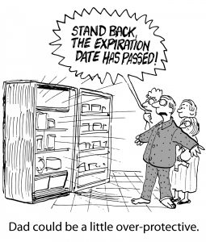
https://therightplan.com/wp-content/uploads/2018/06/expiration-date-comic-2-255x300.jpg
Confidential

Slide 3
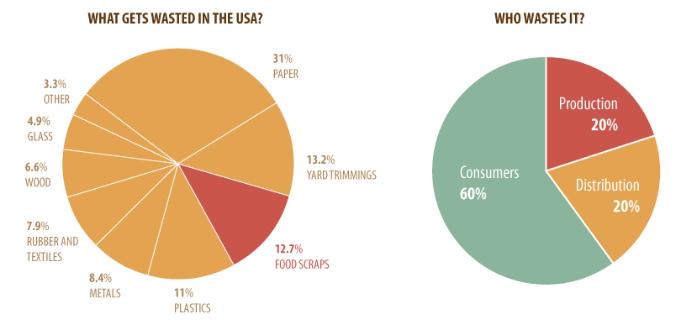
big concern
Courtesy: Wikipedia - Tiffany Farrant [CC BY 2.0 (https://creativecommons.org/licenses/by/2.0)]
Confidential

Slide 4
specific concern
Over 80% of Americans may be prematurely tossing food because they misinterpret expiration dates
- https://www.marketwatch.com/story/this-is-why-americans-throw-out-165-billion-in-food-every-year-2016-07-22
The total number of food recalls in the U.S. increased by 10% between 2013 and 2018
- https://time.com/5504355/food-recalls-more-common/
A food/medicine recall almost always is a voluntary action initiated by the manufacturer to remove food/medicine from commerce that may cause health problems, or death.
- https://www.fns.usda.gov/sites/default/files/Responding_Food_Recall_FNS_Final_May_30_2014.pdf
Confidential

Slide 5

our solution
zaXpire platform connects consumers with manufactures to receive and provide accurate information about the product from a palm of their hand.
AI
Engine
Recall
Engine
Manufacturer
API
API
Processing
Plants
Hospitals
zaXpire
PCP
Suppliers
Consumer
Tracker
Expiry
Engine
Retailers
https://patents.google.com/patent/US20120089409?oq=uttam+pawar
Confidential

Slide 6
various components (another view)
Grocery
Medicines
Personal
Home safety
Item Details
Shopping List
Purchase
Receipts
Name
Purchase date
Freshness status
Receipt link
Ingredients
Content details
Outbreak of some kind, etc.
External
Observation
Expired items
Recalls
Manufacturing/Transport
Name,
Date, Location, Picture
Feedback/Question
AI Models
Suggestions
(recipes, etc.)
Retailers
Manufacturers
Confidential

Slide 7
Conclusion
Solving Real Problems in a domain with multiple Challenges and correspondingly Great Opportunities by incorporation of new technologies.
Confidential

Slide 8
Questions?
Confidential

