Slide 1
Team No: 1
Who designed which subsystems?
Subsystems | Designed By
1. Administrator Management 2. Database Management | Uttam Kumar Saha ID: 2019000000028
3. Client Management 4. Staff Management | Sanjida Akhter ID: 2019000000008
5. Booking Management | Renesha Amin Mayuri ID: 2019000000063

Slide 2
Team No: 1
Project Title: Resort Management System
Team Members
Name | Student ID
Uttam Kumar Saha | 2019000000028
Sanjida Akhter | 2019000000008
Renesha Amin Mayuri | 2019000000063

Slide 3
Subsystems
Subsystems | Scope
Administrator Management | Login as Administrator, Add Rooms, Add Convention Hall, Create Foods, Refund customer payments
Database Management | Customers Details, Staffs Details, Bookings records, Payments records, Update customer details
Client Management | Registration, Login, View customer account’s details, Update booking, Cancel booking, Feedback
Staff Management | Login, View staff details ,Task status, Add staff
Booking Management | Search Availability, Book Rooms, Book Convention Hall, Food booking, Make Payments

Slide 4
Subsystems
Subsystems
Administrator Management
Database Management
Designed by Uttam Kumar Saha

Slide 5
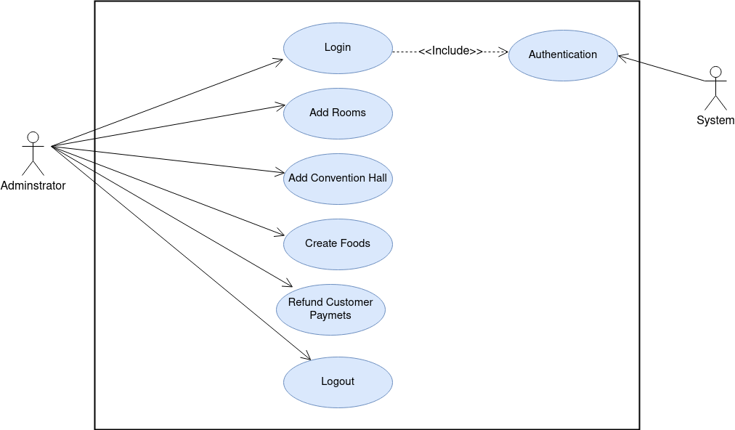
Use Case Diagrams
Fig: Use Case Diagram for Administrator Management

Slide 6
Use Case Narratives for Administrator Management
Usecase Name: Login
Area: Administrator Management
Actors: Administrator
Description: Administrator will be logged in the system using admin ID, and Password.
Success steps/scenario | Information for Setps
1.Administrator enter User ID and Password to login the Secure Website. | userID, Password
2. Read Administrator record and verify userID and password from Database | Administrator record, userID, Password
3. Display Successfully Logged in the system.
Alternate steps/scenario
2.1 If password is wrong, It will show incorrect password.
2.2 It will show userID not found if userID doesn’t exist in the database.
1.3 Administrator can cancel login by press on cancel button.

Slide 7
Usecase Name: Authentication
Area: Administrator Management
Actors: System
Description: It allows to verify administrator userID and password to get logged into the Website. Only authorized user can login.
Success steps/scenario | Information for setps
1.Match password with corresponding userID from the Database. | Database, userID, Password
2.Display successfully logged in.
Alternate steps/scenario
1.1 If password is not match with corresponding userID it will show incorrect password.
1.2 If userID doesn’t exist in the database it will show userID not found.

Slide 8
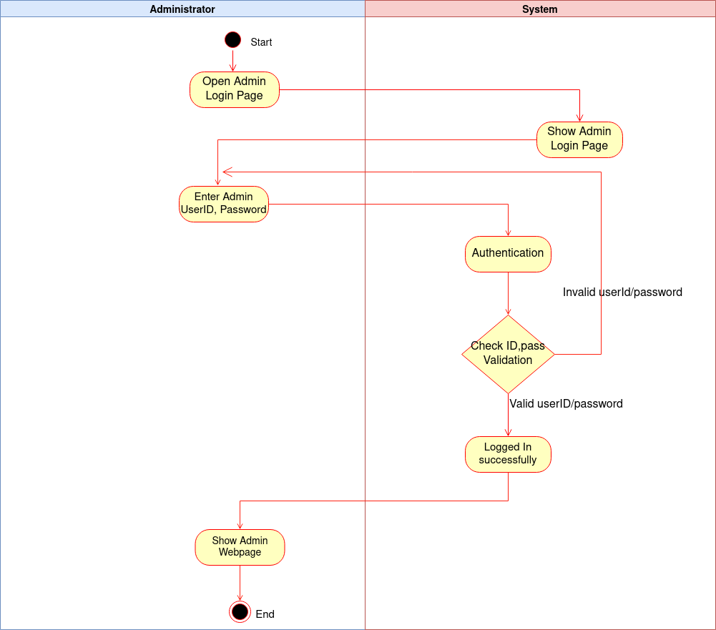
Activity Diagram for Login, Authentication

Slide 9
Usecase Name: Add Rooms
Area: Administrator Management
Actors: Administrator
Description: Allows administrator to add Rooms details in the website. User will get the rooms while booking.
Success steps/scenario | Information for setps
1.Administraror login the website using userID, password | userID, password
2. Go to Add room Option to add rooms from admin panel.
3.Upload room pictures. | Add Pictures
4. Enter Room number. | Room Number
5. Select Room type. | Room Type: Normal, Royal suite,Deluxe
6. Enter Capacity of the room | Room Capacity
7. Enter Price of the room | Price
8.Enter available foods and drinks and corresponding cost and meal type | Foods and Drinks in the Breakfast, Lunch and Dinner
9. Click on Add Room button to add room.
10. Display Successfully added room to website.
Alternate steps/scenario
1.1 If password is not correct it will show incorrect password.
1.2 It will show userID not found if userID doesn’t exist in the database.
9.1 Administrator can click on cancel button instead of clicking submit button if he/she changes his/her decision not to add room.

Slide 10
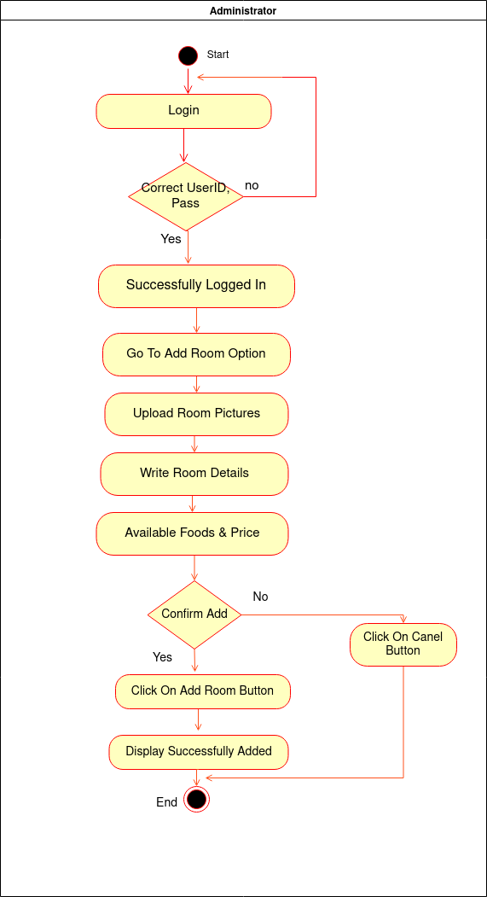
Activity Diagram for Add Rooms

Slide 11
Usecase Name: Add Convention Hall
Area: Administrator Management
Actors: Administrator
Description: Administrator Add Convention Hall details in the website. User will get the added halls wile user will search for booking.
Success steps/scenario | Information for setps
1.Administraror login the website using userID, password | userID, password
2.Go to Add Convention Hall option to add hall details.
3.Upload Hall pictures. | Pictures
4.Enter Hall number | Hall number
5.Enter capacity of the hall | Capacity
6.Add decoration types of the hall and cost | Type & Cost of decoration
7.Enter foods and drinks and corresponding cost and meal type | Food items and cost
8.Enter price of the hall | Hall price
9.Click on Add Hall button to add hall.
10.Display successfully added hall
Alternate steps/scenario
1.1 If password is not correct it will show incorrect password.
1.2 It will show userID not found if userID doesn’t exist in the database.
9.1 Administrator can click on cancel button instead of clicking Add Hall button if he changes his/her decision not to add Hall.

Slide 12
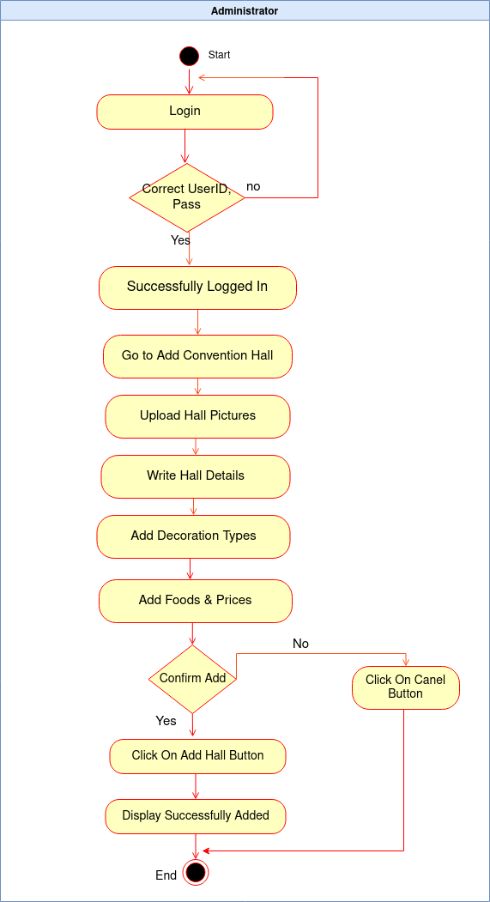
Activity Diagram for Add Convention Hall

Slide 13
Usecase Name: Create Foods
Area: Administrator Management
Actors: Administrator
Description: Add extra available foods for the customers as well as for the restaurant also.
Success steps/scenario | Information for setps
1.Administraror login the website using userID, password | userID, password
2.Go to Create Food option from admin panel.
3.Upload foods and drinks pictures.
4. Add Foods and Drinks items names and corresponding prices. | Price of foods and drinks
5.Click on Add Items button to add items to the website.
6.Display successfully added items
Alternate steps/scenario
1.1 If password is not correct it will show incorrect password.
1.2 It will show userID not found if userID doesn’t exist in the database.
6.1 Administrator can click on cancel button instead of clicking Add Items if he/she changes his/her decision not to add Food items.

Slide 14
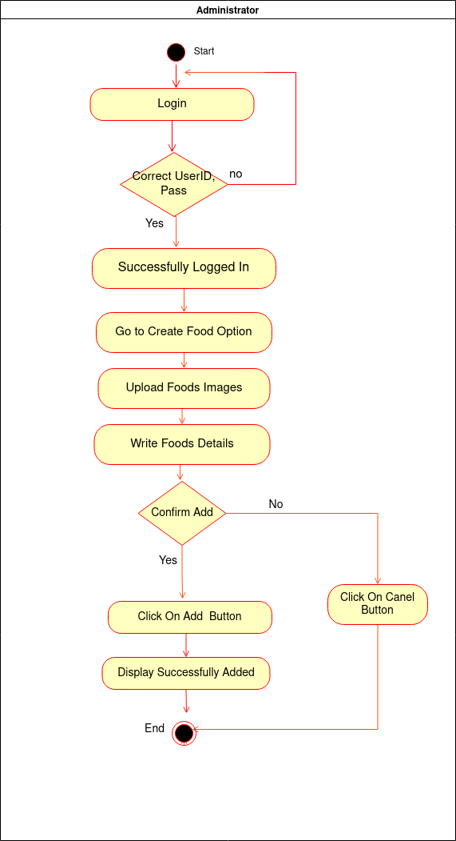
Activity Diagram for Create Foods

Slide 15
Usecase Name: Refund Customer Payments
Area: Administrator Management
Actors: Administrator
Description: Refund customer payments if any customer cancel his/her booking.
Success steps/scenario | Information for setps
1.Administraror login the website using userID, password | userID, password
2.Find customer ID from the database. | CustomerID
3.Find customer banking details. | Banking Details
4. Refund money to customer’s baking account. | Return money
5.Update payment record to database.
Alternate steps/scenario
1.1 If password is not correct it will show incorrect password.
1.2 It will show userID not found if userID doesn’t exist in the database.
4.1 Cancel Payment
Usecase Name: Logout
Area: Administrator Management
Actors: Administrator
Description: Logout from the website.
Success steps/scenario | Information for setps
1.Click on Logout button to logout from the Website

Slide 16
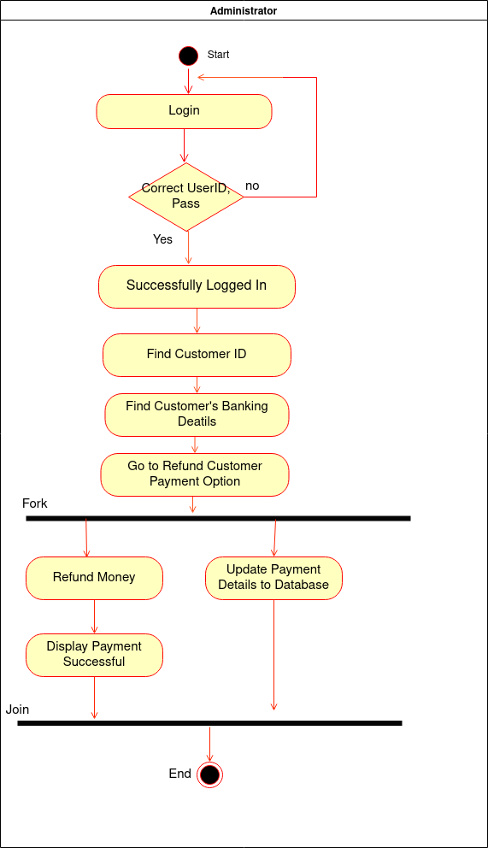
Activity Diagram for Refund Customer Payment

Slide 17
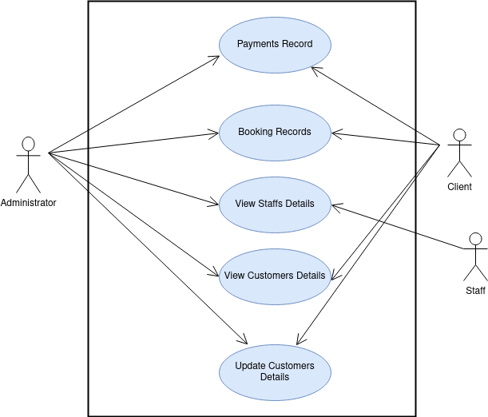
Fig: Use Case Diagram for Database Management

Slide 18
Use Case Narratives for Database Management
Usecase Name: Payments Record
Area: Database Management
Actors: Administrator, Client
Description: Shows all payments records or specific payment records for the customer.
Success steps/scenario | Information for setps
1.Administrator and customer has different role of view payment record.
2.Administrator can see all payments records | Payments records
3.Administrator can find specific customer’s payments record from search option using customer ID or payment ID | CustomerID, paymentID
4.Customer can see only their whole payments history | CustomerID
5.Customer will click on view payment record option to see their payment details in the dispaly
6.Administrator and Customer both can print payment receipt according to their role. | Print money receipt
Alternate steps/scenario
3.1 If customerID or paymentID is invalid it will show record not found.
5.1 If admin and customer not interested to print money receipt he/she can cancel printing.

Slide 19
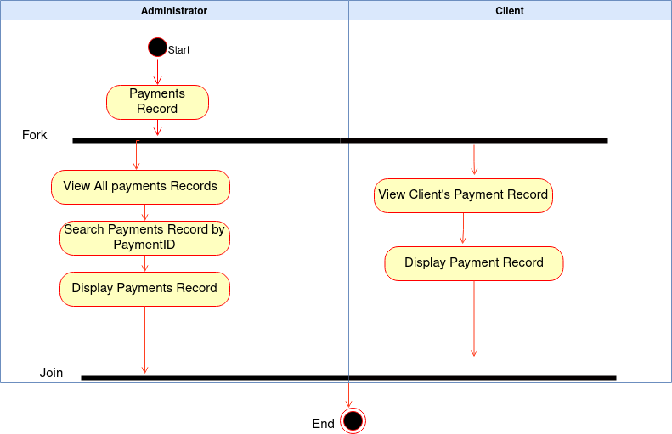
Activity Diagram for Payments Records

Slide 20
Usecase Name: Booking Records
Area: Database Management
Actors: Administrator, Client
Description: Keeps records of all bookings.
Success steps/scenario | Information for setps
1.Administrator and customer has different role of the system. | Admin role, Customer role
2.Administrator can see all bookings records | Booking records
3.Administrator can find specific customer’s booking record using customerID or BookingID | CusomerID, BookingID
4.Customer Can see their own booking records only by clicking on see booking record option.
5.Booking records successfully display.
Alternate steps/scenario
3.1 If customerID or BookngID is invalid it will show record not found.

Slide 21
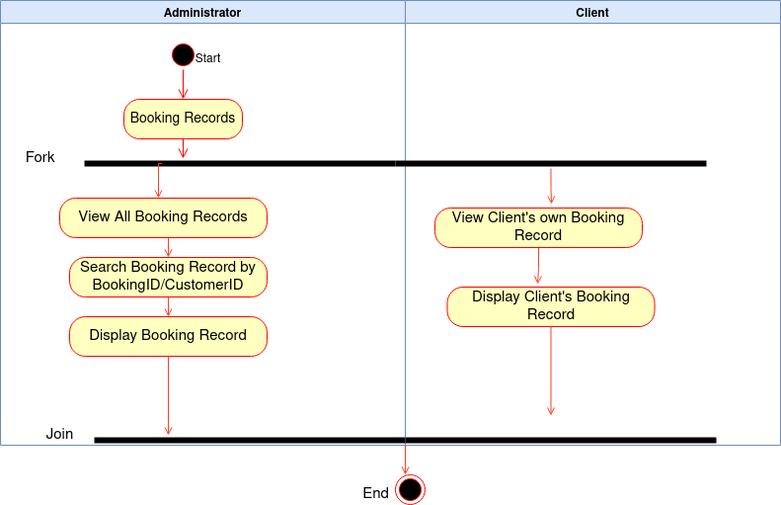
Activity Diagram for Booking Records

Slide 22
Usecase Name: View Staffs Details
Area: Database Management
Actors: Administrator, Staff
Description: It allows to keeps and view all record of staffs.
Success steps/scenario | Information for setps
1.Administrator and Staff has different access role.
2.Administrator can see all staffs details
3.Administrator can find particular staff from search option using staffID | staffID
4.Staff can see their account’s corresponding details.
5.Keeps record of staff’s salary.
Alternate steps/scenario
3.1 If customerID or staffID is invalid it will show record not found.

Slide 23
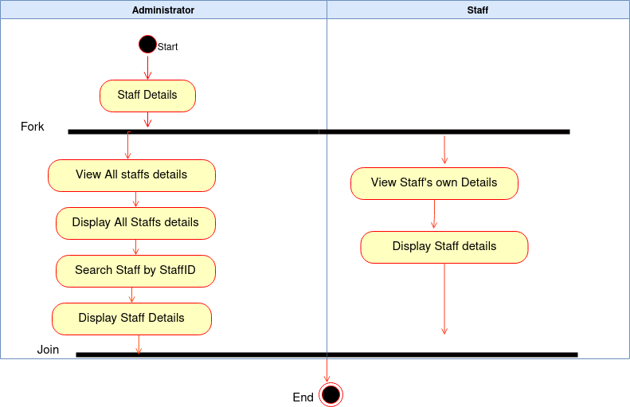
Activity Diagram for view Staff Details

Slide 24
Usecase Name: View Customers Details
Area: Database Management
Actors: Administrator, Client
Description: It shows customers information.
Success steps/scenario | Information for setps
1.Sore customer’s ID | CusotmerID
2.Store customer’s Name. | CustomerName
3.Store Customer’s Contact, Address | Location
4.Stores Customer’s baking information | Banking infoamtion
5.Administror can see all customer’s details and find particular customer’s details using CustomerID | CustomerID
6.Customer can view only their own account information.

Slide 25
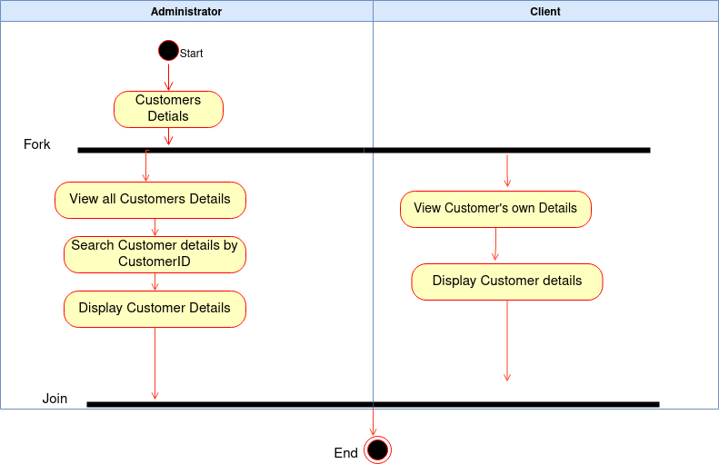
Activity Diagram for view Customer details

Slide 26
Usecase Name: Update Customers Details
Area: Database Management
Actors: Administrator
Description: Administrator can update customer’s details.
Success steps/scenario | Information for setps
1.Administraror can customer both has different role. | Admin role, Client role.
2.Adminstraror update all customer’s details can find particular customer using customerID | customerID, update record
3.Cusotmer can update their own account details. | Update record
4.Click on update button to update details.
6.Dispaly successfully updated information
Alternate steps/scenario
4.1 Administrator and Customer both can click on cancel button if they not want to update now.

Slide 27
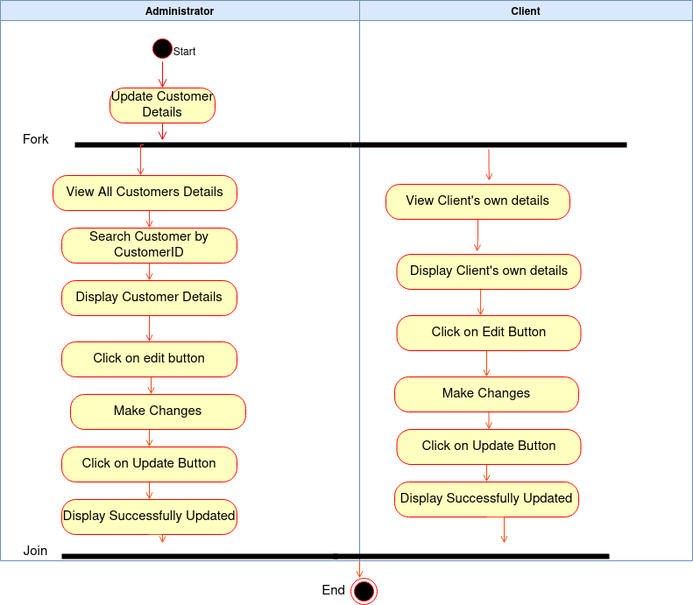
Activity Diagram for Update Customer Details

Slide 28
Subsystems
Subsystems
Client Management
Staff Management
Designed by Sanjida Akhter

Slide 29
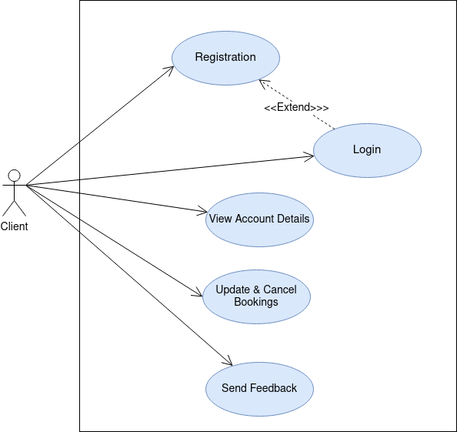
Use Case Diagram
Fig: Use Case Diagram for Client Management

Slide 30
Use Case Narratives for Client Management
Usecase Name: Registration
Area: Client management system
Actors: Client
Description: User can give all details information and registered in an secure website
Success steps/scenario | Information for Setps
1.User visit the registration webpage of the secure website | website
2.Customer information is displayed in the registration webpage | registered web form
3. Client enters the valid information on the registration web form | registered web form
4. Click on the submission button | registered web form
5. Registration confirmation page will open | confirmation web page
6. check and verify the the registered information | confirmation web page
Alternate steps/scenario
6.1 If the information is not valid then enter the valid information again

Slide 31
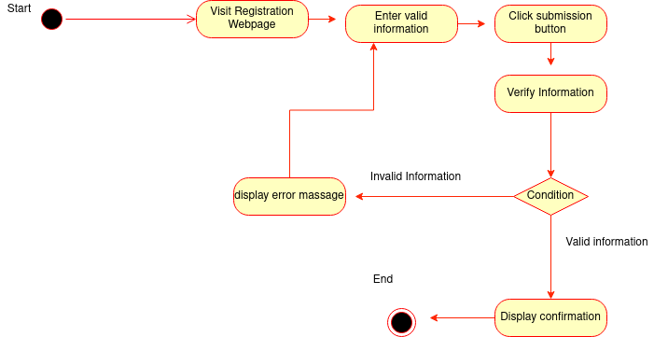
Activity Diagram for Registration
Client

Slide 32
Usecase Name: Login
Area: Client management system
Actors: Client
Description: user give user name, password and login the system
Success steps/scenario | Information for Setps
1. User visit the login webpage of the secure website | website
2. click the login button | Login button
3. enter the user name | Login webpage
4. enter the password(password must be 6 digits) | Login webpage
5. Confirm login on the website | confirmation web page
Alternate steps/scenario
4.1 If the password is not correct then enter correct password again
4.2 If forgot password click on the forgot password button and recover the password

Slide 33
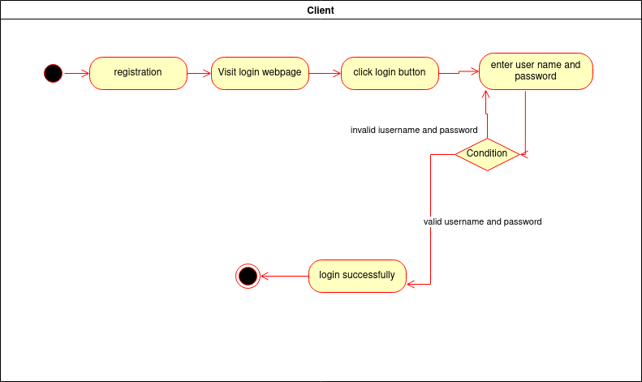
Activity Diagram for Login

Slide 34
Usecase Name: View Account details
Area: Client management system
Actors: Client
Description: client visit the account details web page and see all the information that he/she provide while registered the system
Success steps/scenario | Information for Setps
1. login the webpage | Login webpage
2. User visit the account details webpage of the system | account details webpage
3.view all account details | account details webpage
4. check all the information that provided in the registration form | account details webpage
5. check all the necessary updates | account details webpage
Alternate steps/scenario
4.1 information will be incorrect
5.1 account details webpage will show wrong updates

Slide 35
Usecase Name: Update & Cancel booking
Area: Client management system
Actors: Client
Description: Allow booking from client and also allow cancel booking . Client also can view the booking or cancellation updates
Success steps/scenario | Information for Setps
1.Client click the booking button | Booking web page
2. check the availability | Booking web page
3. give the necessary information | Booking web page
4. confirm booking
5. Visit the booking update web page | Update booking page
6.click the cancel booking button | Update booking page
7.show the valid reason for cancellation | Update booking page
8. confirm cancellation
Alternate steps/scenario
1.Room will be not available
2.Booking information will be incorrect

Slide 36
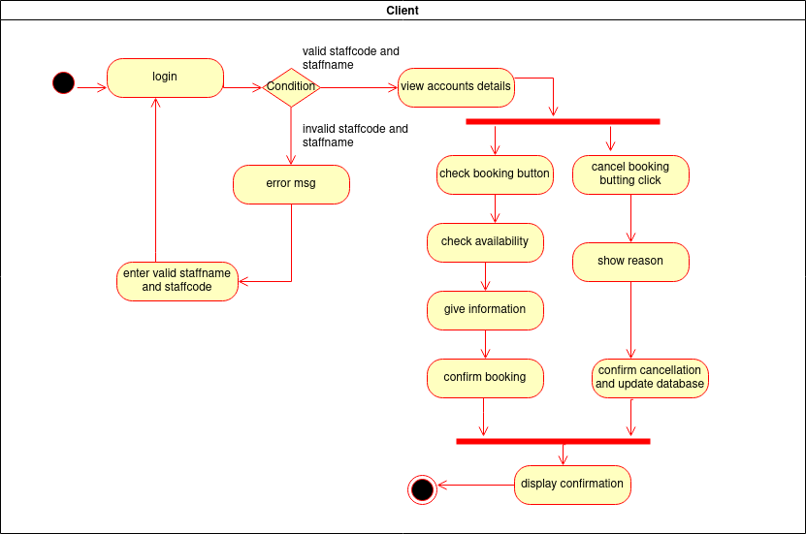
Activity Diagram for view account details , update and cancel booking

Slide 37
Usecase Name: Send Feedback
Area: Client management system
Actors: Client
Description: Client visit the website and lastly they can give feedbeck . Website is usefull or not ,how much efficient
Success steps/scenario | Information for Setps
1.User visit the website | Secure website
2.user can registration login in the system | Login
3.user can booking and cancel booking
4. user can view all the features and seasonal package | Features ,package
5.user visit the feedbeck webpage
6. user can give feedback how the system is. System useful or not | feedback
Alternate steps/scenario
1.user feedback will not be accurate all the time

Slide 38
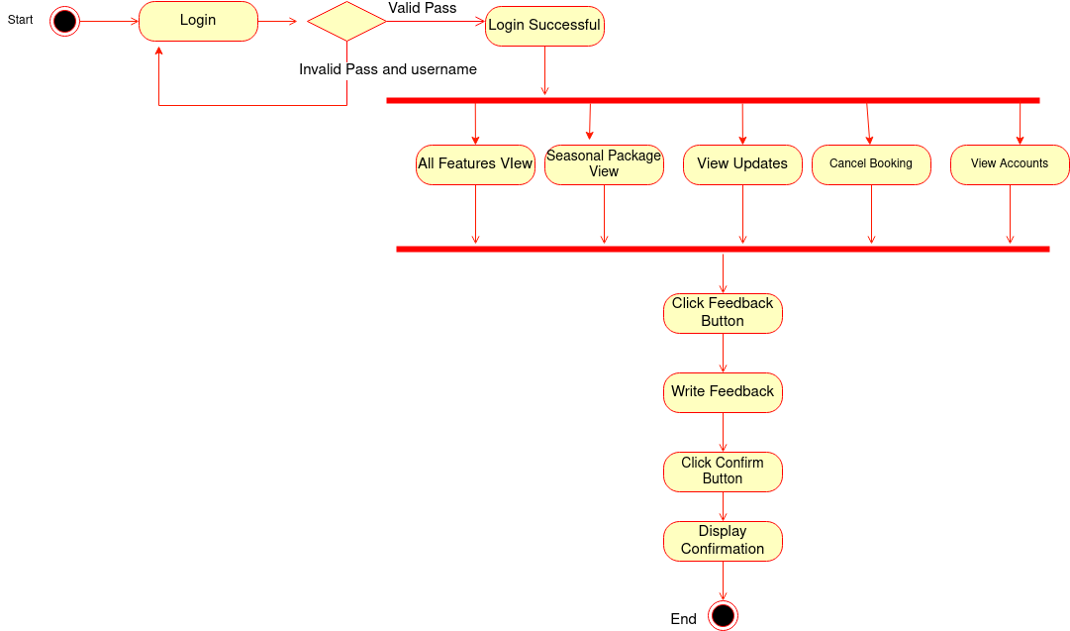
Client
Activity Diagram for send feedback

Slide 39
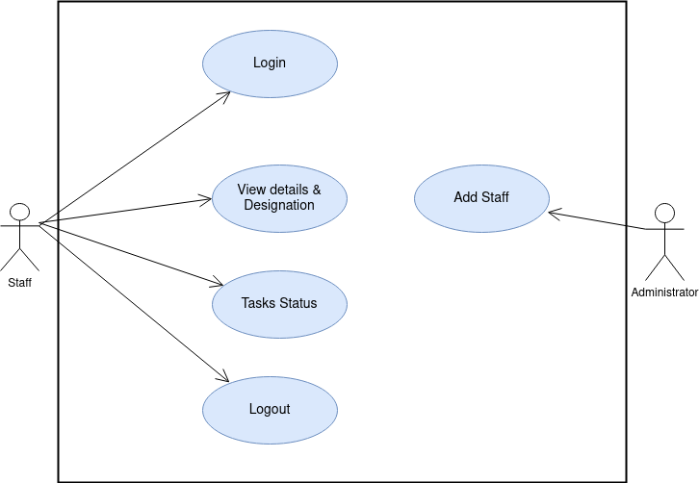
Use Case Diagram
Fig: Use Case Diagram for Staff Management

Slide 40
Use Case Narratives for Staff Management
Usecase Name: login
Area: Staff management system
Actors: Staff
Description: Staff give user name, password and login the system
Success steps/scenario | Information for Setps
1. Staff visit the login webpage of the secure website
2. click the login button
3. enter the staff name | Login web page
4. enter the staff code | Login web page
5. Confirm login on the website | confirmation web page
Alternate steps/scenario
4.1 If the password is not correct then enter correct password again 4.2 If forgot password click on the forgot password button and recover the password

Slide 41

Activity Diagram for Login

Slide 42
Usecase Name:Add staff
Area: Staff management system
Actors: Administrator
Description: Administrator can add staff when they need a staff
Success steps/scenario | Information for Setps
1. Administrator visit the staff page | Staff webpage
2. check the number of staff | Staff record
3. check staff need or not | Staff record
4.Add staff when needed
5.entry the staff information | Staff record
Alternate steps/scenario
3.1 Enough number of staff exist
3.2 Not any vacancy

Slide 43
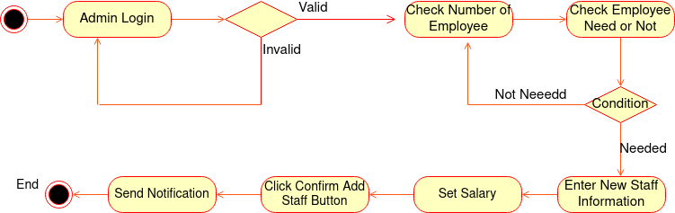
Activity Diagram for add staff
Administrator

Slide 44
Usecase Name: view details & designation
Area: Staff management system
Actors: Staff
Description: Staffs can view their details information and their designation
Success steps/scenario | Information for Setps
1.Staff visit their staff page
2. They can view their details information like name, address, phone number, email address. | Client account
3.They can view their designation | Client account
4.They can know their salary status | Salary status
5. They can know their work schedule | Work schedule
Alternate steps/scenario
2.1 Staffs information will be incorrect

Slide 45
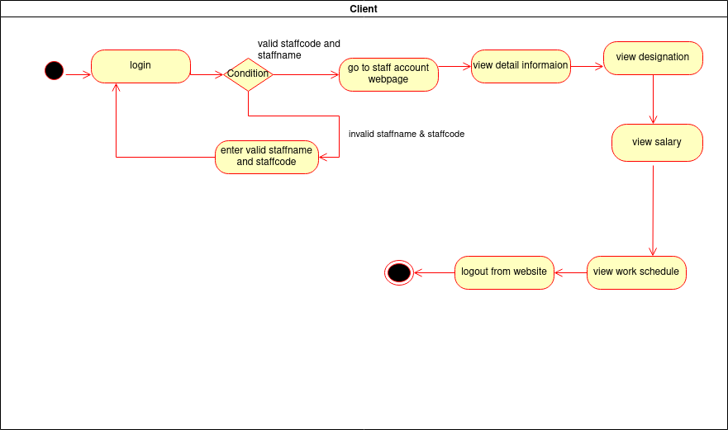
Activity Diagram for view details , designation
staff

Slide 46
Usecase Name: Tasks status
Area: Staff management system
Actors: Staff
Description: Staff can check their daily task
Success steps/scenario | Information for Setps
1.Staff can visit the staff webpage
2.They login the system
3.Click the task button
4. Check the daily task
Alternate steps/scenario
4.1 Daily task will not be updated regular
Usecase Name: logout
Area: Staff management system
Actors: Staff
Description: Staff can logout the system after finish the work
Success steps/scenario | Information for Setps
1.Staff login the system | Login webpage
2.After visit the staff page staff can logout the page
3. Click the logout button | logout button
4. confirm logout | Confirmation page

Slide 47
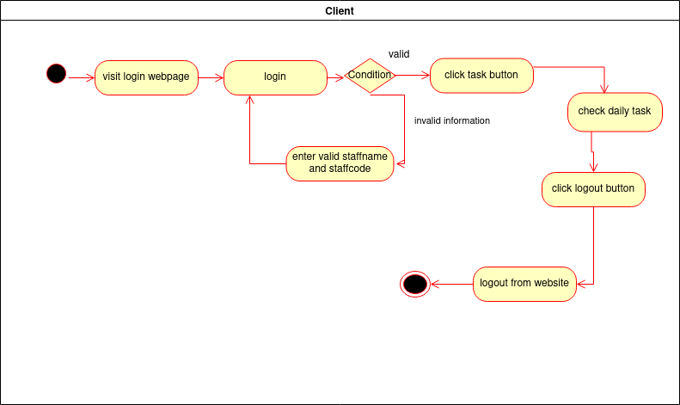
Activity Diagram for Task status
staff

Slide 48
Subsystems
Subsystems
Booking Management
Designed by Renesha Amin Mayuri

Slide 49
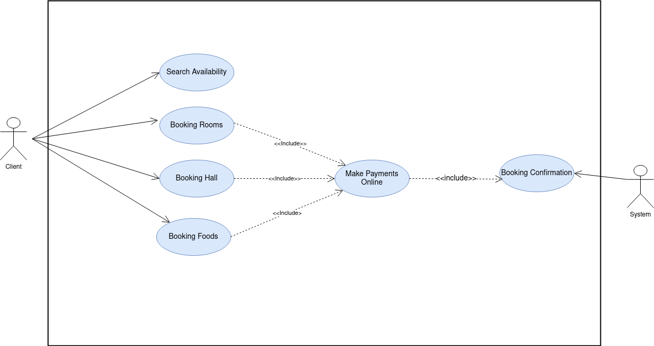
Use Case Diagram
Fig: Use Case Diagram for Booking Management

Slide 50
Use Case Narratives for Booking Management
Usecase Name: Search Availability
Area: Booking Management
Actors: Client
Description: User visit the website and search the available Rooms, Hall and Food items for booking.
Success steps/scenario | Information for Setps
1.Cusotmer visit the secure website server | website
2.Customer login webpage with userID ,password. | userID , password
3.Customer enter check-in and checkout date | Check-in & Checkout date
4. Customer Enter capacity of the room and number of rooms | Room capacity
5.Finally click on the search availability button then all available rooms, halls, foods will be displayed. | Display information
Alternate steps/scenario
2.1 if the password is not correct then enter correct password again.
5.1 If there is nothing available in that case there will be no result.

Slide 51
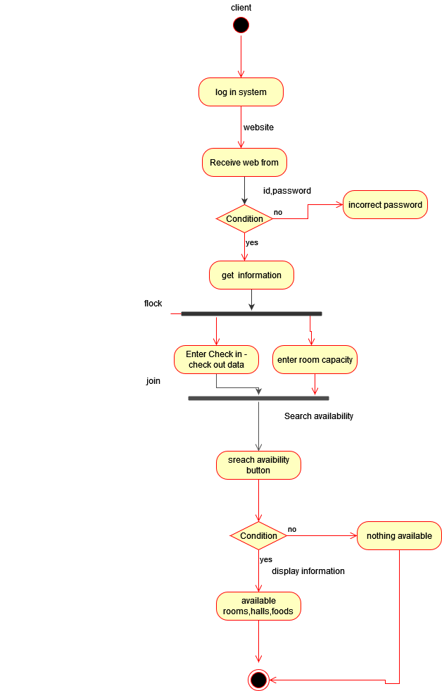
Activity diagram for Search availability

Slide 52
Usecase Name: Booking Rooms
Area: Booking Management system
Actors: Client
Description: Customer can book rooms and can see room booking all details .
Success steps/scenario | Information for Setps
1.Custoemr visit the login secure website server . | website
2.Customer login webpage with ID , PASSWORD. | ID , PASSWORD
3. Customer Click on booking room button | Room booking webpage
4. Customer provides necessary information and get available rooms | Room booking webpage
5. Select rooms, meal type, and foods | Rooms, food items
6. Cost will be calculated automatically based on the customer’s selection. | Total cost
7.Make Payment | payment
8.Display booking confirmation.
Alternate steps/scenario
2.1 Password can be incorrect.
7.1 Customer can exist webpage without making payment.
7.1 Payment details incorrect

Slide 53
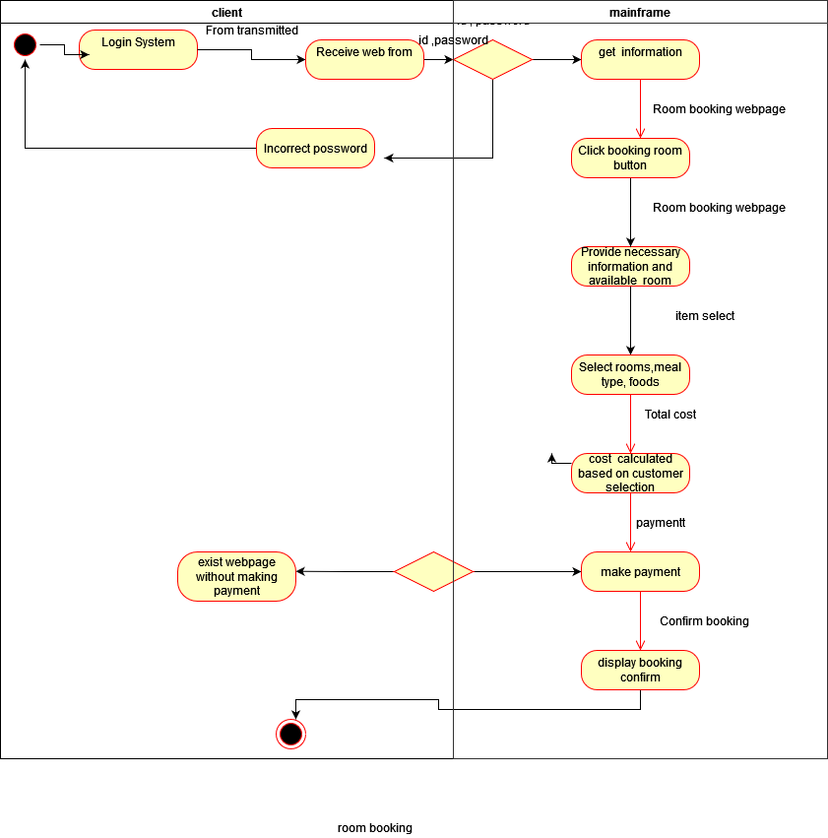
Activity diagram for Booking Rooms

Slide 54
Usecase Name: Booking Convention Hall
Area: Booking Management
Actors: Client
Description: Customer can book convention hall and can see hall booking all details .
Success steps/scenario | Information for Setps
1.Custoemr visit the login secure website server . | website
2.Customer login webpage with ID, PASSWORD. | ID , PASSWORD
3. Customer Click on booking convention hall button | Hall booking webpage
4. Customer provides necessary information and get available halls | Hall booking webpage
5. Select number of guest
6. Select decoration of the hall
7. Select event, meal type, and foods
8. Cost will be calculated automatically based on the customer’s selection. | Total cost
9.Make Payment | payment
10.Display booking confirmation.
Alternate steps/scenario
2.1 Password can be incorrect.
9.1 Customer can exist webpage without making payment.
9.2 Payment details incorrect

Slide 55
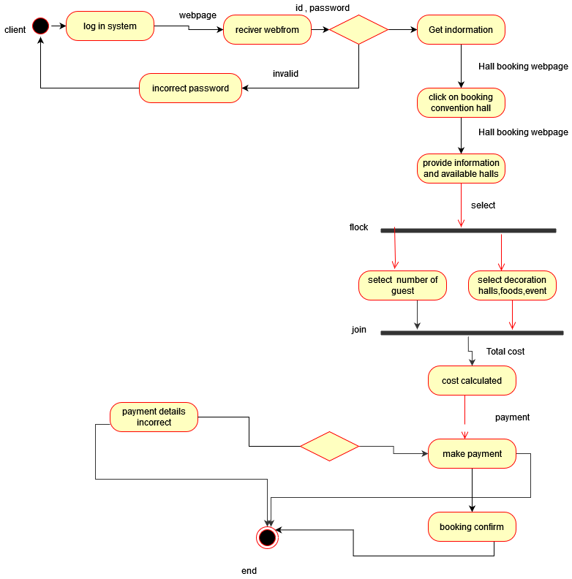
Activity diagram for Booking convention hall

Slide 56
Usecase Name: Booking Foods
Area: Booking Management
Actors: Client
Description: Customer can booking extra foods and can see food booking all details .
Success steps/scenario | Information for Setps
1.users visit the login secure website server . | website
2.user login webpage with ID , PASSWORD. | ID , PASSWORD
3.Customer click on booking foods option. | food booking webpage
4. Customer will get available foods items | food booking webpage
5. Select food items
6.Make payments | Payment
7. Display confirmation of booking.
Alternate steps/scenario
4.1 food will be not available .
6.1 Customer can exit webpage without making payment if customer don’t want to confirm booking.

Slide 57
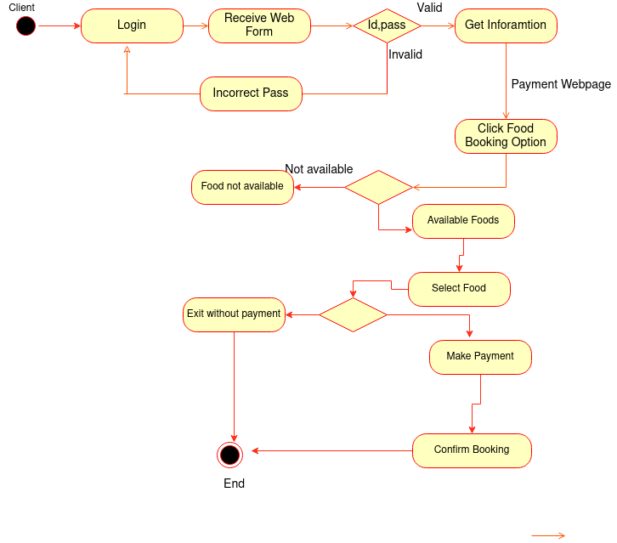
Activity diagram for Booking Foods

Slide 58
Usecase Name: Make Payment
Area: Booking Management
Actors: Client
Description: Customer Can booking and make payments via online baking/ mobile banking.
Success steps/scenario | Information for Setps
1.Cusomer visit the login secure website server . | website
2.user login webpage with ID , PASSWORD. | ID , PASSWORD
3.After select bookings customer click on the make payment button. | Payment webpage
4. Select Mobile Banking/Credit card option | Payment webpage
5. Enter credit card number, key, or mobile banking number. | Payment account information
6. Enter amount | amount
7. Verify payment confirmation code
8. Display payment successful.
Alternate steps/scenario
2.1 Incorrect password if customer enter wrong password.
5.1 Credit card number, pin, or mobile banking number not valid.
7.1 Verification code invalid.

Slide 59
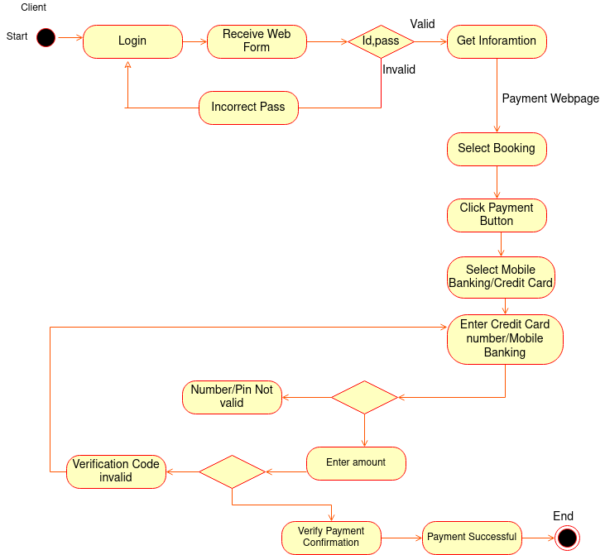
Activity diagram for Make payment

Slide 60
Usecase Name: Booking Confirmation
Area: Booking
Actors: System
Description: System confirmation booking is the payment is successful.
Success steps/scenario | Information for Setps
1.System get all necessary booking and payment information
2.System check the full payment is successful nor not.
3.If the full payment is successful it display booking confirmation pop up. | Room booking webpage
4. Update payment details to the database. | Room booking webpage
5. Display Booking confirmation
Alternate steps/scenario
3.1 Display payment is not successful.
3.2 If full payment is not done display the remaining amount.

Slide 61
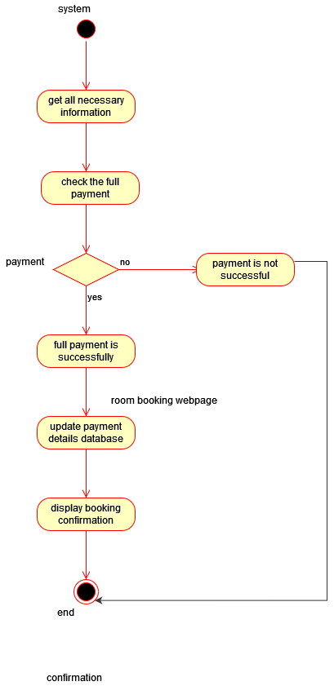
Activity diagram for Booking Confirmation

