Slide 1

Salary Prediction System using Linear Regression
Uttam Kumar Tripathi | BTech AI/ML Student

Slide 2

Project Overview
This machine learning project focuses on predicting employee salaries using Linear Regression. The model analyzes key features such as education level, years of experience, job title, and demographic factors to estimate compensation accurately.
By leveraging historical salary data, the system learns patterns and relationships between various professional attributes and salary outcomes, enabling organizations to make informed compensation decisions.

Slide 3
Dataset Description
The dataset contains comprehensive employee information with diverse features that influence salary determination:
Education
Experience
Degree level and field of study
Years of professional work
Location
Job Title
Geographic region and city
Position and role designation
Age & Gender
Salary
Demographic characteristics
Target variable (compensation)

Slide 4


Libraries Used & Purpose
pandas
Data manipulation and handling CSV files efficiently
numpy
Numerical operations and array processing
sklearn
Machine learning models and evaluation metrics
matplotlib/seaborn
Data visualization and statistical graphics

Slide 5
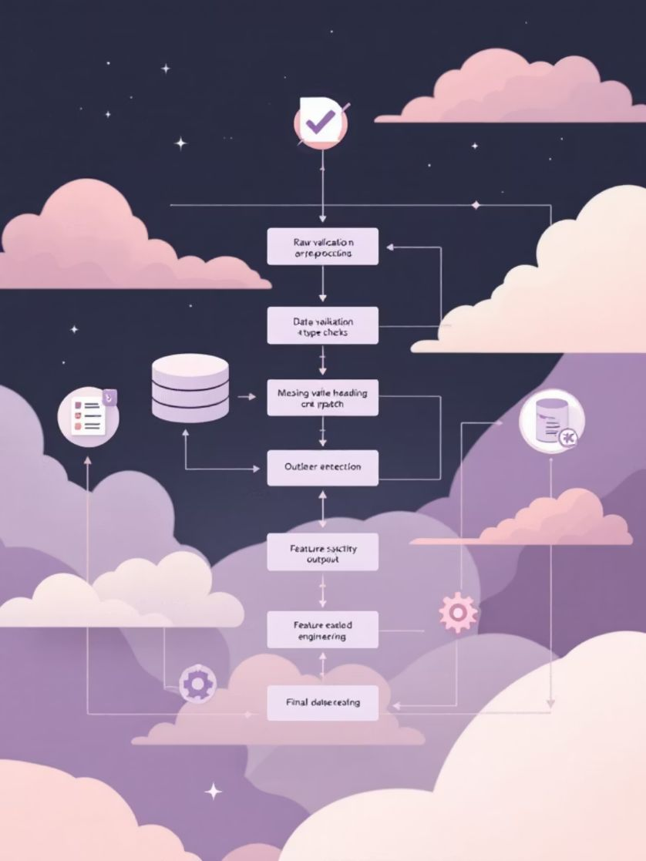
Data Loading & Preprocessing
Code Implementation
df = pd.read_csv('salary_prediction_data.csv') print(df.head()) print(df.info())
The dataset is loaded from a CSV file using pandas. The preprocessing stage involves handling missing values, removing duplicates, and identifying data types for each column.
Categorical variables (Education, Location, Job_Title) require encoding, while numerical features (Age, Experience) need scaling for optimal model performance.

Slide 6

Feature Engineering
ColumnTransformer & OneHotEncoder
Text data must be converted into numerical format for machine learning algorithms. ColumnTransformer applies different transformations to different columns efficiently.
preprocessor = ColumnTransformer( transformers=[ ('num', StandardScaler(), ['Age', 'Experience']), ('cat', OneHotEncoder(), ['Education', 'Location', 'Job_Title', 'Gender']) ])
This approach handles both numerical and categorical data simultaneously, creating a machine-readable feature matrix.

Slide 7

Feature Scaling
01
Identify Numerical Features
Age and Experience columns selected
02
Apply StandardScaler
Transform to mean=0, std=1
03
Normalize Data
Ensure uniform scale across features
04
Combine with Encoded Data
Create complete feature matrix
StandardScaler normalizes numerical columns by removing the mean and scaling to unit variance. This prevents features with larger values from dominating the model and ensures all features contribute equally to predictions.

Slide 8

Data Splitting
Train-Test Split Strategy
X_train, X_test, y_train, y_test = train_test_split( X_processed_df, y, test_size=0.2, random_state=42 )
The dataset is split into 80% training data and 20% test data. This ensures sufficient data for model training while reserving unseen examples for unbiased evaluation.
random_state=42 guarantees reproducible results across multiple runs.

Slide 9



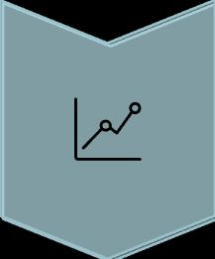
Model Training: The Core
Initialize Model
Create LinearRegression object
Fit Training Data
Learn patterns from X_train and y_train
Build Relationships
Establish weight coefficients
During training, the algorithm iteratively adjusts coefficients to minimize prediction error. The model learns the optimal relationship between input features and salary through Ordinary Least Squares optimization, identifying which factors most strongly influence compensation.

Slide 10

Model Evaluation Metrics
Three key metrics assess prediction accuracy and model performance:
Mean Absolute Error (MAE)
Root Mean Squared Error (RMSE)
Average absolute difference between predicted and actual salaries. Lower values indicate better accuracy. MAE is robust to outliers and easy to interpret in original units.
Square root of average squared errors. Penalizes larger errors more heavily than MAE. Provides a measure of typical prediction deviation from actual values.
R-squared (R²) Score
Proportion of variance in salary explained by the model. Ranges from 0 to 1, where higher values indicate better fit. Represents percentage of salary variability captured by features.

Slide 11

Exploratory Data Analysis (EDA)
Comprehensive analysis using Seaborn for correlation heatmaps and salary distribution plots to understand data patterns and relationships.
Correlation Analysis
Distribution Insights
Seaborn heatmaps revealed strong relationships between experience years and salary, moderate correlations with education level
Salary distributions showed right-skewed patterns, indicating premium compensation for specialized skills and senior roles
Feature Engineering
Identified key predictors including years of experience, education level, and job title categories for model training

Slide 12

Interactive System Architecture
Main Interactive Loop
The system features a real-time interface allowing users to dynamically add training data or request instant salary predictions.
The loop continuously accepts user commands, processes input data, validates entries, and routes to appropriate functions—either data storage or prediction generation.
01
02
User Input Capture
Data Validation
Accept education, experience, and job title from console or GUI
Check input formats and handle missing values gracefully
03
04
Model Processing
Result Generation
Transform categorical variables and scale numerical features
Return predicted salary with confidence intervals

Slide 13

Making Salary Predictions
The trained model processes user-provided features through the model.predict() method to generate instant salary estimates.
Input Preparation
Convert categorical data (education level, job title) into numerical format using encoding techniques. Scale numerical features like experience years.
Model Inference
Pass the transformed feature array to model.predict(new_data) which applies learned patterns to estimate compensation.
Result Delivery
Return predicted salary as float value, optionally with confidence intervals showing prediction reliability.
# Sample prediction code new_data = [[education_encoded, years_experience, job_title_encoded]] predicted_salary = model.predict(new_data) print(f"Predicted Salary: ₹{predicted_salary[0]:,.2f}")

Slide 14

Key Challenges Encountered
1
Categorical Variable Handling
Transforming text-based features (education, job titles) into numerical format required careful encoding strategies to preserve meaningful relationships without introducing bias.
2
Library Compatibility Issues
DLL conflicts between Python versions and machine learning libraries caused installation problems. Resolved through virtual environment isolation and version pinning.
3
Data Quality Concerns
Missing values and inconsistent formatting in raw dataset required robust data cleaning pipelines and imputation strategies to ensure model reliability.
4
Model Interpretability
Explaining predictions to end-users required additional feature importance analysis and partial dependence plots to build trust in automated recommendations.

Slide 15




Future Enhancements
Advanced Algorithms
Implement ensemble methods like Random Forest, Gradient Boosting, and Neural Networks for improved accuracy
Web Deployment
Containerize application with Docker and deploy as scalable web service using Flask or FastAPI
Feature Expansion
Incorporate location, company size, skills, certifications, and market trends for comprehensive predictions

Slide 16

Project Output: Sample Prediction
Education
Experience
Job Title
Master's Degree in Computer Science
5 years of professional software development
Senior Data Scientist
Predicted Salary: ₹12,50,000
Code Implementation
# Prepare input data new_data = np.array([[2, 5, 3]]) # Encoded values # Make prediction prediction = model.predict(new_data) predicted_salary = prediction[0] # Display result print(f"Predicted Salary: ₹{predicted_salary:,.2f}")
Thank you for reviewing this project.
— Uttam Kumar Tripathi

