Slide 1
SD Tutorial
SD NEO – July 2020

Slide 2
During the tutorial, you will be responsible for adding several new features to an existing web application
The SD group has written a web application that helps to view historical sales data of drug(Sales attainment rank problem)
The application is missing several important features to complete it
Feature Design to be added to complete the product

Slide 3
Agenda
Overview of Sales Rank Attainment Application
Walkthrough Sales Rank Attainment Viewer Application
Feature design to complete the product
Deep Dive into the problem statement

Slide 4
What is Sales Attainment Rank Problem?
“How should I track sales of my product and performance of my sales representative?”
Which Drug Performed the best?
Which Sales Representative Performed the best ?
Which Drug Performed the best in which city?
How can I look into performance of previous months?

Slide 5
Problem Statement and Product Description
Problem Statement: Sales pharma company needs a web application which can help them in evaluating the historical sales data of drug. Insights on the UI get updated daily after running the business logic at (scheduled) defined time. This is a typical Sales attainment rank problem of pharma companies.
Description – Web application should allow end user to create new Sales Rep. Existing sales rep can also be viewed in the application. Web application needs to have the capability to upload the (historical) data and place it in S3 bucket. EMR cluster needs to get spun up at a scheduled time with step added on run time to perform the business functionality. The step will run the spark job which will run the business functionality. Result(insights) of the same will be pushed to the Postgres RDS. Final insights need to be displayed on the UI.

Slide 6
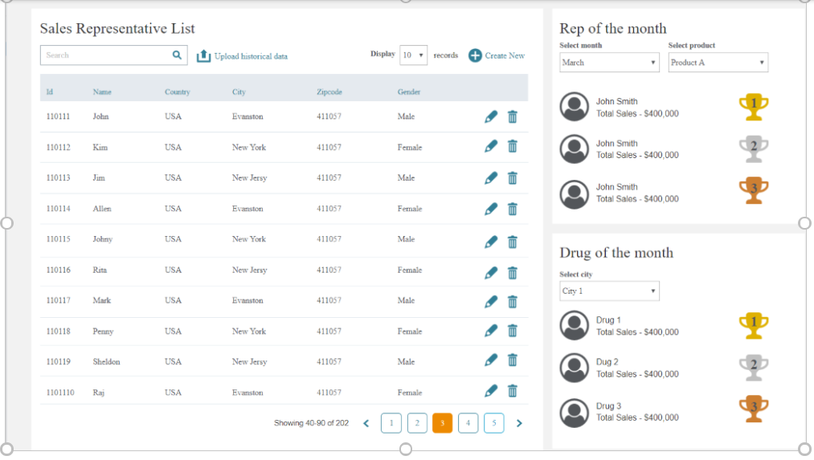
An over view of the Product depicting the features to be achieved post addition of features

Slide 7
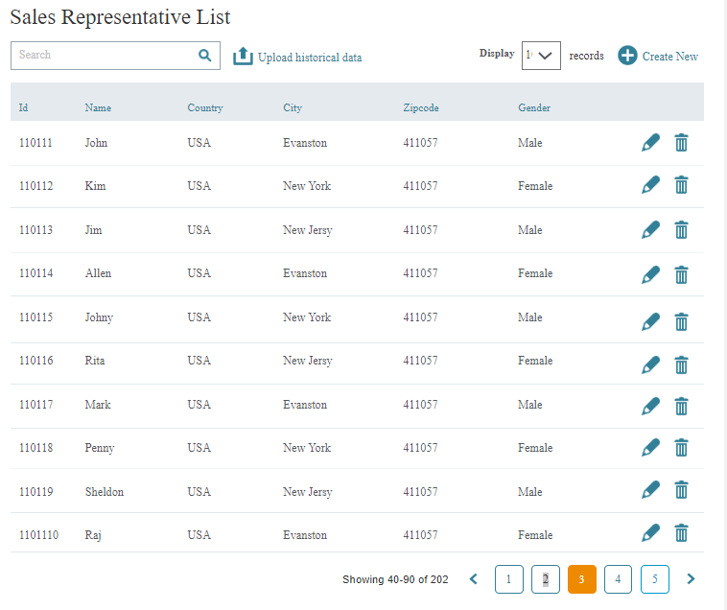
The Sales Representative List
Displays the details about the sales representative list data
Gives the option of create new to add new record
Delete the record from the list
Edit the name country of a record

Slide 8
The Upload of historical data
Support upload of historical data to S3
Displays an option to support the upload of the historical data to S3 location
The historical data will be used to give insight
The historical data is processed with help of Spark/PySpark to give insights

Slide 9
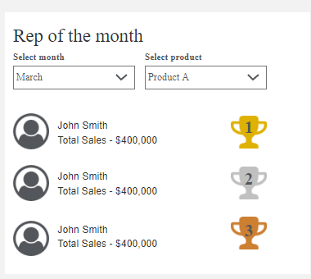
The Rep of the Month View
Rep of the month gives the detail about the rep ranking based on product and month
We can filter the result by using combination of month and product dropdowns

Slide 10
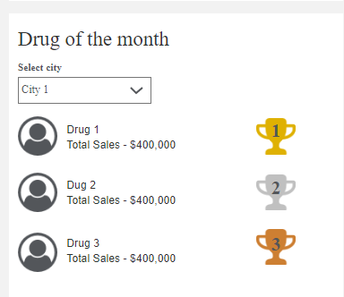
The Drug Of the month View
Drug of the month view provide the drug ranking based on city
The ranking is bases on the total sales made
The ranking provides the latest data for the current month

Slide 11
Agenda
Overview of The existing implementation
Feature design to be added to complete the product
Implement sales representative list [CRUD Operation]
Implement upload of historical data to s3
Implement web end for Rep of the month/Drug of the month
Implement data transformation on spark to update the
rep-of-the-month and drug-of-the-month
Search Box and Pagination[good To have]
Deep Dive Into the Problem

Slide 12
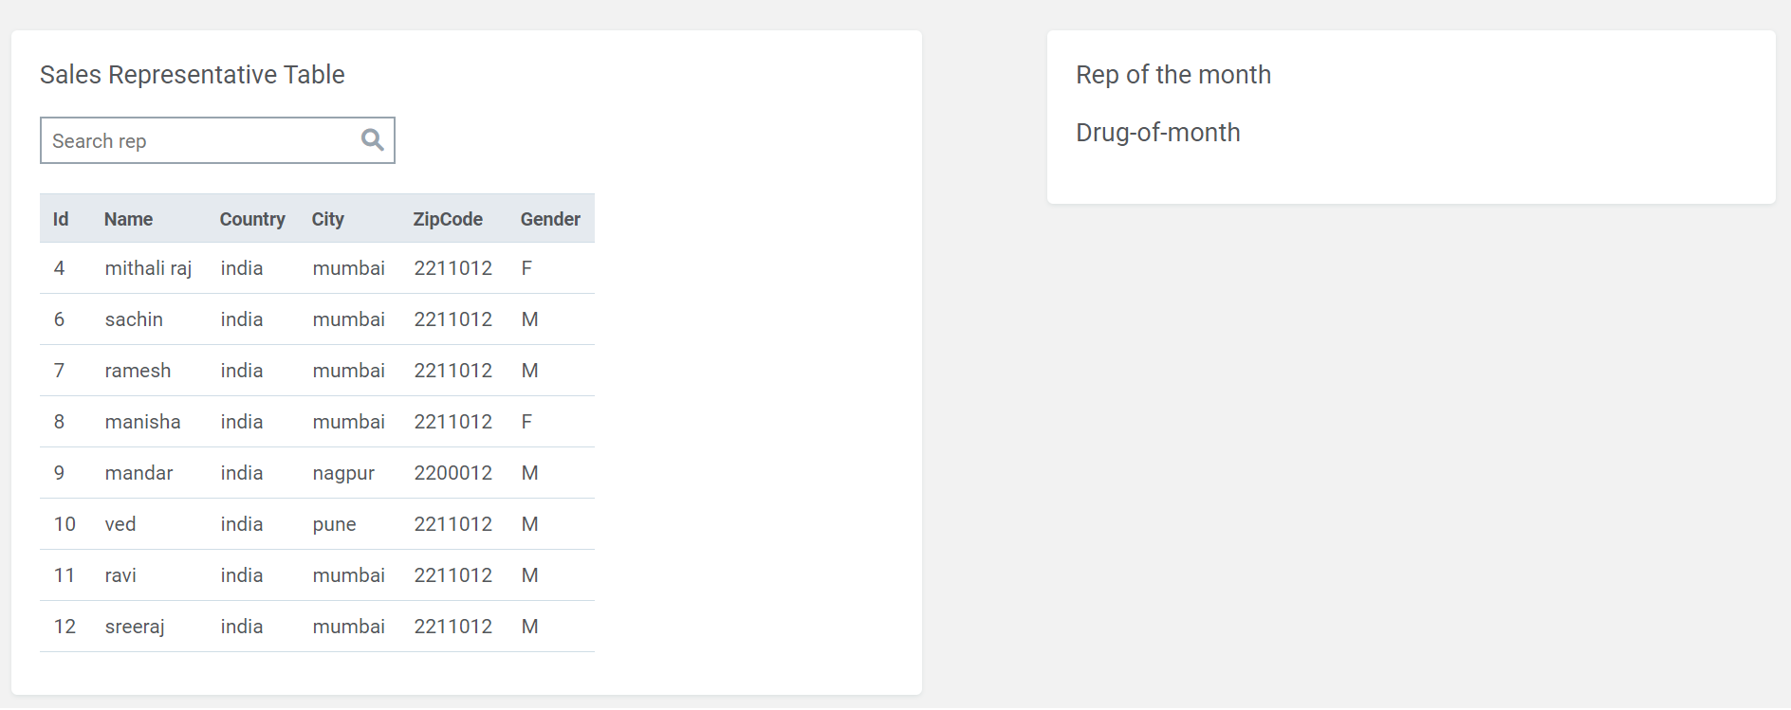
Existing Implementation on which all features is to be added

Slide 13
Feature 1: Sales Representative List
This feature provides the functionality to create/read/update/delete[CRUD operation] the sales representative list.
This feature is useful if the user wants to make changes in the sales representative list data.

Slide 14
User should be able to create a new record from a pop-up
Implement sales representative list [CRUD Operation]
User should be able to edit the list
This is a sample json response list
Create a CRUD operation capability on the list
User should be able to delete from the list

Slide 15
Feature 2: Implement upload of historical data to s3
This feature provides the functionality to upload the historical sales data to s3
This feature includes the following case:
Assumption that the schema of historical data will be same
The historical file should be uploaded successfully and a success/failure message should be displayed as per the condition.

Slide 16
Implement the upload of the historical data
User should be given the capability to upload the historical data to s3 location

Slide 17
Feature 3: Implement Rep of the month/Drug of the month from the web application
This feature provides the view to filter top sales representative performers based on the selected product and selected month.
This feature also provides another view that gives the top 3 brand performing in that particular month

Slide 18
Implement Rep of the month/Drug of the month
Filter the top performer based on the month and the sales product
Filter the drug of the month based on the city and for the current month

Slide 19
Feature 4:Implement data transformation on spark to update the rep-of-the-month and drug-of-the-month
Script/Flow should gets executed as a part of the step should pull up Historical Sales Data from S3 bucket and Sales-Rep data from RDS or through an API and run business rules and derive insights.
These insights should be stored back in Postgres RDS in overwrite mode or should be able to call an API to do so.

Slide 20



Feature 4:Implement data transformation on spark to update the rep-of-the-month and drug-of-the-month
2
1
3
S3 Bucket
EMR+SPARK
AWS RDS
Step 1: The spark reads the historical data from the s3 bucket
Step 2:The spark script will read the sales representative list from RDS or alternatively from API endpoint
Step 3:After the transformation the data should be either pushed to RDS or an API can be used to achieve the same.

Slide 21
Feature 5: Search Box and Pagination[good To have]
This feature provides an option to search the list for a given record and display the same
The pagination allows you to fetch data on the basis of page selected.

Slide 22
Feature 5: Search Box and Pagination
Ability to search any sales rep
Ability to filter sales representative with help of pagination

Slide 23
Deep dive of problem and approach to solution
Frontend
Frontend application build using Angular should list all the Sales-Rep currently registered in the system.
Frontend application to allow all CRUD operation for Sales-Rep.
Application should allow upload of Historical Sales Data from the application.
Application should also show the insights derived from the data.
Services
REST services which support all the CRUD features related to Sales-Rep from the UI.
These REST services will internally interact with Postgres RDS where Sales-REP details will be persisted.
Separate REST API which will support functionality to upload the Historical Sales Data and upload it on S3.
Supported file format is CSV only.
Another REST API will read the insights from the Postgres RDS and return to UI.

Slide 24
Deep dive of problem and approach to solution
Backend
Scheduled timely job which spin up the EMR cluster and execute a step on the cluster. On completion/failure of step, EMR cluster should get terminated.
Script which gets executed as a part of the step should pull up Historical Sales Data from S3 bucket and Sales-Rep data from RDS or through an API and run business rules and derive insights.
These insights should be stored back in Postgres RDS in overwrite mode or should be able to call an API to do so.
Business Rules
If country is not provided in data, assume it to be India.
If city is not provided in data, assume it to be Pune.
If closing inventory is more than opening inventory reject that record.
If both opening and closing inventory is not provided reject the record.
If either of opening or closing inventory is not provided, consider both values to be same.
Consider only those historical records which have matching sales rep id in our system, reject all other records.

Slide 25
Deep dive of problem and approach to solution
Insights
Rep of the month -> Month over month name the top 3 sales rep against individual listed products.
Drug of the month -> In each city which product has the highest sales.
Assumptions
Historical data uploaded will always be adhering to correct schema. Schema of the historical data will be as shown here
Assumptions
Historical data uploaded will always be adhering to correct schema. Schema of the historical data will be as shown here

Slide 26
Historical Sales Table
Column Name | Data Type | Sample Value
Distributor | String | Mediboon Pharma Pvt
Brand | String | Ranbaxy
Product | String | Abacavir
Opening Inventory | Integer | 210
Closing Inventory | Integer | 150
Date | Timestamp | 03-03-2020
SalesRep Id | Integer | 1

Slide 27
Sales Rep Details Table
Column Name | Data Type | Sample Value
SalesRep Id | Integer (auto generated) | 1
SalesRep Name | String | Manish
Country | String | India
City | String | Pune
Pincode | Integer | 411014
Gender | String | Male

Slide 28
Insight Tables
Column Name | Data Type | Sample Value
City | String | Pune
Product | String | Abacavir
Column Name | Data Type | Sample Value
SalesRep Name | String | Manish
Product | String | Abacavir
Month | String | January

