Slide 1

Responsible Artificial Intelligence
UTKU MERT
2017555041

Slide 2

What is Responsible AI
Responsible Artificial Intelligence is an emerging area that investigates the ethics of AI to understand the moral responsibility in emerging technology. The need for responsible AI has stemmed from a limited understanding of important issues that emerge with the use of such technologies.

Slide 3
Recent studies and cases in practice have shown that AI can potentially create unintended consequences such as biases, discrimination, errors or unexpected results, and an overall lack of transparency with regard to how outcomes are achieved.

Slide 4
Responsible AI is concerned specifically with establishing ethical principles and human values in order to reduce biases and promote fairness, facilitate interpretability and explainability of outcomes, and to ensure robustness and security. The ultimate goal of building AI technologies based on responsible principles is to avoid dramatic negative consequences on human and societal well-being.

Slide 5

Why We Need Responsible AI

Slide 6
As an infamous example was the Twitter-based chatbot “Tay”, released by Microsoft in 2016. In less than 24 hours, the chatbot that was originally designed to engage in “conversational understanding”, was taken down after users were teaching it to use misogynist, racist, and politically incorrect phrases. Cases such as these have prompted policy-makers, researchers, and this practitioners to think about how the development and use of AI can follow “responsible” principles.
AI, therefore, introduces new ethical, legal, and governance challenges – including but not limited to – unintended discrimination, biased outcomes, and issues related to the customers’ awareness and knowledge about how AI is involved in decision outcomes.

Slide 7

What is Basic Principles of Responsible AI

Slide 8
AI should benefit people and the planet by driving inclusive growth, sustainable development and well-being.
AI systems should be designed in a way that respects the rule of law, human rights, democratic values and diversity, and they should include appropriate safeguards – for example, enabling human intervention where necessary – to ensure a fair and just society.

Slide 9
There should be transparency and responsible disclosure around AI systems to ensure that people understand AI-based outcomes and can challenge them.
AI systems must function in a robust, secure and safe way throughout their life cycles and potential risks should be continually assessed and managed.

Slide 10
Organizations and individuals developing, deploying or operating AI systems should be held accountable for their proper functioning in line with the above principles.

Slide 11

How To Design a Responsible AI?

Slide 12
Building a responsible AI governance framework can be a lot of work. Ongoing scrutiny is crucial to ensure an organization is committed to providing an unbiased, trustworthy AI. This is why it is crucial for an organization to have a maturity model or rubric to follow while designing and implementing an AI system.

Slide 13
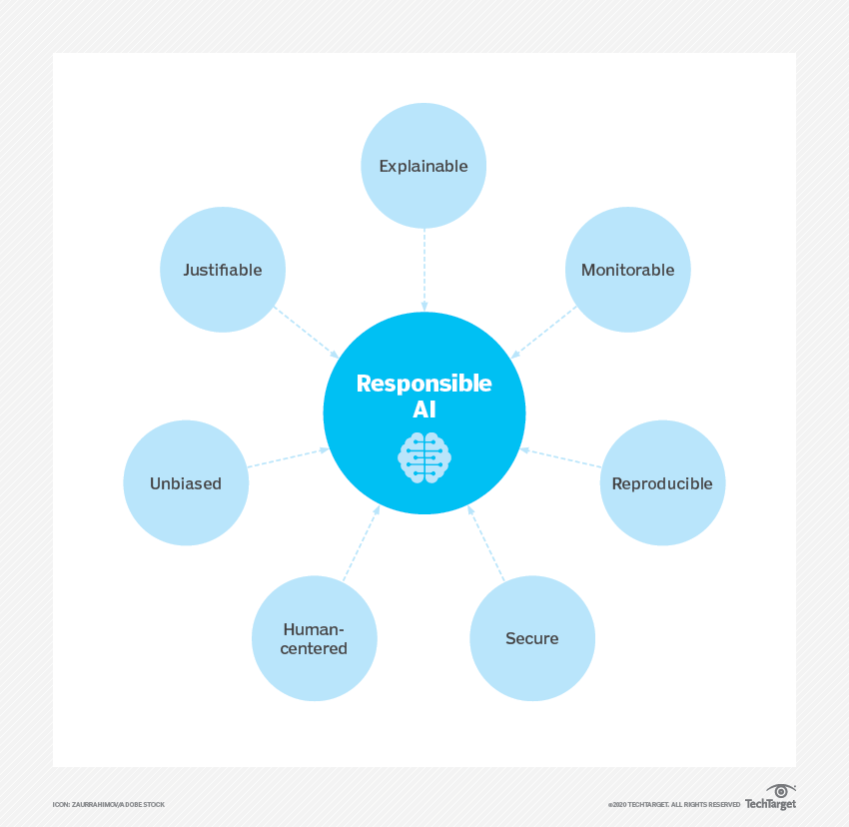
At a base level, to be considered responsible, AI must be built with resources and technology according to a company-wide development standard that mandates the use of:
Shared code repositories
Approved model architectures
Sanctioned variables
Established bias testing methodologies to help determine the validity of tests for AI systems
Stability standards for active machine learning models to make sure AI programming works as intended

Slide 14
Examples of companies embracing responsible AI
Microsoft has created its own responsible AI governance framework with help from their AI, Ethics, and Effects in Engineering and Research (AETHER) Committee and Office of Responsible AI (ORA) groups. These two groups work together within Microsoft to spread and uphold their defined responsible AI values. ORA, specifically, is responsible for setting company-wide rules for responsible AI, through the implementation of governance and public policy work. Microsoft has implemented a number of responsible AI guidelines, checklists and templates.
IBM has its own ethics board dedicated to the issues surrounding artificial intelligence. The IBM AI Ethics Board is a central body that supports the creation of ethical and responsible AI throughout IBM. Some guidelines and resources IBM focuses on include:
AI trust and transparency
Everyday ethics for AI
Open source community resources
Research into trusted AI

Slide 15
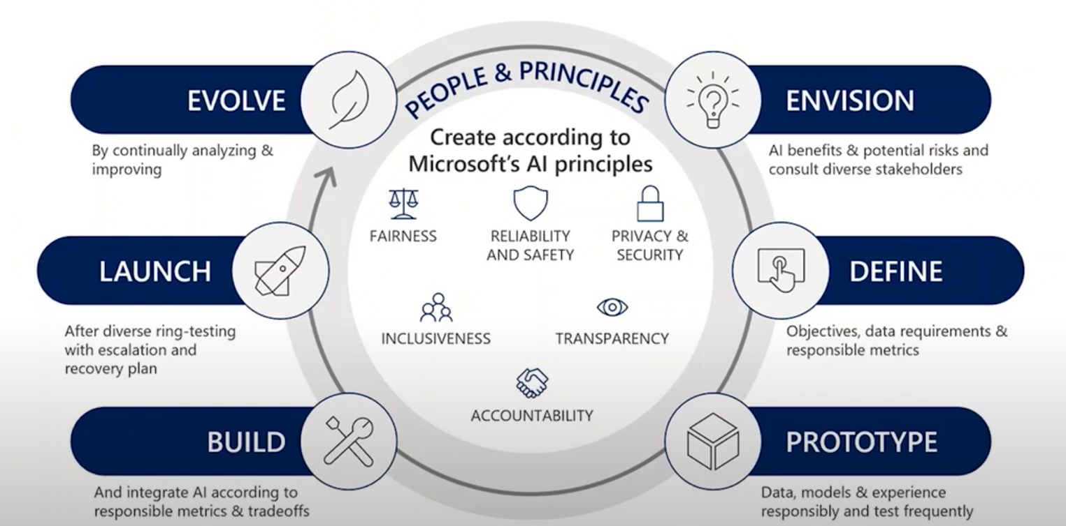
Microsoft's Responsible AI Lifecycle

Slide 16
References
https://www.tandfonline.com/doi/full/10.1080/0960085X.2022.2026621
https://www.responsible.ai/faq
https://www.techtarget.com/searchenterpriseai/definition/responsible-AI
https://www.youtube.com/watch?v=NZGa-1w0PgE&ab_channel=Accenture
https://www.youtube.com/watch?v=dXTg8PmP5wI&t=375s&ab_channel=MicrosoftUSPartnerCommunity
https://www.youtube.com/watch?v=dnC8-uUZXSc&t=24s&ab_channel=Microsoft

Slide 17
Thanks For Watching UTKU MERT 2017555041

