Slide 1
Agricultural Dynamics: Unraveling Crop Production Across States
Key Crops, Seasonal Changes, and Yield Comparisons
Presented By:- Utkarsh Raj

Slide 2
Why do we need data analysis in Agriculture
Technological Advancement: Encourages the adoption of modern agricultural technologies and practices based on data insights, leading to increased efficiency and higher yields.
Targeted Support: Enables governments and organizations to identify underperforming states or crops and implement targeted interventions, support programs, or training to enhance productivity.
Resource Optimization: Helps optimize the use of resources such as water, fertilizers, and pesticides by identifying the most productive crops and practices for specific regions.
Identifying Trends: Analyzes historical data to identify trends in crop production and yields, allowing stakeholders to anticipate future challenges and opportunities in agriculture.
Increased Food Security : Ensuring food security through adequate nutrition not only improves physical and mental health by reducing malnutrition and related diseases but also supports economic stability by fostering growth in agricultural markets and sustaining rural livelihoods.
Developing dependent industry: Numerous industries rely heavily on agricultural products; therefore, ensuring sustainable productivity in agriculture is crucial for their development and growth.

Slide 3
Executive summary
This comprehensive report will enhance our understanding of agricultural dynamics and its impact on economics.
In this report we will be focusing on three key areas:
By measuring state-wise productivity and yield, we provide valuable insights into regional performance, allowing for targeted interventions to enhance agricultural output.
Analysing growth of crop Production over multiple years reveals patterns and trends that inform stakeholders about the effectiveness of current farming practices and policies.
Additionally, identifying seasonal production trends enables farmers and policymakers to optimize planting and harvesting schedules, improving efficiency and minimizing losses.
Together, these insights will facilitate data-driven decision-making and support the development of strategies to enhance agricultural productivity, sustainability, and food security across the regions analyzed.

Slide 4
S.M.A.R.T Framework for Effective Probing (Specific Measurable achievable relevant time bound)
Methodology :
Comparing yield for crop and state to measure efficiency
Calculating YoY growth percentage for each crop and state
Identifying states with largest change in cultivated area over the years
Finding out how crop production varies seasonally accros years
Variance in production
Identifying regional top crops by production
Finding out Production has evolved over the years for key crops

Slide 5
Dataset description
Dataset name :- ‘Crop_prod_study’
Number of columns : 7
State_Name: Name of the state where the crop was grown.
District_Name: District within the state.
Crop_Year: Year of crop production.
Season: Season in which the crop was grown (e.g., Kharif, Whole Year).
Crop: Type of crop produced.
Area: The area (presumably in hectares) used for cultivation.
Production: The crop production output (presumably in metric tons).
Rows/Records : 246091

Slide 6
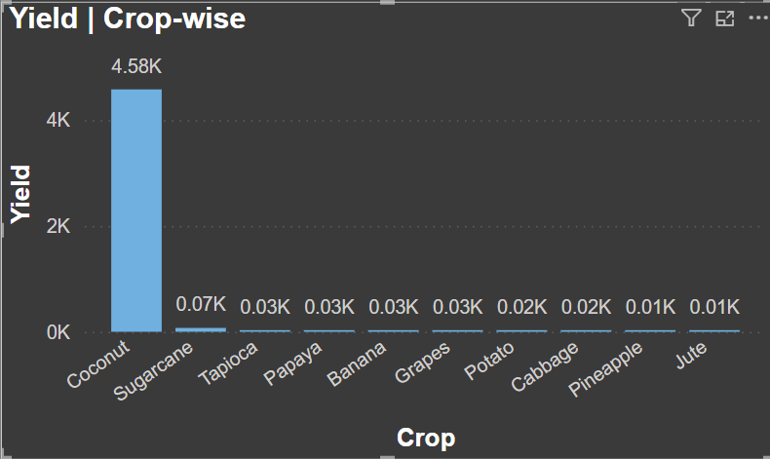
Yield comparison for crops
Coconut dominates over all other crops with 1000+ times higher yield.
Coconut farming is a key driver of agricultural output, and investments or focus on this crop could significantly boost production or revenue in regions where it is grown.
The yield range for the crops, excluding Coconut and Sugarcane, is very narrow, hovering between 0.01K and 0.07K , Other minimally contributing crops could be deprioritized in favor of more productive crops, or efforts might be made to improve their yield through better practices or innovations.

Slide 7
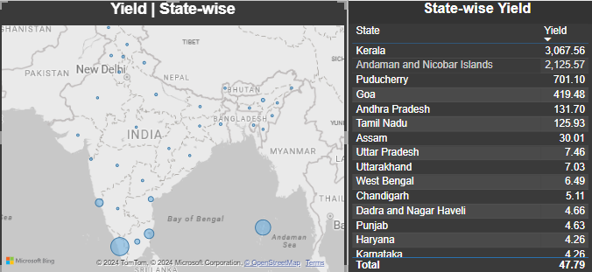
Yield comparison for states
Southern states generally have higher yields than northern states, likely due to factors like climate, soil quality, or better farming techniques. Improving technology transfer, soil management, and climate-adapted crop selection could boost yields in the north.
Understanding what drives exceptional high productivity of Kerela and Andaman Nicobar Islands could provide insights that can be applied to other southern regions or Northern regions as well.

Slide 8
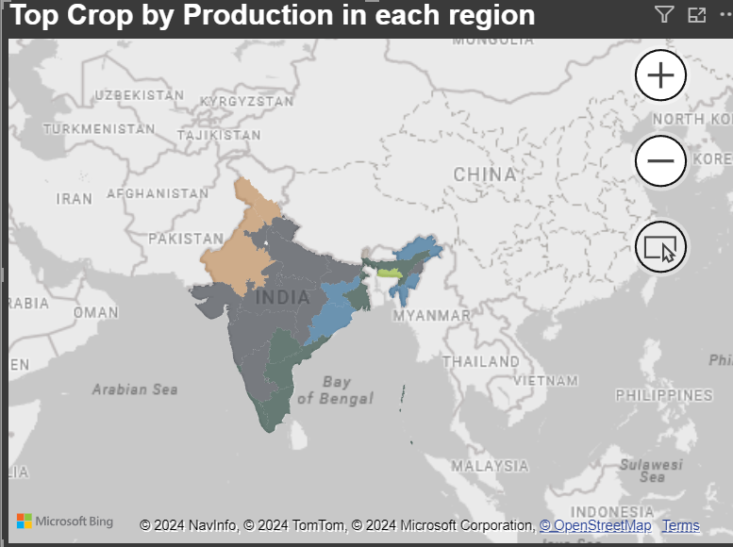
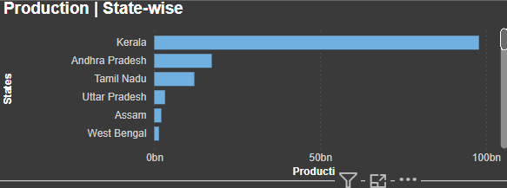
Productivity of states and top regional crops
Kerala has the highest crop production, followed by Andhra Pradesh and Tamil Nadu, despite its smaller size.
Kerala's farming techniques, if adopted in Andhra Pradesh and Tamil Nadu, could significantly boost their agricultural output.
Sugarcane is widely produced in the northern, western, and southwestern regions, especially in Karnataka.
Supporting sugarcane productivity through government policies can enhance biodiesel infrastructure, reducing India's crude oil dependency and promoting energy security.
Encouraging coconut production, due to its high yield, can significantly boost overall agricultural output.
Promoting wheat production in the northwest enhances food security, while increasing rice cultivation in the rain-rich northeast can help meet national demand without straining drought-prone areas.

Slide 9
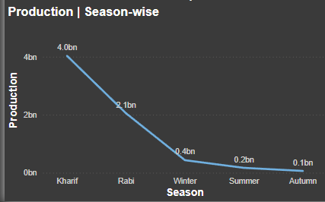
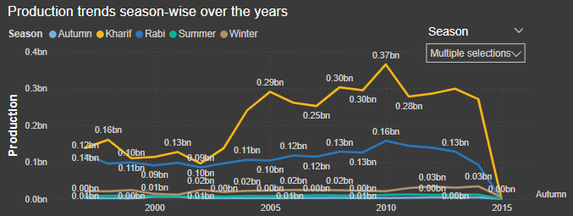
Seasonal Trends in crop production
Kharif crops show the highest production levels, benefiting from climate, soil suitability, and increased technological advancements.
Rabi crops are the second most promising category, needing effective strategies to unlock their full potential.
Summer and autumn crops contribute negligibly to overall production.
Coconut stands out with high yield and year-round cultivation, making it a safe and profitable investment for boosting national production.

Slide 10
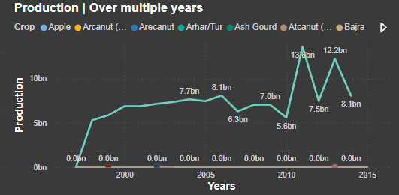
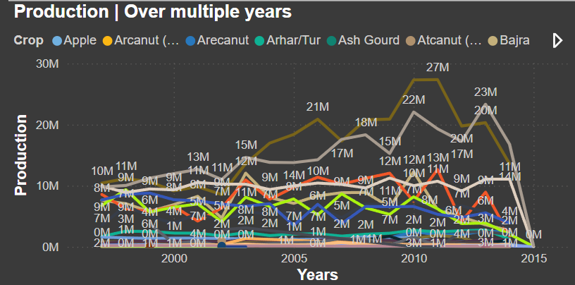
Evolution of Key crop Production over years
Coconut has seen exponential growth in productivity over the years suggesting effective government policies, technological awareness among farmers and credited to climate and soil suitability and high yield and year-round cultivation.
Other crops which has seen significant growth in production are Cotton(lint), Banana, Maize and Jute.
West Bengal( Jute), Karnataka( Maize), Tamilnadu( Banana) and Gujarat (Cotton) should encourage these crops since they are more suitable to these respective crops.
Govt should identify low productive but potential crops and their most suitable regions and formulate encouraging policies.

Slide 11
Production Variance
Kerala has highest variance in its production.
Coconut has highest variance in it’s production.

Slide 12
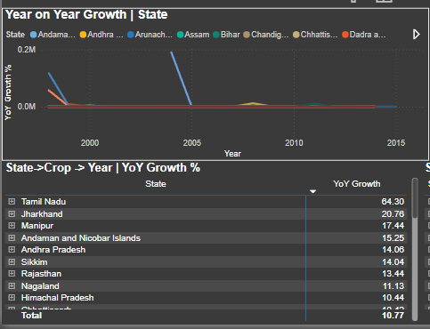
Year-on-Year Growth | State
The chart shows decreasing spikes in production data, likely due to new state formations or other factors affecting data availability in previous years.
Aside from these spikes, the year-on-year (YoY) growth percentage appears stable across all states, indicating sustainable productivity.
Tamil Nadu exhibits the highest average YoY growth percentage among the states.
Goa and Assam show almost negligible average growth, highlighting potential areas of concern.
There is a need for the government to address the challenges faced by states with slow growth.
Supporting initiatives in underperforming states could help enhance overall agricultural productivity.

Slide 13
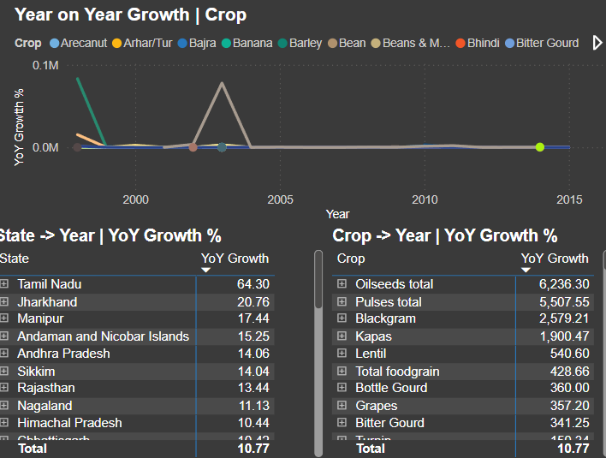
Year-on-year growth | crop
The initial decreasing spike in production data indicates unavailability of production figures from the previous year.
A notable spike in oilseed production in 2003 can be attributed to rising demand for edible oil due to the growing fast food culture, along with policy reforms that increased cultivation area and initiatives like the National Oilseeds Mission.
Oilseeds, along with pulses, black-gram, and Cotton(lint), exhibit the highest average growth percentages, each surpassing 1000%, indicating they are safe investments with the potential for good returns.
The most underperforming crops include sunflower, safflower, and drumsticks, which highlight the need for government intervention.
Addressing the challenges faced by underperforming crops could enhance overall agricultural productivity and economic stability.
The strong performance of oilseeds and pulses suggests a shift in investment strategies towards these high-growth crops to maximize returns.

Slide 14
Take-away points
Focus on Coconut Production: Considering its large volume and perennial manner of cultivation, it would be more fruitful to invest in coconut farmers’ activities as the production would reaffirm agricultural activities and net income in areas where it is appropriate.
Innovate for Other Crops: Investigate crops that are not doing well, especially those with narrower yield ranges and seek to improve their yields through innovative farming practices or technologies most appropriate for them so that better returns can be realized.
Leverage Southern States' Success: Look at the farming practices that are related to Kerala and the Andaman Nicobar Islands which are successful and replicate the same in regions such as Andhra Pradesh and Tamil Nadu for enhancing agricultural productivity.
Enhance Sugarcane Productivity: Put in place and enforce national policies designed to promote cane farming and that would also assist in the production of biofuel and bioenergy in order to lessen reliance on fossil fuels.
Expand Wheat and Rice Cultivation: Expansion in wheat farming is essential in the northwest region while rice needs to be increasingly harvested in the northeast region where there is plenty of rain in order to achieve and guarantee food security and answer to the country’s food demand effectively.
Identify Potential Crops: Go around making interviews so as to look for apparently low-yield crops but which are in reality amazing crops with concerns of special types of interventions saluting the appropriate structures necessary for their farming.
Support Kharif and Rabi Crops: Support and put in place outlines that seek to boost the Volume and the levels of production during the Kharif period as well as the Volume and dimensions of output during the Rabi period respectively.

Slide 15
Thank you

