Slide 1
E-Commerce Furniture Sales Dashboard (2024)
An interactive Power BI dashboard analyzing product sales, pricing trends, and shipping impact on performance.
Email:pathakutkarsha69@gmail.com
Name:Utkarsha S Pathak

Slide 2
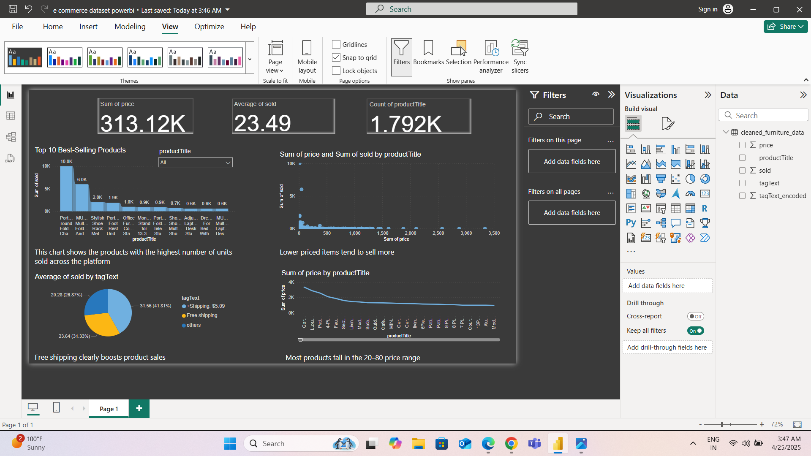
Dashboard Image

Slide 3
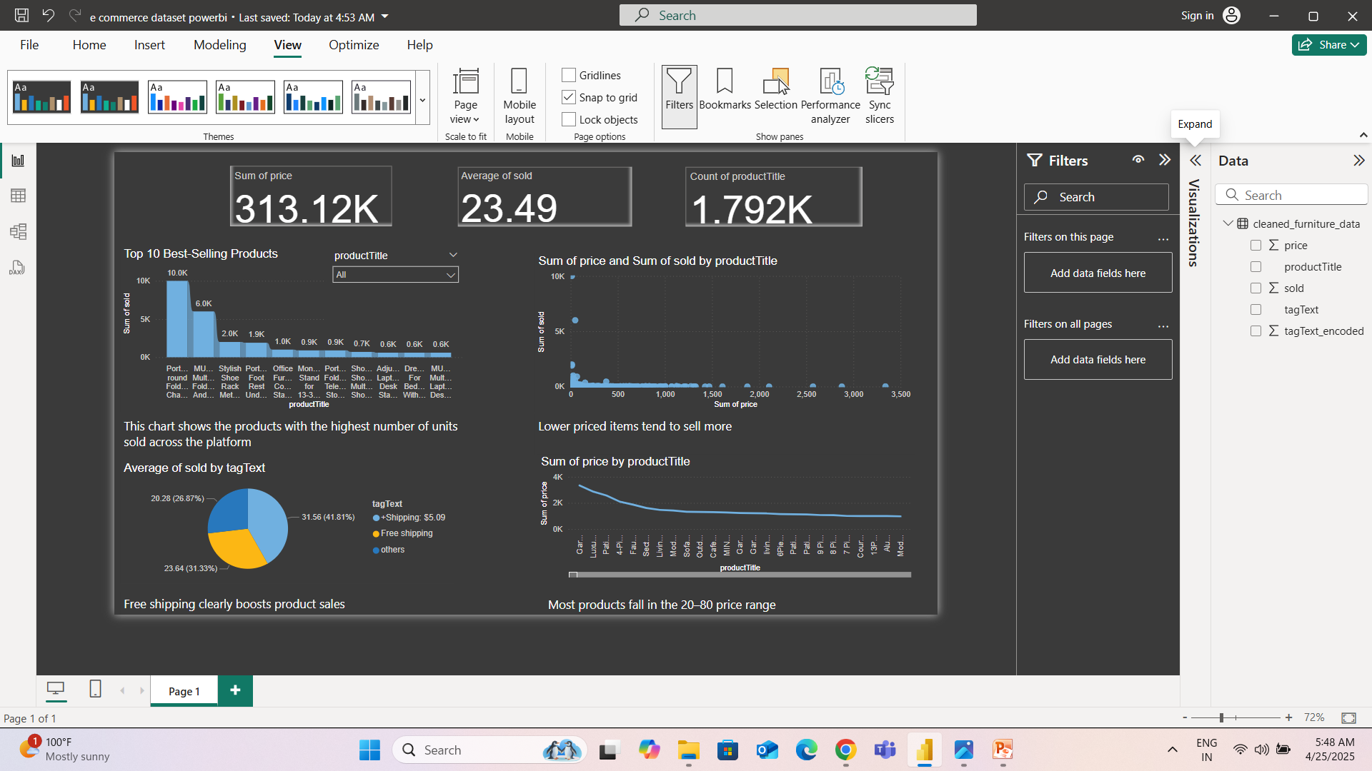

Slide 4
Key Insights
Top-selling Product: "One of the key insights from this dashboard is that the top-selling product sold over 10,000 units, which shows that there is high demand for certain products in the furniture category."
Pricing Trends: "It also shows that lower-priced items seem to have a higher sales volume. This could mean that more affordable products attract more buyers, which could be useful for pricing strategies."
Shipping Impact: "The dashboard clearly shows that free shipping significantly impacts sales. On average, products with free shipping sell more—about 23.6 units compared to 20.2 units for those without free shipping."
Revenue Insights: "In total, the dashboard calculates the overall revenue across all products to be approximately ₹313K."
Price Range Distribution: "A lot of the products fall in the ₹20–₹80 price range, which might suggest this is the most popular pricing category for this type of product."

Slide 5
Tools Used
Power BI: The only tool used for this project was Power BI. I used it to build the dashboard, create interactive visualizations, and analyze the sales data. Power BI’s ability to integrate various data sources and its powerful visualization options made it ideal for this project.
Learning Experience: Through this project, I learned how to use Power BI to create interactive and insightful dashboards that can help businesses make informed decisions based on real-time data.

Slide 6
Conclusion
In conclusion, the dashboard provides a clear and interactive view of key sales trends, pricing strategies, and the impact of shipping on sales. It allows users to explore the data and extract meaningful insights for making business decisions

