Slide 1
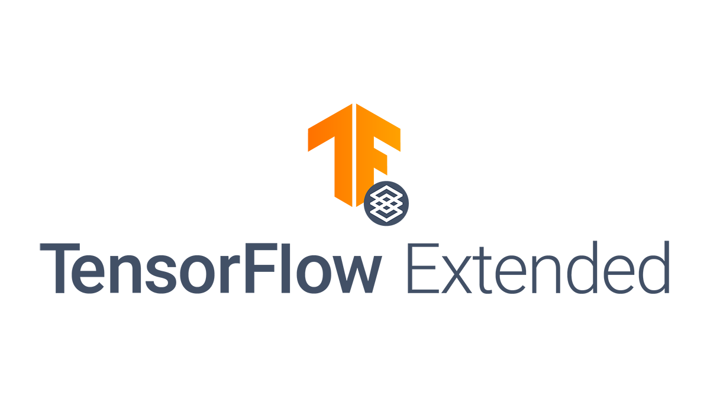
All the material in these slides are retreived by Utku Türkbey
from the TFX 101 Tutorial of Sascha Heyer
https://blog.doit-intl.com/tensorflow-extended-101-literally-everthing-you-need-to-know-aeecc51e6832

Slide 2

What is TFX?
TFX is a Google-production-scale machine learning (ML) platform based on TensorFlow. It provides a configuration framework and shared libraries to integrate common components needed to define, launch, and monitor your machine learning system.

Slide 3
Downsides of a basic ML rollout
It is a manual process.
No validation or tracking involved (model performance over time)
Preprocessing in two separated parts of our application
Manual training and deployment
No automatic training
No artifacts tracking
Serving involves unnecessary Python API wrapper due to preprocessing

Slide 4
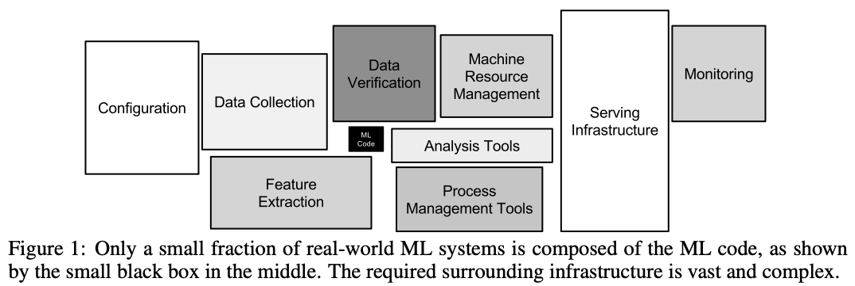
Production-scale ML Pipelines

Slide 5
Where to run our TensorFlow Extended Pipeline in production:
Apache Beam
Apache Airflow
AI Platform Pipelines (easy to start)
Kubeflow (full-grown solution)
Note: Notebooks are a great way for initial development and POCs. TFX provides this exact use case an InteractiveContext. Enabling this is required to get the pipeline running without the need to do more advanced configuration.

Slide 6
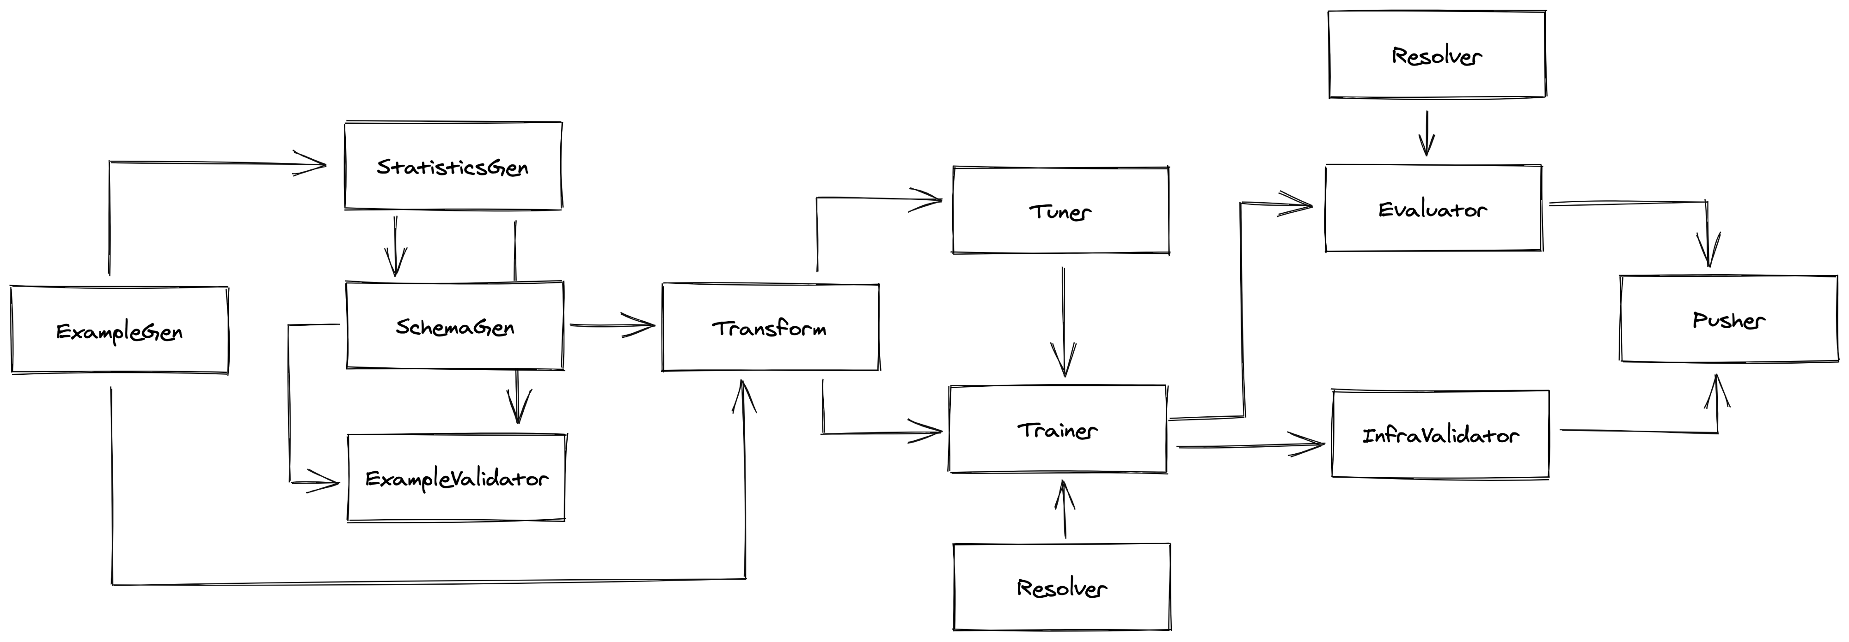
TFX Components
TensorFlow Extended is built out of various components. Each component is solving a unique task of your machine learning solution:
ExampleGen
StatisticsGen
SchemaGen
ExampleValidator
Transform
Trainer
Resolver
Evaluator
Pusher
Tuner
InfraValidator

Slide 7
TFX Libraries
In addition, these components use various libraries. Those libraries are integrated into the TFX components, but you also can use them as standalone libraries.
ML Metadata
TensorFlow Data Validation (TFDV)
TensorFlow Transform (TFT)
TensorFlow Model Analysis (TFMA)
TensorFlow Serving

Slide 8
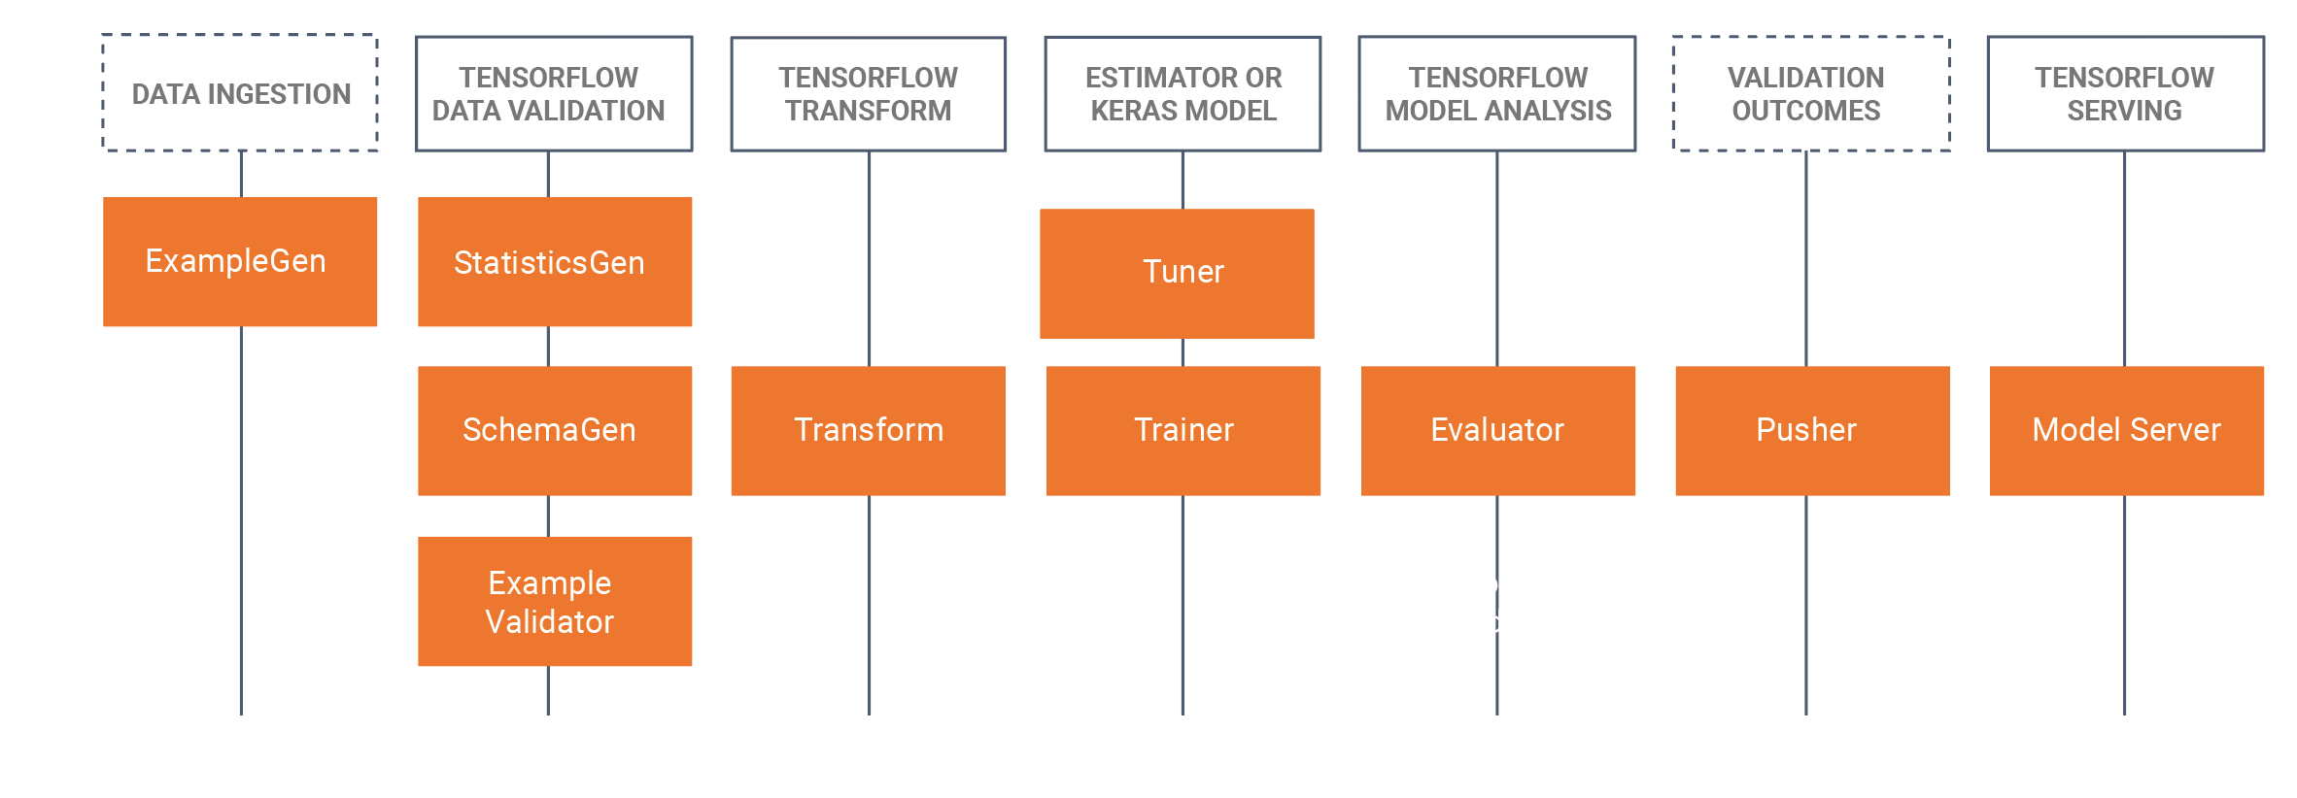

Slide 9
ML Metadata
A library for storing and retrieving the metadata our pipeline is producing. Metadata is the output of each of our components. This can be information like hyperparameter, data location, model metrics. Basically, everything is stored in a database.
TensorFlow Data Validation (TFDV)
A library for analyzing and validating data.
TensorFlow Transform (TFT)
This is for feature-engineering and pre-processing your data as part of the machine learning pipeline.
TensorFlow Model Analysis (TFMA)
For when you’re evaluating your trained model or comparing it with previously-trained models.

Slide 10
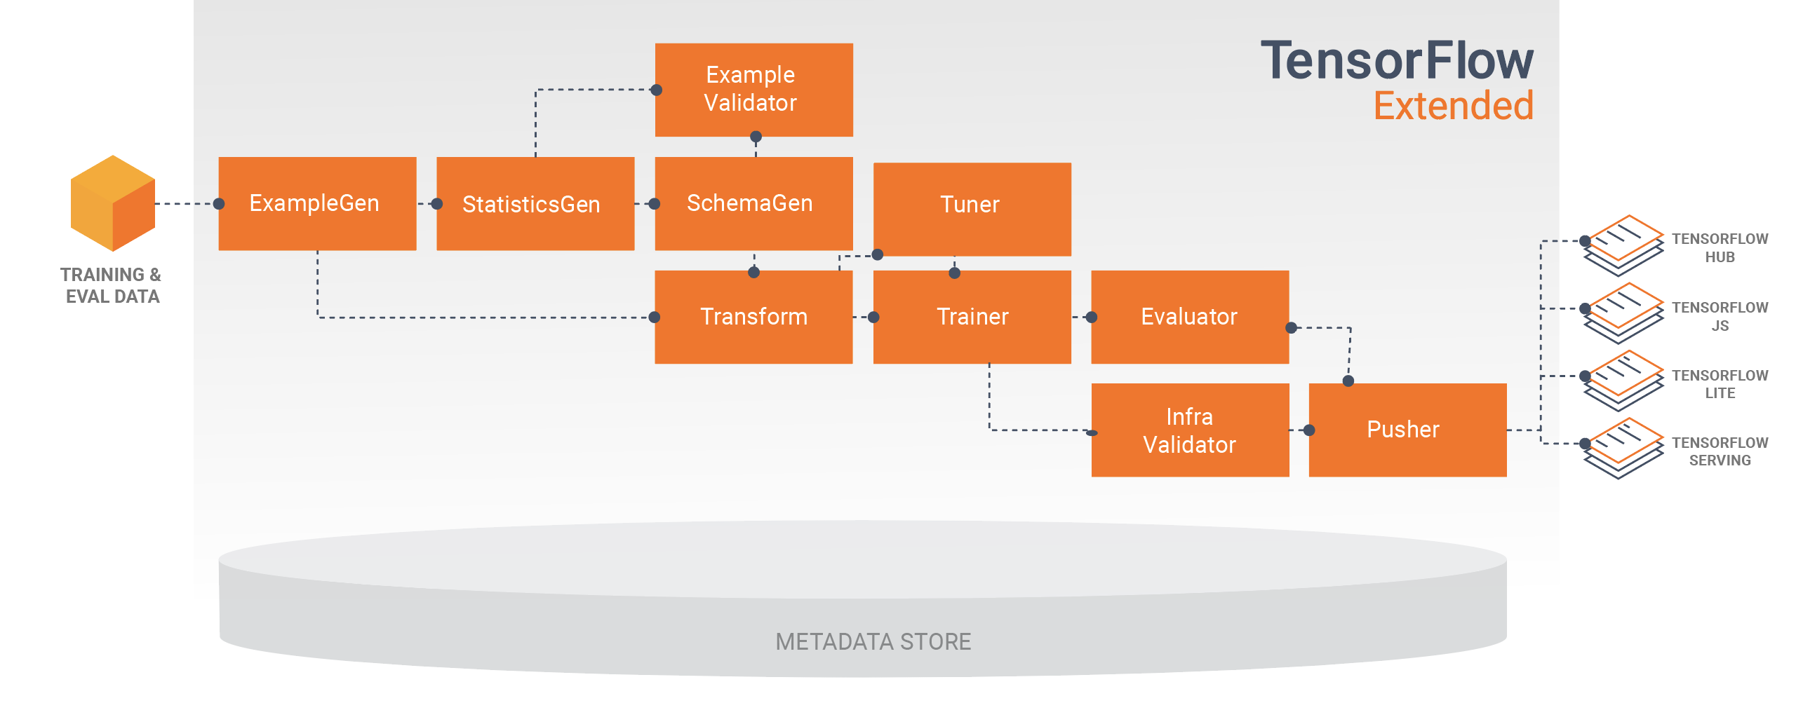

Slide 11
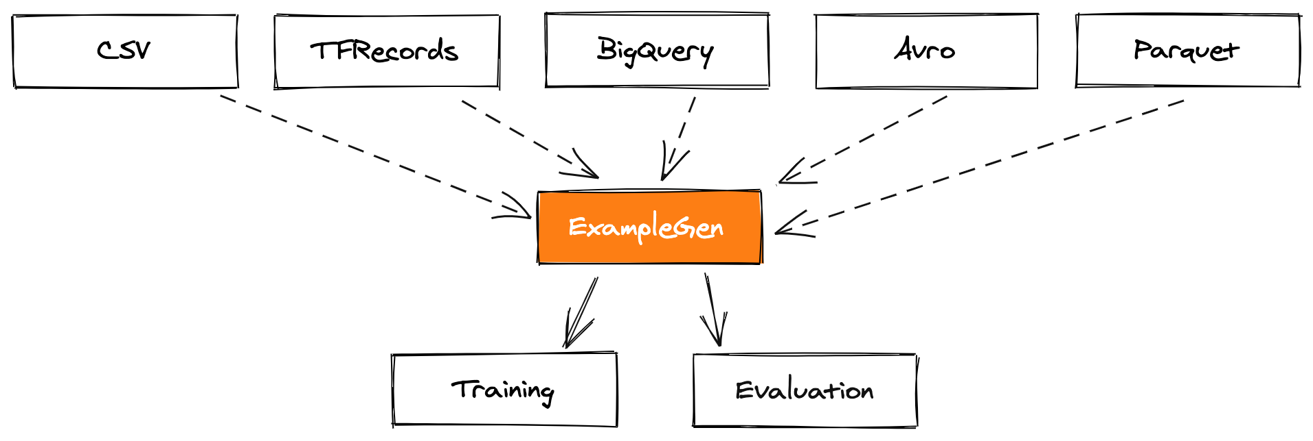
Getting the data with ExampleGen
As always, machine learning starts with gathering data. Our first component is used to get our data into our TensorFlow Extended pipeline.
The ExampleGen component, as the name suggests, generates TFRecords containing the data as TensorFlow examples. TFRecords increase the performance of your pipeline, and therefore the training time of your model.
Note: If you need additional sources, you can implement your own or convert your data to TFRecords and continue with ImportExampleGen.

Slide 12
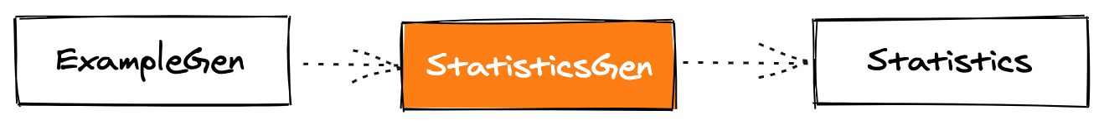
Know your data with StatisticsGen
The StatisticsGen components gives you an overview of your data. This is super helpful for indicating unbalanced datasets. For example, finding missing data using histograms; or identifying min, max values, and data distribution. Use StatisticsGen to compare your training and validation dataset and see if they both represent your dataset well.

Slide 13
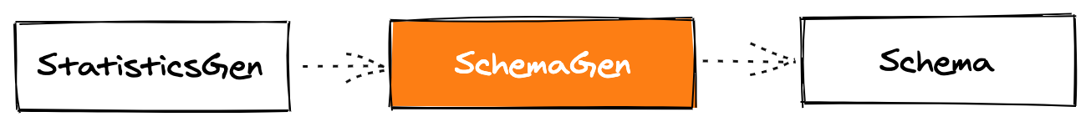
Don’t assume; Know what to expect with SchemaGen
The SchemaGen component generates a schema of your data by using the statistics you get after using StatisticsGen. The schema describes what correct data is. This is useful for detecting errors and changes in your dataset.

Slide 14
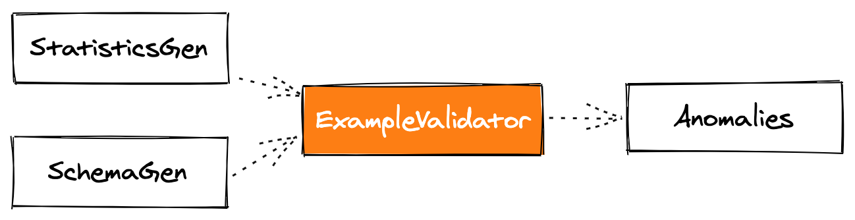
Identify anomalies with ExampleValidator
The ExampleValidator component goes over our data and looks for anomalies. ExampleValidator currently checks for ~80 types of anomalies, including:
Unexpected types
No values
Unexpected values (like our defined domain for our labels)
New columns not known in the schema
Not enough examples
Average string length (great for our review text)
Drift / Skew

Slide 15
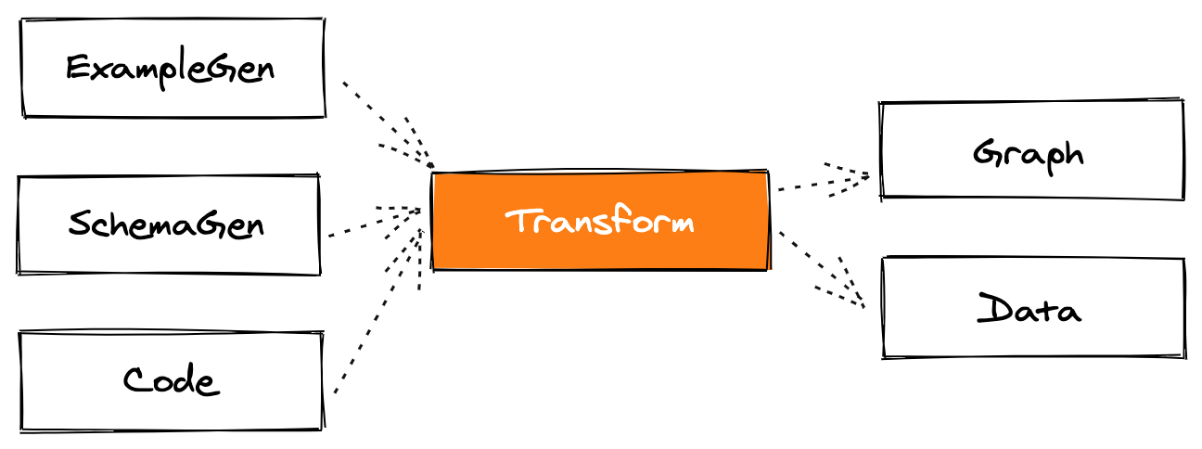
Transform your data with Transform
Transform is the feature engineering component of TensorFlow Extended. Data needs to be preprocessed before a machine learning model can use it. This component takes care of the preprocessing as part of the pipeline.

Slide 16
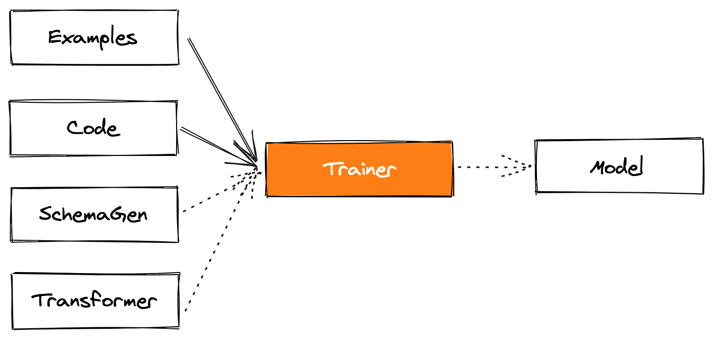
Train the model with Trainer
Finally, we train our TensorFlow model using the Trainer component. Trainer uses the transformed data, the transformation graph mentioned in the previous article, and the trainer code.
Assuming our data is already transformed, you could directly use the examples from the ExampleGen component. As you see, the pipeline is quite flexible.

Slide 17
It contains all the necessary code to train your model and prepare it for
predictions. Trainer invokes the training module, a Python module,
a single file (or files) containing our training code. Trainer will look for
a function with the namerun_fn and execute it. This function usually
has the following tasks:
Load the pre-trained model
Build the model
Fit the model
Define the model signature
Save the model

Slide 18
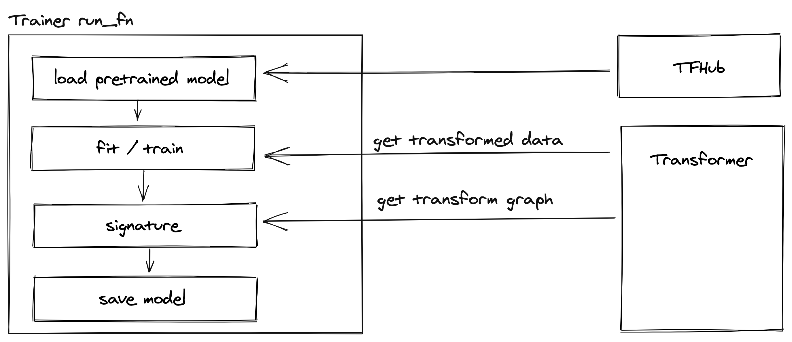
It contains all the necessary code to train your model and prepare it for predictions. Trainer invokes the training module, a Python module, a single file (or files) containing our training code. Trainer will look for a function with the name run_fn and execute it. This function usually has the following tasks:
Load the pre-trained model
Build the model
Fit the model
Define the model signature
Save the model

Slide 19
Access your model and data with Resolver
Resolver is a component that handles artifact resolution. In other words, a way to access our model, data, or other artifacts.
The most common use cases are:
Loading a previous model to compare it with the current model. We will use that for our next component, Evaluator.
Loading a model to warm start a training (not covered in this article).
Resolver is an important part of ML automation because you can resolve artifacts from past runs. Implementing your own Resolver gives you flexibility, and you can even use it to resolve specific parts of your training data.

Slide 20
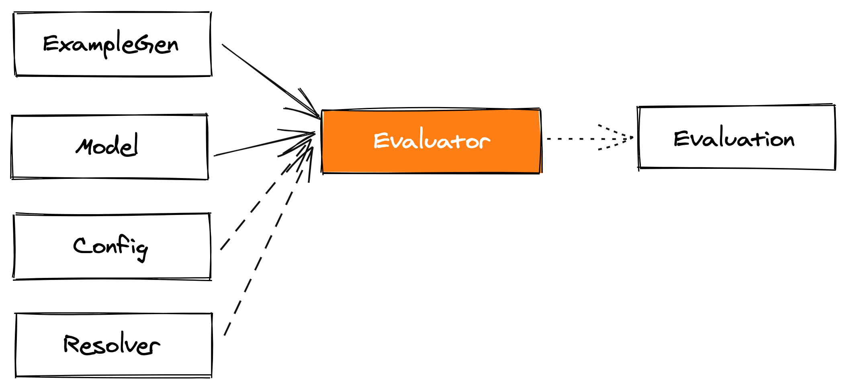
Evaluate your model with Evaluator
The model is trained, but before you can push it into production, you need to know how the model performs on your data. This step is known as Analysis. The Evaluator uses TensorFlow Model Analysis to evaluate the model.
And you might even want to know if your new model is better than the previous model you trained. This step is called Validation.

Slide 21
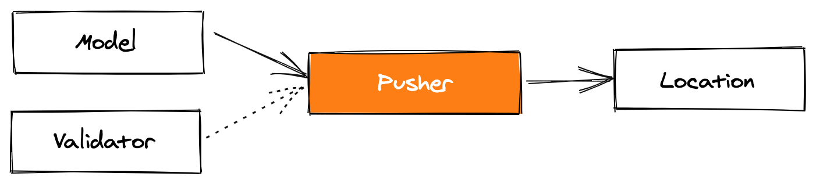
Publish the model with Pusher
Pusher is the very last component of our TFX pipeline. It takes the Model and Validator to check if the model has passed the validation and will push the model to a specified location.
Various locations are supported:
Filesystem
Cloud Storage (GCP Bucket and AWS S3) (Great if you are running TensorFlow Serving)
Google Cloud AI Platform Serving
BigQueryML

Slide 23
Example TFX Pipeline by Hasan Rafiq
https://colab.research.google.com/gist/rafiqhasan/2164304ede002f4a8bfe56e5434e1a34/dl-e2e-taxi-dataset-tfx-e2e.ipynb

