Slide 1
NoSQL Migration
ISE WS 2018/19
Group 304

Slide 2
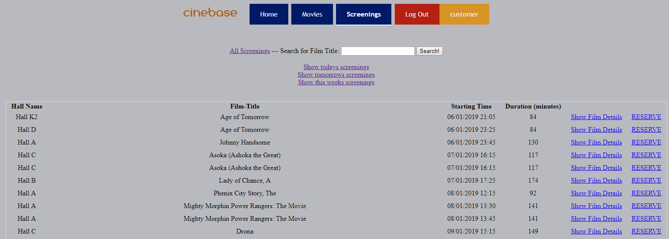
Our Project - cinebase
Cinema database
Administration of films, screenings, employees etc.
User can register, browse films, buy tickets etc.

Slide 3
Motivation
Better integration with OO programming interfaces
What if others want to join our infrastructure? -> Horizontal scaling
What if we decide to premiere a new Star Wars movie? (->peak traffic!)
Cheaper administration

Slide 4
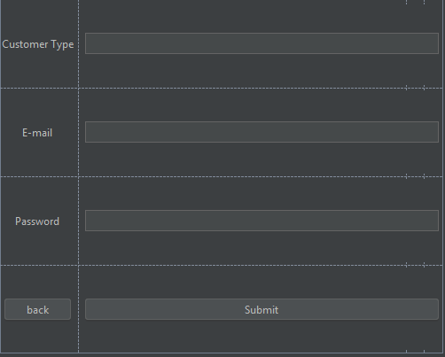
Challenges
Migrating our data
Adjusting our data import tools

Slide 5
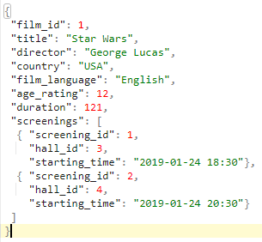
Example Film – Screening:
insert into screening values (1, 1, '2019-01-24 18:30');
insert into screening values (2, 1, '2019-01-24 20:30');

Slide 6
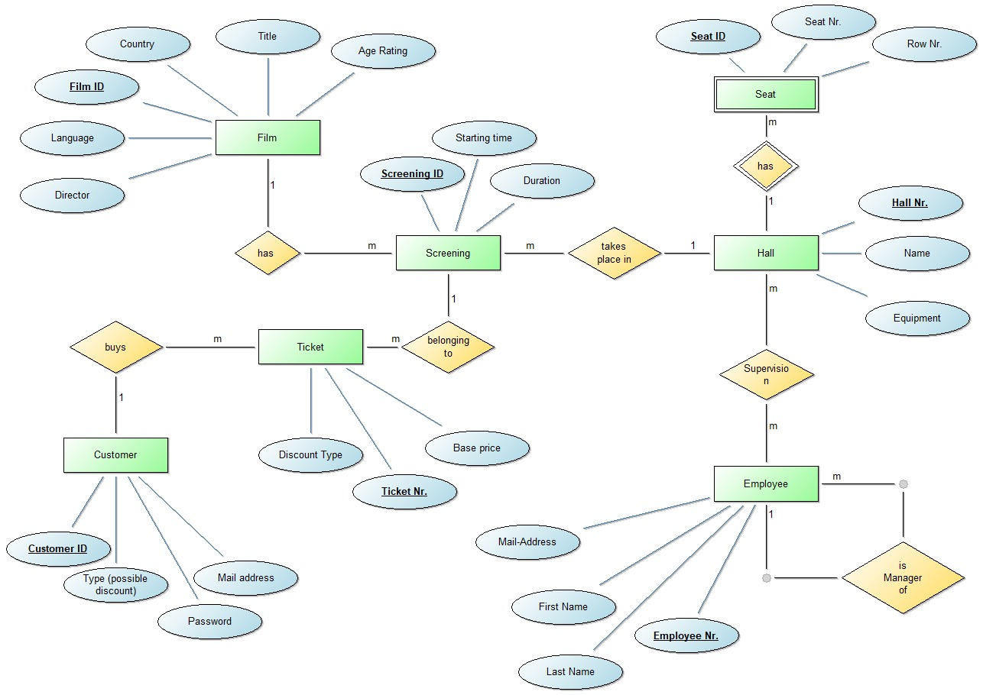
ER diagram

Slide 7
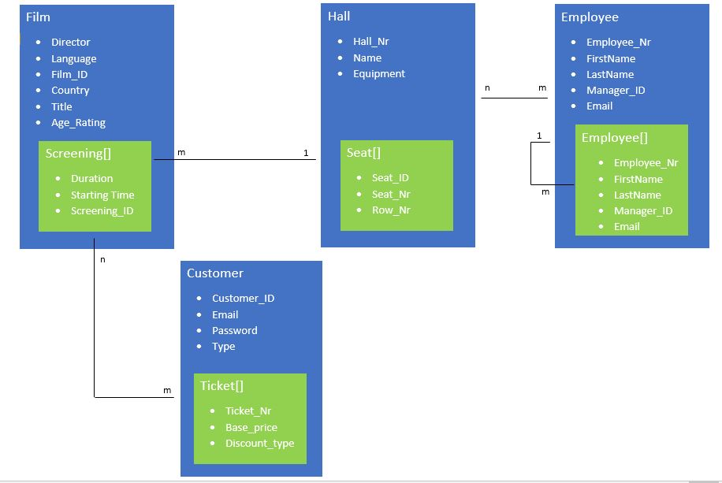
MongoDB Design

Slide 8
Thank you for your attention!
Yasin Ergüven
Utz Nisslmüller
Alexander Ramharter
Oliver Schweiger

