Slide 1
NoSQL Migration
ISE WS 2018/19
Team 11

Slide 2
Motivation
Better integration with OO programming interfaces
What if others want to join our infrastructure? -> Horizontal scaling
What if we decide to premiere a new Star Wars movie? ( -> peak traffic!)
Cheaper administration

Slide 3
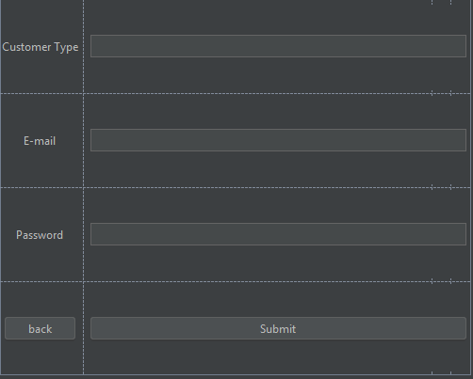
Challenges
Migrating our data
Adjusting our data import tools

Slide 4
Our Plan
Option 1: Migrate data by selecting tuples and import them into MongoDB with Java
Option 2: Save data into SQL scripts and create parser in Java

Slide 5
Thank you for your attention!
Yasin Ergüven
Utz Nisslmüller
Alexander Ramharter
Oliver Schweiger

