Slide 1

Investment Analytics System
Using Machine Learning
Third Progress Report (6.21)
Group members:
Du Jianzhang, Wu Zhouyin, Yang Anjinyu, Xie Tianyou
Notes:
(DOSB) acceptance of chess
(a) a sport has to
include some form of physical activity; (b) it should convey ethical values, such as fair play, equal opportunities, as well as a
person’s inviolability; and (c) clear organisational structures need to be existent

Slide 2

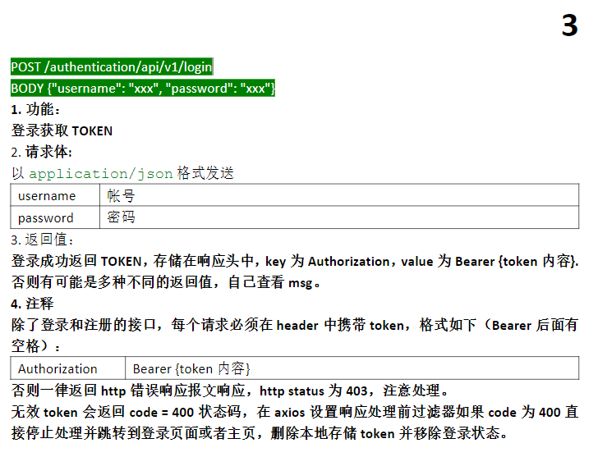
Frontend
Refactor login/registration pages
Validate naming rules on the front end
Routing Jump
Create interface documentation
Carry token access, business logic
Dynamic processing based on the response

Slide 3
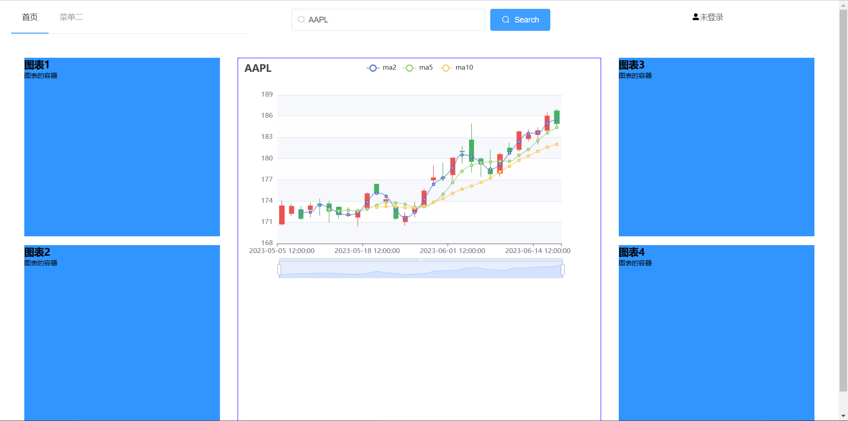
Frontend
Process more data
Zoomable image
Macd indicator
Dynamic Response

Slide 4
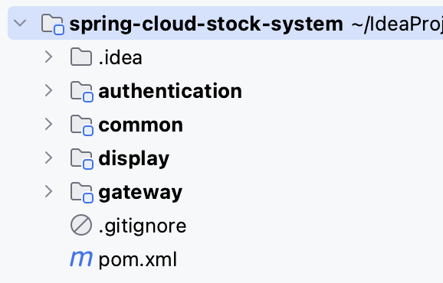
Backend
Completed Modules
Gateway Service
Loadbalance the requests
Distribute requests from Nginx
Authentication Service
Login logic
Distribute Json Web Token (JWT)
Register logic
Display Service
Query historical stock
Return result to client asynchronously

Slide 5
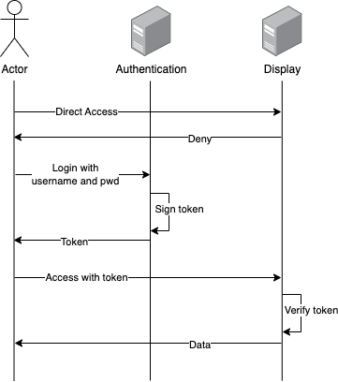
Auth Process

Slide 6
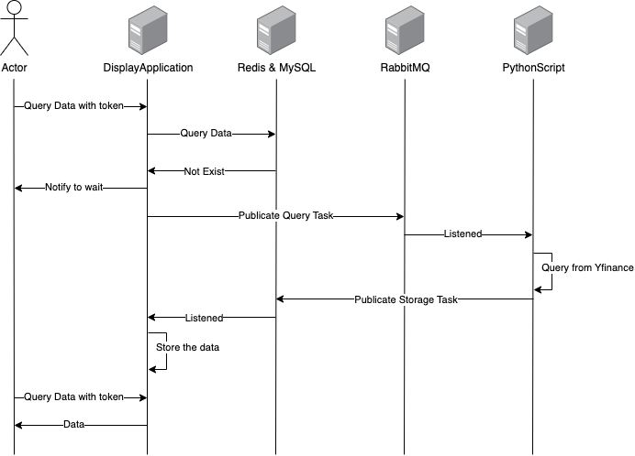
Display Process

Slide 7

Backend
Current Environment on Servers
Server1 (8.137.96.5) | Nginx, SpringBoot(Gateway), Redis, RabbitMQ
Server2 (8.137.98.1) | Nacos, Redis, RabbitMQ
Server3 (47.109.79.121) | SpringBoot(AuthenticationApplication), MysqlTable(k_data_predicted), MysqlTable(k_account), PythonScript(prediction), Redis, RabbitMQ
Server4 (47.109.56.80) | SpringBoot(DisplayApplication), MysqlTable(t_k_data), Redis, RabbitMQ
Server5 (16.163.97.36) | PythonScript(k_data_query_listener)

Slide 8
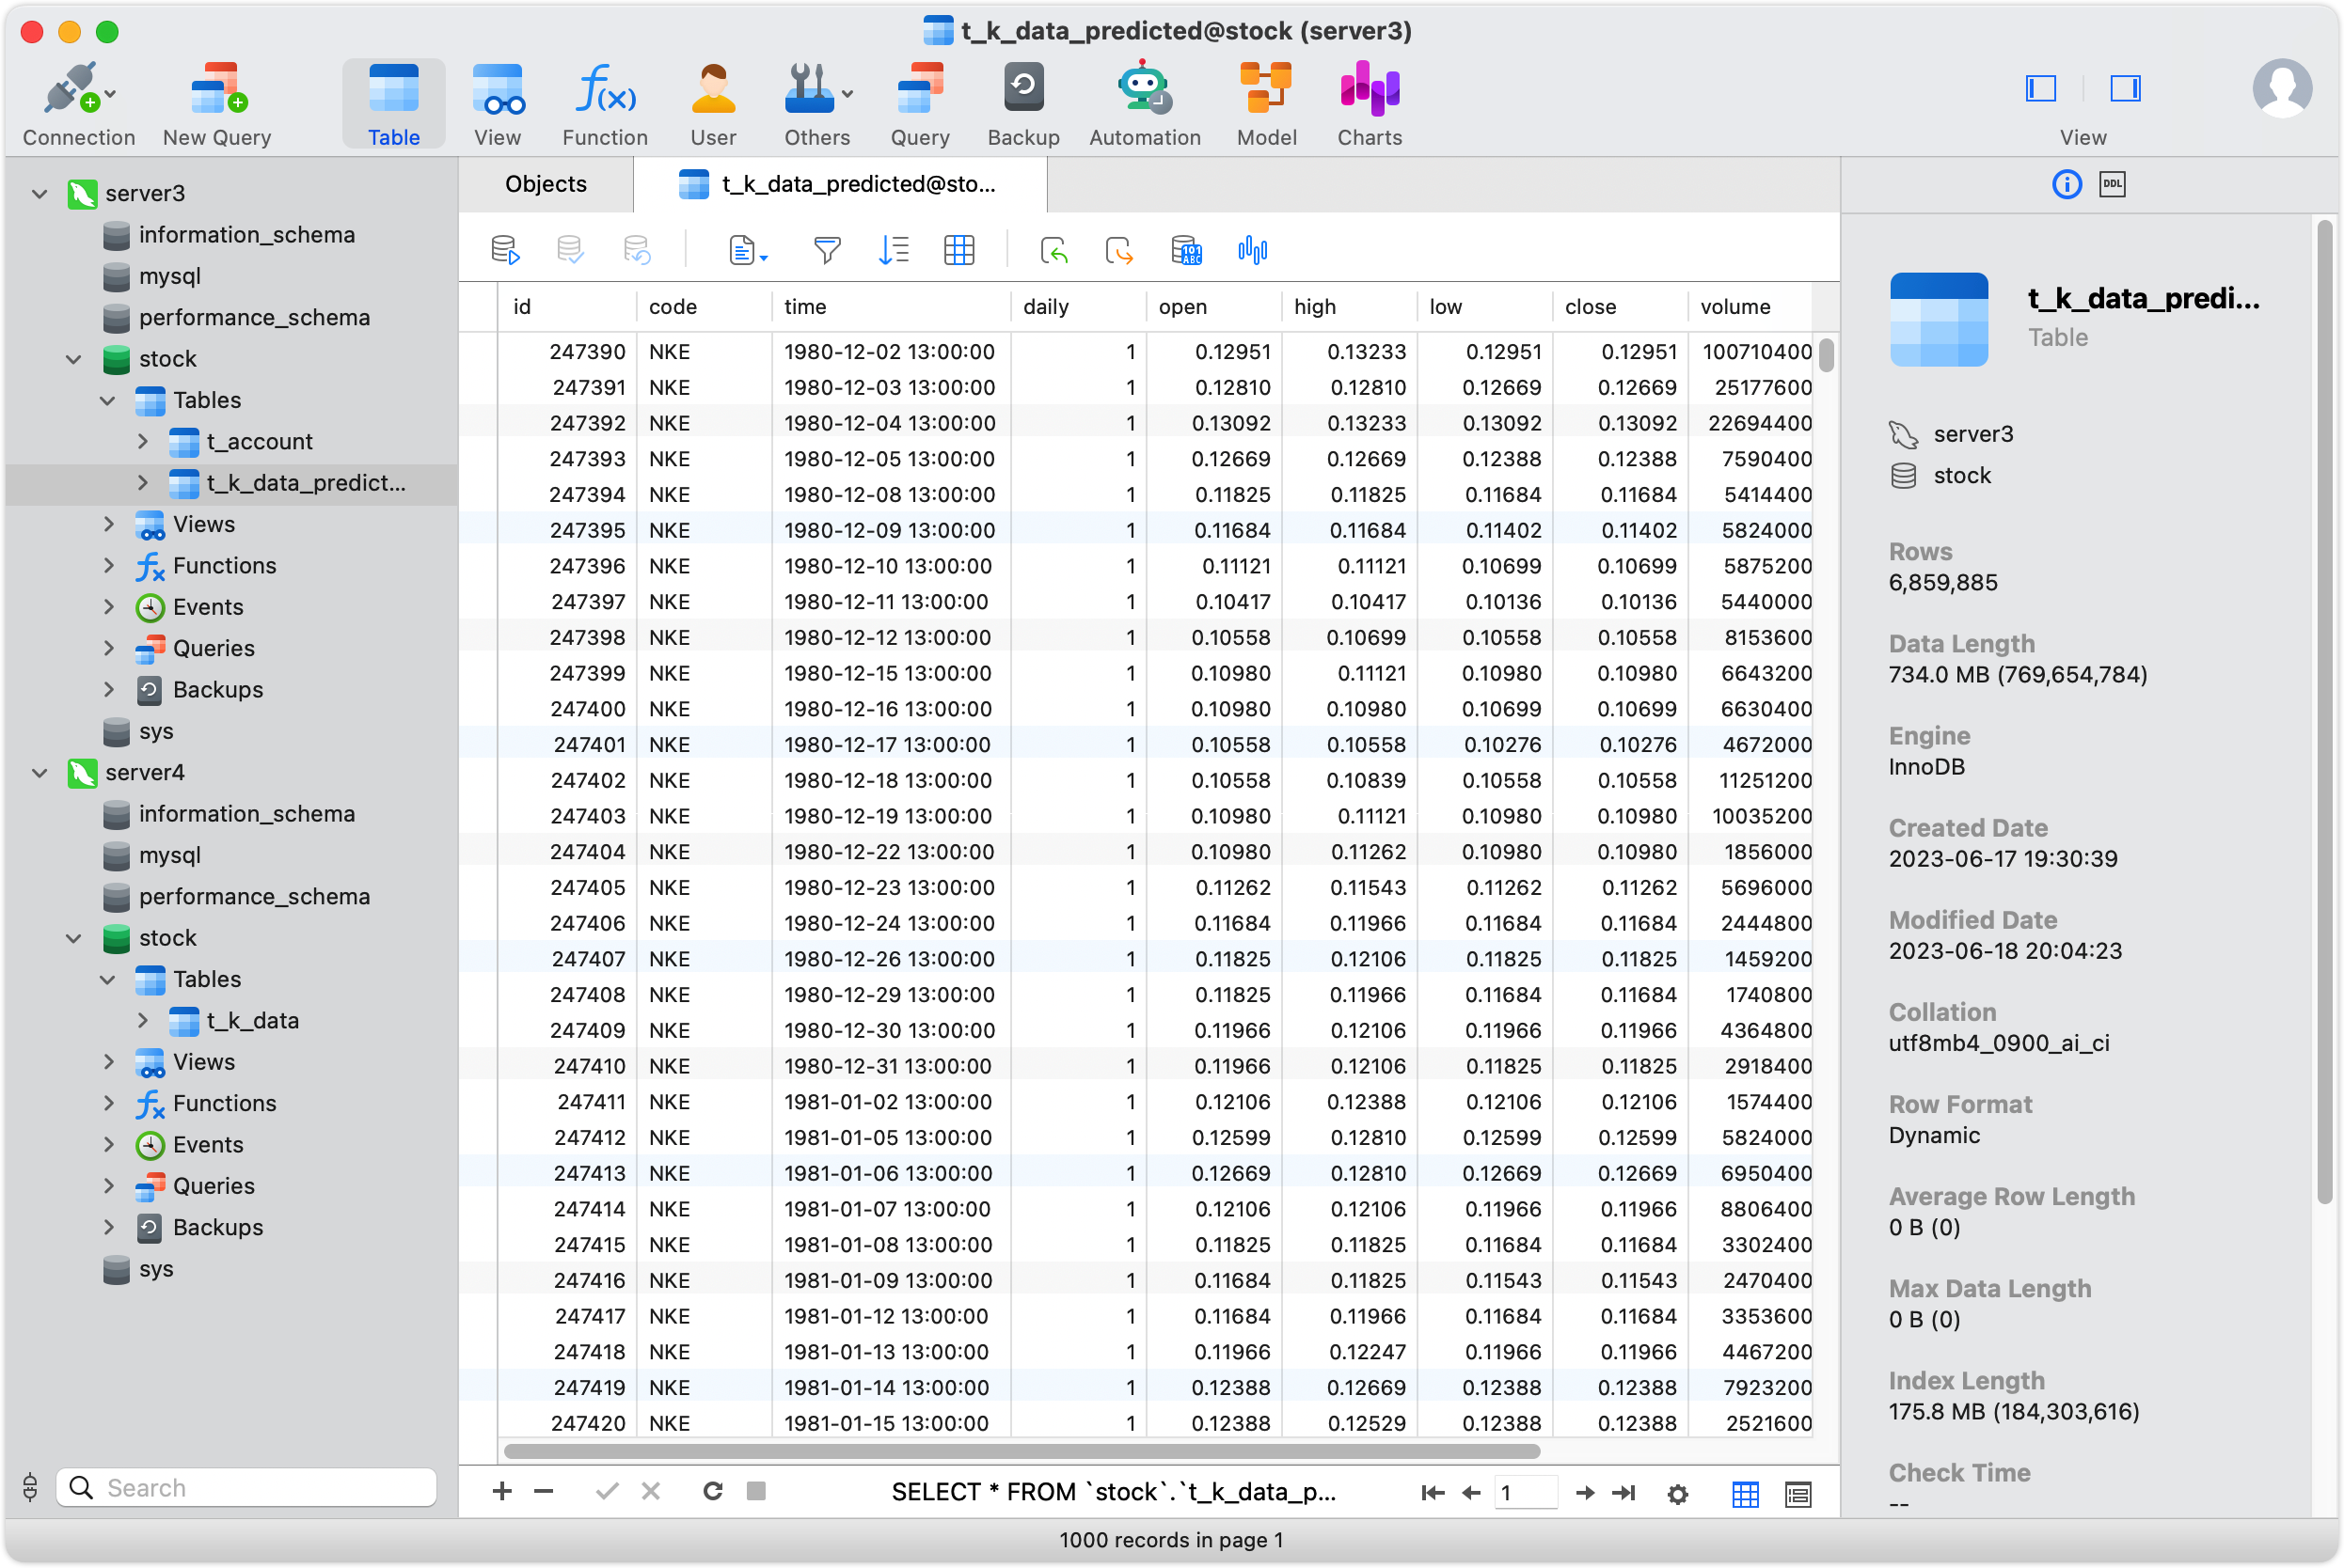
Dataset
Historical data
Predicted data

Slide 9
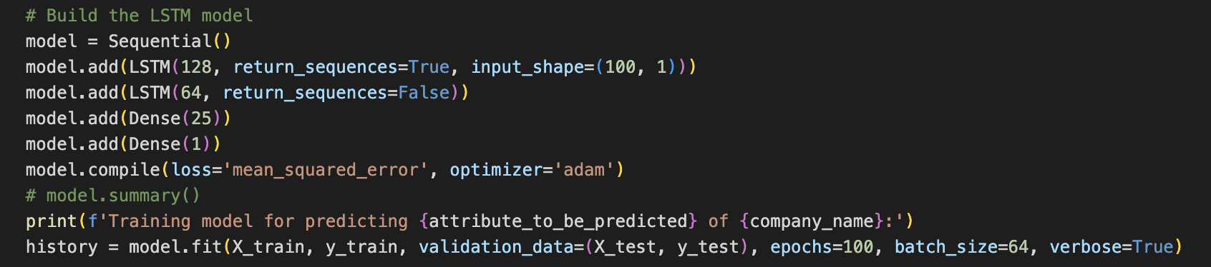
Model

Slide 10
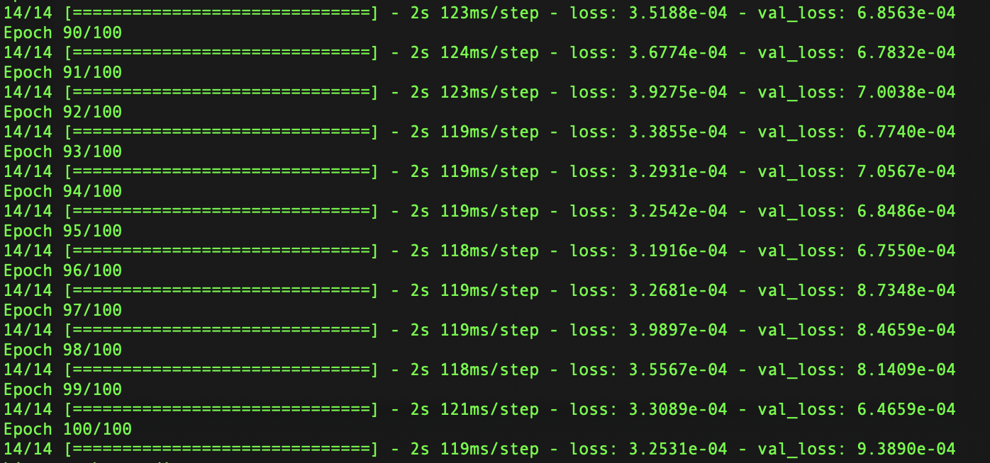
Performance
An example of predicting Apple's opening price

Slide 11
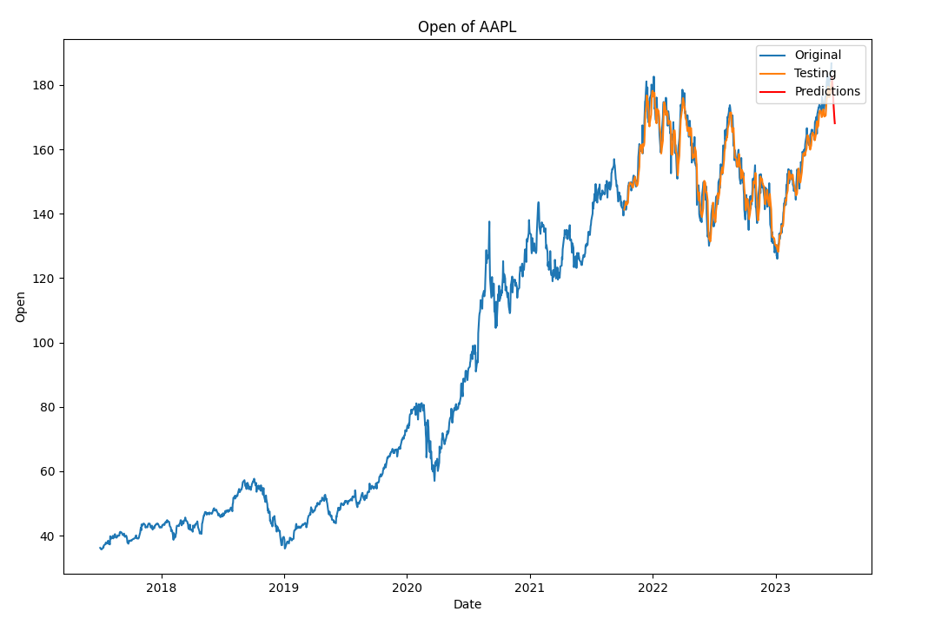
Performance

Slide 12
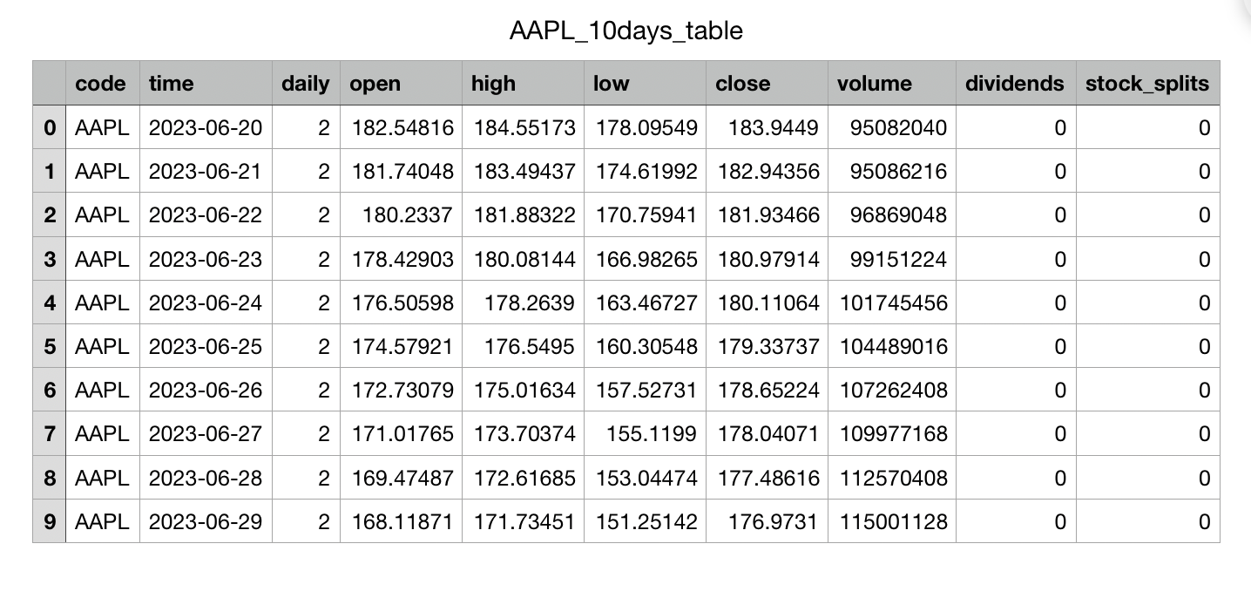
Result

Slide 13
Plan
Tasks |  | Estimated completion time | Estimated number of learning hours
 | Data Collection | Done | 15
 | Data Preprocessing | Done | 20
 | Feature Selection | Done | 20
 | Model Development | 23 June | 80
 | Model Evaluation | 30 June | 20
 | Graphical Representation | 5 July | 35
 | User Interface Development | 15 July | 35
 | Real-time Data Integration | 20 July | 40
 | System Testing | 25 July | 15
 | Deployment & Maintenance | 30 July | 20
 |  |  | Total: 300

