Slide 1
HyperGCN: A New Method of Training Graph Convolutional Networks on Hypergraphs
Presenter: Keyan

Slide 2
outline
Hpyergraph introduction
GCN backgroud
Contributions
1-HyperGCN
HyperGCN
FastHyperGCN
Result Comparison
Conclusion
Questions

Slide 3
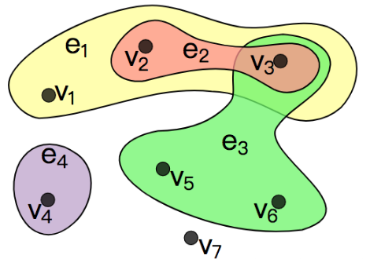
Hypergraph introduction
Hypergraph provides a flexable modeling tool to model a complex and go beyond pairwise relationships.
datasets examples: co-authors, email communacations
usually we can define two vertices to construct a common graph. However for a hypergraph, a hypereage will contain multible vertices.
like the right side picture.

Slide 4

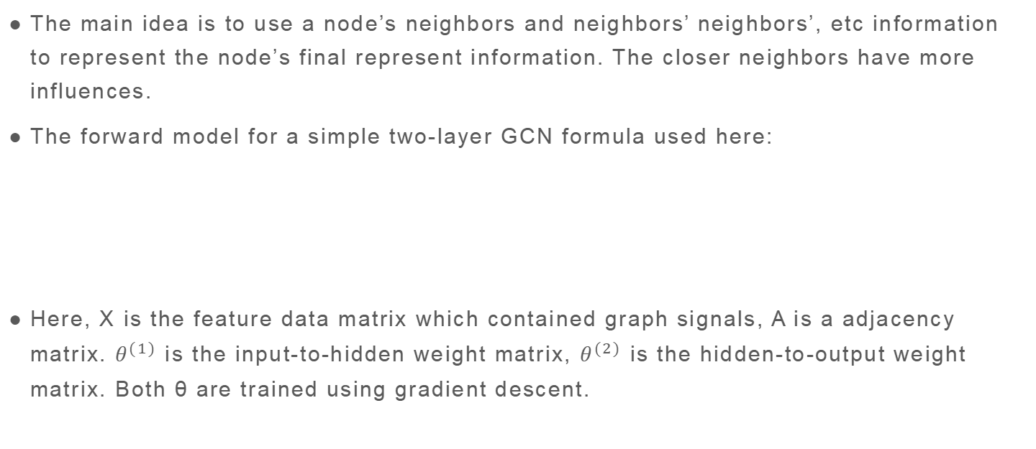
GCN backgroud
The main idea is to use a node’s neighbors and neighbors’ neighbors’, etc information to represent the node’s final represent information. The closer neighbors have more influences.
The forward model for a simple two-layer GCN formula used here:
Here, X is the feature data matrix which contained graph signals, A is a adjacency matrix. $θ^{(1)}$ is the input-to-hidden weight matrix, $θ^{(2)}$ is the hidden-to-output weight matrix. Both θ are trained using gradient descent.

Slide 5

GCN backgroud
GCN training for SSL: For multi-class, classification with q classes, they minimise cross-entropy:
VL is the set of labeled examples.

Slide 6
Contributions
proposed a new training method for training Semi supervised learning on hypergraph and also introduce its variants.
1-HyperGCN
HyperGCN
FastHyperGCN

Slide 7

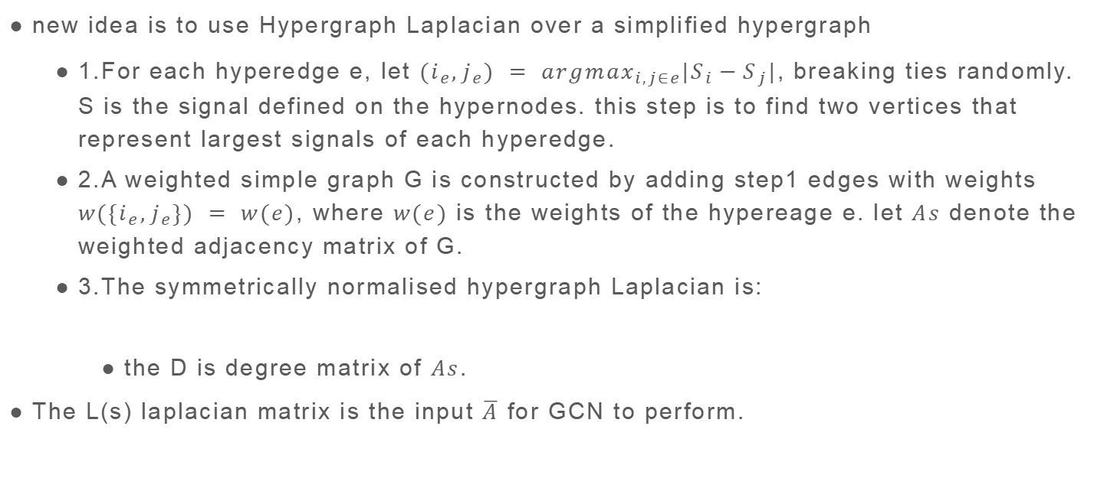
1-HyperGCN
new idea is to use Hypergraph Laplacian over a simplified hypergraph
1.For each hyperedge e, let ${(i}_{e},j_{e}) = {argmax}_{i,j∈e}|S_{i}−S_{j}|$, breaking ties randomly. S is the signal defined on the hypernodes. this step is to find two vertices that represent largest signals of each hyperedge.
2.A weighted simple graph G is constructed by adding step1 edges with weights ${w(\{i}_{e},j_{e}\}) = w(e)$, where $w(e)$ is the weights of the hypereage e. let $As$ denote the weighted adjacency matrix of G.
3.The symmetrically normalised hypergraph Laplacian is:
the D is degree matrix of $As$.
The L(s) laplacian matrix is the input $\overline{A}$ for GCN to perform.

Slide 8

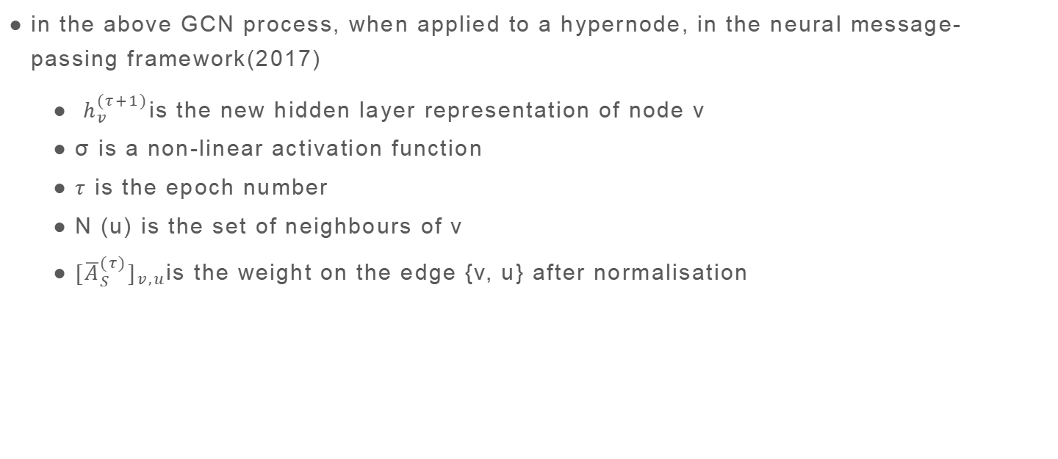
1-HyperGCN
in the above GCN process, when applied to a hypernode, in the neural message-passing framework(2017)
$h_{v}^{(τ+1)}$is the new hidden layer representation of node v
σ is a non-linear activation function
$τ$ is the epoch number
N (u) is the set of neighbours of v
${{[\overline{A}}_{S}^{(τ)}]}_{v,u}$is the weight on the edge {v, u} after normalisation

Slide 9
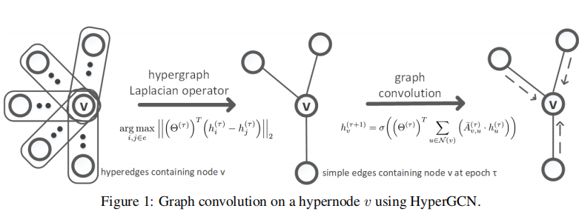
1-HyperGCN
for epoch τ, use two nodes based on max L2 norm max hidden layer represtation to determine hyperedge

Slide 10
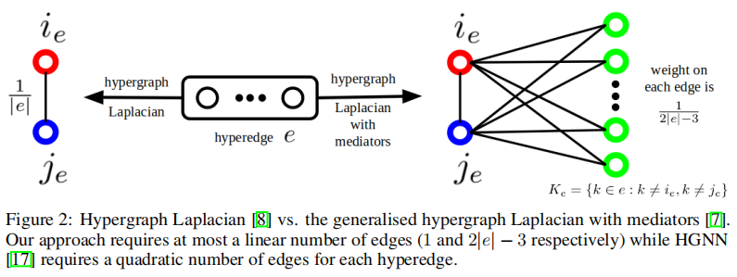
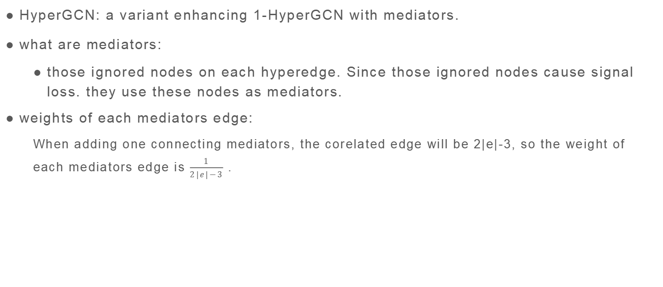
HyperGCN
HyperGCN: a variant enhancing 1-HyperGCN with mediators.
what are mediators:
those ignored nodes on each hyperedge. Since those ignored nodes cause signal loss. they use these nodes as mediators.
weights of each mediators edge:
When adding one connecting mediators, the corelated edge will be 2|e|-3, so the weight of each mediators edge is $\frac{1}{2|e|−3}$ .

Slide 11
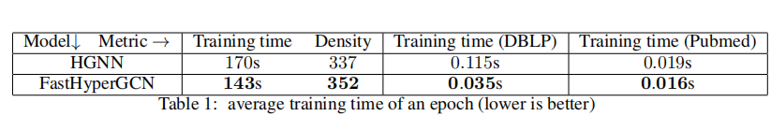
FastHyperGCN
use just the initial features X (without the weights) to construct the hypergraph Laplacian matrix(with mediators)
training time is much less than other methods.
the results performance is worse than HyperGCN

Slide 12
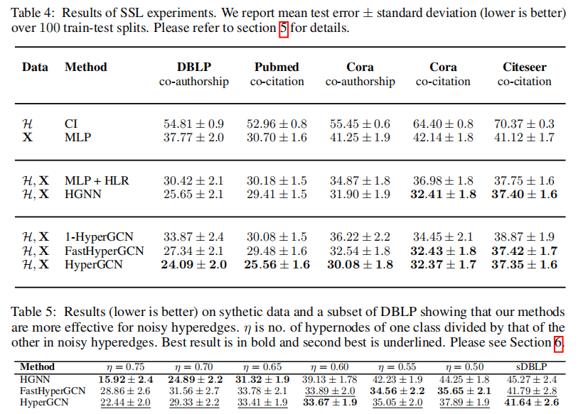
Result Comparison

Slide 13
Conclusion
This paper introduces a new Hypergraph convlutional network traing method and it’s variations.
the main idea is to simplify the hypergraph to a simple graph, and then use Laplacian construction for performing GCN.
For saving the training time, try to use FastHyperGCN, the trainning time is much less than HyperGCN

Slide 14
Questions
How to use the meditors?
store the signals in feature matrix? or weights matrix?
what is Y represent in cross-entropy.

Slide 15
Thank you

