Slide 1
Apache Hbase Application in ETL
Chen, Chih Chun
2019/05/09

Slide 2
Table of Contents
Hbase Explained
Case Study
Conclusion

Slide 3
Hbase Explained
Definition
Deconstruction
Inner working

Slide 4
Hbase/Definition
What is Hbase?
IT IS NOT A RDBMS!
IT IS the Hadoop database!

Slide 5
Hbase/Definition
What is Hbase? (Continued)
A “NoSQL” Database.
the database is not an RDBMS
supports SQL as its primary access language
More like a Storage than a RDBMS
Built on top of HDFS
Lacks features find in an RDBMS such as:
typed columns,
secondary indexes,
triggers, and
advanced query languages, etc.

Slide 6
Hbase/Definition
What is Hbase Use Case?
Good: Many Seek+Read, OR Seek+Write.
NO GOOD: BULK Read and Write.

Slide 7
Hbase/Definition
What is Hbase Use Case?
Perform high-speed Update. i.e. counter aggregation.
Strongly consistent reads/writes.
Not an "eventually consistent" DataStore
Store hundreds of millions or billions of rows
Big table for Big data
Fast record lookups for large tables.
Data are sorted.

Slide 8
Hbase/Deconstruction
Architecture Overview
Composed of three types of servers in a master slave type of architecture.
Region servers
HBase Master
Zookeeper

Slide 9
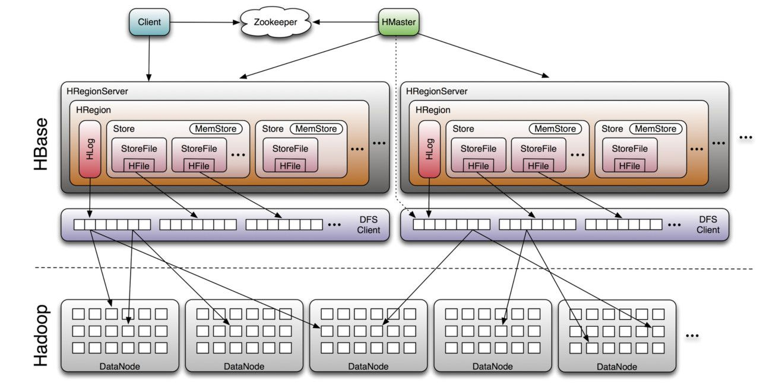
Hbase/Deconstruction
Architecture Overview(Continued)

Slide 10
Hbase/Deconstruction
Architecture Overview(Continued)
Region servers
Serve data for reads and writes.
When accessing data, clients communicate with HBase RegionServers directly.
HBase Master processes the following:
Region assignment,
DDL (create, delete tables) operations.
Zookeeper
maintains a live cluster state.

Slide 11
Hbase/Deconstruction
ZooKeeper : The Coordinator
HBase uses ZooKeeper as a distributed coordination service to maintain server state in the cluster.
maintains which servers are alive and available, and provides server failure notification.
uses consensus to guarantee common shared state.
Note that there should be three or five machines for consensus.

Slide 12
Hbase/Deconstruction
HMaster
Coordinating the region servers
Assigning regions on startup.
Re-assigning regions for recovery or load balancing.
Monitoring all RegionServer instances in cluster
listens for notifications from zookeeper
Admin functions, Interface for
creating,
deleting, or
updating tables

Slide 13
Hbase/Deconstruction
HMaster – Background Processes
LoadBalancer
Periodically, and when there are no regions in transition, a load balancer will run and move regions around to balance the cluster’s load. See Balancer for configuring this property.
CatalogJanitor
Periodically checks and cleans up the hbase:meta table

Slide 14
Hbase/Deconstruction
RegionServer
Run an HDFS data node.
Responsible for serving and managing regions.

Slide 15
Hbase/Deconstruction
RegionServer – Background Processes
CompactSplitThread
Checks for splits and handle minor compactions.
MajorCompactionChecker
Checks for major compactions.
MemStoreFlusher
Periodically flushes in-memory writes in the MemStore to StoreFiles.

Slide 16
Hbase/Deconstruction
WAL(Write-Ahead Log)
The region servers keep data in-memory until enough is collected to flush to disk, avoiding the creation of too many very small files.
While the data resides in memory it is volatile. This is a likely occurrence when operating at large scale.

Slide 17
Hbase/Deconstruction
WAL(Write-Ahead Log) (Continued)
A common approach to solving this issue is write-ahead logging:
Each update (also called an “edit”) is written to a log, and only if the update has succeeded is the client informed that the operation has succeeded.
The server then has the liberty to batch or aggregate the data in memory as needed.
For an example, a binary log in MySQL, the WAL records all changes to the data when disaster strikes.

Slide 18
Hbase/Deconstruction
Regions
the basic element of availability and distribution for tables.
Dividing HBase Tables horizontally by row key range into “Regions.”
contains all rows in the table between the region’s start key and end key.
assigned to the nodes in the cluster, called “Region Servers,” and these serve data for reads and writes

Slide 19
Hbase/Deconstruction
Store
hosts a MemStore
hosts 0 or more StoreFiles (HFiles).
corresponds to a column family for a table for a given region

Slide 20
Hbase/Deconstruction
MemStore
holds in-memory modifications to the Store.
stores updates in memory as sorted KeyValues, the same as it would be stored in an HFile.
There is one MemStore per column family.
The updates are sorted per column family.

Slide 21
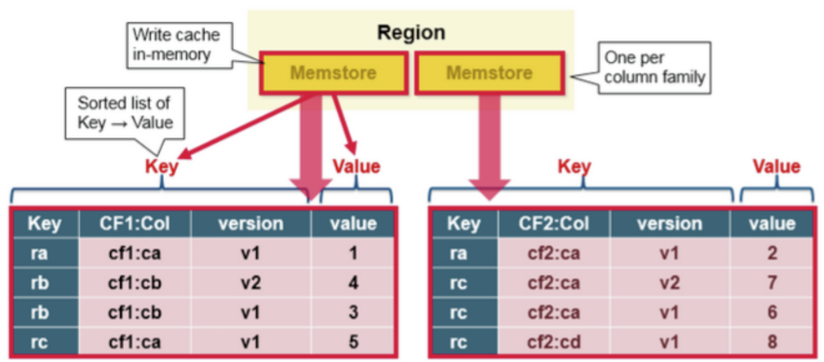
Hbase/Deconstruction
MemStore – Illustration

Slide 22
Hbase/Deconstruction
StoreFile (HFile)
StoreFiles are where your data lives.
Data is stored in an HFile which contains sorted key/values.
When the MemStore accumulates enough data, the entire sorted KeyValue set is written to a new HFile in HDFS. This is a sequential write. It is very fast, as it avoids moving the disk drive head.

Slide 23
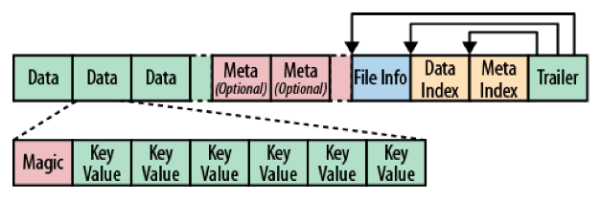
Hbase/Deconstruction
StoreFile (Hfile)
The files contain a variable number of blocks,
only fixed ones are the file info and trailer blocks.
the trailer has the pointers to the other blocks. It is written after the data has been persisted to the file, finalizing the now immutable data store.
The index blocks record the offsets of the data and meta blocks.

Slide 24

Hbase/Deconstruction
StoreFile (Hfile)

Slide 25
Hbase/Deconstruction
StoreFile And HDFS
the HBase storage file blocks do not match the Hadoop blocks.
no correlation between these two block types
HBase stores its files transparently into a filesystem
HDFS also does not know what HBase stores; it only sees binary files

Slide 26
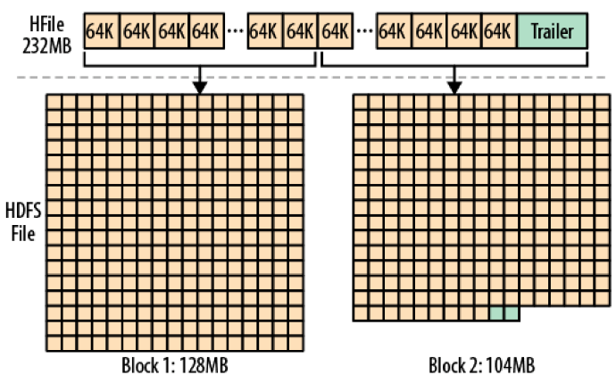
Hbase/Deconstruction
StoreFile And HDFS (Continued)

Slide 27
Hbase/Deconstruction
Blocks
StoreFiles are composed of blocks.
The blocksize is configured on a per-ColumnFamily basis.
Compression happens at the block level within StoreFiles.
Default size is 64 k

Slide 28
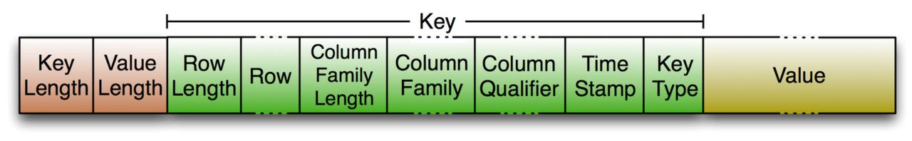
Hbase/Deconstruction
KeyValue
heart of data storage in HBase.
low-level byte array that allows for zerocopy access to the data
not split across blocks

Slide 29
Hbase/Deconstruction
Data Model
In HBase, data is stored in tables, which have rows and columns.
BUT It is NOT the same as in relational databases (RDBMSs)
Instead, it can be helpful to think of an HBase table as a multi-dimensional map.

Slide 30
Hbase/Deconstruction
Data Model - Terminology
Table
consists of multiple rows.
Row
consists of a row key and one or more columns with values associated with them.
Rows are sorted alphabetically by the row key as they are stored.

Slide 31
Hbase/Deconstruction
Data Model – Terminology
Column
A column in HBase consists of a column family and a column qualifier, which are delimited by a : (colon) character.
Column Family
Column families physically colocate a set of columns and their values, often for performance reasons.
Each column family has a set of storage properties, such as whether its values should be cached in memory, how its data is compressed or its row keys are encoded, and others. Each row in a table has the same column families, though a given row might not store anything in a given column family.
Column Qualifier
A column qualifier is added to a column family to provide the index for a given piece of data
Though column families are fixed at table creation, column qualifiers are mutable and may differ greatly between rows.

Slide 32
Hbase/Deconstruction
Data Model – Terminology
Cell
A cell is a combination of row, column family, and column qualifier, and contains a value and a timestamp, which represents the value’s version.
Timestamp
A timestamp is written alongside each value, and is the identifier for a given version of a value.

Slide 33
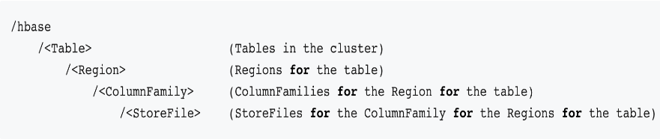
Hbase/Inner Working
Where on HDFS?
The HDFS directory structure of HBase tables in a cluster

Slide 34
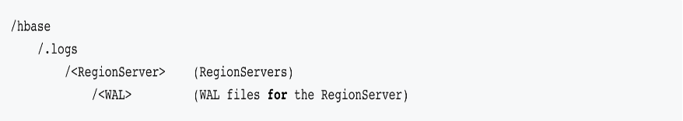
Hbase/Inner Working
Where on HDFS? (Continue)
The HDFS directory structure of HBase WAL

Slide 35
Hbase/Inner Working
Guide Line for Table Schema
have regions sized between 10 and 50 GB.
have cells no larger than 10 MB, or 50 MB if mob is used. Otherwise, consider storing your cell data in HDFS and store a pointer to the data in Hbase.
1 to 3 column families per table. HBase tables should not be designed to mimic RDBMS tables.

Slide 36
Hbase/Inner Working
Guide Line for Table Schema (Continued)
Around 50-100 regions is a good number for a table with 1 or 2 column families. Remember that a region is a contiguous segment of a column family.
Keep your column family names as short as possible. The column family names are stored for every value (ignoring prefix encoding).
They should not be self-documenting and descriptive like in a typical RDBMS.

Slide 37
Hbase/Inner Working
Keep the Region Count Low!
Keep around 100 regions per RegionServer has yielded the best results.

Slide 38
Hbase/Inner Working
Keep the Region Count Low! Why?
Memory Constrain.
MSLAB (MemStore-local allocation buffer) requires 2MB per MemStore (that’s 2MB per family per region).
i.e. 1000 regions that have 2 families each is 3.9GB of heap used, and it’s not even storing data yet.
2MB X 1000 X 2 = 4000 MB => 3.9GB

Slide 39
Hbase/Inner Working
Keep the Region Count Low! Why?
Resource consumption for MapReduce jobs
One mapper per HBase region.
Hosting only 5 regions per RS may not be enough to get sufficient number of tasks for a MapReduce job, while 1000 regions will generate far too many tasks.

Slide 40
Hbase/Inner Working
Keep the Region Count Low! Why?
Cascading effect of OOM for RS
In older versions of HBase (pre-HFile v2, 0.90 and previous), tons of regions on a few RS can cause the store file index to rise, increasing heap usage and potentially creating memory pressure or OOME on the RSs

Slide 41
Hbase/Inner Working
Keep the Region Count Low! Why?
ZK resource constrain
The master takes a lot of time assigning and moving regions around in batches.
Put too much pressure on ZK usage

Slide 42
Hbase/Inner Working
Determining region count and size
Number of regions per RS - upper bound
((RS memory) * (total memstore fraction)) / ((memstore size)*(# column families))
Region size maximum region size is mostly limited by compactions - very large compactions, esp. major, can degrade cluster performance.
maximum region size is 10-20Gb
5-10Gb is optimal

Slide 43
Hbase/Inner Working
Pre-splitting the table
Based on the target number of the regions per RS and number of RSes, one can pre-split the table at creation time.
This would both avoid some costly splitting as the table starts to fill up, and ensure that the table starts out already distributed across many servers.

Slide 44
Hbase/Inner Working
Pre-splitting the table
If the table is expected to grow large enough to justify that, at least one region per RS should be created.
It is not recommended to split immediately into the full target number of regions (e.g. 50 * number of RSes), but a low intermediate value can be chosen.

Slide 45
Case Study/Introduction
The Use Case
Use the current h/w to accomplish the following:
Data latency less than 5 minutes. From source to query the same data from Hadoop.
Must process data from at least 100 sources.
This cluster still have band width left from ETL to produce at least 400 daily reports.

Slide 46
Case Study/Introduction
The Use Case (continued)
Use the current h/w to accomplish the following:
Must have at least 80% compatibility with current Reporting back-end system. User will use JDBC to export data from hadoop.

Slide 47
Case Study
Methodology
Learn from History
The Architecture
The Implementation iterations
Design
Schema design
Rowkey design
Testing
Performance tuning
Troubleshooting

Slide 48
Case Study/Methodology/Learn from the History
The “Old” World: Case 1 – Solar Search based Solution
Goods
Out of box solution for Document indexing.
Quick implementation cycle.
Easy to deploy, Cloudera has integrate this into their CDH.
Support SQL

Slide 49
Case Study/Methodology/Learn from the History
The “Old” World: Case 1 – Solar Search based Solution (Continue)
Limitations
Not good for Reporting System. Due to NLP will yield different results for same queries some time.
Still have Query performance issue. Time increases after document accumulate pass certain amount.

Slide 50
Case Study/Methodology/Learn from the History
The “Old” World: Case 2 – HDFS w/t Impala Based Solution
Good
Support SQL much better compare to the previous case.
Easy to Implement. Only have to focused on parsing.
Easy to debug. File based.
Easy to deploy. HDFS, and Impala come with CDH.

Slide 51
Case Study/Methodology/Learn from the History
The “Old” World: Case 2 – HDFS w/t Impala Based Solution (Continued)
Limitation
Parser generates too many small files within maximum time slot. Put stress on HDFS. Cause HDFS low performance.
Data is not sorted in“big”blocks. (continuous).
Impala dose not like this. In fact, no computer application likes this situation, too. This means that Impala takes extract time to do planning, and move data round.

Slide 52
Case Study/Methodology/The Architecture
The Logical Block Diagram
Sources
Data in-take
HBase
HDFS
JDBC
Impala
(Parquet,
internal table)
Data Proc.
Report System
In-time Query

Slide 53
Case Study/Methodology/The Architecture
The Data Flow Diagram – Data in-take
Sources
CEF
Data in-take
Key-value pairs
HBase
HDFS

Slide 54
Case Study/Methodology/The Architecture
The Data Flow Diagram – Data Processing
HDFS
HBase
Impala
Data Proc.
HDFS
Partitioned
Parquet

Slide 55
Case Study/Methodology/The Architecture
HDFS
HBase
The Data Flow Diagram – Data Accessing
HDFS
Partitioned
Parquet
Tables
Impala
JDBC
Report System
In-time Query

Slide 56
Case Study/Methodology/The Architecture
The Concept
Impala can work with Hbase on Hadoop platform.
Utilize Hbase built-in ability to:
sort data,
“pack”related data into one big block, and
Read/ Write from different “heads”.
Utilize Impala built-in ability to:
Support SQL like queries
Support JDBC
Interactive Queries

Slide 57
Case Study/Methodology/The Architecture
The Concept – In Plain English!
Impala and Hbase can work together hand-in-hand on Hadoop platform.
Hbase will sort data and store them in a big chunk. Further more, it offer high read/ write throughputs.
Impala is good for processing “big”data in similar traditional RMDB way.

Slide 58
Case Study/Methodology/The Implementation iterations
Round 0: Hbase has low write throughput of 250 EPS.
Initial Deployment right after BVT.
ENG-1162: https://datasparker.atlassian.net/browse/ENG-1162
EPS=1000

Slide 59
Case Study/Methodology/The Implementation iterations
Round 1: Hbase has low write throughput of 1000 EPS.
https://datasparker.atlassian.net/browse/ENG-1205
https://datasparker.atlassian.net/browse/ENG-1206
EPS=4000

Slide 60
Case Study/Methodology/The Implementation iterations
Round 2: Hbase has low write throughput of Caused By too many Compaction.
https://datasparker.atlassian.net/browse/ENG-1140
Reduce memory operation overhead.
Program halt due to Java GC.

Slide 61
Case Study/Methodology/The Implementation iterations
Round 3: Hbase has low write throughput Caused by too many MemStore flushes.
EPS=7000
hbase.hregion.memstore.flush.size = 128 default should be good
hbase.hregion.memstore.block.multiplier
Reduce memory operation overhead.

Slide 62
Case Study/Methodology/The Implementation iterations
Round 3: Hbase Low Write Throughput Caused by Hot-spotting.
Before: EPS=
After: EPS=25,000

Slide 63
Case Study/Methodology/The Implementation iterations/Round 3
What is Hot-spotting?
When records are being written to Hbase, most of, in some extreme cases, all writes hit one Region.

Slide 64
Case Study/Methodology/The Implementation iterations/Round 3
What are the causes of Hot-spotting?
Sequential key.
One Region per RegionServer.
Not enough data.

Slide 65
Case Study/Methodology/The Implementation iterations/Round 3
Will Region split help?
Nope! This is why.
As mentioned before, one region per RS. Therefore all splited region will be on the same RS.
Actually … … This is the situation.
Each Region has a pre-defined maximal size, so after a Region reaches that size it is split in two smaller Regions.
Following that, one of these new Regions takes all new records and then this Region and the RegionServer that serves it becomes the new hotspot victim.

Slide 66
Case Study/Methodology/The Implementation iterations/Round 3
Conclusion
Obviously, this uneven write load distribution is highly undesirable
it limits the write throughput to the capacity of a single server instead of making use of multiple/all nodes in the HBase cluster.

Slide 67
Case Study/Methodology/The Implementation iterations/Round 3
How to detect Hot-spotting?
Parse Client Logs
Parse RS Logs
Monitoring Region server cpu load.
Cloudera Manager can help.
“Use Chart builder”
select cpu_user_rate / getHostFact(numCores, 1) * 100 where entityName RLIKE"hbase-REGIONSERVER-.*"

Slide 68
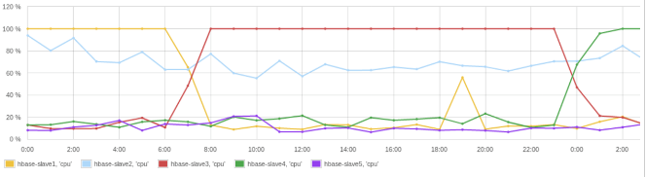
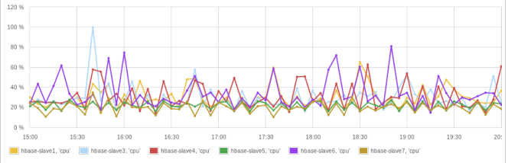
Case Study/Methodology/The Implementation iterations/Round 3
Hot-spotting in Action

Slide 69
Case Study/Methodology/The Implementation iterations/Round 3
How to Resolve Hot-spotting?
Bulk loading
Good for batch job.
Need to understand MR
Need sophisticated coding

Slide 70
Case Study/Methodology/The Implementation iterations/Round 3
How to Resolve Hot-spotting?
For those Streaming data situation:
Random row keys
Unfortunately, this would compromise ability to do fast range scans using start and stop keys
Inverted row keys, hashing
Need extra computing power
Salted row key

Slide 71
Case Study/Methodology/The Implementation iterations/Round 3
How to Resolve Hot-spotting?
For those Streaming data situation:
Random row keys
Simple
Unfortunately, this would compromise ability to do fast range scans using start and stop keys
Inverted row keys
Need extra computing power
But preserving the ability to fetch data by start and stop key.

Slide 72
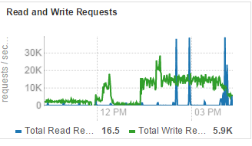
Case Study/Methodology/The Implementation iterations/Round 3
How to Resolve Hot-spotting?
A better one, Salted row key
Code review
Encoder
Decoder

Slide 73
Case Study/Methodology/The Implementation iterations/Round4
Coding: Tuning Put Operation – Disable Auto flash
When performing a lot of Puts, make sure that setAutoFlush is set to false on your Table instance.
Otherwise, the Puts will be sent one at a time to the RegionServer.
Puts added via table.add(Put) and table.add( <List> Put) wind up in the same write buffer.
If autoFlush = false, these messages are not sent until the write-buffer is filled. To explicitly flush the messages, call flushCommits. Calling close on the Table instance will invoke flushCommits.

Slide 74
Case Study/Methodology/The Implementation iterations/Round4
Table Schema: Compression
Disk performance is almost always bottleneck in Hadoop clusters.
This is because Hadoop and Hbase jobs are data intensive, thus making data accessing a bottleneck in overall application.
By using compression, the data occupies less space on disk. Thus the process of accessing data has to take place on smaller, compressed data size.
This leads to increased performance of data accessing .
Compression is CPU bound.

Slide 75
Case Study/Methodology/The Implementation iterations/Round4
Table Schema: Compression
Compression algorithms
 | LZO | GZIP | Snappy
CUP load ratio | 2 | 3 | 1
Use case | warm | Cold | Hot

Slide 76
Case Study/Methodology/The Implementation iterations/Round4
Table Schema: Compression
create 'adi_raw', {NAME => 'c', DATA_BLOCK_ENCODING => 'FAST_DIFF', COMPRESSION => 'SNAPPY',TTL => 259200}

Slide 77
Case Study/Methodology/The Implementation iterations/Round4
Table Schema: Bloom filter
What is Bloom filter - General?
Named for its creator, Burton Howard Bloom
A data structure designed to predict whether a given element is a member of a set of data.
A positive result from a Bloom filter is not always accurate, but a negative result is guaranteed to be accurate.
Bloom filters are designed to be "accurate enough" for sets of data which are so large that conventional hashing mechanisms would be impractical.

Slide 78
Case Study/Methodology/The Implementation iterations/Round4
Table Schema: Bloom filter
What is Bloom filter - HBase?
Bloom filters provide a lightweight in-memory structure to reduce the number of disk reads for a given Get operation to only the StoreFiles likely to contain the desired Row.
The potential performance gain increases with the number of parallel reads.
The Bloom filters themselves are stored in the metadata of each HFile and never need to be updated. When an HFile is opened because a region is deployed to a RegionServer, the Bloom filter is loaded into memory.
HBase includes some tuning mechanisms for folding the Bloom filter to reduce the size and keep the false positive rate within a desired range.
Bloom filters were introduced in HBASE-1200. Since HBase 0.96, row-based Bloom filters are enabled by default. (HBASE-8450)

Slide 79
Case Study/Methodology/The Implementation iterations/Round4
Table Schema: Bloom filter
When To Use Bloom Filters?
Check the value of blockCacheHitRatio in the RegionServer metrics. If Bloom filters are enabled, the value of blockCacheHitRatio should increase, because the Bloom filter is filtering out blocks that are definitely not needed.
Two options for Bloom filters:
filter a row or
filter a row+column combination.
If you generally scan entire rows, the row+column combination will not provide any benefit.
A row-based Bloom filter can operate on a row+column Get, but not the other way around.

Slide 80
Case Study/Methodology/The Implementation iterations/Round4
Enabling Bloom Filters
Bloom filters are enabled on a Column Family.
The following example creates a table and enables a ROWCOL Bloom filter on the colfam1 column family.
hbase> create 'mytable',{NAME => 'colfam1', BLOOMFILTER => 'ROWCOL'}

Slide 81
Case Study/Methodology/The Implementation iterations/Round4
Table Schema: Table pre-splitting
Tables in HBase are initially created with one region by default.
All clients will write to the same region until it is large enough to split and become distributed across the cluster.
A useful pattern to speed up import process is to pre-create empty regions.
Be somewhat conservative in this, because too-many regions can actually degrade performance.

Slide 82
Case Study/Methodology/The Implementation iterations/Round4
Admin: CM Config:
https://datasparker.atlassian.net/browse/ENG-1166

Slide 83
Conclusion
Use Hbase as “Temp”Storage with limited amount.
Hbase is not RMDB. No join, No “select * from A_TABLE”.
RowKey design is important.

Slide 84
Referance
Apache HBase ™ Reference Guide: http://hbase.apache.org/book.html
Cloudera Administration – Managing CDH and Managed service – Managing Individual Service – Managing Hbase: https://www.cloudera.com/documentation/enterprise/5-7-x/topics/admin_hbase_config.html

Slide 85

Thank you
info@athemaster.com

