Slide 1
Kerberos
By Ethon Wu

Slide 2
Kerberos Introduction

Slide 3

Kerberos
In Greek mythology , Kerberos is a dog with three Heads

Slide 4
What is Kerberos ?
Network authentication protocol
Developed at MIT in the mid 1980s
Available as open source or in supported commercial software

Slide 5
Why Kerberos ?
Security
Authentication
It should be scalable
Notes:
Access to many services will depend on the authentication service.
Someone watching the network should not be able to obtain the information necessary to impersonate another user.
安全性
認證
可拓展性

Slide 6
How Kerberos Works ?
Architecture & Authorization Part

Slide 7




Kerberos Architecture
Ticket Granting Server (TGS)
Authentication Server (AS)
File Service
User
Key Distribution Center(KDC)

Slide 8
Kerberos Authorization
Step 1: Connect to Authentication Server (AS)
Step 2: Connect to Ticket Granting Server (TGS)
Step 3: Access to Service (e.g. File Service)

Slide 9
Kerberos Authorization - Step 1 Connect to Authentication Server (AS)
以遊樂園為例子：
湯姆(USER)這次員工旅遊，公司包下遊樂場，湯姆進遊樂園前，守衛(AS)會先檢查他手邊的資料(AD)，確認有沒有湯姆的身份資訊，如果有，守衛(AS)會發給湯姆一張進去遊樂園的門禁卡(TGT, Ticket Grant Ticket)
Notes:
依賴Hive Metastore和HDFS

Slide 10
Kerberos Authorization - Step 2 Connect to Ticket Granting Server (TGS)
延續前一頁使用遊樂園為例子：
目前湯姆手邊的東西：門禁卡(TGT, Ticket Grant Ticket)
湯姆想要坐雲霄飛車，當他要進去時，雲霄飛車的管理員將湯姆擋下，詢問湯姆有沒有雲霄飛車的票據(ST, Service Ticket)？湯姆說他目前只有門禁卡(TGT)，這時湯姆必須把手邊的門禁卡(TGT)在刷卡機(TGS, Ticket Grant Server)刷一下，刷卡機(TGS)會印出票據(ST)給湯姆。

Slide 11
Kerberos Authorization - Step 3 Access to Service (e.g. File Service)
延續前一頁的例子：
目前湯姆手邊的東西：票據(ST, Service Ticket)
湯姆取得了票據(ST)後，給雲霄飛車管理員驗證就可以順利的去玩雲霄飛車了
此票據只能讓湯姆在遊樂園玩8小時而已，如果超過時間就會失效，湯姆必須要在回去遊樂園門口重新向守衛拿取門禁卡(TGT, Ticket Grant Ticket)。

Slide 12










❶
USER-IDENTITY
USER
T.G.T
KDC
Authentication Server
❸
❺
❷
+ USER-INFO
Ticket Grant Server
T.G.T
AUTHENTICATOR
(TIMESTAMP + USER-INFO)
❹
TIMESTAMP
AUTHENTICATOR(TIMESTAMP)
SERVICE(HIVE)
+ USER-INFO
ST
+ USER-INFO
ST
❻
+ USER-INFO
SERVICE(HIVE)

Slide 13
Kerberos Security Concept
Security Part

Slide 14
Kerberos Security - Replay attack
延續前一頁的例子：
由於伊森上次沒有得逞，這次特地找來了一名鎖匠想要將湯姆的門禁卡(TGT, Ticket Grant Ticket)或票據(ST, Service Ticket)打開來看並且複製一份，假冒湯姆偷偷潛入遊樂設施遊玩
防止辦法：
每當湯姆向遊樂園守衛或是遊樂設施管理員取得票時，上面會印有時間標記，因此當壞人伊森請了鎖匠花了一段時間終於解開湯姆鎖盒將票複製一份，準備要偷偷潛入遊樂設施時，遊樂園守衛或是遊樂設施管理員會去檢查你票上面的時間，如果時間與向我申請票的時間相差太長，就不讓你通行，由於解鎖相當耗費時間，因此壞人因為時間間隔太久無法潛入遊樂設施，使得伊森再次無法得逞。

Slide 15
Kerberos Security - Encryption Types
des-cbc-crc | DES cbc mode with CRC-32 (weak)
des-cbc-md4 | DES cbc mode with RSA-MD4 (weak)
des-cbc-md5 | DES cbc mode with RSA-MD5 (weak)
des-cbc-raw | DES cbc mode raw (weak)
des3-cbc-raw | Triple DES cbc mode raw (weak)
des3-cbc-sha1 des3-hmac-sha1 des3-cbc-sha1-kd | Triple DES cbc mode with HMAC/sha1
des-hmac-sha1 | DES with HMAC/sha1 (weak)
aes256-cts-hmac-sha1-96 aes256-cts aes256-sha1 | AES-256 CTS mode with 96-bit SHA-1 HMAC
aes128-cts-hmac-sha1-96 aes128-cts aes128-sha1 | AES-128 CTS mode with 96-bit SHA-1 HMAC
aes256-cts-hmac-sha384-192 aes256-sha2 | AES-256 CTS mode with 192-bit SHA-384 HMAC
aes128-cts-hmac-sha256-128 aes128-sha2 | AES-128 CTS mode with 128-bit SHA-256 HMAC
arcfour-hmac rc4-hmac arcfour-hmac-md5 | RC4 with HMAC/MD5
arcfour-hmac-exp rc4-hmac-exp arcfour-hmac-md5-exp | Exportable RC4 with HMAC/MD5 (weak)
camellia256-cts-cmac camellia256-cts | Camellia-256 CTS mode with CMAC
camellia128-cts-cmac camellia128-cts | Camellia-128 CTS mode with CMAC
des | The DES family: des-cbc-crc, des-cbc-md5, and des-cbc-md4 (weak)
des3 | The triple DES family: des3-cbc-sha1
aes | The AES family: aes256-cts-hmac-sha1-96, aes128-cts-hmac-sha1-96, aes256-cts-hmac-sha384-192, and aes128-cts-hmac-sha256-128
rc4 | The RC4 family: arcfour-hmac
camellia | The Camellia family: camellia256-cts-cmac and camellia128-cts-cmac

Slide 16
Kerberos Security - Encryption Types Setting Example : OS Setting
Config path /var/kerberos/krb5kdc
[kdcdefaults]
kdc_ports = 88
kdc_tcp_ports = 88
[realms]
FERRARI.COM = {
#master_key_type = aes256-cts
max_renewable_life= 7d 0h 0m 0s
acl_file = /var/kerberos/krb5kdc/kadm5.acl
dict_file = /usr/share/dict/words
admin_keytab = /var/kerberos/krb5kdc/kadm5.keytab
supported_enctypes = rc4-hmac:normal aes256-cts:normal aes256-cts-hmac-sha1-96:normal aes128-cts-hmac-sha1-96:normal aes128-cts:normal des3-hmac-sha1:normal arcfour-hmac camellia256-cts:normal camellia128-cts:normal des3-hmac-sha1:normal des-cbc-md5:normal des-cbc-crc:normal
}

Slide 17
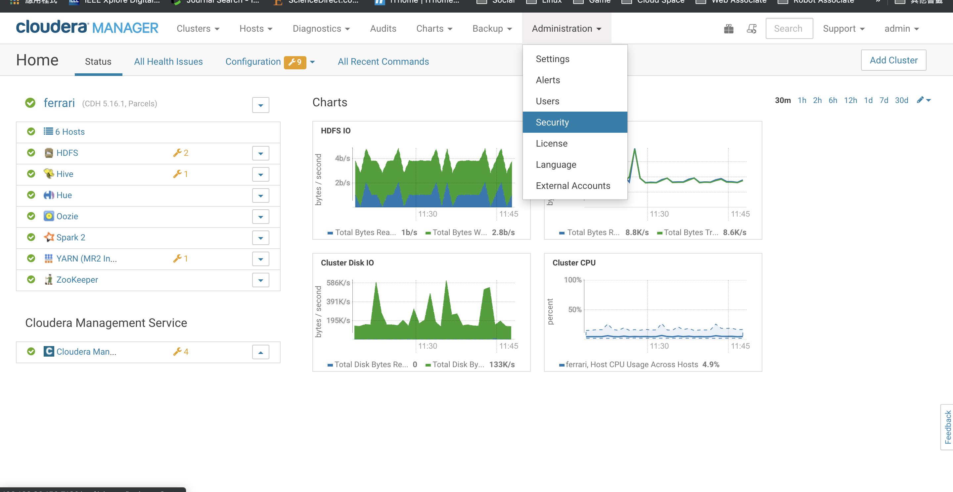
Kerberos Security - Encryption Types Setting Example : CM Setting

Slide 18
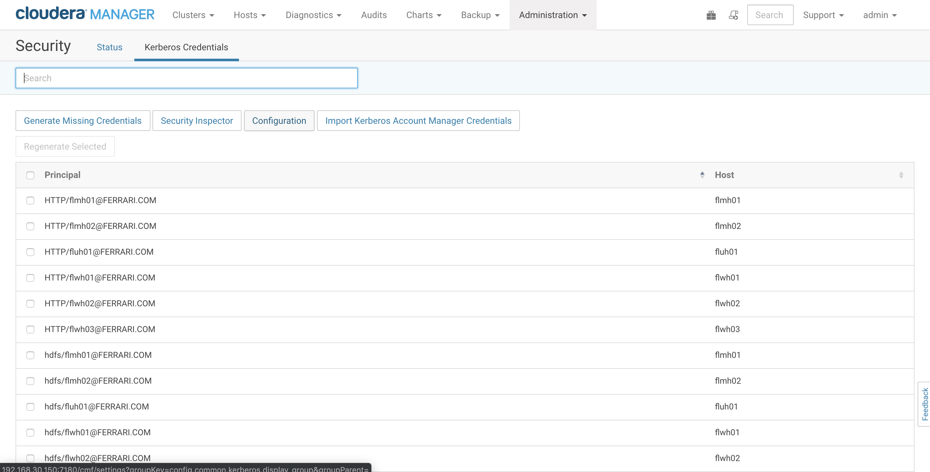
Kerberos Security - Encryption Types Setting Example : CM Setting

Slide 19
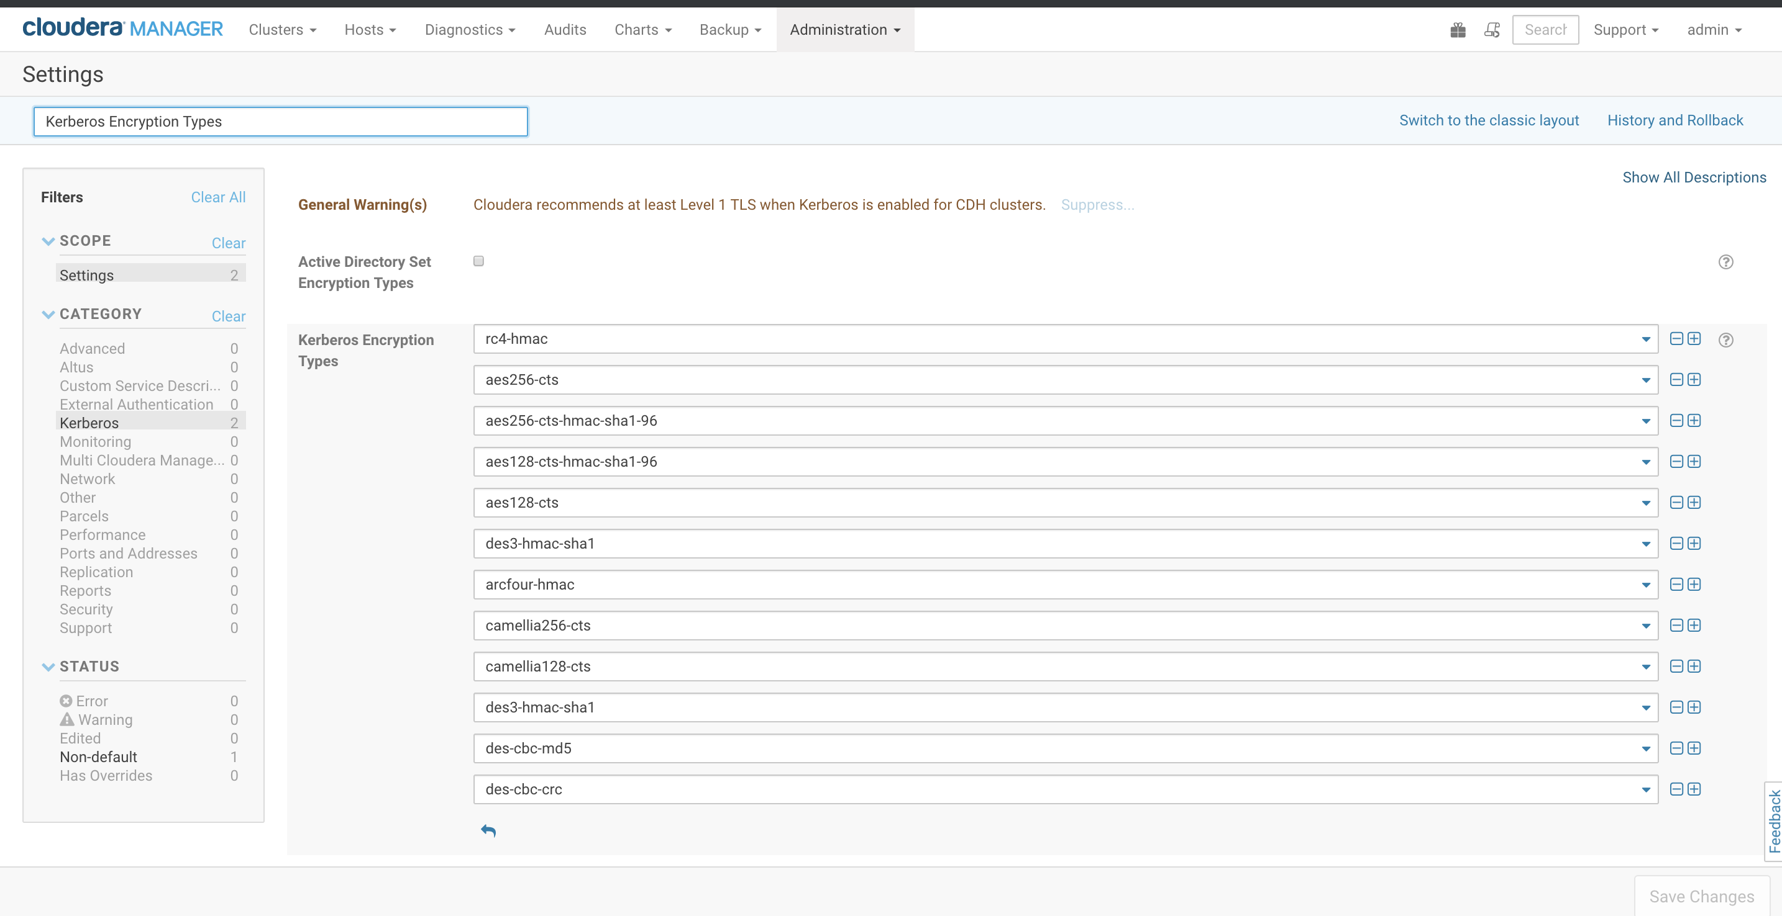
Kerberos Security - Encryption Types Setting Example : CM Setting

Slide 20
How to Kerberos on OS
User Site

Slide 21
Kerberos Command - kinit ( Get Kerberos Authorization )
1. Use password get Kerberos authorization
[root@fluh01 ~]# kinit enzo
Password for enzo@FERRARI.COM:
2. Use keytab get Kerberos authorization
[root@fluh01 ~]# kinit -kt enzo.keytab enzo

Slide 22
Kerberos Command - keytab introduction
A keytab is a file containing pairs of Kerberos principals and encrypted keys (which are derived from the Kerberos password).
You can use a keytab file to authenticate to various remote systems using Kerberos without entering a password.
When you change your Kerberos password, you will need to recreate all your keytabs.

Slide 23
Kerberos Command - klist ( List cached Kerberos tickets )
Show info after kinit
[root@fluh01 ~]# klist
Ticket cache: FILE:/tmp/krb5cc_0
Default principal: enzo@FERRARI.COM
Valid starting Expires Service principal
2019-07-04T14:53:37 2019-07-05T14:53:37 krbtgt/FERRARI.COM@FERRARI.COM
renew until 2019-07-11T14:53:37
T.G.T cache path
Notes:
第三個框框懶得打字，使用嘴巴技能
總之 valid starting 就是起始時間
Expires 就是終止時間
中間可以使用 kinit –R 更新就這樣拉

Slide 24
Kerberos Command - renew time and expires time concept
Valid starting : Your kinit start time
Expires : Your ticket expire time
renew until : This example renew time is 7 days, you can run Kinit –R without using password login, but after 7 days, you should use kinit to enter password.
Valid starting Expires
2019-07-04T14:53:37 2019-07-05T14:53:37
renew until 2019-07-11T14:53:37

Slide 25
Kerberos Command - renew time and expires time concept
How to setting renew time and expires time ?
Modify config file path : /etc/krb5.conf
.
.
.
[libdefaults]
ticket_lifetime = 24h
renew_lifetime = 7d
.
.
.

Slide 26
Kerberos Command - renew time and expires time concept
How to setting renew time and expires time ?
Modify by using command
kinit <principal name> -l <lifetime> -r <renewable time> -s <start time>

Slide 27
Example : kinit a principal, now time is 17:27 and my ticket effective time is 22:27 , life time is 12hr, renew time is 1 day.
[root@fluh01 ~]# kinit enzo -l 12h -r 1d -s 5:00
Password for enzo@FERRARI.COM:
[root@fluh01 ~]# klist
Ticket cache: FILE:/tmp/krb5cc_0
Default principal: enzo@FERRARI.COM
Valid starting Expires Service principal
2019-07-04T22:27:20 2019-07-05T10:27:20 krbtgt/FERRARI.COM@FERRARI.COM
renew until 2019-07-05T22:27:20

Slide 28
Kerberos Command - klist (Show keytab info)
How to get keytab file information
Generate keytab file time
Principal name
Encryption algorithm
[root@fluh01 ~]# klist -kte enzo.keytab
Keytab name: FILE:enzo.keytab
KVNO Timestamp Principal
---- ------------------- ------------------------------------------------------
1 2019-07-04T17:33:16 enzo@FERRARI.COM (arcfour-hmac)
1 2019-07-04T17:33:16 enzo@FERRARI.COM (aes256-cts-hmac-sha1-96)
1 2019-07-04T17:33:16 enzo@FERRARI.COM (aes128-cts-hmac-sha1-96)
1 2019-07-04T17:33:16 enzo@FERRARI.COM (des3-cbc-sha1)
1 2019-07-04T17:33:16 enzo@FERRARI.COM (camellia256-cts-cmac)
1 2019-07-04T17:33:16 enzo@FERRARI.COM (camellia128-cts-cmac)
1 2019-07-04T17:33:16 enzo@FERRARI.COM (des-cbc-md5)

Slide 29
Kerberos Command - kdestroy ( Destroy Kerberos tickets)
The kdestroy utility destroys the user's active Kerberos authorization tickets by deleting the credentials cache that contains them.
[root@fluh01 ~]# klist
Ticket cache: FILE:/tmp/krb5cc_0
Default principal: enzo@FERRARI.COM
Valid starting Expires Service principal
2019-07-04T17:47:28 2019-07-05T17:47:28 krbtgt/FERRARI.COM@FERRARI.COM
renew until 2019-07-11T17:47:28
[root@fluh01 ~]# kdestroy
[root@fluh01 ~]# klist
klist: No credentials cache found (filename: /tmp/krb5cc_0)

Slide 30
How to Kerberos on OS
Administrator Site

Slide 31
Kerberos Command - kadmin & kadmin.local (Kerberos V5 database administration program)
kadmin and kadmin.local are command-line interfaces to the Kerberos V5 administration system.
Kadmin: Using command-line and enter password to login Kerberos V5 database from client (not Kerberos from server).
kadmin.local: Using command-line to login Kerberos V5 database( don’t need password ).

Slide 32
Kerberos Command - kadmin & kadmin.local (Kerberos V5 database administration program)
kadmin.local login example:
[root@fluh01 ~]# kadmin.local
Authenticating as principal root/admin@FERRARI.COM with password.
kadmin.local:
kadmin.local must be logged by root account, and do not need password , so this account is very important, if someone get this permission, it can modify everything on Kerberos Database.

Slide 33
Kerberos Command - kadmin & kadmin.local (Kerberos V5 database administration program)
kadmin login example:
[root@flwh02 ~]# kinit admin/admin
Password for admin/admin@FERRARI.COM:
[root@flwh02 ~]# kadmin
Authenticating as principal admin/admin@FERRARI.COM with password.
Password for admin/admin@FERRARI.COM:
kadmin:
1. Get admin principal
2. Login to Kerberos DB

Slide 34
Kerberos Command - kadmin interface : list principal
kadmin interface : list principal
[root@fluh01 ~]# kadmin.local
Authenticating as principal root/admin@FERRARI.COM with password.
kadmin.local: listprincs
HTTP/flmh01@FERRARI.COM
....
Using OS command : list principal
[root@fluh01 ~]# kadmin.local -q "listprincs"
Authenticating as principal root/admin@FERRARI.COM with password.
HTTP/flmh01@FERRARI.COM
. . .

Slide 35
Kerberos Command - kadmin interface : add principal
kadmin interface : add principal
kadmin.local: addprinc test
WARNING: no policy specified for test@FERRARI.COM; defaulting to no policy
Enter password for principal "test@FERRARI.COM":
Re-enter password for principal "test@FERRARI.COM":
Principal "test@FERRARI.COM" created.
All_info.txt
Using OS command : add principal
[root@fluh01 ~]# kadmin.local -q "addprinc test"
Authenticating as principal root/admin@FERRARI.COM with password.
WARNING: no policy specified for test@FERRARI.COM; defaulting to no policy
Enter password for principal "test@FERRARI.COM":
Re-enter password for principal "test@FERRARI.COM":
Principal "test@FERRARI.COM" created.

Slide 36
Kerberos Command - kadmin interface : add principal
kadmin interface : add principal with password
kadmin.local: addprinc -pw 1234 test
WARNING: no policy specified for test@FERRARI.COM; defaulting to no policy
Principal "test@FERRARI.COM" created.
Using OS command : add principal
[root@fluh01 ~]# kadmin.local -q "addprinc -pw 1234 test"
Authenticating as principal root/admin@FERRARI.COM with password.
WARNING: no policy specified for test@FERRARI.COM; defaulting to no policy
Principal "test@FERRARI.COM" created.

Slide 37
Kerberos Command - kadmin interface : add principal with random key
kadmin interface : add principal with random key
kadmin.local: addprinc -randkey yo
WARNING: no policy specified for yo@FERRARI.COM; defaulting to no policy
Principal "yo@FERRARI.COM" created.
Using OS command : add principal with random key
[root@fluh01 ~]# kadmin.local -q "addprinc -randkey yo"
Authenticating as principal root/admin@FERRARI.COM with password.
WARNING: no policy specified for yo@FERRARI.COM; defaulting to no policy
Principal "yo@FERRARI.COM" created.

Slide 38
Kerberos Command - Login with random key principal
Due to use random key create principal, the only way to kinit is use keytab login
Generate keytab
kadmin.local: xst -k yo.keytab yo
Entry for principal yo with kvno 3, encryption type arcfour-hmac added to keytab WRFILE:yo.keytab.
2. kinit with keytab
[root@fluh01 ~]# kinit -kt yo.keytab yo

Slide 39
Kerberos Command - kadmin interface : Generate keytab from principal with no random key
If this principal has password must add -norandkey option.
kadmin.local: xst -norandkey -k test.keytab test
Entry for principal test with kvno 1, encryption type arcfour-hmac added to keytab WRFILE:test.keytab.
Entry for principal test with kvno 1, encryption type aes256-cts-hmac-sha1-96 added to keytab WRFILE:test.keytab.
Entry for principal test with kvno 1, encryption type aes128-cts-hmac-sha1-96 added to keytab WRFILE:test.keytab.
Entry for principal test with kvno 1, encryption type des3-cbc-sha1 added to keytab WRFILE:test.keytab.
Entry for principal test with kvno 1, encryption type camellia256-cts-cmac added to keytab WRFILE:test.keytab.
Entry for principal test with kvno 1, encryption type camellia128-cts-cmac added to keytab WRFILE:test.keytab.
Entry for principal test with kvno 1, encryption type des-cbc-md5 added to keytab WRFILE:test.keytab.
Keytab file name
Principal name

Slide 40
Kerberos Command - kadmin interface : get principal info
kadmin.local: getprinc yo
Principal: yo@FERRARI.COM
Expiration date: [never]
Last password change: 二 7月 09 17:11:23 CST 2019
Password expiration date: [never]
Maximum ticket life: 1 day 00:00:00
Maximum renewable life: 7 days 00:00:00
Last modified: 二 7月 09 17:11:23 CST 2019 (root/admin@FERRARI.COM)
Last successful authentication: [never]
Last failed authentication: [never]
Failed password attempts: 0
Number of keys: 7
Key: vno 3, arcfour-hmac
…
MKey: vno 1
Attributes:
Policy: [none]

Slide 41
Kerberos Command - kadmin interface : modify principal
1. Change principal password.
kadmin.local: cpw test
Enter password for principal "test@FERRARI.COM":
Re-enter password for principal "test@FERRARI.COM":
Password for "test@FERRARI.COM" changed.
2. Change max renew time & life time
kadmin.local: modprinc -maxrenewlife 10d -maxlife 2d yo
Principal "yo@FERRARI.COM" modified.

Slide 42
Kerberos Command - kadmin interface : delete principal
kadmin interface : delete principal
kadmin.local: delete_principal test
Are you sure you want to delete the principal "test@FERRARI.COM"? (yes/no): yes
Principal "test@FERRARI.COM" deleted.
Make sure that you have removed this principal from all ACLs before reusing.
Using OS command : delete principal
[root@fluh01 ~]# kadmin.local -q "delete_principal test"
Authenticating as principal root/admin@FERRARI.COM with password.
Are you sure you want to delete the principal "test@FERRARI.COM"? (yes/no): yes
Principal "test@FERRARI.COM" deleted.
Make sure that you have removed this principal from all ACLs before reusing.

Slide 43
Q & A

