Slide 1
Connect to Hive and Impala on a kerberized Cluster
Yunhan Tsai

Slide 2
Connect to Hive and Impala on a kerberized Cluster
Kerberized CDH Cluster [Realm: FERRARI]
Host Name: flmh01
Host Name: flwh01
Host Name: fluh01
…
Impalad:21050
HiveServer2:10000
…
…
…
…
…
…
Host Name: yht-uh01
Java Program
Using Keytab and krb5.conf to connect the Cluster
Python Program

Slide 3
Connect to Hive and Impala on a kerberized Cluster
STEP 1. Kerberos Authentication
STEP 2. Set up a DB Connection
STEP 3. Implement your business logic

Slide 4
Java Project
src/
|
|_ java/
| |_ com.athemaster/
| | |_ krbCerti/
| | | |_ KerberosCerti.java
| | |
| | |_ conn/
| | |_ HiveConnFactory.java
| | |_ ImpalaConnFactory.java
| |
| |_ hiveExample.java
| |_ impalaExample.java
|
|_ resources/
|_ config.properties

Slide 5
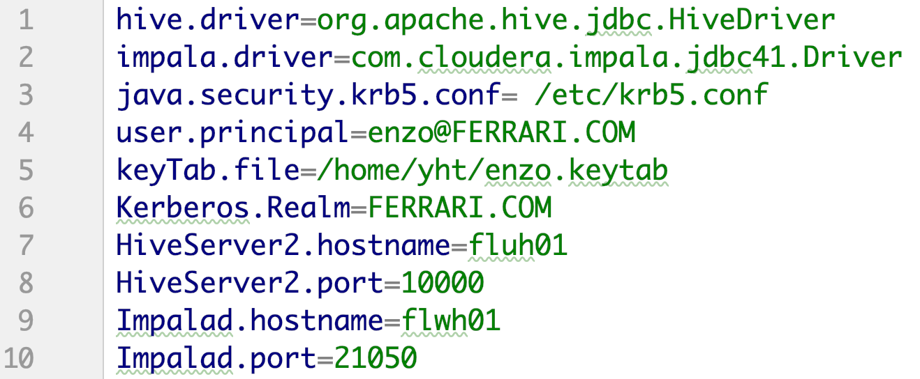
Java: Get your configuration prepared
src/
|
|_ java/
| |_ com.athemaster/
| | |_ krbCerti/
| | | |_ KerberosCerti.java
| | |
| | |_ conn/
| | |_ HiveConnFactory.java
| | |_ ImpalaConnFactory.java
| |
| |_ hiveExample.java
| |_ impalaExample.java
|
|_ resources/
|_ config.properties

Slide 6
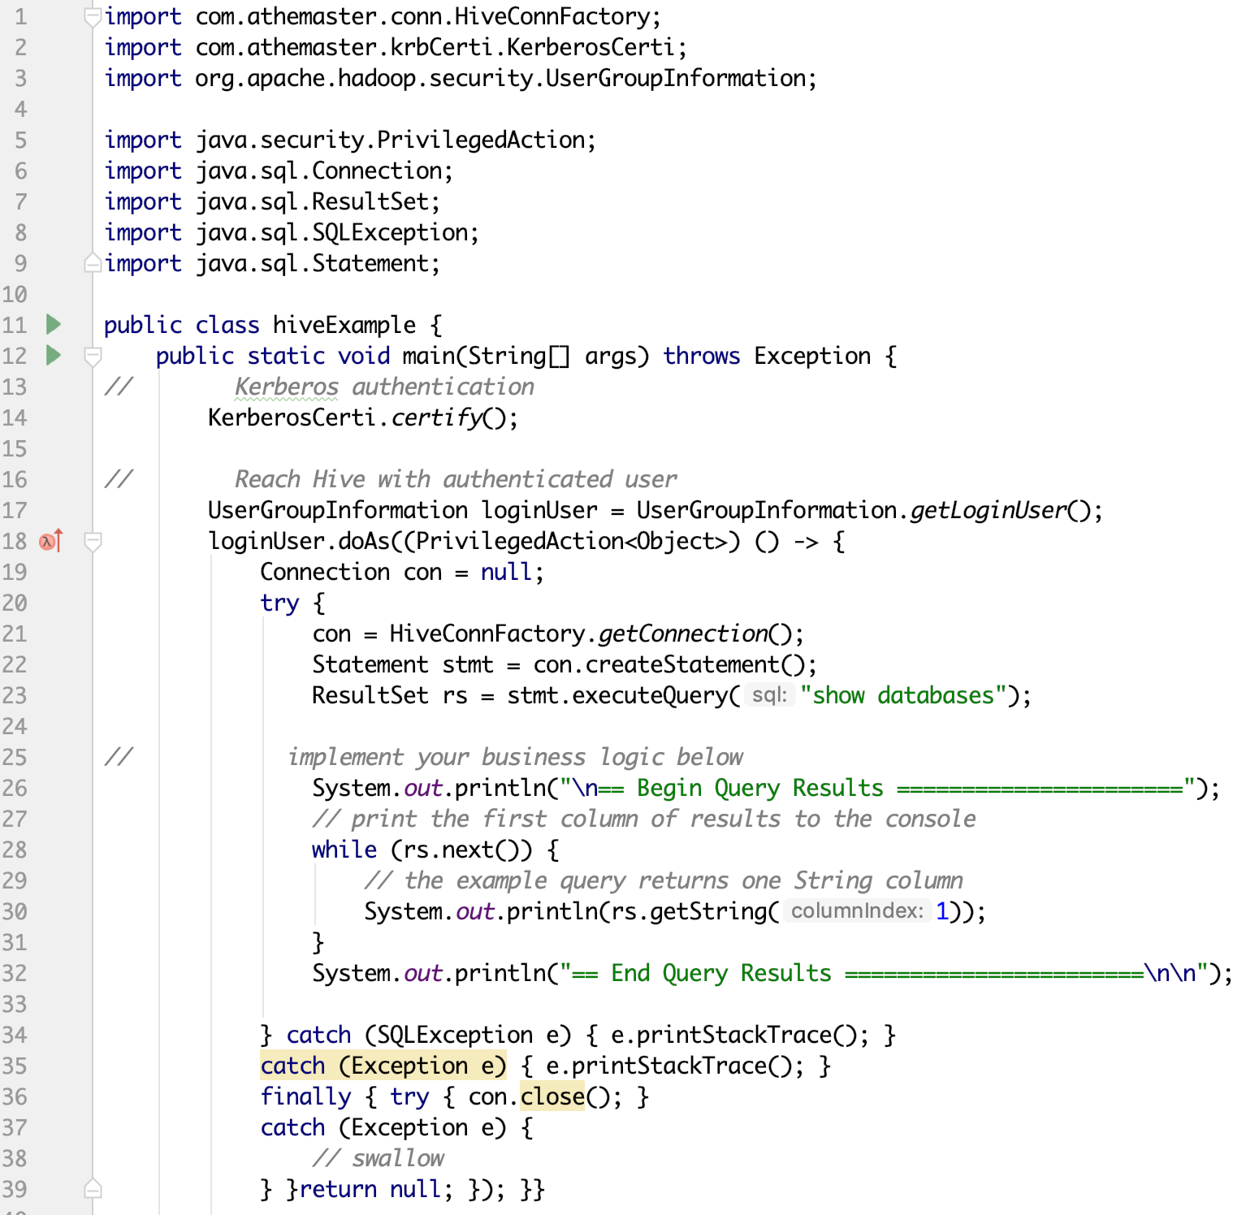
Java
Hive Example
src/
|
|_ java/
| |_ com.athemaster/
| | |_ krbCerti/
| | | |_ KerberosCerti.java
| | |
| | |_ conn/
| | |_ HiveConnFactory.java
| | |_ ImpalaConnFactory.java
| |
| |_ hiveExample.java
| |_ impalaExample.java
|
|_ resources/
|_ config.properties
SETP 1: Kerberos Authentication
SETP 2: Set up a DB Connection
SETP 3: Implement your business logic

Slide 7
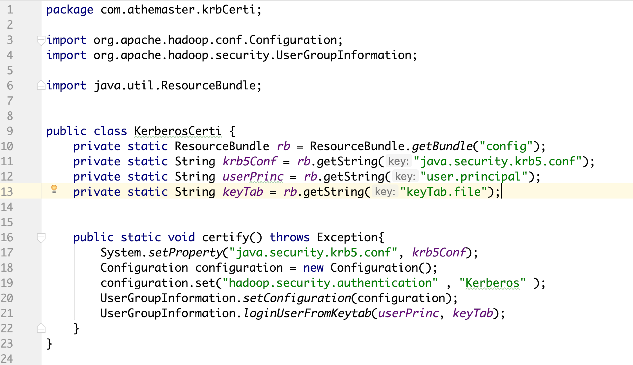
Java
Hive Example
src/
|
|_ java/
| |_ com.athemaster/
| | |_ krbCerti/
| | | |_ KerberosCerti.java
| | |
| | |_ conn/
| | |_ HiveConnFactory.java
| | |_ ImpalaConnFactory.java
| |
| |_ hiveExample.java
| |_ impalaExample.java
|
|_ resources/
|_ config.properties
STEP 1: KerberosCerti.certify();

Slide 8
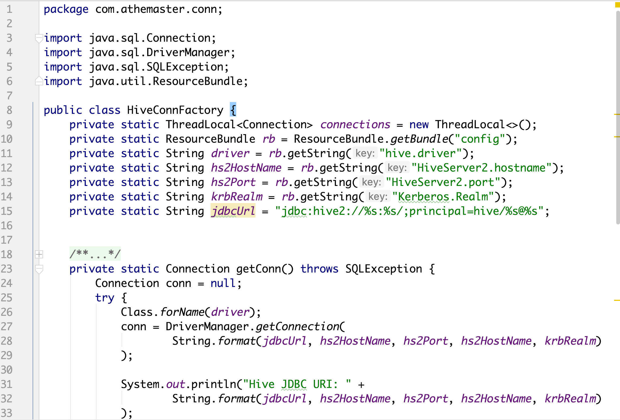
Java
Hive Example
src/
|
|_ java/
| |_ com.athemaster/
| | |_ krbCerti/
| | | |_ KerberosCerti.java
| | |
| | |_ conn/
| | |_ HiveConnFactory.java
| | |_ ImpalaConnFactory.java
| |
| |_ hiveExample.java
| |_ impalaExample.java
|
|_ resources/
|_ config.properties
STEP 2: con = HiveConnFactory.getConnection();

Slide 9
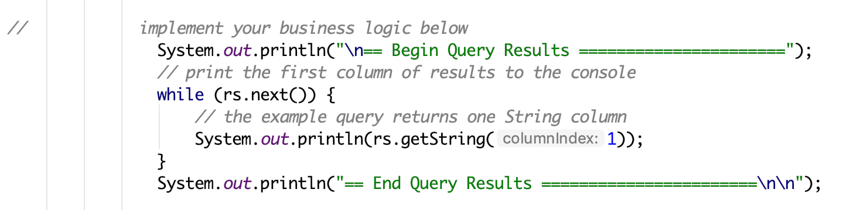
Java
Hive Example
src/
|
|_ java/
| |_ com.athemaster/
| | |_ krbCerti/
| | | |_ KerberosCerti.java
| | |
| | |_ conn/
| | |_ HiveConnFactory.java
| | |_ ImpalaConnFactory.java
| |
| |_ hiveExample.java
| |_ impalaExample.java
|
|_ resources/
|_ config.properties
STEP 3: Implement your business logic

Slide 10
Java
Hive Example
src/
|
|_ java/
| |_ com.athemaster/
| | |_ krbCerti/
| | | |_ KerberosCerti.java
| | |
| | |_ conn/
| | |_ HiveConnFactory.java
| | |_ ImpalaConnFactory.java
| |
| |_ hiveExample.java
| |_ impalaExample.java
|
|_ resources/
|_ config.properties
hiveExample.java

Slide 11
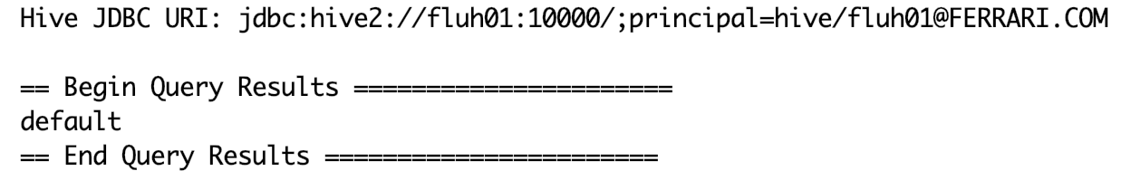
Java
Hive Example
src/
|
|_ java/
| |_ com.athemaster/
| | |_ krbCerti/
| | | |_ KerberosCerti.java
| | |
| | |_ conn/
| | |_ HiveConnFactory.java
| | |_ ImpalaConnFactory.java
| |
| |_ hiveExample.java
| |_ impalaExample.java
|
|_ resources/
|_ config.properties
Result of running hiveExample.java

Slide 12
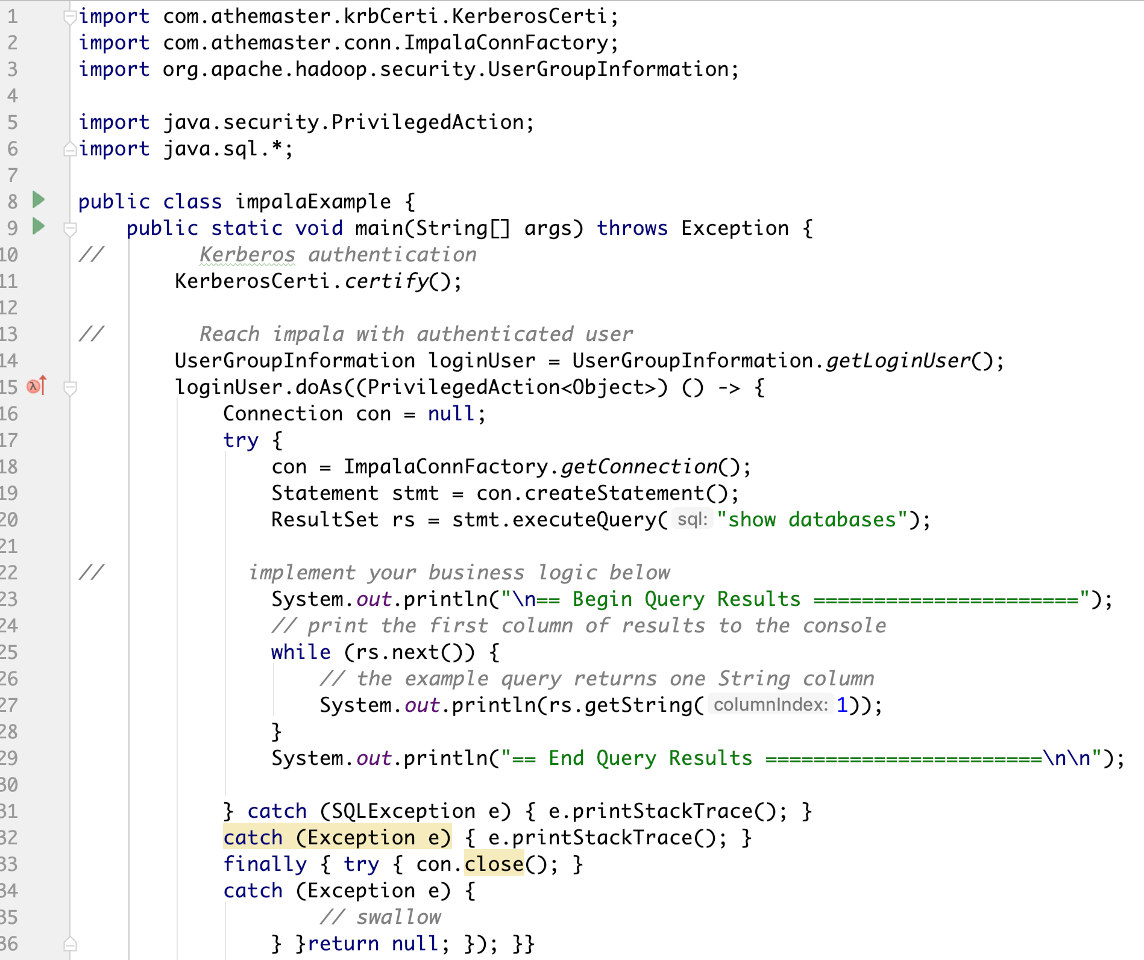
Java
Impala Example
src/
|
|_ java/
| |_ com.athemaster/
| | |_ krbCerti/
| | | |_ KerberosCerti.java
| | |
| | |_ conn/
| | |_ HiveConnFactory.java
| | |_ ImpalaConnFactory.java
| |
| |_ hiveExample.java
| |_ impalaExample.java
|
|_ resources/
|_ config.properties
SETP 1: Kerberos Authentication
SETP 2: Set up a DB Connection
SETP 3: Implement your business logic

Slide 13
Java
Impala Example
src/
|
|_ java/
| |_ com.athemaster/
| | |_ krbCerti/
| | | |_ KerberosCerti.java
| | |
| | |_ conn/
| | |_ HiveConnFactory.java
| | |_ ImpalaConnFactory.java
| |
| |_ hiveExample.java
| |_ impalaExample.java
|
|_ resources/
|_ config.properties
STEP 1: KerberosCerti.certify();

Slide 14
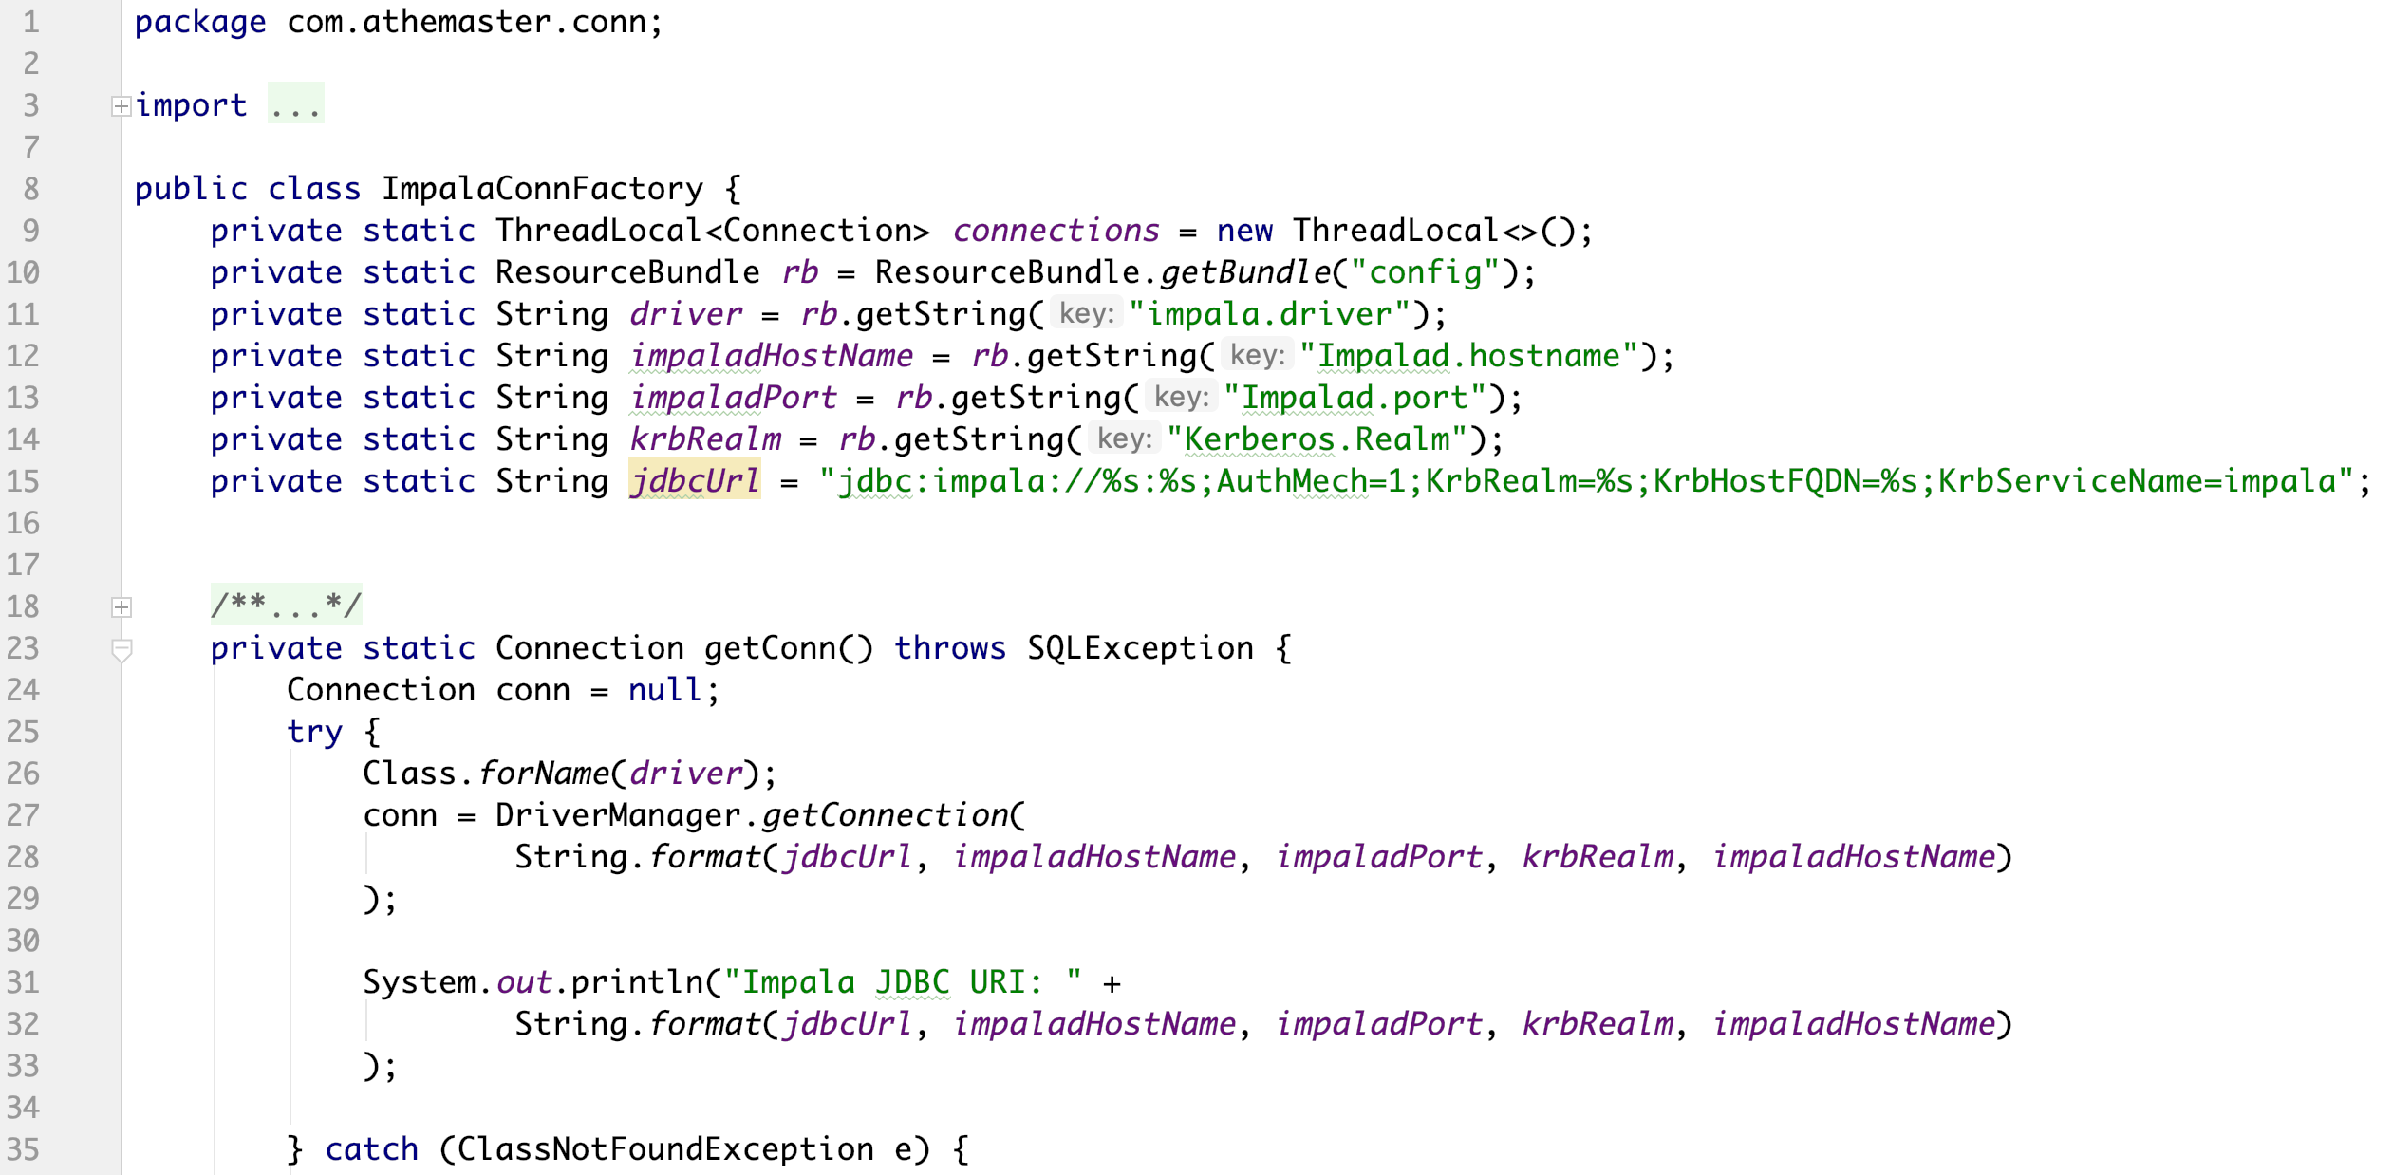
Java
Impala Example
src/
|
|_ java/
| |_ com.athemaster/
| | |_ krbCerti/
| | | |_ KerberosCerti.java
| | |
| | |_ conn/
| | |_ HiveConnFactory.java
| | |_ ImpalaConnFactory.java
| |
| |_ hiveExample.java
| |_ impalaExample.java
|
|_ resources/
|_ config.properties
STEP 2: con = ImpalaConnFactory.getConnection();

Slide 15
Java
Impala Example
src/
|
|_ java/
| |_ com.athemaster/
| | |_ krbCerti/
| | | |_ KerberosCerti.java
| | |
| | |_ conn/
| | |_ HiveConnFactory.java
| | |_ ImpalaConnFactory.java
| |
| |_ hiveExample.java
| |_ impalaExample.java
|
|_ resources/
|_ config.properties
STEP 3: Implement your business logic

Slide 16
Java
Impala Example
src/
|
|_ java/
| |_ com.athemaster/
| | |_ krbCerti/
| | | |_ KerberosCerti.java
| | |
| | |_ conn/
| | |_ HiveConnFactory.java
| | |_ ImpalaConnFactory.java
| |
| |_ hiveExample.java
| |_ impalaExample.java
|
|_ resources/
|_ config.properties
impalaIExample.java

Slide 17
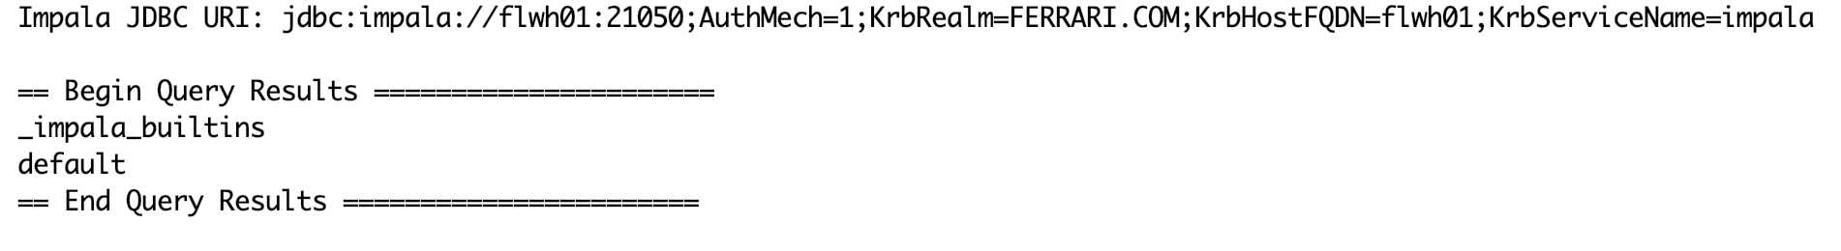
Java
Impala Example
src/
|
|_ java/
| |_ com.athemaster/
| | |_ krbCerti/
| | | |_ KerberosCerti.java
| | |
| | |_ conn/
| | |_ HiveConnFactory.java
| | |_ ImpalaConnFactory.java
| |
| |_ hiveExample.java
| |_ impalaExample.java
|
|_ resources/
|_ config.properties
Result of running impalaExample.java

Slide 18
Python Project
baseDir/
|_ config.ini
|_ hiveKrb.py
|_ impalaKrb.py

Slide 19
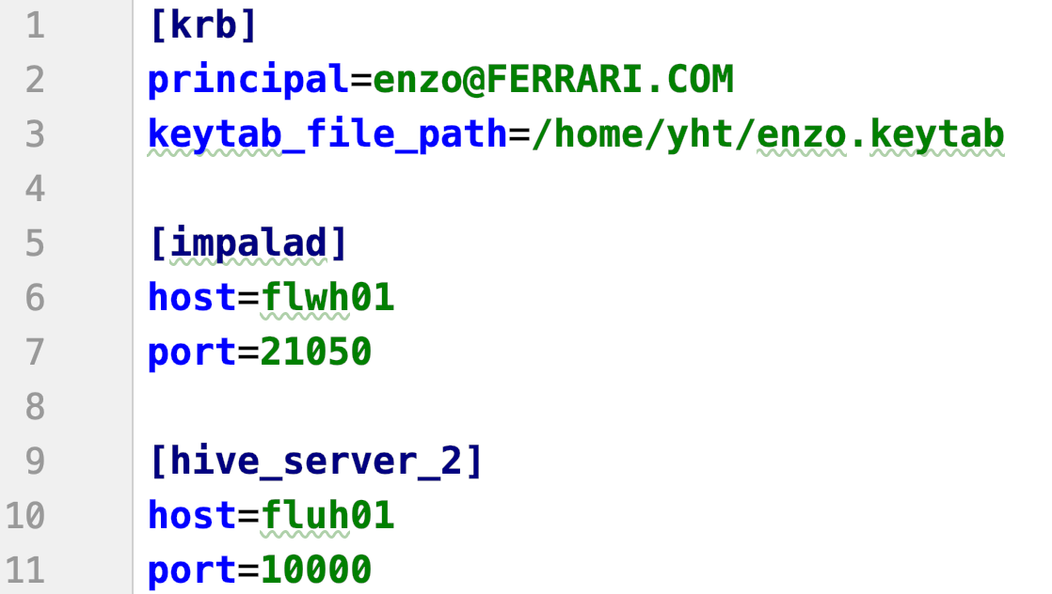
Python: Get your configuration prepared
baseDir/
|_ config.ini
|_ hiveKrb.py
|_ impalaKrb.py

Slide 20
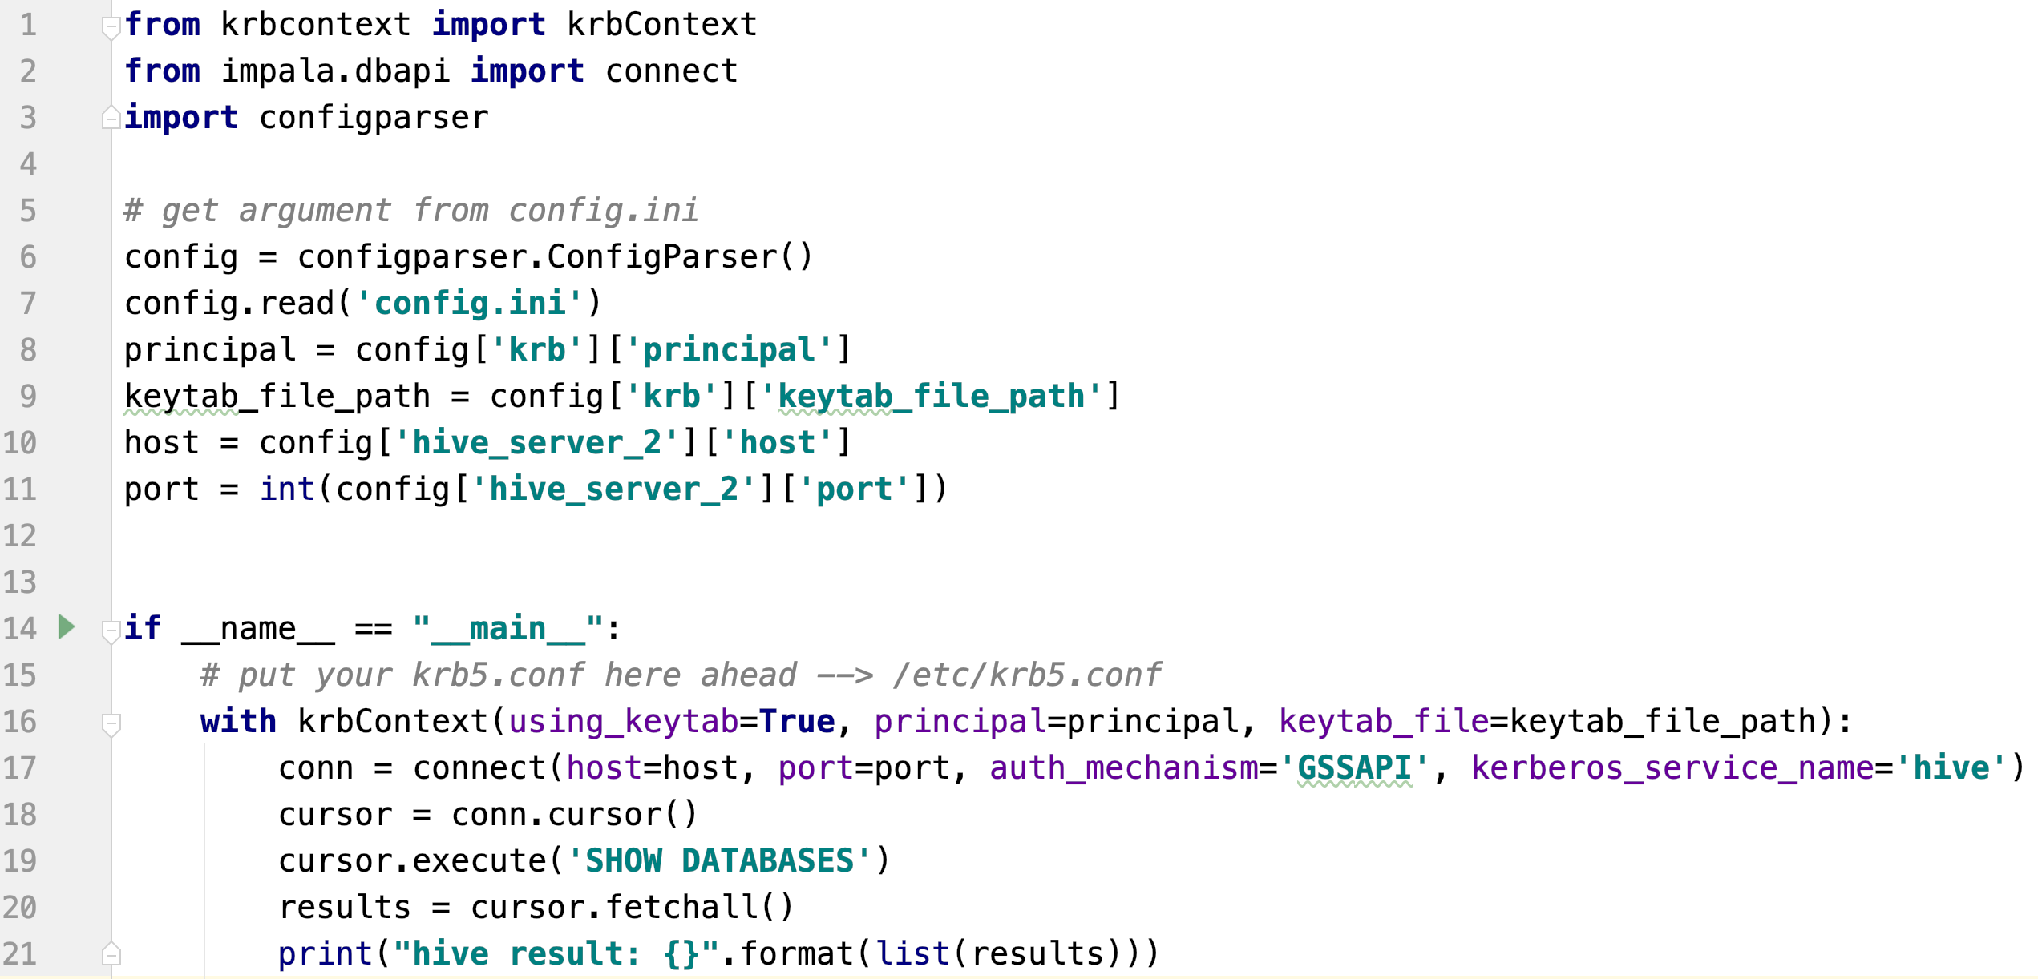
Python
Hive Example
baseDir/
|_ config.ini
|_ hiveKrb.py
|_ impalaKrb.py
SETP 1: Kerberos Authentication
SETP 2: Set up a DB Connection
SETP 3: Implement your business logic

Slide 21
Python
Hive Example
baseDir/
|_ config.ini
|_ hiveKrb.py
|_ impalaKrb.py
STEP 1: KrbContext

Slide 22
Python
Hive Example
baseDir/
|_ config.ini
|_ hiveKrb.py
|_ impalaKrb.py
STEP 2: impyla connect

Slide 23
Python
Hive Example
baseDir/
|_ config.ini
|_ hiveKrb.py
|_ impalaKrb.py
STEP 3: Implement your business logic

Slide 24
Python
Hive Example
hiveKrb.py
baseDir/
|_ config.ini
|_ hiveKrb.py
|_ impalaKrb.py

Slide 25
Python
Hive Example
Result of running hiveKrb.py

Slide 26
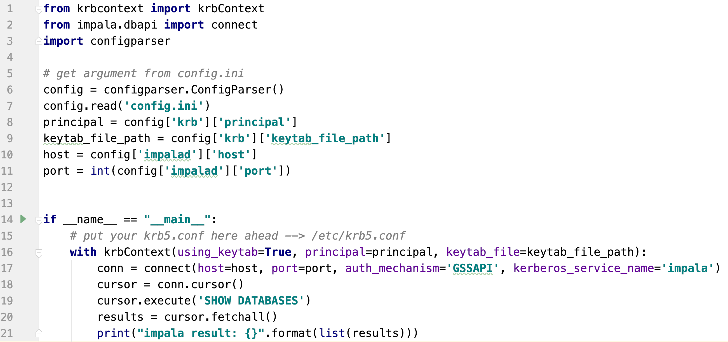
Python
Impala Example
baseDir/
|_ config.ini
|_ hiveKrb.py
|_ impalaKrb.py
SETP 1: Kerberos Authentication
SETP 2: Set up a DB Connection
SETP 3: Implement your business logic

Slide 27
Python
Impala Example
baseDir/
|_ config.ini
|_ hiveKrb.py
|_ impalaKrb.py
STEP 1: KrbContext

Slide 28
Python
Hive Example
Impala Example
baseDir/
|_ config.ini
|_ hiveKrb.py
|_ impalaKrb.py
STEP 2: impyla connect

Slide 29
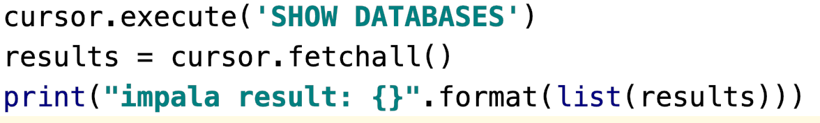
Python
Hive Example
Impala Example
baseDir/
|_ config.ini
|_ hiveKrb.py
|_ impalaKrb.py
STEP 3: Implement your business logic

Slide 30
Python
Hive Example
Impala Example
impalaKrb.py
baseDir/
|_ config.ini
|_ hiveKrb.py
|_ impalaKrb.py

Slide 31
Python
Impala Example
Result of runningle impalaKrb.py

Slide 32
Q & A

