Slide 1

VETKA: The Spatial OS for AI-Native Thinking
Eternal Memory, Agent Orchestration & Multimodal Knowledge Graphs Investor Opportunity: $10M Seed for 2026 Hypergrowth

Slide 2
Executive Summary
• Problem: Knowledge silos and 'agent amnesia' (90% hallucination waste).
• Solution: VETKA – A Universal Spatial OS using 3D DAG graphs for reality montage.
• Traction: Live prototype (Phase 153), 700+ nodes, multimodal artifact scanning.
• Ask: $10M Seed ($2M MVP + $8M Scale) to reach $50M ARR by 2027.
• Why Now: The explosion of AI agents requires a foundational Operating System.

Slide 3
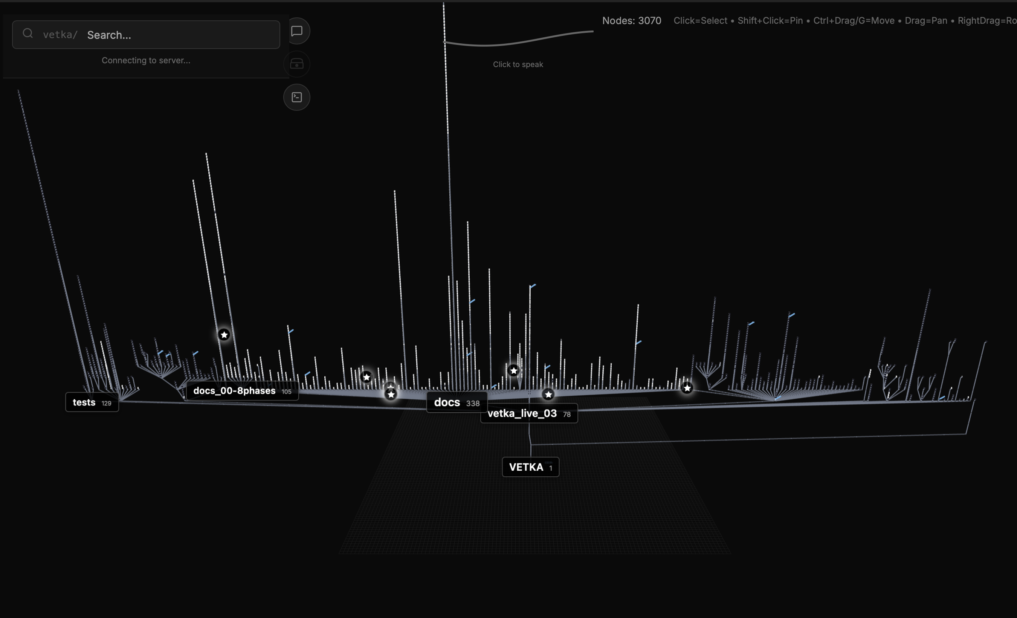
What is VETKA? (Core Vision)
Spatial 3D Graphs: Files as nodes, semantic/temporal links as edges.
Eternal Memory: Qdrant/Weaviate triples ensure zero context loss.
Local-First + MCP: Tauri desktop privacy with remote GPU scaling.
MYCELIUM: The command center layer for agent orchestration.

Slide 4
Phased Roadmap to Revenue
Phase | Q4'24 | Q1'25 | Q2'25 | 2026+
Product | Multimodal UI | Local Beta | SaaS Alpha | Full SaaS
Features | Artifact Scan | Agent Orch | Cloud Sync | Enterprise
Users | 1K Nodes Demo | 100 Beta | 1,000 | 10,000
Revenue | Bootstrap | $10K MRR | $100K MRR | $5M ARR

Slide 5
Market Analysis: TAM $5B+
Knowledge Tools: $50B (Focusing on Cursor/Notion subset)
Agent Orchestration: $10B (Emerging: LangChain/Replit)
Spatial Compute: $5B (Blender/Unity + AI convergence)

Slide 6
The Hybrid SaaS Model
FREE Local Core 1K Nodes Basic Agents
PRO ($29/mo) Unlimited Nodes Mycelium Pro Local MCPs
ENTERPRISE ($99/mo) Cloud MCPs (GPU) Team Sync Custom Agents

Slide 7
The Ask: $10M Seed
• 40% Engineering: Rust, 3D Graphics, & AI Orchestration.
• 30% Cloud Infrastructure: Managed MCPs and GPU clusters.
• 20% GTM: Partnerships with Ollama, Replit, and Anthropic.
• 10% Operations & Security.

