Slide 1
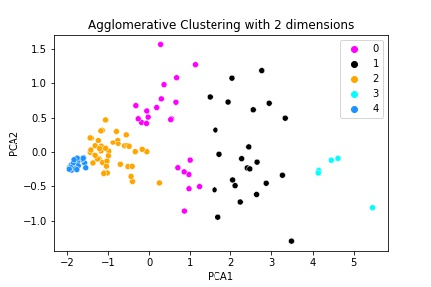
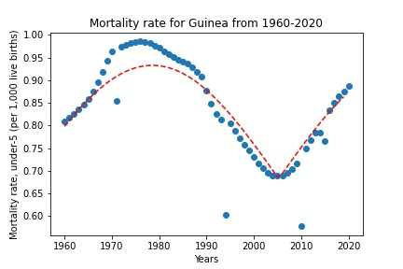
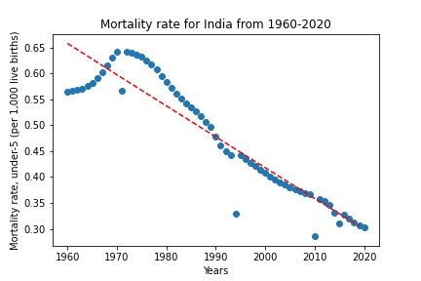
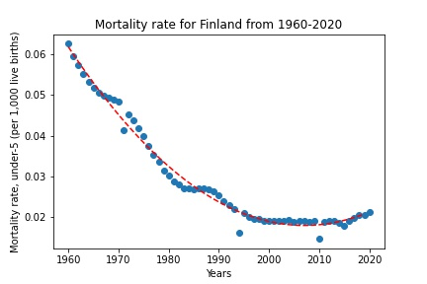
Mortality Rates of countries 1960-2020
vplomkmkmkmkmkm,z
Plot 3
The work considers the mortality rate of various countries from years 1960-2020. Agglomerative clustering is used for clustering countries based on the mortality rates. In total 5 clusters are made whose PCA plot is shown. From 3 clusters, 3 countries are selected. The rates are all different in all the countries. The curves from all the countries are fitted with a different objective function. For the curve of Guinea, a sinusoidal function is applied whereas for the curve of India, a logarithmic function is applied. For Finland, a second order polynomial function is applied.
Plot 1 is an Agglomerative Clustering with 2 dimensions which shows PCA1 on X-axis and PCA2 on y-axis.
The plot 2 shows Mortality rate for India from 1960-2020 which consists of years on X-axis and Mortality rate on Y-axis and mortality rate is 0.55 at 1960 and it is increased upto 0.65 at 1970 and decreased gradually from 1970 to 2020.
Plot 3 shows mortality rate for Guinea for the years 1960-2020 which consists of years on X-axis and mortality rate on Y-axis. The mortality rate is 0.80 at 1960 and it increased 0.99 in between 1970-1980. From 1980 the mortality rate is decreased in between 2000-2010 then again it increasing gradually upto 2020.
Plot 4 indicates mortality rate for Finland from 1960-2020 which consists of years on X-axis and mortality rate on Y-axis. The mortality rate is 0.06 at 1960 and it decreased gradually upto 2020.
Conclusion: From the above graphs Mortality rate for the India is a straight line that decreased gradually compared to Guinea and Finland.
Reference: Mortality rate, under-5 (per 1,000 live births) | Data (worldbank.org)
Plot 1
p
Plot 2
Plot 4

