Slide 1


Ai Gym Coach
Assiut University
1/26

Slide 2
Table of Contents:
Team Member
Task description
Demo of the running application
Contribution
Data
Project architecture
Methods
Results
Assiut University
2/26

Slide 3
Team Member.
Assiut University
3/26

Slide 4
Team Member
38_Team
Khaled Ibrahem Al-Desouky ID 162021111
Khaled Ahmed Mohamed ID 162021113
Hassan Khaled Mohamed ID 162021104
4/26

Slide 5
2. Task description
Assiut University
5/26

Slide 6
Task description
The task involves developing an "AI Gym Coach" application that leverages computer vision and machine learning techniques to assist users during their workout routines.
The application aims to provide real-time guidance and feedback on exercise form and technique, helping users optimize their workouts and achieve their fitness goals effectively.
The "AI Gym Coach" application utilizes the MediaPipe framework for pose detection and analysis, enabling it to track users' movements during workout sessions.
It offers personalized feedback and instructions based on the user's performance, ensuring proper form and technique for various exercises.
Assiut University
6/26

Slide 7
Key Components:
Pose Detection and Analysis
Voice Feedback Integration
User-Defined Workout Repetitions
Workout Techniques Implementation
Assiut University
7/26

Slide 8
3. Demo of the running application
Assiut University
8/26

Slide 9
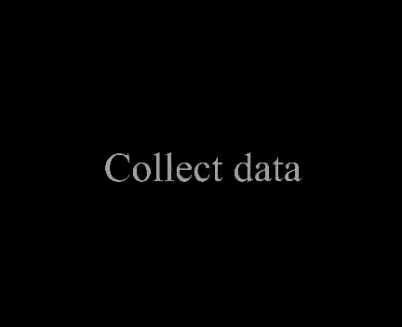
Demo
Assiut University
9/26

Slide 10
4. Contribution
Assiut University
10/26

Slide 11
Contribution
We enriched the code to support Ai Gym Coach:
This advancement enables the software to recognize and interpret hand gestures, effectively bridging communication gaps for individuals who rely on American Sign Language as their primary means of expression.
Voice Feedback upon Workout Completion
Implemented voice feedback functionality to provide real-time audio cues to the user upon completion of each workout session and upon finishing all scheduled workouts.
This feature enhances the user experience by providing auditory confirmation of progress and completion without the need to visually monitor the application interface constantly.
Assiut University
11/26

Slide 12
3. User-Defined Workout Repetitions
Enhanced user interaction by integrating a feature allowing users to specify the number of repetitions for each workout session.
This improvement empowers users to customize their workout routines according to their fitness goals and preferences, promoting flexibility and adaptability within the application.
4. We've upgraded the AI Coach to analyze users' physical movements:
Allowing it to deliver personalized feedback on workout execution. This enhancement empowers users to refine their form and technique, optimizing their fitness journey with tailored guidance and support.
Assiut University
12/26

Slide 13
5. The implementation of the draw_todo_list function provides users
with a clear visual representation of their workout schedule, including the type of exercise and the number of repetitions remaining.
This feature enhances user engagement by keeping them informed about their progress and upcoming activities throughout their workout session
Assiut University
13/26

Slide 14
5. Data
Assiut University
14/26

Slide 15
Data
All data is available here: https://drive.google.com/drive/folders/1pWfn826toqbvN4z61YLNzhapyvHHAZX8?usp=drive_link
Some data when training:
Figure 1. Alphabet “B”.
Figure 2. Alphabet “I LOVE YOU”.
Assiut University
15/26

Slide 16
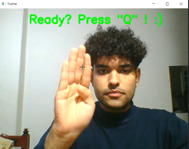
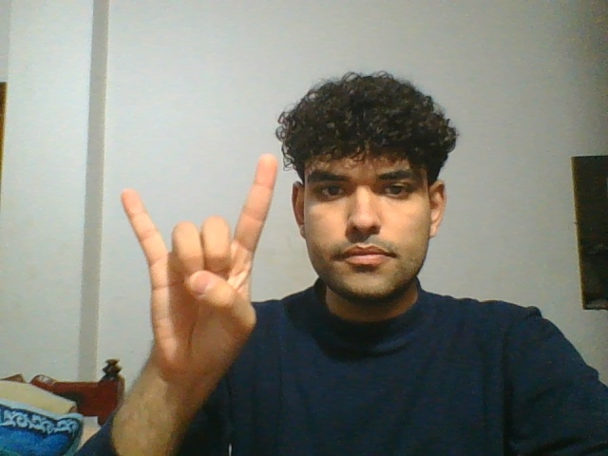
Figure 1. Alphabet “B”.
Figure 2. Alphabet “I LOVE YOU”.
Assiut University
16/26

Slide 17
6. Project architecture
Assiut University
17/26

Slide 18
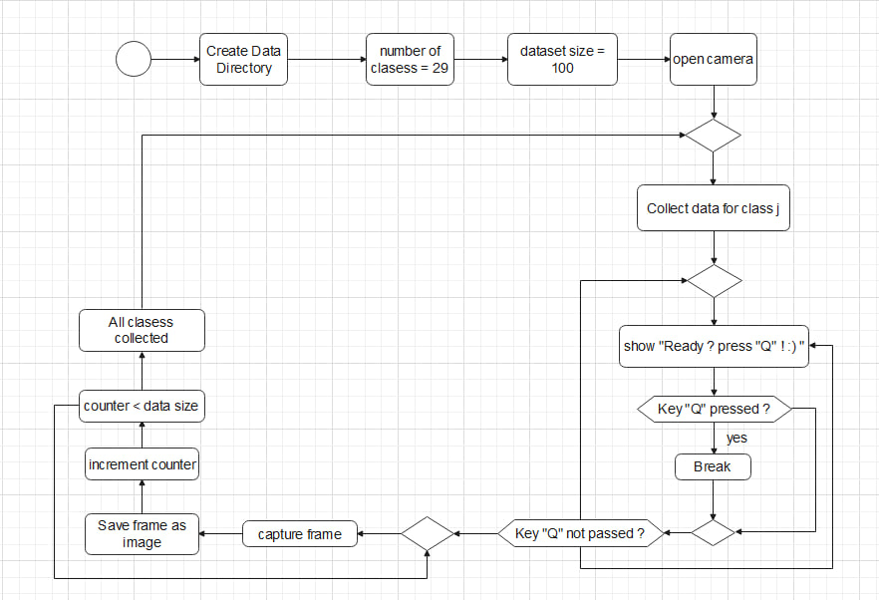
Project architecture
1. Collect Data in figure 3.
Figure 3. Flowchart to explain how model collect data
Assiut University
18/26

Slide 19
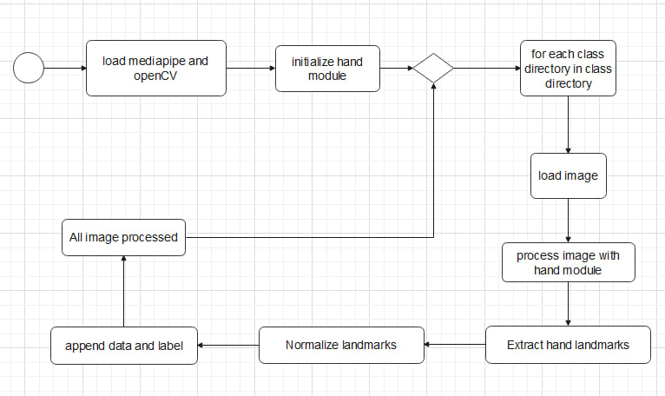
2. Hand initialization in Figure 4.
Figure 4. Flowchart to explain how model make Hand initialization
Assiut University
19/26

Slide 20
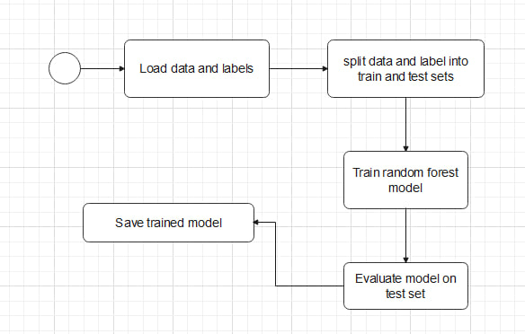
3. Training Model in Figure 5.
Figure 5. Flowchart to explain how model training model
Assiut University
20/26

Slide 21
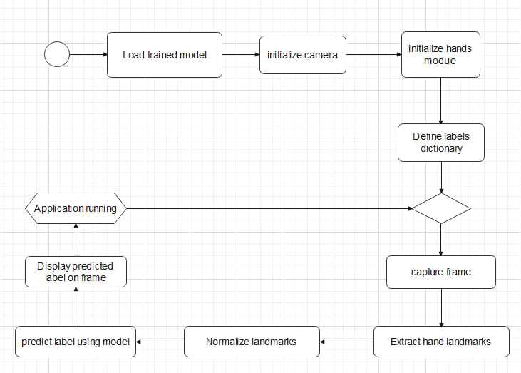
4. Real-time Gesture Recognition in Figure 6.
Figure 6. Flowchart to explain how model Real-time Gesture Recognition
Assiut University
21/26

Slide 22
7. Methods
Assiut University
22/26

Slide 23
Methods
Support Vector Classifier (SVC) :
This model is trained using the SVC() class from scikit-learn (sklearn.svm).
It's a supervised learning model used for classification tasks.
In the provided code, it's trained to classify hand gestures based on extracted hand landmarks.
Assiut University
23/26

Slide 24
Methods
2. MediaPipe Hands Model :
This model is utilized through the mp_hands.Hands() method from the MediaPipe library (mediapipe.solutions.hands).
It's a pre-trained model designed for detecting hand landmarks in images.
The detected landmarks are used as features for training the SVC model and for real-time hand gesture recognition.
Assiut University
24/26

Slide 25
8. Results
Assiut University
25/26

Slide 26
Results
Accuracy of the model which is made is 100%
Assiut University
26/26

Slide 27
Thank You

