Slide 1

Facebook Usage

Slide 2

Question
Is the mean daily time spent on Facebook effected by the number of times a day my phone screen is being unlocked?

Slide 3
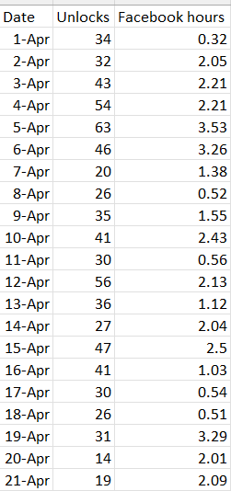
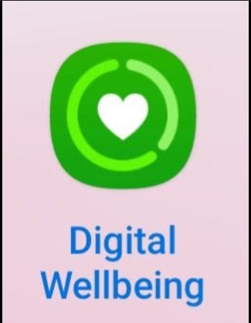
21 Observations
Screen Unlocks > 20 times/day?
Time Spent on Facebook?

Slide 4
HYPOTHESIS TESTING
Does the mean number of time spent on Facebook per daily differ as the daily number of phone screen unlocks exceeds 20 times per day?
Variables:
Dependent: Time spent on fb
Independent: Screen unlocks > 20 times Y/N

Slide 5
HYPOTHESIS TESTING
Null Hypothesis: The mean daily time spent on Facebook is the same regardless of the number of screen unlocks.
Alternative Hypothesis: The mean daily time spent on Facebook changes as the number of screen unlocks exceed 20 times/day
T-test

Slide 6
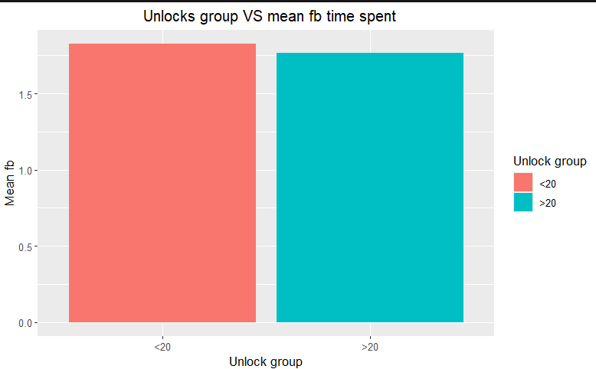
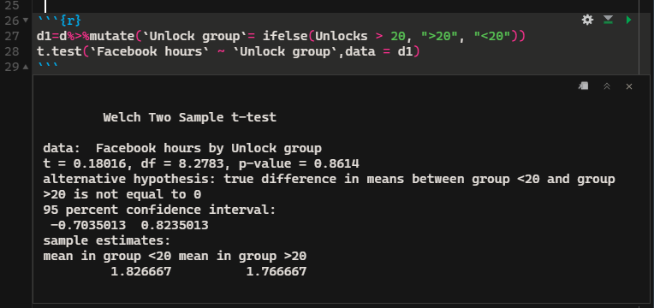
The p-value = .8614 which is less than the .05 significance level. Therefore, we fail to reject the null hypothesis.
We conclude that the mean daily time spent on Facebook is similar regardless of the daily number of screen unlocks.

