Slide 1


Direction Matters: On the Implicit Bias of Stochastic Gradient Descent with Moderate Learning Rate
Jingfeng Wu, Difan Zou, Vladimir Braverman, Quanquan Gu
Johns Hopkins University & UCLA
May 2021

Slide 2
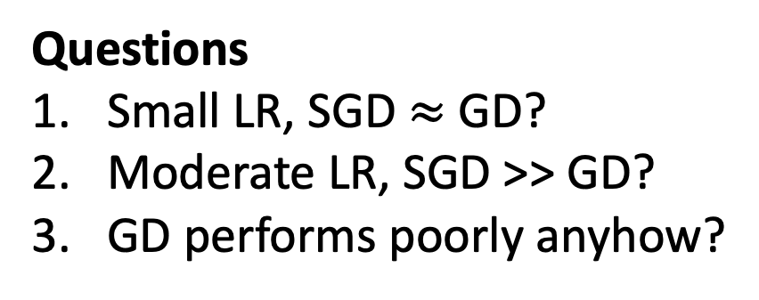
SGD vs. GD: Learning Rate Matters!
Loss
GD
SGD
Questions
Small LR, SGD $≈$ GD?
Moderate LR, SGD >> GD?
GD performs poorly anyhow?
A subset of FashionMNIST, a convolutional network

Slide 3



Small Learning Rate: SGD $≈$ GD
$$η=dt→0$$
GD
Gradient Flow (GF)
Higher order term!
Stochastic Modified Equation (SME)
$$η=dt→0$$
SGD
Unbiased Noise

Slide 4
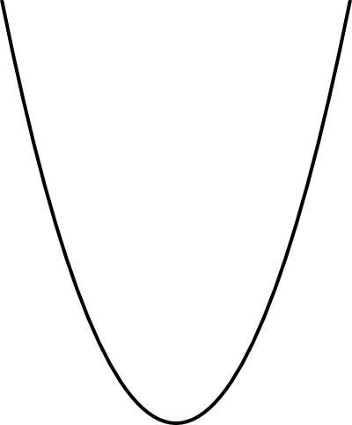
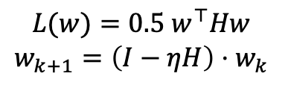
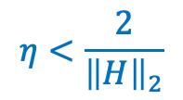
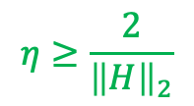
Effects of Moderate, Annealing Learning Rate
GD
SGD
$$η≥\frac{2}{{\left\|H\right\|}_{2}}$$
$$η<\frac{2}{{\left\|H\right\|}_{2}}$$
Always flat!
One of them can
be sharp
$$L(w)=0.5 w^{⊤}Hw$$
$$w_{k+1}=\left(I−ηH\right)⋅w_{k}$$
SGD + moderate and annealing LR
Phase 1: moderate LR => fits flat losses first
Phase 2: small LR => fits sharp losses then

Slide 5
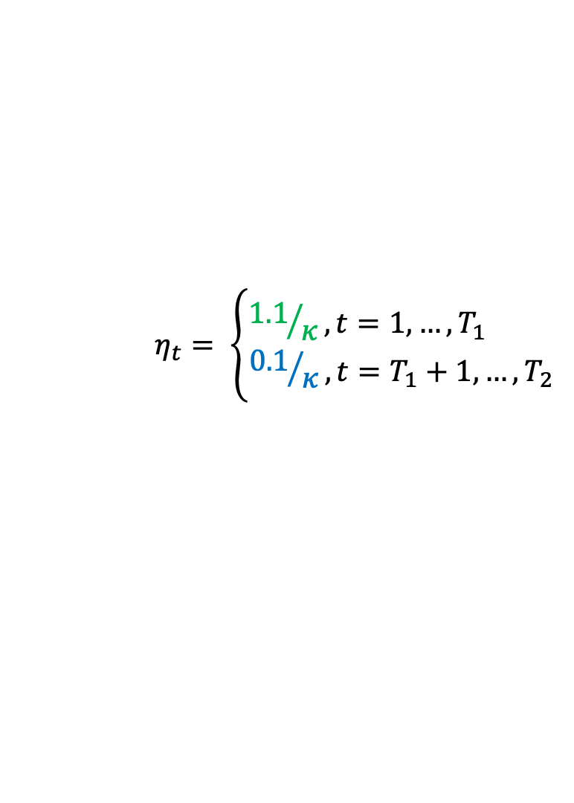
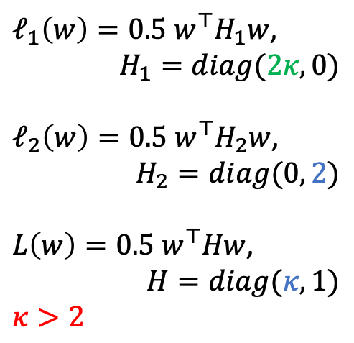
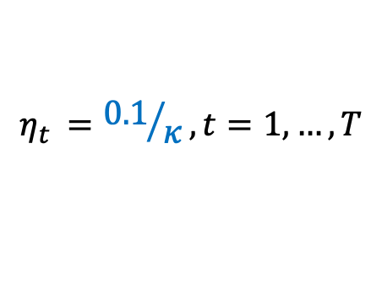
A 2-D Example: Convergence Directions
$ℓ_{1}\left(w\right)=0.5 w^{⊤}H_{1}w$,
$$H_{1}=diag(2κ, 0)$$
$ℓ_{2}\left(w\right)=0.5 w^{⊤}H_{2}w$,
$$H_{2}=diag(0, 2)$$
$L\left(w\right)=0.5 w^{⊤}Hw$,
$$H=diag(κ,1)$$
$$κ>2$$
Small LR
$$η_{t }={0.1}/κ, t=1,…, T$$
Moderate LR
$$η_{t}= \left\{\begin{aligned}{1.1}/κ, t=1,…, T_{1} \\ {0.1}/κ, t=T_{1}+1,…, T_{2}\end{aligned}\right.$$
Same limits
Different convergence directions

Slide 6
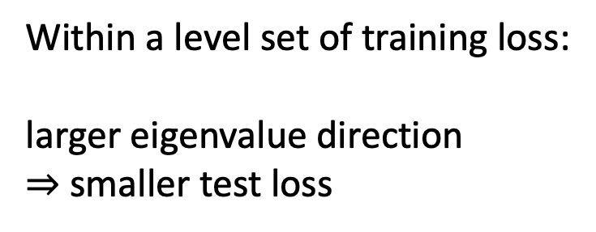
A 2-D Example: Effects on Generalization
Training Loss
Within a level set of training loss:
larger eigenvalue direction
$⇒$ smaller test loss
Test Loss

Slide 7
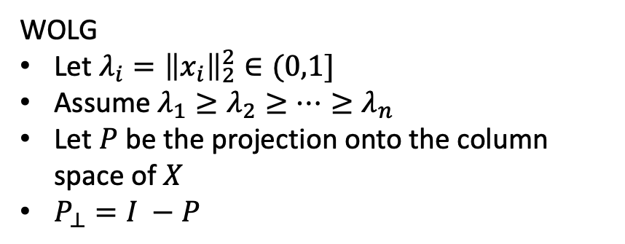
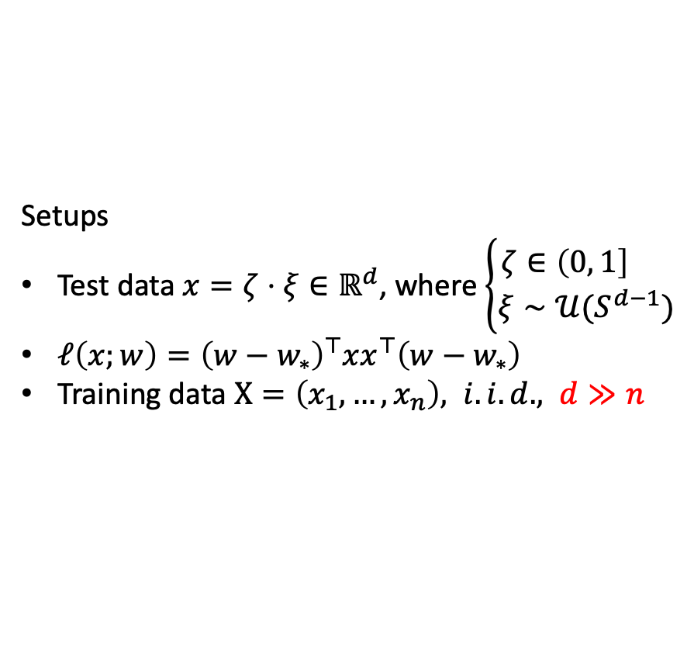
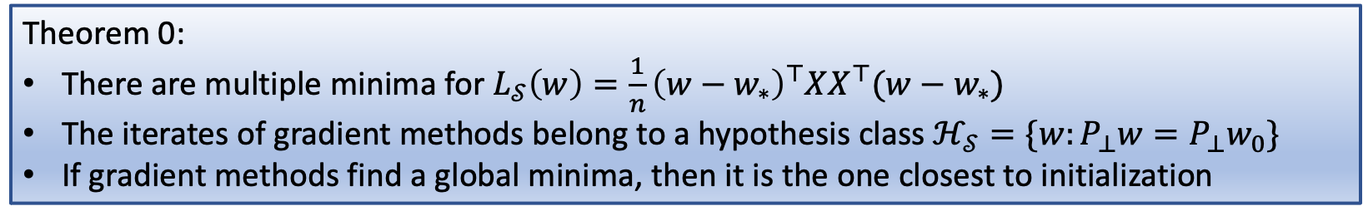
A High Dimensional Linear Regression
Setups
Test data $x=ζ⋅ξ∈ℝ^{d}$, where $\left\{\begin{aligned}ζ∈\left(0, 1\right] \\ ξ∼𝒰(S^{d−1})\end{aligned}\right.$
$ℓ\left(x;w\right)={\left(w−w_{∗}\right)}^{⊤}{xx}^{⊤}\left(w−w_{∗}\right)$
Training data $X=\left(x_{1},…, x_{n}\right), i.i.d., d≫n$
WOLG
Let $λ_{i}={\left\|x_{i}\right\|}_{2}^{2}∈(0,1]$
Assume $λ_{1}≥λ_{2}≥⋯≥λ_{n}$
Let $P$ be the projection onto the column space of $X$
$P_{⊥}=I −P$
Theorem 0:
There are multiple minima for $L_{𝒮}\left(w\right)=\frac{1}{n}{\left(w−w_{∗}\right)}^{⊤}XX^{⊤}(w−w_{∗})$
The iterates of gradient methods belong to a hypothesis class $ℋ_{𝒮}=\{w:P_{⊥}w=P_{⊥}w_{0}\}$
If gradient methods find a global minima, then it is the one closest to initialization
Remark: this is also known as “minimal-norm solution” since the initialization is usually zero

Slide 8
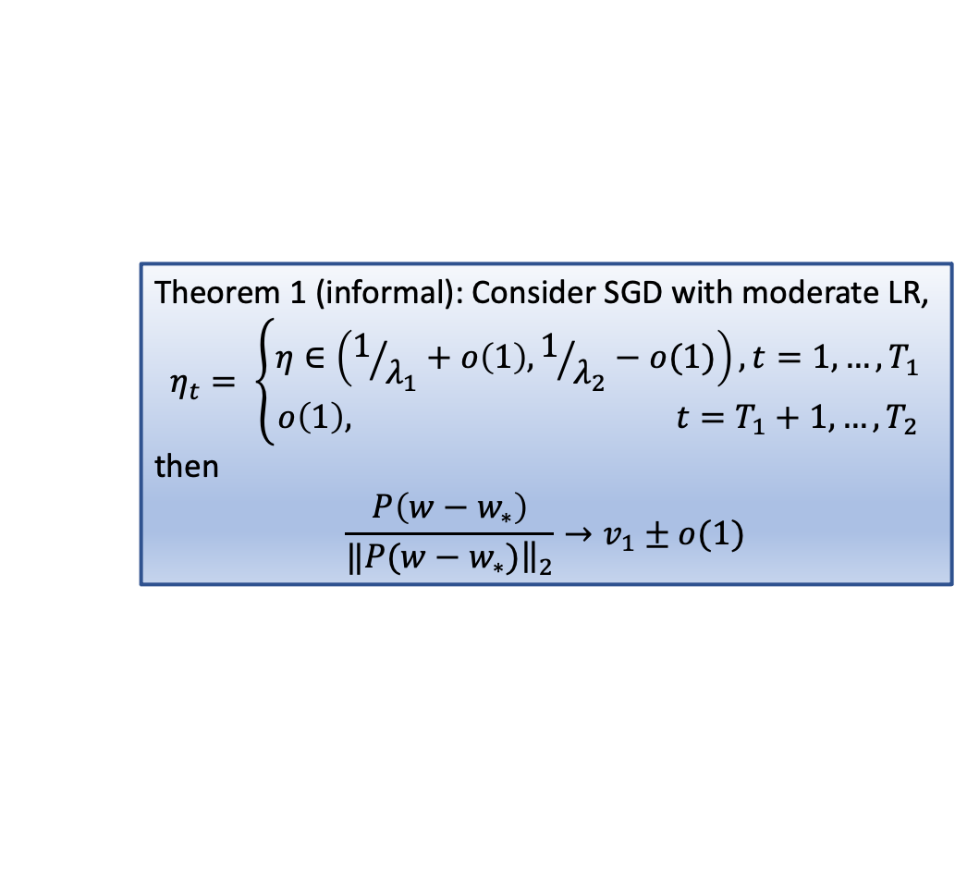

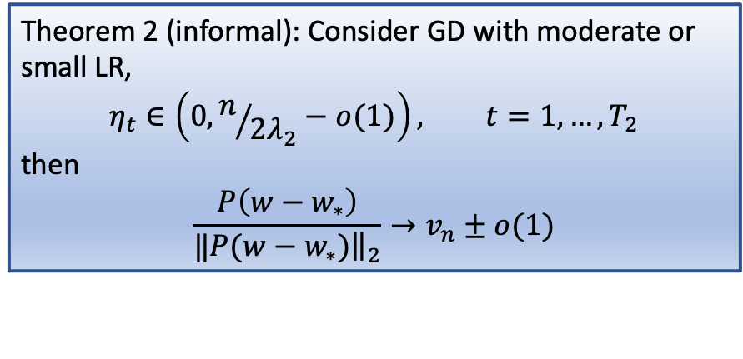
Theory: Convergence Directions
Theorem 1 (informal): Consider SGD with moderate LR,
$$η_{t}= \left\{\begin{aligned}η∈\left(1/{λ_{1}}+o\left(1\right), 1/{λ_{2}}−o(1)\right), t=1,…, T_{1} \\ o\left(1\right), t=T_{1}+1,…, T_{2}\end{aligned}\right.$$
then
$$\frac{P\left(w−w_{∗}\right)}{‖{\left.​P(w−w_{∗})\right\|}_{2}}→v_{1}±o(1)$$
Theorem 2 (informal): Consider GD with moderate or small LR,
$$η_{t}∈\left(0, n/{2λ_{2}}−o(1)\right), t=1,…, T_{2}$$
then
$$\frac{P\left(w−w_{∗}\right)}{‖{\left.​P(w−w_{∗})\right\|}_{2}}→v_{n}±o(1)$$
Rayleigh quotient: $R\left(XX^{⊤},u\right)=\frac{u^{⊤}XX^{⊤}u}{u^{⊤}u}$
Remark: $v_{1}$ ($v_{n}$) is the largest (smallest) eigen vector of $XX^{⊤}$

Slide 9
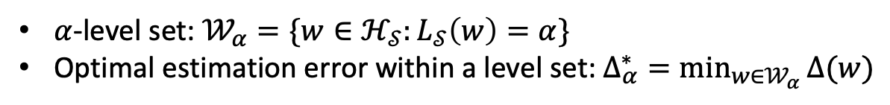
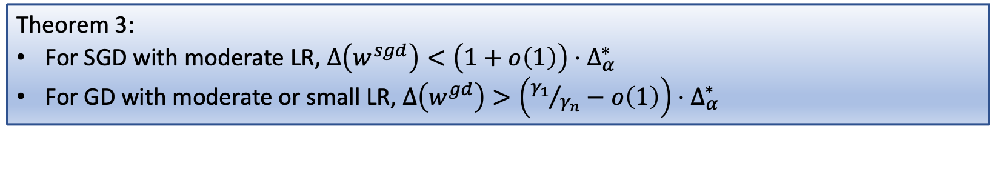
Continued Theory: Generalization Separation
determined by the algorithms and hyperparameters
intrinsic error, not improvable
$α$-level set: $𝒲_{α}=\{w∈ℋ_{𝒮}:L_{𝒮}\left(w\right)=α\}$
Optimal estimation error within a level set: $Δ_{α}^{∗}=\min_{w∈𝒲_{α}}{Δ(w)}$
Theorem 3:
For SGD with moderate LR, $Δ\left(w^{sgd}\right)<\left(1+o\left(1\right)\right)⋅Δ_{α}^{∗}$
For GD with moderate or small LR, $Δ\left(w^{gd}\right)>\left({γ_{1}}/{γ_{n}}−o\left(1\right)\right)⋅Δ_{α}^{∗}$
Remark: $γ_{1}$ ($γ_{n}$) is the largest (smallest) eigenvalue of $XX^{⊤}$

Slide 10
Take Home
SGD + moderate LR: converge along large eigenvalue directions
GD + moderate or small LR: converge along small eigenvalue directions
The former directional bias benefits generalization
Get the paper ->

