Slide 1


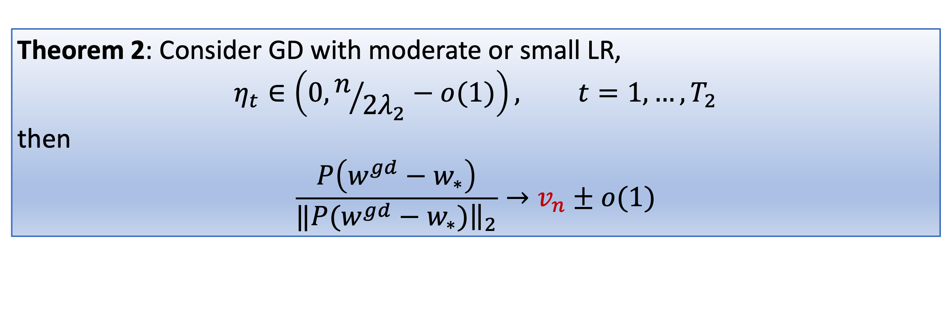
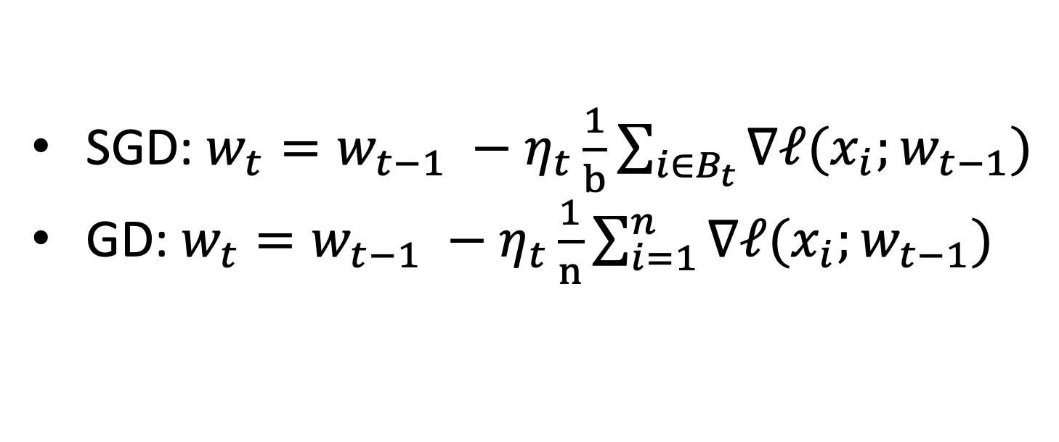
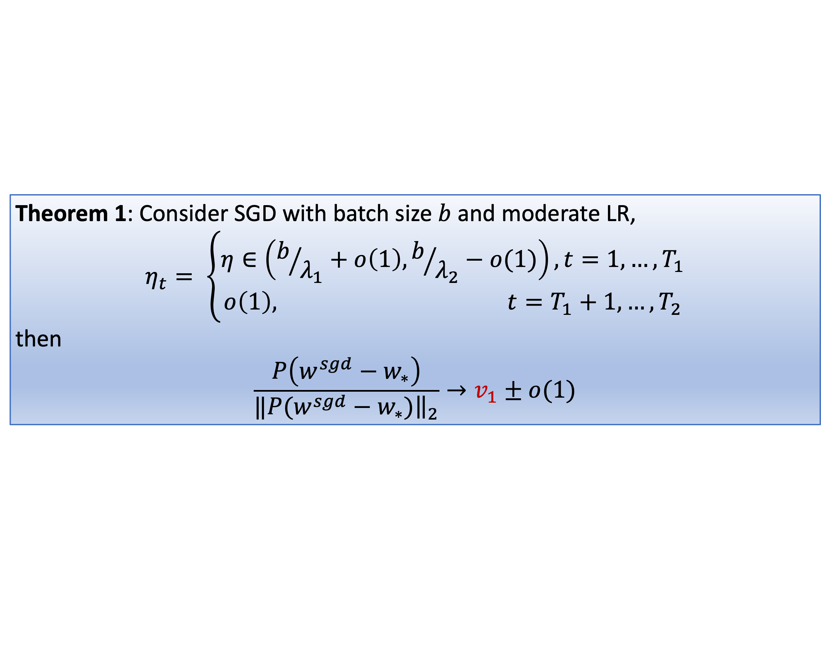

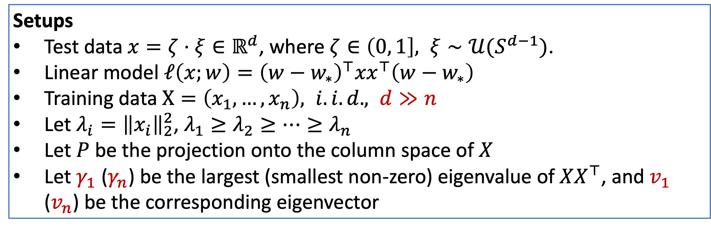
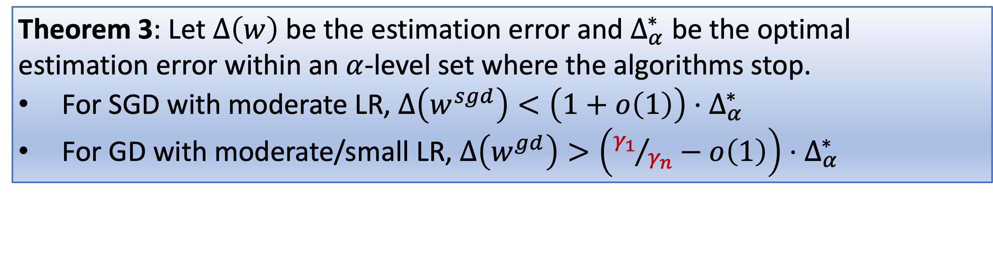
Direction Matters: On the Implicit Bias of
Stochastic Gradient Descent with Moderate Learning Rate
Jingfeng Wu, Difan Zou, Vladimir Braverman, Quanquan Gu
Johns Hopkins University & UCLA
1. Background
2. Theory
3. Verifications
SGD: $w_{t}=w_{t−1} −η_{t}\frac{1}{b}\sum_{i∈B_{t}}{∇ℓ(x_{i};w_{t−1})}$
GD: $w_{t}=w_{t−1} −η_{t}\frac{1}{n}\sum_{i=1}^{n}{∇ℓ(x_{i};w_{t−1})}$
Setups
Test data $x=ζ⋅ξ∈ℝ^{d}$, where $ζ∈\left(0, 1\right], ξ∼𝒰(S^{d−1})$.
Linear model $ℓ\left(x;w\right)={\left(w−w_{∗}\right)}^{⊤}{xx}^{⊤}\left(w−w_{∗}\right)$
Training data $X=\left(x_{1},…, x_{n}\right), i.i.d., d≫n$
Let $λ_{i}={\left\|x_{i}\right\|}_{2}^{2}$, $λ_{1}≥λ_{2}≥⋯≥λ_{n}$
Let $P$ be the projection onto the column space of $X$
Let $γ_{1}$ ($γ_{n}$) be the largest (smallest non-zero) eigenvalue of $XX^{⊤}$, and $v_{1}$ ($v_{n}$) be the corresponding eigenvector
2D numerical simulation
CNN on a subset of FashionMNIST
Theorem 1: Consider SGD with batch size $b$ and moderate LR,
$$η_{t}= \left\{\begin{aligned}η∈\left(b/{λ_{1}}+o\left(1\right), b/{λ_{2}}−o(1)\right), t=1,…, T_{1} \\ o\left(1\right), t=T_{1}+1,…, T_{2}\end{aligned}\right.$$
then
$$\frac{P\left(w^{sgd}−w_{∗}\right)}{‖{\left.​P(w^{sgd}−w_{∗})\right\|}_{2}}→v_{1}±o(1)$$
CNN on a subset of FashionMNIST
 | Small LR | Moderate LR
GD | ☹ | ☹
SGD | ☹ | ☺
Theorem 2: Consider GD with moderate or small LR,
$$η_{t}∈\left(0, n/{2λ_{2}}−o(1)\right), t=1,…, T_{2}$$
then
$$\frac{P\left(w^{gd}−w_{∗}\right)}{‖{\left.​P(w^{gd}−w_{∗})\right\|}_{2}}→v_{n}±o(1)$$
4. Conclusions
SGD + moderate LR: converges along large eigenvalue directions
GD + moderate/small LR: converge along small eigenvalue directions
The former directional bias benefits generalization
Questions
Small LR, SGD $≈$ GD?
Moderate LR, SGD >> GD?
GD performs poorly anyhow?
Theorem 3: Let $Δ\left(w\right)$ be the estimation error and $Δ_{α}^{∗}$ be the optimal estimation error within an $α$-level set where the algorithms stop.
For SGD with moderate LR, $Δ\left(w^{sgd}\right)<\left(1+o\left(1\right)\right)⋅Δ_{α}^{∗}$
For GD with moderate/small LR, $Δ\left(w^{gd}\right)>\left({γ_{1}}/{γ_{n}}−o\left(1\right)\right)⋅Δ_{α}^{∗}$

