Slide 1


Direction Matters: On the Implicit Regularization Effect of Stochastic Gradient Descent with Moderate Learning Rate
Jingfeng Wu, Difan Zou, Vladimir Braverman, Quanquan Gu
Johns Hopkins University & UCLA
November 2020

Slide 2
Overview
Background
SGD vs. GD: Different Convergence Directions
Small Learning Rate
Moderate Learning Rate
Direction Matters: SGD + Moderate LR is Good
Proof Sketches

Slide 3
Implicit Regularization: SGD >> GD
Loss
GD
SGD
CIFAR-10, ResNet-18, w/o weight decay,
w/o data augmentation
Wu, Jingfeng, et al. "On the Noisy Gradient Descent that Generalizes as SGD." ICML 2020.

Slide 4
Two More Figures about SGD (Less Relevant)
Wilson, Ashia C., et al. "The marginal value of adaptive gradient methods in machine learning." NIPS 2017.
Zhu, Zhanxing, et al. "The Anisotropic Noise in Stochastic Gradient Descent: Its Behavior of Escaping from Sharp Minima and Regularization Effects." ICML 2019.

Slide 5
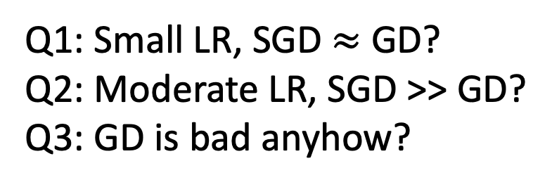
SGD vs. GD: Learning Rate Matters!
 | Small LR | Moderate LR
GD | ☹ | ☹
SGD | ☹ | ☺
Q1: Small LR, SGD $≈$ GD?
Q2: Moderate LR, SGD >> GD?
Q3: GD is bad anyhow?

Slide 6
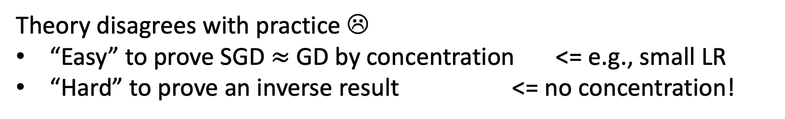

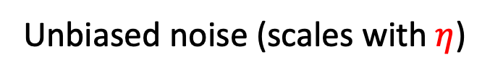
In Theory, SGD $≈$ GD or SGD $≠$ GD ??
GD
SGD
Unbiased noise (scales with $η$)
Theory disagrees with practice ☹
“Easy” to prove SGD $≈$ GD by concentration <= e.g., small LR
“Hard” to prove an inverse result <= no concentration!

Slide 7



Small Learning Rate: SGD $≈$ GD
$$η=dt→0$$
GD
Gradient Flow (GF)
Stochastic Modified Equation (SME)
$$η=dt→0$$
Higher order term
SGD

Slide 8
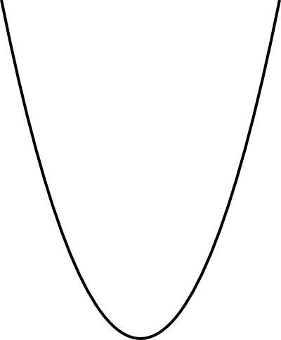
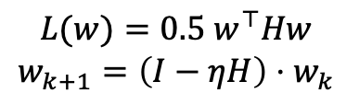
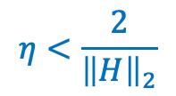
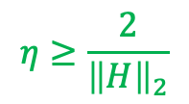
Effects of Non-Small Learning Rate
GD
SGD
$$η≥\frac{2}{{\left\|H\right\|}_{2}}$$
$$η<\frac{2}{{\left\|H\right\|}_{2}}$$
Always smooth!
One of them can
be non-smooth
$$L(w)=0.5 w^{⊤}Hw$$
$$w_{k+1}=\left(I−ηH\right)⋅w_{k}$$
SGD + moderate and annealing LR
Phase 1: moderate LR => fits smooth losses
Phase 2: small LR => fits non-smooth losses

Slide 9
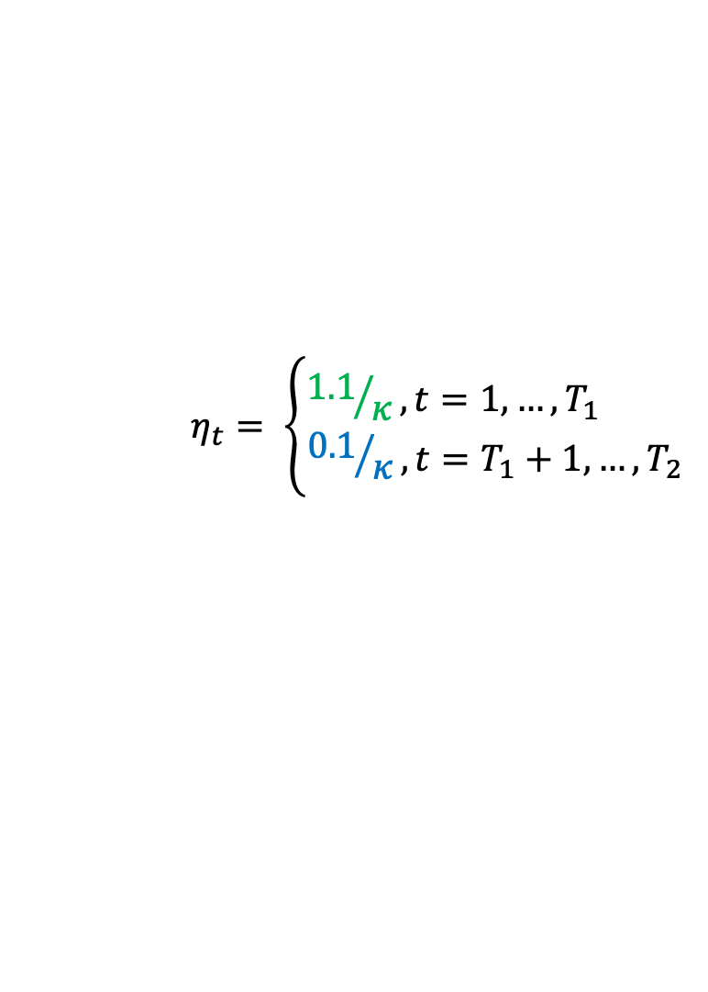
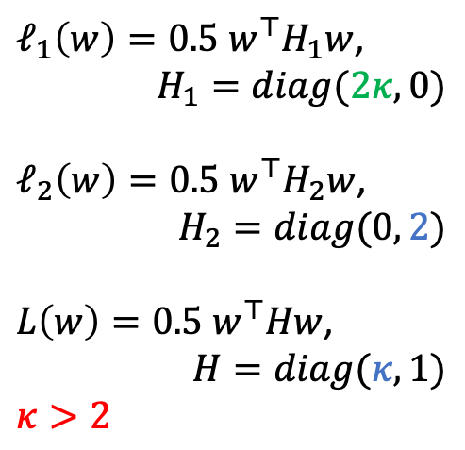
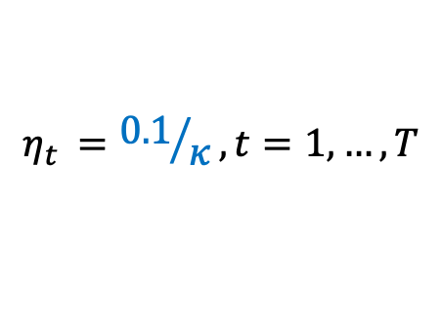
A 2-D Example
$ℓ_{1}\left(w\right)=0.5 w^{⊤}H_{1}w$,
$$H_{1}=diag(2κ, 0)$$
$ℓ_{2}\left(w\right)=0.5 w^{⊤}H_{2}w$,
$$H_{2}=diag(0, 2)$$
$L\left(w\right)=0.5 w^{⊤}Hw$,
$$H=diag(κ,1)$$
$$κ>2$$
Small LR
$$η_{t }={0.1}/κ, t=1,…, T$$
Moderate LR
$$η_{t}= \left\{\begin{aligned}{1.1}/κ, t=1,…, T_{1} \\ {0.1}/κ, t=T_{1}+1,…, T_{2}\end{aligned}\right.$$
Same limits
Different convergence directions

Slide 10
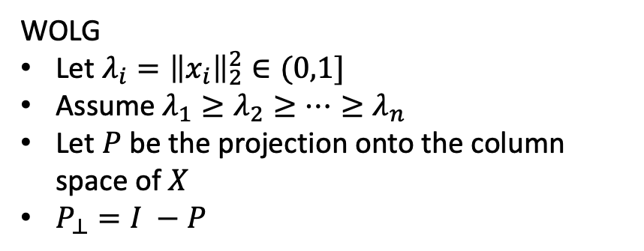
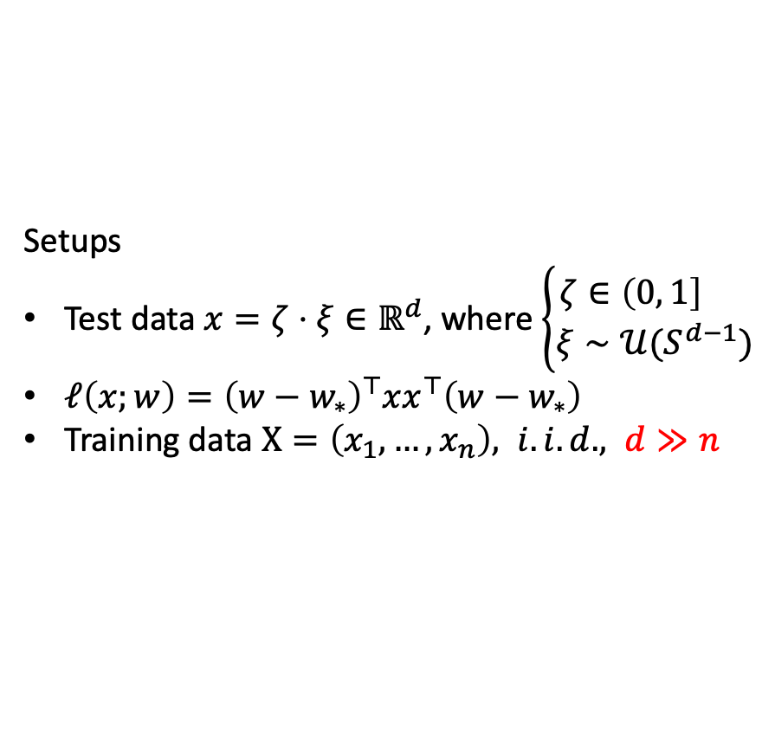
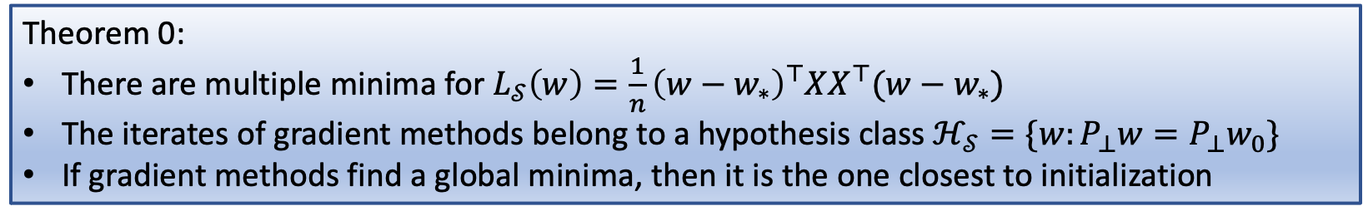
A High Dimensional Linear Regression
Setups
Test data $x=ζ⋅ξ∈ℝ^{d}$, where $\left\{\begin{aligned}ζ∈\left(0, 1\right] \\ ξ∼𝒰(S^{d−1})\end{aligned}\right.$
$ℓ\left(x;w\right)={\left(w−w_{∗}\right)}^{⊤}{xx}^{⊤}\left(w−w_{∗}\right)$
Training data $X=\left(x_{1},…, x_{n}\right), i.i.d., d≫n$
WOLG
Let $λ_{i}={\left\|x_{i}\right\|}_{2}^{2}∈(0,1]$
Assume $λ_{1}≥λ_{2}≥⋯≥λ_{n}$
Let $P$ be the projection onto the column space of $X$
$P_{⊥}=I −P$
Theorem 0:
There are multiple minima for $L_{𝒮}\left(w\right)=\frac{1}{n}{\left(w−w_{∗}\right)}^{⊤}XX^{⊤}(w−w_{∗})$
The iterates of gradient methods belong to a hypothesis class $ℋ_{𝒮}=\{w:P_{⊥}w=P_{⊥}w_{0}\}$
If gradient methods find a global minima, then it is the one closest to initialization
Remark: this is also known as “minimal-norm solution” since the initialization is usually zero

Slide 11
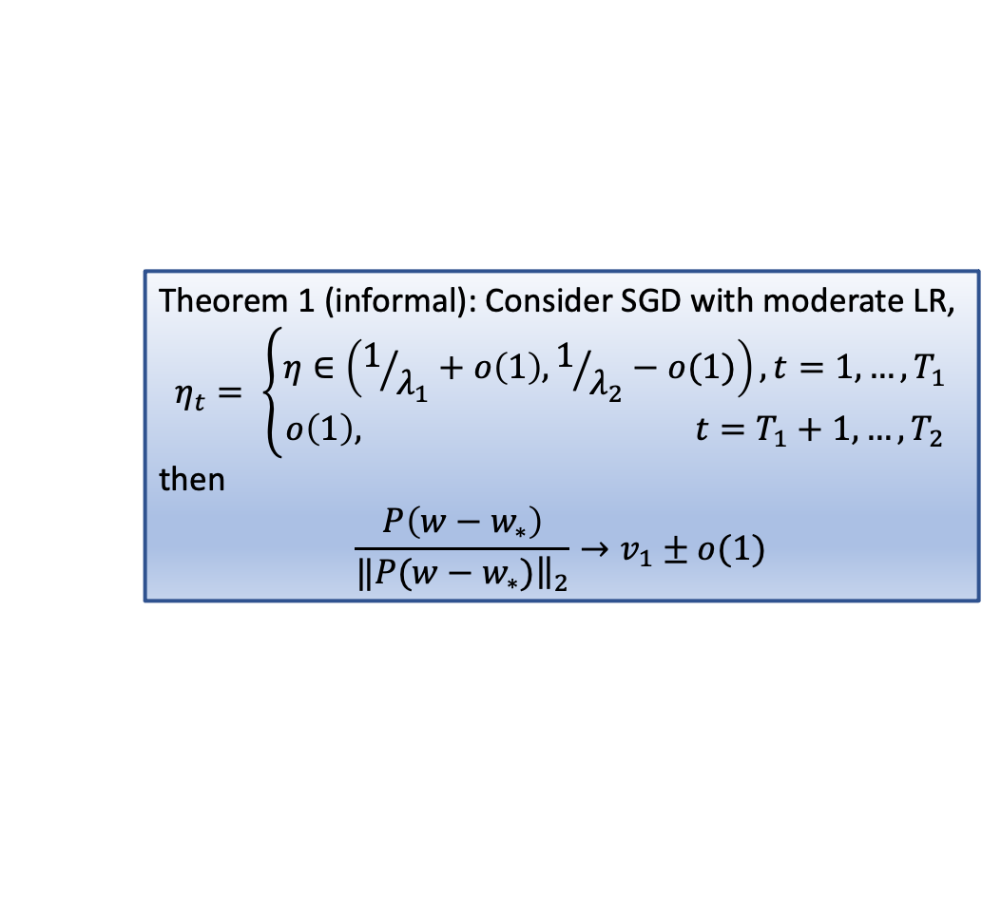

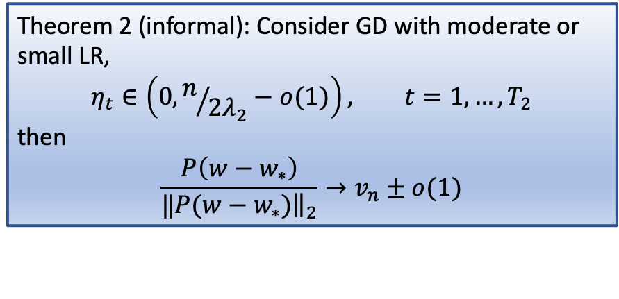
A High Dimensional Linear Regression
Theorem 1 (informal): Consider SGD with moderate LR,
$$η_{t}= \left\{\begin{aligned}η∈\left(1/{λ_{1}}+o\left(1\right), 1/{λ_{2}}−o(1)\right), t=1,…, T_{1} \\ o\left(1\right), t=T_{1}+1,…, T_{2}\end{aligned}\right.$$
then
$$\frac{P\left(w−w_{∗}\right)}{‖{\left.​P(w−w_{∗})\right\|}_{2}}→v_{1}±o(1)$$
Theorem 2 (informal): Consider GD with moderate or small LR,
$$η_{t}∈\left(0, n/{2λ_{2}}−o(1)\right), t=1,…, T_{2}$$
then
$$\frac{P\left(w−w_{∗}\right)}{‖{\left.​P(w−w_{∗})\right\|}_{2}}→v_{n}±o(1)$$
Rayleigh quotient: $R\left(XX^{⊤},u\right)=\frac{u^{⊤}XX^{⊤}u}{u^{⊤}u}$
Remark: $v_{1}$ ($v_{n}$) is the largest (smallest) eigen vector of $XX^{⊤}$

Slide 12
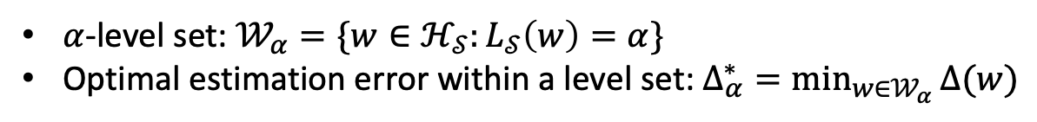
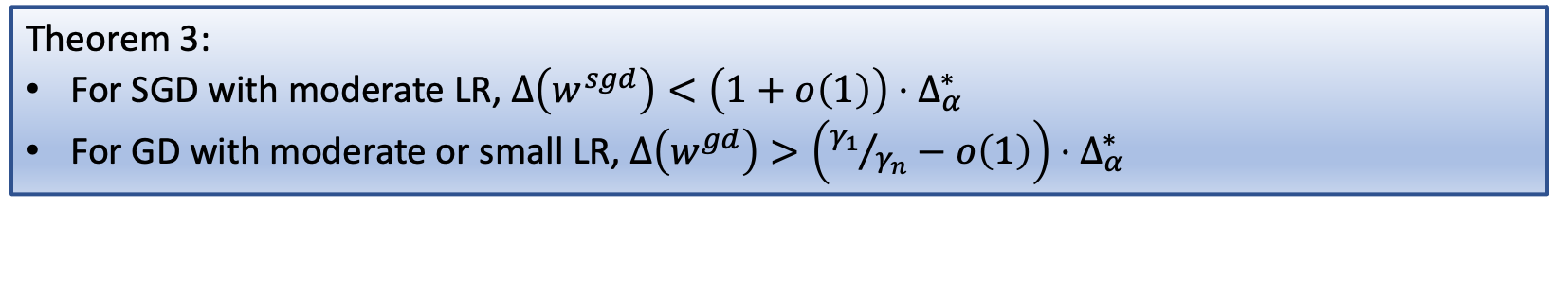
Convergence Direction Matters
determined by the algorithms and hyperparameters
intrinsic error, not improvable
$α$-level set: $𝒲_{α}=\{w∈ℋ_{𝒮}:L_{𝒮}\left(w\right)=α\}$
Optimal estimation error within a level set: $Δ_{α}^{∗}=\min_{w∈𝒲_{α}}{Δ(w)}$
Theorem 3:
For SGD with moderate LR, $Δ\left(w^{sgd}\right)<\left(1+o\left(1\right)\right)⋅Δ_{α}^{∗}$
For GD with moderate or small LR, $Δ\left(w^{gd}\right)>\left({γ_{1}}/{γ_{n}}−o\left(1\right)\right)⋅Δ_{α}^{∗}$
Remark: $γ_{1}$ ($γ_{n}$) is the largest (smallest) eigenvalue of $XX^{⊤}$

Slide 13
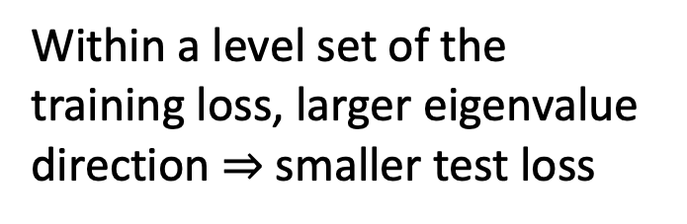
Proof Sketch of Theorem 3
Within a level set of the training loss, larger eigenvalue direction $⇒$ smaller test loss
Training Loss
Test Loss

Slide 14
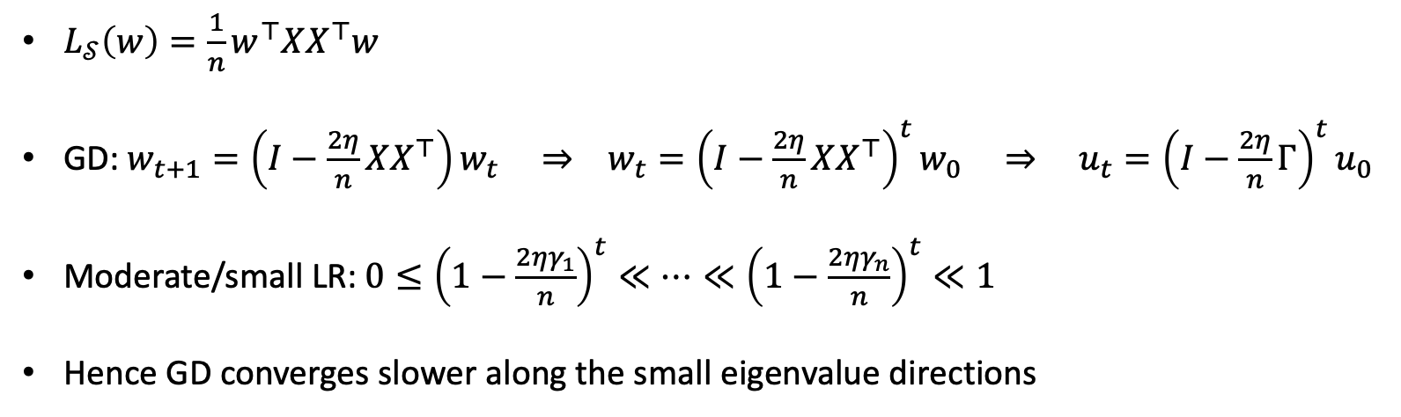
Proof Sketch of Theorem 2
$L_{𝒮}\left(w\right)=\frac{1}{n}w^{⊤}XX^{⊤}w$
GD: $w_{t+1}=\left(I−\frac{2η}{n}XX^{⊤}\right)w_{t} ⇒ w_{t}={\left(I−\frac{2η}{n}XX^{⊤}\right)}^{t}w_{0} ⇒ u_{t}={\left(I−\frac{2η}{n}Γ\right)}^{t}u_{0}$
Moderate/small LR: $0≤{\left(1−\frac{2ηγ_{1}}{n}\right)}^{t}≪⋯≪{\left(1−\frac{2ηγ_{n}}{n}\right)}^{t}≪1$
Hence GD converges slower along the small eigenvalue directions

Slide 15
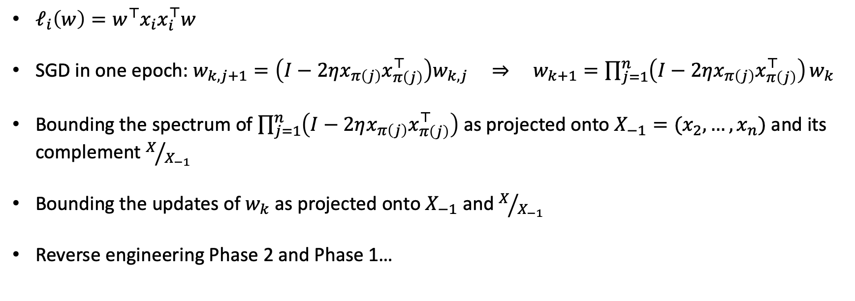
Proof Sketch of Theorem 1
$ℓ_{i}\left(w\right)=w^{⊤}x_{i}x_{i}^{⊤}w$
SGD in one epoch: $w_{k, j+1}=\left(I−2ηx_{π\left(j\right)}x_{π\left(j\right)}^{⊤}\right)w_{k,j} ⇒ w_{k+1}=\prod_{j=1}^{n}{\left(I−2ηx_{π\left(j\right)}x_{π\left(j\right)}^{⊤}\right)}w_{k}$
Bounding the spectrum of $\prod_{j=1}^{n}{\left(I−2ηx_{π\left(j\right)}x_{π\left(j\right)}^{⊤}\right)}$ as projected onto $X_{−1}=(x_{2},…, x_{n})$ and its complement $X/{X_{−1}}$
Bounding the updates of $w_{k}$ as projected onto $X_{−1}$ and $X/{X_{−1}}$
Reverse engineering Phase 2 and Phase 1…
Remark: with moderate LR, concentration of matrix products turns out to be vacuous
Henriksen, Amelia, and Rachel Ward. "Concentration inequalities for random matrix products." Linear Algebra and its Applications 594 (2020): 81-94.

Slide 16
Take Home
SGD + moderate LR: converges along large eigenvalue directions
GD or SGD + small LR: converge along small eigenvalue directions
The former directional bias benefits generalization
The analysis is “anti-concentration”
Get the paper ->

