Slide 1




A 21st Century Census
Curated Data Enterprise:
Pilot Demonstration on Food Insecurity
Presentation to UVA Census CDE Team
March 28, 2023
Team: Vicki Lancaster, Cesar Montalvo, Ed Wu,
Joseph Salvo, Stephanie Shipp

Slide 2
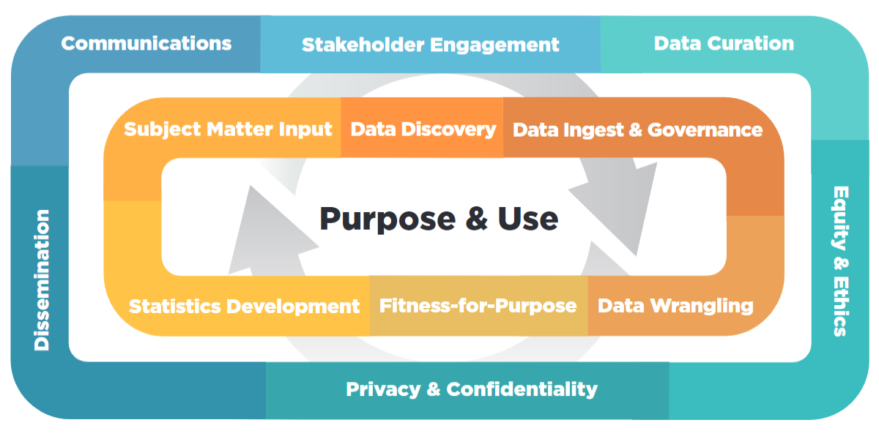
Curated Data Enterprise Framework
Goal: Illuminate the needed capabilities of the CDE to create a research agenda

Slide 3
Baseline Question
The USDA Current Population Survey Food Security Supplement (CPS-FSS) food insecurity measure is designed to monitor food insecurity over time at national and state levels.
If a food insecurity measure is to inform action and target interventions, it must be constructed for
smaller geographic levels.
Can we construct a measure of food insecurity at the household level that can be aggregated up to the census tract?
Notes:
resource-constrained food insecurity
Motivated by a request the Fairfax government one of our partners working on the Social Impact Data Commons – where are food insecure households located.

Slide 4

Curated Data Enterprise Framework
Question
Can we construct a food insecurity measure at the census tract level?
Literature Review
What are the determinants of food insecurity?
Data Discovery
Inventory
Screening
Acquisition
Ingestion
Governance
Wrangling
Metric
Ideas
Notes:
Based on our literature review... Literature leads us to discipline experts
So far, we have spoken to the Jake Erlich, data scientist, at the Capital Area Food Bank (Hunger 2022 report where they work with NORC on a survey of the Capital Area Region).
and have scheduled a meeting with Alisha Coleman-Jensen at USDA (the rock-star of food insecurity).

Slide 5
Literature Review: Determinants of Food Insecurity
“Food insecurity is a multidimensional concept, experienced differently by different household types and population groups. While an overall measure of food insecurity, valid for the whole U.S. population, would be desirable, it is likely that such a measure would underestimate hunger and food insecurity for certain subgroups, especially for children and elderly adults. . . Food insecurity is a complex issue that may not be fully captured by a one-dimensional item response model, especially as it will be used to track food insecurity over time, across different surveys, and for different subpopulations.”
(Opsomer et al., 2002, p 35)
Opsomer JD, Jensen HH, Nusser SM, Drignei D, & Amemiya Y. (2002). Statistical considerations for the USDA food insecurity index. https://dr.lib.iastate.edu/server/api/core/bitstreams/6e0682b1-9124-4c88-892a-31410fdeb6a1/content
Notes:
Focused on resource constrained food insecurity at the household level.
In 1995, the Household Food Security Survey Module (HFSSM) was added to the Current Population Survey to elicited information on whether the household
experienced difficulty in meeting basic food needs due to lack of resources. These food security questions are asked only of household with incomes below 185% of the federal poverty line and above 185% if the household gives any indication of food access problems on either of the two screener questions.
In 1997 to 2003, USDA entered into a cooperative agreement with statisticians and economist at Iowa State University (Opsomer et al., 2002) to conduct research to:
to evaluate the robustness of the approach used for the measurement of food insecurity and
to measure the effect of household-level variables on measured food insecurity.

Slide 6
Literature Review: Determinants of Food Insecurity
The empirical literature on the determinants of food insecurity can be grouped into two broad categories:
the first is the demographic and socioeconomic characteristics of the food insecure (households (HHs) with children; single-parent HHs; large HHs; low income HHs; low levels of education; uneducated).
the second consists of expenditures on basic needs that compete with the amount of money available for food (housing, utilities, transportation, taxes, health insurance, medical bills, transportation).
There is strong evidence that expenditures for basic needs should be adjusted for geographic cost-of-living (COL).

Slide 7
Literature Review: Determinants of Food Insecurity
D.C. has a 2021 regional price parity (RPP) value of 111.3, an indication that prices in the District are 11.3% higher than the U.S. on average. In contrast, Mississippi has a 2021 RPP value of 86.6, prices in the Mississippi are 13.4% lower than the U.S. on average.
Bureau of Economic Analysis (2021) Regional Price Parities:
https://www.bea.gov/news/2022/real-personal-consumption-expenditures-state-and-real-personal-income-state-and
Todd et al. (2011) reported that most analyses of food prices report annual inflation over time at the national level, ignoring the fact that food price variation between geographic market groups within the U.S. is greater than annual inflation. They used the 2006 Quarterly Food-at-Home Price Database to show the difference for eggs between the highest and lowest geographic market groups was 80 percent, the difference for low-fat milk was 77 percent, and for fresh/frozen fruit 80 percent.
Todd JE, E Leibtag, and C Penberthy. (June 2011).
Geographic Differences in the Relative Price of Healthy Foods, EIB-78, U.S. Department of Agriculture, Economic Research Service
https://www.ers.usda.gov/webdocs/publications/44558/7476_eib78.pdf?v=0
“Evidence of cost-of-living differences among geographic areas—such as between metropolitan and nonmetropolitan areas—suggests that the poverty thresholds should be adjusted accordingly, but inadequate data make it difficult to determine appropriate adjustments.”
National Research Council. (1995).
Measuring Poverty: A New Approach.
Washington, DC: The National Academies Press. https://doi.org/10.17226/4759

Slide 8
Food Insecurity Metric
Estimate the COL for every household size and composition in every census tract in the U.S.
Estimate the income for every household size and composition in every census tract in the U.S.
Food Insecure
At Risk
Food Secure

Slide 9
Cost-of-Living Definition & Assumptions
Definition: COL estimates are based on the amount of income necessary to pay federal and state income taxes and meet a household’s basic essential needs. The basic needs include housing, food, transportation, health insurance, childcare, broadband, and other necessities such as clothing and a phone. The COL is a function of family size and composition and where the family resides. Assumptions: The full cost of each need, without government subsidies (e.g., public housing, Medicaid, or childcare assistance); or nonprofit or informal assistance from family and friends (e.g., unpaid childcare by a relative, food from food banks, or shared housing).

Slide 10
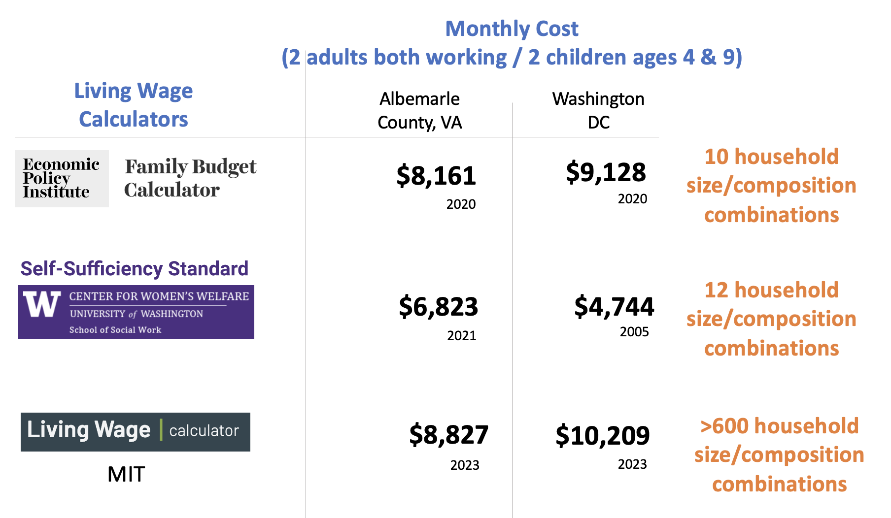
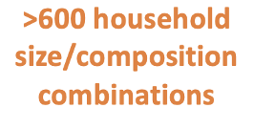
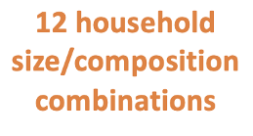
Living Wage Calculators
Tools to help individuals, communities, and employers determine a local wage rate that allows residents to meet minimum standards of living.
The cost-of-living is used to backout the area minimum wage.
Notes:
This

Slide 11
Why Household Size /Composition?
Household Size by PUMAs in Fairfax County, VA
PUMA | 1 | 2 | 3 | 4 | 5 | 6 | 7 | 8 | 9 | 10 | 11 | 12 | 13 | 14 | 15
59301 | 710 | 932 | 434 | 351 | 175 | 71 | 27 | 12 | 3 | 1 | 1 | 0 | 1 | 0 | 0
59302 | 677 | 885 | 410 | 382 | 151 | 55 | 24 | 8 | 5 | 2 | 0 | 1 | 0 | 0 | 0
59303 | 541 | 1152 | 658 | 613 | 247 | 73 | 31 | 11 | 3 | 4 | 1 | 1 | 0 | 0 | 0
59304 | 301 | 615 | 382 | 369 | 136 | 54 | 22 | 7 | 2 | 0 | 0 | 0 | 0 | 0 | 0
59305 | 507 | 875 | 466 | 466 | 149 | 58 | 23 | 0 | 2 | 3 | 0 | 0 | 0 | 0 | 0
59306 | 507 | 657 | 366 | 317 | 129 | 54 | 11 | 7 | 7 | 2 | 0 | 1 | 0 | 0 | 0
59307 | 801 | 1164 | 618 | 573 | 170 | 63 | 18 | 10 | 3 | 1 | 2 | 0 | 0 | 1 | 0
59308 | 517 | 845 | 409 | 390 | 199 | 48 | 8 | 2 | 1 | 0 | 0 | 0 | 0 | 0 | 1
59309 | 412 | 601 | 361 | 355 | 141 | 39 | 11 | 6 | 1 | 2 | 1 | 0 | 0 | 1 | 0
Number of Different PUMA Household Compositions by Size
1 | 2 | 3 | 4 | 5 | 6 | 7 | 8 | 9 | 10 | 11 | 12 | 13 | 14 | 15
1 | 6 | 18 | 35 | 62 | 78 | 63 | 43 | 23 | 14 | 5 | 3 | 1 | 1 | 1

Slide 12
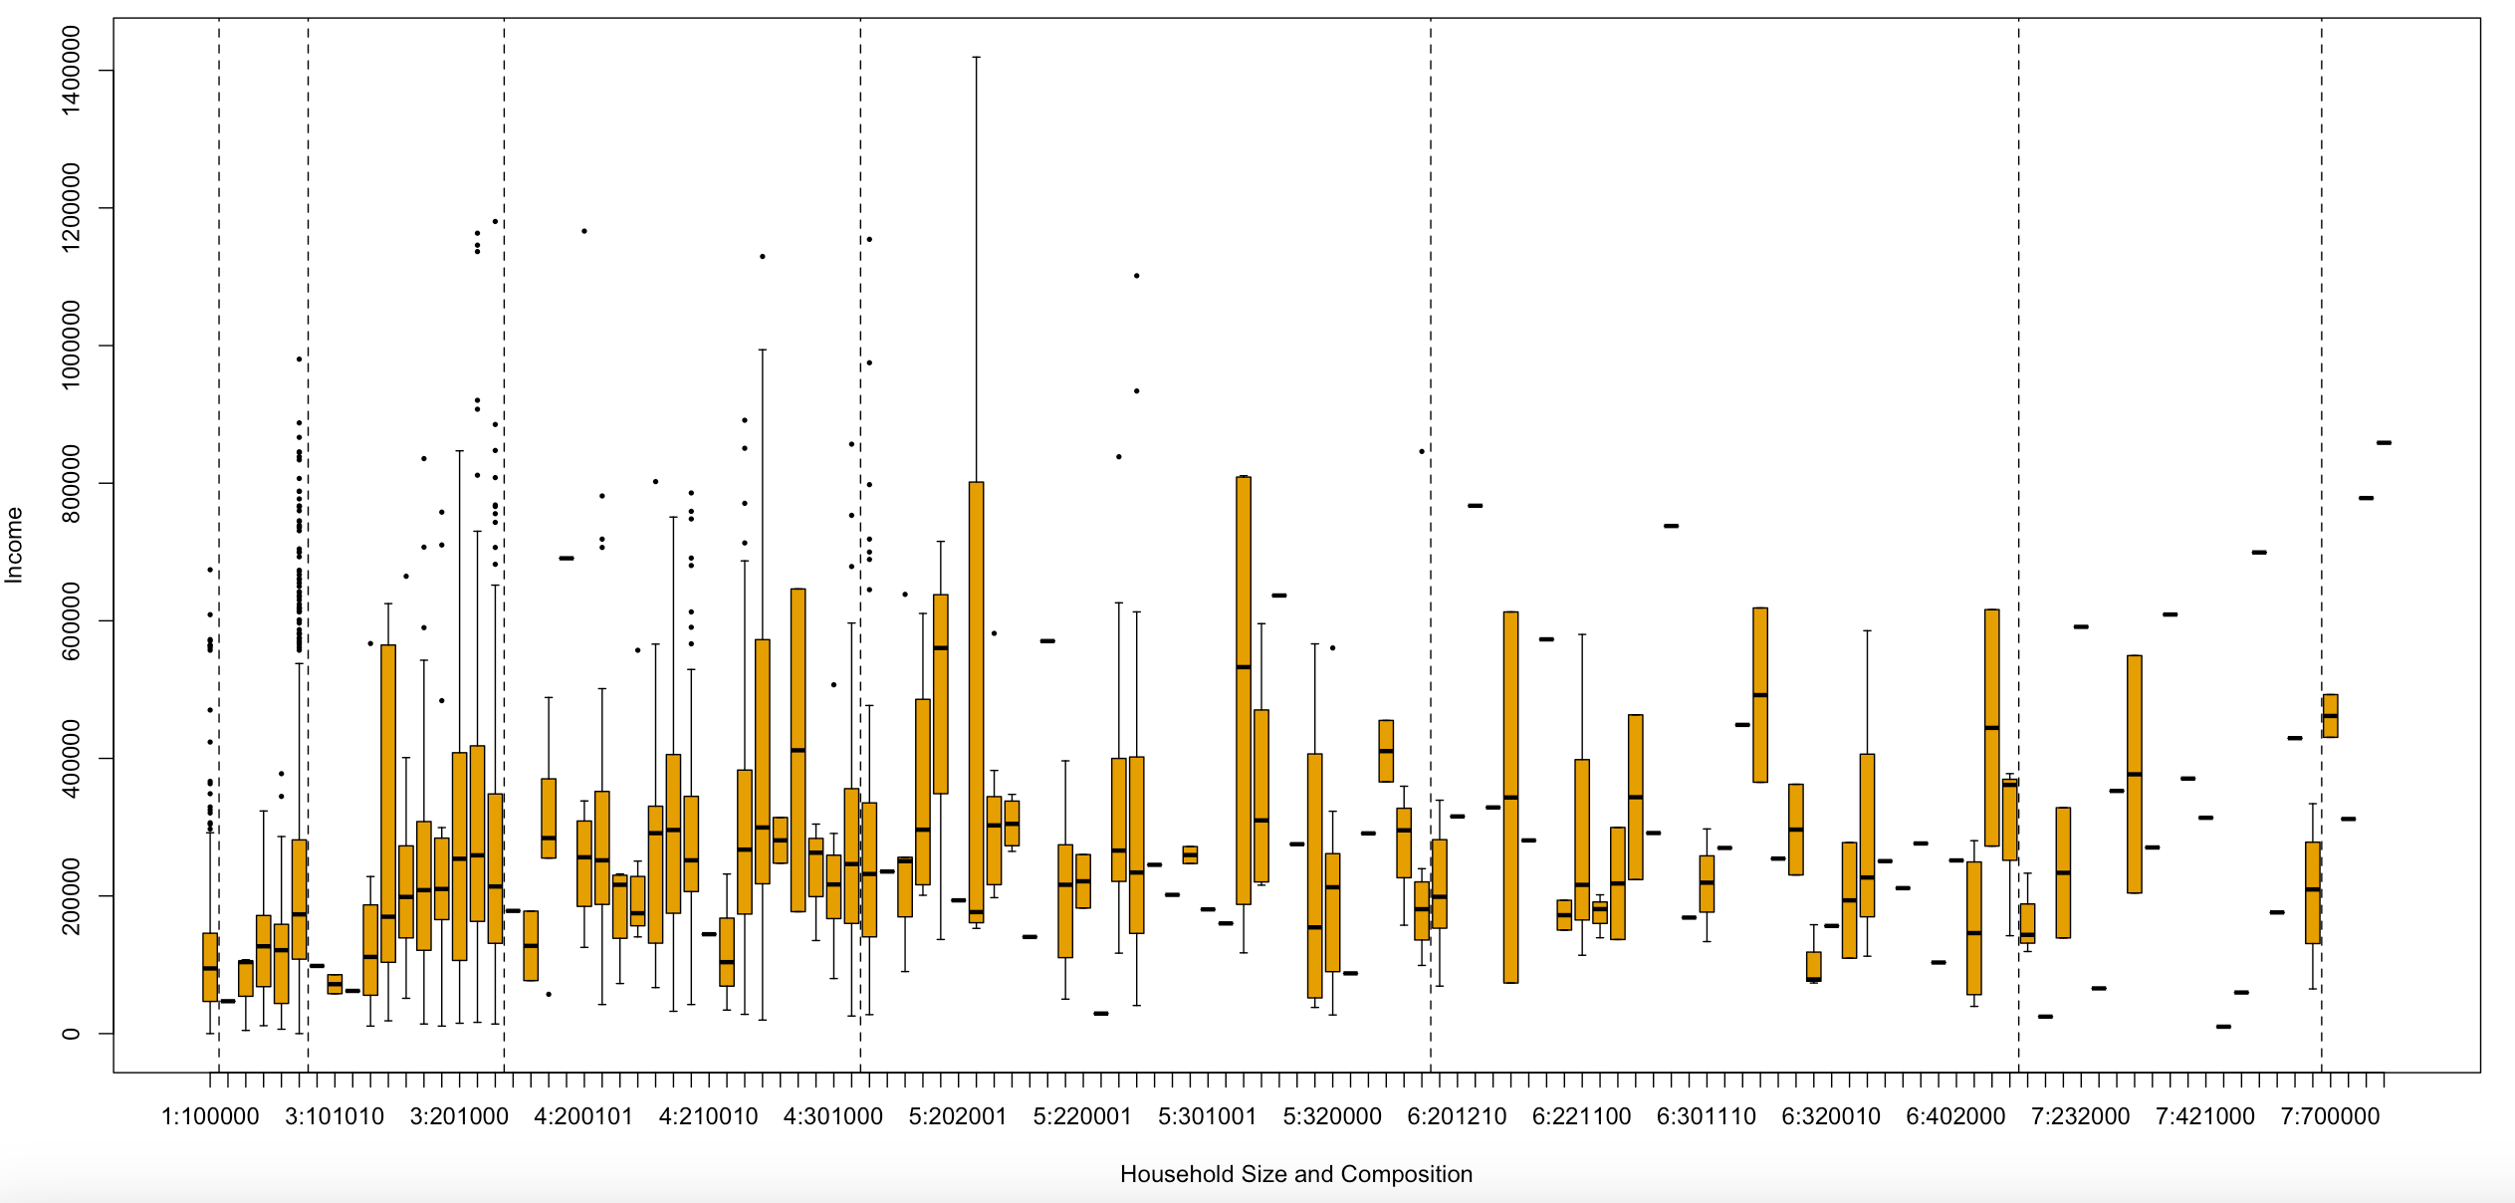
Why Household Size /Composition?
Fairfax Puma 59305: Household Income by 124 Household Size/Composition Combinations
1
2
3
4
5
6
7
10
#:######
Household Size:
Number of Adults
Number of Teenagers
Number of Schoolers
Number of Preschoolers
Number of Toddlers
Number of Infants

Slide 13
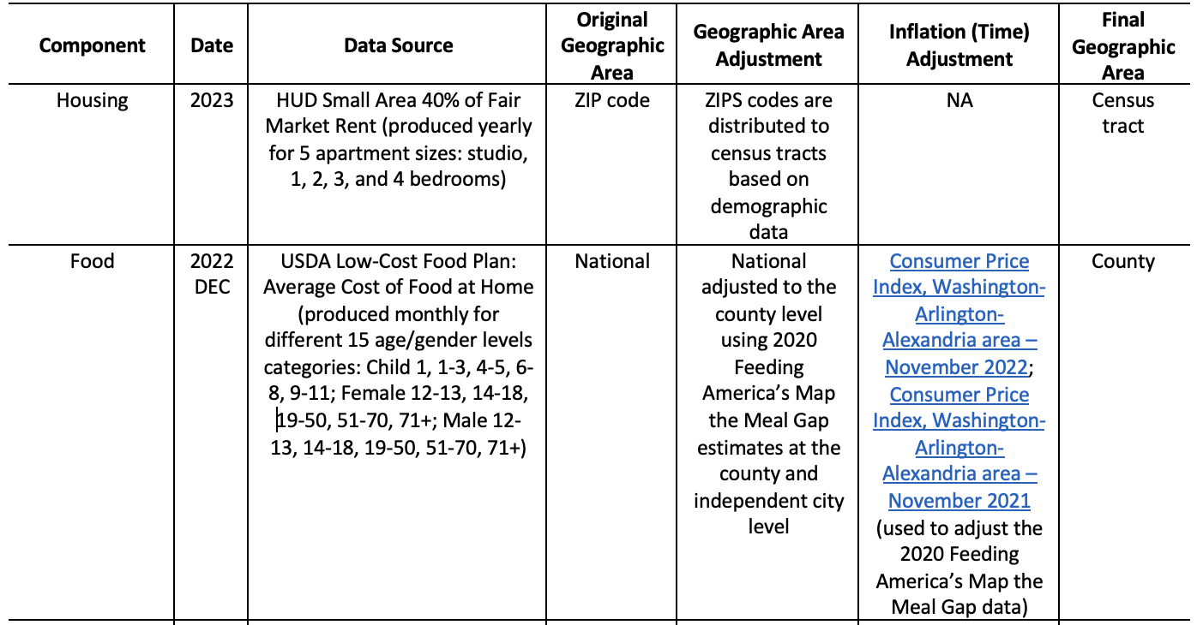
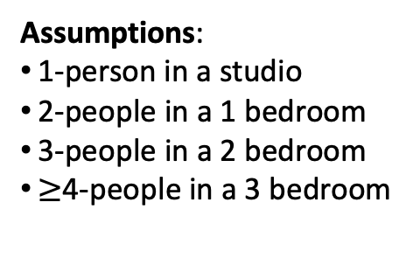
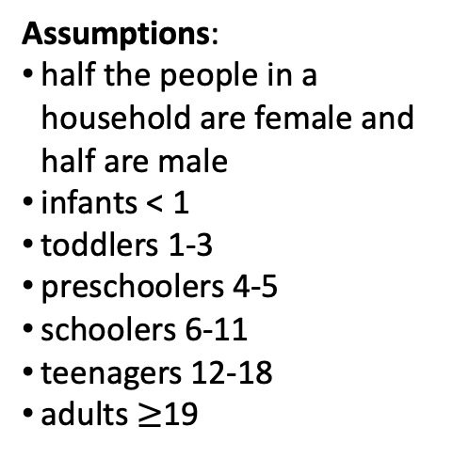
COL Data Discovery Results
Assumptions:
1-person in a studio
2-people in a 1 bedroom
3-people in a 2 bedroom
$≥$4-people in a 3 bedroom
Assumptions:
half the people in a household are female and half are male
infants < 1
toddlers 1-3
preschoolers 4-5
schoolers 6-11
teenagers 12-18
adults $≥$19

Slide 14
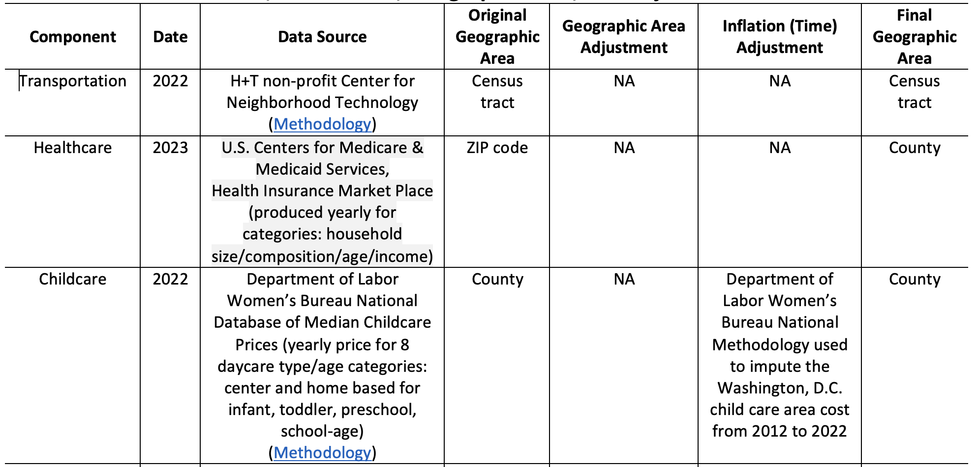
COL Data Discovery Results
Assumptions:
includes auto ownership, auto use, and transit use
independent of family size and composition
Assumptions:
households purchase health insurance through the Affordable Care Act Market Place
Assumptions:
parents use home-based care
children > 12 (teenagers) do not require childcare
infants < 1
toddlers 1-3
preschoolers 4-5
school-age 6-18

Slide 15
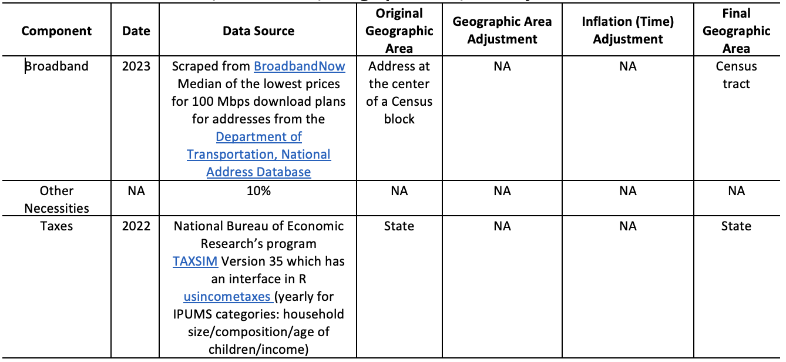
COL Data Discovery Results
Assumptions:
every household has a download plan with a minimum of 100 Mbps
Assumptions:
work in progress
Assumptions:
all households are renters therefore pay no property taxes
tax liability includes income and sales taxes at the federal and state levels
there are no household deductions

Slide 16
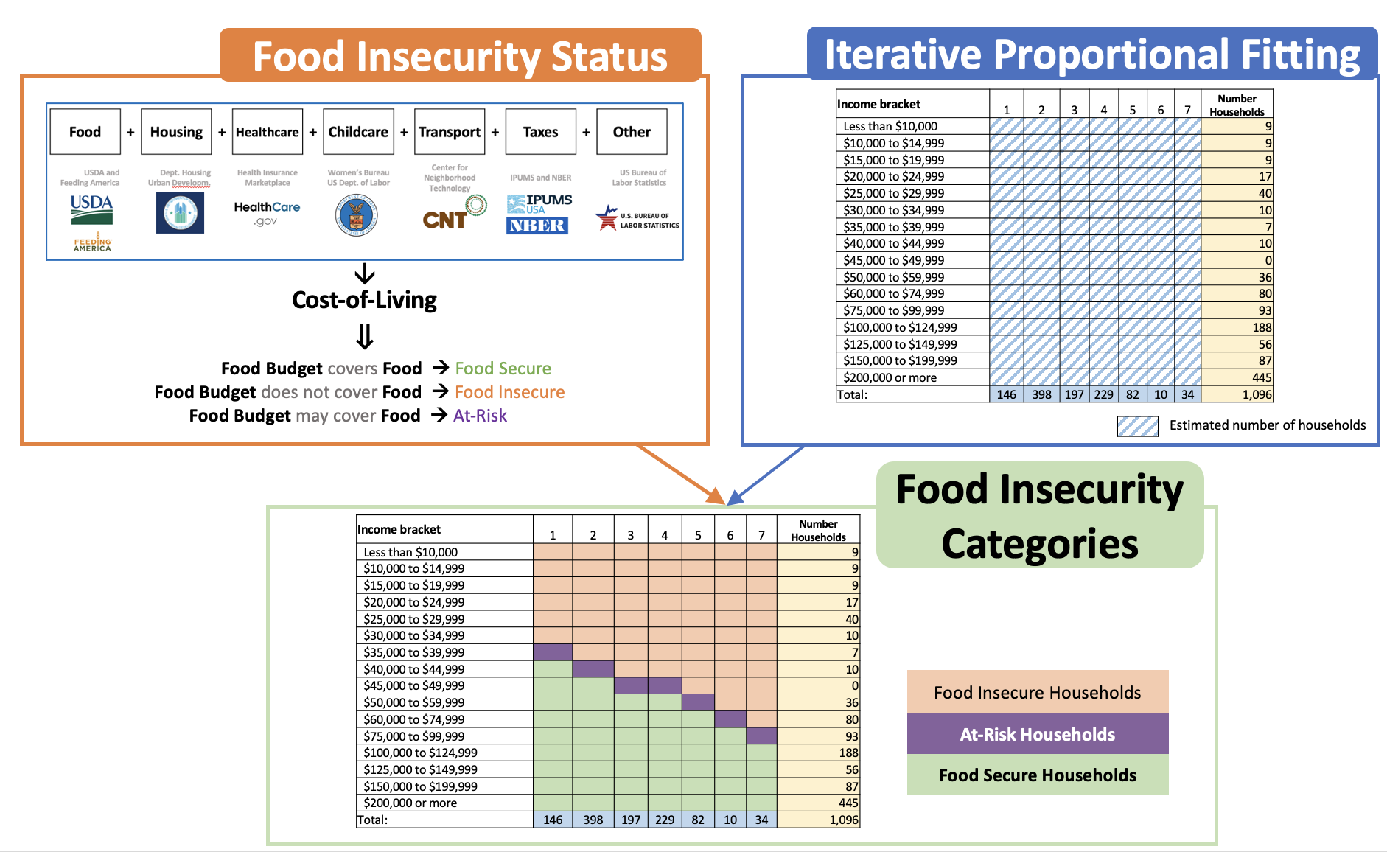
Our original idea was to use Iterative
Proportional Fitting using the marginals
from the ACS.
We think we can
do better with a new
methodology and using
PUMA data.

Slide 17
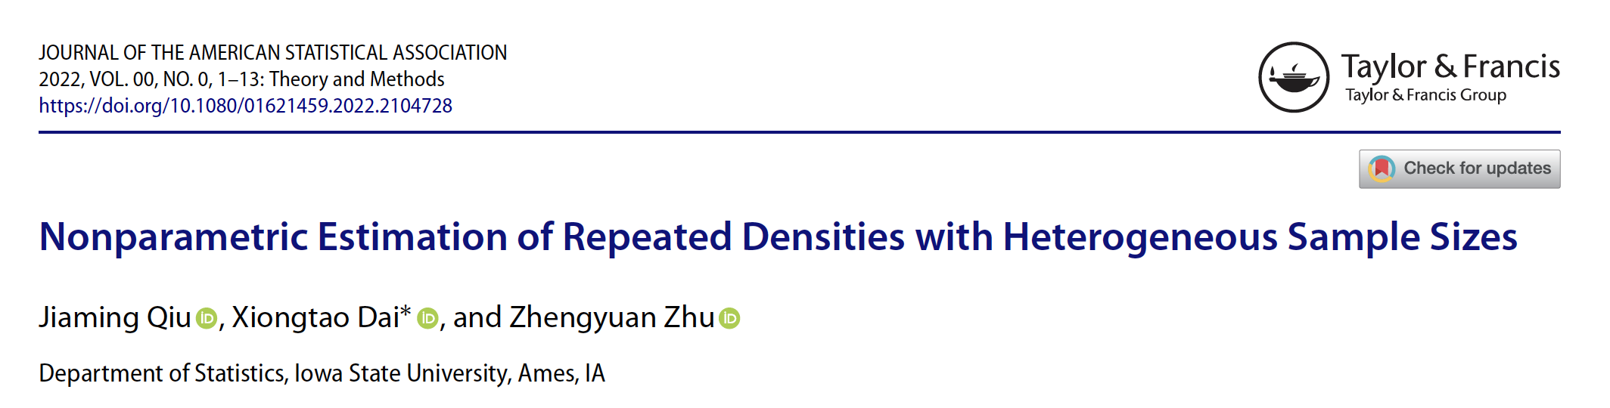
Next Steps
The idea is to estimate a distribution of incomes for every household size and composition for every census tract by using household data at the census tract level from the ACS along with the household income and composition for the PUMA.
Provide three estimates at the census tract level, food secure, food insecure, and at-risk of food insecurity along with a MOE.

