Slide 1















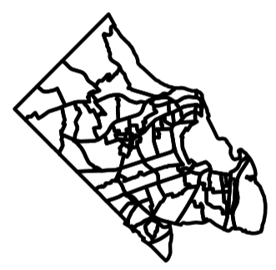

Housing
Business climate
Health
Broadband
Education
Food
Data Repositories
-
New datasets supporting local decision-making -
Below county geographies -
Open Access Data & Code (Fully Reproducible)
Environment
Dashboards - Explore decision-relevant datasets
Transport
Financial well-being
Data
Commons
Applications
-
Open-Source Applications & Code for Assessing and Accessing Data
APIs
-
Connect from enterprise tools (Tableau, Power BI)
Tools & Methods
-
New Open-Source Tools for Building Datasets -
New Methods for Calculating New Measures
Catchment Areas
-
Calculating supply and access to critical resources
Demographic Redistribution -
Redistributing demographic estimates to local geographies
Food Security
-
Estimating household food insecurity and item access

Slide 2
Data Repos
Broadband
Education
Transport-ation
Health
Food
Environ-ment
Business climate
Financial well being
Housing

Slide 3
