Slide 1



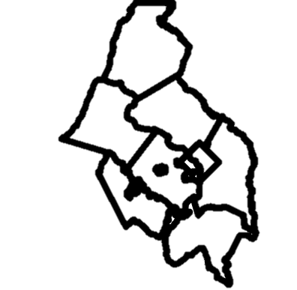

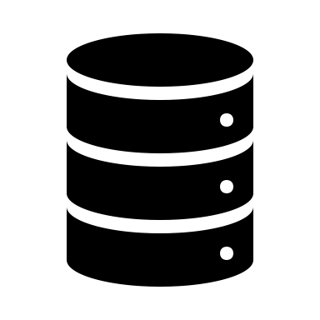




sdc.food
sdc.broad-band
Data Repositories
sdc.health
Data
Commons
Dashboard
Applications
API
Tools & Methods
New Open-Source Tools for Building Datasets
New methodologies for calculating new measures
Catchment areas
Food security
-
Estimating household food insecurity below the county level
Demographic Redistribution
-
Redistributing demographic estimates to local geographies

Slide 2






Data Repos
Broadband
Education
Transport-ation
Health
Food
Environ-ment
Business climate
Financial well being
Housing

Slide 3
