Slide 1







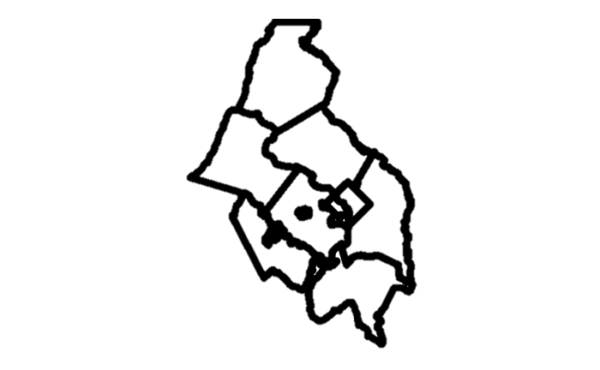







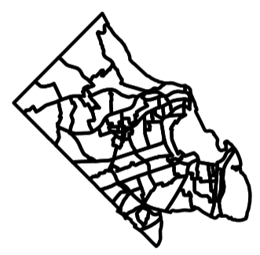

Business climate
Health
Housing
Education
Broadband
Environment
Data Repositories
-
New datasets supporting local decision-making -
Below county geographies -
Open Access Data & Code (Fully Reproducible)
Food
Dashboards - Explore decision-relevant datasets
Transport
Data
Commons
Applications
-
Open-Source Applications & Code for Assessing and Accessing Data
Financial well-being
APIs
-
Connect from enterprise tools (Tableau, Power BI)
Tools & Methods
-
New Open-Source Tools for Building Datasets -
New Methods for Calculating New Measures
Catchment Areas
-
Calculating supply and access to critical resources
Demographic Redistribution -
Redistributing demographic estimates to local geographies
Food Security
-
Estimating household food insecurity and item access

Slide 2
Business climate
Health
Housing
Education
Broadband
Environment
Data Repositories
-
New datasets supporting local decision-making -
Below county geographies -
Open Access Data & Code (Fully Reproducible)
Food
Dashboards - Explore decision-relevant datasets
Transport
Data
Commons
Applications
-
Open-Source Applications & Code for Assessing and Accessing Data
Financial well-being
APIs
-
Connect from enterprise tools (Tableau, Power BI)
Tools & Methods
-
New Open-Source Tools for Building Datasets -
New Methods for Calculating New Measures
Catchment Areas
-
Calculating supply and access to critical resources
Demographic Redistribution -
Redistributing demographic estimates to local geographies
Food Security
-
Estimating household food insecurity and item access

Slide 3
Housing
Business climate
Health
Broadband
Education
Data Repositories
-
New datasets supporting local decision-making -
Below county geographies -
Open Access Data & Code (Fully Reproducible)
Food
Environment
Dashboards - Explore decision-relevant datasets
Financial well-being
Data
Commons
Applications
-
Open-Source Applications & Code for Assessing and Accessing Data
Transport
APIs
-
Connect from enterprise tools (Tableau, Power BI)
Tools & Methods
-
New Open-Source Tools for Building Datasets -
New Methods for Calculating New Measures
Catchment Areas
-
Calculating supply and access to critical resources
Demographic Redistribution -
Redistributing demographic estimates to local geographies
Food Security
-
Estimating household food insecurity and item access

Slide 4
Data Repos
Broadband
Education
Transport-ation
Health
Food
Environ-ment
Business climate
Financial well being
Housing

Slide 5
Housing
Data Repositories
-
New datasets supporting local decision-making -
Below county geographies -
Open Access Data & Code (Fully Reproducible)
Business climate
Food
Health
Financial well-being
Education
Transport
Environment
Broadband

Slide 6
