Slide 1
CS4102 Algorithms Fall 2021 – Floryan and Horton
Module 8 Dynamic Programming

Slide 2
Dynamic Programming and Greedy Approach
TOPICS:
Intro to Dynamic Programming
Memoization
Three DP Problems:
Log Cutting
0/1 Knapsack
Coin Change
Weighted Activity Selection

Slide 3

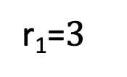


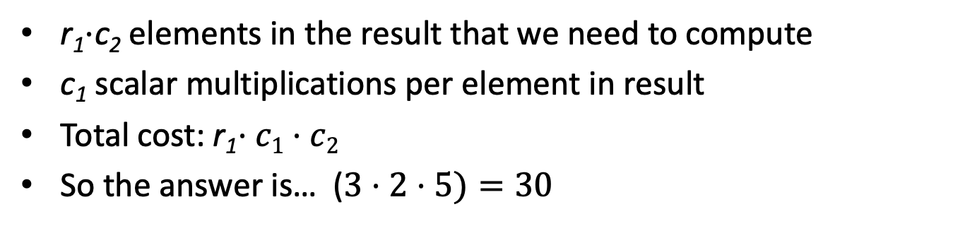
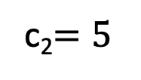



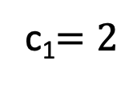

Motivating Example
How many scalar multiplications are required to multiply matrices A and B in this example?
c₁$=2$
c₂$=5$
$$5$$
r₁=$3$
$$×$$
$$2$$
$$=$$
$$3$$
$$A$$
$$B$$
r₁$⋅$c₂ elements in the result that we need to compute
c₁ scalar multiplications per element in result
Total cost: r₁$⋅c1⋅c2$
So the answer is… ($3⋅2⋅5)=30$

Slide 4

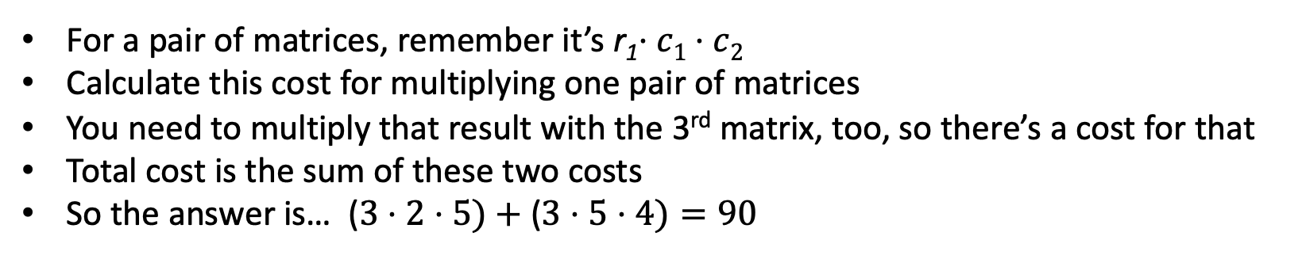












Trickier Question
What’s the smallest number of scalar multiplications required to calculate the matrix product ABC in this example?
$$4$$
$$2$$
$$5$$
$$4$$
$$3$$
$$×$$
$$2$$
$$×$$
$$5$$
$$=$$
$$3$$
$$A$$
$$B$$
$$C$$
For a pair of matrices, remember it’s r₁$⋅c1⋅c2$
Calculate this cost for multiplying one pair of matrices
You need to multiply that result with the 3rd matrix, too, so there’s a cost for that
Total cost is the sum of these two costs
So the answer is… ($3⋅2⋅5)+$($3⋅5⋅4)=90$
Nope! The answer is 64. Think about how this might be!
Notes:
A(BC) vs. (AB)C

Slide 5
CLRS Readings
Chapter 15, Dynamic Programming
Section 15.1, Log/Rod cutting, optimal substructure property
Note: r_{i} in book is called Cut() or C[] in our slides. We do use their example.
Section 15.3, More on elements of DP, including optimal substructure property

Slide 6
Dynamic Programming and Greedy Approach
Module 8 is on Dynamic Programming
Similar to Greedy Algorithms
Solves problems that have optimal substructure, but do NOT have a known greedy choice for optimal solutions
Instead, try every option for the first “greedy” choice and see which one leads to optimal solution.
Will need some optimizations to make this efficient.

Slide 7
Optimization Problems
Both DP and Greedy solve optimization problems:
Find the best solution among all feasible solutions
An example you know: Find the shortest path in a weighted graph G from s to v
Form of the solution: a path (and sum of its edge-weights)
Feasible solutions must meet problem constraints
Example: All edges in solution are in graph G and form a simple path from s to v
We can get a score for each feasible solution on some criteria:
We call this the objective function
Example: the sum of the edge weights in path
One (or more) feasible solutions that scores highest (by the objective function) is the optimal solution(s)

Slide 8
Memoization

Slide 9
Remember Fibonacci numbers?
Formula: F(n) = F(n-1) + F(n-2)
Recursive code: long fib(int n) { assert(n >= 0); if ( n == 0 ) return 0; if ( n == 1 ) return 1; return fib(n-1) + fib(n-2); }
What's the problem?
Repeatedly solves the same subproblems
“Obscenely” exponential

Slide 10
Top-down using Memoization
Before talking about bottom-up dynamic programming using tables, top-down approach uses general technique of Memoization
AKA using a memory function
Simple idea:
Calculate and store solutions to subproblems
Before solving it (again), look to see if you've remembered it

Slide 11
Memoization
Use a Table abstract data type
Lookup key: whatever identifies a subproblem
Value stored: the solution
Could be an array/vector or 2D table(s)
E.g. for Fibonacci, store fib(n) using index n
Need to initialize the array
Could use a map / hash-table

Slide 12
Memoization and Fibonacci
Before recursive code below called, must initialize results[] so all values are -1 long fib_mem(int n, long results[]) { if ( results[n] != -1 ) return results[n]; // return stored value long val; if ( n == 0 || n ==1 ) val = n; // odd but right else val = fib_mem(n-1, results) + fib_mem(n-2, results); results[n] = val; // store calculated value return val; }

Slide 13
Observations on fib_mem()
Same elegant top-down, recursive approach based on definition
Without repeated subproblems
Memory function: a function that remembers
Save time by using extra space
Can show this runs in Θ(n)

Slide 14
CLRS’s Top-Down CUT-ROD using Memoization
MEMOIZED-CUT(p, n)
1 let C[0..n] be a new array // for revenue values
2 for i = 0 to n
3 C[i] = -∞
4 return MEMOIZED-CUT-AUX(p, n, C)
MEMOIZED-CUT-AUX(p, n, C)
1 if C[n] ≥ 0 // subproblem already solved
2 return C[n]
3 if n == 0 // log of length 0
4 best = 0
5 else best = -∞
6 for i = 1 to n
7 best = max(best, p[i] + MEMOIZED-CUT-AUX(p, n-i, C)
8 C[n] = best // store solution for this length n
9 return C[n]

Slide 15
Memoization and Functional Languages
Languages like Lisp and Scheme are functional languages
How could memoization help?
What could go wrong? Would this always work?
Side effects
Haskell does this (call-by-need)
Notes:
From:
http://en.wikipedia.org/wiki/Dynamic_programming
Some functional programming languages, most notably Haskell, can automatically memoize the result of a function call with a particular set of arguments, in order to speed up call-by-name evaluation (this mechanism is referred to as call-by-need). This is only possible for a function which has no side-effects, which is always true in Haskell but seldom true in imperative languages.

Slide 16
Dynamic Programming and Log Cutting

Slide 17
Dynamic programming
Old “bad” name (see Wikipedia or textbook)
Useful when the solution can be recursively described in terms of solutions to sub-problems (optimal substructure)
But greedy choice property doesn’t hold for the problem
Algorithm finds solutions to sub-problems and stores them in memory for later use
More efficient than brute-force methods or recursive approaches that solve the same sub-problems over and over again

Slide 18
Optimal Substructure Property
Definition
If S is an optimal solution to a problem, then the components of S are optimal solutions to sub-problems
Examples:
True for coin-changing
True for single-source shortest path
Not true for longest-simple-path
True for knapsack

Slide 19
Dynamic Programming
Works “bottom-up”
Finds solutions to small sub-problems first
Stores them
Combines them somehow to find a solution to a slightly larger sub-problem
Comparison to greedy approach
Also requires optimal substructure
But greedy makes choice first, then solves
Greedy looks only at the current situation, not at a past ‘history’
DP is good when sub-problems overlap, when they’re not independent
No need to repeat the calculation to solve them
Dynamic programming has stored them, so doesn’t repeat the calculation

Slide 20
Process for Dynamic Programming
Recognize what the sub-problems are
Identify the recursive structure of the problem in terms of its sub-problems
At the top level, what is the “last thing” done?
This helps you see a recursive solution for any generic sub-problem in terms of smaller sub-problems
Formulate a data structure (array, table) that can look-up solution to any sub-problem in constant time
Develop an algorithm that loops through data structure solving each sub-problem one at a time
Bottom-up: from smallest sub-problems, to next largest, …, to complete problem

Slide 21
Problems Solved with Dyn. Prog.
Log cutting (first example, uses list data structure)
0/1 knapsack problem
Coin changing with “non-standard” coin selection
Longest common subsequence
Multiplying a sequence of matrices
Can do in various orders: (AB)C vs. A(BC)
Pick order that does fewest number of scalar multiplications
And ones we might not get to:
All-pairs shortest paths (Floyd’s algorithm)
Constructing optimal binary search trees

Slide 22
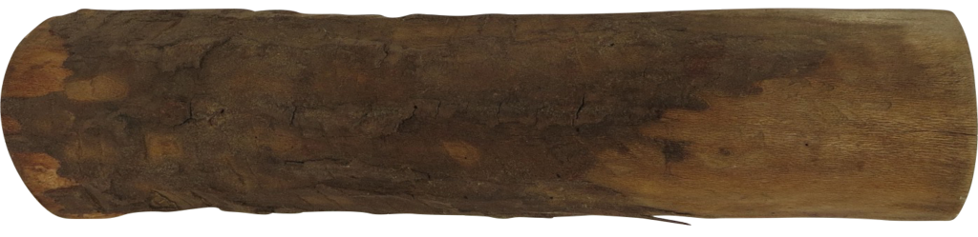
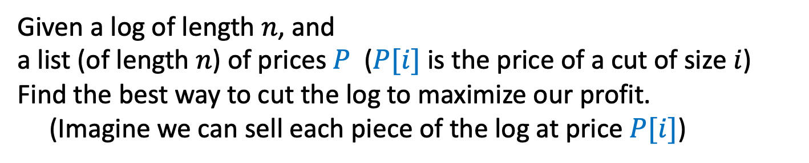
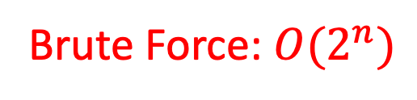
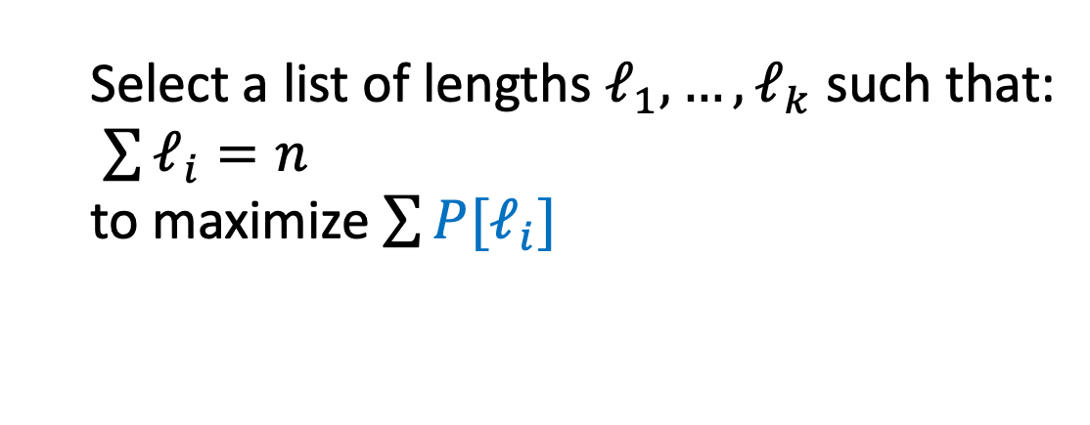
Log Cutting
Given a log of length $n$, and
a list (of length $n$) of prices $P$ ($P[i]$ is the price of a cut of size $i$)
Find the best way to cut the log to maximize our profit.
(Imagine we can sell each piece of the log at price $P[i]$)
Price:
1
5
8
9
10
17
17
20
24
30
Length:
1
2
3
4
5
6
7
8
9
10
Select a list of lengths $ℓ_{1}, …, ℓ_{k}$ such that:
$\sum{ℓ_{i}=n}$
to maximize $\sum{{P[ℓ}_{i}]}$
Brute Force: $O(2^{n})$

Slide 23
Dynamic Programming
Requires Optimal Substructure
Solution to larger problem contains the solutions to smaller ones
Idea:
Identify the recursive structure of the problem
What is the “last thing” done?
Formulate a data structure (array, table) that can look-up solution to any sub-problem in constant time
Select a good order for solving subproblems
“Top Down”: Solve each recursively. (Using memorization – we’ll do later!)
“Bottom Up”: Iteratively solve smallest to largest

Slide 24
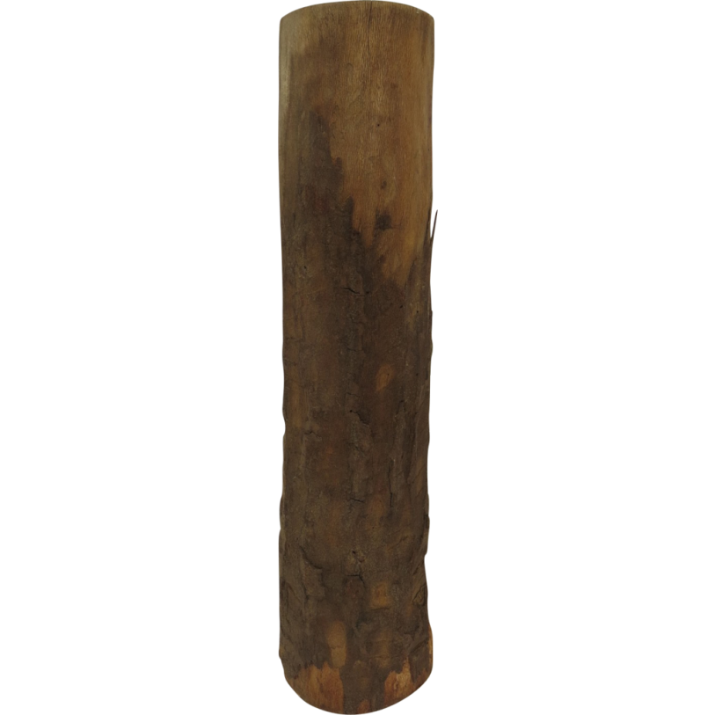
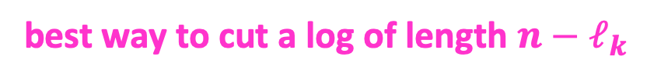
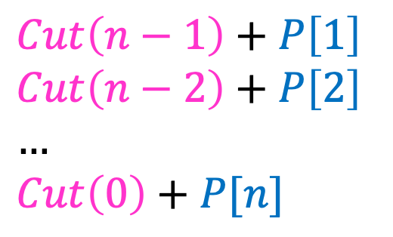
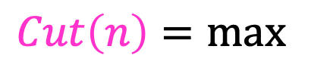


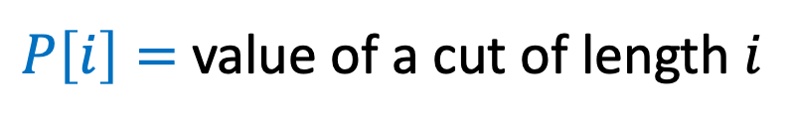
1. Identify Recursive Structure
$P\left[i\right]=$ value of a cut of length $i$
$Cut(n)=$ value of best way to cut a log of length $n$
$Cut\left(n−1\right)+P\left[1\right]$
$Cut\left(n−2\right)+P\left[2\right]$
$…$
$Cut\left(0\right)+P[n]$
So for a given value of n, to find Cut(n), we need sub-problem solutions for Cut(n-1) down to Cut(0).
$Cut\left(n\right)=max⁡$
$$Cut(n−ℓ_{k})$$
What’s the problem with a top-down recursive approach?
$$ℓ_{k}$$
best way to cut a log of length $n−ℓ_{k}$
Last Cut

Slide 25
Dynamic Programming
Requires Optimal Substructure
Solution to larger problem contains the solutions to smaller ones
Idea:
Identify the recursive structure of the problem
What is the “last thing” done?
Save the solution to each subproblem in memory
Select a good order for solving subproblems
“Top Down”: Solve each recursively
“Bottom Up”: Iteratively solve smallest to largest

Slide 26

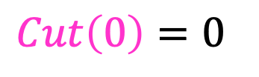
3. Select a Good Order for Solving Subproblems
Solve smallest sub-problem first
$Cut\left(0\right)=0⁡$
$Cut(i)$:
0
Length:
0
1
2
3
4
5
6
7
8
9
10
0

Slide 27
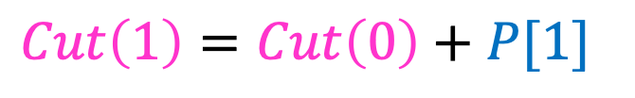
3. Select a Good Order for Solving Subproblems
Solve smallest sub-problem first
$Cut\left(1\right)=Cut\left(0\right)+P[1]⁡$
$Cut(i)$:
0
Length:
0
1
2
3
4
5
6
7
8
9
10
1
Price:
1
5
8
9
10
17
17
20
24
30
Length:
1
2
3
4
5
6
7
8
9
10

Slide 28
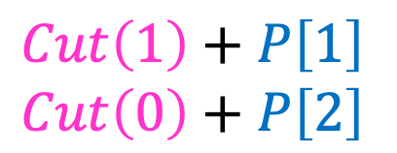
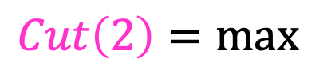
3. Select a Good Order for Solving Subproblems
Solve smallest sub-problem first
$Cut\left(1\right)+P\left[1\right]$
$Cut\left(0\right)+P\left[2\right]$
$Cut\left(2\right)=max⁡$
$Cut(i)$:
0
Length:
0
1
2
3
4
5
6
7
8
9
10
2
Price:
1
5
8
9
10
17
17
20
24
30
Length:
1
2
3
4
5
6
7
8
9
10

Slide 29
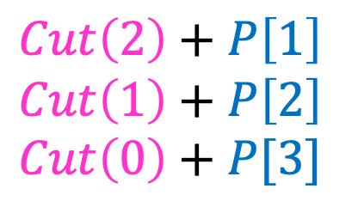
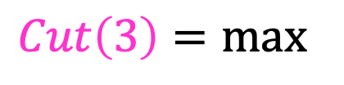
3. Select a Good Order for Solving Subproblems
Solve smallest sub-problem first
$Cut\left(2\right)+P\left[1\right]$
$Cut\left(1\right)+P\left[2\right]$
$Cut\left(0\right)+P[3]$
$Cut\left(3\right)=max⁡$
$Cut(i)$:
0
Length:
0
1
2
3
4
5
6
7
8
9
10
3
Price:
1
5
8
9
10
17
17
20
24
30
Length:
1
2
3
4
5
6
7
8
9
10

Slide 30
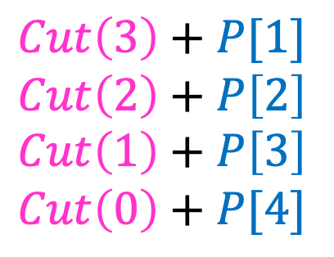
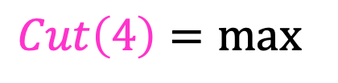
3. Select a Good Order for Solving Subproblems
Solve smallest sub-problem first
$Cut\left(3\right)+P[1]$
$Cut\left(2\right)+P\left[2\right]$
$Cut\left(1\right)+P\left[3\right]$
$Cut\left(0\right)+P[4]$
$Cut\left(4\right)=max⁡$
$Cut(i)$:
0
Length:
0
1
2
3
4
5
6
7
8
9
10
4
Price:
1
5
8
9
10
17
17
20
24
30
Length:
1
2
3
4
5
6
7
8
9
10

Slide 31
Price:
1
5
8
9
10
17
17
20
24
30
Length:
1
2
3
4
5
6
7
8
9
10

Slide 32
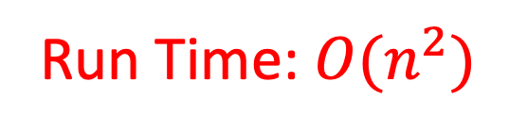
Log Cutting Pseudocode
Initialize Memory C
Cut(n):
C[0] = 0
for i=1 to n: // log size
best = 0
for j = 1 to i: // last cut
best = max(best, C[i-j] + P[j])
C[i] = best
return C[n]
Run Time: $O(n^{2})$

Slide 33
How to find the cuts?
This procedure told us the profit, but not the cuts themselves
Idea: remember the choice that you made, then backtrack

Slide 34
Remember the choice made
Initialize Memory C, Choices
Cut(n):
C[0] = 0
for i=1 to n:
best = 0
for j = 1 to i:
if best < C[i-j] + P[j]:
best = C[i-j] + P[j]
Choices[i]=j
C[i] = best
return C[n]
Gives the size of the last cut

Slide 35
Reconstruct the Cuts
Backtrack through the choices
Choices:
0
1
1
2
4
3
4
1
2
4
3
Length:
0
1
2
3
4
5
6
7
8
9
10
1
2
6
7
Example to demo Choices[] only. Profit of 20 is not optimal!

Slide 36
Backtracking Pseudocode
i = n
while i > 0:
print Choices[i]
i = i – Choices[i]

Slide 37
Our Example: Getting Optimal Solution
i | 0 | 1 | 2 | 3 | 4 | 5 | 6 | 7 | 8 | 9 | 10
C[i] | 0 | 1 | 5 | 8 | 10 | 13 | 17 | 18 | 22 | 25 | 30
Choices[i] | 0 | 1 | 2 | 3 | 2 | 2 | 6 | 1 | 2 | 3 | 10
If n were 5
Best score is 13
Cut at Choices[n]=2, then cut at Choices[n-Choices[n]]= Choices[5-2]= Choices[3]=3
If n were 7
Best score is 18
Cut at 1, then cut at 6

Slide 38
Weighted Activity Selection

Slide 39
Weighted Interval Scheduling
Recall Interval Scheduling:
Given a list of intervals pick a schedule of non-overlapping intervals that maximizes the number chosen
i.e. each one has the same value
Weighted interval scheduling is similar, but…
Each interval has a different value

Slide 40
Greedy solution to interval scheduling
The algorithm:
Sort the activities by finish time
Schedule the first activity
Then schedule the next activity in sorted list which starts after previous activity finishes
Repeat until no more activities
Intuition is even more simple:
Always pick next activity that finishes earliest

Slide 41
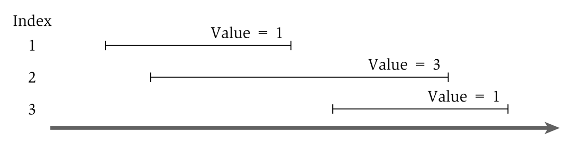
Greedy solution to the weighted version
What would the greedy algorithm pick for this example?
And is that answer optimal?
We can see that the greedy algorithm does not work for the weighted version

Slide 42
Step 1
Define the sub-problem
This problem has optimal substructure, so let’s only consider intervals up to a certain point.
Let Opt(j) be the solution to this problem when only considering intervals 1 through j
How should we order the intervals? Does it matter? We will see soon that it does.
Note that Opt(0) = 0

Slide 43
Step 2
Define solution to problem in terms of sub-problems
Base Case:
Opt(0) = 0
Opt(j) = ?

Slide 44
Step 2
Opt(j) = ?
Two cases:
Interval j is not in the optimal solution
Opt(j) = Opt(j-1) //same solution, because j interval doesn’t matter
Interval j is in the optimal solution
Opt(j) = Vj + Opt(intervals compatible with j)
Intervals compatible with j? Yikes? How do we calculate that?

Slide 45
Calculating Opt(j)
Sort all intervals by their finish time
And number them sequentially
We define interval i is less than interval j if i finishes before j (i.e. is before it in the sort)
Define p(j) to be the highest numbered interval i<j such that i and j are disjoint
Define OPT(j) to be the value of an optimal solution for intervals 1 through j only

Slide 46
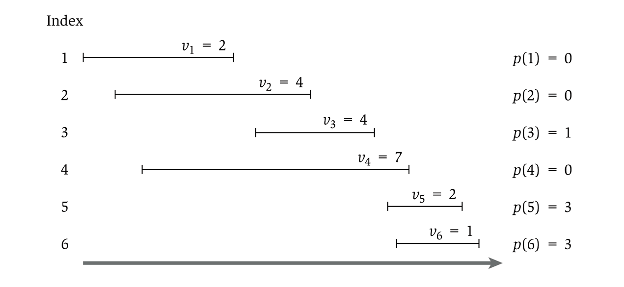
Showing p(j)

Slide 47
Step 2
Opt(j) = ?
Two cases:
Interval j is not in the optimal solution
Opt(j) = Opt(j-1) //same solution, because j interval doesn’t matter
Interval j is in the optimal solution
Opt(j) = Vj + Opt(p(j))
So…we have
Opt(j) = Max( Opt(j-1), Vj + Opt(p(j)) )

Slide 48
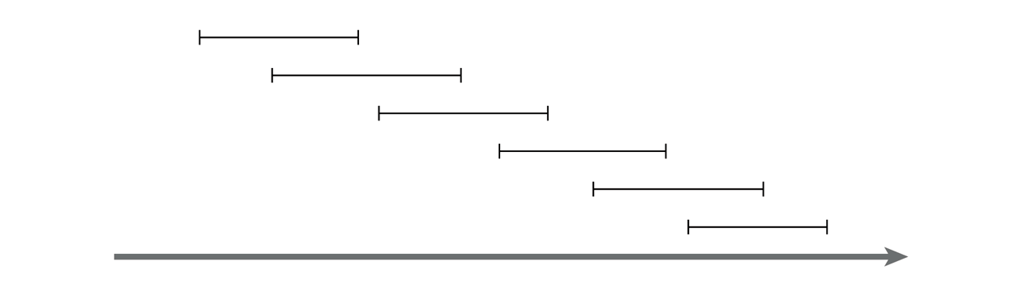
Recursive solution
OPT(j) = max(v_{j} + OPT(p(j)), OPT(j-1))
And OPT(0) = 0
This is similar in running time to the Fibonacci sequence
And similarly exponential
Consider a simple example:
Notes:
For any j, will generate recursive calls on inputs of size j-1 and j-2.
Just like Fibonacci!

Slide 49
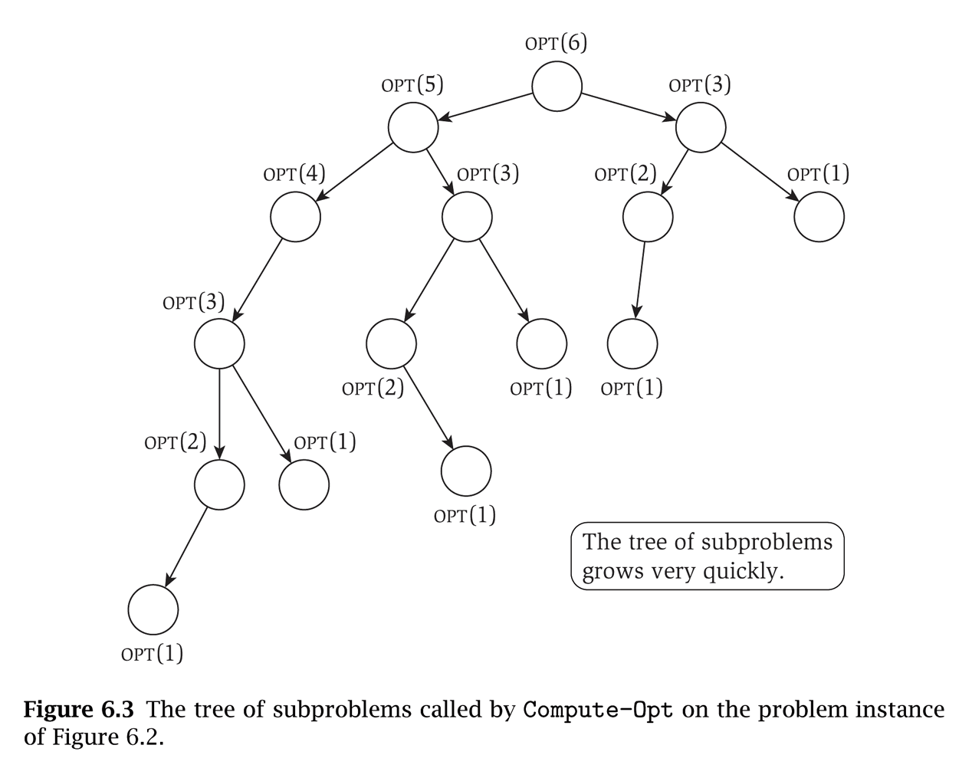
That example will take exponential time
Notice that the sub-problems are being re-computed each time

Slide 50
Step 3!
Formulate the data structure to look up subproblems.
Pretty simple, define M[n]
M[j] stores the solution to Opt(j)

Slide 51
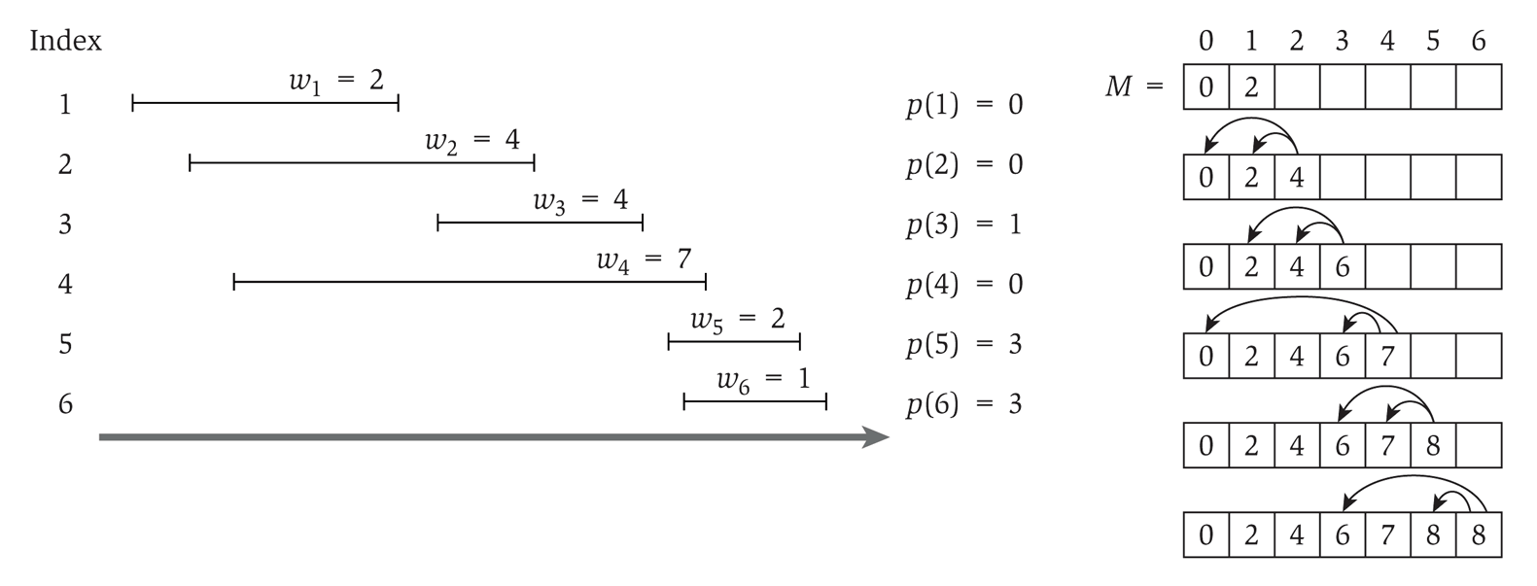
So we add memoization…
This runs in linear time

Slide 52
Computing the intervals
The solution only gives us the final value
Computing a sub-array each step would make it quadratic running time
To determine the intervals:
If v_{j} + M[p(j)] ≥ M[j-1]
Then j is part of the solution, and consider p(j)
Else
Then j is NOT part of the solution, and consider j-1

Slide 53
0/1 Knapsack Problem

Slide 54


Reminder: Knapsack Problems
Pages 425-427 in textbook
Description: Thief robbing a store finds n items, each with a profit amount p_{i} and a weight w_{i}
Wants to steal as valuable a load as possible
But can only carry total weight C in their knapsack
Which items should they take to maximize profit?
Form of the solution: an x_{i} value for each item, showing if (or how much) of that item is taken
Inputs are: C, n, the p_{i} and w_{i} values
54

Slide 55
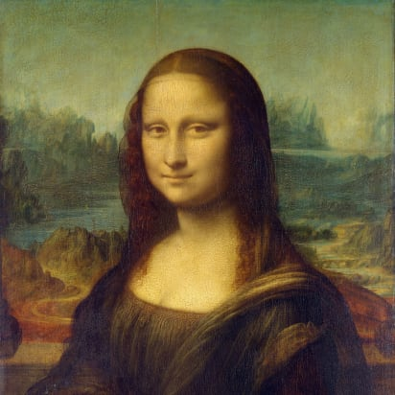

Two Types of Knapsack Problem
0/1 knapsack problem
Each item is discrete: must choose all of it or none of it. So each x_{i} is 0 or 1
Greedy approach does not produce optimal solutions
But dynamic programming does
Fractional knapsack problem (AKA continuous knapsack)
Can pick up fractions of each item. So each x_{i} is a value between 0 or 1
A greedy algorithm finds the optimal solution
55

Slide 56
A Bit More Terminology
Problems solvable by both Dynamic Programming and the Greedy approach have the optimal substructure property:
An optimal solution to a problem contains within it optimal solutions to subproblems
This allows us to build a solution one step at a time, because we can solve increasingly smaller problems with confidence
Dynamic Programming not a good solution for problems that have the greedy-choice property:
We can assemble a globally-optimal solution for the current by making a locally-optimal choice, without considering results from subproblems

Slide 57
0/1 knapsack
n = 3, C = 4
Let’s try this same greedy solution with the 0/1 version
New example inputs →
Item 1 first. So x₁ is 1. Capacity used is 1 of 4. Profit so far is 3.
Item 2 next. There’s room for it! So x₂ is 1. Capacity used is 3 of 4. Profit so far is 3 + 5 = 8.
Item 3 would be next, but its weight is 3 and knapsack only has 1 unit left! So x₃ is 0. Total profit is 8. x_{i} = (1, 1, 0)
But picking items 1 and 3 will fit in knapsack, with total value of 9
Thus, the greedy solution does not produce an optimal solution to the 0/1 knapsack algorithm
Greedy choice left unused room, but we can’t take a fraction of an item
The 0/1 knapsack problem doesn’t have the greedy choice property
Item | Value | Weight | Ratio
1 | 3 | 1 | 3
2 | 5 | 2 | 2.5
3 | 6 | 3 | 2

Slide 58
Reminders about Dynamic Programming
Requires Optimal Substructure
Solution to larger problem contains the solutions to smaller ones
Strategy:
Identify the recursive structure of the problem
What is the “last thing” done?
Formulate a data structure (array, table) that can look-up solution to any sub-problem in constant time
Select a good order for solving subproblems
“Bottom Up”: Iteratively solve smallest to largest
“Top Down”: Solve each recursively. (We won’t do this for 0/1 knapsack.)

Slide 59
Dynamic programming solution to 0/1
We need to:
Identify a recursive definition of how a larger solution is built from optimal results for smaller sub-problems.
For 0/1 knapsack, what a sub-problem solution look like? What can be “smaller”?
Smaller capacity for the knapsack
Fewer items

Slide 60
Some assumptions and observations
Given a set S of the objects and a capacity C
We assume the optimal solution is O, a subset of S
For example, the items in O could be the bolded ones: S = { s₁, s₂, s₃, …, s_{k-1}, s_{k}, …, s_{n} }
Note that the last item s_{n} may or may not be in the solution O
Let’s use subscripts on O_{k} and S_{k} when we’re talking about the first k items
BTW, we’ll assume C and all w_{i} are integer values
And, most books etc. use “W” for what we’re calling C

Slide 61
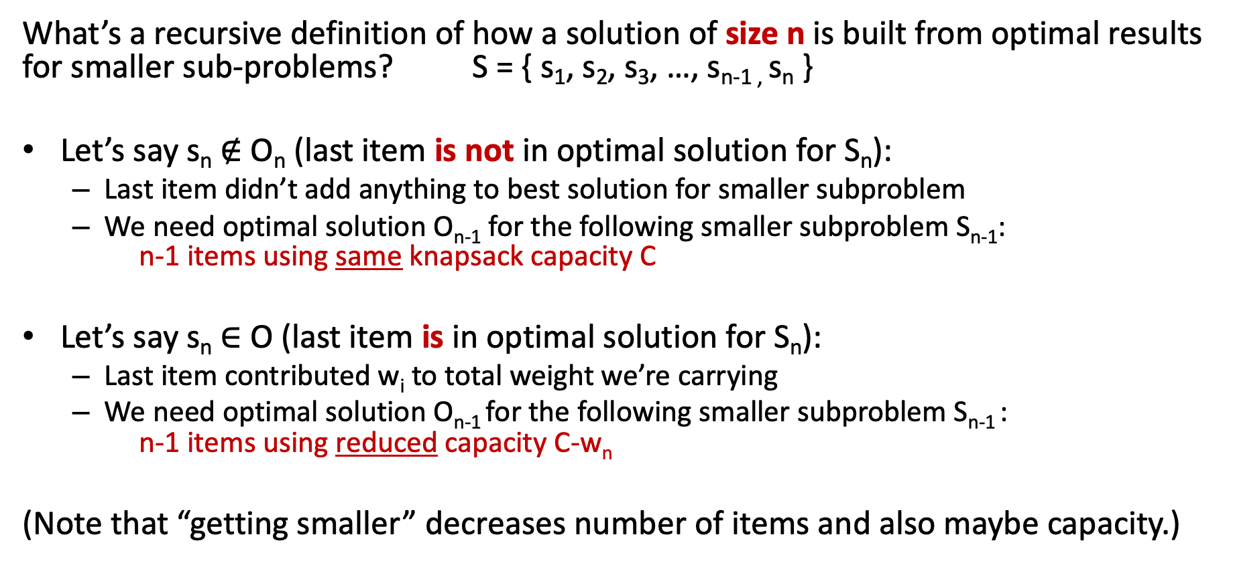
Recursive Structure
What’s a recursive definition of how a solution of size n is built from optimal results for smaller sub-problems? S = { s₁, s₂, s₃, …, s_{n-1 ,} s_{n} }
Let’s say s_{n} $∉$ O_{n} (last item is not in optimal solution for S_{n}):
Last item didn’t add anything to best solution for smaller subproblem
We need optimal solution O_{n-1} for the following smaller subproblem S_{n-1}: n-1 items using same knapsack capacity C
Let’s say s_{n} $∈$ O (last item is in optimal solution for S_{n}):
Last item contributed w_{i} to total weight we’re carrying
We need optimal solution O_{n-1} for the following smaller subproblem S_{n-1} : n-1 items using reduced capacity C-w_{n}
(Note that “getting smaller” decreases number of items and also maybe capacity.)

Slide 62
First Step: Getting Things Started
For sub-problems, what variables change in size?
Maybe C (the capacity) and definitely k (number of items to steal)
Define what we’re calculating: call it Knap(k, w)
Note: we’ll use “w” for the changing capacity value in Knap(), but keep “C” as the overall total capacity for the entire problem. (Sorry if confusing!)
Whether we do recursion of work bottom-up, we need to know the smallest cases
Some small or boundary cases:
No knapsack capacity (w=0), can’t add an item, so Knap(k, 0) = 0
Nothing to steal (k=0), so Knap(0, w) = 0

Slide 63
Three cases to calculate Knap(k, w)
Three cases for calculating Knap(k, w):
There is sufficient capacity to add item s_{k} to the knapsack, and that creates an optimal solution for k items
There is sufficient capacity to add item s_{k} to the knapsack, and that does NOT create an optimal solution for k items
There is insufficient capacity to add item s_{k} to the knapsack
Case 3 is easy to determine; we’ll have to compute whether 1 or 2 is optimal
How do we know which is optimal? Compute both, pick larger value!

Slide 64
Case 1: Sufficient capacity and Optimal
There is sufficient capacity to add item s_{k} to the knapsack, and that creates an optimal solution for k items
Thus, our solution for the first k items is when we add item s_{k} to the optimal solution for the first k-1 items
But by adding item s_{k} to the knapsack, we have reduced capacity
In particular, we only have w-w_{k} for to steal the first k-1 items
So the value for Knap(k, w) = v_{k} + Knap(k-1, w-w_{k})

Slide 65
Case 2: Sufficient Capacity but Non-optimal
There is sufficient capacity to add item s_{k} to the knapsack, and that does NOT create an optimal solution for k items
Thus, our solution for the first k items is when we do NOT add item s_{k} to the solution for the first k-1 items
Since we are not adding item s_{k} to the knapsack, the solution is the optimal solution to steal the first k-1 items with the same capacity
So Knap(k, w) = Knap(k-1, w)

Slide 66
Case 3: Insufficient Capacity
There is insufficient capacity to add item s_{k} to the knapsack
This is because w-w_{k} < 0 (i.e. w < w_{k})
Then Knap(k, w) = Knap(k-1, w)
Since we can’t add item s_{k} to the knapsack, the solution is the same as the first k-1 items with the same capacity
Note that this formula is the same as case 2

Slide 67
Putting It All Together
Recursively define solutions to sub-problems
Base Case
Knap(k,0) = 0
Knap(0,w) = 0
Recursive Case
Knap(k, w) = max( Knap(k-1, w), Knap(k-1, w-w_{k}) + v_{k} )
Subproblems are smaller!
No room for s_{k} or not part optimal solution
s_{k} is part of optimal solution

Slide 68
Reminders about Dynamic Programming
Requires Optimal Substructure
Solution to larger problem contains the solutions to smaller ones
Strategy:
Identify the recursive structure of the problem
What is the “last thing” done?
Formulate a data structure (array, table) that can look-up solution to any sub-problem in constant time
Select a good order for solving subproblems
“Bottom Up”: Iteratively solve smallest to largest
“Top Down”: Solve each recursively. (We won’t do this for 0/1 knapsack.)

Slide 69
Lookup Table
We want a data-structure that allows us to lookup a sub-problem value in O(1) time
Knap(k, w) has two parameters, so two-dimensional array works great.
Make an array called V[k, w]
Store solution to Knap(k, w) at position V[k, w]

Slide 70
Determining the cases
To determine between cases 1 and 2
Simply compute both values, and take the higher
if (w-w_{k}< 0) // not room for item k
V[k, w] = V[k-1, w] // best result for k-1 items
else {
val_with_kth = v_{k} + V[k-1, w-w_{k}] // Case 1 above
val_for_k-1 = V[k-1, w] // Case 2 above
V[k, w] = max( val_with_kth, val_for_k-1 )
}

Slide 71
Put Values in Table
Write a loop that fills in the table one cell at a time
The table fills in one row at a time, moving rightwards and downwards
V[k,w] | w = 0 | w = 1 | w = 2 | … | w = C
k = 0 | 0 | 0 | 0 | 0 | 0
k = 1 | 0
k = 2 | 0
… | 0
k = n | 0

Slide 72
Pseudo-code
Knapsack(v, w, C) {
for (w = 0 to C) V[0, w] = 0
for (k = 0 to n) V[k, 0] = 0
for (k = 1 to n) { // loop over all rows
for (w = 1 to C) { // loop over all columns
if (w-w_{k} < 0) // not room for item k
V[k, w] = V[k-1, w] // best result for k-1 items
else {
val_with_kth = v_{k} + V[k-1, w-w_{k}] // Case 1 above
val_for_k-1 = V[k-1, w] // Case 2 above
V[k, w] = max( val_with_kth, val_for_k-1 )
}
}
}
return V[n,C]
}

Slide 73
But our solution is only the value!
Value V[n, C] is the optimal value
To find which items were chosen, we can trace backward through the table starting at V[n, C]
If V[k, w] = V[k-1, w], then s_{k} is not an item in the knapsack (this was from cases 2 and 3). Look at V[k-1, w] next.
Otherwise, s_{k} is an item in the knapsack, and we look at V[k-1, w-w_{k}] next (this was from case 1)

Slide 74
Coin Change with non-traditional coin sets

Slide 75
Making Change
The problem:
Give back the right amount of change, and…
Return the fewest number of coins!
Inputs: the dollar-amount to return
Also, the set of possible coins. (Do we have half-dollars? That affects the answer we give.)
Output: a set of coins
Note this problem statement is simply a transformation
Given input, generate output with certain properties
No statement about how to do it.
Can you describe the algorithm you use?

Slide 76
Greedy algorithm
Given coin cent amounts of 10, 6, 5, and 1
Compute the coins needed for 12 cents
The greedy algorithm picks {10, 1, 1}
But {6, 6} is more optimal (fewer coins)

Slide 77
Definitions
We define an array denom which holds the denominations of the coins such that:
denom[1] > denom[2] > … > denom[n] = 1
In other words, we sort the coin denominations in decreasing order, ending with a penny
We are obtaining change for an amount A
Consider the i,j problem:
The available denominations are denom[i] through denom[n], where i ≥ 1 (i.e. the smaller n-i+1 coins)
Note: when i is large, you’re working with fewer types of coins, and when i=1 you’re working with your complete set
The amount we are looking for is j, where j ≤ A (i.e. the remaining amount of money)

Slide 78
The i,j problem
Consider the i,j problem: (Remember, i is which coins, and j is the amount)
The available denominations are denom[i] through denom[n], where i ≥ 1 (i.e. the smaller n-i+1 coins)
The amount we are looking for is j, where j ≤ A (i.e. the remaining amount of money)
Given coins of denominations 10, 6, and 1, here’s the table showing how to create change up to 12 cents:
Our answer!
j (the amount)
 | 0 | 1 | 2 | 3 | 4 | 5 | 6 | 7 | 8 | 9 | 10 | 11 | 12
1 | 0 | 1 | 2 | 3 | 4 | 5 | 1 | 2 | 3 | 4 | 1 | 2 | 2
2 | 0 | 1 | 2 | 3 | 4 | 5 | 1 | 2 | 3 | 4 | 5 | 6 | 2
3 | 0 | 1 | 2 | 3 | 4 | 5 | 6 | 7 | 8 | 9 | 10 | 11 | 12
Can use 1, 6 & 10
Can use 1 & 6
Can use 1
i

Slide 79
Solving the problem
How to solve the i,j problem (Remember, i is which coins, and j is the amount)
If denom[i] > j, then not possible to include this coin
Then the solution is the same as the (i+1),j problem (same amount, but with one fewer of the coin-options)
In the table, that’s the cell right below the current cell.
Is this making the problem simpler?
Maybe the best answer does use a coin of denomination i
Then the solution is 1 more than the i,(j-denom[i]) problem
j changes to j-denom[i] because we subtract off the value of the coin used
i doesn’t change because there could be multiple coins of denomination i used in the solution
Maybe the best answer does NOT use a coin of denomination i
Then the solution is the same as the (i+1),j problem
In the table, that’s the cell right below the current cell

Slide 80
The formulaic solution
The solution becomes:
Where C[i][0] = 0 for all values of i
If we have a penny, then C[n][j] = j
This is required to get all amounts, so we assume a penny is the smallest denomination

Slide 81
Recursive solution
The solution:
Note that a given problem (C[i][j]) is expressed in terms of sub-problems
We can write a solution now using memorization with a top-down solution (recursive calls), or a bottom-up approach (build a table)

Slide 82
The bottom-up algorithm
dynamic_coin_change1 (denom, A, C) {
n = denom.last
for j = 0 to A
C[n][j] = j
for i = n-1 down to 1
for j = 0 to A
if ( denom[j] > j ||
C[i+1][j] < 1 + C[i][j-denom[i]] )
C[i][j] = C[i+1][j]
else
C[i][j] = 1 + C[i][j-denom[i]]
}
Time complexity?
Constant time to file each cell in the table. So Θ(n ・ A) where n is the number of coins and A is the amount

Slide 83
But how to get the coins chosen?
It’s easy to trace back through the values
Or, we could keep a used Boolean array
If used[i][j] is true, then the solution for i,j does use a coin of denom[i] for amount j
If false, it does not
j
 | 0 | 1 | 2 | 3 | 4 | 5 | 6 | 7 | 8 | 9 | 10 | 11 | 12
1 | F | F | F | F | F | F | F | F | F | F | T | T | F
2 | F | F | F | F | F | F | T | T | T | T | T | T | T
3 | F | T | T | T | T | T | T | T | T | T | T | T | T
Can use 1, 6 & 10
Can use 1 & 6
Can use 1
i

Slide 84
Recording the answers
dynamic_coin_change2 (denom, A, C, used) {
n = denom.last
for j = 0 to A
C[n][j] = j
used[n][j] = true
for i = n-1 downto 1
for j = 0 to A
if ( denom[j] > j ||
C[i+1][j] < 1+C[i][j-denom[i]] )
C[i][j] = C[i+1][j]
used[i][j] = false
else
C[i][j] = 1 + C[i][j-denom[i]]
used[i][j] = true
}

Slide 85
Obtaining the coin set
optimal_coins_set (i, j, denom, used) {
if ( j == 0 )
return
if ( used[i][j] )
println (“Use coin of denomination “ + denom[i])
optimal_coins_set (i, j-denom[i], denom, used)
else
optimal_coins_set (i+1, j, denom, used)
}

