Slide 1
CS4102 Algorithms Fall 2021 – Floryan and Horton
Greedy Algorithms

Slide 2
CLRS Readings
Chapter 16, Greedy Algorithms
Intro, page 414
Section 16.2, Elements of the Greedy Strategy, Knapsack problem
Later Section 16.1, Activity Selection problem

Slide 3
Topics
Greedy Algorithms: Our next algorithmic technique
How to analyze problems with greedy solutions:
Optimal substructure property
Greedy choice property
Proving correctness of greedy algorithms
Three example problems
Coin Change
Activity Selection
Knapsack (fractional version)

Slide 4
Optimization Problems
Greedy algorithms can (sometimes) solve optimization problems:
Find the best solution among all feasible solutions
An example you know: Find the shortest path in a weighted graph G from s to v
Form of the solution: a path (and sum of its edge-weights)
Feasible solutions must meet problem constraints
Example: All edges in solution are in graph G and form a simple path from s to v
We can get a score for each feasible solution on some criteria:
We call this the objective function
Example: the sum of the edge weights in path
One (or more) feasible solutions that scores highest (by the objective function) is the optimal solution(s)

Slide 5
Coin Change, Optimal Substructure, and the Greedy Choice Property

Slide 6
Goals!
First problem with a greedy algorithm solution (Coin Change!)
What is optimal substructure? Why is it useful?
Making a greedy choice to solve the problem
What is the greedy choice property?

Slide 7
Everyone Already Knows Many Algorithms!
Worked retail? You know how to make change!
Example:
My item costs $4.37. I give you a five dollar bill. What do you give me in change?
Answer: two quarters, a dime, three pennies
Why? How do we figure that out?

Slide 8
Making Change
The problem:
Give back the right amount of change, and…
Return the fewest number of coins!
Inputs: the dollar-amount to return
Also, the set of possible coins. (Do we have half-dollars? That affects the answer we give.)
Output: a set of coins
Note this problem statement is simply a transformation
Given input, generate output with certain properties
No statement about how to do it.
Can you describe the algorithm you use?

Slide 9
Optimal Substructure
This problem has optimal substructure
Optimal Substructure: If given an optimal solution to the larger problem, it can be seen to be made up of optimal solutions to smaller versions of the same problem.
e.g., Optimal solution for giving 15 cents of change contains within it the optimal set of coins to make 5 cents of change (because a dime is part of the solution for 15 cents)
Another way of stating it: If A is an optimal solution to a problem, then the components of A are optimal solutions to subproblems

Slide 10
Optimal Substructure
This problem has optimal substructure
Lemma 1: If a problem has optimal substructure, then a greedy algorithm MIGHT solve it (but not necessarily).
Lemma 2: If a greedy algorithm solves the problem, then it has optimal substructure.
Lesson: Check for optimal substructure to see if a greedy algorithm MIGHT be applicable. Also gives hints as to what the algorithm might be!!

Slide 11
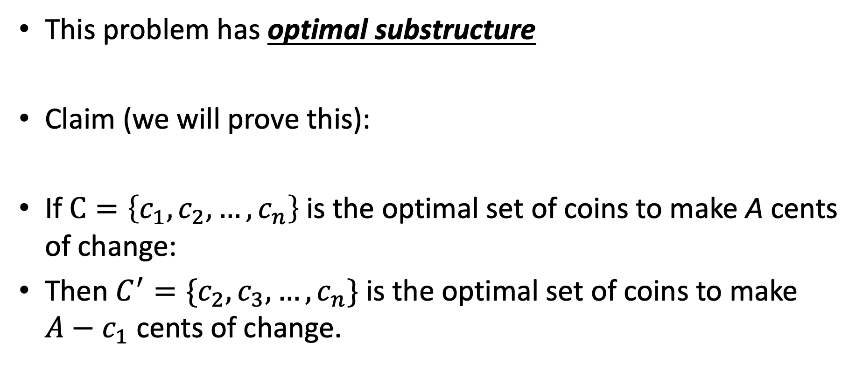
Optimal Substructure
This problem has optimal substructure
Claim (we will prove this):
If $C=\left\{c_{1},c_{2},…,c_{n}\right\}$is the optimal set of coins to make A cents of change:
Then $C^{′}=\{c_{2},c_{3},…,c_{n}\}$ is the optimal set of coins to make $A−c_{1}$ cents of change.

Slide 12
Need more on Optimal Substructure Property?
Detailed discussion on p. 379 of CLRS (chapter on Dynamic Programming)
If A is an optimal solution to a problem, then the components of A are optimal solutions to subproblems
Another example: Shortest Path in graph problem
Say P is min-length path from CHO to LA and includes DAL
Let P₁ be component of P from CHO to DAL, and P₂ be component of P from DAL to LA
P₁ must be shortest path from CHO to DAL, and P₂ must be shortest path from DAL to LA
Why is this true? Can you prove it? Yes, by contradiction. (Try this at home!)

Slide 13
A Change Algorithm
Consider the largest coin
How many go into the amount left?
Add that many of that coin to the output
Subtract the amount for those coins from the amount left to return
If the amount left is zero, done!
If not, consider next largest coin, and go back to Step 2
Notes:
Will this always finish? Yes, because we have pennies!

Slide 14
Evaluating Our Greedy Algorithm
How much work does it do?
Say C is the amount of change, and N is the number of coins in our coin-set
Loop at most N times, and inside the loop we do:
A division
Add something to the output list
A subtraction, and a test
We say this is O(N), or linear in terms of the size of the coin-set
Could we do better?
Is this an optimal algorithm?
We need to do a proof somehow to show this

Slide 15
Another Change Algorithm
Give me another way to do this?
Brute force:
Generate all possible combinations of coins that add up to the required amount
From these, choose the one with smallest number
What would you say about this approach?
There are other ways to solve this problem
Dynamic programming: build a table of solutions to small subproblems, work your way up

Slide 16
Algorithm for making change
This algorithm makes change for an amount A using coins of denominations
denom[1] > denom[2] > ··· > denom[n] = 1.
Input Parameters: denom, A
Output Parameters: None
greedy_coin_change(denom, A) {
i = 1
while (A > 0) {
c = A / denom[i]
println(“use ” + c + “ coins of denomination ” + denom[i])
A = A - c * denom[i]
i = i + 1
}
}

Slide 17
Making change proof
One methodology for proving correctness of greedy algorithms:
A greedy algorithm is correct if the following hold:
The problem has optimal substructure
The algorithm has the greedy choice property (see next slide)

Slide 18
Making change proof
What is the greedy choice property?
Your algorithm makes some greedy choice and then continues
e.g., choose largest coin, then continue
Prove that the one thing the greedy algorithm selects MUST be in some optimal solution to the problem.

Slide 19
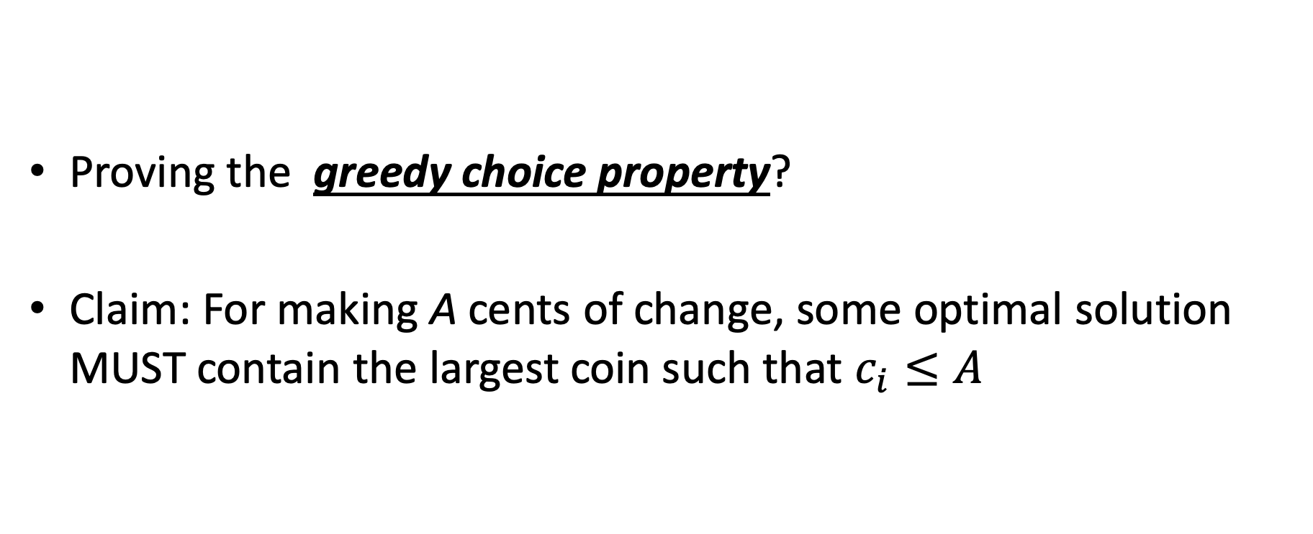
Making change proof
Proving the greedy choice property?
Claim: For making A cents of change, some optimal solution MUST contain the largest coin such that $c_{i}≤A$

Slide 20
Proof
Overview of proof:
Assume largest coin NOT in some optimal solution
Ok, some other coins must be in there instead.
4 Cases:
Largest coin that fits is penny (1 cent) //this one is trivial though!
Largest coin that fits is nickel (5 cent)
Largest coin that fits is dime (10 cent)
Largest coin that fits is quarter (25 cent)

Slide 21
Proof
Largest coin that fits is penny (1 cent) //this one is trivial though!
means A < 5
Only penny fits, so penny must be in some optimal solution!
Largest coin that fits is nickel (5 cent)
Assume nickel not in optimal solution. Note A >= 5
Pennies are only other option, so 5 or more pennies in optimal solution
But I can swap out 5 of those pennies with a nickel
Solution decreases by 4 coins!! Contradiction!!

Slide 22
Proof
Largest coin that fits is Dime (10 cent)
Assume dime not in optimal solution. Note A >= 10 and A < 25
So the optimal solution contains:
>= 2 nickels, some number of pennies (might be 0)
1 nickel, some pennies (at least 5)
all pennies (more than 10)
In each case above, I can swap a dime in for some combination of nickels or pennies
Solution decreases by 1, 5, or 9 coins respectively. Contradiction!
Largest coin that fits is quarter (25 cent)
Assume quarter not in optimal solution. Note A >= 25
So the optimal solution contains:

Slide 23
Proof
Largest coin that fits is quarter (25 cent)
Assume quarter not in optimal solution. Note A >= 25
So the optimal solution contains:
2 dimes, 1 nickel, some pennies maybe
2 dimes, 0 nickels, 5 or more pennies
1 dime, 3 nickels, 0 or more pennies
1 dime, 2 nickels, 5 or more pennies
1 dime, 1 nickel, 10 or more pennies
1 dime, 0 nickel, 15 or more pennies
0 dime, 5 nickels, 0 or more pennies
…
For each case above, a quarter can be swapped back in for more than 1 coin to make the solution better!! Contradiction!

Slide 24
How would a failed proof work?
Prove greedy choice property for denominations 1, 6, and 10
This is going to fail because the algorithm doesn’t work. Let’s see it!
For A = 12, greedy outputs 10,1,1
Best answer is 6,6

Slide 25
How would a failed proof work?
Largest coin that fits is Dime (10 cent)
Assume dime not in optimal solution. Note A >= 10
So the optimal solution contains:
2 or more six-cent coins, pennies maybe (could be 0)
1 six-cent coin, at least 4 pennies
0 six-cent coins, at least 10 pennies
For the second two, we can do the exchange, but NOT for the first one. The proof doesn’t work!!

Slide 26
Knapsack Problems

Slide 27


Knapsack Problems
Pages 425-427 in textbook
Description: Thief robbing a store finds n items, each with a profit amount p_{i} and a weight w_{i}
Wants to steal as valuable a load as possible
But can only carry total weight C in their knapsack
Which items should they take to maximize profit?
Form of the solution: an x_{i} value for each item, showing if (or how much) of that item is taken
Inputs are: C, n, the p_{i} and w_{i} values
27

Slide 28
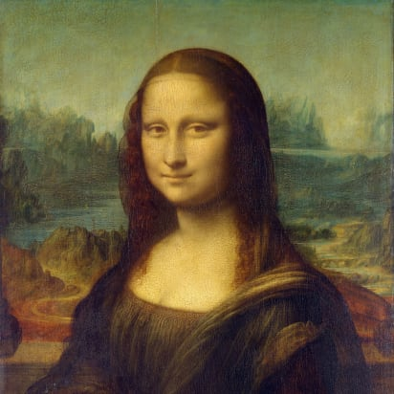
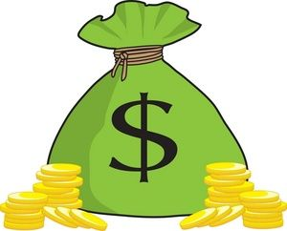
Two Types of Knapsack Problem
0/1 knapsack problem
Each item is discrete: must choose all of it or none of it. So each x_{i} is 0 or 1
Greedy approach does not produce optimal solutions
But dynamic programming does
Fractional knapsack problem (AKA continuous knapsack)
Can pick up fractions of each item. So each x_{i} is a value between 0 or 1
A greedy algorithm finds the optimal solution
28

Slide 29
Formal Statement of Fractional Knapsack Problem
Given n objects and a knapsack of capacity C, where object i has weight w_{i} and earns profit p_{i}, find values x_{i} that maximize the total profit subject to the constraints

Slide 30
Greedy Approach
Let’s use a greedy strategy to solve the fractional knapsack
Build solution by stages, adding one item to partial solution found so far
At each stage, make locally optimal choice based on the greedy choice (sometimes called the greedy rule or the selection function)
Locally optimal, i.e. best choice given what info available now
Irrevocable: a choice can’t be un-done
Sequence of locally optimal choices leads to globally optimal solution (hopefully)
Must prove this for a given problem!
Approximation algorithms, heuristic algorithms

Slide 31
A Bit More Terminology
Problems solvable by both Dynamic Programming and the Greedy approach have the optimal substructure property:
An optimal solution to a problem contains within it optimal solutions to subproblems
This allows us to build a solution one step at a time, because we can solve increasingly smaller problems with confidence

Slide 32
Greedy Approach for Fractional Knapsack?
Build up a partial solutions:
Determine which of the remaining items to add
How much can you add (its x_{i})
Repeat until knapsack is full (or no more items)
Which item to choose next? What’s a good greedy choice (AKA greedy selection)?
Let’s try several obvious options on this example:
n = 3, C = 20
Item | Value | Weight
1 | 25 | 18
2 | 24 | 15
3 | 15 | 10

Slide 33
Possible Greedy Choices for Knapsack
Greedy choice #1: by highest profit value
n = 3, C = 20
Item 1 first. Can take all of it, so x₁ is 1. Capacity used is 18 of 20. Profit so far is 25.
Item 2 next. Room for only 2 units, so x₂ is 2/15 = 0.133. Capacity used is 20 of 20. Profit so far is 25 + (24 x 0.133) = 28.2.
Item 3 would be next, but knapsack full! x₃ is 0. Total profit is 28.2. x_{i} = (1, .133, 0)
Item | Value | Weight
1 | 25 | 18
2 | 24 | 15
3 | 15 | 10
Select item 1 first, then item 2, then item 3. Take as much of each as fits!

Slide 34
Possible Greedy Choices for Knapsack
Greedy choice #2: by lowest weight
n = 3, C = 20
Item 3 first. Can take all of it, so x₃ is 1. Capacity used is 10 of 20. Profit so far is 15.
Item 2 next. Room for only 10 units, so x₂ is 10/15 = 0.667. Capacity used is 20 of 20. Profit so far is 15 + (24 x 0.667) = 31.
Item 1 would be next, but knapsack full! x₁ is 0. Total profit is 31.0. x_{i} = (0, .667, 1)
Note it’s better than previous greedy choice.
Best possible?
Item | Value | Weight
1 | 25 | 18
2 | 24 | 15
3 | 15 | 10
Select item 3 first, then item 2, then item 1. Take as much of each as fits!

Slide 35
Possible Greedy Choices for Knapsack
Greedy choice #3: highest value-to-weight ratio
n = 3, C = 20
Item 2 first. Can take all of it, so x₂ is 1. Capacity used is 15 of 20. Profit so far is 24.
Item 3 next. Room for only 5 units, so x₁ is 5/10 = 0.5. Capacity used is 20 of 20. Profit so far is 24 + (15 x 0.5) = 31.5.
Item 1 would be next, but knapsack full! x₁ is 0. Total profit is 31.5. x_{i} = (0, 1, 0.5)
This greedy choice produces optimal solution!
Must prove this (but we won’t today).
Item | Value | Weight | Ratio
1 | 25 | 18 | 1.4
2 | 24 | 15 | 1.6
3 | 15 | 10 | 1.5
Select item 2 first, then item 3, then item 1. Take as much of each as fits!

Slide 36
Fractional Knapsack Algorithm
FRACTIONAL_KNAPSACK(a, C)
1 n = a.last
2 for i = 1 to n
3 ratio[i] = a[i].p / a[i].w
4 sort(a, ratio)
5 weight = 0
6 i = 1
7 while (i ≤ n and weight < C)
8 if (weight + a[i].w ≤ C)
9 println “select all of object “ + a[i].id
10 weight = weight + a[i].w
11 else
12 r = (C – weight) / a[i].w
13 println “select “ + r + “ of object “ + a[i].id
14 weight = C
15 i = i+1
Worst-case runtime: for loop and while loop take θ(n) time,
sorting takes θ(nlgn) time, so algorithm takes θ(nlgn) time

Slide 37
Another Knapsack Example to Try
Assume for this problem that:
Ratios of profit to weight:
What order do we examine items?
What are the x_{i} values that result?
What’s the total profit?
p₁/w₁ = 5/120 = .0417
p₂/w₂ = 5/150 = .0333
p₃/w₃ = 4/200 = .0200
p₄/w₄ = 8/150 = .0533
p₅/w₅ = 3/140 = .0214

Slide 38
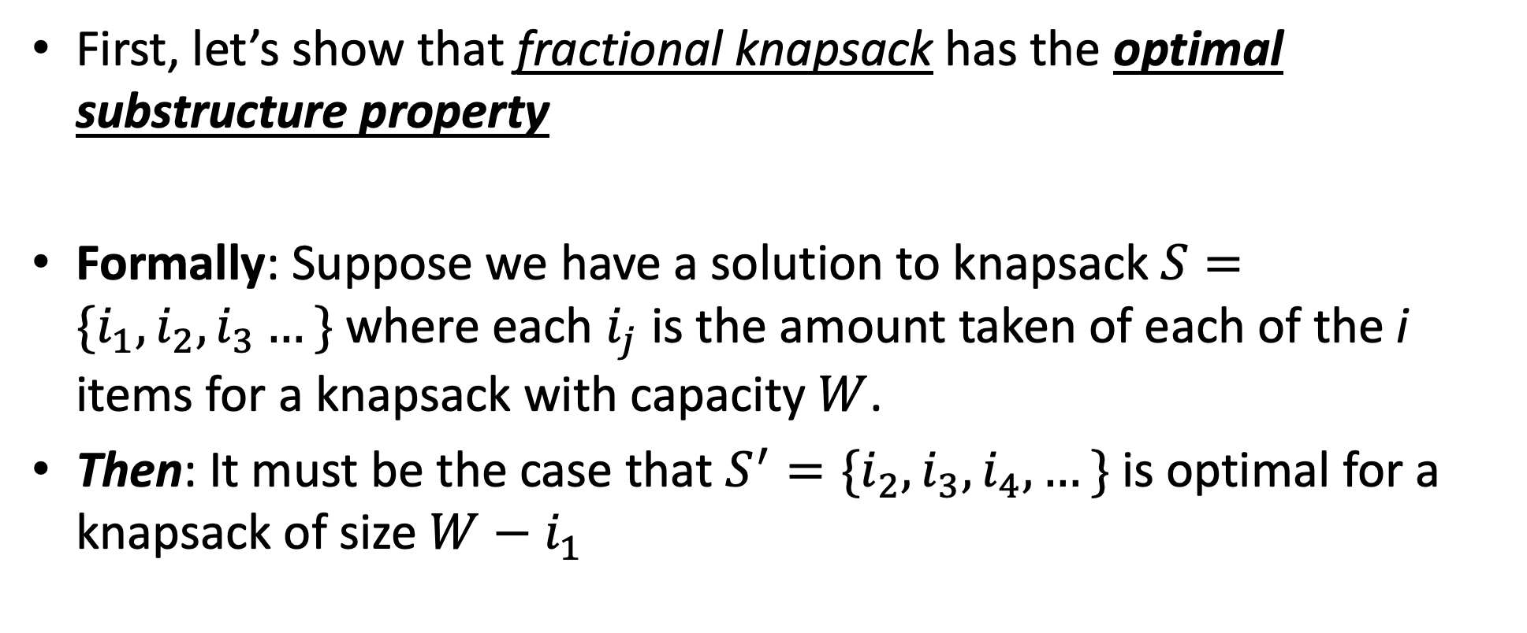
Optimal Substructure Proof
First, let’s show that fractional knapsack has the optimal substructure property
Formally: Suppose we have a solution to knapsack $S=\{i_{1},i_{2},i_{3}…\}$ where each $i_{j}$ is the amount taken of each of the i items for a knapsack with capacity $W$.
Then: It must be the case that $S^{′}=\{i_{2},i_{3},i_{4},…\}$ is optimal for a knapsack of size $W−i_{1}$

Slide 39
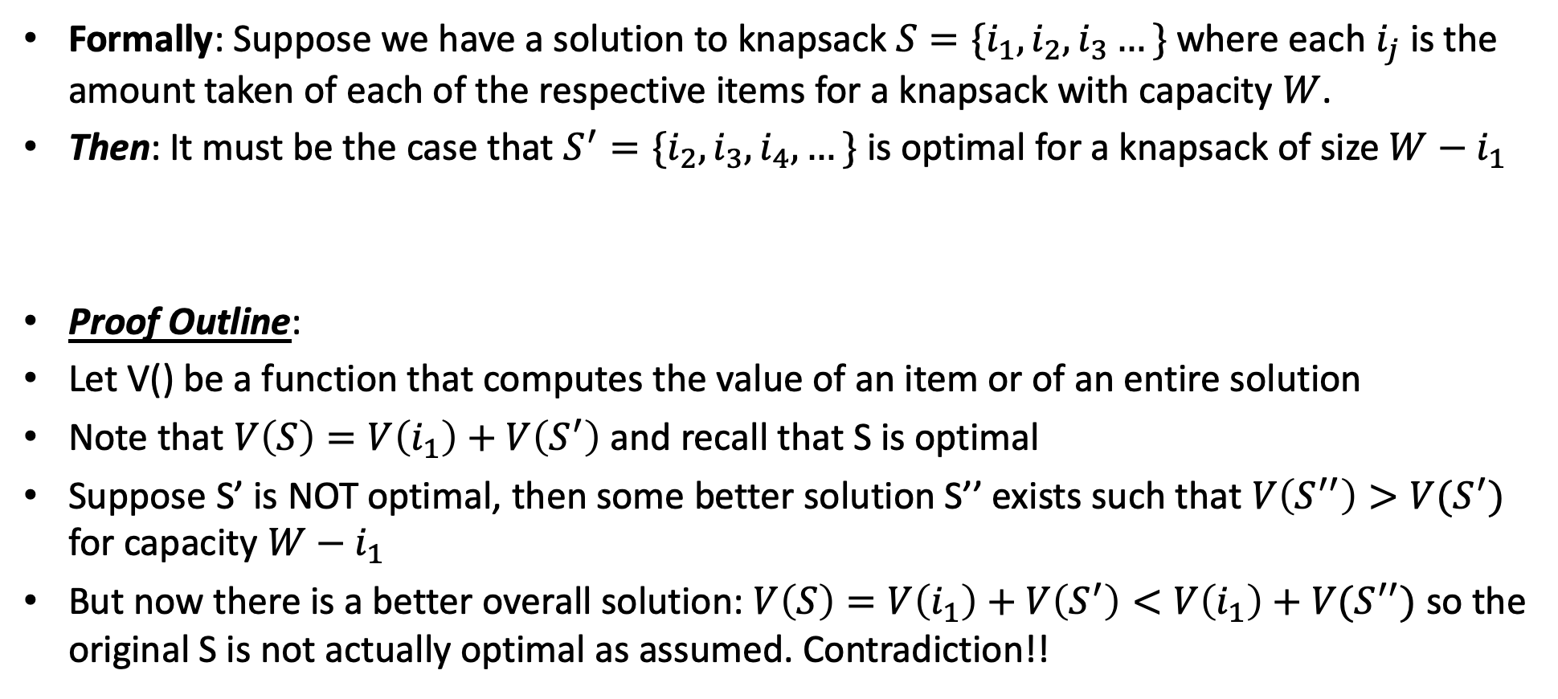
Optimal Substructure Proof
Formally: Suppose we have a solution to knapsack $S=\{i_{1},i_{2},i_{3}…\}$ where each $i_{j}$ is the amount taken of each of the respective items for a knapsack with capacity $W$.
Then: It must be the case that $S^{′}=\{i_{2},i_{3},i_{4},…\}$ is optimal for a knapsack of size $W−i_{1}$
Proof Outline:
Let V() be a function that computes the value of an item or of an entire solution
Note that $V\left(S\right)=V\left(i_{1}\right)+V\left(S^{′}\right)$ and recall that S is optimal
Suppose S’ is NOT optimal, then some better solution S’’ exists such that $V\left(S^{′′}\right)>V(S^{′})$ for capacity $W−i_{1}$
But now there is a better overall solution: $V\left(S\right)=V\left(i_{1}\right)+V\left(S^{′}\right)<V\left(i_{1}\right)+V(S^{′′})$ so the original S is not actually optimal as assumed. Contradiction!!

Slide 40
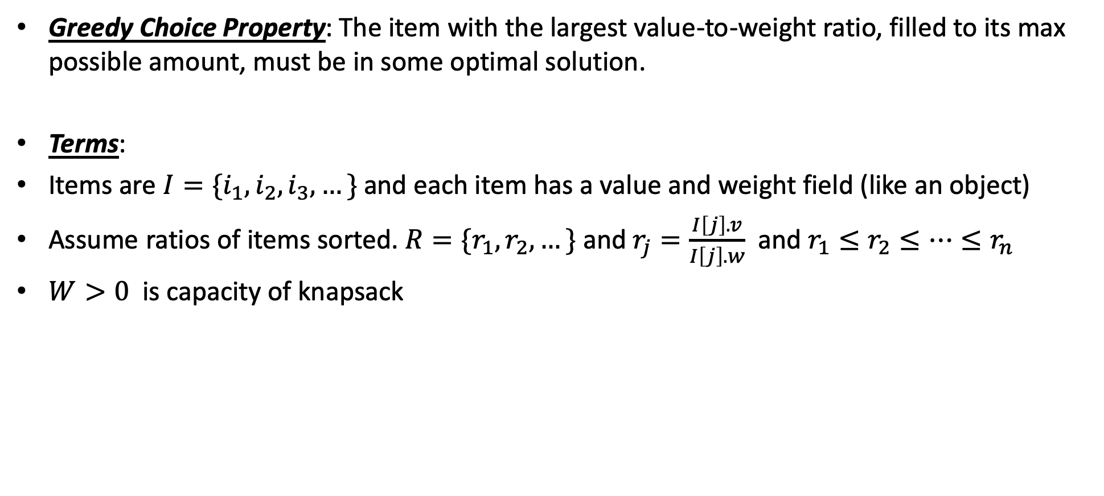
Greedy Choice Property
Greedy Choice Property: The item with the largest value-to-weight ratio, filled to its max possible amount, must be in some optimal solution.
Terms:
Items are $I=\{i_{1}, i_{2},i_{3},…\}$ and each item has a value and weight field (like an object)
Assume ratios of items sorted. $R=\{r_{1},r_{2},…\}$ and $r_{j}=\frac{I\left[j\right].v}{I\left[j\right].w}$ and $r_{1}≤r_{2}≤…≤r_{n}$
$W>0$ is capacity of knapsack

Slide 41
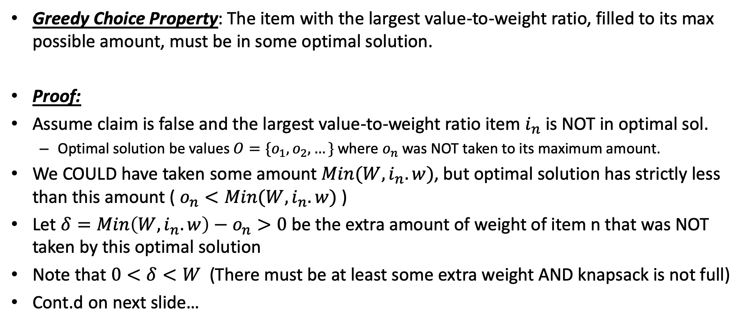
Greedy Choice Property
Greedy Choice Property: The item with the largest value-to-weight ratio, filled to its max possible amount, must be in some optimal solution.
Proof:
Assume claim is false and the largest value-to-weight ratio item $i_{n}$ is NOT in optimal sol.
Optimal solution be values $O=\{o_{1},o_{2},…\}$ where $o_{n}$ was NOT taken to its maximum amount.
We COULD have taken some amount $Min(W,i_{n}.w)$, but optimal solution has strictly less than this amount ( $o_{n}<Min(W,i_{n}.w)$ )
Let $δ=Min\left(W,i_{n}.w\right)−o_{n}>0$ be the extra amount of weight of item n that was NOT taken by this optimal solution
Note that $0<δ<W$ (There must be at least some extra weight AND knapsack is not full)
Cont.d on next slide…

Slide 42
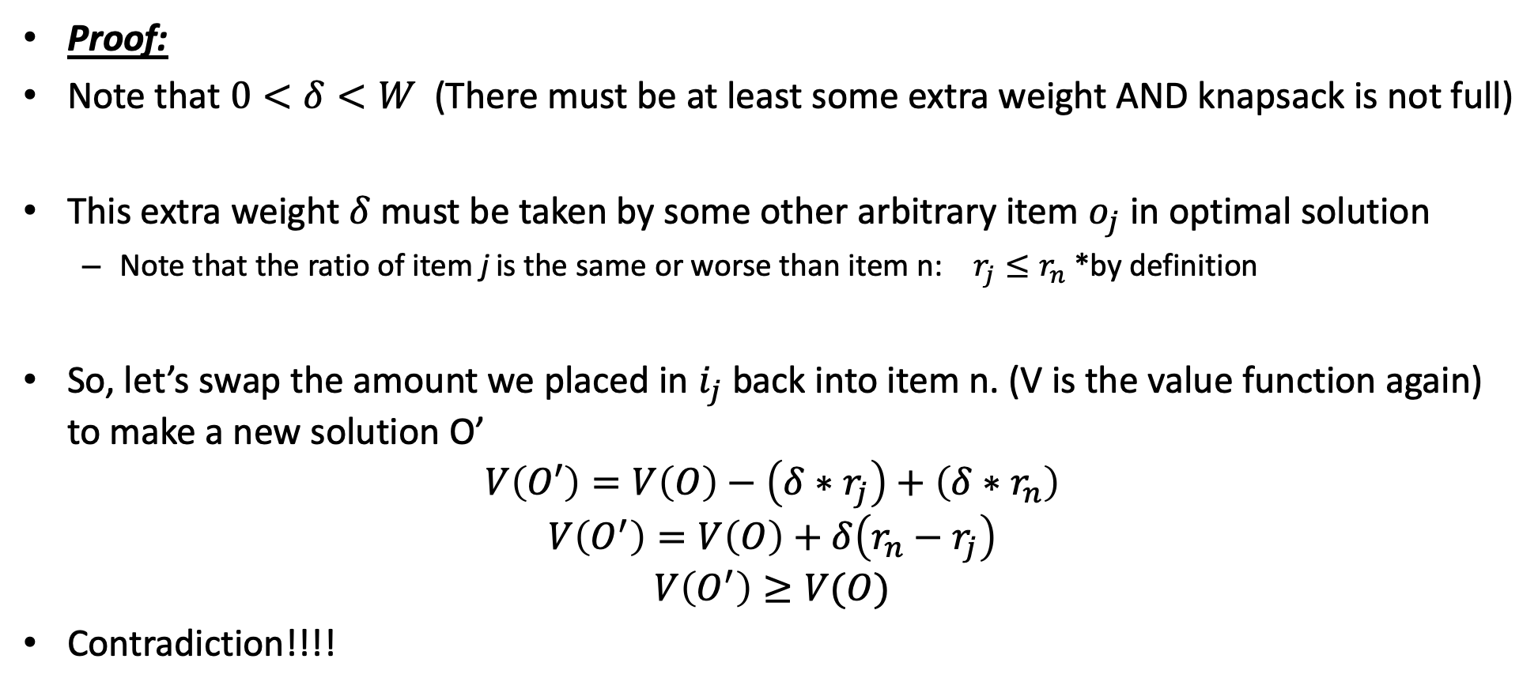
Greedy Choice Property
Proof:
Note that $0<δ<W$ (There must be at least some extra weight AND knapsack is not full)
This extra weight $δ$ must be taken by some other arbitrary item $o_{j}$ in optimal solution
Note that the ratio of item j is the same or worse than item n: $r_{j}≤r_{n}$ *by definition
So, let’s swap the amount we placed in $i_{j}$ back into item n. (V is the value function again) to make a new solution O’
$$V\left(O′\right)=V\left(O\right)−\left(δ∗r_{j}\right)+\left(δ∗r_{n}\right)$$
$$V\left(O^{′}\right)=V\left(O\right)+δ\left(r_{n}−r_{j}\right)$$
$$V\left(O^{′}\right)≥V(O)$$
Contradiction!!!!

Slide 43
0/1 knapsack
n = 3, C = 4
Let’s try this same greedy solution with the 0/1 version
New example inputs →
Item 1 first. So x₁ is 1. Capacity used is 1 of 4. Profit so far is 3.
Item 2 next. There’s room for it! So x₂ is 1. Capacity used is 3 of 4. Profit so far is 3 + 5 = 8.
Item 3 would be next, but its weight is 3 and knapsack only has 1 unit left! So x₃ is 0. Total profit is 8. x_{i} = (1, 1, 0)
But picking items 1 and 3 will fit in knapsack, with total value of 9
Thus, the greedy solution does not produce an optimal solution to the 0/1 knapsack algorithm
Greedy choice left unused room, but we can’t take a fraction of an item
The 0/1 knapsack problem doesn’t have the greedy choice property
Item | Value | Weight | Ratio
1 | 3 | 1 | 3
2 | 5 | 2 | 2.5
3 | 6 | 3 | 2

Slide 44
Activity Selection

Slide 45
Activity-Selection Problem
Problem: You and your classmates go on Semester at Sea
Many exciting activities each morning
Each starting and ending at different times
Maximize your “education” by doing as many as possible
This problem: they’re all equally good!
Another problem: they have weights (we need DP for that one)
Welcome to the activity selection problem
Also called interval scheduling

Slide 46
The Activities!
Id | Start | End | Activity
1 | 9:00 | 10:45 | Fractals, Recursion and Crayolas
2 | 9:15 | 10:15 | Tropical Drink Engineering with Prof. Bloomfield
3 | 9:30 | 12:30 | Managing Keyboard Fatigue with Swedish Massage
4 | 9:45 | 10:30 | Applied ChemE: Suntan Oil or Lotion?
5 | 9:45 | 11:15 | Optimization, Greedy Algorithms, and the Buffet Line
6 | 10:15 | 11:00 | Hydrodynamics and Surfing
7 | 10:15 | 11:30 | Computational Genetics and Infectious Diseases
8 | 10:30 | 11:45 | Turing Award Speech Karaoke
9 | 11:00 | 12:00 | Pool Tanning for Engineers
10 | 11:00 | 12:15 | Mechanics, Dynamics and Shuffleboard Physics
11 | 12:00 | 12:45 | Discrete Math Applications in Gambling

Slide 47
Generalizing Start, End
Id | Start | End | Len | Activity
1 | 0 | 6 | 7 | Fractals, Recursion and Crayolas
2 | 1 | 4 | 4 | Tropical Drink Engineering with Prof. Bloomfield
3 | 2 | 13 | 12 | Managing Keyboard Fatigue with Swedish Massage
4 | 3 | 5 | 3 | Applied ChemE: Suntan Oil or Lotion?
5 | 3 | 8 | 6 | Optimization, Greedy Algorithms, and the Buffet Line
6 | 5 | 7 | 3 | Hydrodynamics and Surfing
7 | 5 | 9 | 5 | Computational Genetics and Infectious Diseases
8 | 6 | 10 | 5 | Turing Award Speech Karaoke
9 | 8 | 11 | 4 | Pool Tanning for Engineers
10 | 8 | 12 | 5 | Mechanics, Dynamics and Shuffleboard Physics
11 | 12 | 14 | 3 | Discrete Math Applications in Gambling

Slide 48
Greedy Approach
Select a first item.
Eliminate items that are incompatible with that item. (I.e. they overlap, not part of a feasible solution)
Apply the greedy choice (AKA selection function) to pick the next item.
Go to Step 2
What is a good greedy choice for selecting next item?

Slide 49
Some Possibilities
Maybe pick the next compatible activity that starts earliest?
“Compatible” here means “doesn’t overlap”
Or, pick the shortest one?
Or, pick the one that has the least conflicts (i.e. overlaps)?
Or…?

Slide 50
Activity-Selection
Formally:
Given a set S of n activities
s_{i} = start time of activity i
f_{i} = finish time of activity i
Find max-size subset A of compatible activities
3
4
6
2
1
5
Assume (wlog) that f₁ ≤ f₂ ≤ … ≤ f_{n}

Slide 51
Activity Selection: A Greedy Algorithm
The algorithm using the best greedy choice is simple:
Sort the activities by finish time
Schedule the first activity
Then schedule the next activity in sorted list which starts after previous activity finishes
Repeat until no more activities
Or in simpler terms:
Always pick the compatible activity that finishes earliest

Slide 52
Optimal Substructure Property
Remember?
Detailed discussion on p. 379 (in chapter on Dynamic Programming)
If A is an optimal solution to a problem, then the components of A are optimal solutions to subproblems
Reminder: Example 1, Shortest Path
Say P is min-length path from CHO to LA and includes DAL
Let P₁ be component of P from CHO to DAL, and P₂ be component of P from DAL to LA
P₁ must be shortest path from CHO to DAL, and P₂ must be shortest path from DAL to LA
Why is this true? Can you prove it? Yes, by contradiction.
Do it! In-class exercise

Slide 53
Activity Selection: Optimal Substructure
Let k be the minimum activity in the solution A (i.e., the one with the earliest finish time). Then A - {k} is an optimal solution to S’ = {i ∈ S: s_{i} ≥ f_{k}}
In words: once activity #1 is selected, the problem reduces to finding an optimal solution for activity-selection over activities in S compatible with activity #1
Proof: if we could find optimal solution B’ to S’ with |B| > |A - {k}|,
Then B U {k} is compatible
And |B U {k}| > |A| -- contradiction! We said A is the overall best.
Note: book’s discussion on p. 416 is essentially this, but doesn’t assume we choose the 1st activity

Slide 54
Back to Semester at Sea…
Id | Start | End | Len | Activity
2 | 1 | 4 | 4 | Tropical Drink Engineering with Prof. Bloomfield
4 | 3 | 5 | 3 | Applied ChemE: Suntan Oil or Lotion?
1 | 0 | 6 | 7 | Fractals, Recursion and Crayolas
6 | 5 | 7 | 3 | Hydrodynamics and Surfing
5 | 3 | 8 | 6 | Optimization, Greedy Algorithms, and the Buffet Line
7 | 5 | 9 | 5 | Computational Genetics and Infectious Diseases
8 | 6 | 10 | 5 | Turing Award Speech Karaoke
9 | 8 | 11 | 4 | Pool Tanning for Engineers
10 | 8 | 12 | 5 | Mechanics, Dynamics and Shuffleboard Physics
3 | 2 | 13 | 12 | Managing Keyboard Fatigue with Swedish Massage
11 | 12 | 14 | 3 | Discrete Math Applications in Gambling
Solution: 2, 6, 9, 11

Slide 55
Visualizing these Activities
ID | Start | End |  | 0 | 1 | 2 | 3 | 4 | 5 | 6 | 7 | 8 | 9 | 10 | 11 | 12 | 13 | 14
1 | 0 | 6
2 | 1 | 4
3 | 2 | 13
4 | 3 | 5
5 | 3 | 8
6 | 5 | 7
7 | 5 | 9
8 | 6 | 10
9 | 8 | 11
10 | 8 | 12
11 | 12 | 14

Slide 56
Visualizing these Activities in Solution
ID | Start | End |  | 0 | 1 | 2 | 3 | 4 | 5 | 6 | 7 | 8 | 9 | 10 | 11 | 12 | 13 | 14
1 | 0 | 6
2 | 1 | 4
3 | 2 | 13
4 | 3 | 5
5 | 3 | 8
6 | 5 | 7
7 | 5 | 9
8 | 6 | 10
9 | 8 | 11
10 | 8 | 12
11 | 12 | 14

Slide 57
Sorted, Then Showing Selection and Incompatibilities
ID | Start | End |  | 0 | 1 | 2 | 3 | 4 | 5 | 6 | 7 | 8 | 9 | 10 | 11 | 12 | 13 | 14
2 | 1 | 4
4 | 3 | 5
1 | 0 | 6
6 | 5 | 7
5 | 3 | 8
7 | 5 | 9
8 | 6 | 10
9 | 8 | 11
10 | 8 | 12
3 | 2 | 13
11 | 12 | 14
Select solid-colored item,
Eliminates activities X’d
out of same color

Slide 58
Book’s Recursive Greedy Algorithm
RECURSIVE-ACTIVITY-SELECTOR(s, f, k, n)
1 m = k + 1 // start with the activity after the last added activity
2 while m ≤ n and s[m] < f[k] // find the first activity in S_{k} to finish
3 m = m + 1
4 if m ≤ n
5 return {a_{m}} U RECURSIVE-ACTIVITY-SELECTOR(s, f, m, n)
6 else return Ø
Add dummy activity a₀ with f₀ = 0, so that sub-problem S₀ is entire set of activities S
Initial call: RECURSIVE-ACTIVITY-SELECTOR(s, f, 0, n)
Run time is θ(n), assuming the activities are already sorted by finish times

Slide 59
Non-recursive algorithm
greedy-interval (s, f)
n = s.length
A = {a₁}
k = 1 # last added
for m = 2 to n
if s[m] ≥ f[k]
A = A U {a_{m}}
k = m
return A
s is an array of the intervals’ start times
f is an array of the intervals’ finish times, sorted
A is the array of the intervals to schedule
How long does this take?

Slide 61
Does Greedy Always Find Optimal Solution?
Yes, we can prove that the greedy algorithm always “stays ahead”!

Slide 62
Does Greedy Always Find Optimal Solution?
Yes, we can prove that the greedy algorithm always “stays ahead”!
How?
Overall idea: Show the i’th interval algorithm chooses always ends earlier than optimal solution

Slide 63
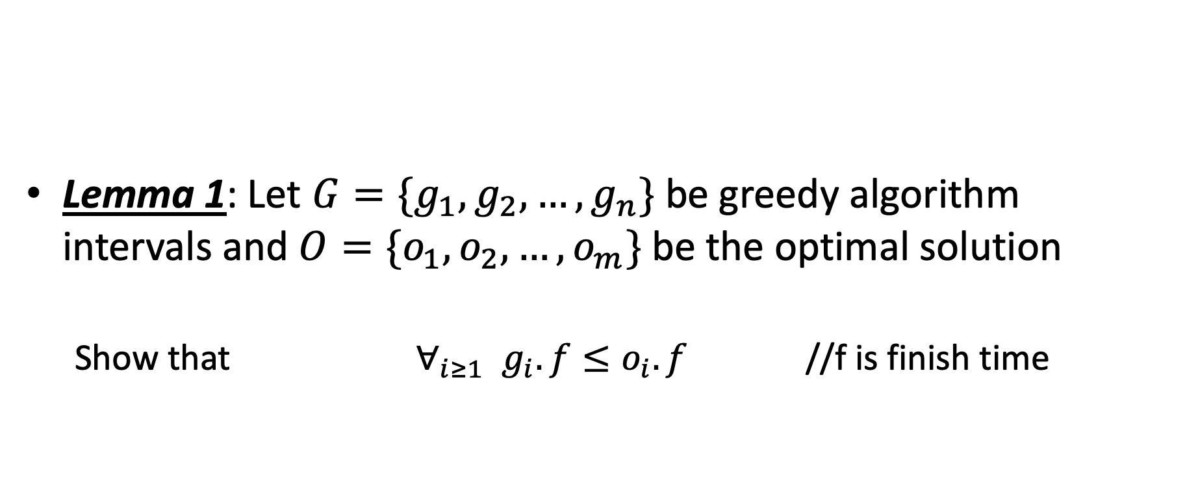
Does Greedy Always Find Optimal Solution?
Lemma 1: Let $G=\{g_{1},g_{2},…,g_{n}\}$ be greedy algorithm intervals and $O=\{o_{1},o_{2},…, o_{m}\}$ be the optimal solution
Show that $∀_{i≥1}{ g}_{i}.f≤o_{i}.f$ //f is finish time

Slide 64
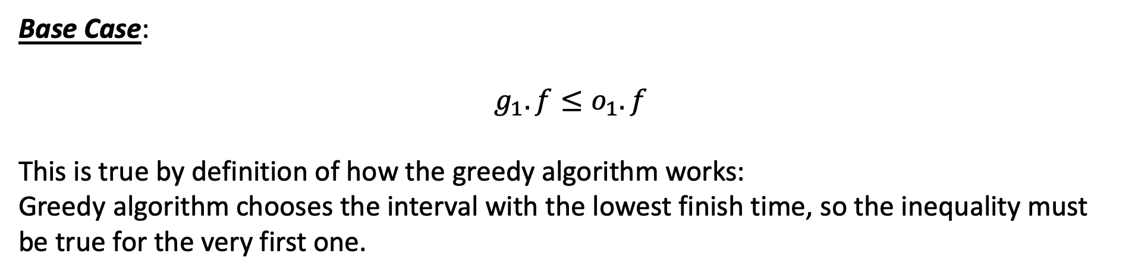
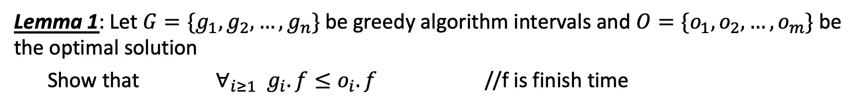
Does Greedy Always Find Optimal Solution?
Lemma 1: Let $G=\{g_{1},g_{2},…,g_{n}\}$ be greedy algorithm intervals and $O=\{o_{1},o_{2},…, o_{m}\}$ be the optimal solution
Show that $∀_{i≥1}{ g}_{i}.f≤o_{i}.f$ //f is finish time
Base Case:
$$g_{1}.f≤o_{1}.f$$
This is true by definition of how the greedy algorithm works:
Greedy algorithm chooses the interval with the lowest finish time, so the inequality must be true for the very first one.

Slide 65
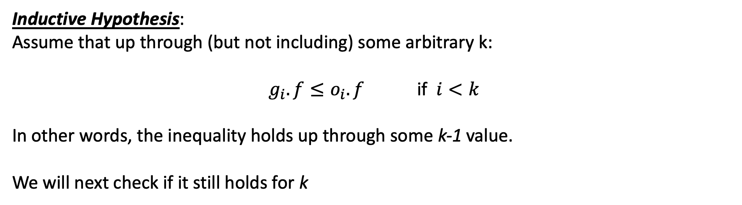
Does Greedy Always Find Optimal Solution?
Lemma 1: Let $G=\{g_{1},g_{2},…,g_{n}\}$ be greedy algorithm intervals and $O=\{o_{1},o_{2},…, o_{m}\}$ be the optimal solution
Show that $∀_{i≥1}{ g}_{i}.f≤o_{i}.f$ //f is finish time
Inductive Hypothesis:
Assume that up through (but not including) some arbitrary k:
$g_{i}.f≤o_{i}.f$ if $i<k$
In other words, the inequality holds up through some k-1 value.
We will next check if it still holds for k

Slide 66
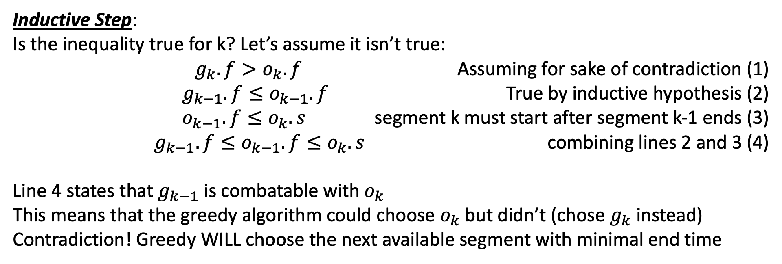
Does Greedy Always Find Optimal Solution?
Lemma 1: Let $G=\{g_{1},g_{2},…,g_{n}\}$ be greedy algorithm intervals and $O=\{o_{1},o_{2},…, o_{m}\}$ be the optimal solution
Show that $∀_{i≥1}{ g}_{i}.f≤o_{i}.f$ //f is finish time
Inductive Step:
Is the inequality true for k? Let’s assume it isn’t true:
$g_{k}.f>o_{k}.f$ Assuming for sake of contradiction (1)
$g_{k−1}.f≤o_{k−1}.f$ True by inductive hypothesis (2)
$o_{k−1}.f≤o_{k}.s$ segment k must start after segment k-1 ends (3)
$g_{k−1}.f≤o_{k−1}.f≤o_{k}.s$ combining lines 2 and 3 (4)
Line 4 states that $g_{k−1}$ is combatable with $o_{k}$
This means that the greedy algorithm could choose $o_{k}$ but didn’t (chose $g_{k}$ instead)
Contradiction! Greedy WILL choose the next available segment with minimal end time

Slide 67
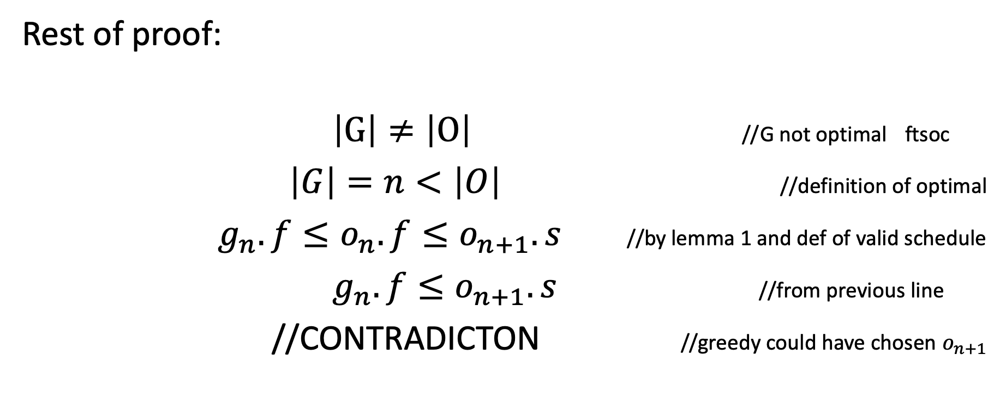
Does Greedy Always Find Optimal Solution?
Rest of proof:
$\left|G\right|≠\left|O\right|$ //G not optimal ftsoc
$\left|G\right|=n<\left|O\right|$ //definition of optimal
$g_{n}.f≤o_{n}.f≤o_{n+1}.s$ //by lemma 1 and def of valid schedule
$g_{n}.f≤o_{n+1}.s$ //from previous line
//CONTRADICTON //greedy could have chosen $o_{n+1}$

Slide 68
Bridge Crossing

Slide 69
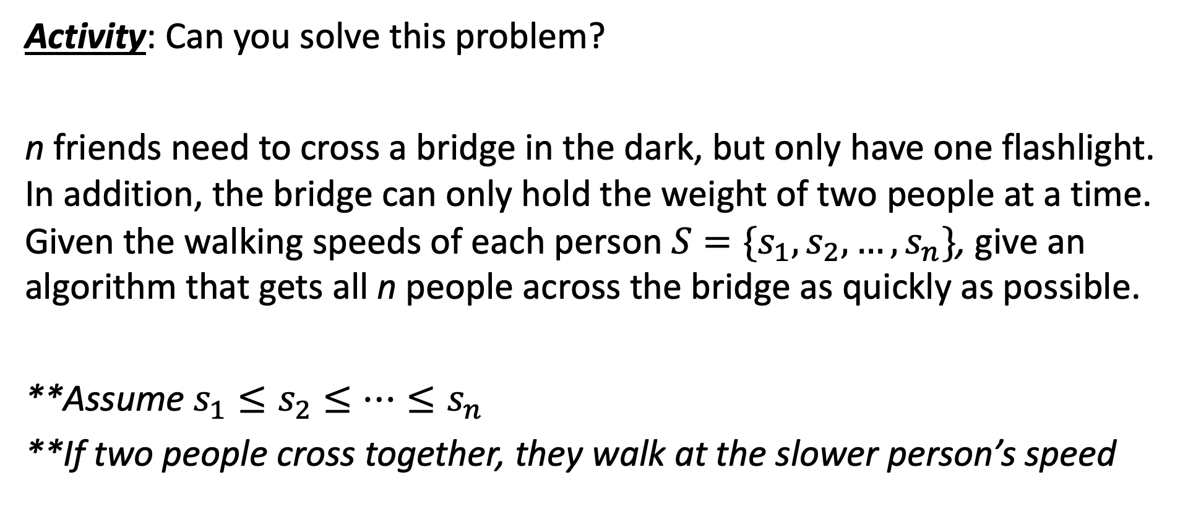
Can you solve it??
Activity: Can you solve this problem?
n friends need to cross a bridge in the dark, but only have one flashlight. In addition, the bridge can only hold the weight of two people at a time. Given the walking speeds of each person $S=\{s_{1},s_{2},…,s_{n}\}$, give an algorithm that gets all n people across the bridge as quickly as possible.
**Assume $s_{1}≤s_{2}≤…≤s_{n}$
**If two people cross together, they walk at the slower person’s speed

Slide 70
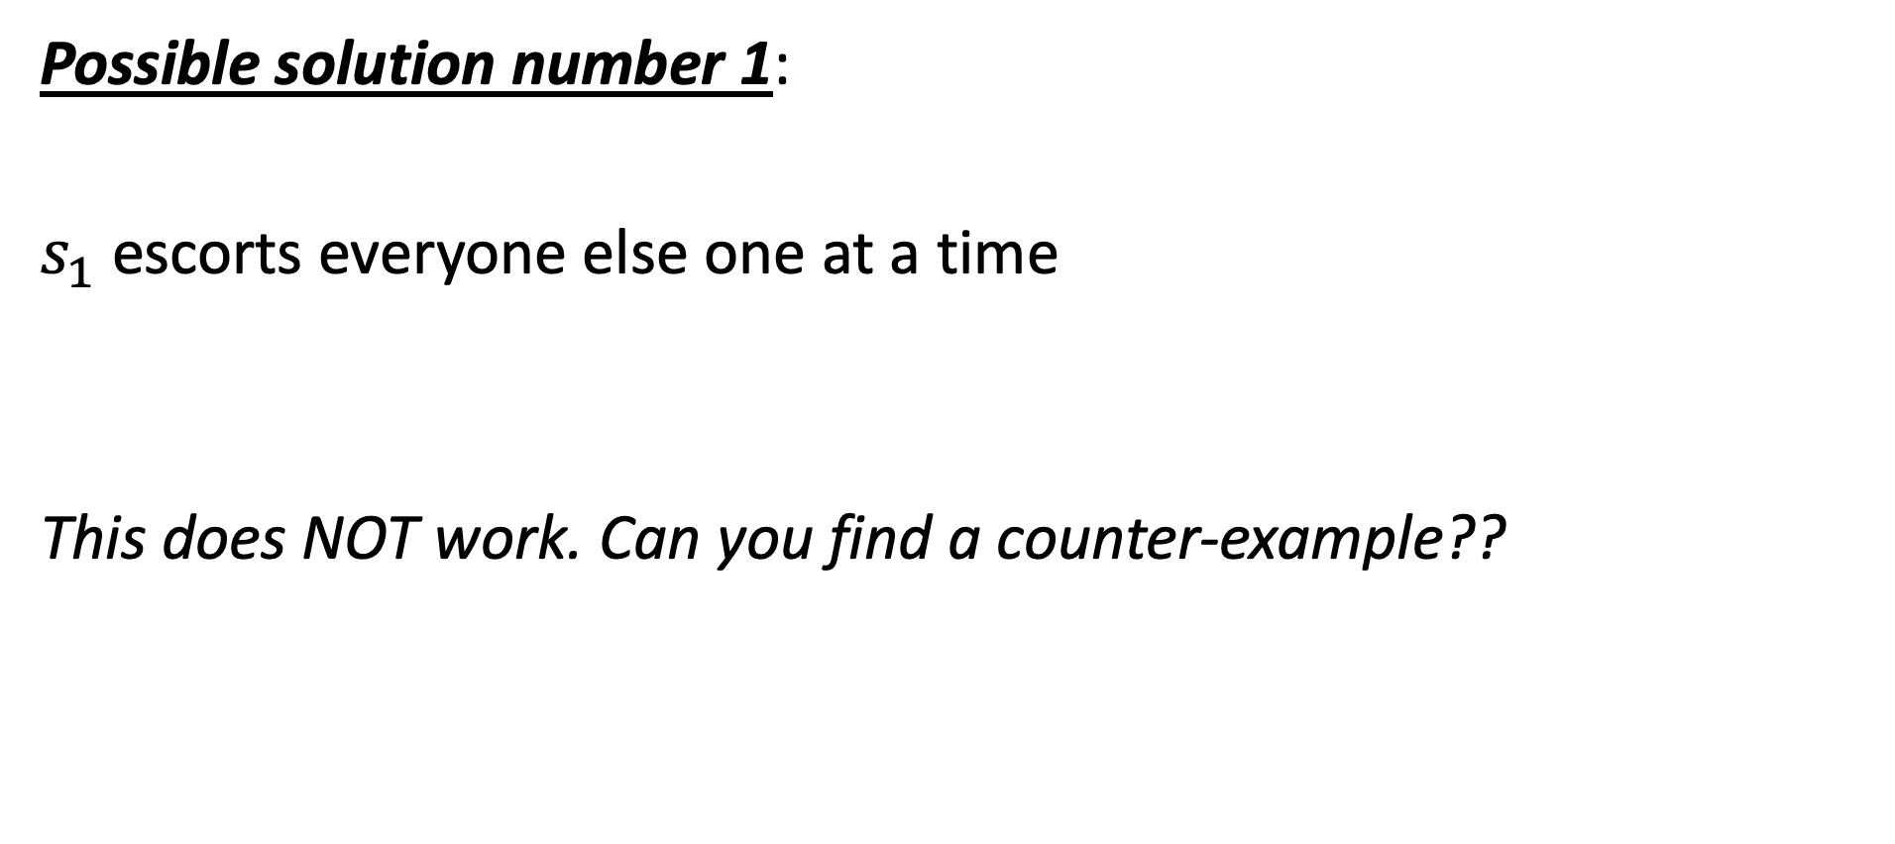
Can you solve it??
Possible solution number 1:
$s_{1}$ escorts everyone else one at a time
This does NOT work. Can you find a counter-example??

Slide 71
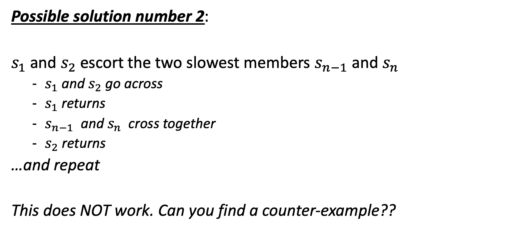
Can you solve it??
Possible solution number 2:
$s_{1}$ and $s_{2}$ escort the two slowest members $s_{n−1}$ and $s_{n}$
$s_{1}$ and $s_{2}$ go across
$s_{1}$ returns
$s_{n−1}$ and $s_{n}$ cross together
$s_{2}$ returns
…and repeat
This does NOT work. Can you find a counter-example??

Slide 72
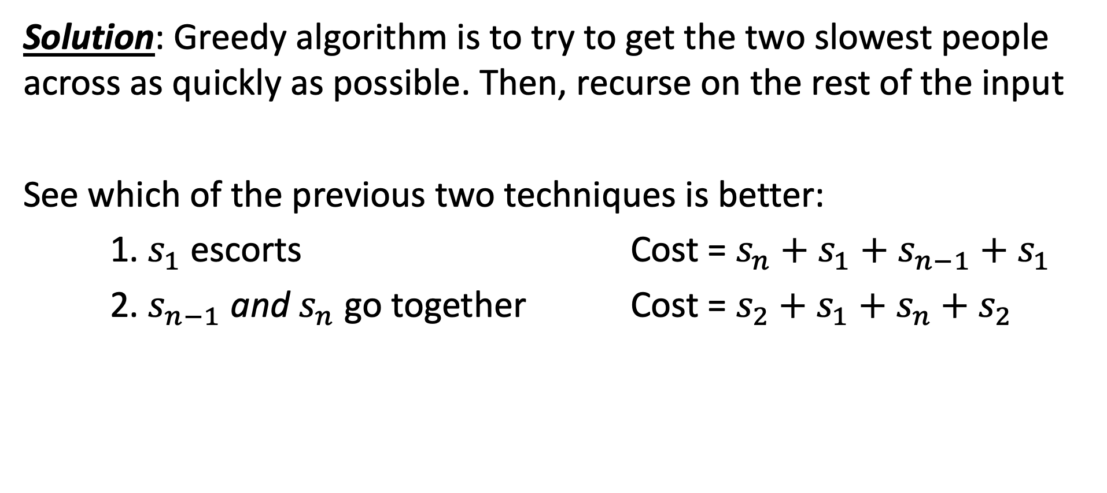
Can you solve it??
Solution: Greedy algorithm is to try to get the two slowest people across as quickly as possible. Then, recurse on the rest of the input
See which of the previous two techniques is better:
1. $s_{1}$ escorts Cost = $s_{n}+s_{1}+s_{n−1}+s_{1}$
2. $s_{n−1}$ and $s_{n}$ go together Cost = $s_{2}+s_{1}+s_{n}+s_{2}$

Slide 73
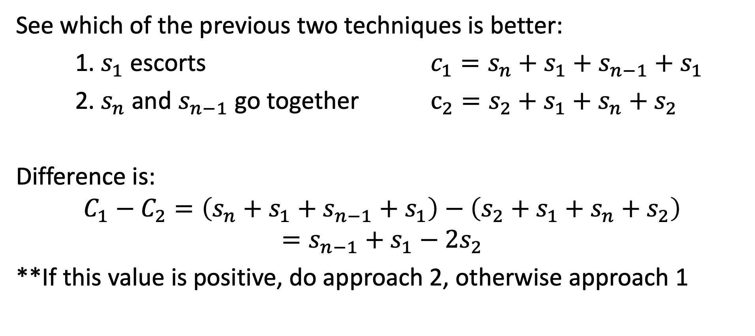
Can you solve it??
See which of the previous two techniques is better:
1. $s_{1}$ escorts ${c_{1}=s}_{n}+s_{1}+s_{n−1}+s_{1}$
2. $s_{n}$ and $s_{n−1}$ go together $c_{2}=s_{2}+s_{1}+s_{n}+s_{2}$
Difference is:
$$C_{1}−C_{2}=\left(s_{n}+s_{1}+s_{n−1}+s_{1}\right)−\left(s_{2}+s_{1}+s_{n}+s_{2}\right)$$
$$=s_{n−1}+s_{1}−2s_{2}$$
**If this value is positive, do approach 2, otherwise approach 1

