Slide 1
Network Flow
Mark Floryan and Tom Horton CS4102 – Fall 2021

Slide 2
Topics

Slide 3
Topics in this slide-deck:
Flow-Networks
Max-flow problem
Ford-Fulkerson Algorithm
Max-Flow Min-Cut Theorem
What is it? Why does it matter?
Proof!
An introduction to reductions (topic of next section)

Slide 4
Maximal Flow

Slide 5
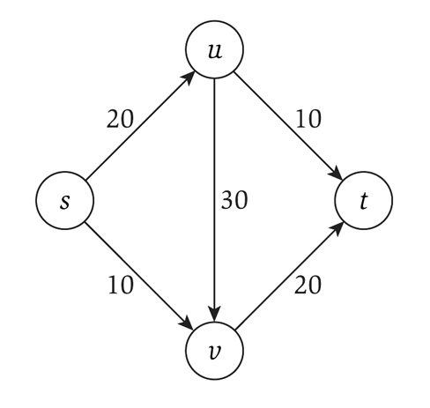
Flow networks
Consider a flow network, which is a specialized directed graph with:
A single source node s
A single terminus node t
Capacities on each edge
That must be integer!
What is the maximum flow you can send from s to t?

Slide 6
Applications
Transportation networks
How many people can be routed?
Computer networks
Electrical distribution
Water distribution
Note that all these applications have multiple sources and multiple sinks!
Whereas the flow networks we study do not, yet

Slide 7
Some rules
Source node has NO incoming flow
Terminal (sink) node has NO outgoing flow
Internal nodes has net zero flow
all units of flow going in must be going out as well
No edge is over capacity
GOAL: Find the maximum flow that can be “pushed” through the network

Slide 8
Algorithm notation
Graph G has vertices V and edges E
s ∈V is the source
t ∈V is the sink (terminus)
f(u,v): the flow on the edge from u to v
f(v,u): the backflow on the edge from v to u
c(u,v): the capacity on the edge from u to v
c_{f}(u,v): the residual capacity on the edge from u to v
G_{f} is the graph where the edges weights are the residual capacities
THIS is usually the graph we actually use when running the algorithm we are about to see.

Slide 9
Ford-Fulkerson: Algorithm overview
Consider the residual capacities
Meaning how much capacity is left after taking into account how much flow is going through that edge
Find a path from s to t such that the minimum residual capacity is greater than zero
Since everything is integer, it must be 1 or more
Update the residual capacities after taking into account this new flow
Repeat until no more such paths are found

Slide 10
Backflow
Each edge has forward flow and backflow
The two must always be inverses of each other!
This allows for modeling of flow “returning” along a given edge

Slide 11
Ford-Fulkerson Algorithm
f(u,v) = 0 for all edges (u,v)
While there is an “augmenting” path p from s to t in G_{f} such that c_{f}(u,v) > 0 for all edges (u,v) ∈ p
Find c_{f}(p) = min{c_{f}(u,v) | (u,v) ∈ p}
For each edge (u,v) ∈ p
f(u,v) = f(u,v) + c_{f}(p) send flow along the path
f(v,u) = f(v,u) - c_{f}(p) send backflow the other way

Slide 12
Running time
Is O(E*f)
E is the number of edges
Maximum time to find an augmenting path via depth-first search
Can also use breadth-first search!
f is the maximum flow of the final graph
Minimum flow on an augmenting path is 1, so the maximum number of steps is thus f

Slide 13
What type of search?
“While there is a path p from s to t in G_{f}”
A depth-first search is the Ford-Fulkerson algorithm
Each augmenting path can be found in O(m) time
And there can be f paths
So the running time is O(mf)
Will not terminate with irrational edge values
A breadth-first search is the Edmonds-Karp algorithm
Runs in O(nm²)
Total number of augmentations is O(nm)
And finding each augmentation takes O(m)
Guaranteed termination with irrational edge values
Run-time is independent of the maximum flow of the graph

Slide 14
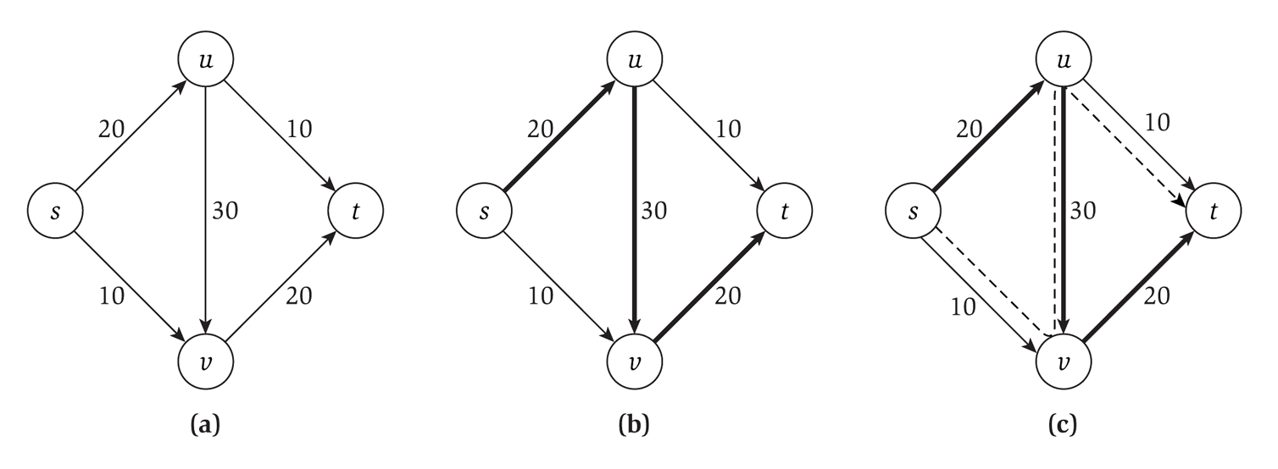
Our example

Slide 15
Minimum Cut

Slide 16
Definition: Cut
Given a flow network, we want to cut edges…
A cut C = (A, B) where:
A is a set of vertices (A is a subset of V)
B is a set of vertices (B also a subset of V)
A intersect B = null set (no shared vertices)
A union B = V (all vertices in either A or B)
s in A, t in B
What do we care about?
Well, we care about the edges that go across this cut.
Either from node in A to a node in B or vice versa.

Slide 17
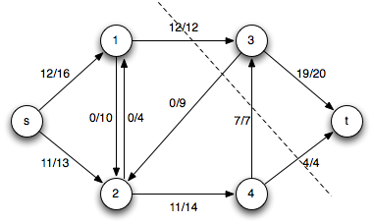
Definition: Net Flow across Cut
Given a cut C = (A, B)
The net flow across the cut C = (A, B) is the sum of the flows on its edges from A to B minus the sum of the flow on its edges from B to A

Slide 18
Definition: Flow-value lemma
Let f be any flow and C = (A, B) be any cut
The net flow across (A, B) equals the value of the flow f

Slide 19
Proof: Flow-value lemma
Let f be any flow and C = (A, B) be any cut
The net flow across (A, B) equals the value of the flow f
Proof by induction on the size of B
B.C. B = {t} (B is only the sink)
Clearly this is true as the flow across the cut is everyone sinking into t, which is the definition of the flow f
I.H. Assume true for some cut C = (A, B)
I.S. Move one node from A to B
Choose an a’ to move that has at least one edge to a node in B
We know the flow f never changes
How does the value of the new cut C’ = (A’, B’) change?
It doesn’t! Why? See next slide…

Slide 20
Proof: Flow-value lemma cont.
Let f be any flow and C = (A, B) be any cut
The net flow across (A, B) equals the value of the flow f
Why does C’ = (A’, B’) have the same net flow?
Local equilibrium: net flow coming into a’ from nodes in A only must equal the flow going out across the cut to nodes in B
After a’ is moved:
everything going across the cut now goes to something in B from B, everything going to or from a node in A now goes across the cut.
Thus, by local equilibrium the value of the cut C’ is equivalent to the value of the cut C
Induction done!

Slide 21
Max-flow min-cut theorem
The max-flow min-cut theorem states that the maximum value of an s-t flow is equal to the minimum capacity of an s-t cut
In other words, if you look at all the possible cuts in the graph, and find the smallest capacity of those cuts, then that value is the value of the maximum flow for that network.

Slide 22
Another definition: Weak Duality
Let f be any flow and C = (A, B) be any cut
Then:
Value of f <= capacity of C
Note: We are talking about the CAPACITY of C, not the value of the flow across C

Slide 23
Another version of MaxFlow-MinCut
The following three statements are equivalent:
For some flow f
1) There exists a cut whose capacity equals the value of f
2) f is a maximum flow
3) There is no augmenting path with respect to f
Let’s prove this!
1 → 2
2 → 3
3 → 1

Slide 24
How to determine the min cut?
Use the Ford-Fulkerson algorithm to determine max flow
Time is O(mf)
Worst case is each edge needs a cut
So we can determine the min cut in O(m) additional time
O(mf) + O(m) = O(mf)

