Slide 1
NP-Completeness
CS 4102: Algorithms
Spring 2021
Mark Floryan and Tom Horton

Slide 2
Topics

Slide 3
Why Study NP-Completeness
All semester, we’ve studied finding algorithms to solve problems using various tools.
Sometimes we instead need to prove that a problem is extremely hard, so as not to waste time on it!
NP-Complete Problems are hard
Let’s go over a few of them quickly
Let’s show how to prove a new problem is NP-Complete

Slide 4
NP-Completeness

Slide 5
Quick Background!
P: Set of problems solved in polynomial time (e.g., sorting a list)
NP: Set of problems that can be:
1) Solved in non-deterministic polynomial time
2) Verified in polynomial time
NP-Hard: Set of problems that are as hard as (or harder) than the hardest problems in NP
NP-Complete: Set of problems that are both NP and NP-Hard (i.e., the equally hardest problems in NP)

Slide 6
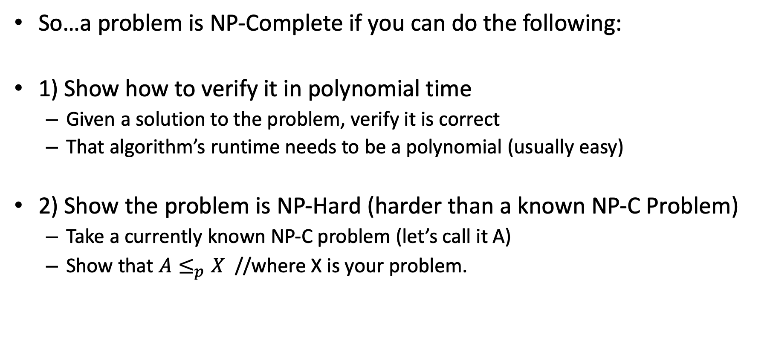
NP-Completeness
So…a problem is NP-Complete if you can do the following:
1) Show how to verify it in polynomial time
Given a solution to the problem, verify it is correct
That algorithm’s runtime needs to be a polynomial (usually easy)
2) Show the problem is NP-Hard (harder than a known NP-C Problem)
Take a currently known NP-C problem (let’s call it A)
Show that $A≤_{p}X$ //where X is your problem.

Slide 7
But You Need One NP-Hard First…
If you have one NP-Hard problem, you can use the technique just described to prove other problems are NP-Hard and NP-c
We need an NP-C problem to start this off
The definition of NP-Hard was created to prove a point
There might be problems that are at least as hard as “anything” (i.e. all NP problems)
Are there really NP-complete problems?
Cook-Levin Theorem: The satisfiability problem (SAT) is NP-Complete.
Stephen Cook proved this “directly”, from first principles, in 1971
Proven independently by Leonid Levin (USSR)
Showed that any problem that meets the definition of NP can be transformed in polynomial time to a CNF formula.
Proof outside the scope of this course (lucky you)

Slide 8
More About The SAT Problem
The first problem to be proved NP-Complete was satisfiability (SAT):
Given a Boolean expression on n variables, can we assign values such that the expression is TRUE?
Ex: ((x₁ →x₂) ∨ ¬((¬x₁ ↔ x₃) ∨ x₄)) ∧¬x₂
You might imagine that lots of decision problems could be expressed as a complex logical expression
And Cook and Levin proved you were right!
Proved the general result that any NP problem can be expressed this way

Slide 9
Conjunctive Normal Form (CNF)
Even if the form of the Boolean expression is simplified, the problem may be NP-Complete
Literal: an occurrence of a Boolean or its negation
A Boolean formula is in conjunctive normal form, or CNF, if it is an AND of clauses, each of which is an OR of literals
Ex: (x₁ ∨ ¬x₂) ∧ (¬x₁ ∨ x₃ ∨ x₄) ∧ (¬x₅)
3-CNF: each clause has exactly 3 distinct literals
Ex: (x₁ ∨ ¬x₂ ∨ ¬x₃) ∧ (¬x₁ ∨ x₃ ∨ x₄) ∧ (¬x₅ ∨ x₃ ∨ x₄)
Notice: true if at least one literal in each clause is true
Note: Arbitrary SAT expressions can be translated into CNF forms by introducing intermediate variables etc.

Slide 10
The 3-CNF Problem
Satisfiability of Boolean formulas in 3-CNF form (the 3-CNF Problem) is NP-Complete
Proof: Also done by Cook (“part 2” of Cook’s theorem)
But it’s not that hard to show SAT ≤_{p} 3-CNF
The reason we care about the 3-CNF problem is that it is relatively easy to reduce to others
Thus by proving 3-CNF is NP-Complete we can prove many seemingly unrelated problems are NP-Complete

Slide 11
Joining the Club
Given one NP-c problem, others can join the club
Prove that SAT reduces to another problem, and so on…
Membership in NP-c grows…
Classic textbook: Garey, M. and D. Johnson, Computers and Intractability: A Guide to the Theory of NP-Completeness, 1979.
SAT
3-CNF-SAT
SUBSET-SUM
CLIQUE
VERTEX- COVER
HAM- CYCLE
TSP

Slide 12
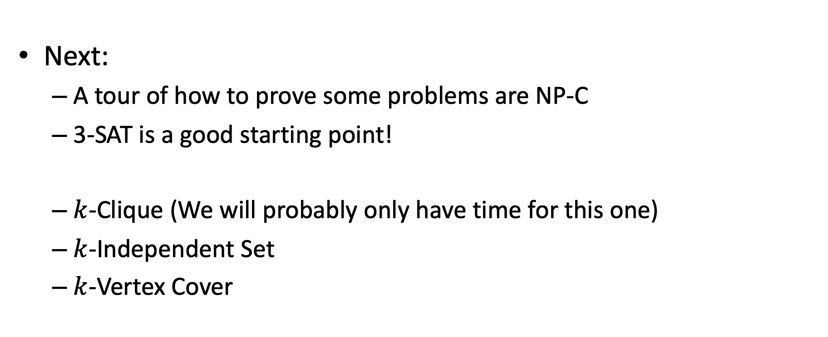
Reductions to Prove NP-C
Next:
A tour of how to prove some problems are NP-C
3-SAT is a good starting point!
$k$-Clique (We will probably only have time for this one)
$k$-Independent Set
$k$-Vertex Cover

Slide 13
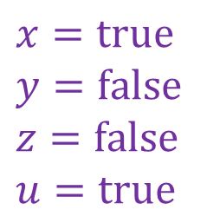
Reminder about 3-SAT
Shown to be NP-hard by Cook
Given a 3-CNF formula (logical AND of clauses, each an OR of 3 variables), is there an assignment of true/false to each variable to make the formula true (i.e., satisfy the formula)?
$$\left(x∨y∨z\right)∧\left(x∨\overline{y}∨y\right)∧\left(u∨y∨\overline{z}\right)∧\left(z∨\overline{x}∨u\right)∧(\overline{x}∨\overline{y}∨\overline{z})$$
Clause
$$x=true$$
$$y=false$$
$$z=false$$
$$u=true$$
Variables

Slide 14
Next example: k-Clique
Let’s show that k-Clique is NP-Complete!

Slide 15
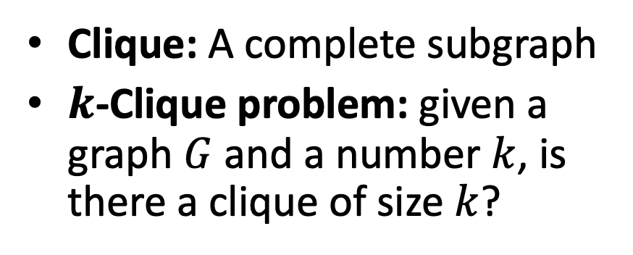

$k$-Clique Problem
Clique: A complete subgraph
$k$-Clique problem: given a graph $G$ and a number $k$, is there a clique of size $k$?
4-Clique
3-Clique

Slide 16
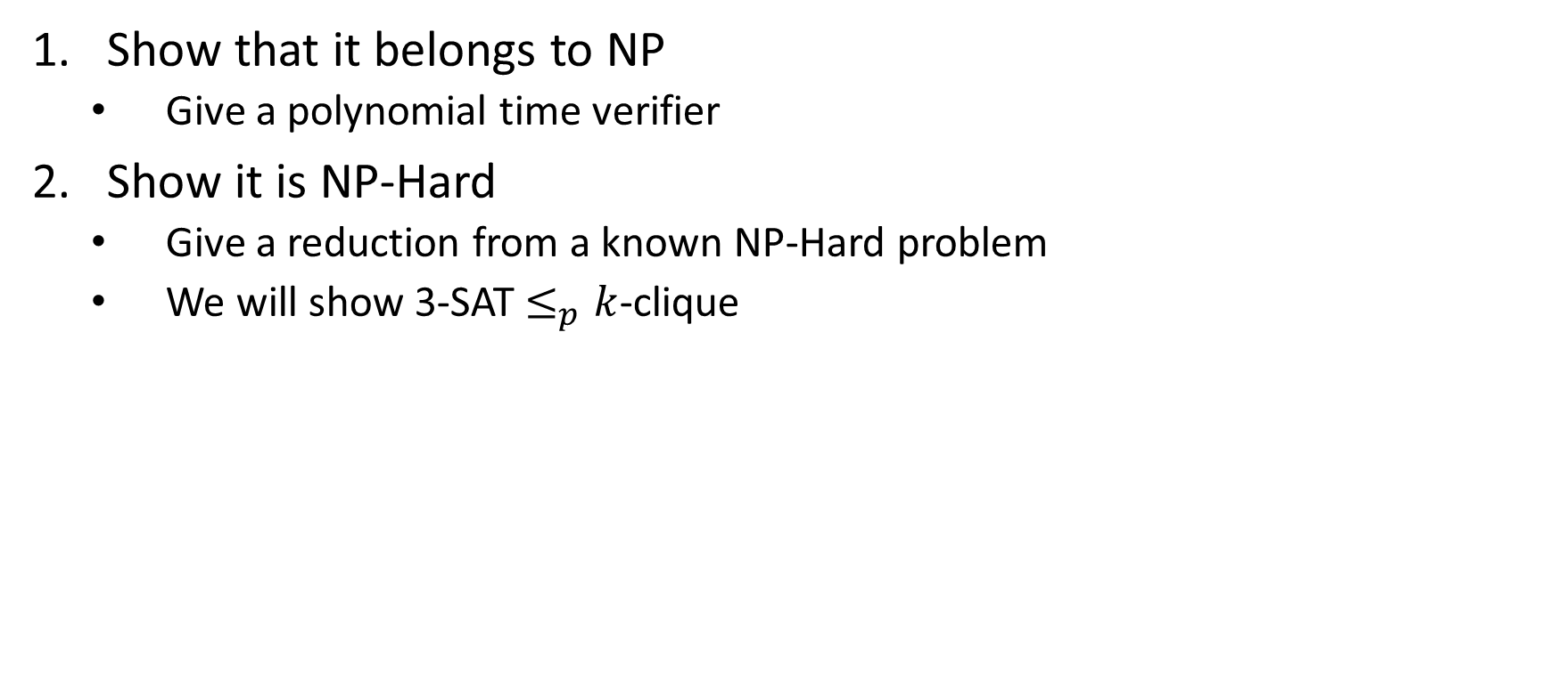

$k$-Clique is NP-Complete
Show that it belongs to NP
Give a polynomial time verifier
Show it is NP-Hard
Give a reduction from a known NP-Hard problem
We will show 3-SAT $≤_{p}k$-clique

Slide 17
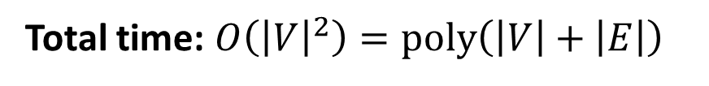
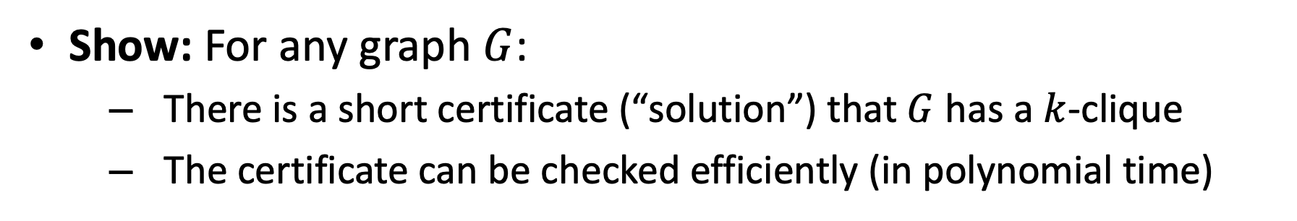



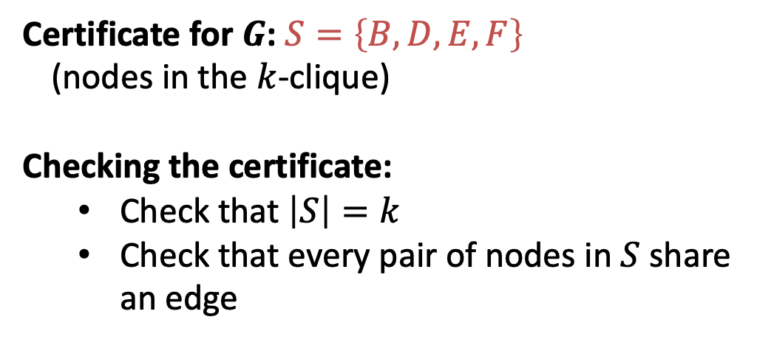
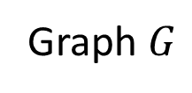
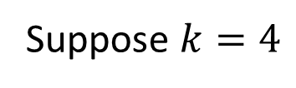
$k$-Clique is in NP
Show: For any graph $G$:
There is a short certificate (“solution”) that $G$ has a $k$-clique
The certificate can be checked efficiently (in polynomial time)
Suppose $k=4$
C
Certificate for $G$: $S=\left\{B,D,E,F\right\}$
(nodes in the $k$-clique)
Checking the certificate:
Check that $\left|S\right|=k$
Check that every pair of nodes in $S$ share an edge
B
4-Clique
A
E
D
F
$$O\left(k\right)=O\left(\left|V\right|\right)$$
G
I
3-Clique
$$O\left(k^{2}\right)=O({\left|V\right|}^{2})$$
H
Graph $G$
Total time: $O\left({\left|V\right|}^{2}\right)=poly\left(\left|V\right|+\left|E\right|\right)$

Slide 18

$k$-Clique is NP-Complete
Show that it belongs to NP
Give a polynomial time verifier
Show it is NP-Hard
Give a reduction from a known NP-Hard problem
We will show 3-SAT $≤_{p}k$-clique

Slide 19
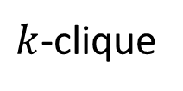

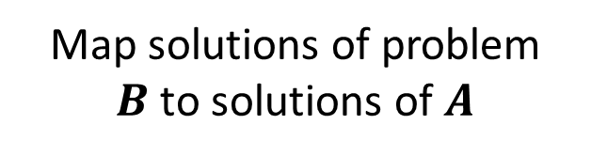
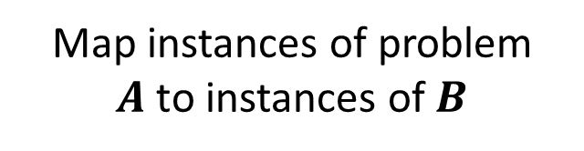
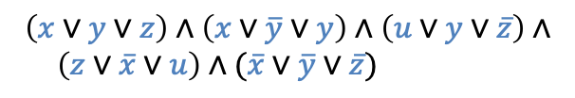

3-SAT $≤_{p}$ $k$-Clique
3-SAT
$k$-clique
Map instances of problem $A$to instances of $B$
$$\left(x∨y∨z\right)∧\left(x∨\overline{y}∨y\right)∧\left(u∨y∨\overline{z}\right)∧$$ $\left(z∨\overline{x}∨u\right)∧(\overline{x}∨\overline{y}∨\overline{z})$
polynomial time
Map solutions of problem $B$to solutions of $A$
$$x=true$$
$$y=false$$
$$z=false$$
$$u=true$$
polynomial time
polynomial-time reduction

Slide 20




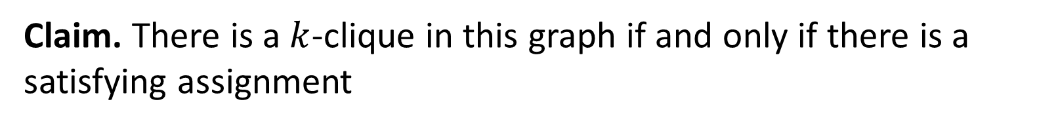












3-SAT $≤_{p}$ $k$-Clique
$$\left(x∨y∨z\right)∧\left(x∨\overline{y}∨y\right)∧\left(u∨y∨\overline{z}\right)∧\left(z∨\overline{x}∨u\right)∧(\overline{x}∨\overline{y}∨\overline{z})$$
$$x$$
$$\overline{y}$$
$$y$$
$$z$$
$$\overline{x}$$
$$u$$
$$x$$
(also do this for the other clauses, omitted due to clutter)
$$y$$
$$z$$
$$u$$
$$y$$
$$\overline{z}$$
$$\overline{x}$$
$$\overline{y}$$
$$\overline{z}$$
For each clause, introduce a node for each of its three variables
Add an edge from each node to all non-contradictory nodes in the other clauses (i.e., to all nodes that is not the negation of its own variable)
Let $k=$ number of clauses
Claim. There is a $k$-clique in this graph if and only if there is a satisfying assignment

Slide 21


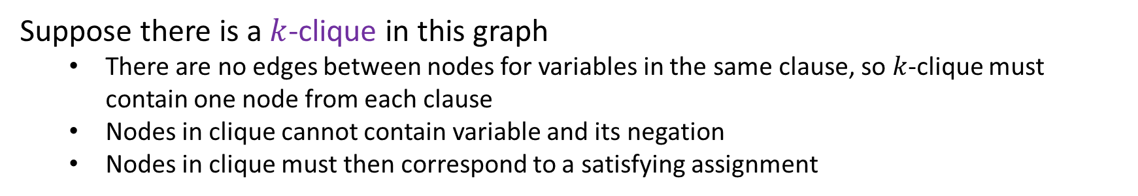
3-SAT $≤_{p}$ $k$-Clique
$$\left(x∨y∨z\right)∧\left(x∨\overline{y}∨y\right)∧\left(u∨y∨\overline{z}\right)∧\left(z∨\overline{x}∨u\right)∧(\overline{x}∨\overline{y}∨\overline{z})$$
$$x$$
$$y$$
$$\overline{y}$$
$$z$$
$$\overline{x}$$
$$u$$
$$x$$
$$y$$
$$z$$
$$u$$
$$y$$
$$\overline{z}$$
$$\overline{x}$$
$$\overline{y}$$
$$\overline{z}$$
Suppose there is a $k$-clique in this graph
There are no edges between nodes for variables in the same clause, so $k$-clique must contain one node from each clause
Nodes in clique cannot contain variable and its negation
Nodes in clique must then correspond to a satisfying assignment

Slide 22


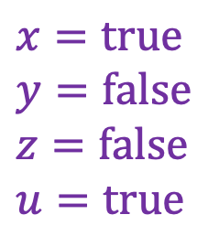



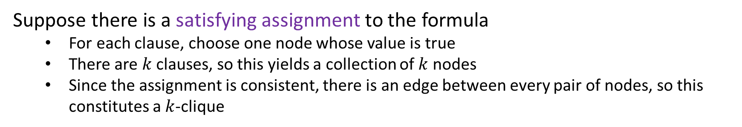
3-SAT $≤_{p}$ $k$-Clique
$$\left(x∨y∨z\right)∧\left(x∨\overline{y}∨y\right)∧\left(u∨y∨\overline{z}\right)∧\left(z∨\overline{x}∨u\right)∧(\overline{x}∨\overline{y}∨\overline{z})$$
$$x$$
$$y$$
$$\overline{y}$$
$$z$$
$$\overline{x}$$
$$u$$
$$x$$
$$y$$
$$x=true$$
$$y=false$$
$$z=false$$
$$u=true$$
$$z$$
$$u$$
$$y$$
$$\overline{z}$$
$$\overline{x}$$
$$\overline{y}$$
$$\overline{z}$$
Suppose there is a satisfying assignment to the formula
For each clause, choose one node whose value is true
There are $k$ clauses, so this yields a collection of $k$ nodes
Since the assignment is consistent, there is an edge between every pair of nodes, so this constitutes a $k$-clique

Slide 23
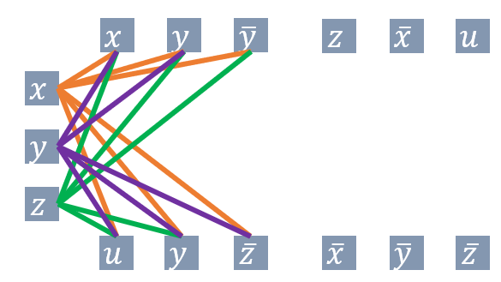
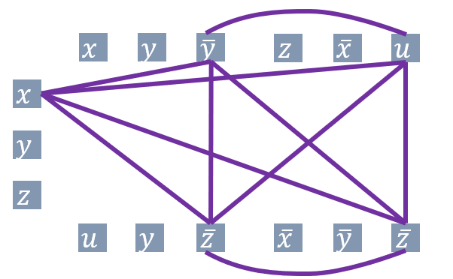
3-SAT $≤_{p}$ $k$-Clique
3-SAT
$k$-clique
Map instances of problem $A$to instances of $B$
$$\left(x∨y∨z\right)∧\left(x∨\overline{y}∨y\right)∧\left(u∨y∨\overline{z}\right)∧$$ $\left(z∨\overline{x}∨u\right)∧(\overline{x}∨\overline{y}∨\overline{z})$
polynomial time
Map solutions of problem $B$to solutions of $A$
$$x=true$$
$$y=false$$
$$z=false$$
$$u=true$$
polynomial time
polynomial-time reduction

Slide 24
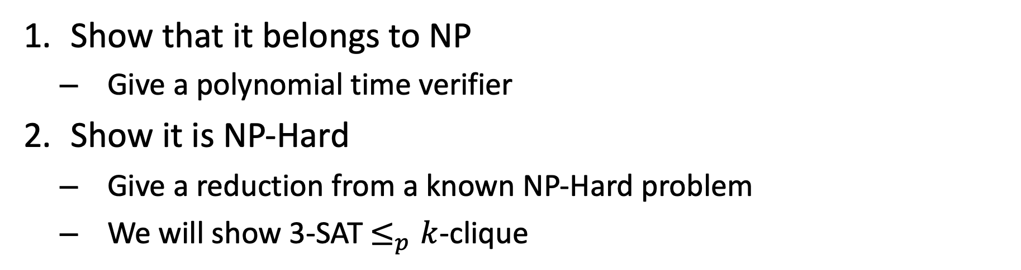
$k$-Clique is NP-Complete
Show that it belongs to NP
Give a polynomial time verifier
Show it is NP-Hard
Give a reduction from a known NP-Hard problem
We will show 3-SAT $≤_{p}k$-clique

Slide 25
END HERE
More below if you are interested

Slide 26
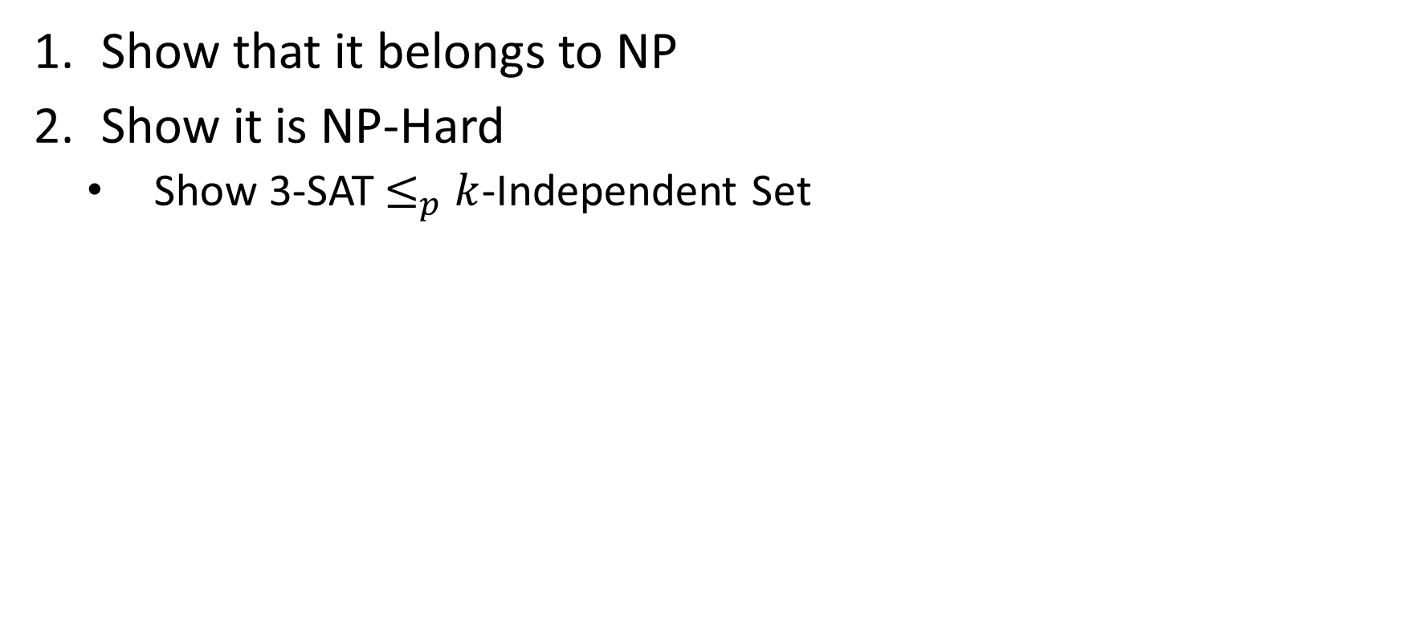
$k$-Independent Set is NP-Complete
Show that it belongs to NP
Show it is NP-Hard
Show 3-SAT$≤_{p}$ $k$-Independent Set

Slide 27
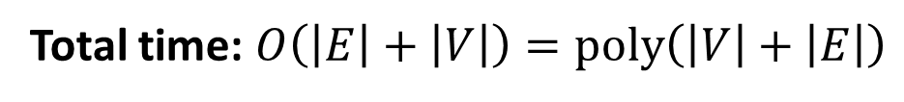
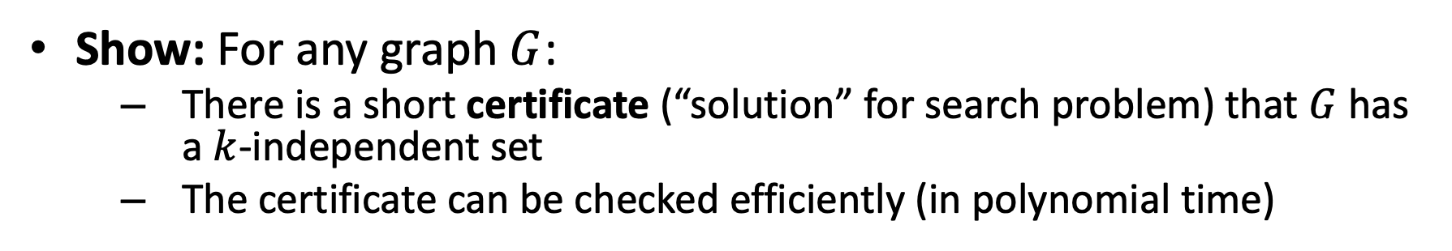



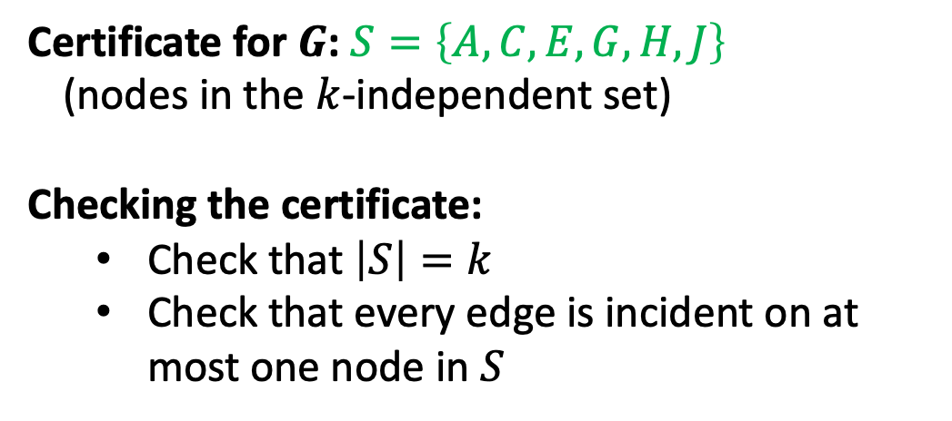
$k$-Independent Set is in NP
Show: For any graph $G$:
There is a short certificate (“solution” for search problem) that $G$ has a $k$-independent set
The certificate can be checked efficiently (in polynomial time)
A
B
Certificate for $G$: $S=\left\{A,C,E,G,H,J\right\}$
(nodes in the $k$-independent set)
Checking the certificate:
Check that $\left|S\right|=k$
Check that every edge is incident on at most one node in $S$
C
D
E
F
G
$$O\left(k\right)=O\left(\left|V\right|\right)$$
J
H
I
$$O\left(\left|V\right|+\left|E\right|\right)$$
K
L
Total time: $O\left(\left|E\right|+\left|V\right|\right)=poly\left(\left|V\right|+\left|E\right|\right)$
Graph $G$

Slide 28
$k$-Independent Set is NP-Complete
Show that it belongs to NP
Show it is NP-Hard
Show 3-SAT$≤_{p}$ $k$-Independent Set

Slide 29
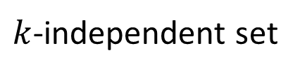

3-SAT $≤_{p}$ $k$-Independent Set
3-SAT
$k$-independent set
Map instances of problem $A$to instances of $B$
polynomial time
Map solutions of problem $B$to solutions of $A$
$$x=true$$
$$y=false$$
$$z=false$$
$$u=true$$
polynomial time
polynomial-time reduction

Slide 30


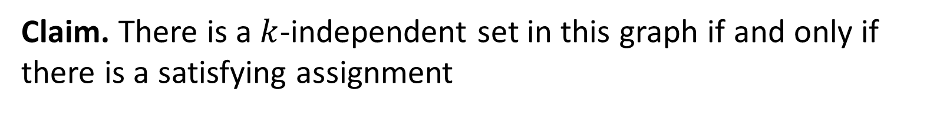












3-SAT $≤_{p}$ $k$-Independent Set
$$\left(x∨y∨z\right)∧\left(x∨\overline{y}∨y\right)∧\left(u∨y∨\overline{z}\right)∧\left(z∨\overline{x}∨u\right)∧(\overline{x}∨\overline{y}∨\overline{z})$$
$$x$$
$$x$$
$$u$$
$$z$$
$$\overline{u}$$
$$z$$
$$y$$
$$y$$
$$\overline{y}$$
$$\overline{z}$$
$$y$$
$$u$$
$$\overline{x}$$
$$\overline{z}$$
$$\overline{y}$$
For each clause, construct a triangle graph with its three variables as nodes
Add an edge between each node and its negation
Let $k=$ number of clauses
Claim. There is a $k$-independent set in this graph if and only if there is a satisfying assignment

Slide 31



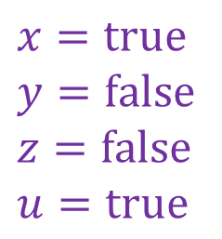

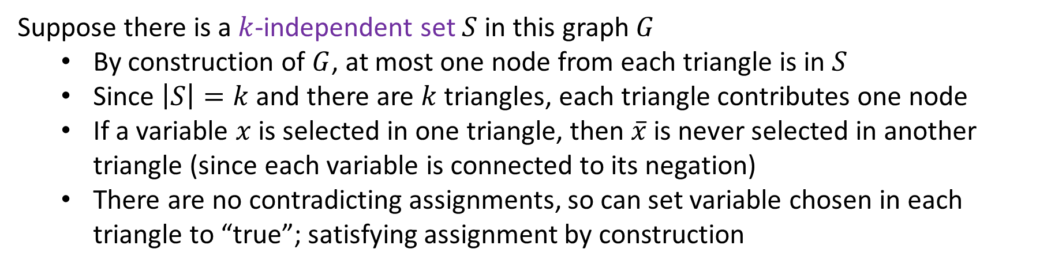

3-SAT $≤_{p}$ $k$-Independent Set
$$\left(x∨y∨z\right)∧\left(x∨\overline{y}∨y\right)∧\left(u∨y∨\overline{z}\right)∧\left(z∨\overline{x}∨u\right)∧(\overline{x}∨\overline{y}∨\overline{z})$$
$$x=true$$
$$y=false$$
$$z=false$$
$$u=true$$
$$x$$
$$x$$
$$u$$
$$z$$
$$\overline{u}$$
$$z$$
$$y$$
$$y$$
$$\overline{y}$$
$$\overline{z}$$
$$y$$
$$u$$
$$\overline{x}$$
$$\overline{z}$$
$$\overline{y}$$
Suppose there is a $k$-independent set $S$ in this graph $G$
By construction of $G$, at most one node from each triangle is in $S$
Since $\left|S\right|=k$ and there are $k$ triangles, each triangle contributes one node
If a variable $x$ is selected in one triangle, then $\overline{x}$ is never selected in another triangle (since each variable is connected to its negation)
There are no contradicting assignments, so can set variable chosen in each triangle to “true”; satisfying assignment by construction

Slide 32
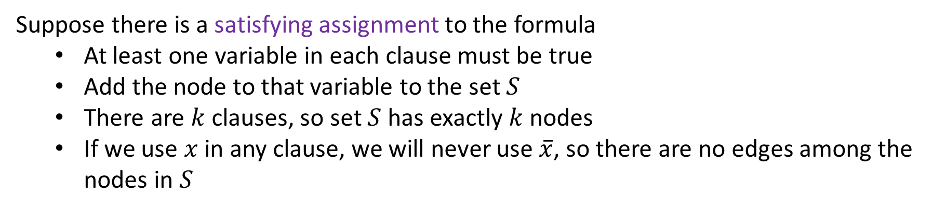
3-SAT $≤_{p}$ $k$-Independent Set
$$\left(x∨y∨z\right)∧\left(x∨\overline{y}∨y\right)∧\left(u∨y∨\overline{z}\right)∧\left(z∨\overline{x}∨u\right)∧(\overline{x}∨\overline{y}∨\overline{z})$$
$$x=true$$
$$y=false$$
$$z=false$$
$$u=true$$
$$x$$
$$x$$
$$u$$
$$z$$
$$\overline{u}$$
$$z$$
$$y$$
$$y$$
$$\overline{y}$$
$$\overline{z}$$
$$y$$
$$u$$
$$\overline{x}$$
$$\overline{z}$$
$$\overline{y}$$
Suppose there is a satisfying assignment to the formula
At least one variable in each clause must be true
Add the node to that variable to the set $S$
There are $k$ clauses, so set $S$ has exactly $k$ nodes
If we use $x$ in any clause, we will never use $\overline{x}$, so there are no edges among the nodes in $S$

Slide 33
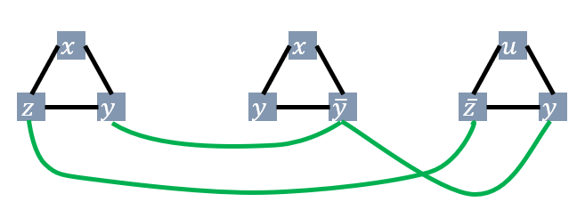
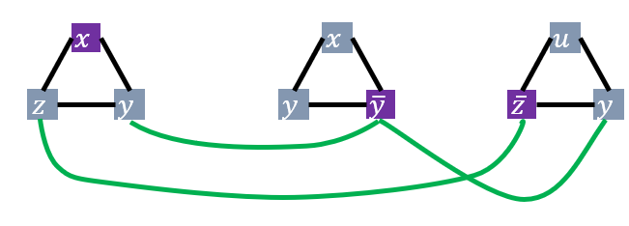
3-SAT $≤_{p}$ $k$-Independent Set
3-SAT
$k$-independent set
Map instances of problem $A$to instances of $B$
polynomial time
Map solutions of problem $B$to solutions of $A$
$$x=true$$
$$y=false$$
$$z=false$$
$$u=true$$
polynomial time
polynomial-time reduction

Slide 34
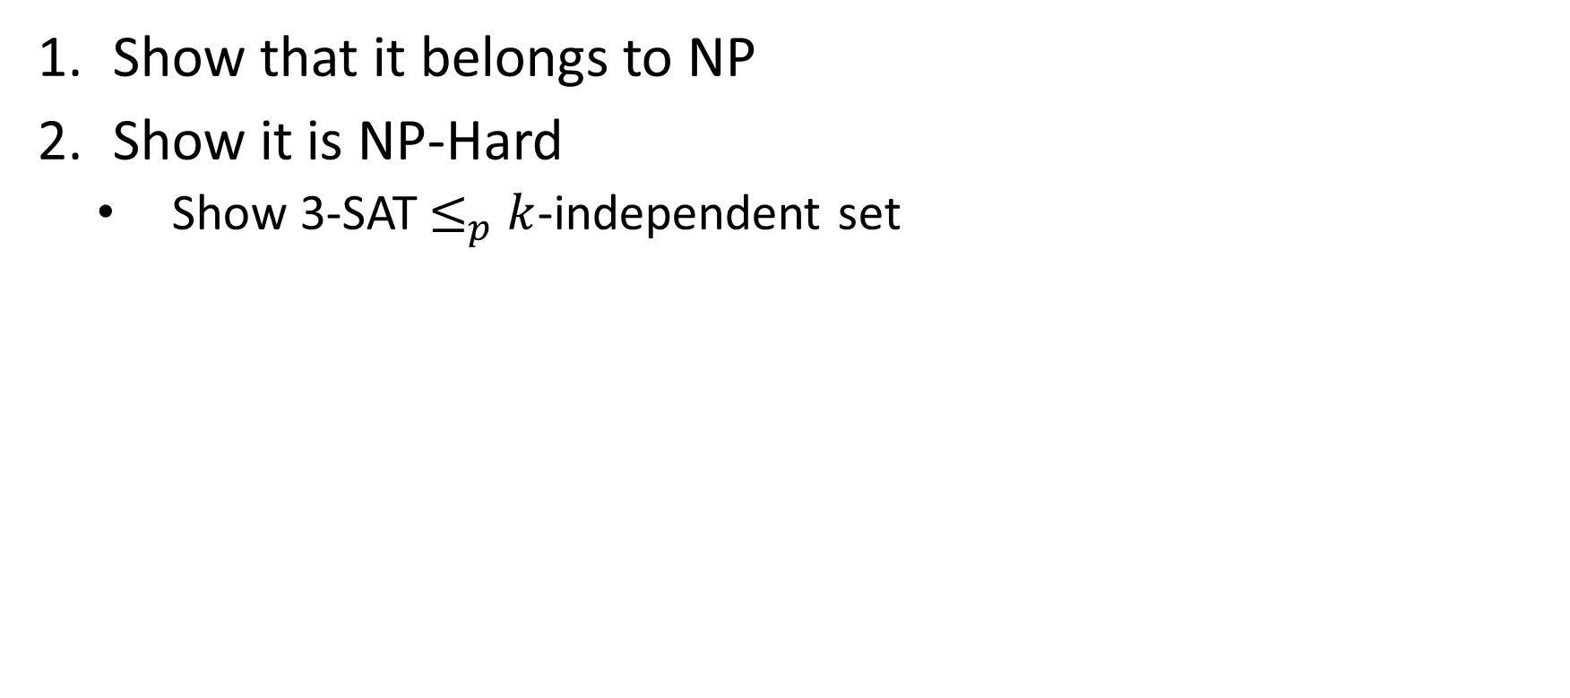
$k$-Independent Set is NP-Complete
Show that it belongs to NP
Show it is NP-Hard
Show 3-SAT$≤_{p}$ $k$-independent set

Slide 35
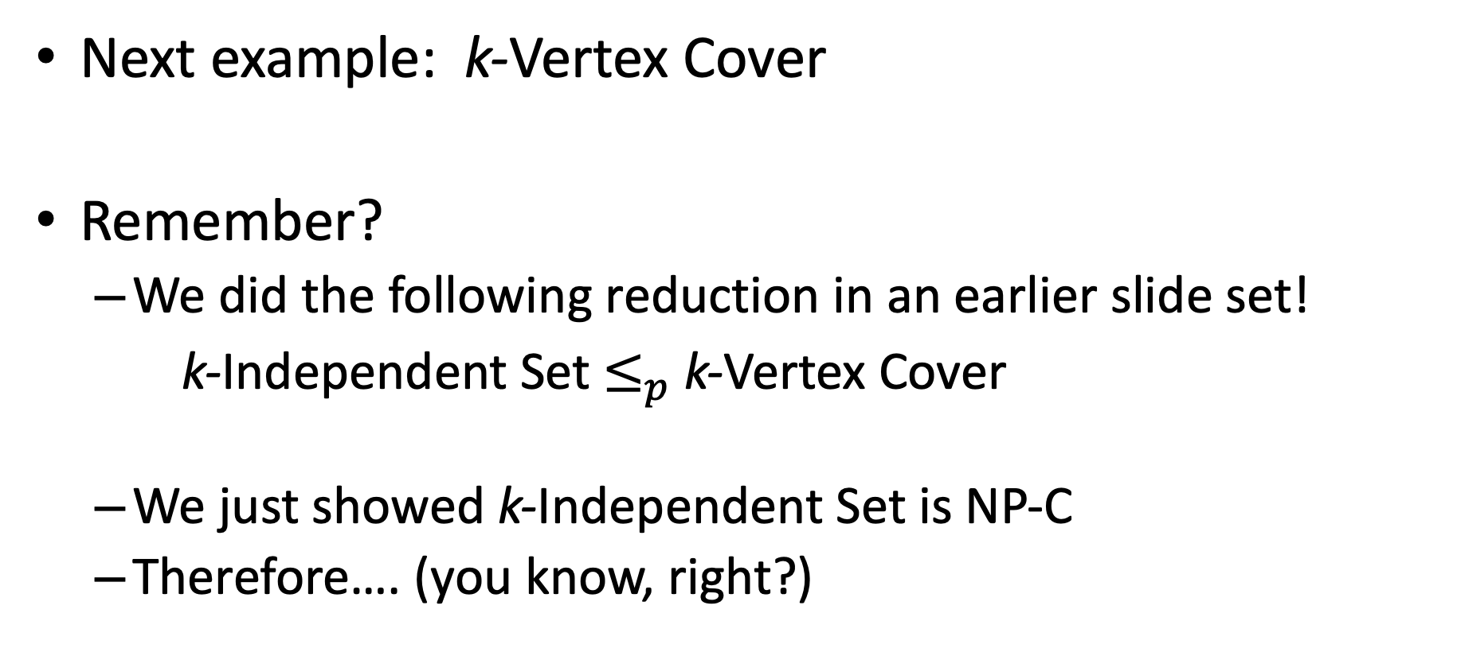
Next example: k-Vertex Cover
Remember?
We did the following reduction in an earlier slide set!
k-Independent Set $≤_{p}$ k-Vertex Cover
We just showed k-Independent Set is NP-C
Therefore…. (you know, right?)

Slide 36
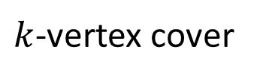

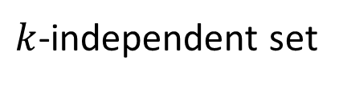


Max Independent Set $≤_{p}$ k-Vertex Cover
$k$-independent set
$k$-vertex cover
Map instances of problem $A$to instances of $B$
$O(1)$ time
Map solutions of problem $B$to solutions of $A$
$O\left(\left|V\right|\right)$ time
Reduction

Slide 37


$k$-Vertex Cover is NP-Complete
Show that it belongs to NP
Given a candidate cover, check that every edge is covered
Show it is NP-Hard
Show $k$-independent set$≤_{p}$ $k$-vertex cover

Slide 38
Wrap Up and Reminders

Slide 39
Why Prove NP-Completeness?
Though nobody has proven that P ≠ NP, if you prove a problem NP-Complete, most people accept that it is probably exponential
Therefore it can be important for you to prove that a problem is NP-Complete
Don't need to try to come up perfect non-exponential algorithm
Can instead work on approximation algorithms

Slide 40
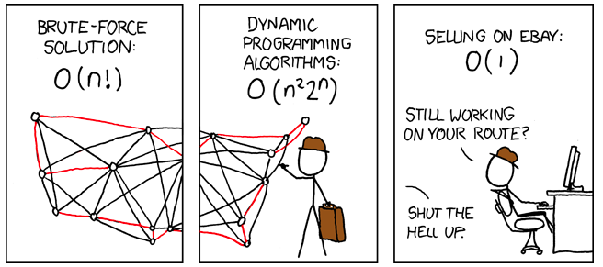
What’s a poor salesperson to do?
http://xkcd.com/399/

Slide 41
Approximation Algorithms
Look at first 3 pages of Ch. 35 of CLRS textbook
Can we find an algorithm for problem A ∈ NP-C that:
Runs in polynomial time
Gets “near optimal” results
Prove some bound on the algorithm’s correctness in terms of the true optimal result
No worse that (some factor) of optimal
“It’s not always right (best), but it’s guaranteed to be this close.”

Slide 42
General Comments
At least 3000 problems have been shown to be NP-Complete
That number is from a non-recent report, so we might say that counts is a weak lower-bound on the true number found
https://en.wikipedia.org/wiki/List_of_NP-complete_problems including some popular games
Some reductions are profound, some are comparatively easy, many are easy once the key insight is given

Slide 43
Other NP-Complete Problems
Hamilton Path/Cycle, Traveling Salesperson
Subset-sum: Given a set of integers, does there exist a subset that adds up to some target T ?
0-1 knapsack: when weights not just integers
Graph coloring: can a given graph be colored with k colors such that no adjacent vertices are the same color?
Etc…

Slide 44
Review (Again)
A problem B is NP-complete
if it is in NP and it is NP-hard.
A problem B is NP-hard
if every problem in NP is reducible to B.
A problem A is reducible to a problem B if
there exists a polynomial reduction function T such that
For every string x,
if x is a yes input for A, then T(x) is a yes input for B
if x is a no input for A, then T(x) is a no input for B.
T can be computed in polynomially bounded time.

Slide 45
“Consequences” of NP-Completeness
NP-Complete the set of the“hardest” problems in NP, with these important properties:
If any one NP-Complete problem can be solved in polynomial time…
…then every NP-Complete problem can be solved in polynomial time…
…and in fact every problem in NP can be solved in polynomial time (which would show P = NP)
Or, prove an exponential lower-bound for any single NP-C problem, then every NP-C problem is exponential
Therefore: solve (say) traveling salesperson problem in O(n¹⁰⁰) time, you've proved that P = NP. Retire rich & famous!

Slide 46
What We Don’t Know: Open Questions
Is it impossible to solve an NP-c problem in polynomial time?
No one has proved an exponential lower bound for any problem in NP.
But, most computer scientists believe such a lower bound exists for NP-c problems.
Are all problems in NP tractable or intractable? I.e., does P=NP or not?
If someone found a polynomial solution to any NP-c problem, we’d know P = NP.
But, most computer scientists believe P≠ NP.

