Slide 1
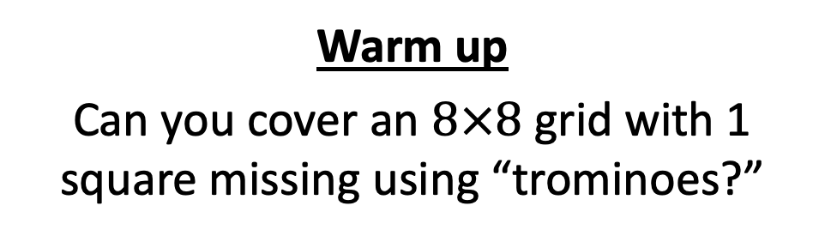
CS4102 Algorithms Spring 2022
Warm up
Can you cover an $8×8$ grid with 1 square missing using “trominoes?”
Can you cover this?
With these?
https://nstarr.people.amherst.edu/trom/puzzle-8by8/

Slide 2
Announcements

Slide 3
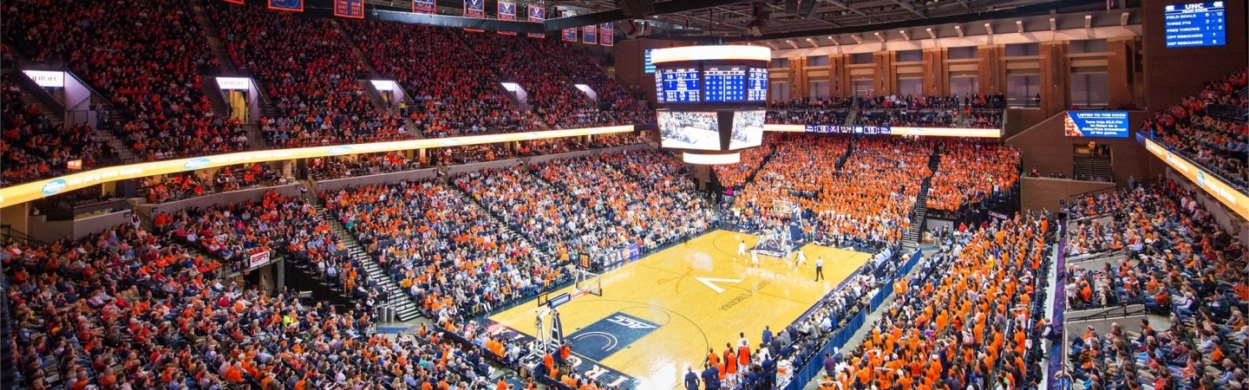

Cheer Loudest For Pizza
At UVA games, there’s a contest where two adjacent sections cheer. The loudest section gets pizza! Let’s give each of the n sections a chance to win
Divide the sections into two halves
One half cheers, then the other half cheers
The louder half continues, the other half is eliminated
Repeat until just two sections left.
The louder of the final two wins free pizza!
What are we going to count?

Slide 4



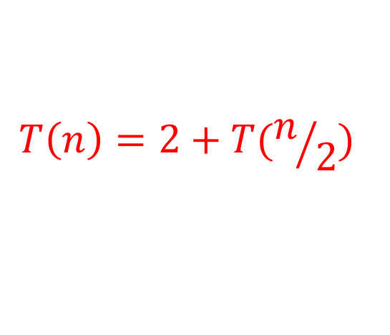
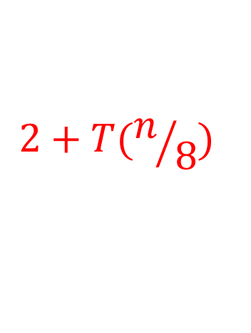
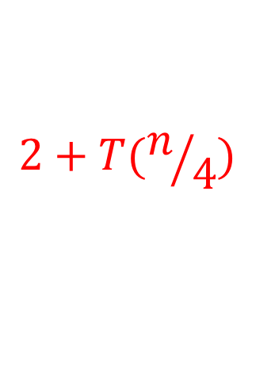
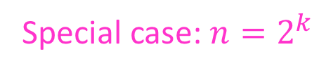
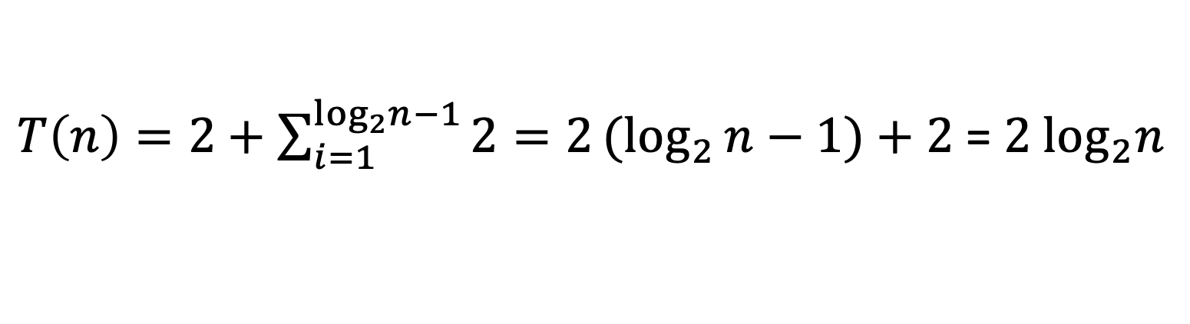
Let’s solve the recurrence!
Special case: $n=2^{k}$
$$T\left(2\right)=2$$
$$T\left(n\right)=2+T(n/2)$$
$$2+T(n/4)$$
$$k−1$$
$$2+T(n/8)$$
…
$$2$$
$T\left(n\right)=2+\sum_{i=1}^{\log_{2}n−1}{2}=2{(log}_{2}{n−1)}+2$ = ${2 log}_{2}n$

Slide 5

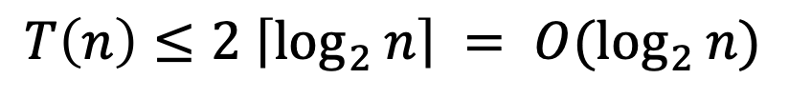
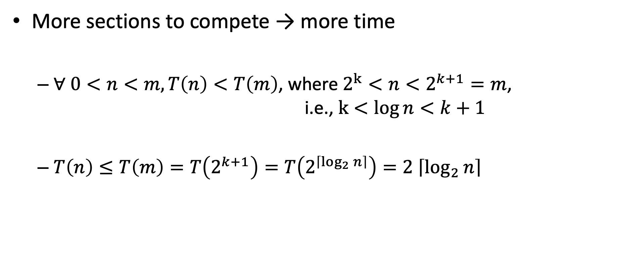
What if $n≠2^{k}$?
More sections to compete → more time
$∀ 0<n<m, T\left(n\right)<T\left(m\right)$, where $2^{k}<n<2^{k+1}=m$, i.e., $k<log{n<k+1}$
$T\left(n\right)≤T\left(m\right)=T\left(2^{k+1}\right)=T\left(2^{\left\lceil \log_{2}{n}\right\rceil }\right)=2 \left\lceil \log_{2}{n}\right\rceil$
$$T\left(n\right)≤2 \left\lceil \log_{2}{n}\right\rceil = O(\log_{2}{n})$$
Why?

Slide 6
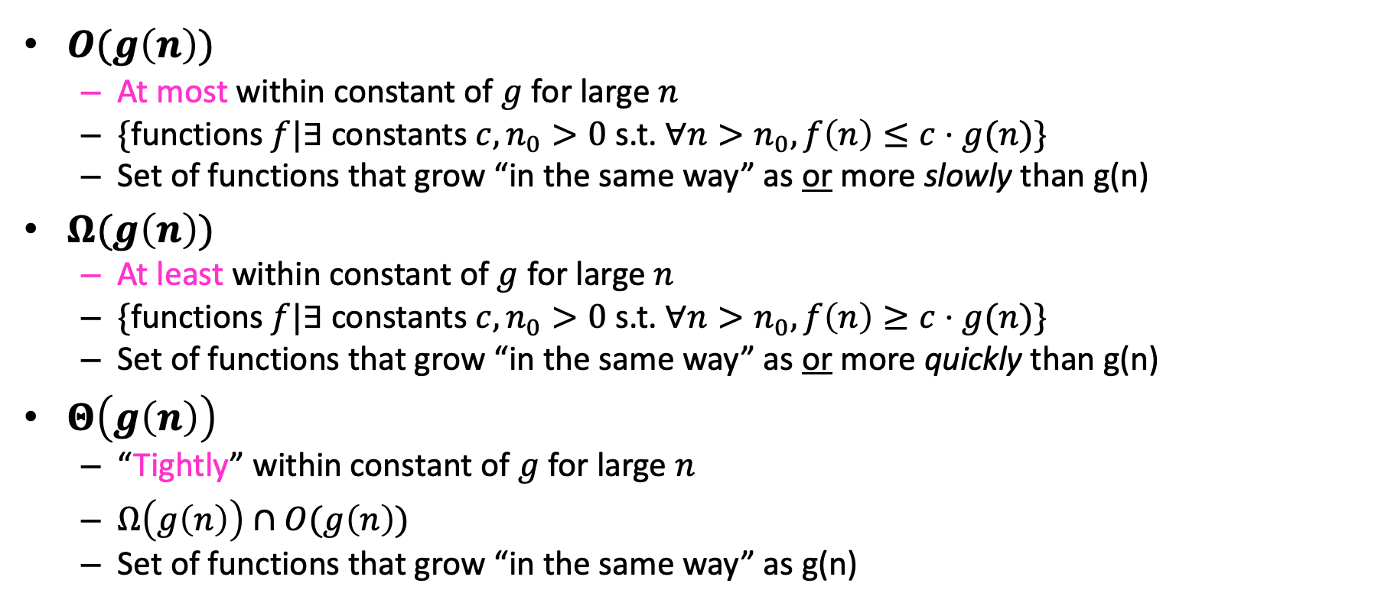
Asymptotic Notation*
$O(g\left(n\right))$
At most within constant of $g$ for large $n$
$\{$functions $f|∃$constants $c, n_{0}>0$ s.t. $∀n>n_{0}, f\left(n\right)≤c⋅g(n)\}$
Set of functions that grow “in the same way” as or more slowly than g(n)
$Ω(g\left(n\right))$
At least within constant of $g$ for large $n$
$\{$functions $f|∃$constants $c, n_{0}>0$ s.t. $∀n>n_{0}, f\left(n\right)≥c⋅g(n)\}$
Set of functions that grow “in the same way” as or more quickly than g(n)
$Θ\left(g\left(n\right)\right)$
“Tightly” within constant of $g$ for large $n$
$Ω\left(g\left(n\right)\right)∩O(g\left(n\right))$
Set of functions that grow “in the same way” as g(n)
*CLRS Chapter 3

Slide 7
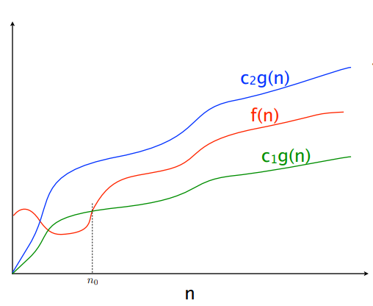
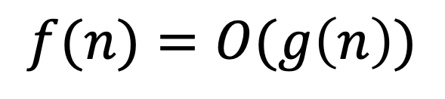
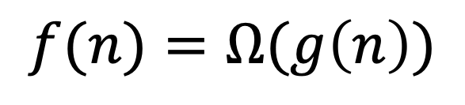
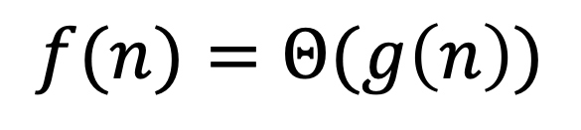
$$f(n)=O(g\left(n\right))$$
$$f(n)=Θ(g\left(n\right))$$
$$f(n)=Ω(g\left(n\right))$$

Slide 8
Asymptotic Bounds
The Sets “big oh” O(g), “big theta” Θ(g), “big omega” Ω(g) – remember these meanings:
O(g): functions that grow no faster than g, or g is an asymptotic upper bound
Ω(g): functions that grow at least as fast as g, or g is an asymptotic lower bound
Θ(g): functions that grow at the same rate as g, or g is an asymptotic tight bound

Slide 9

Asymptotic Notation Example
Show: $n\log{n}∈O\left(n^{2}\right)$

Slide 10
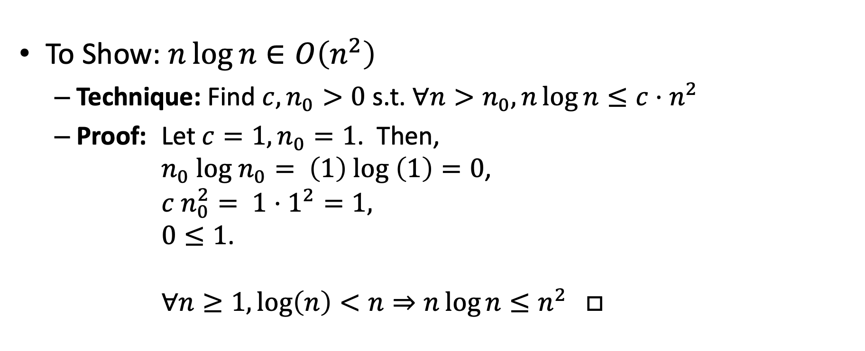
Asymptotic Notation Example
To Show: $n\log{n}∈O\left(n^{2}\right)$
Technique: Find $c, n_{0}>0$ s.t. $∀n>n_{0}, n\log{n}≤c⋅n^{2}$
Proof: Let $c=1, n_{0}=1$. Then, $n_{0} log n_{0}= \left(1\right) log \left(1\right)=0$, $c n_{0}^{2}= 1⋅1^{2}=1,$ $0≤1$. $∀n≥1,\log\left(n\right)<n⇒n\log{n}≤n^{2}$ $□$
Direct Proof!

Slide 11

Asymptotic Notation Example
Show: $n^{2}∉O\left(n\right)$

Slide 12
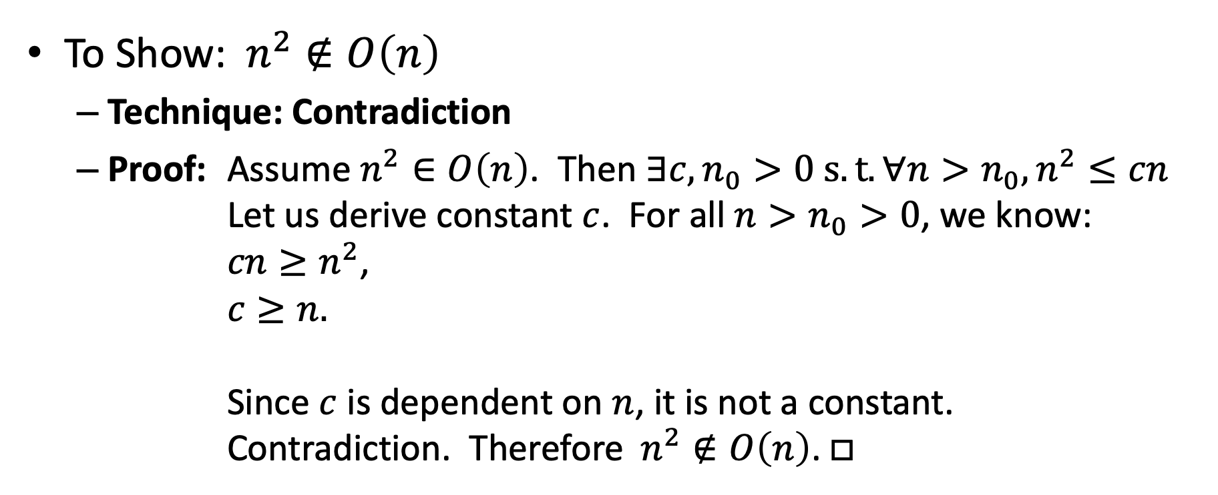
Asymptotic Notation Example
To Show:$n^{2}∉O\left(n\right)$
Technique: Contradiction
Proof: Assume $n^{2}∈O\left(n\right)$. Then $∃c,n_{0}>0 s.t. ∀n>n_{0},n^{2}≤cn$ Let us derive constant $c$. For all $n>n_{0}>0$, we know: $cn≥n^{2}$, $c≥n.$ Since $c$ is dependent on $n$, it is not a constant. Contradiction. Therefore$n^{2}∉O\left(n\right)$.$□$
Proof by Contradiction!

Slide 13

Proof Techniques
Direct Proof
From the assumptions and definitions, directly derive the statement
Proof by Contradiction
Assume the statement is true, then find a contradiction
Proof by Cases
Induction

Slide 14
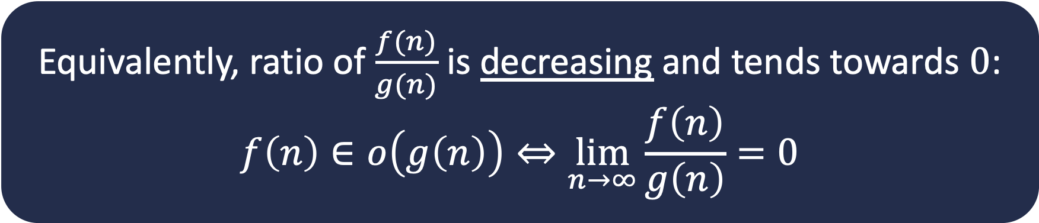

More Asymptotic Notation
$o(g\left(n\right))$
Smaller than any constant factor of $g$ for sufficiently large $n$
$\{$functions $f :∀$constants $c>0, {∃n}_{0}$ such that $∀n>n_{0}, f\left(n\right)<c⋅g(n)\}$
Set of functions that always grow more slowly than g(n)
Equivalently, ratio of $\frac{f(n)}{g(n)}$ is decreasing and tends towards $0$:
$$f\left(n\right)∈o\left(g\left(n\right)\right)⇔\lim_{n→∞}{\frac{f\left(n\right)}{g\left(n\right)}=0}$$

Slide 15

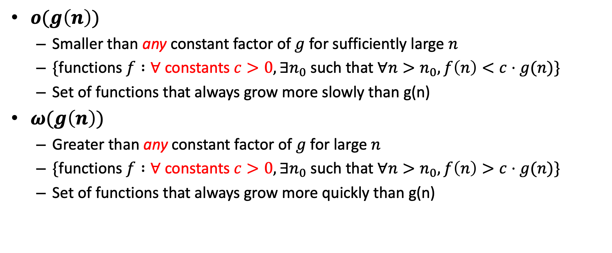
More Asymptotic Notation
$o(g\left(n\right))$
Smaller than any constant factor of $g$ for sufficiently large $n$
$\{$functions $f :∀$constants $c>0, {∃n}_{0}$ such that $∀n>n_{0}, f\left(n\right)<c⋅g(n)\}$
Set of functions that always grow more slowly than g(n)
$ω(g\left(n\right))$
Greater than any constant factor of $g$ for large $n$
$\{$functions $f :∀$constants $c>0, {∃n}_{0}$ such that $∀n>n_{0}, f\left(n\right)>c⋅g(n)\}$
Set of functions that always grow more quickly than g(n)
Equivalently, $f\left(n\right)∈ω\left(g\left(n\right)\right)⇔\lim_{n→∞}{\frac{f\left(n\right)}{g\left(n\right)}=\text{∞}}$

Slide 16
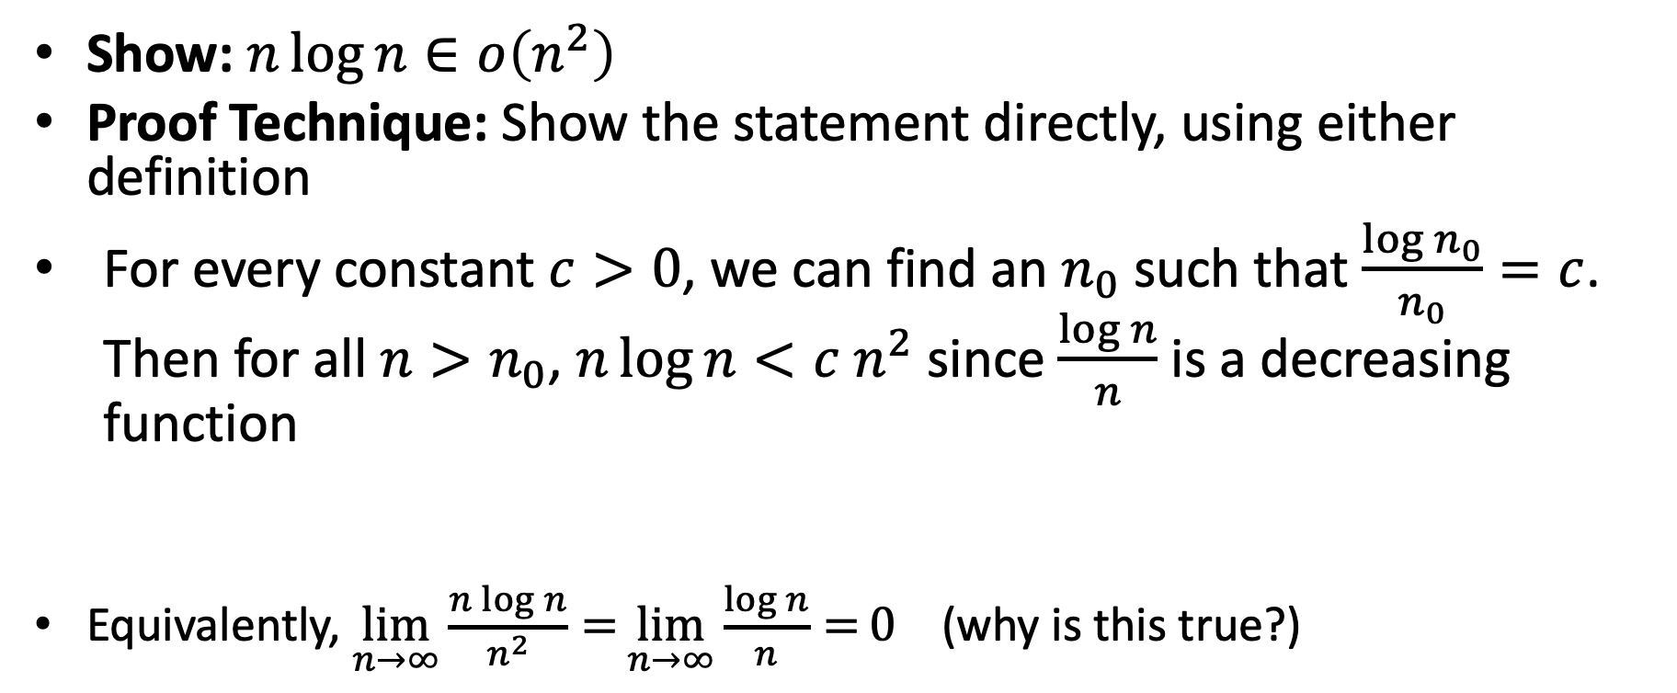
Another Asymptotic Notation Example
Direct Proof
Show: $n\log{n}∈o\left(n^{2}\right)$
Proof Technique: Show the statement directly, using either definition
For every constant $c>0$, we can find an $n_{0}$ such that $\frac{\log{n_{0}}}{n_{0}}=c$. Then for all $n>n_{0}$, $n\log{n}<c n^{2}$ since $\frac{\log{n}}{n}$ is a decreasing function
Equivalently, $\lim_{n→∞}{\frac{n\log{n}}{n^{2}}=}\lim_{n→∞}{\frac{\log{n}}{n}=}0$ (why is this true?)
$∀$constants $c>0, {∃n}_{0}$ such that $∀n>n_{0}, f\left(n\right)<c⋅g(n)$

Slide 17
Summary: Using Limit Definition
Comparing f(n) and g(n) as n approaches infinity, calculate this:
If the result….
< ∞, including the case in which the limit is 0, then f ∈ O(g)
> 0, including the case in which the limit is ∞, then f ∈ Ω(g)
= c and 0 < c < ∞ then f ∈ Θ(g)
= 0 then f ∈ o(g)
= ∞ then f ∈ ω(g)

Slide 18
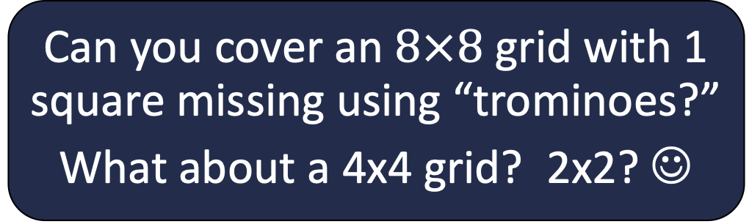
Back to Trominoes
Can you cover an $8×8$ grid with 1 square missing using “trominoes?”
What about a 4x4 grid? 2x2? ☺
A solution!
Tromino

Slide 19

Trominoes Puzzle Solution
$$2^{n}$$
$$2^{n}$$
What about larger boards?

Slide 20
Trominoes Puzzle Solution
Divide the board into quadrants

Slide 21
Trominoes Puzzle Solution
Place a tromino to occupy the three quadrants without the missing piece

Slide 22
Trominoes Puzzle Solution
Each quadrant is now a smaller subproblem

Slide 23
Trominoes Puzzle Solution
Solve Recursively

Slide 24
Divide and Conquer
Our first algorithmic technique!

Slide 25
Trominoes Puzzle Solution

Slide 26
Divide and Conquer
[CLRS Chapter 4]
Divide:
Break the problem into multiple subproblems, each smaller instances of the original
Conquer:
If the suproblems are “large”:
Solve each subproblem recursively
If the subproblems are “small”:
Solve them directly (base case)
Combine:
Merge solutions to subproblems to obtain solution for original problem
When is this an effective strategy?

Slide 27
Generic Divide and Conquer Solution
def myDCalgo(problem):
if baseCase(problem):
solution = solve(problem) #brute force if necessary
return solution
subproblems = Divide(problem)
for sub in subproblems:
subsolutions.append(myDCalgo(sub))
solution = Combine(subsolutions)
return solution

Slide 28
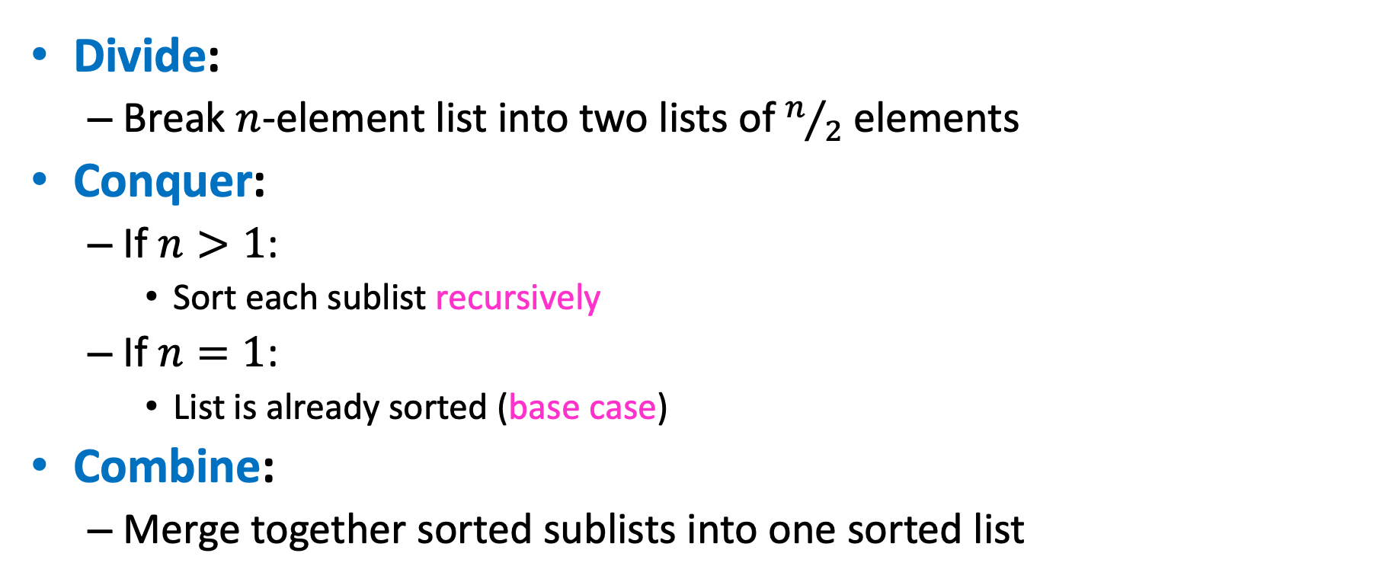
Merge Sort: Divide and Conquer Sorting
Divide:
Break $n$-element list into two lists of $n/2$ elements
Conquer:
If $n>1$:
Sort each sublist recursively
If $n=1$:
List is already sorted (base case)
Combine:
Merge together sorted sublists into one sorted list

Slide 29
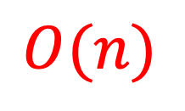
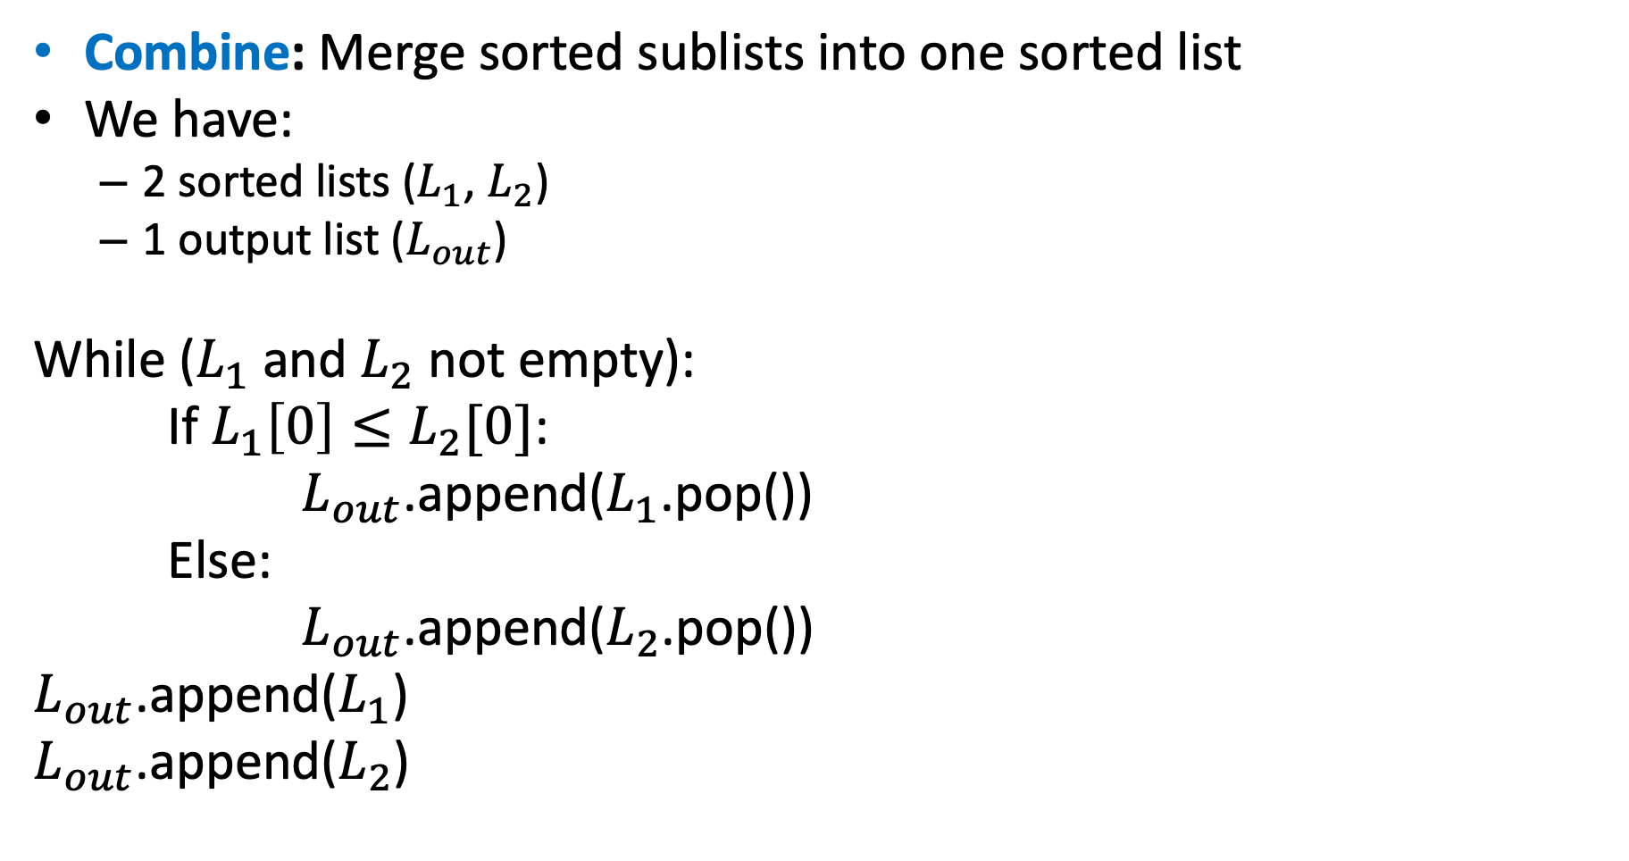
Merge
Combine: Merge sorted sublists into one sorted list
We have:
2 sorted lists ($L_{1}$, $L_{2}$)
1 output list ($L_{out}$)
While ($L_{1}$ and $L_{2}$ not empty):
If $L_{1}\left[0\right]≤L_{2}[0]$:
$L_{out}$.append($L_{1}$.pop())
Else:
$L_{out}$.append($L_{2}$.pop())
$L_{out}$.append($L_{1}$)
$L_{out}$.append($L_{2}$)
$$O(n)$$

Slide 30
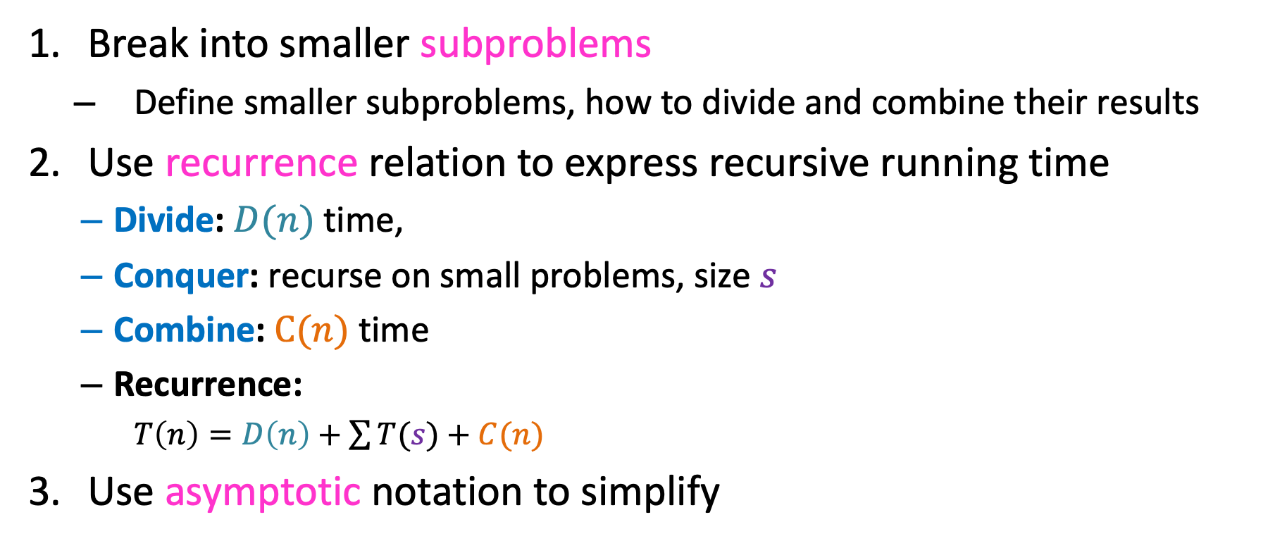
Analyzing Divide and Conquer
Break into smaller subproblems
Define smaller subproblems, how to divide and combine their results
Use recurrence relation to express recursive running time
Divide: $D(n)$ time,
Conquer: recurse on small problems, size $s$
Combine: $C(n)$ time
Recurrence:
$T\left(n\right)=D\left(n\right)+\sum{T(s)}+C(n)$
Use asymptotic notation to simplify

Slide 31
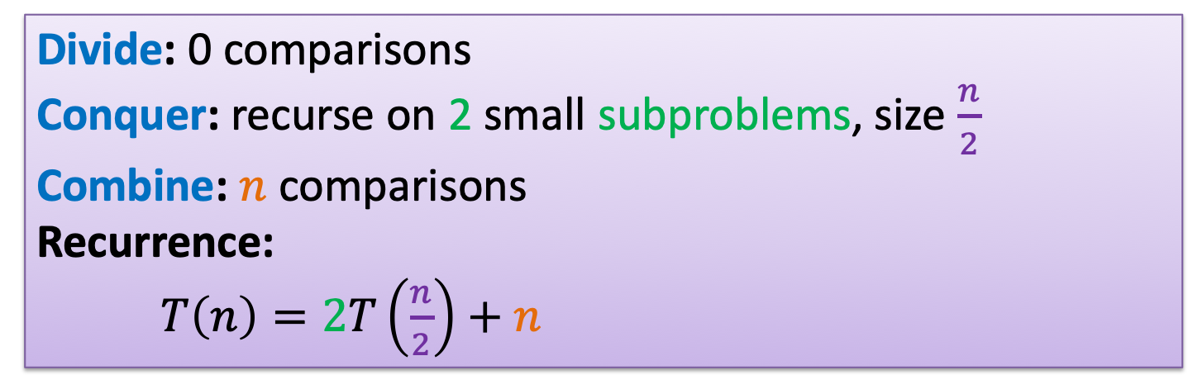
Analyzing Merge Sort
Break into smaller subproblems
Use recurrence relation to express recursive running time
Use asymptotic notation to simplify
Divide: 0 comparisons
Conquer: recurse on 2 small subproblems, size $\frac{n}{2}$
Combine: $n$ comparisons
Recurrence:
$T\left(n\right)=2T\left(\frac{n}{2}\right)+n$

Slide 32



Recurrence Solving Techniques
Four methods for solving recurrences
Unrolling: expand the recurrence
Tree: get a picture of recursion
Guess/Check: Substitution by guessing the solution and using induction to prove
“Cookbook”: Use magic (a.k.a. Master Theorem)
?

Slide 33
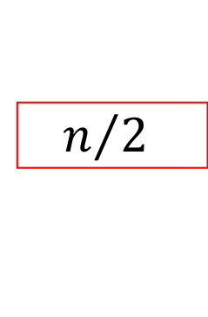


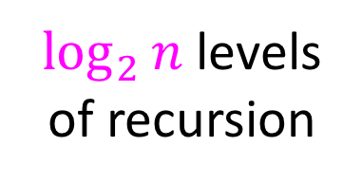




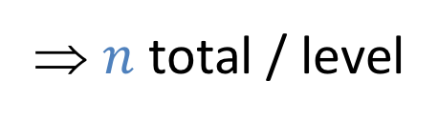


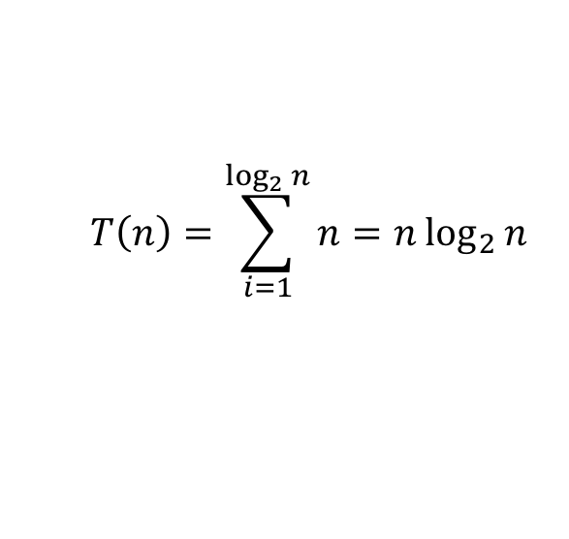
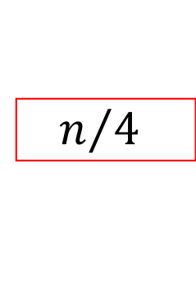
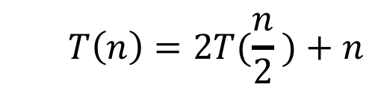








Tree method
$$T\left(n\right)=2T(\frac{n}{2} )+n$$
$$n$$
$$n$$
⇒ $n$ total / level
$$n/2$$
$$\frac{n}{2}$$
$$n/2$$
$$\frac{n}{2}$$
$$\frac{n}{4}$$
$$\frac{n}{4}$$
$$\frac{n}{4}$$
$$\frac{n}{4}$$
$\log_{2}⁡n$ levels
of recursion
$$n/4$$
$$n/4$$
$$n/4$$
$$n/4$$
…
…
…
…
…
$$1$$
$$1$$
$$1$$
$$1$$
$$1$$
$$1$$
$$1$$
$$1$$
$$1$$
$$1$$
$$1$$
$$1$$
$$T\left(n\right)=\sum_{i=1}^{\log_{2}{n}}{n}=n\log_{2}{n}$$

