Slide 1
CS 4102: Algorithms – Unit C Dynamic Programming
Co-instructors: Robbie Hott and Tom Horton
Spring 2022

Slide 2
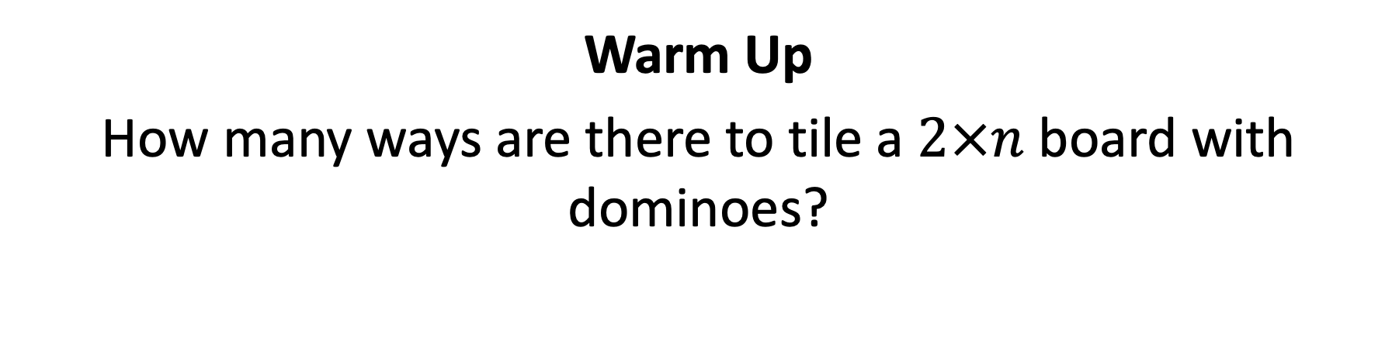
CS4102 Algorithms Spring 2022
Warm Up
How many ways are there to tile a $2×n$ board with dominoes?
How many ways to tile this:
With these?

Slide 3
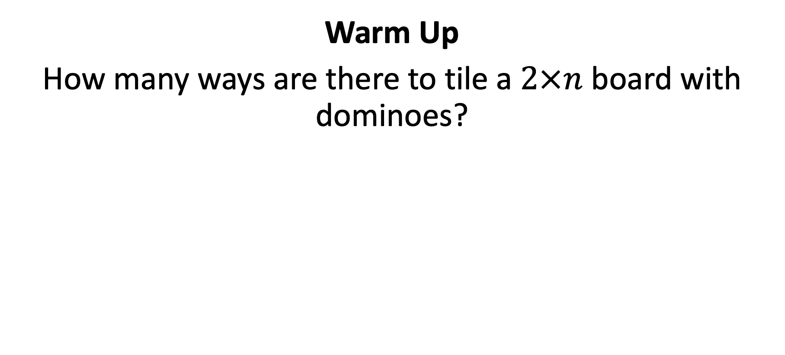
Warm Up
How many ways are there to tile a $2×n$ board with dominoes?
Two ways to fill the final column:
$$Tile\left(n\right)=Tile\left(n−1\right)+Tile(n−2)$$
$$Tile\left(0\right)=Tile\left(1\right)=1$$
$$n−1$$
$$n−2$$

Slide 4
Today’s Keywords
Maximum Sum Continuous Subarray
Domino Tiling
Dynamic Programming
Log Cutting

Slide 5
CLRS Readings
Chapter 15
Section 15.1, Log/Rod cutting, optimal substructure property
Note: r_{i} in book is called Cut() or C[] in our slides. We use their example.
Section 15.3, More on elements of DP, including optimal substructure property
Section 15.2, matrix-chain multiplication (later example)
Section 15.4, longest common subsequence (even later example)

Slide 6
How to compute $Tile(n)$?
Tile(n):
if n < 2:
return 1
return Tile(n-1)+Tile(n-2)
Problem?

Slide 7
Recursion Tree
Tile(5)
Tile(4)
Tile(3)
Tile(3)
Tile(2)
Tile(2)
Tile(1)
Tile(2)
Tile(1)
Tile(1)
Tile(0)
Tile(1)
Tile(0)
Tile(1)
Tile(0)
Many redundant calls!
Run time: $Ω(2^{n})$
Better way: Use Memory!

Slide 8
Computing $Tile(n)$ with Memory
Initialize Memory M
Tile(n):
if n < 2:
return 1
if M[n] is filled:
return M[n]
M[n] = Tile(n-1)+Tile(n-2)
return M[n]
M
0
1
2
3
4
5
6
Technique: “memoization” (note no “r”)

Slide 9
Computing $Tile(n)$ with Memory - “Top Down”
Initialize Memory M
Tile(n):
if n < 2:
return 1
if M[n] is filled:
return M[n]
M[n] = Tile(n-1)+Tile(n-2)
return M[n]
M
1
0
1
1
2
2
3
3
5
4
8
5
13
6

Slide 10
Dynamic Programming
Requires Optimal Substructure
Solution to larger problem contains the (optimal) solutions to smaller ones
Idea:
Identify recursive structure of the problem
What is the “last thing” done?
$$n−1$$
$$n−2$$

Slide 11
Dynamic Programming
Requires Optimal Substructure
Solution to larger problem contains the (optimal) solutions to smaller ones
Idea:
Identify the recursive structure of the problem
What is the “last thing” done?
Save the solution to each subproblem in memory

Slide 12
Generic Divide and Conquer Solution
def myDCalgo(problem):
if baseCase(problem):
solution = solve(problem)
return solution
for subproblem of problem: # After dividing
subsolutions.append(myDCalgo(subproblem))
solution = Combine(subsolutions)
return solution

Slide 13
Generic Top-Down Dynamic Programming Soln
mem = {}
def myDPalgo(problem):
if mem[problem] not blank:
return mem[problem]
if baseCase(problem):
solution = solve(problem)
mem[problem] = solution
return solution
for subproblem of problem:
subsolutions.append(myDPalgo(subproblem))
solution = OptimalSubstructure(subsolutions)
mem[problem] = solution
return solution

Slide 14
Computing $Tile(n)$ with Memory - “Top Down”
Initialize Memory M
Tile(n):
if n < 2:
return 1
if M[n] is filled:
return M[n]
M[n] = Tile(n-1)+Tile(n-2)
return M[n]
M
1
0
1
1
2
2
3
3
5
4
8
5
13
6
Recursive calls happen in a predictable order

Slide 15
Better $Tile(n)$ with Memory - “Bottom Up”
Tile(n):
Initialize Memory M
M[0] = 1
M[1] = 1
for i = 2 to n:
M[i] = M[i-1] + M[i-2]
return M[n]
M
0
1
2
3
4
5
6

Slide 16
Dynamic Programming
Requires Optimal Substructure
Solution to larger problem contains the (optimal) solutions to smaller ones
Idea:
Identify the recursive structure of the problem
What is the “last thing” done?
Save the solution to each subproblem in memory
Select a good order for solving subproblems
“Top Down”: Solve each recursively
“Bottom Up”: Iteratively solve smallest to largest

Slide 17
More on Optimal Substructure Property
Detailed discussion on CLRS p. 379
If A is an optimal solution to a problem, then the components of A are optimal solutions to subproblems
Examples (we’ll see these come up later):
True for coin-changing
True for single-source shortest path
True for knapsack problem

Slide 18
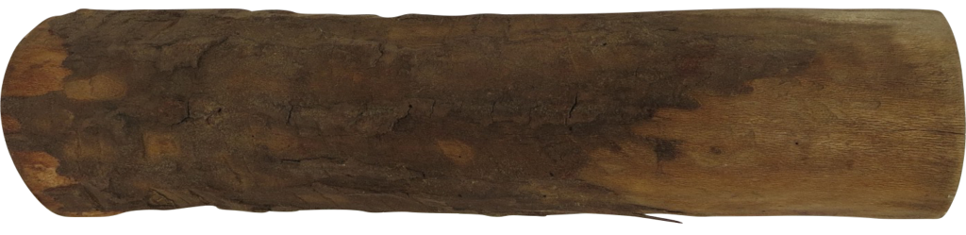
Log Cutting
Given a log of length $n$
A list (of length $n$) of prices $P$ ($P[i]$ is the price of a cut of size $i$)
Find the best way to cut the log
Price:
1
5
8
9
10
17
17
20
24
30
Length:
1
2
3
4
5
6
7
8
9
10
Select a list of lengths $ℓ_{1}, …, ℓ_{k}$ such that:
$\sum{ℓ_{i}=n}$
to maximize $\sum{{P[ℓ}_{i}]}$
Brute Force: $O(2^{n})$

Slide 19
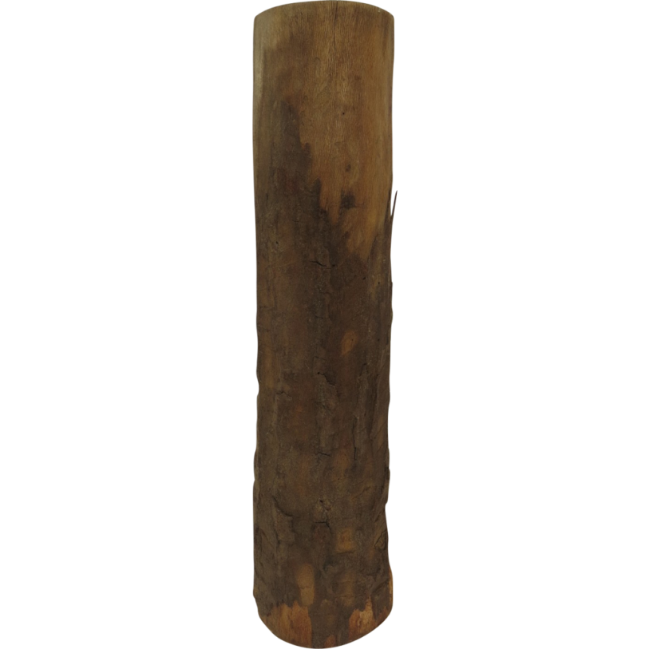
Greedy won’t work
Greedy algorithms (next unit) build a solution by picking the best option “right now”
Select the most profitable cut first
1
18
24
36
50
50
Greedy: Lengths: 5, 1
Profit: 51
Price:
Length:
1
2
3
4
5
6
Better: Lengths: 2, 4
Profit: 54

Slide 20
Greedy won’t work
Greedy algorithms (next unit) build a solution by picking the best option “right now”
Select the “most bang for your buck”
(best price / length ratio)
1
18
24
36
50
50
Greedy: Lengths: 5, 1
Profit: 51
Price:
Length:
1
2
3
4
5
6
Better: Lengths: 2, 4
Profit: 54

Slide 21
Dynamic Programming
Requires Optimal Substructure
Solution to larger problem contains the solutions to smaller ones
Idea:
Identify the recursive structure of the problem
What is the “last thing” done?
Save the solution to each subproblem in memory
Select a good order for solving subproblems
“Top Down”: Solve each recursively
“Bottom Up”: Iteratively solve smallest to largest

Slide 22

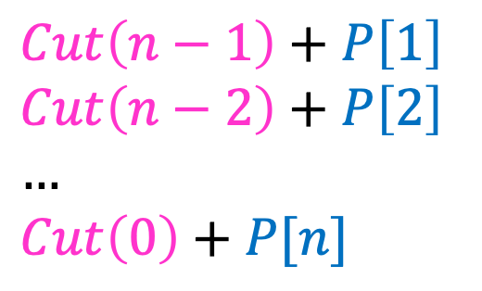



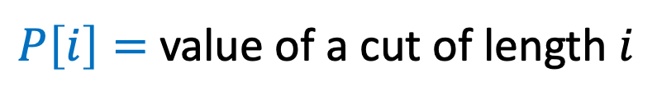
1. Identify Recursive Structure
$P\left[i\right]=$ value of a cut of length $i$
$Cut(n)=$ value of best way to cut a log of length $n$
$Cut\left(n−1\right)+P\left[1\right]$
$Cut\left(n−2\right)+P\left[2\right]$
$…$
$Cut\left(0\right)+P[n]$
$Cut\left(n\right)=max⁡$
$$Cut(n−ℓ_{k})$$
$$ℓ_{k}$$
best way to cut a log of length $n−ℓ_{k}$
Last Cut

Slide 23
Dynamic Programming
Requires Optimal Substructure
Solution to larger problem contains the solutions to smaller ones
Idea:
Identify the recursive structure of the problem
What is the “last thing” done?
Save the solution to each subproblem in memory
Select a good order for solving subproblems
“Top Down”: Solve each recursively
“Bottom Up”: Iteratively solve smallest to largest

Slide 24

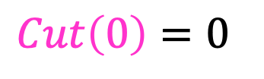
3. Select a Good Order for Solving Subproblems
Solve Smallest subproblem first
$Cut\left(0\right)=0⁡$
$Cut(i)$:
0
Length:
0
1
2
3
4
5
6
7
8
9
10
0

Slide 25

3. Select a Good Order for Solving Subproblems
Solve Smallest subproblem first
$Cut\left(1\right)=Cut\left(0\right)+P[1]⁡$
$Cut(i)$:
0
Length:
0
1
2
3
4
5
6
7
8
9
10
1

Slide 26
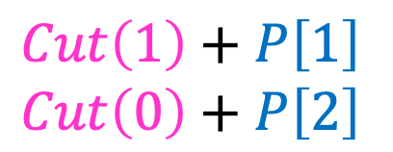

3. Select a Good Order for Solving Subproblems
Solve Smallest subproblem first
$Cut\left(1\right)+P\left[1\right]$
$Cut\left(0\right)+P\left[2\right]$
$Cut\left(2\right)=max⁡$
$Cut(i)$:
0
Length:
0
1
2
3
4
5
6
7
8
9
10
2

Slide 27
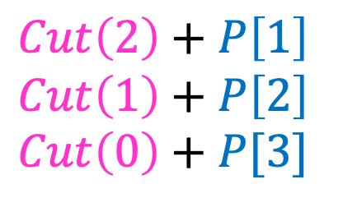

3. Select a Good Order for Solving Subproblems
Solve Smallest subproblem first
$Cut\left(2\right)+P\left[1\right]$
$Cut\left(1\right)+P\left[2\right]$
$Cut\left(0\right)+P[3]$
$Cut\left(3\right)=max⁡$
$Cut(i)$:
0
Length:
0
1
2
3
4
5
6
7
8
9
10
3

Slide 28
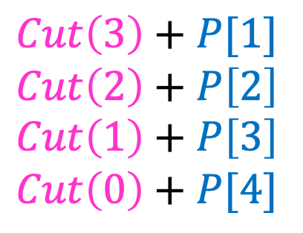

3. Select a Good Order for Solving Subproblems
Solve Smallest subproblem first
$Cut\left(3\right)+P[1]$
$Cut\left(2\right)+P\left[2\right]$
$Cut\left(1\right)+P\left[3\right]$
$Cut\left(0\right)+P[4]$
$Cut\left(4\right)=max⁡$
$Cut(i)$:
0
Length:
0
1
2
3
4
5
6
7
8
9
10
4

Slide 29
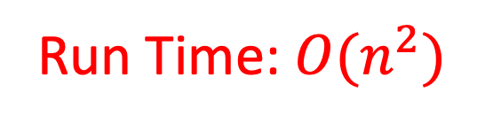
Log Cutting Pseudocode
Initialize Memory C
Cut(n):
C[0] = 0
for i=1 to n: // log size
best = 0
for j = 1 to i: // last cut
best = max(best, C[i-j] + P[j])
C[i] = best
return C[n]
Run Time: $O(n^{2})$

Slide 30
How to find the cuts?
This procedure told us the profit, but not the cuts themselves
Idea: remember the choice that you made, then backtrack

Slide 31
Remember the choice made
Initialize Memory C, Choices
Cut(n):
C[0] = 0
for i=1 to n:
best = 0
for j = 1 to i:
if best < C[i-j] + P[j]:
best = C[i-j] + P[j]
Choices[i]=j
C[i] = best
return C[n]
Gives the size of the last cut

Slide 32
Reconstruct the Cuts
Backtrack through the choices
Choices:
0
1
1
2
4
3
4
1
2
4
3
Length:
0
1
2
3
4
5
6
7
8
9
10
1
2
6
7
Example to demo Choices[] only. Profit of 20 is not optimal!

Slide 33
Backtracking Pseudocode
i = n
while i > 0:
print Choices[i]
i = i – Choices[i]

Slide 34
Our Example: Getting Optimal Solution
i | 0 | 1 | 2 | 3 | 4 | 5 | 6 | 7 | 8 | 9 | 10
C[i] | 0 | 1 | 5 | 8 | 10 | 13 | 17 | 18 | 22 | 25 | 30
Choice[i] | 0 | 1 | 2 | 3 | 2 | 2 | 6 | 1 | 2 | 3 | 10
If n were 5
Best score is 13
Cut at Choice[n]=2, then cut at Choice[n-Choice[n]]= Choice[5-2]= Choice[3]=3
If n were 7
Best score is 18
Cut at 1, then cut at 6

Slide 35
Dynamic Programming
Requires Optimal Substructure
Solution to larger problem contains the solutions to smaller ones
Idea:
Identify the recursive structure of the problem
What is the “last thing” done?
Save the solution to each subproblem in memory
Select a good order for solving subproblems
“Top Down”: Solve each recursively
“Bottom Up”: Iteratively solve smallest to largest

Slide 36


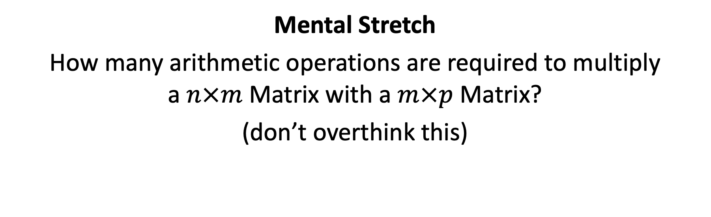



Mental Stretch
How many arithmetic operations are required to multiply a $n×m$ Matrix with a $m×p$ Matrix?
(don’t overthink this)
$$p$$
$$m$$
$$n$$
$$×$$
$$m$$

Slide 37
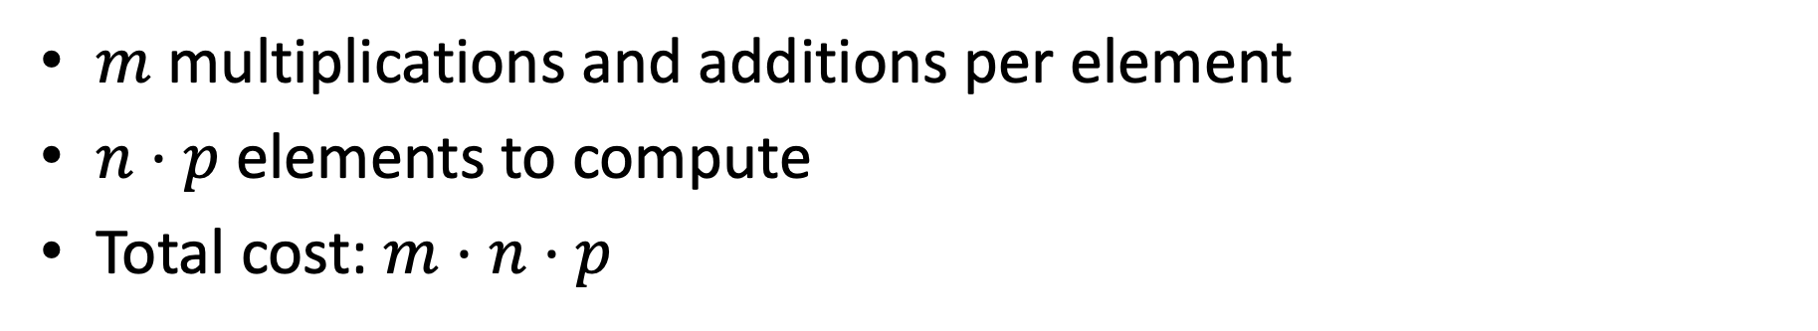
Mental Stretch
How many arithmetic operations are required to multiply a $n×m$ Matrix with a $m×p$ Matrix?
(don’t overthink this)
$$p$$
$$m$$
$$n$$
$$×$$
$$m$$
$m$ multiplications and additions per element
$n⋅p$ elements to compute
Total cost: $m⋅n⋅p$

Slide 38
















Matrix Chaining
Given a sequence of Matrices $(M_{1}, …, M_{n})$, what is the most efficient way to multiply them?
$$c_{4}$$
$$c_{2}$$
$$M_{4}$$
$$c_{1}$$
$$M_{2}$$
$$c_{3}$$
$$M_{1}$$
$$M_{3}$$
$$r_{1}$$
$$×$$
$$r_{2}$$
$$×$$
$$r_{3}$$
$$×$$
$$r_{4}$$

Slide 39

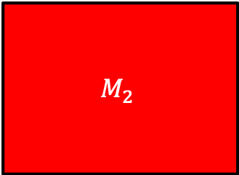
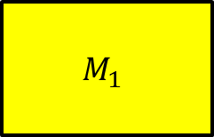


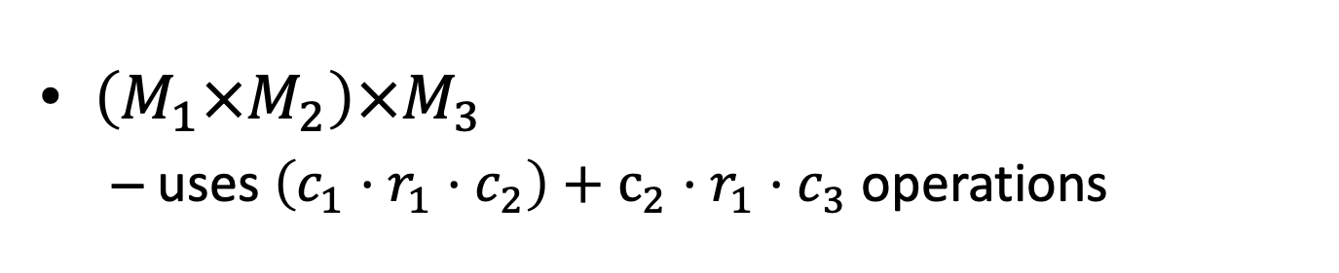
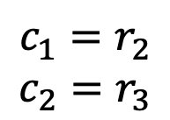








Order Matters!
$$c_{1}=r_{2}$$
$$c_{2}=r_{3}$$
$$c_{2}$$
$$c_{3}$$
$$c_{1}$$
$$M_{2}$$
$$M_{3}$$
$$M_{1}$$
$$r_{1}$$
$$×$$
$$r_{2}$$
$$×$$
$$r_{3}$$
$$c_{2}$$
$$r_{1}$$
$\left(M_{1}×M_{2}\right)×M_{3}$
uses $\left(c_{1}⋅r_{1}⋅c_{2}\right)+c_{2}⋅r_{1}⋅c_{3}$ operations

Slide 40

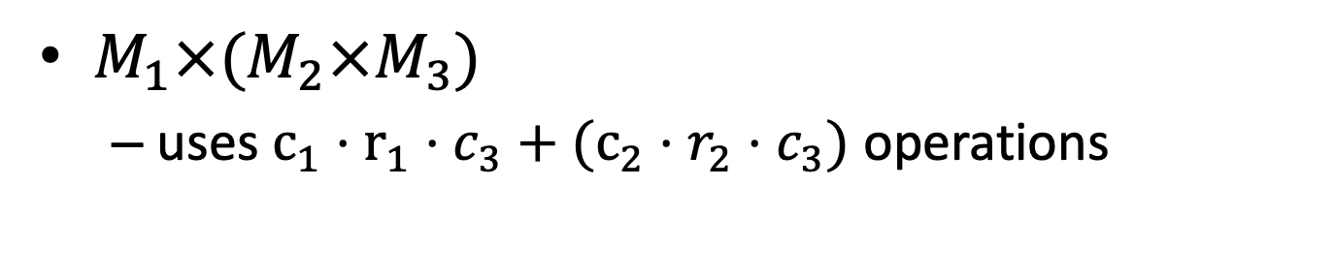
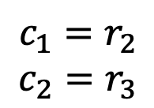

Order Matters!
$$c_{2}$$
$$c_{3}$$
$$c_{1}=r_{2}$$
$$c_{2}=r_{3}$$
$$c_{1}$$
$$M_{2}$$
$$M_{3}$$
$$M_{1}$$
$$r_{1}$$
$$×$$
$$r_{2}$$
$$×$$
$$r_{3}$$
$$c_{3}$$
$$r_{2}$$
$M_{1}×(M_{2}×M_{3})$
uses $c_{1}⋅r_{1}⋅c_{3}+(c_{2}⋅r_{2}⋅c_{3})$ operations

Slide 41
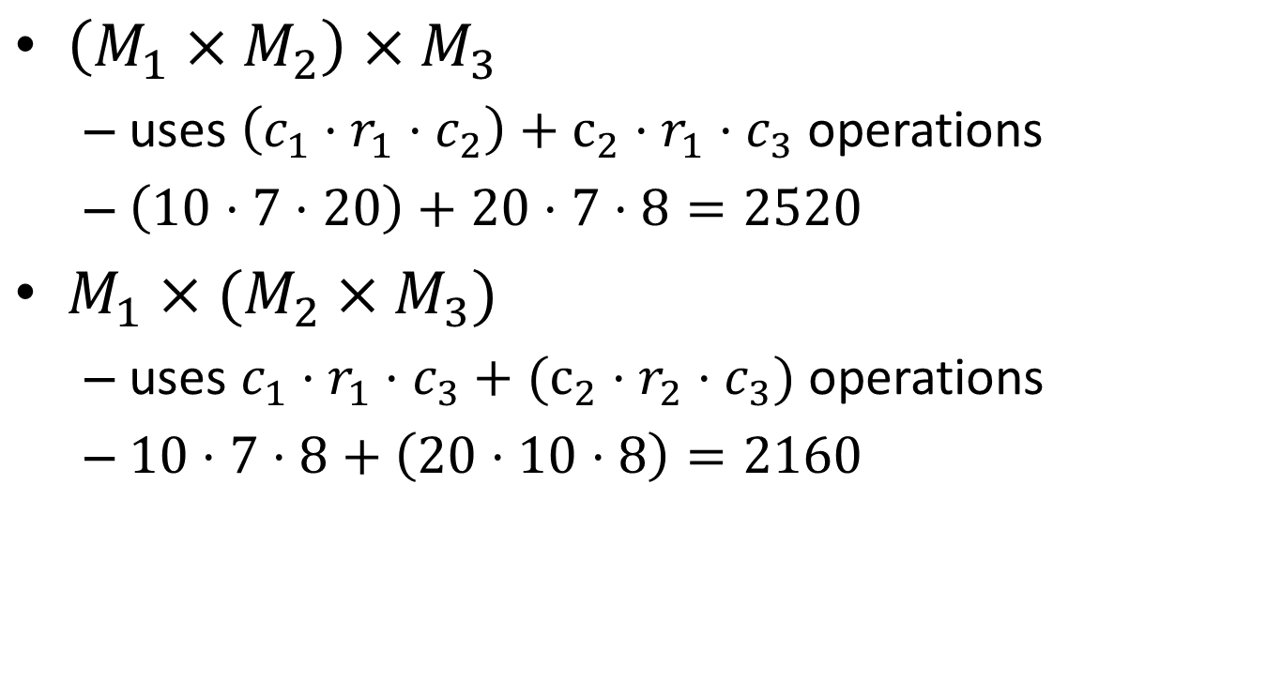
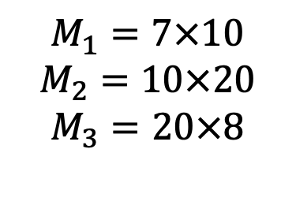

Order Matters!
$$c_{1}=r_{2}$$
$$c_{2}=r_{3}$$
$\left(M_{1}×M_{2}\right)×M_{3}$
uses $\left(c_{1}⋅r_{1}⋅c_{2}\right)+c_{2}⋅r_{1}⋅c_{3}$ operations
$\left(10⋅7⋅20\right)+20⋅7⋅8=2520$
$M_{1}×(M_{2}×M_{3})$
uses $c_{1}⋅r_{1}⋅c_{3}+(c_{2}⋅r_{2}⋅c_{3})$ operations
$10⋅7⋅8+\left(20⋅10⋅8\right)=2160$
$$M_{1}=7×10$$
$$M_{2}=10×20$$
$$M_{3}=20×8$$
$$c_{1}=10$$
$$c_{2}=20$$
$$c_{3}=8$$
$$r_{1}=7$$
$$r_{2}=10$$
$$r_{3}=20$$

Slide 42
Dynamic Programming
Requires Optimal Substructure
Solution to larger problem contains the solutions to smaller ones
Idea:
Identify the recursive structure of the problem
What is the “last thing” done?
Save the solution to each subproblem in memory
Select a good order for solving subproblems
“Top Down”: Solve each recursively
“Bottom Up”: Iteratively solve smallest to largest

Slide 43




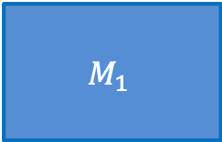
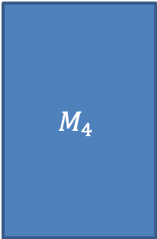







1. Identify the Recursive Structure of the Problem
$Best\left(1,n\right)=$ cheapest way to multiply together $M_{1}$ through $M_{n}$
$$c_{4}$$
$$c_{2}$$
$$M_{4}$$
$$c_{1}$$
$$M_{2}$$
$$c_{3}$$
$$M_{1}$$
$$M_{3}$$
$$r_{1}$$
$$×$$
$$r_{2}$$
$$×$$
$$r_{3}$$
$$×$$
$$r_{4}$$

Slide 44


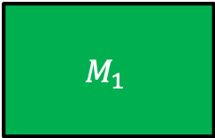


1. Identify the Recursive Structure of the Problem
$Best\left(1,n\right)=$ cheapest way to multiply together $M_{1}$ through $M_{n}$
$$Best\left(2,4\right)+r_{1}r_{2}c_{4}$$
$$Best\left(1,4\right)=min$$
$$c_{4}$$
$$r_{2}$$
$$c_{4}$$
$$c_{2}$$
$$M_{4}$$
$$c_{1}$$
$$M_{2}$$
$$c_{3}$$
$$M_{1}$$
$$M_{3}$$
$$r_{1}$$
$$×$$
$$r_{2}$$
$$×$$
$$r_{3}$$
$$×$$
$$r_{4}$$

Slide 45

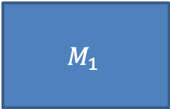




1. Identify the Recursive Structure of the Problem
$Best\left(1,n\right)=$ cheapest way to multiply together $M_{1}$ through $M_{n}$
$$Best\left(2,4\right)+r_{1}r_{2}c_{4}$$
$$Best\left(1,4\right)=min$$
$$Best\left(1,2\right)+Best\left(3, 4\right)+r_{1}r_{3}c_{4}$$
$$c_{2}$$
$$c_{4}$$
$$r_{3}$$
$$r_{1}$$
$$c_{4}$$
$$c_{2}$$
$$M_{4}$$
$$c_{1}$$
$$M_{2}$$
$$c_{3}$$
$$M_{1}$$
$$M_{3}$$
$$r_{1}$$
$$×$$
$$r_{2}$$
$$×$$
$$r_{3}$$
$$×$$
$$r_{4}$$

Slide 46

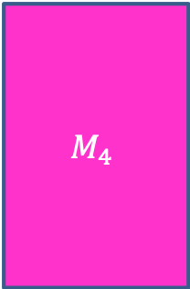




1. Identify the Recursive Structure of the Problem
$Best\left(1,n\right)=$ cheapest way to multiply together $M_{1}$ through $M_{n}$
$$Best\left(2,4\right)+r_{1}r_{2}c_{4}$$
$$Best\left(1,4\right)=min$$
$$Best\left(1,2\right)+Best\left(3, 4\right)+r_{1}r_{3}c_{4}$$
$$Best\left(1,3\right)+r_{1}r_{4}c_{4}$$
$$c_{3}$$
$$r_{1}$$
$$c_{4}$$
$$c_{2}$$
$$M_{4}$$
$$c_{1}$$
$$M_{2}$$
$$c_{3}$$
$$M_{1}$$
$$M_{3}$$
$$r_{1}$$
$$×$$
$$r_{2}$$
$$×$$
$$r_{3}$$
$$×$$
$$r_{4}$$

Slide 47






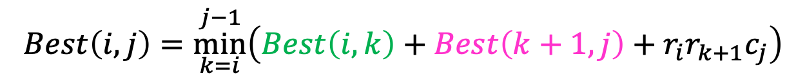


1. Identify the Recursive Structure of the Problem
In general:
$Best\left(i,j\right)=$ cheapest way to multiply together $M_{i}$ through $M_{j}$
$$Best\left(i,j\right)=\underset{k=i}{\overset{j−1}{min}}\left(Best\left(i,k\right)+Best\left(k+1, j\right)+r_{i}r_{k+1}c_{j}\right)$$
$$Best\left(i,i\right)=0$$
$$Best\left(2,n\right)+r_{1}r_{2}c_{n}$$
$$Best\left(1,2\right)+Best\left(3, n\right)+r_{1}r_{3}c_{n}$$
$$Best\left(1,3\right)+Best\left(4, n\right)+r_{1}r_{4}c_{n}$$
$$Best\left(1,n\right)=min$$
$$Best\left(1,4\right)+Best\left(5, n\right)+r_{1}r_{5}c_{n}$$
$$…$$
$$Best\left(1,n−1\right)+r_{1}r_{n}c_{n}$$

Slide 48
Dynamic Programming
Requires Optimal Substructure
Solution to larger problem contains the solutions to smaller ones
Idea:
Identify the recursive structure of the problem
What is the “last thing” done?
Save the solution to each subproblem in memory
Select a good order for solving subproblems
“Top Down”: Solve each recursively
“Bottom Up”: Iteratively solve smallest to largest

Slide 49







2. Save Subsolutions in Memory
In general:
$Best\left(i,j\right)=$ cheapest way to multiply together $M_{i}$ through $M_{j}$
$$Best\left(i,j\right)=\underset{k=i}{\overset{j−1}{min}}\left(Best\left(i,k\right)+Best\left(k+1, j\right)+r_{i}r_{k+1}c_{j}\right)$$
$$Best\left(i,i\right)=0$$
Read from M[n]
if present
Save to M[n]
$$Best\left(2,n\right)+r_{1}r_{2}c_{n}$$
$$Best\left(1,2\right)+Best\left(3, n\right)+r_{1}r_{3}c_{n}$$
$$Best\left(1,3\right)+Best\left(4, n\right)+r_{1}r_{4}c_{n}$$
$$Best\left(1,n\right)=min$$
$$Best\left(1,4\right)+Best\left(5, n\right)+r_{1}r_{5}c_{n}$$
$$…$$
$$Best\left(1,n−1\right)+r_{1}r_{n}c_{n}$$

Slide 50
Dynamic Programming
Requires Optimal Substructure
Solution to larger problem contains the solutions to smaller ones
Idea:
Identify the recursive structure of the problem
What is the “last thing” done?
Save the solution to each subproblem in memory
Select a good order for solving subproblems
“Top Down”: Solve each recursively
“Bottom Up”: Iteratively solve smallest to largest

Slide 51
3. Select a good order for solving subproblems
In general:
$Best\left(i,j\right)=$ cheapest way to multiply together $M_{i}$ through $M_{j}$
$$Best\left(i,j\right)=\underset{k=i}{\overset{j−1}{min}}\left(Best\left(i,k\right)+Best\left(k+1, j\right)+r_{i}r_{k+1}c_{j}\right)$$
$$Best\left(i,i\right)=0$$
Read from M[n]
if present
Save to M[n]
$$Best\left(2,n\right)+r_{1}r_{2}c_{n}$$
$$Best\left(1,2\right)+Best\left(3, n\right)+r_{1}r_{3}c_{n}$$
$$Best\left(1,3\right)+Best\left(4, n\right)+r_{1}r_{4}c_{n}$$
$$Best\left(1,n\right)=min$$
$$Best\left(1,4\right)+Best\left(5, n\right)+r_{1}r_{5}c_{n}$$
$$…$$
$$Best\left(1,n−1\right)+r_{1}r_{n}c_{n}$$

Slide 52



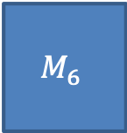























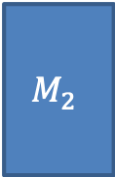

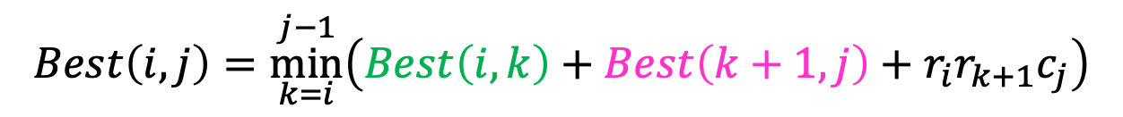




3. Select a good order for solving subproblems
$$35$$
$$15$$
$$5$$
$$10$$
$$20$$
$$25$$
$$M_{1}$$
$$M_{2}$$
$$M_{3}$$
$$M_{4}$$
$$M_{5}$$
$$M_{6}$$
$$30$$
$$×$$
$$35$$
$$×$$
$$15$$
$$×$$
$$5$$
$$×$$
$$10$$
$$×$$
$$20$$
$$Best\left(i,j\right)=\underset{k=i}{\overset{j−1}{min}}\left(Best\left(i,k\right)+Best\left(k+1, j\right)+r_{i}r_{k+1}c_{j}\right)$$
$$j=$$
$$1$$
$$2$$
$$3$$
$$4$$
$$5$$
$$6$$
$$=i$$
$$Best\left(i,i\right)=0$$
0
$$1$$
0
$$2$$
0
$$3$$
0
$$4$$
0
$$5$$
0
$$6$$

Slide 53



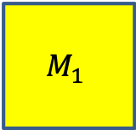
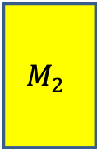
3. Select a good order for solving subproblems
$$35$$
$$15$$
$$5$$
$$10$$
$$20$$
$$25$$
$$M_{1}$$
$$M_{2}$$
$$M_{3}$$
$$M_{4}$$
$$M_{5}$$
$$M_{6}$$
$$30$$
$$×$$
$$35$$
$$×$$
$$15$$
$$×$$
$$5$$
$$×$$
$$10$$
$$×$$
$$20$$
$$Best\left(i,j\right)=\underset{k=i}{\overset{j−1}{min}}\left(Best\left(i,k\right)+Best\left(k+1, j\right)+r_{i}r_{k+1}c_{j}\right)$$
$$j=$$
$$1$$
$$2$$
$$3$$
$$4$$
$$5$$
$$6$$
$$=i$$
$$Best\left(i,i\right)=0$$
0
15750
$$1$$
0
$$2$$
0
$$3$$
0
$$4$$
$$Best\left(1,1\right)+Best\left(2, 2\right)+r_{1}r_{2}c_{2}$$
0
$$5$$
$$Best\left(1,2\right)=min$$
0
$$6$$

Slide 54




3. Select a good order for solving subproblems
$$35$$
$$15$$
$$5$$
$$10$$
$$20$$
$$25$$
$$M_{1}$$
$$M_{2}$$
$$M_{3}$$
$$M_{4}$$
$$M_{5}$$
$$M_{6}$$
$$30$$
$$×$$
$$35$$
$$×$$
$$15$$
$$×$$
$$5$$
$$×$$
$$10$$
$$×$$
$$20$$
$$Best\left(i,j\right)=\underset{k=i}{\overset{j−1}{min}}\left(Best\left(i,k\right)+Best\left(k+1, j\right)+r_{i}r_{k+1}c_{j}\right)$$
$$j=$$
$$1$$
$$2$$
$$3$$
$$4$$
$$5$$
$$6$$
$$=i$$
$$Best\left(i,i\right)=0$$
0
15750
$$1$$
0
2625
$$2$$
0
$$3$$
0
$$4$$
$$Best\left(2,2\right)+Best\left(3, 3\right)+r_{2}r_{3}c_{3}$$
0
$$5$$
$$Best\left(2,3\right)=min$$
0
$$6$$

Slide 55

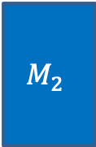
3. Select a good order for solving subproblems
$$35$$
$$15$$
$$5$$
$$10$$
$$20$$
$$25$$
$$M_{1}$$
$$M_{2}$$
$$M_{3}$$
$$M_{4}$$
$$M_{5}$$
$$M_{6}$$
$$30$$
$$×$$
$$35$$
$$×$$
$$15$$
$$×$$
$$5$$
$$×$$
$$10$$
$$×$$
$$20$$
$$Best\left(i,j\right)=\underset{k=i}{\overset{j−1}{min}}\left(Best\left(i,k\right)+Best\left(k+1, j\right)+r_{i}r_{k+1}c_{j}\right)$$
$$j=$$
$$1$$
$$2$$
$$3$$
$$4$$
$$5$$
$$6$$
$$=i$$
$$Best\left(i,i\right)=0$$
0
15750
$$1$$
0
2625
$$2$$
0
750
$$3$$
0
1000
$$4$$
0
5000
$$5$$
0
$$6$$

Slide 56









3. Select a good order for solving subproblems
$$35$$
$$15$$
$$5$$
$$10$$
$$20$$
$$25$$
$$M_{1}$$
$$M_{2}$$
$$M_{3}$$
$$M_{4}$$
$$M_{5}$$
$$M_{6}$$
$$30$$
$$×$$
$$35$$
$$×$$
$$15$$
$$×$$
$$5$$
$$×$$
$$10$$
$$×$$
$$20$$
$$Best\left(i,j\right)=\underset{k=i}{\overset{j−1}{min}}\left(Best\left(i,k\right)+Best\left(k+1, j\right)+r_{i}r_{k+1}c_{j}\right)$$
$$j=$$
$$1$$
$$2$$
$$3$$
$$4$$
$$5$$
$$6$$
$$=i$$
$$Best\left(i,i\right)=0$$
0
15750
7875
$$1$$
$$r_{1}r_{2}c_{3}=30⋅35⋅5=5250$$
0
2625
$$2$$
$$r_{1}r_{3}c_{3}=30⋅15⋅5=2250$$
0
750
$$3$$
0
1000
$$4$$
$$0$$
$$2625$$
$$Best\left(1,1\right)+Best\left(2, 3\right)+r_{1}r_{2}c_{3}$$
0
5000
$$5$$
$$Best\left(1,3\right)=min$$
$$Best\left(1,2\right)+Best\left(3, 3\right)+r_{1}r_{3}c_{3}$$
0
$$6$$
$$15750$$
$$0$$

Slide 57

3. Select a good order for solving subproblems
$$35$$
$$15$$
$$5$$
$$10$$
$$20$$
$$25$$
$$M_{1}$$
$$M_{2}$$
$$M_{3}$$
$$M_{4}$$
$$M_{5}$$
$$M_{6}$$
$$30$$
$$×$$
$$35$$
$$×$$
$$15$$
$$×$$
$$5$$
$$×$$
$$10$$
$$×$$
$$20$$
$$Best\left(i,j\right)=\underset{k=i}{\overset{j−1}{min}}\left(Best\left(i,k\right)+Best\left(k+1, j\right)+r_{i}r_{k+1}c_{j}\right)$$
$$j=$$
$$1$$
$$2$$
$$3$$
$$4$$
$$5$$
$$6$$
$$=i$$
$$Best\left(i,i\right)=0$$
0
15750
7875
$$1$$
0
2625
$$2$$
To find $Best(i,j)$: Need all preceding terms of row $i$ and column $j$
0
750
$$3$$
0
1000
$$4$$
Conclusion: solve in order of diagonal
0
5000
$$5$$
0
$$6$$

Slide 58






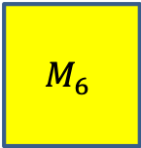



Matrix Chaining
$$35$$
$$15$$
$$5$$
$$10$$
$$20$$
$$25$$
$$M_{1}$$
$$M_{2}$$
$$M_{3}$$
$$M_{4}$$
$$M_{5}$$
$$M_{6}$$
$$30$$
$$×$$
$$35$$
$$×$$
$$15$$
$$×$$
$$5$$
$$×$$
$$10$$
$$×$$
$$20$$
$$Best\left(i,j\right)=\underset{k=i}{\overset{j−1}{min}}\left(Best\left(i,k\right)+Best\left(k+1, j\right)+r_{i}r_{k+1}c_{j}\right)$$
$$j=$$
$$1$$
$$2$$
$$3$$
$$4$$
$$5$$
$$6$$
$$=i$$
$$Best\left(i,i\right)=0$$
0
15750
7875
9375
11875
$$15125$$
$$1$$
0
2625
4375
7125
10500
$$2$$
0
750
2500
5375
$$3$$
$$Best\left(1,1\right)+Best\left(2, 6\right)+r_{1}r_{2}c_{6}$$
0
1000
3500
$$4$$
$$Best\left(1,2\right)+Best\left(3, 6\right)+r_{1}r_{3}c_{6}$$
$$Best\left(1,6\right)=min$$
$$Best\left(1,3\right)+Best\left(4, 6\right)+r_{1}r_{4}c_{6}$$
0
5000
$$5$$
$$Best\left(1,4\right)+Best\left(5, 6\right)+r_{1}r_{5}c_{6}$$
0
$$Best\left(1,5\right)+Best\left(6, 6\right)+r_{1}r_{6}c_{6}$$
$$6$$

Slide 59
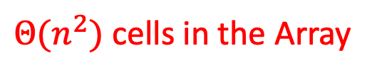
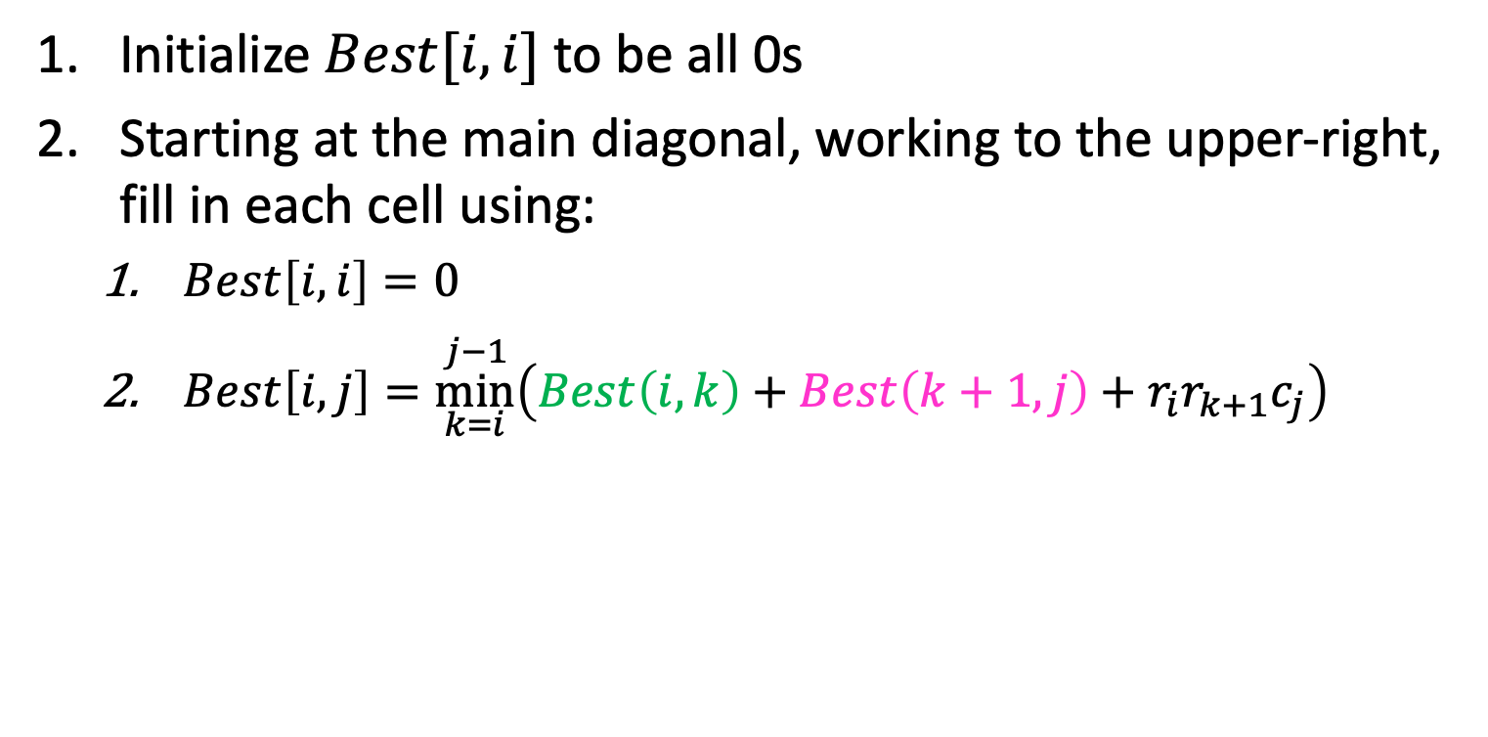
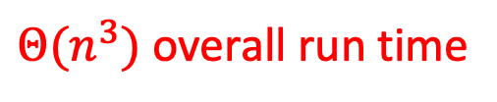
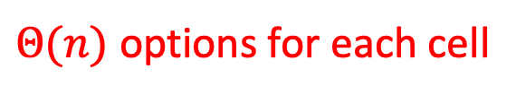
Run Time
Initialize $Best[i,i]$ to be all 0s
Starting at the main diagonal, working to the upper-right, fill in each cell using:
$Best\left[i,i\right]=0$
$Best\left[i,j\right]=\underset{k=i}{\overset{j−1}{min}}\left(Best\left(i,k\right)+Best\left(k+1, j\right)+r_{i}r_{k+1}c_{j}\right)$
$Θ(n^{2})$ cells in the Array
Each “call” to Best() is a O(1) memory lookup
$Θ(n)$ options for each cell
$Θ(n^{3})$ overall run time

Slide 60




Backtrack to find the best order
“remember” which choice of $k$ was the minimum at each cell
$$Best\left(i,j\right)=\underset{k=i}{\overset{j−1}{min}}\left(Best\left(i,k\right)+Best\left(k+1, j\right)+r_{i}r_{k+1}c_{j}\right)$$
$$j=$$
$$1$$
$$2$$
$$3$$
$$4$$
$$5$$
$$6$$
$$=i$$
$$Best\left(i,i\right)=0$$
0
15750
7875
9375
11875
$$15125$$
$$1$$
$$1$$
$$3$$
0
2625
4375
7125
10500
$$2$$
0
750
2500
5375
$$3$$
$$Best\left(1,1\right)+Best\left(2, 6\right)+r_{1}r_{2}c_{6}$$
0
1000
3500
$$4$$
$$Best\left(1,2\right)+Best\left(3, 6\right)+r_{1}r_{3}c_{6}$$
$$5$$
$$Best\left(1,6\right)=min$$
$$Best\left(1,3\right)+Best\left(4, 6\right)+r_{1}r_{4}c_{6}$$
0
5000
$$5$$
$$Best\left(1,4\right)+Best\left(5, 6\right)+r_{1}r_{5}c_{6}$$
0
$$Best\left(1,5\right)+Best\left(6, 6\right)+r_{1}r_{6}c_{6}$$
$$6$$
60

Slide 61
Matrix Chaining
$$35$$
$$15$$
$$5$$
$$10$$
$$20$$
$$25$$
$$M_{1}$$
$$M_{2}$$
$$M_{3}$$
$$M_{4}$$
$$M_{5}$$
$$M_{6}$$
$$30$$
$$×$$
$$35$$
$$×$$
$$15$$
$$×$$
$$5$$
$$×$$
$$10$$
$$×$$
$$20$$
$$Best\left(i,j\right)=\underset{k=i}{\overset{j−1}{min}}\left(Best\left(i,k\right)+Best\left(k+1, j\right)+r_{i}r_{k+1}c_{j}\right)$$
$$j=$$
$$1$$
$$2$$
$$3$$
$$4$$
$$5$$
$$6$$
$$=i$$
$$Best\left(i,i\right)=0$$
0
15750
7875
9375
11875
$$15125$$
$$1$$
$$1$$
$$3$$
0
2625
4375
7125
10500
$$2$$
0
750
2500
5375
$$3$$
$$Best\left(1,1\right)+Best\left(2, 6\right)+r_{1}r_{2}c_{6}$$
0
1000
3500
$$4$$
$$Best\left(1,2\right)+Best\left(3, 6\right)+r_{1}r_{3}c_{6}$$
$$5$$
$$Best\left(1,6\right)=min$$
$$Best\left(1,3\right)+Best\left(4, 6\right)+r_{1}r_{4}c_{6}$$
0
5000
$$5$$
$$Best\left(1,4\right)+Best\left(5, 6\right)+r_{1}r_{5}c_{6}$$
0
$$Best\left(1,5\right)+Best\left(6, 6\right)+r_{1}r_{6}c_{6}$$
$$6$$

Slide 62
Storing and Recovering Optimal Solution
Maintain table Choice[i,j] in addition to Best table
Choice[i,j] = k means the best “split” was right after M_{k}
Work backwards from value for whole problem, Choice[1,n]
Note: Choice[i,i+1] = i because there are just 2 matrices
From our example:
Choice[1,6] = 3. So [M₁ M₂ M₃] [M₄ M₅ M₆]
We then need Choice[1,3] = 1. So [(M₁) (M₂ M₃)]
Also need Choice[4,6] = 5. So [(M₄ M₅) M₆]
Overall: [(M₁) (M₂ M₃)] [(M₄ M₅) M₆]

Slide 63
Dynamic Programming
Requires Optimal Substructure
Solution to larger problem contains the solutions to smaller ones
Idea:
Identify the recursive structure of the problem
What is the “last thing” done?
Save the solution to each subproblem in memory
Select a good order for solving subproblems
“Top Down”: Solve each recursively
“Bottom Up”: Iteratively solve smallest to largest

