Slide 1
NP-Completeness
CS 4102: Algorithms
Spring 2022
Robbie Hott and Tom Horton

Slide 2
Today’s Keywords
Reductions
P vs NP
NP Hard, NP Completeness
k-Independent Set
k-Vertex Cover
3SAT
k-Clique

Slide 3
Reductions
(We’re about to get interested in problems that seem to require exponential time…)

Slide 4
Max-flow vs. Edge-disjoint paths
These two problems are “related”
Here we’re saying: if you can solve Max-flow, you can solve Edge-disjoint path
Alternatively, we can say that one problem reduces to the other
The problem of finding Edge-disjoint paths reduces to the problem of finding max-flow
Maybe this reduction requires some work to “convert”
Could be nothing or minimal
For these problems, the cost of the conversion is hopefully small (more on this in a moment).

Slide 5
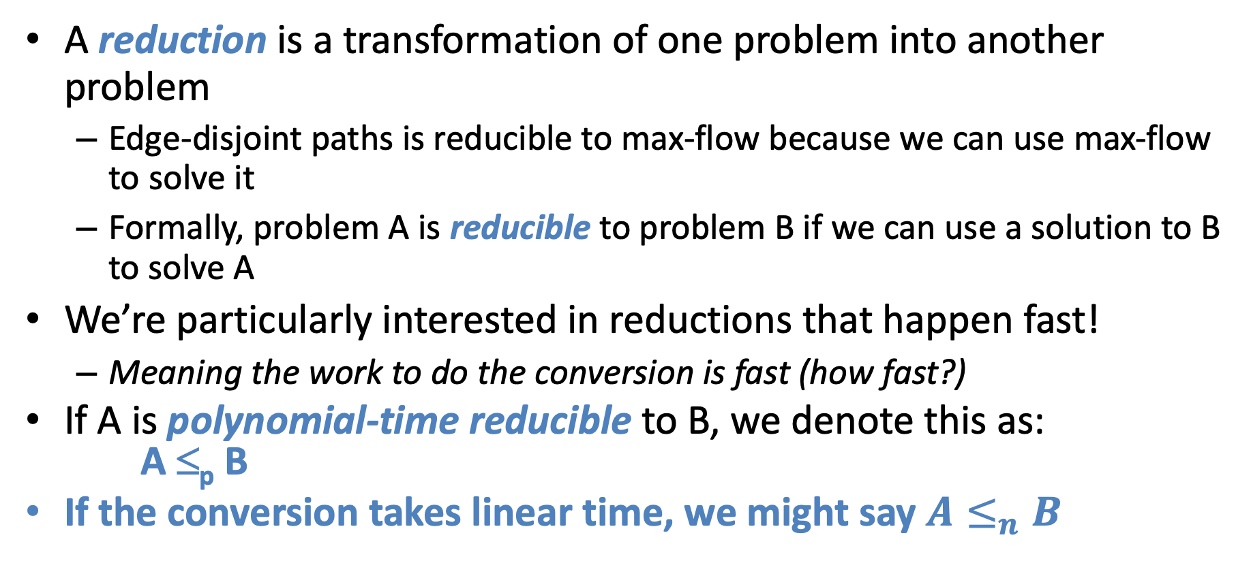
Reduction
A reduction is a transformation of one problem into another problem
Edge-disjoint paths is reducible to max-flow because we can use max-flow to solve it
Formally, problem A is reducible to problem B if we can use a solution to B to solve A
We’re particularly interested in reductions that happen fast!
Meaning the work to do the conversion is fast (how fast?)
If A is polynomial-time reducible to B, we denote this as: A ≤_{p} B
If the conversion takes linear time, we might say $A≤_{n}B$

Slide 6
In General: A Reduction
A problem we don’t know how to solve
Reduction
A problem we do know how to solve
$$A$$
Map Instances of problem $A$to Instances of $B$
$$B$$
Using any Algorithm for $B$
Map Solutions of problem $B$to Solutions of $A$
Solution for $A$
Solution for $B$
$$RA$$
$$RB$$

Slide 7
In General: Reduction
Problem we don’t know how to solve
Reduction
Problem we do know how to solve
$$A$$
Map Instances of problem $A$to Instances of $B$
$$B$$
Using any Algorithm for $B$
Map Solutions of problem $B$to Solutions of $A$
For now: we are NOT focusing on an algorithm to solve one of these, just on the reduction!
Solution for $A$
Solution for $B$
$$RA$$
$$RB$$

Slide 8
Total Runtime
The total runtime to solve A is:
Convert(A->B): Time it takes to convert problem A into problem B
Execute(B): Time it takes to execute algorithm to solve B
Solve(B->A): Time to convert solution of B back to solution of A
Total Runtime: Convert(A->B) + Execute(B) + Solve(B->A)
Do you see why we want convert() and solve() to be FAST. We want the slowest part to be the actual algorithm that solves B if possible.

Slide 9
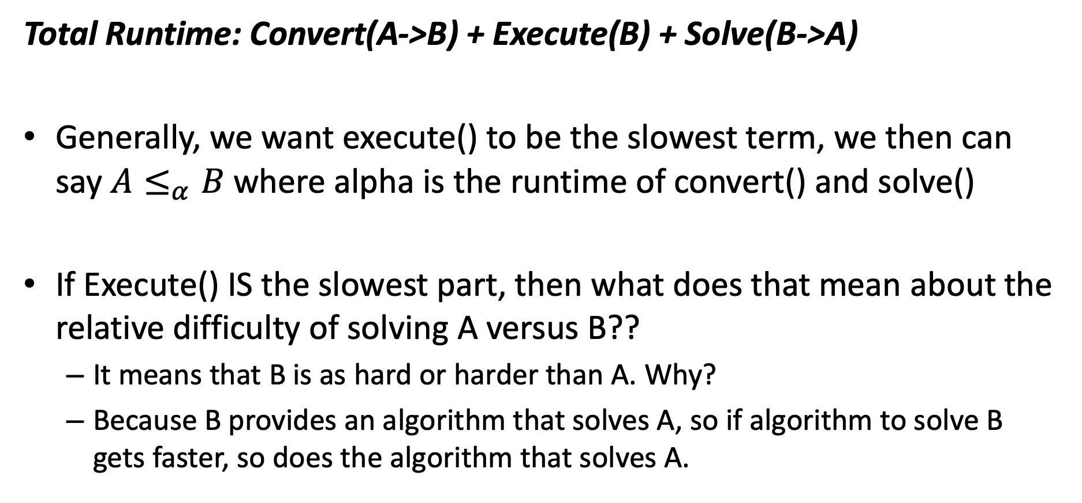
Relative Hardness
Total Runtime: Convert(A->B) + Execute(B) + Solve(B->A)
Generally, we want execute() to be the slowest term, we then can say $A≤_{α}B$ where alpha is the runtime of convert() and solve()
If Execute() IS the slowest part, then what does that mean about the relative difficulty of solving A versus B??
It means that B is as hard or harder than A. Why?
Because B provides an algorithm that solves A, so if algorithm to solve B gets faster, so does the algorithm that solves A.

Slide 10


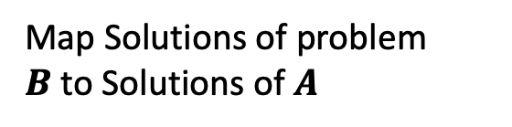
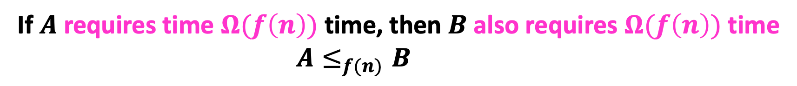
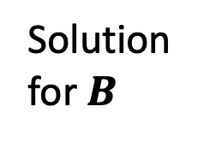
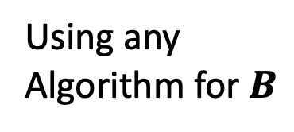
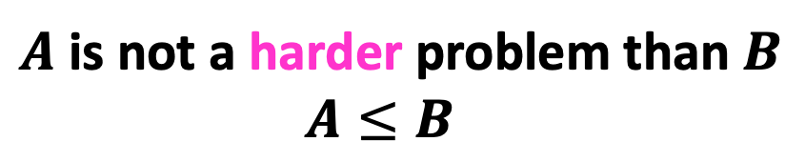
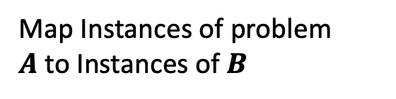
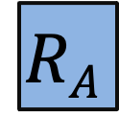
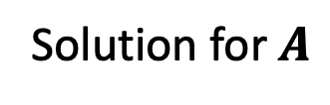

Reductions and Hardness (again)
Problem we don’t know how to solve
Reduction
$$A$$
$$B$$
Problem we do know how to solve
Map Instances of problem $A$to Instances of $B$
Solve A using B’s solver. Cost: Cost of B’s solver plus O(f(n)) for reduction.
Reduction cost: O(f(n))
Using any Algorithm for $B$
Solution for $A$
Map Solutions of problem $B$to Solutions of $A$
$$RA$$
$$RB$$
Solution for $B$
Or we could have solved A faster using B’s solver!
$A$ is not a harder problem than $B$
$A≤B$
If $A$ requires time $Ω(f\left(n\right))$ time, then $B$ also requires $Ω(f\left(n\right))$ time
$A≤_{f(n)}B$

Slide 11
Reduction for Bipartite Matching
We have transformed (in polynomial time) a bipartite matching problem into a max flow problem
Specifically, bipartite-matching ≤_{p} max-flow
Because we can transform bipartite matching to max-flow in polynomial time
But is it the case that max-flow ≤_{p} bipartite-matching?
Not so much: a solution to bipartite matching does not help us with a non-bipartite graph

Slide 13
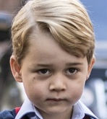



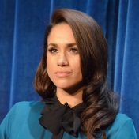
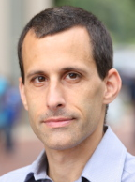
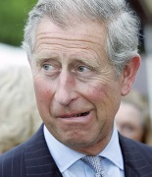




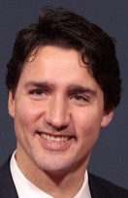
Party Problem
Draw edges between people who don’t get along.
Find the maximum number of people who get along.

Slide 14
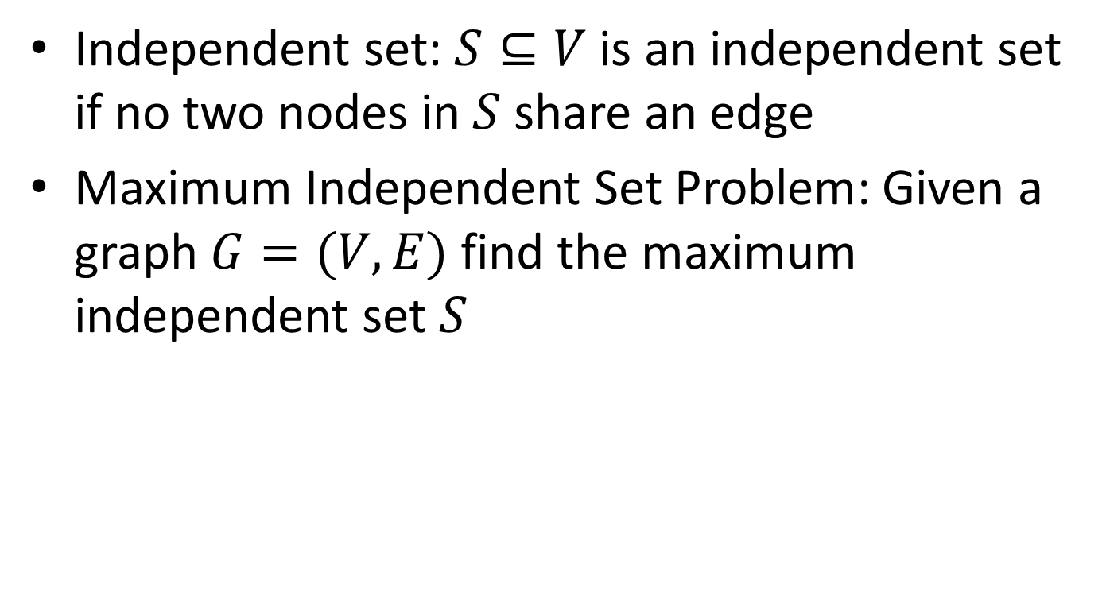
Maximum Independent Set
Independent set: $S⊆V$ is an independent set if no two nodes in $S$ share an edge
Maximum Independent Set Problem: Given a graph $G=(V,E)$ find the maximum independent set $S$

Slide 15
Example
Independent set of size 6

Slide 16
Generalized Baseball

Slide 17
Generalized Baseball
Need to place defenders on bases such that every edge is defended
What’s the fewest number of defenders needed?

Slide 18
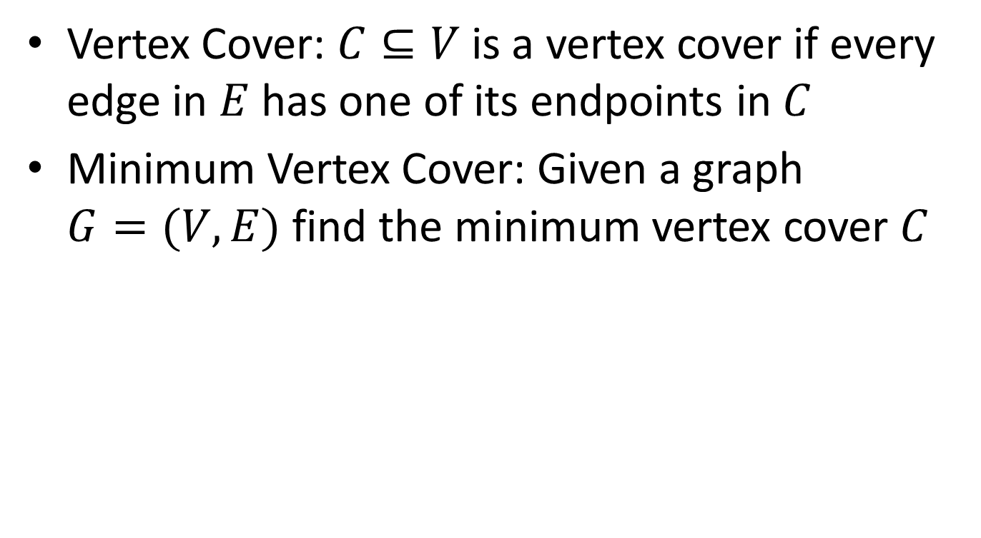
Minimum Vertex Cover
Vertex Cover: $C⊆V$ is a vertex cover if every edge in $E$ has one of its endpoints in $C$
Minimum Vertex Cover: Given a graph $G=(V,E)$ find the minimum vertex cover $C$

Slide 19
Example
Vertex cover of size 5

Slide 20















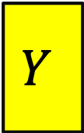



MaxIndSet$≤_{V}$MinVertCov
$$A$$
$$B$$
$O(V)$-reduces to
Problem B
Problem A
$$Y$$
$$X$$
can be used to make
With $O(V)$ overhead
Algorithm for B
Algorithm for A
If $A$ requires time $Ω(f\left(n\right))$ time then $B$ also requires $Ω(f\left(n\right))$ time
$A≤_{V}B$

Slide 21















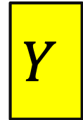
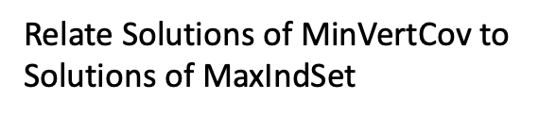
We need to build this Reduction
MaxIndSet
O(V) Time
MinVertCov
$$A$$
Relate Instances of MaxIndSet
to Instances of MinVertCov
$$B$$
Using any Algorithm for MinVertCov
Relate Solutions of MinVertCov to Solutions of MaxIndSet
Solution for MaxIndSet
Solution for MinVertCov
$$X$$
$$Y$$
Reduction

Slide 22









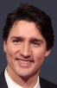
Reduction Idea
$S$ is an independent set of $G$ iff $V−S$ is a vertex cover of $G$
Independent Set
Vertex Cover

Slide 23
Reduction Idea
$S$ is an independent set of $G$ iff $V−S$ is a vertex cover of $G$
Vertex Cover
Independent Set

Slide 24


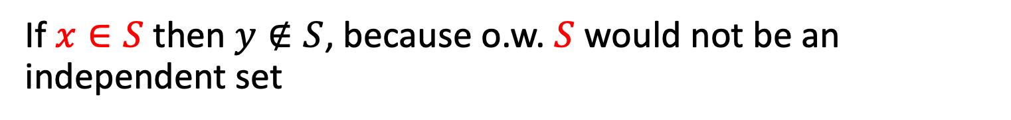
Proof: $⇒$
$S$ is an independent set of $G$ iff $V−S$ is a vertex cover of $G$
Let $S$ be an independent set
Consider any edge $\left(x,y\right)∈E$
If $x∈S$ then $y∉S$, because o.w. $S$ would not be an independent set
Therefore $y∈V−S$, so edge $(x,y)$ is covered by $V−S$

Slide 25
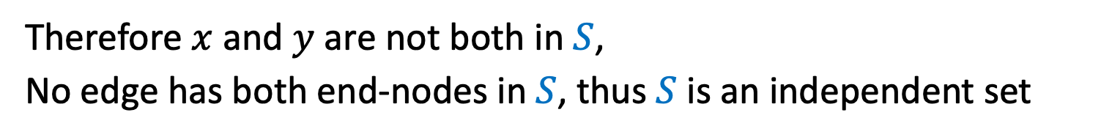

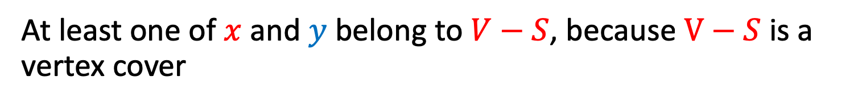
Proof: $⇐$
$S$ is an independent set of $G$ iff $V−S$ is a vertex cover of $G$
Let $V−S$ be a vertex cover
Consider any edge $\left(x,y\right)∈E$
At least one of $x$ and $y$ belong to $V−S$, because $V−S$ is a vertex cover
Therefore $x$ and $y$ are not both in $S$,
No edge has both end-nodes in $S$, thus $S$ is an independent set

Slide 26

MaxVertCov $V$-Time Reducible to MinIndSet
MaxIndSet
O(V) Time
MinVertCov
$$A$$
$$B$$
Do nothing
Using any Algorithm for MinVertCov
Solution for MaxIndSet
Take complement of solution
Solution for MinVertCov
$$X$$
$$Y$$
Reduction

Slide 27
MaxVertCov $V$-Time Reducible to MinIndSet
MaxIndSet
MinVertCov
O(V) Time
$$A$$
$$B$$
Do nothing
Using any Algorithm for MaxIndSet
Solution for MinVertCov
Take complement of solution
Solution for MaxIndSet
$$X$$
$$Y$$
Reduction

Slide 28
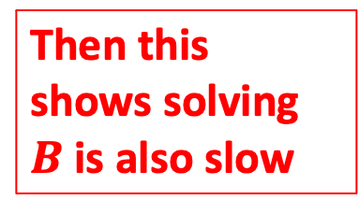
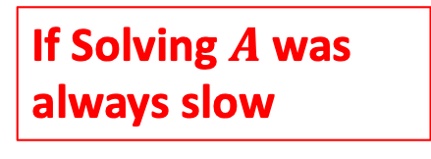
Corollary
MaxIndSet
O(V) Time
MinVertCov
$$A$$
$$B$$
Do nothing
Using any Algorithm for MinIndSet
Then this shows solving $B$ is also slow
If Solving $A$ was always slow
Solution for MaxIndSet
Take complement of solution
Solution for MinVertCov
$$X$$
$$Y$$
Reduction

Slide 29
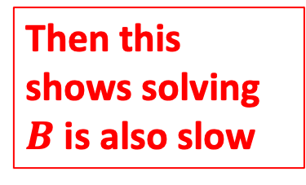
Corollary
MaxIndSet
MinVertCov
O(V) Time
$$A$$
$$B$$
Do nothing
Using any Algorithm for MaxVertCov
Then this shows solving $B$ is also slow
If Solving $A$ was always slow
Solution for MinVertCov
Take complement of solution
Solution for MaxIndSet
$$X$$
$$Y$$
Reduction

Slide 30
Conclusion
MaxIndSet and MinVertCov are either both fast, or both slow
Spoiler alert: We don’t know which!
(But we think they’re both slow)
Both problems are NP-Complete
Next time!

