Slide 1
NP-Completeness
CS 4102: Algorithms
Spring 2022
Robbie Hott and Tom Horton

Slide 2
Today’s Keywords
Reductions
P vs NP
NP Hard, NP Completeness
k-Independent Set
k-Vertex Cover
3SAT
k-Clique

Slide 3
Why Study NP-Completeness
All semester, we’ve studied finding algorithms to solve problems using various tools.
Sometimes we instead need to prove that a problem is extremely hard, so as not to waste time on it!
NP-Complete Problems are hard
Let’s go over a few of them quickly
Let’s show how to prove a new problem is NP-Complete

Slide 4
Some Preliminaries
Before we go further on this topic….
This is a complex (and interesting!) topic in CS theory
In our few lectures, we may approach things from a simpler viewpoint than you’d get in a CS theory course
The math and theory related to NP-complete problems starts with decision problems
What’s that? Let’s use vertex cover as an example
What’s described next applies to any optimization problems we’ve seen

Slide 5
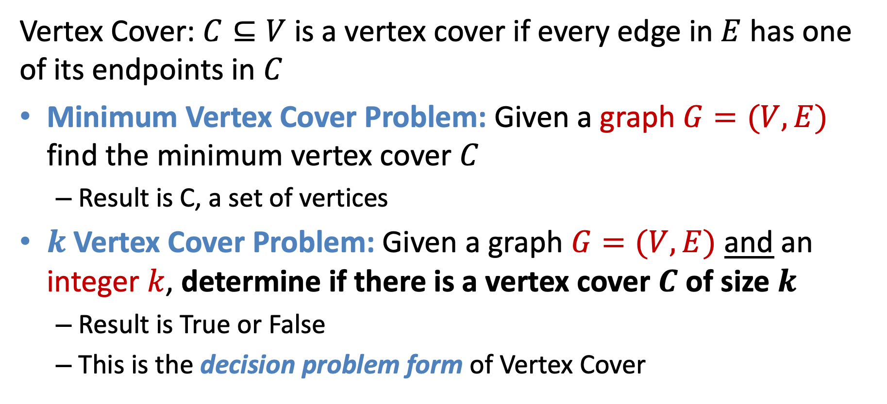
Forms of the Vertex Cover Problem
Vertex Cover: $C⊆V$ is a vertex cover if every edge in $E$ has one of its endpoints in $C$
Minimum Vertex Cover Problem: Given a graph $G=(V,E)$ find the minimum vertex cover $C$
Result is C, a set of vertices
$k$Vertex Cover Problem: Given a graph $G=(V,E)$ and an integer $k$, determine if there is a vertex cover $C$ of size $k$
Result is True or False
This is the decision problem form of Vertex Cover

Slide 6

k Vertex Cover
$k$Vertex Cover Problem: Given a graph $G=(V,E)$ and an integer $k$, determine if there is a vertex cover $C$ of size $k$
True for k=6
True for k=5
Is 5 the smallest? True for k=4?

Slide 7
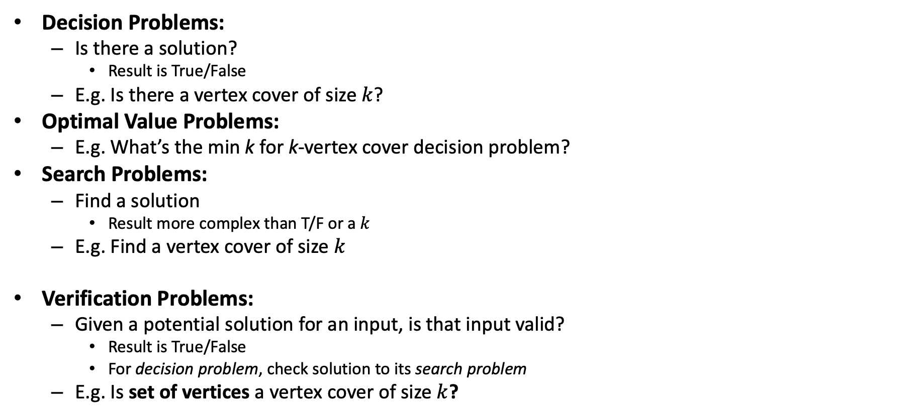
Problem Types
Decision Problems:
Is there a solution?
Result is True/False
E.g. Is there a vertex cover of size $k$?
Optimal Value Problems:
E.g. What’s the min k for k-vertex cover decision problem?
Search Problems:
Find a solution
Result more complex than T/F or a $k$
E.g. Find a vertex cover of size $k$
Verification Problems:
Given a potential solution for an input, is that input valid?
Result is True/False
For decision problem, check solution to its search problem
E.g. Is set of vertices a vertex cover of size $k$?
If we can solve this…
Looking ahead: We’ll use this to define a problem classes P and NP
…Then we can solve this,… …and also this
Looking ahead: We’ll use this to define a problem class called NP

Slide 8
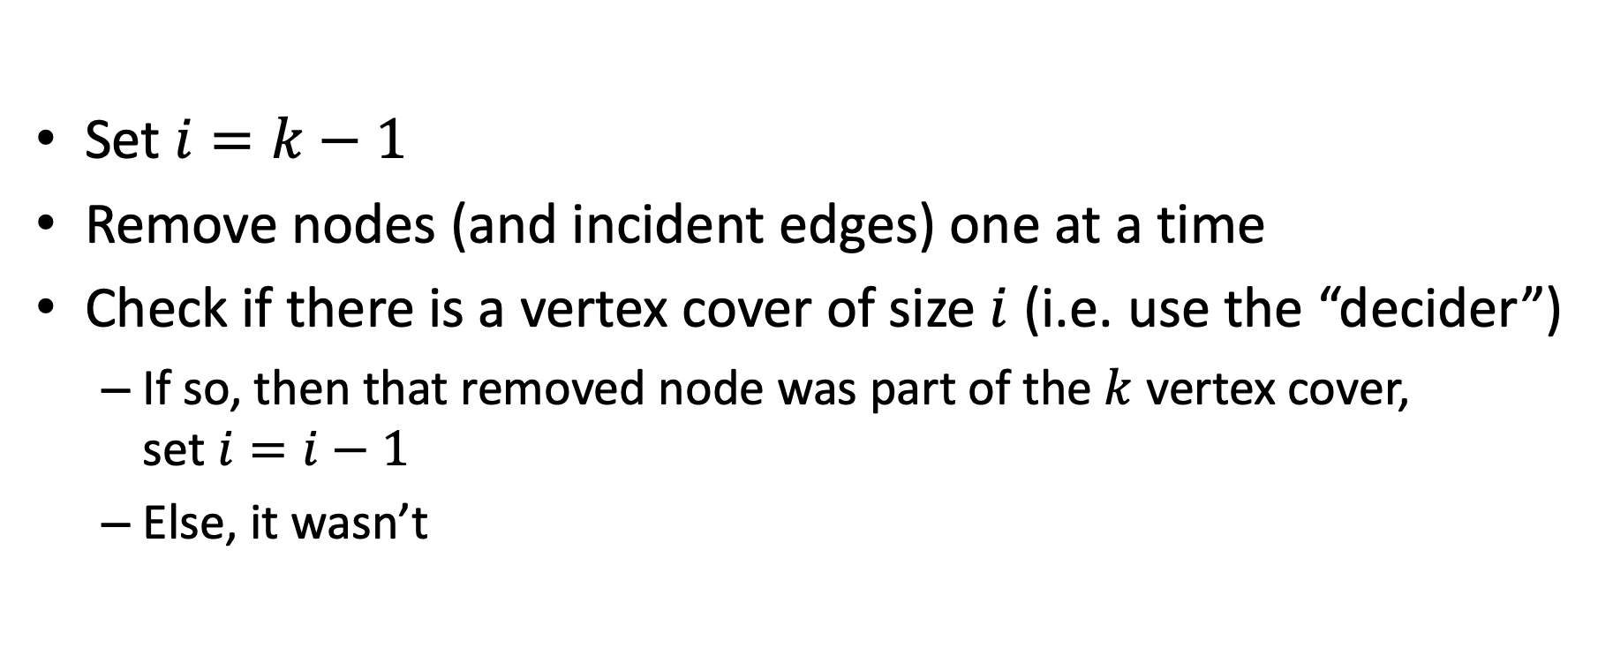
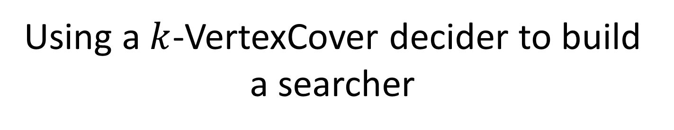
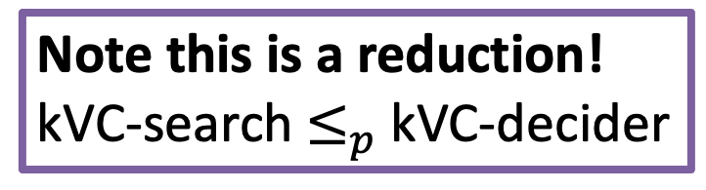
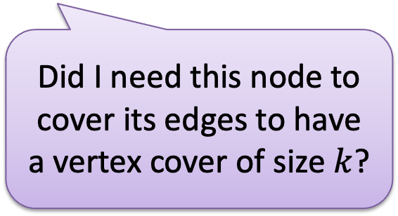
Using a $k$-VertexCover decider to build a searcher
Note this is a reduction! kVC-search$≤_{p}$kVC-decider
Set $i=k−1$
Remove nodes (and incident edges) one at a time
Check if there is a vertex cover of size $i$ (i.e. use the “decider”)
If so, then that removed node was part of the $k$ vertex cover, set $i=i−1$
Else, it wasn’t
Did I need this node to cover its edges to have a vertex cover of size $k$?

Slide 9
Quick Background!
P: Set of problems solved in polynomial time (e.g., sorting a list)
NP: Set of problems that can be:
1) Solved in non-deterministic polynomial time
2) A solution verified in polynomial time
NP-Hard: Set of problems that are as hard as (or harder) than the hardest problems in NP
NP-Complete: Set of problems that are both NP and NP-Hard (i.e., the equally hardest problems in NP)

Slide 11
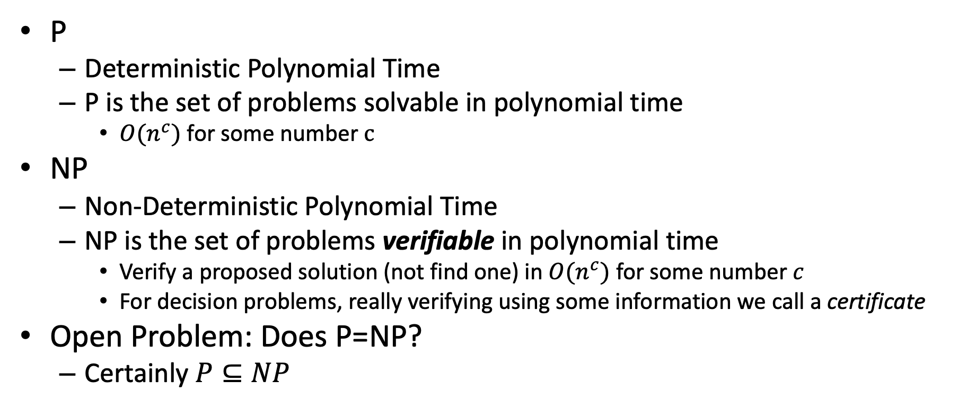
Classes of Problems: P vs NP
P
Deterministic Polynomial Time
P is the set of problems solvable in polynomial time
$O(n^{c})$ for some number $c$
NP
Non-Deterministic Polynomial Time
NP is the set of problems verifiable in polynomial time
Verify a proposed solution (not find one) in $O(n^{c})$ for some number $c$
For decision problems, really verifying using some information we call a certificate
Open Problem: Does P=NP?
Certainly $P⊆NP$
NP
P

Slide 12
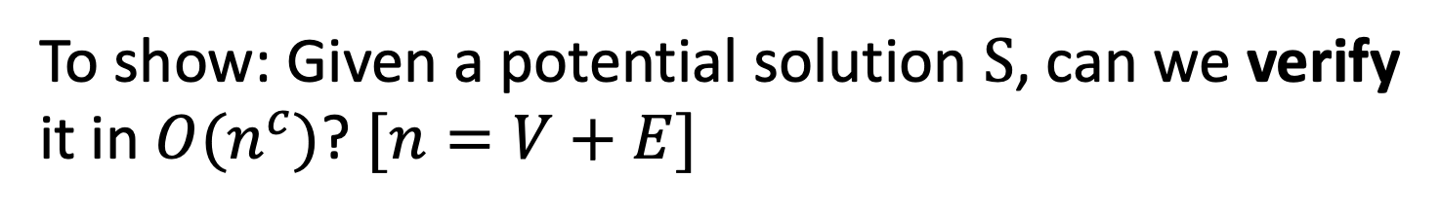


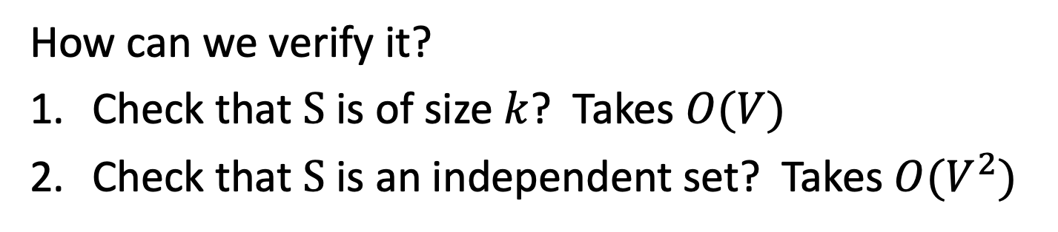
$k$-Independent Set is NP
To show: Given a potential solution $S$, can we verify it in $O(n^{c})$? $[n=V+E]$
How can we verify it?
Check that $S$ is of size $k$? Takes $O(V)$
Check that $S$ is an independent set? Takes $O(V^{2})$
Therefore, k-IndSet $⊆NP$

Slide 13
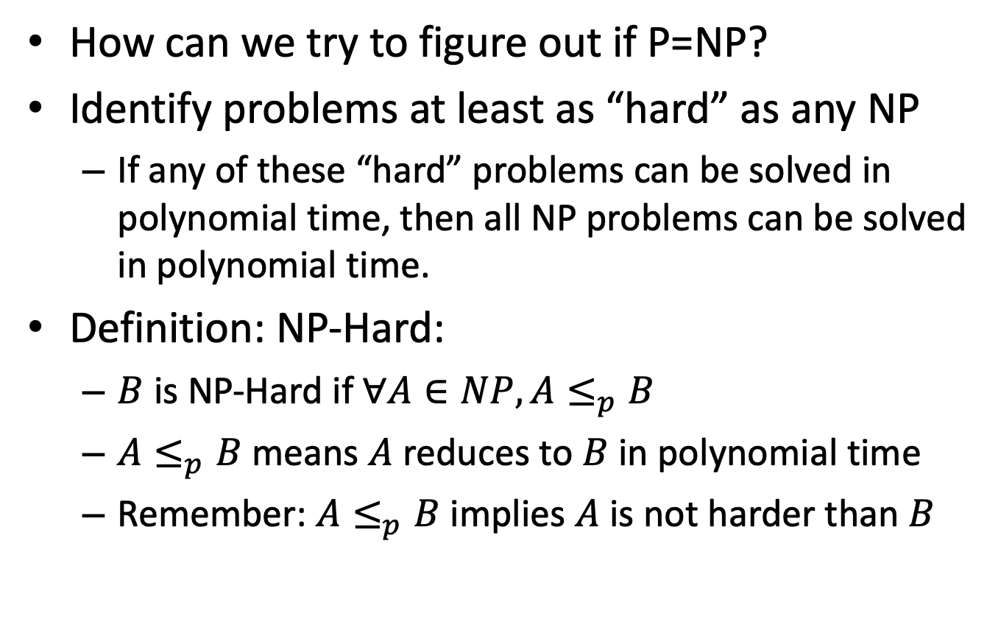
NP-Hard
How can we try to figure out if P=NP?
Identify problems at least as “hard” as any NP
If any of these “hard” problems can be solved in polynomial time, then all NP problems can be solved in polynomial time.
Definition: NP-Hard:
$B$ is NP-Hard if $∀A∈NP, A≤_{p}B$
$A≤_{p}B$ means $A$ reduces to $B$ in polynomial time
Remember: $A≤_{p}B$implies $A$ is not harder than $B$
NP-Hard
At least as “hard” as any NP
NP
P

Slide 14


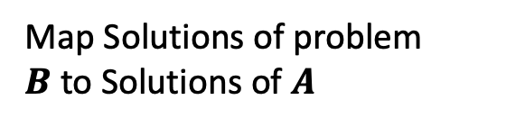
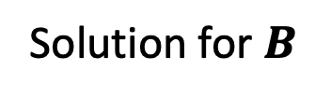
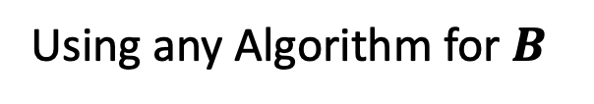



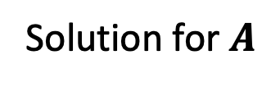

Polynomial Reduction & Relative Hardness
$$A≤_{p}B$$
Polynomial Reduction
A problem we do know how to solve
A problem we don’t know how to solve
$$A$$
$$B$$
Map Instances of problem $A$to Instances of $B$
Using any Algorithm for $B$
Then A could be solved in polynomial time
Map Solutions of problem $B$to Solutions of $A$
If B could be solved in polynomial time
Solution for $A$
Solution for $B$
$$RA$$
$$RB$$

Slide 15
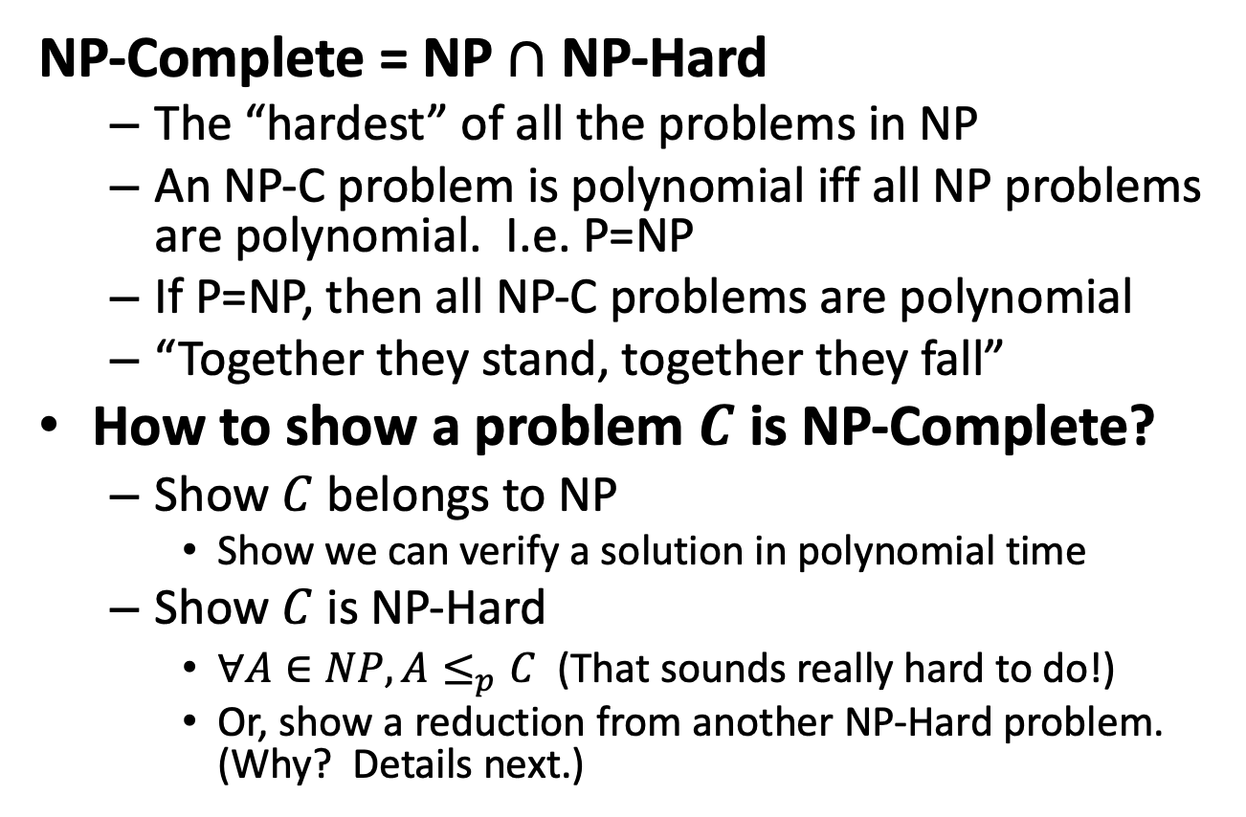
NP-Complete
NP-Complete = NP $∩$ NP-Hard
The “hardest” of all the problems in NP
An NP-C problem is polynomial iff all NP problems are polynomial. I.e. P=NP
If P=NP, then all NP-C problems are polynomial
“Together they stand, together they fall”
How to show a problem $C$ is NP-Complete?
Show $C$ belongs to NP
Show we can verify a solution in polynomial time
Show $C$ is NP-Hard
$∀A∈NP, A≤_{p}C$ (That sounds really hard to do!)
Or, show a reduction from another NP-Hard problem. (Why? Details next.)
NP-C
NP-Hard
At least as “hard” as any NP
NP
P

Slide 16
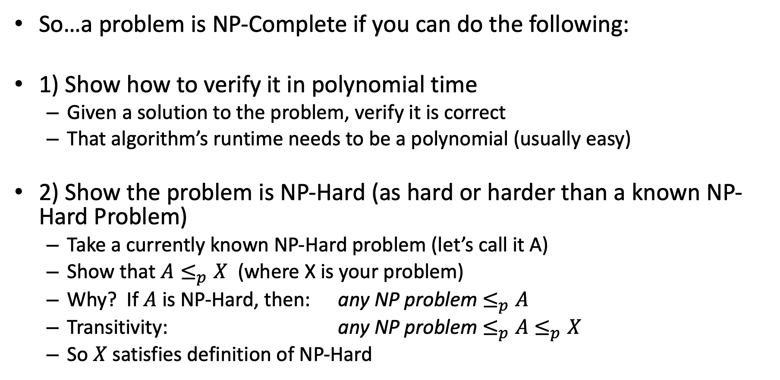
NP-Completeness
So…a problem is NP-Complete if you can do the following:
1) Show how to verify it in polynomial time
Given a solution to the problem, verify it is correct
That algorithm’s runtime needs to be a polynomial (usually easy)
2) Show the problem is NP-Hard (as hard or harder than a known NP-Hard Problem)
Take a currently known NP-Hard problem (let’s call it A)
Show that $A≤_{p}X$ (where X is your problem)
Why? If $A$ is NP-Hard, then: any NP problem $≤_{p}A$
Transitivity: any NP problem $≤_{p}A$ $≤_{p}X$
So $X$ satisfies definition of NP-Hard

Slide 17
“Consequences” of NP-Completeness
NP-Complete is the set of “hardest” problems in NP, with these important properties:
If any one NP-Complete problem can be solved in polynomial time…
…then every NP-Complete problem can be solved in polynomial time…
…and in fact every problem in NP can be solved in polynomial time (which would show P = NP)
Or, prove an exponential lower-bound for any single NP-hard problem, then every NP-hard problem (including NP-C) is exponential
Therefore: solve (say) traveling salesperson problem in O(n¹⁰⁰) time, you've proved that P = NP. Retire rich & famous!

Slide 18

$A≤_{p}B$ and B in P
Problem we don’t know how to solve
Reduction
Problem we do know how to solve
$$A$$
Map Instances of problem $A$to Instances of $B$
$$B$$
Using any Algorithm for $B$
Map Solutions of problem $B$to Solutions of $A$
If a polynomial algorithm exists to solve B, what does that tell us about A?
Solution for $A$
Solution for $B$
$$RA$$
$$RB$$

Slide 19

$A≤_{p}B$ and we prove A not in P
Problem we don’t know how to solve
Reduction
Problem we do know how to solve
$$A$$
Map Instances of problem $A$to Instances of $B$
$$B$$
If we prove an exponential lower bound for problem A, what does that tell us about solving B?
Using any Algorithm for $B$
Map Solutions of problem $B$to Solutions of $A$
Solution for $A$
Solution for $B$
$$RA$$
$$RB$$

Slide 20
Summary of Where We Are
Focusing on “hard” problems, those that seem to be exponential
Reductions used to show “hardness” relationships between problems
Starting to define “classes” of problems based on complexity issues
P are problems that can be solved in polynomial time
NP are problems where a solution can be verified in polynomial time
NP-hard are problems that are at least as hard as anything in NP
NP-complete are NP-hard problems that “stand or fall together”

Slide 21
Review: P And NP Summary
P = set of problems that can be solved in polynomial time
NP = set of problems for which a solution can be verified in polynomial time
Note: this is a more “informal” definition, but it’s fine for CS4102
See later slide on ”certificates” for more info.
P ⊆ NP
Open question: Does P = NP?

Slide 22
More Reminders and Some Consequences
Definition of NP-Hard and NP-Complete:
If all problems A ∈ NP are reducible to B , then B is NP-Hard
We say B is NP-Complete if:
B is NP-Hard
and B ∈ NP
Any NP-C must reduce to any other NP-C. Can you see why?
If B ≤_{p} C and B is NP-Complete, C is also NP-Complete
Don’t see why? We’ll show details in two more slides
As long as C ∈ NP. Otherwise can only say C ∈ NP-hard.

Slide 24
But You Need One NP-Hard First…
If you have one NP-Hard problem, you can use the technique just described to prove other problems are NP-Hard and NP-c
We need an NP-C problem to start this off
The definition of NP-Hard was created to prove a point
There might be problems that are at least as hard as “anything” (i.e. all NP problems)
Are there really NP-complete problems?
Cook-Levin Theorem: The satisfiability problem (SAT) is NP-Complete.
Stephen Cook proved this “directly”, from first principles, in 1971
Proven independently by Leonid Levin (USSR)
Showed that any problem that meets the definition of NP can be transformed in polynomial time to a CNF formula.
Proof outside the scope of this course (lucky you)

Slide 25
More About The SAT Problem
The first problem to be proved NP-Complete was satisfiability (SAT):
Given a Boolean expression on n variables, can we assign values such that the expression is TRUE?
Ex: ((x₁ →x₂) ∨ ¬((¬x₁ ↔ x₃) ∨ x₄)) ∧¬x₂
You might imagine that lots of decision problems could be expressed as a complex logical expression
And Cook and Levin proved you were right!
Proved the general result that any NP problem can be expressed this way

Slide 26
Conjunctive Normal Form (CNF)
Even if the form of the Boolean expression is simplified, the problem may be NP-Complete
Literal: an occurrence of a Boolean or its negation
A Boolean formula is in conjunctive normal form, or CNF, if it is an AND of clauses, each of which is an OR of literals
Ex: (x₁ ∨ ¬x₂) ∧ (¬x₁ ∨ x₃ ∨ x₄) ∧ (¬x₅)
3-CNF: each clause has exactly 3 distinct literals
Ex: (x₁ ∨ ¬x₂ ∨ ¬x₃) ∧ (¬x₁ ∨ x₃ ∨ x₄) ∧ (¬x₅ ∨ x₃ ∨ x₄)
Notice: true if at least one literal in each clause is true
Note: Arbitrary SAT expressions can be translated into CNF forms by introducing intermediate variables etc.

Slide 27
The 3-CNF Problem
Satisfiability of Boolean formulas in 3-CNF form (the 3-CNF Problem) is NP-Complete
Intuitively it’s not hard to imagine that SAT ≤_{p} 3-CNF
Proof: Also done by Cook (“part 2” of Cook’s theorem)
The reason we care about the 3-CNF problem is that it is relatively easy to reduce to others
Having a proof that 3-CNF is NP-Complete lets us use it to prove many seemingly unrelated problems are NP-Complete

Slide 28
Joining the Club
Given one NP-c problem, others can join the club
Prove that SAT reduces to another problem, and so on…
Membership in NP-c grows…
Classic textbook: Garey, M. and D. Johnson, Computers and Intractability: A Guide to the Theory of NP-Completeness, 1979.
SAT
3-CNF-SAT
SUBSET-SUM
CLIQUE
VERTEX- COVER
HAM- CYCLE
TSP

Slide 29
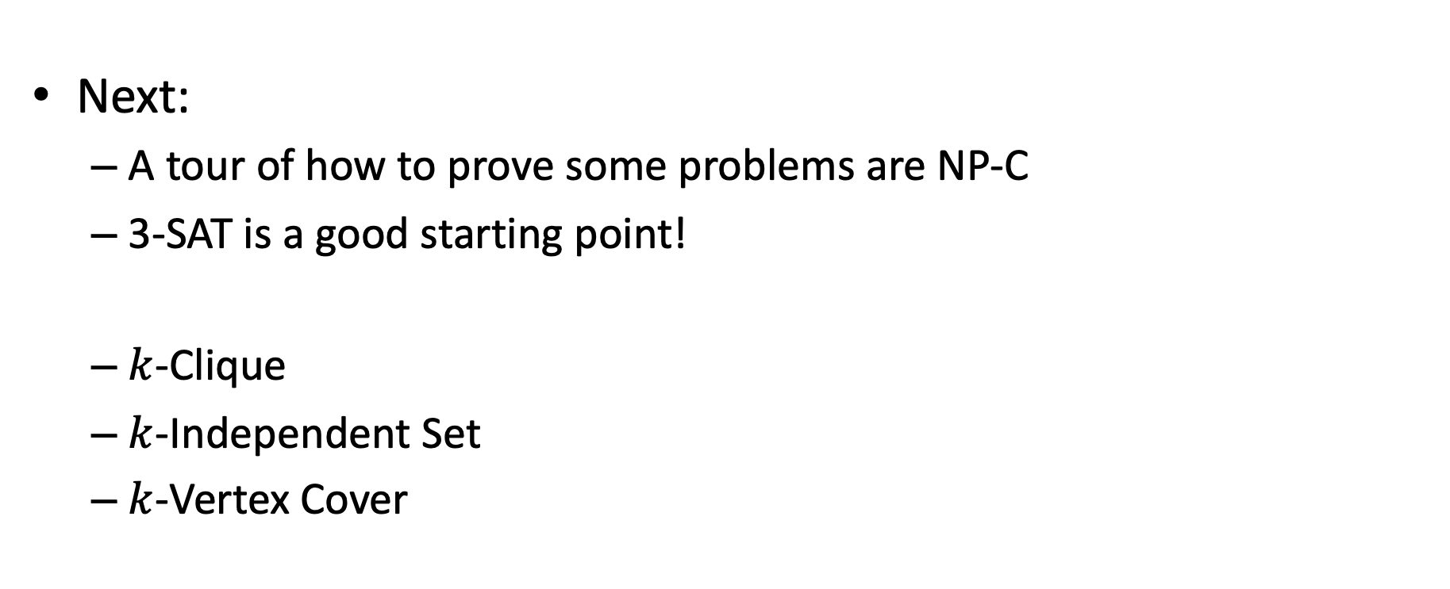
Reductions to Prove NP-C
Next:
A tour of how to prove some problems are NP-C
3-SAT is a good starting point!
$k$-Clique
$k$-Independent Set
$k$-Vertex Cover

Slide 30
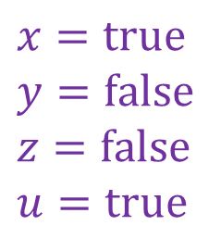
Reminder about 3-SAT
Shown to be NP-hard by Cook
Given a 3-CNF formula (logical AND of clauses, each an OR of 3 variables), is there an assignment of true/false to each variable to make the formula true (i.e., satisfy the formula)?
$$\left(x∨y∨z\right)∧\left(x∨\overline{y}∨y\right)∧\left(u∨y∨\overline{z}\right)∧\left(z∨\overline{x}∨u\right)∧(\overline{x}∨\overline{y}∨\overline{z})$$
Clause
$$x=true$$
$$y=false$$
$$z=false$$
$$u=true$$
Variables

Slide 31
Next example: k-Clique
Let’s show that k-Clique is NP-Complete!

Slide 32
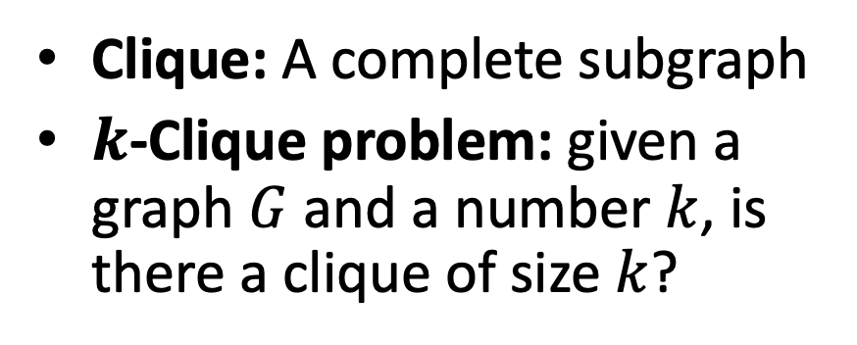

$k$-Clique Problem
Clique: A complete subgraph
$k$-Clique problem: given a graph $G$ and a number $k$, is there a clique of size $k$?
4-Clique
3-Clique

Slide 33
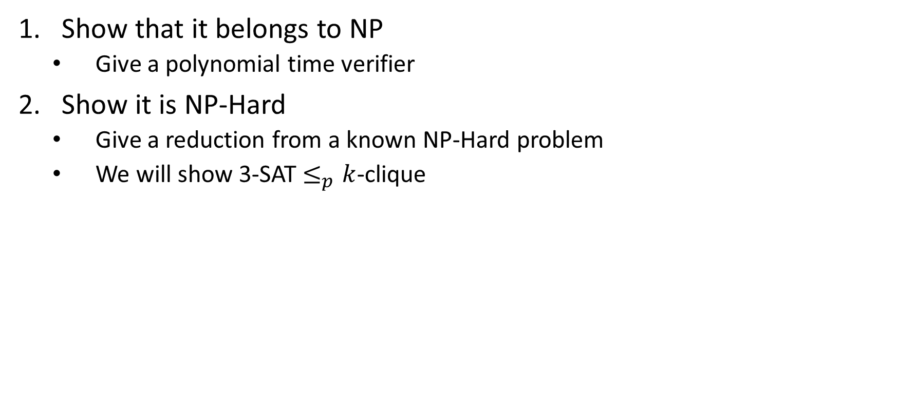

$k$-Clique is NP-Complete
Show that it belongs to NP
Give a polynomial time verifier
Show it is NP-Hard
Give a reduction from a known NP-Hard problem
We will show 3-SAT $≤_{p}k$-clique

Slide 34
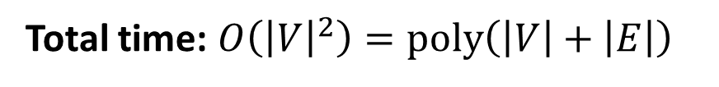
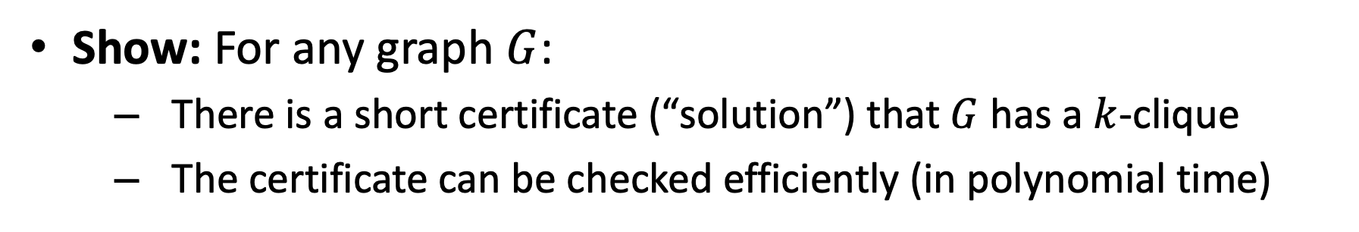



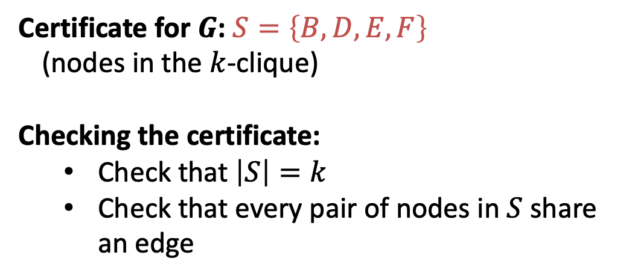
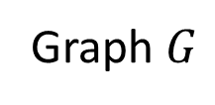
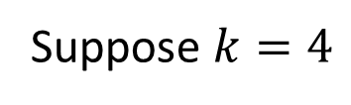
$k$-Clique is in NP
Show: For any graph $G$:
There is a short certificate (“solution”) that $G$ has a $k$-clique
The certificate can be checked efficiently (in polynomial time)
Suppose $k=4$
C
Certificate for $G$: $S=\left\{B,D,E,F\right\}$
(nodes in the $k$-clique)
Checking the certificate:
Check that $\left|S\right|=k$
Check that every pair of nodes in $S$ share an edge
B
4-Clique
A
E
D
F
$$O\left(k\right)=O\left(\left|V\right|\right)$$
G
I
3-Clique
$$O\left(k^{2}\right)=O({\left|V\right|}^{2})$$
H
Graph $G$
Total time: $O\left({\left|V\right|}^{2}\right)=poly\left(\left|V\right|+\left|E\right|\right)$

Slide 35

$k$-Clique is NP-Complete
Show that it belongs to NP
Give a polynomial time verifier
Show it is NP-Hard
Give a reduction from a known NP-Hard problem
We will show 3-SAT $≤_{p}k$-clique

Slide 36
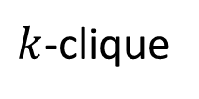

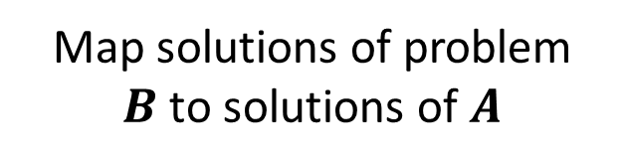
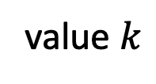
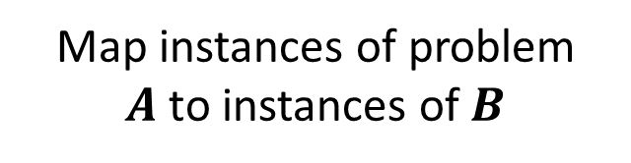
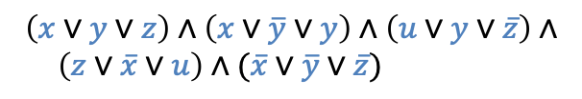

3-SAT $≤_{p}$ $k$-Clique
3-SAT
$k$-clique
Map instances of problem $A$to instances of $B$
$$\left(x∨y∨z\right)∧\left(x∨\overline{y}∨y\right)∧\left(u∨y∨\overline{z}\right)∧$$ $\left(z∨\overline{x}∨u\right)∧(\overline{x}∨\overline{y}∨\overline{z})$
polynomial time
value $k$
Map solutions of problem $B$to solutions of $A$
$$x=true$$
$$y=false$$
$$z=false$$
$$u=true$$
polynomial time
polynomial-time reduction

Slide 37




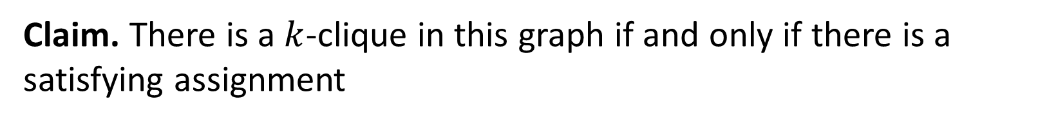













3-SAT $≤_{p}$ $k$-Clique
$$\left(x∨y∨z\right)∧\left(x∨\overline{y}∨y\right)∧\left(u∨y∨\overline{z}\right)∧\left(z∨\overline{x}∨u\right)∧(\overline{x}∨\overline{y}∨\overline{z})$$
$$x$$
$$\overline{y}$$
$$y$$
$$z$$
$$\overline{x}$$
$$u$$
$$x$$
(also do this for the other clauses, omitted due to clutter)
$$k=5$$
$$y$$
$$z$$
$$u$$
$$y$$
$$\overline{z}$$
$$\overline{x}$$
$$\overline{y}$$
$$\overline{z}$$
For each clause, introduce a node for each of its three variables
Add an edge from each node to all non-contradictory nodes in the other clauses (i.e., to all nodes that is not the negation of its own variable)
Let $k=$ number of clauses
Claim. There is a $k$-clique in this graph if and only if there is a satisfying assignment

Slide 38



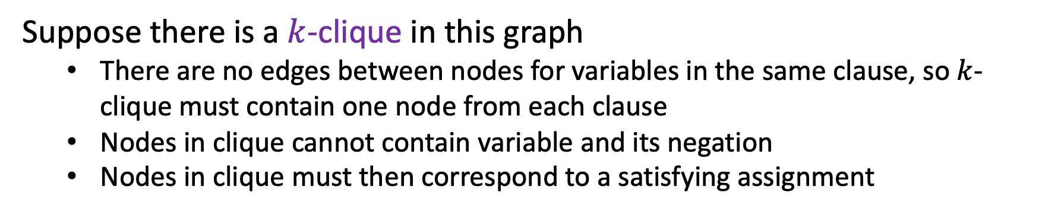
3-SAT $≤_{p}$ $k$-Clique
$$\left(x∨y∨z\right)∧\left(x∨\overline{y}∨y\right)∧\left(u∨y∨\overline{z}\right)∧\left(z∨\overline{x}∨u\right)∧(\overline{x}∨\overline{y}∨\overline{z})$$
$$x$$
$$y$$
$$\overline{y}$$
$$z$$
$$\overline{x}$$
$$u$$
$$x$$
$$k=5$$
$$y$$
$$z$$
$$u$$
$$y$$
$$\overline{z}$$
$$\overline{x}$$
$$\overline{y}$$
$$\overline{z}$$
Suppose there is a $k$-clique in this graph
There are no edges between nodes for variables in the same clause, so $k$-clique must contain one node from each clause
Nodes in clique cannot contain variable and its negation
Nodes in clique must then correspond to a satisfying assignment

Slide 39



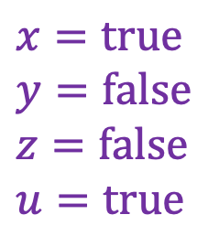



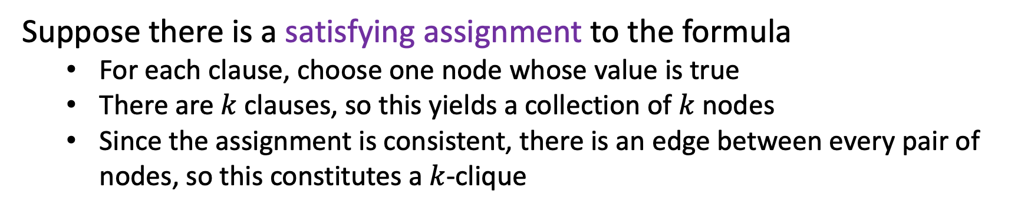
3-SAT $≤_{p}$ $k$-Clique
$$\left(x∨y∨z\right)∧\left(x∨\overline{y}∨y\right)∧\left(u∨y∨\overline{z}\right)∧\left(z∨\overline{x}∨u\right)∧(\overline{x}∨\overline{y}∨\overline{z})$$
$$x$$
$$y$$
$$\overline{y}$$
$$z$$
$$\overline{x}$$
$$u$$
$$x$$
$$k=5$$
$$y$$
$$x=true$$
$$y=false$$
$$z=false$$
$$u=true$$
$$z$$
$$u$$
$$y$$
$$\overline{z}$$
$$\overline{x}$$
$$\overline{y}$$
$$\overline{z}$$
Suppose there is a satisfying assignment to the formula
For each clause, choose one node whose value is true
There are $k$ clauses, so this yields a collection of $k$ nodes
Since the assignment is consistent, there is an edge between every pair of nodes, so this constitutes a $k$-clique

Slide 40
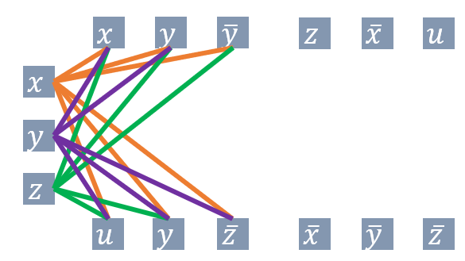
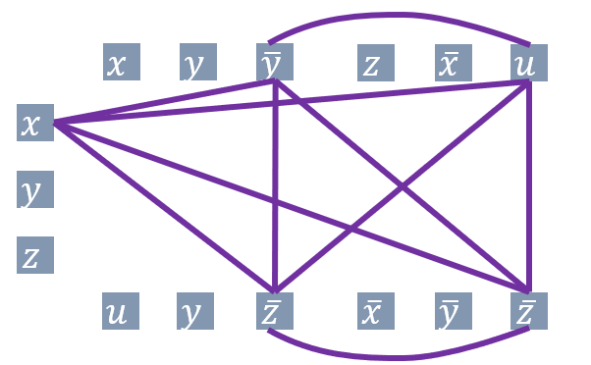

3-SAT $≤_{p}$ $k$-Clique
3-SAT
$k$-clique
Map instances of problem $A$to instances of $B$
$$\left(x∨y∨z\right)∧\left(x∨\overline{y}∨y\right)∧\left(u∨y∨\overline{z}\right)∧$$ $\left(z∨\overline{x}∨u\right)∧(\overline{x}∨\overline{y}∨\overline{z})$
polynomial time
$$k=5$$
Map solutions of problem $B$to solutions of $A$
$$x=true$$
$$y=false$$
$$z=false$$
$$u=true$$
polynomial time
$$k=5$$
polynomial-time reduction

Slide 41
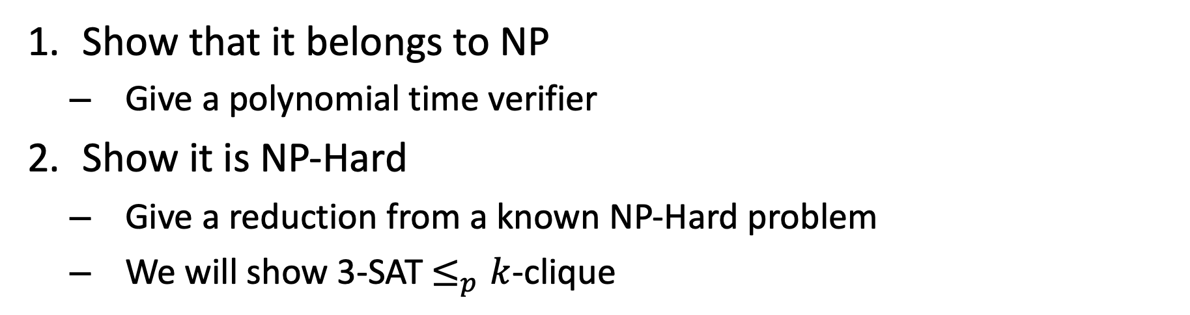
$k$-Clique is NP-Complete
Show that it belongs to NP
Give a polynomial time verifier
Show it is NP-Hard
Give a reduction from a known NP-Hard problem
We will show 3-SAT $≤_{p}k$-clique

Slide 42
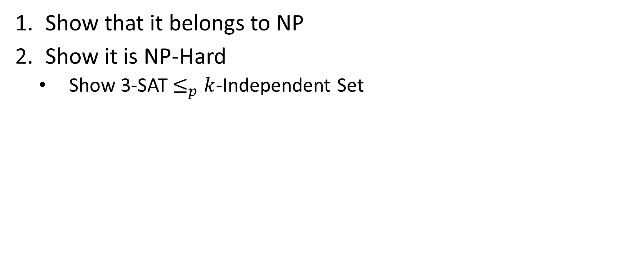
$k$-Independent Set is NP-Complete
Show that it belongs to NP
Show it is NP-Hard
Show 3-SAT$≤_{p}$ $k$-Independent Set

Slide 43
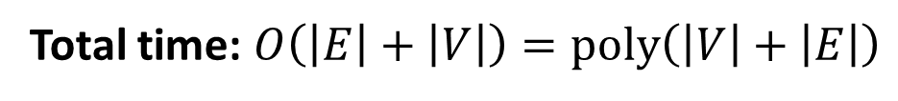
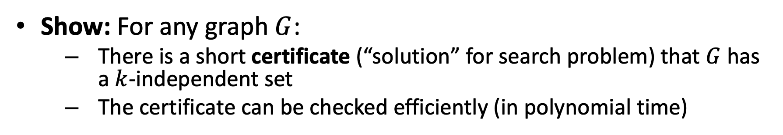



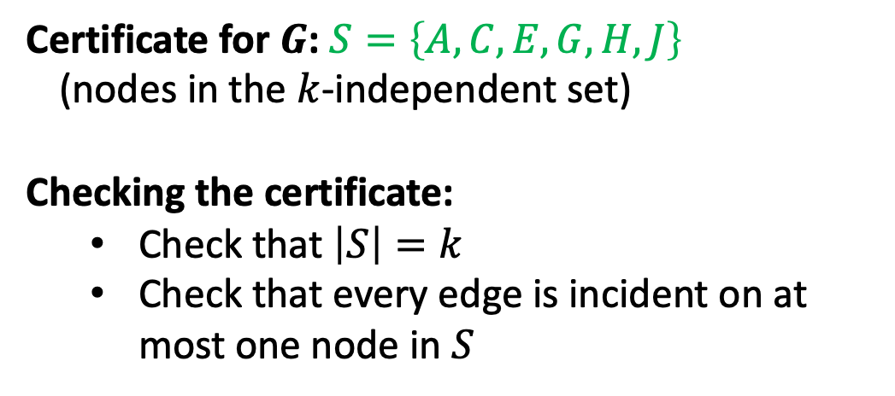
$k$-Independent Set is in NP
Show: For any graph $G$:
There is a short certificate (“solution” for search problem) that $G$ has a $k$-independent set
The certificate can be checked efficiently (in polynomial time)
A
B
Certificate for $G$: $S=\left\{A,C,E,G,H,J\right\}$
(nodes in the $k$-independent set)
Checking the certificate:
Check that $\left|S\right|=k$
Check that every edge is incident on at most one node in $S$
C
D
E
F
G
$$O\left(k\right)=O\left(\left|V\right|\right)$$
J
H
I
$$O\left(\left|V\right|+\left|E\right|\right)$$
K
L
Total time: $O\left(\left|E\right|+\left|V\right|\right)=poly\left(\left|V\right|+\left|E\right|\right)$
Graph $G$

Slide 44
$k$-Independent Set is NP-Complete
Show that it belongs to NP
Show it is NP-Hard
Show 3-SAT$≤_{p}$ $k$-Independent Set

Slide 45
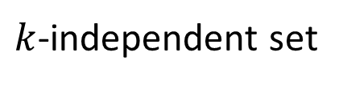

3-SAT $≤_{p}$ $k$-Independent Set
3-SAT
$k$-independent set
Map instances of problem $A$to instances of $B$
polynomial time
Map solutions of problem $B$to solutions of $A$
$$x=true$$
$$y=false$$
$$z=false$$
$$u=true$$
polynomial time
polynomial-time reduction

Slide 46


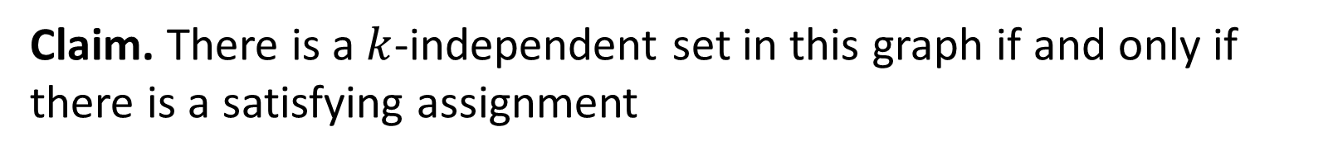













3-SAT $≤_{p}$ $k$-Independent Set
$$\left(x∨y∨z\right)∧\left(x∨\overline{y}∨y\right)∧\left(u∨y∨\overline{z}\right)∧\left(z∨\overline{x}∨u\right)∧(\overline{x}∨\overline{y}∨\overline{z})$$
$$x$$
$$x$$
$$u$$
$$z$$
$$\overline{u}$$
$$z$$
$$y$$
$$y$$
$$\overline{y}$$
$$\overline{z}$$
$$y$$
$$u$$
$$\overline{x}$$
$$\overline{z}$$
$$\overline{y}$$
For each clause, construct a triangle graph with its three variables as nodes
Add an edge between each node and its negation
Let $k=$ number of clauses
Claim. There is a $k$-independent set in this graph if and only if there is a satisfying assignment

Slide 47



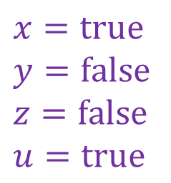

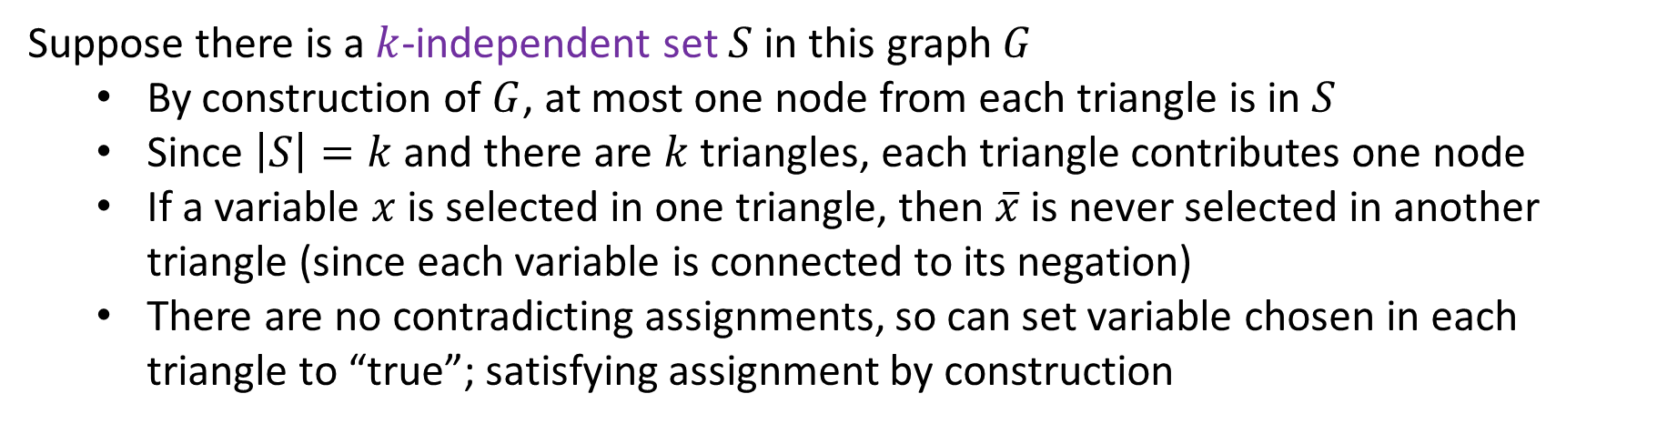

3-SAT $≤_{p}$ $k$-Independent Set
$$\left(x∨y∨z\right)∧\left(x∨\overline{y}∨y\right)∧\left(u∨y∨\overline{z}\right)∧\left(z∨\overline{x}∨u\right)∧(\overline{x}∨\overline{y}∨\overline{z})$$
$$x=true$$
$$y=false$$
$$z=false$$
$$u=true$$
$$x$$
$$x$$
$$u$$
$$z$$
$$\overline{u}$$
$$z$$
$$y$$
$$y$$
$$\overline{y}$$
$$\overline{z}$$
$$y$$
$$u$$
$$\overline{x}$$
$$\overline{z}$$
$$\overline{y}$$
Suppose there is a $k$-independent set $S$ in this graph $G$
By construction of $G$, at most one node from each triangle is in $S$
Since $\left|S\right|=k$ and there are $k$ triangles, each triangle contributes one node
If a variable $x$ is selected in one triangle, then $\overline{x}$ is never selected in another triangle (since each variable is connected to its negation)
There are no contradicting assignments, so can set variable chosen in each triangle to “true”; satisfying assignment by construction

Slide 48
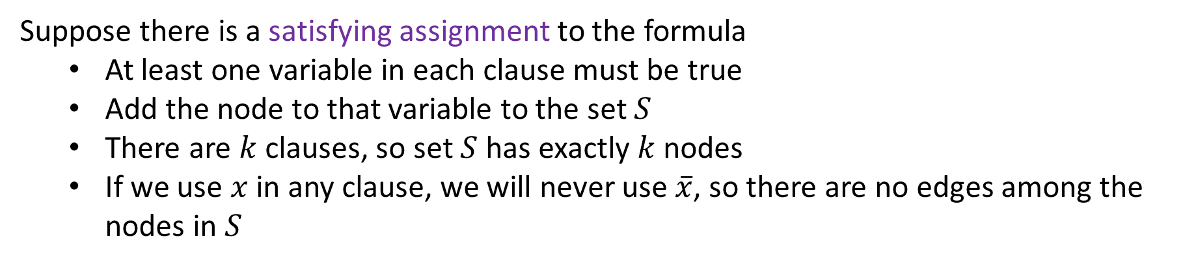
3-SAT $≤_{p}$ $k$-Independent Set
$$\left(x∨y∨z\right)∧\left(x∨\overline{y}∨y\right)∧\left(u∨y∨\overline{z}\right)∧\left(z∨\overline{x}∨u\right)∧(\overline{x}∨\overline{y}∨\overline{z})$$
$$x=true$$
$$y=false$$
$$z=false$$
$$u=true$$
$$x$$
$$x$$
$$u$$
$$z$$
$$\overline{u}$$
$$z$$
$$y$$
$$y$$
$$\overline{y}$$
$$\overline{z}$$
$$y$$
$$u$$
$$\overline{x}$$
$$\overline{z}$$
$$\overline{y}$$
Suppose there is a satisfying assignment to the formula
At least one variable in each clause must be true
Add the node to that variable to the set $S$
There are $k$ clauses, so set $S$ has exactly $k$ nodes
If we use $x$ in any clause, we will never use $\overline{x}$, so there are no edges among the nodes in $S$

Slide 49
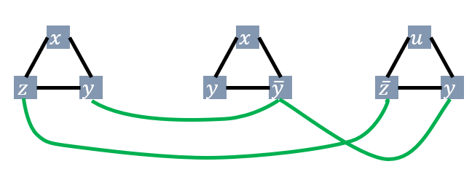
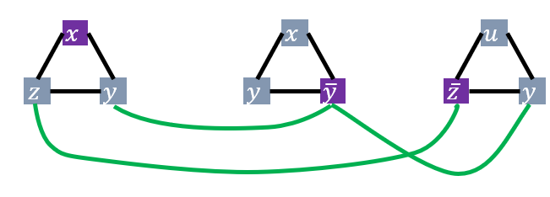


3-SAT $≤_{p}$ $k$-Independent Set
3-SAT
$k$-independent set
Map instances of problem $A$to instances of $B$
polynomial time
$$k=3$$
Map solutions of problem $B$to solutions of $A$
$$x=true$$
$$y=false$$
$$z=false$$
$$u=true$$
polynomial time
$$k=3$$
polynomial-time reduction

Slide 50
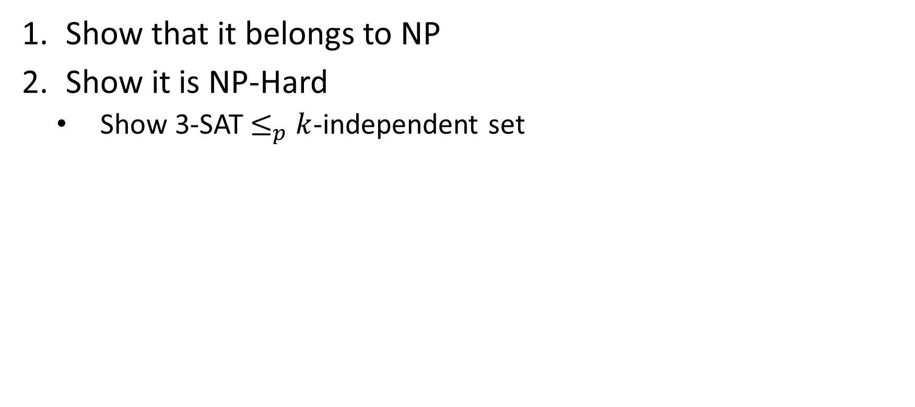
$k$-Independent Set is NP-Complete
Show that it belongs to NP
Show it is NP-Hard
Show 3-SAT$≤_{p}$ $k$-independent set

Slide 51

Next example: k-Vertex Cover
Remember?
We did the following reduction in an earlier slide set!
k-Independent Set $≤_{p}$ k-Vertex Cover
We just showed k-Independent Set is NP-C
Therefore…. (you know, right?)

Slide 52






Max Independent Set $≤_{p}$ k-Vertex Cover
$k$-independent set
$k$-vertex cover
Map instances of problem $A$to instances of $B$
value $k$
$O(1)$ time
Map solutions of problem $B$to solutions of $A$
$O\left(\left|V\right|\right)$ time
Reduction

Slide 53


$k$-Vertex Cover is NP-Complete
Show that it belongs to NP
Given a candidate cover, check that every edge is covered
Show it is NP-Hard
Show $k$-independent set$≤_{p}$ $k$-vertex cover

Slide 55
Wrap Up and Reminders

Slide 56
Why Prove NP-Completeness?
Though nobody has proven that P ≠ NP, if you prove a problem NP-Complete, most people accept that it is probably exponential
Therefore it can be important for you to prove that a problem is NP-Complete
Don't need to try to come up perfect non-exponential algorithm
Can instead work on approximation algorithms

Slide 57

What’s a poor salesperson to do?
http://xkcd.com/399/

Slide 58
Approximation Algorithms
Look at first 3 pages of Ch. 35 of CLRS textbook
Can we find an algorithm for problem A ∈ NP-C that:
Runs in polynomial time
Gets “near optimal” results
Prove some bound on the algorithm’s correctness in terms of the true optimal result
No worse that (some factor) of optimal
“It’s not always right (best), but it’s guaranteed to be this close.”

Slide 59
General Comments
At least 3000 problems have been shown to be NP-Complete
That number is from a non-recent report, so we might say that counts is a weak lower-bound on the true number found
https://en.wikipedia.org/wiki/List_of_NP-complete_problems including some popular games
Some reductions are profound, some are comparatively easy, many are easy once the key insight is given

Slide 60
Other NP-Complete Problems
Hamilton Path/Cycle, Traveling Salesperson
Subset-sum: Given a set of integers, does there exist a subset that adds up to some target T ?
0-1 knapsack: when weights not just integers
Graph coloring: can a given graph be colored with k colors such that no adjacent vertices are the same color?
Etc…

Slide 61
Review (Again)
A problem B is NP-complete
if it is in NP and it is NP-hard.
A problem B is NP-hard
if every problem in NP is reducible to B.
A problem A is reducible to a problem B if
there exists a polynomial reduction function T such that
For every string x,
if x is a yes input for A, then T(x) is a yes input for B
if x is a no input for A, then T(x) is a no input for B.
T can be computed in polynomially bounded time.

Slide 62
“Consequences” of NP-Completeness
NP-Complete the set of the“hardest” problems in NP, with these important properties:
If any one NP-Complete problem can be solved in polynomial time…
…then every NP-Complete problem can be solved in polynomial time…
…and in fact every problem in NP can be solved in polynomial time (which would show P = NP)
Or, prove an exponential lower-bound for any single NP-C problem, then every NP-C problem is exponential
Therefore: solve (say) traveling salesperson problem in O(n¹⁰⁰) time, you've proved that P = NP. Retire rich & famous!

Slide 63
What We Don’t Know: Open Questions
Is it impossible to solve an NP-c problem in polynomial time?
No one has proved an exponential lower bound for any problem in NP.
But, most computer scientists believe such a lower bound exists for NP-c problems.
Are all problems in NP tractable or intractable? I.e., does P=NP or not?
If someone found a polynomial solution to any NP-c problem, we’d know P = NP.
But, most computer scientists believe P≠ NP.

