Slide 1
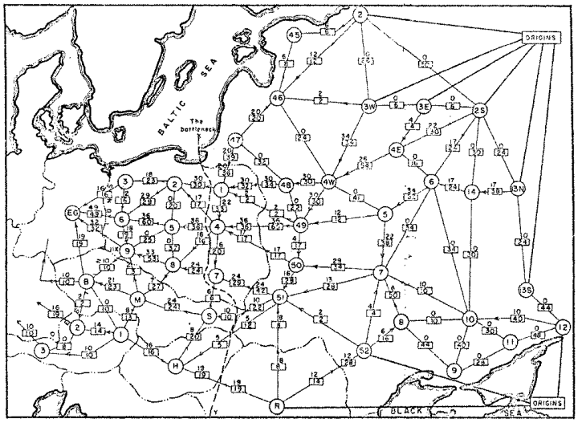
Network Flow
Question: What is the maximum throughput of the railroad network?
Railway map of Western USSR, 1955

Slide 2
Announcements
Unit B
Programming due Friday, 4/15, 11:30pm
Unit C
Basic 1 + 2 due Friday, 4/15, 11:30pm
Advanced due Friday, 4/22
Programming due Friday 4/22 – Seam carving!

Slide 3

Kruskal’s Algorithm
Start with an empty tree $A$
Add to $A$ the lowest-weight edge that does not create a cycle
B
8
10
E
8
7
H
A
9
2
D
5
9
I
12
3
C
3
11
G
1
F
6

Slide 4
Greedy Algorithms
Require Optimal Substructure
Solution to larger problem contains the solution to a smaller one
Only one subproblem to consider!
Idea:
Identify a greedy choice property
How to make a choice guaranteed to be included in some optimal solution
Repeatedly apply the choice property until no subproblems remain

Slide 5
Kruskal’s Algorithm
Start with an empty tree $A$
Add to $A$ the lowest-weight edge that does not create a cycle
B
8
10
E
8
7
H
A
9
2
D
5
9
I
12
3
C
3
11
G
1
F
6

Slide 6
Kruskal’s Algorithm
Start with an empty tree $A$
Add to $A$ the lowest-weight edge that does not create a cycle
B
8
10
E
8
7
H
A
9
2
D
5
9
I
12
3
C
3
11
G
1
F
6

Slide 7
Kruskal’s Algorithm
Start with an empty tree $A$
Add to $A$ the lowest-weight edge that does not create a cycle
B
8
10
E
8
7
H
A
9
2
D
5
9
I
12
3
C
3
11
G
1
F
6

Slide 8
Kruskal’s Algorithm
Start with an empty tree $A$
Add to $A$ the lowest-weight edge that does not create a cycle
B
8
10
E
8
7
H
A
9
2
D
5
9
I
12
3
C
3
11
G
1
F
6

Slide 9
Kruskal’s Algorithm
Start with an empty tree $A$
Add to $A$ the lowest-weight edge that does not create a cycle
B
8
10
E
8
7
H
A
9
2
D
5
9
I
12
3
C
3
11
G
1
F
6

Slide 10

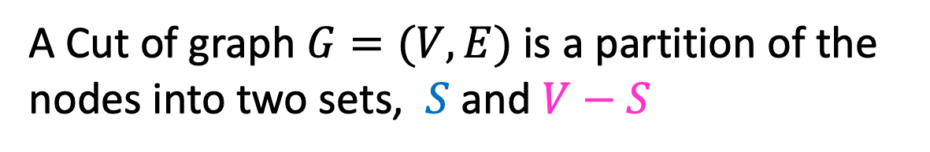
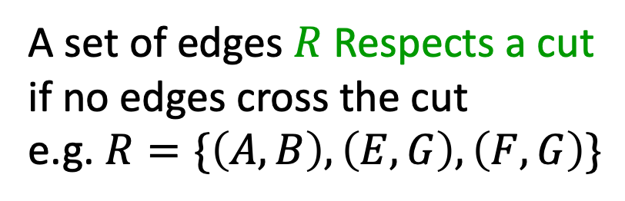
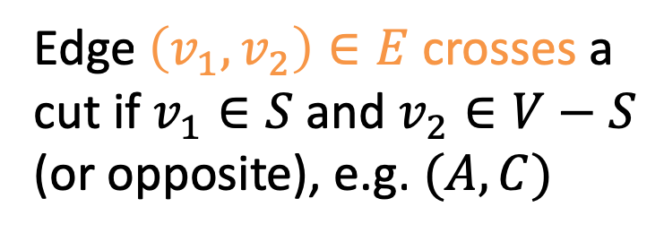
Definition: Cut
A Cut of graph $G=(V,E)$ is a partition of the nodes into two sets, $S$ and $V−S$
B
8
10
E
8
7
H
A
9
2
D
5
9
$$S$$
I
12
3
C
3
11
G
1
F
6
Edge $\left(v_{1},v_{2}\right)∈E$ crosses a cut if $v_{1}∈S$ and $v_{2}∈V−S$ (or opposite), e.g. $(A,C)$
A set of edges $R$ Respects a cut if no edges cross the cut
e.g. $R=\{\left(A,B\right),\left(E,G\right),\left(F,G\right)\}$

Slide 11
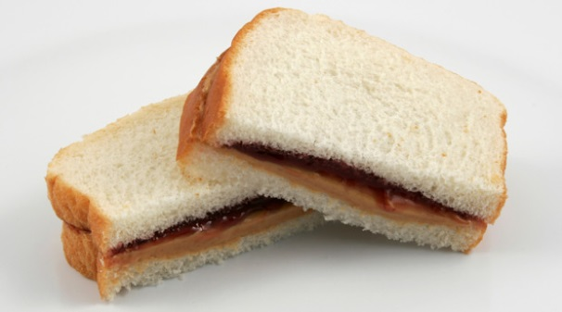
Exchange argument
Shows correctness of a greedy algorithm
Idea:
Show exchanging an item from an arbitrary optimal solution with your greedy choice makes the new solution no worse
How to show my sandwich is at least as good as yours:
Show: “I can remove any item from your sandwich, and it would be no worse by replacing it with the same item from my sandwich”

Slide 12

Cut Theorem
If a set of edges $A$ is a subset of a minimum spanning tree $T$, let $(S, V−S)$ be any cut which $A$ respects. Let $e$ be the least-weight edge which crosses $(S, V−S)$. $A∪\{e\}$ is also a subset of a minimum spanning tree.
B
8
10
E
8
7
H
A
9
2
D
5
9
I
12
3
C
3
11
G
1
F
6

Slide 13
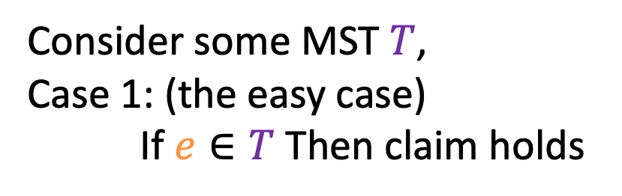


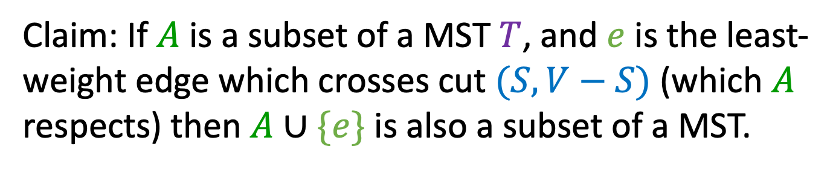


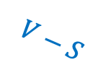
Proof of Cut Theorem
Claim: If $A$ is a subset of a MST $T$, and $e$ is the least-weight edge which crosses cut $(S, V−S)$ (which $A$ respects) then $A∪\{e\}$ is also a subset of a MST.
$$T$$
Consider some MST $T$,
Case 1: (the easy case)
If $e∈T$ Then claim holds
$$A⊆T$$
$$S$$
$$e$$
$$V−S$$

Slide 14



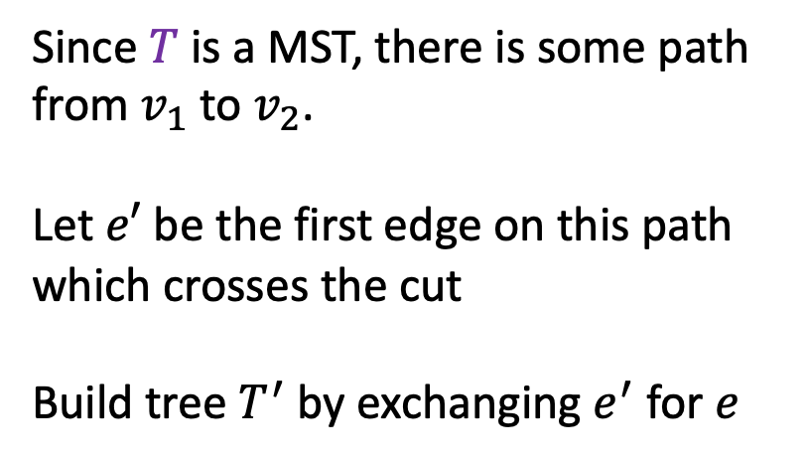

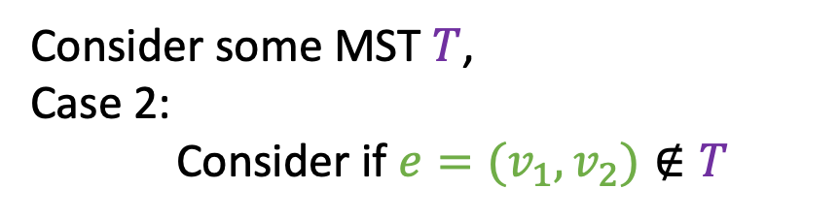
Proof of Cut Theorem
Claim: If $A$ is a subset of a MST $T$, and $e$ is the least-weight edge which crosses cut $(S, V−S)$ (which $A$ respects) then $A∪\{e\}$ is also a subset of a MST.
$$T$$
Consider some MST $T$,
Case 2:
Consider if $e=(v_{1},v_{2})∉T$
$$A⊆T$$
$$S$$
Since $T$ is a MST, there is some path from $v_{1}$ to $v_{2}$.
Let $e′$ be the first edge on this path which crosses the cut
Build tree $T^{′}$ by exchanging $e^{′}$ for $e$
$$v_{1}$$
$$e$$
$$e′$$
$$v_{2}$$
$$V−S$$

Slide 15
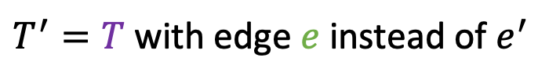
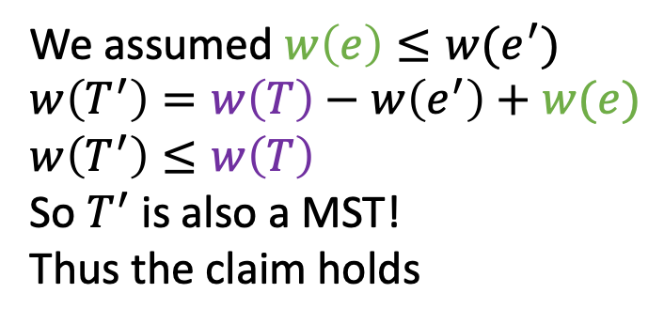
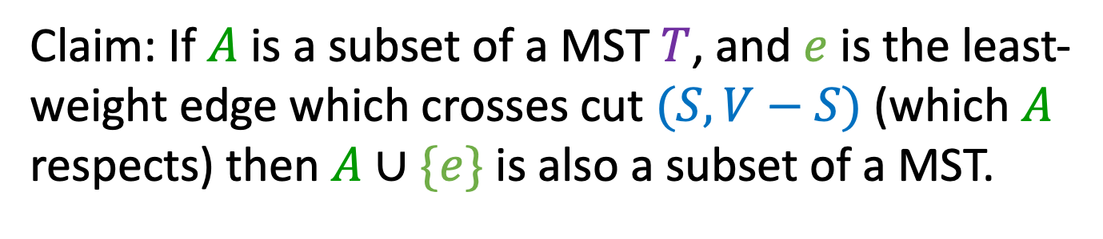

Proof of Cut Theorem
Claim: If $A$ is a subset of a MST $T$, and $e$ is the least-weight edge which crosses cut $(S, V−S)$ (which $A$ respects) then $A∪\{e\}$ is also a subset of a MST.
$$T$$
Consider some MST $T$,
Case 2:
Consider if $e=(v_{1},v_{2})∉T$
$$A⊆T$$
$$S$$
$$v_{1}$$
$T^{′}=T$ with edge $e$ instead of $e^{′}$
We assumed $w\left(e\right)≤w(e^{′})$
$w\left(T^{′}\right)=w\left(T\right)−w\left(e^{′}\right)+w(e)$
$w\left(T^{′}\right)≤w\left(T\right)$
So $T^{′}$ is also a MST!
Thus the claim holds
$$e$$
$$e′$$
$$v_{2}$$
$$V−S$$

Slide 16

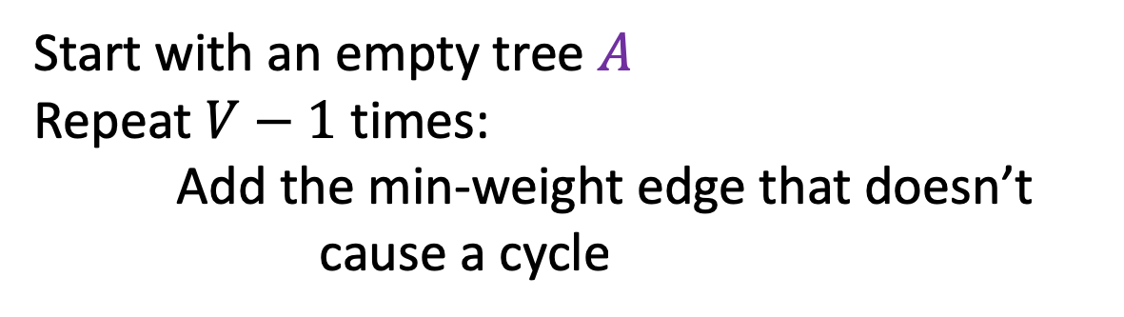
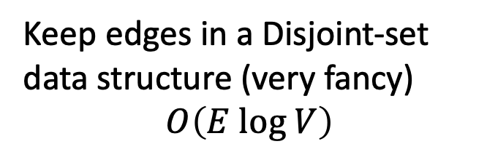

Kruskal’s Algorithm
Start with an empty tree $A$
Repeat $V−1$ times:
Add the min-weight edge that doesn’t cause a cycle
Keep edges in a Disjoint-set data structure (very fancy)
$$O\left(E log V\right)$$
B
8
10
E
8
7
H
A
9
2
D
5
9
I
12
3
C
3
$$e$$
11
G
1
F
6
$$S$$

Slide 17
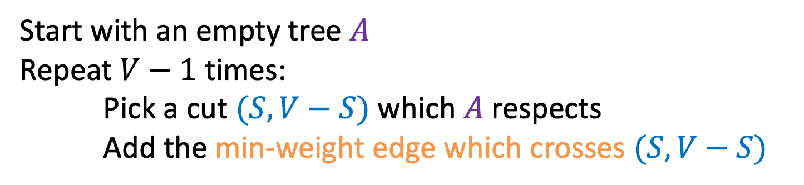
General MST Algorithm
Start with an empty tree $A$
Repeat $V−1$ times:
Pick a cut $(S,V−S)$ which $A$ respects
Add the min-weight edge which crosses $(S,V−S)$
B
8
10
E
8
7
H
A
9
2
D
5
9
I
12
3
C
3
11
G
1
F
6

Slide 18
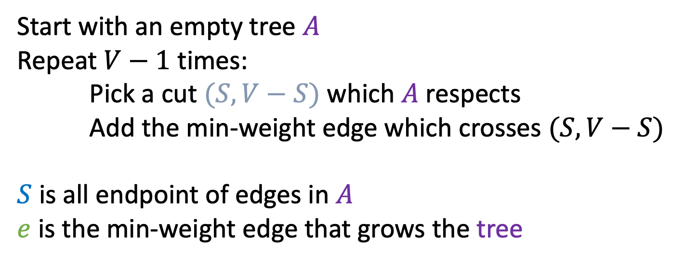
Prim’s Algorithm
Start with an empty tree $A$
Repeat $V−1$ times:
Pick a cut $(S,V−S)$ which $A$ respects
Add the min-weight edge which crosses $(S,V−S)$
$S$ is all endpoint of edges in $A$
$e$ is the min-weight edge that grows the tree
B
8
10
E
6
7
H
A
9
2
D
5
9
I
12
3
C
3
11
G
1
F
7

Slide 19
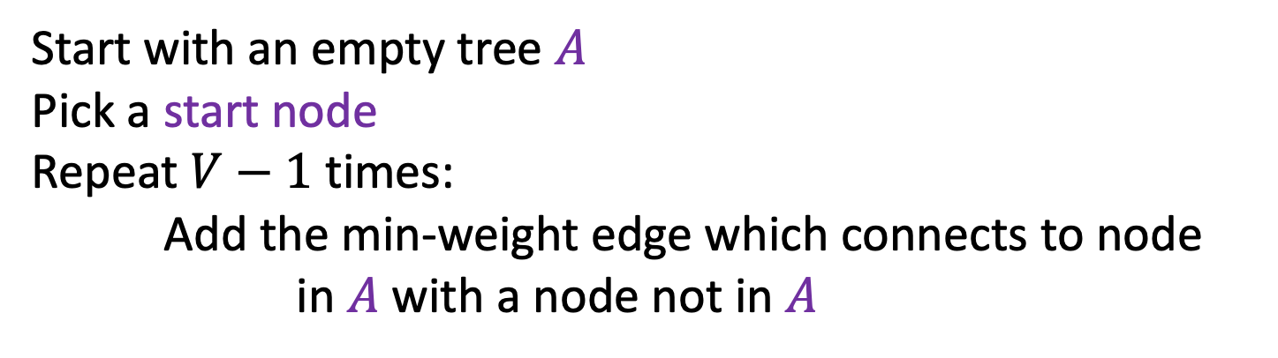
Prim’s Algorithm
Start with an empty tree $A$
Pick a start node
Repeat $V−1$ times:
Add the min-weight edge which connects to node in $A$ with a node not in $A$
B
8
10
E
6
7
H
A
9
2
D
5
9
I
12
3
C
3
11
G
1
F
7

Slide 20

Prim’s Algorithm
Start with an empty tree $A$
Pick a start node
Repeat $V−1$ times:
Add the min-weight edge which connects to node in $A$ with a node not in $A$
B
8
10
E
6
7
H
A
9
2
D
5
9
I
12
3
C
3
11
G
1
F
7

Slide 21
Prim’s Algorithm
Start with an empty tree $A$
Pick a start node
Repeat $V−1$ times:
Add the min-weight edge which connects to node in $A$ with a node not in $A$
B
8
10
E
6
7
H
A
9
2
D
5
9
I
12
3
C
3
11
G
1
F
7

Slide 22
Prim’s Algorithm
Start with an empty tree $A$
Pick a start node
Repeat $V−1$ times:
Add the min-weight edge which connects to node in $A$ with a node not in $A$
B
8
10
E
6
7
H
A
9
2
D
5
9
I
12
3
C
3
11
G
1
F
7

Slide 23
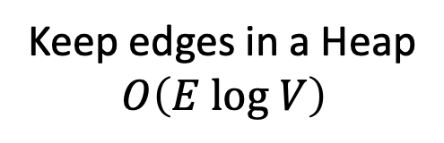
Prim’s Algorithm
Start with an empty tree $A$
Pick a start node
Repeat $V−1$ times:
Add the min-weight edge which connects to node in $A$ with a node not in $A$
Keep edges in a Heap
$$O\left(E log V\right)$$
B
8
10
E
6
7
H
A
9
2
D
5
9
I
12
3
C
3
11
G
1
F
7

Slide 24

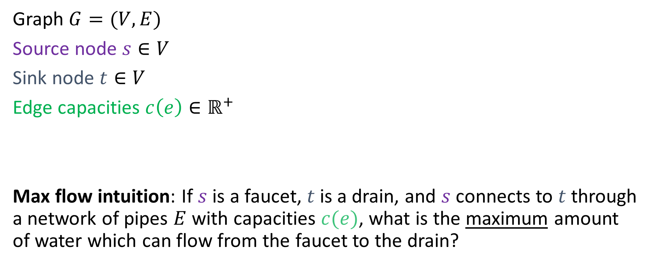

Flow Networks
3
2
Graph $G=(V,E)$
Source node $s∈V$
Sink node $t∈V$
Edge capacities $c\left(e\right)∈ℝ^{+}$
Max flow intuition: If $s$ is a faucet, $t$ is a drain, and $s$ connects to $t$ through a network of pipes $E$ with capacities $c(e)$, what is the maximum amount of water which can flow from the faucet to the drain?
3
$$s$$
3
2
$$t$$
2
1
3
1
2
3

Slide 25
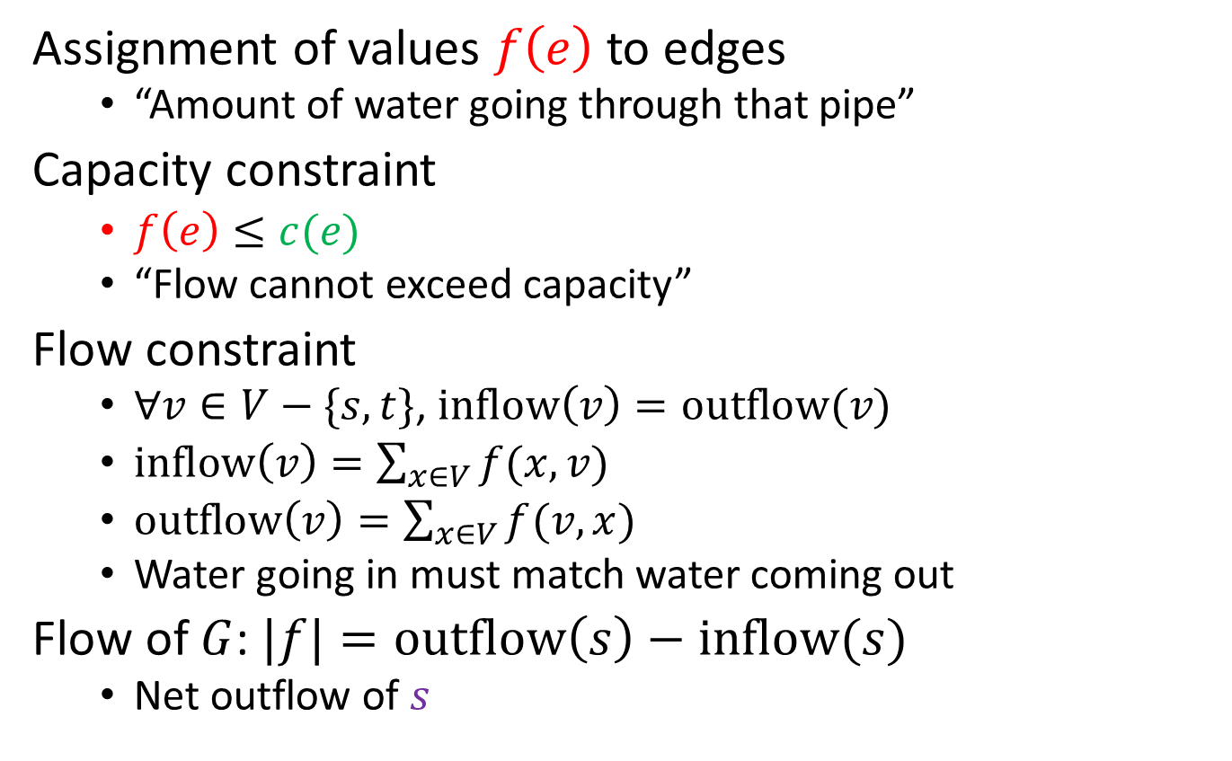


Network Flow
Assignment of values $f\left(e\right)$ to edges
“Amount of water going through that pipe”
Capacity constraint
$f\left(e\right)≤c(e)$
“Flow cannot exceed capacity”
Flow constraint
$∀v∈V−\{s,t\}$, $inflow\left(v\right)=outflow(v)$
$inflow\left(v\right)=\sum_{x∈V}{f(x,v)}$
$outflow\left(v\right)=\sum_{x∈V}{f(v,x)}$
Water going in must match water coming out
Flow of $G$: $|f|=outflow\left(s\right)−inflow(s)$
Net outflow of $s$
2/2
1/3
2/3
$$s$$
1/3
1/1
1/2
$$t$$
2/2
2/3
0/1
1/2
2/3
flow / capacity
3 in this example

Slide 26

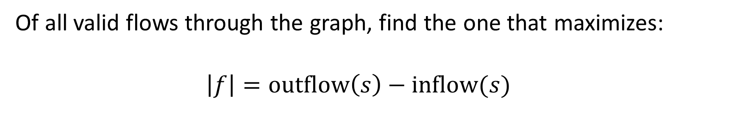



Maximum Flow Problem
Of all valid flows through the graph, find the one that maximizes:
$$\left|f\right|=outflow\left(s\right)−inflow(s)$$
2
2/2
3
2/3
3
2/3
$$s$$
$$s$$
0/3
3
1
0/1
2
$$t$$
0/2
$$t$$
2
2/2
3
0/3
1
2
0/1
2/2
3
2/3

Slide 27


Greedy Approach
Greedy choice: saturate highest capacity path first
20
10
$$s$$
30
$$t$$
10
20

Slide 28
Greedy Approach
Greedy choice: saturate highest capacity path first
20
10
$$s$$
30
$$t$$
10
20

Slide 29
Greedy Approach
Greedy choice: saturate highest capacity path first
20/20
10
$$s$$
20/30
$$t$$
10
20/20
Flow: 20

Slide 30
Greedy Approach
Greedy choice: saturate highest capacity path first
20/20
10/10
$$s$$
10/30
$$t$$
10/10
20/20
Maximum Flow: 30
Observe: highest capacity path is not saturated in optimal solution

Slide 31




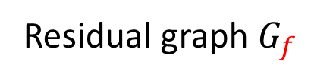
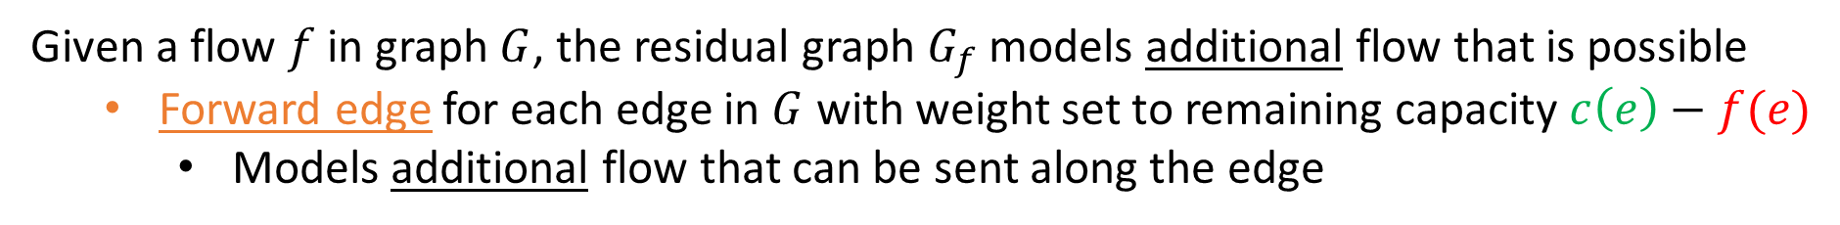
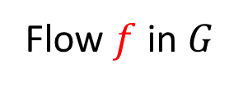
Residual Graphs
Given a flow $f$ in graph $G$, the residual graph $G_{f}$ models additional flow that is possible
Forward edge for each edge in $G$ with weight set to remaining capacity $c\left(e\right)−f(e)$
Models additional flow that can be sent along the edge
2/2
1/3
2
2/3
1
$$s$$
1/3
$$s$$
1/1
2
1/2
$$t$$
1
1
$$t$$
2/2
2/3
0/1
1/2
1
1
2/3
1
Flow $f$ in $G$
Residual graph $G_{f}$

Slide 32
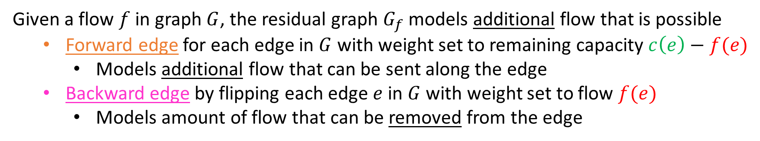
Residual Graphs
Given a flow $f$ in graph $G$, the residual graph $G_{f}$ models additional flow that is possible
Forward edge for each edge in $G$ with weight set to remaining capacity $c\left(e\right)−f(e)$
Models additional flow that can be sent along the edge
Backward edge by flipping each edge $e$ in $G$ with weight set to flow $f(e)$
Models amount of flow that can be removed from the edge
2/2
2
1/3
2
2/3
1
$$s$$
1
$$s$$
1/3
1
2
1/1
2
1
1/2
$$t$$
2
1
1
$$t$$
2/2
2
1
1
2/3
2
1
0/1
1/2
1
2/3
1
Flow $f$ in $G$
Residual graph $G_{f}$

Slide 33








Residual Graphs Example
Flow Graph
Residual Graph
20
20/20
10
0
0/10
0
$$s$$
20/30
$$t$$
$$s$$
20
$$t$$
10
10
0
0/10
20/20
0
20
20
20/20
10
10/10
0
0
$$s$$
10/30
$$t$$
$$s$$
20
10
$$t$$
0
0
10/10
20/20
10
20

Slide 34
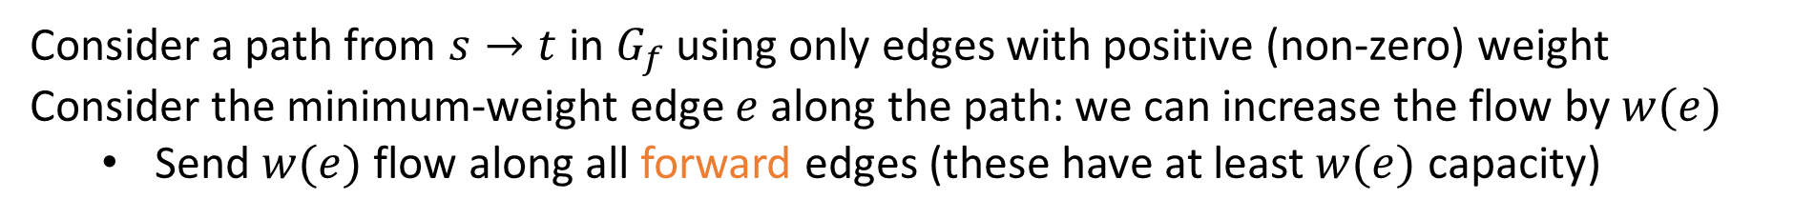
Residual Graphs
Consider a path from $s→t$ in $G_{f}$ using only edges with positive (non-zero) weight
Consider the minimum-weight edge $e$ along the path: we can increase the flow by $w(e)$
Send $w(e)$ flow along all forward edges (these have at least $w(e)$ capacity)
2/2
2
1/3
2
2/3
1
$$s$$
1
$$s$$
1/3
1
2
1/1
2
1
1/2
$$t$$
2
1
1
$$t$$
2/2
2
1
1
2/3
2
1
0/1
1/2
1
2/3
1
Flow $f$ in $G$
Residual graph $G_{f}$

Slide 35
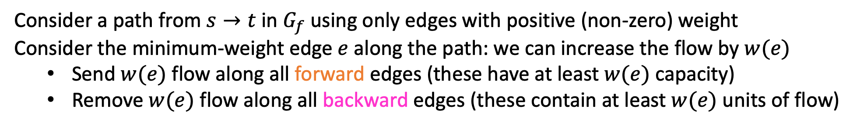
Residual Graphs
Consider a path from $s→t$ in $G_{f}$ using only edges with positive (non-zero) weight
Consider the minimum-weight edge $e$ along the path: we can increase the flow by $w(e)$
Send $w(e)$ flow along all forward edges (these have at least $w(e)$ capacity)
Remove $w(e)$ flow along all backward edges (these contain at least $w(e)$ units of flow)
2/2
2
1/3
2
2/3
1
$$s$$
1
$$s$$
1/3
1
2
1/1
2
1
1/2
$$t$$
2
1
1
$$t$$
2/2
2
1
1
2/3
2
1
0/1
1/2
1
2/3
1
Flow $f$ in $G$
Residual graph $G_{f}$

Slide 36


Residual Graphs
Consider a path from $s→t$ in $G_{f}$ using only edges with positive (non-zero) weight
Consider the minimum-weight edge $e$ along the path: we can increase the flow by $w(e)$
Send $w\left(e\right)$ flow along all forward edges (these have at least $w(e)$ capacity)
Remove $w(e)$ flow along all backward edges (these contain at least $w(e)$ units of flow)
Observe: Flow has increased by $w(e)$
2/2
2
2/3
2
3/3
1
$$s$$
1
$$s$$
0/3
1
2
0/1
2
1
1/2
$$t$$
2
1
1
$$t$$
2/2
2
1
1
2/3
2
1
0/1
1/2
1
2/3
1
Flow $f$ in $G$
Residual graph $G_{f}$

Slide 37
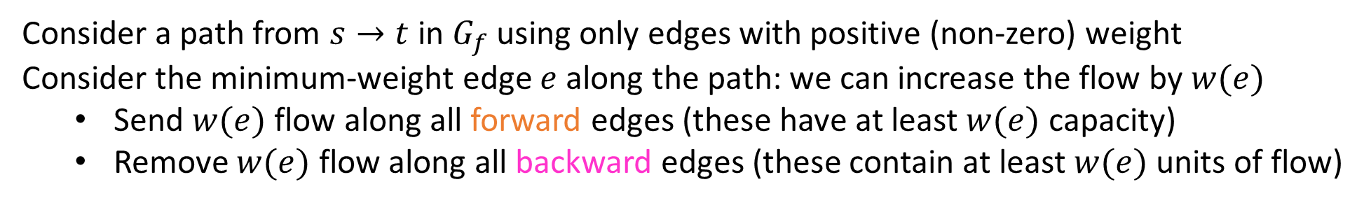
Residual Graphs
Consider a path from $s→t$ in $G_{f}$ using only edges with positive (non-zero) weight
Consider the minimum-weight edge $e$ along the path: we can increase the flow by $w(e)$
Send $w(e)$ flow along all forward edges (these have at least $w(e)$ capacity)
Remove $w(e)$ flow along all backward edges (these contain at least $w(e)$ units of flow)
Observe: Flow has increased by $w(e)$
Why does this respect flow constraints?
Incoming edge to a node always corresponds to increased flow to the node (more incoming flow from forward edge or less outgoing flow from backward edge)
Outgoing edge to a node always corresponds to decreased flow to the node
2
2
1
$$s$$
1
2
1
2
1
$$t$$
1
2
1
1
1
2
2
1
1
1
Residual graph $G_{f}$

Slide 38
Residual Graphs
Consider a path from $s→t$ in $G_{f}$ using only edges with positive (non-zero) weight
Consider the minimum-weight edge $e$ along the path: we can increase the flow by $w(e)$
Send $w(e)$ flow along all forward edges (these have at least $w(e)$ capacity)
Remove $w(e)$ flow along all backward edges (these contain at least $w(e)$ units of flow)
Observe: Flow has increased by $w(e)$
Capacity constraints satisfied by construction of the residual network
Why does this respect flow constraints?
Incoming edge to a node always corresponds to increased flow to the node (more incoming flow from forward edge or less outgoing flow from backward edge)
Outgoing edge to a node always corresponds to decreased flow to the node
2
2
1
$$s$$
1
2
1
2
1
$$t$$
1
2
1
1
1
2
2
1
1
1
Residual graph $G_{f}$

Slide 39
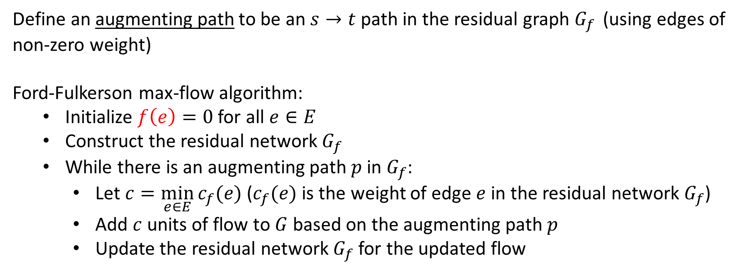
Ford-Fulkerson Algorithm
Define an augmenting path to be an $s→t$ path in the residual graph $G_{f }$ (using edges of non-zero weight)
Ford-Fulkerson max-flow algorithm:
Initialize $f\left(e\right)=0$ for all $e∈E$
Construct the residual network $G_{f}$
While there is an augmenting path $p$ in $G_{f}$:
Let $c=\min_{e∈E}{c_{f}(e)}$ ($c_{f}(e)$ is the weight of edge $e$ in the residual network $G_{f}$)
Add $c$ units of flow to $G$ based on the augmenting path $p$
Update the residual network $G_{f}$ for the updated flow
Ford-Fulkerson approach: take any augmenting path
(will revisit this later)

Slide 40


Ford-Fulkerson Example
0/2
2
0/3
3
0/3
$$s$$
0/3
$$s$$
3
3
0/1
1
0/2
$$t$$
2
$$t$$
0/2
3
0/3
2
0/1
0/2
1
2
0/3
3
Initially: $f\left(e\right)=0$ for all $e∈E$
Residual graph $G_{f}$

Slide 41
Ford-Fulkerson Example
Increase flow by 1 unit
0/2
2
0/3
3
0/3
$$s$$
0/3
$$s$$
3
3
0/1
1
0/2
$$t$$
2
$$t$$
0/2
3
0/3
2
0/1
0/2
1
2
0/3
3
Residual graph $G_{f}$

Slide 42
Ford-Fulkerson Example
Increase flow by 1 unit
1/2
2
1/3
3
0/3
$$s$$
0/3
$$s$$
3
3
1/1
1
0/2
$$t$$
2
$$t$$
0/2
3
0/3
2
0/1
1/2
1
2
1/3
3
Residual graph $G_{f}$

Slide 43
Ford-Fulkerson Example
1/2
1
1/3
2
0/3
1
$$s$$
0/3
$$s$$
1
3
3
1/1
1
0/2
$$t$$
2
1
$$t$$
0/2
3
0/3
2
1
0/1
1/2
1
1
1/3
2
Residual graph $G_{f}$

Slide 44
Ford-Fulkerson Example
Increase flow by 1 unit
1/2
1
1/3
2
0/3
1
$$s$$
0/3
$$s$$
1
3
3
1/1
1
0/2
$$t$$
2
1
$$t$$
0/2
3
0/3
2
1
0/1
1/2
1
1
1/3
2
Residual graph $G_{f}$

Slide 45
Ford-Fulkerson Example
Increase flow by 1 unit
2/2
1
2/3
2
1/3
1
$$s$$
0/3
$$s$$
1
3
3
1/1
1
0/2
$$t$$
2
1
$$t$$
0/2
3
0/3
2
1
0/1
1/2
1
1
1/3
2
Residual graph $G_{f}$

Slide 46
Ford-Fulkerson Example
Increase flow by 1 unit
2/2
2/3
1
1/3
2
1
$$s$$
0/3
$$s$$
2
3
2
1/1
1
0/2
$$t$$
2
1
$$t$$
0/2
3
0/3
2
1
0/1
1/2
1
1
1/3
2
Residual graph $G_{f}$

Slide 47


Ford-Fulkerson Example
2/2
2/3
1
1/3
2
1
$$s$$
0/3
$$s$$
2
3
2
1/1
1
0/2
$$t$$
2
1
$$t$$
0/2
3
0/3
2
1
0/1
1/2
1
1
1/3
2
Residual graph $G_{f}$

Slide 48
Ford-Fulkerson Example
Increase flow by 1 unit
2/2
2/3
1
2/3
2
1
$$s$$
0/3
$$s$$
2
3
2
0/1
1
0/2
$$t$$
2
1
$$t$$
1/2
3
0/3
2
1
0/1
1/2
1
1
1/3
2
Residual graph $G_{f}$

Slide 49
Ford-Fulkerson Example
Increase flow by 1 unit
2/2
2/3
1
2/3
2
2
$$s$$
0/3
$$s$$
2
3
1
0/1
1
0/2
$$t$$
2
1
$$t$$
1/2
1
3
0/3
1
1
0/1
1/2
1
1
1/3
2
Residual graph $G_{f}$

Slide 50
Ford-Fulkerson Example
2/2
2/3
1
2/3
2
2
$$s$$
0/3
$$s$$
2
3
1
0/1
1
0/2
$$t$$
2
1
$$t$$
1/2
1
3
0/3
1
1
0/1
1/2
1
1
1/3
2
Residual graph $G_{f}$

Slide 51
Ford-Fulkerson Example
Increase flow by 1 unit
2/2
2/3
1
2/3
2
2
$$s$$
0/3
$$s$$
2
3
1
0/1
1
0/2
$$t$$
2
1
$$t$$
2/2
1
3
0/3
1
1
0/1
2/2
1
1
2/3
2
Residual graph $G_{f}$

Slide 52
Ford-Fulkerson Example
No more augmenting paths
2/2
2/3
1
2/3
2
2
$$s$$
0/3
$$s$$
2
3
1
0/1
1
0/2
$$t$$
2
2
$$t$$
2/2
2
3
0/3
2
0/1
2/2
1
2/3
1
Residual graph $G_{f}$
Maximum flow: 4

Slide 53
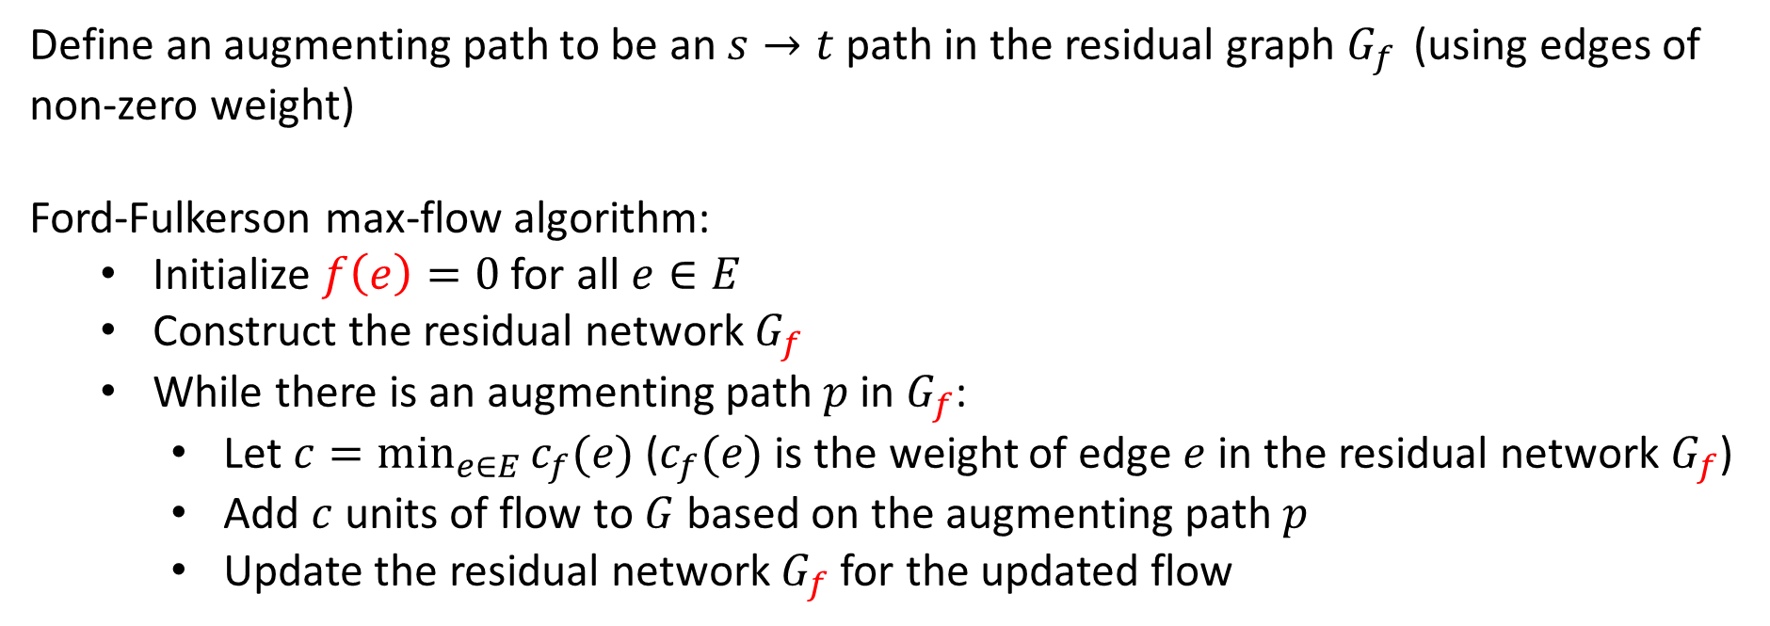
Ford-Fulkerson Running Time
Define an augmenting path to be an $s→t$ path in the residual graph $G_{f }$ (using edges of non-zero weight)
Ford-Fulkerson max-flow algorithm:
Initialize $f\left(e\right)=0$ for all $e∈E$
Construct the residual network $G_{f}$
While there is an augmenting path $p$ in $G_{f}$:
Let $c=\min_{e∈E}{c_{f}(e)}$ ($c_{f}(e)$ is the weight of edge $e$ in the residual network $G_{f}$)
Add $c$ units of flow to $G$ based on the augmenting path $p$
Update the residual network $G_{f}$ for the updated flow
Initialization: $O\left(\left|E\right|\right)$

Slide 54

Ford-Fulkerson Running Time
Define an augmenting path to be an $s→t$ path in the residual graph $G_{f }$ (using edges of non-zero weight)
Ford-Fulkerson max-flow algorithm:
Initialize $f\left(e\right)=0$ for all $e∈E$
Construct the residual network $G_{f}$
While there is an augmenting path $p$ in $G_{f}$:
Let $c=\min_{e∈E}{c_{f}(e)}$ ($c_{f}(e)$ is the weight of edge $e$ in the residual network $G_{f}$)
Add $c$ units of flow to $G$ based on the augmenting path $p$
Update the residual network $G_{f}$ for the updated flow
Initialization: $O\left(\left|E\right|\right)$
Construct residual network: $O\left(\left|E\right|\right)$

Slide 55

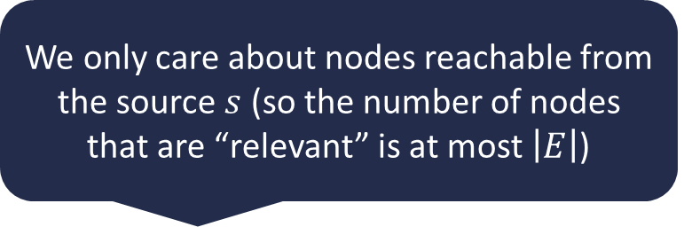
Ford-Fulkerson Running Time
Define an augmenting path to be an $s→t$ path in the residual graph $G_{f }$ (using edges of non-zero weight)
Ford-Fulkerson max-flow algorithm:
Initialize $f\left(e\right)=0$ for all $e∈E$
Construct the residual network $G_{f}$
While there is an augmenting path $p$ in $G_{f}$:
Let $c=\min_{e∈E}{c_{f}(e)}$ ($c_{f}(e)$ is the weight of edge $e$ in the residual network $G_{f}$)
Add $c$ units of flow to $G$ based on the augmenting path $p$
Update the residual network $G_{f}$ for the updated flow
We only care about nodes reachable from the source $s$ (so the number of nodes that are “relevant” is at most $\left|E\right|$)
Initialization: $O\left(\left|E\right|\right)$
Construct residual network: $O\left(\left|E\right|\right)$
Finding augmenting path in residual network: $O\left(\left|E\right|\right)$ using BFS/DFS

Slide 56
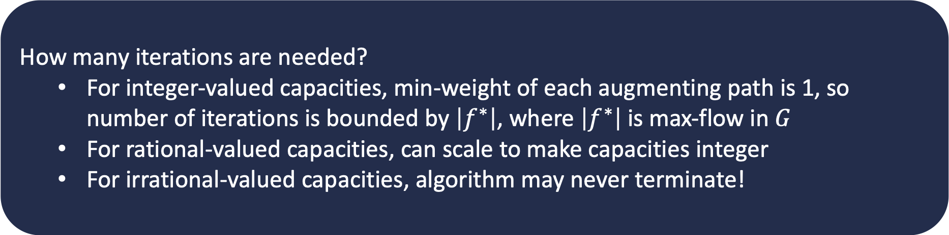
Ford-Fulkerson Running Time
Define an augmenting path to be an $s→t$ path in the residual graph $G_{f }$ (using edges of non-zero weight)
Ford-Fulkerson max-flow algorithm:
Initialize $f\left(e\right)=0$ for all $e∈E$
Construct the residual network $G_{f}$
While there is an augmenting path $p$ in $G_{f}$:
Let $c=\min_{e∈E}{c_{f}(e)}$ ($c_{f}(e)$ is the weight of edge $e$ in the residual network $G_{f}$)
Add $c$ units of flow to $G$ based on the augmenting path $p$
Update the residual network $G_{f}$ for the updated flow
How many iterations are needed?
For integer-valued capacities, min-weight of each augmenting path is 1, so number of iterations is bounded by $\left|f^{∗}\right|$, where $\left|f^{∗}\right|$ is max-flow in $G$
For rational-valued capacities, can scale to make capacities integer
For irrational-valued capacities, algorithm may never terminate!
Initialization: $O\left(\left|E\right|\right)$
Construct residual network: $O\left(\left|E\right|\right)$
Finding augmenting path in residual network: $O\left(\left|E\right|\right)$ using BFS/DFS

Slide 57

Ford-Fulkerson Running Time
Define an augmenting path to be an $s→t$ path in the residual graph $G_{f }$ (using edges of non-zero weight)
Ford-Fulkerson max-flow algorithm:
Initialize $f\left(e\right)=0$ for all $e∈E$
Construct the residual network $G_{f}$
While there is an augmenting path $p$ in $G_{f}$:
Let $c=\min_{e∈E}{c_{f}(e)}$ ($c_{f}(e)$ is the weight of edge $e$ in the residual network $G_{f}$)
Add $c$ units of flow to $G$ based on the augmenting path $p$
Update the residual network $G_{f}$ for the updated flow
For graphs with integer capacities, running time of Ford-Fulkerson is
$$O\left(\left|f^{∗}\right|⋅\left|E\right|\right)$$
Highly undesirable if $\left|f^{∗}\right|≫|E|$ (e.g., graph is small, but capacities are $≈2^{32}$)
As described, algorithm is not polynomial-time!
Initialization: $O\left(\left|E\right|\right)$
Construct residual network: $O\left(\left|E\right|\right)$
Finding augmenting path in residual network: $O\left(\left|E\right|\right)$ using BFS/DFS

Slide 58




Worst-Case Ford-Fulkerson
0/100
0/100
100
100
$$s$$
0/1
$$t$$
$$s$$
1
$$t$$
0/100
0/100
100
100

Slide 59
Worst-Case Ford-Fulkerson
Increase flow by 1 unit
0/100
0/100
100
100
$$s$$
0/1
$$t$$
$$s$$
1
$$t$$
0/100
0/100
100
100

Slide 60
Worst-Case Ford-Fulkerson
Increase flow by 1 unit
1/100
0/100
100
100
$$s$$
1/1
$$t$$
$$s$$
1
$$t$$
0/100
1/100
100
100

Slide 61
Worst-Case Ford-Fulkerson
1/100
0/100
99
100
1
$$s$$
1/1
$$t$$
$$s$$
1
$$t$$
1
0/100
1/100
100
99

Slide 62
Worst-Case Ford-Fulkerson
Increase flow by 1 unit
1/100
0/100
99
100
1
$$s$$
1/1
$$t$$
$$s$$
1
$$t$$
1
0/100
1/100
100
99

Slide 63
Worst-Case Ford-Fulkerson
Increase flow by 1 unit
1/100
1/100
99
100
1
$$s$$
0/1
$$t$$
$$s$$
1
$$t$$
1
1/100
1/100
100
99

Slide 64
Worst-Case Ford-Fulkerson
1/100
1/100
99
99
1
1
$$s$$
0/1
$$t$$
$$s$$
1
$$t$$
1
1
1/100
1/100
99
99

Slide 65
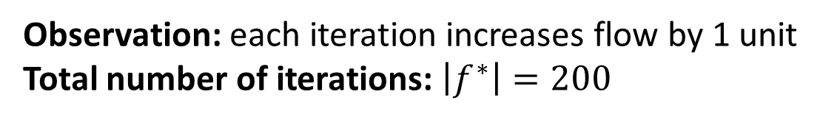
Worst-Case Ford-Fulkerson
1/100
1/100
99
99
1
1
$$s$$
0/1
$$t$$
$$s$$
1
$$t$$
1
1
1/100
1/100
99
99
Observation: each iteration increases flow by 1 unit
Total number of iterations: $\left|f^{∗}\right|=200$

Slide 66
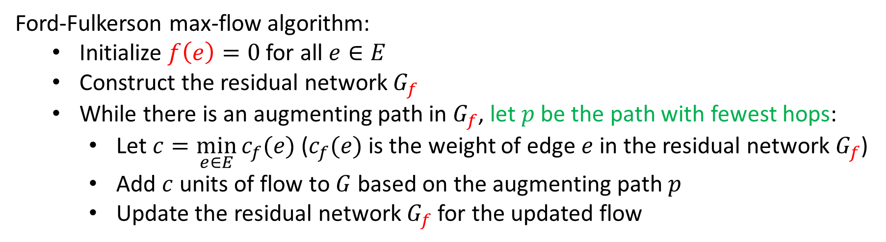

Can We Avoid this?
Edmonds-Karp Algorithm: choose augmenting path with fewest hops
Running time: $Θ\left(\min\left(\left|E\right|\left|f^{∗}\right|, \left|V\right|{\left|E\right|}^{2}\right)\right)=O\left(\left|V\right|{\left|E\right|}^{2}\right)$
How to find this?
Use breadth-first search (BFS)!
Edmonds-Karp = Ford-Fulkerson using BFS to find augmenting path
Ford-Fulkerson max-flow algorithm:
Initialize $f\left(e\right)=0$ for all $e∈E$
Construct the residual network $G_{f}$
While there is an augmenting path in $G_{f}$, let $p$ be the path with fewest hops:
Let $c=\min_{e∈E}{c_{f}(e)}$ ($c_{f}(e)$ is the weight of edge $e$ in the residual network $G_{f}$)
Add $c$ units of flow to $G$ based on the augmenting path $p$
Update the residual network $G_{f}$ for the updated flow
Proof: See CLRS (Chapter 26.2)

Slide 67




Correctness of Ford-Fulkerson
Consider cuts which separate $s$ and $t$
Let $s∈S$, $t∈T$, such that $V=S∪T$
Cost $\left\|S,T\right\|$of cut $\left(S,T\right)$: sum of the capacities of edges from $S$ to $T$
2
3
3
$$s$$
3
1
2
$$t$$
2
3
$$S$$
1
2
$$\left\|S,T\right\|=5$$
3
$$T$$

Slide 68
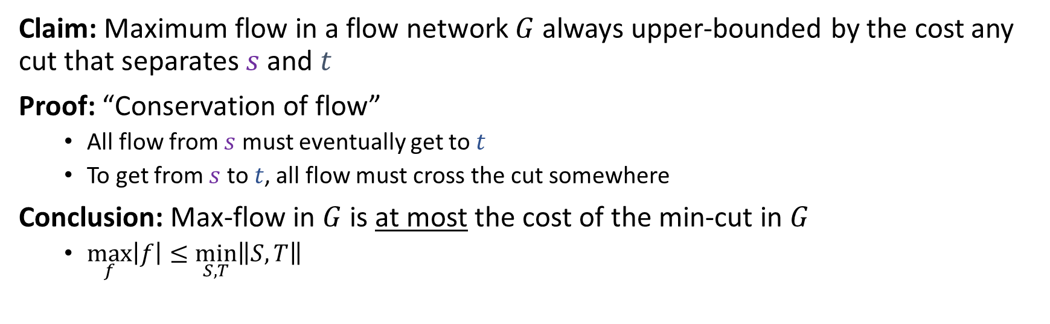
Max-Flow / Min-Cut
Claim: Maximum flow in a flow network $G$ always upper-bounded by the cost any cut that separates $s$ and $t$
Proof: “Conservation of flow”
All flow from $s$ must eventually get to $t$
To get from $s$ to $t$, all flow must cross the cut somewhere
Conclusion: Max-flow in $G$ is at most the cost of the min-cut in $G$
$\max_{f}\left|f\right|≤\min_{S,T}\left\|S,T\right\|$
2
3
3
$$s$$
3
1
2
$$t$$
2
3
$$S$$
1
2
3
$$T$$

Slide 69
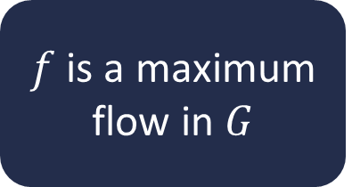
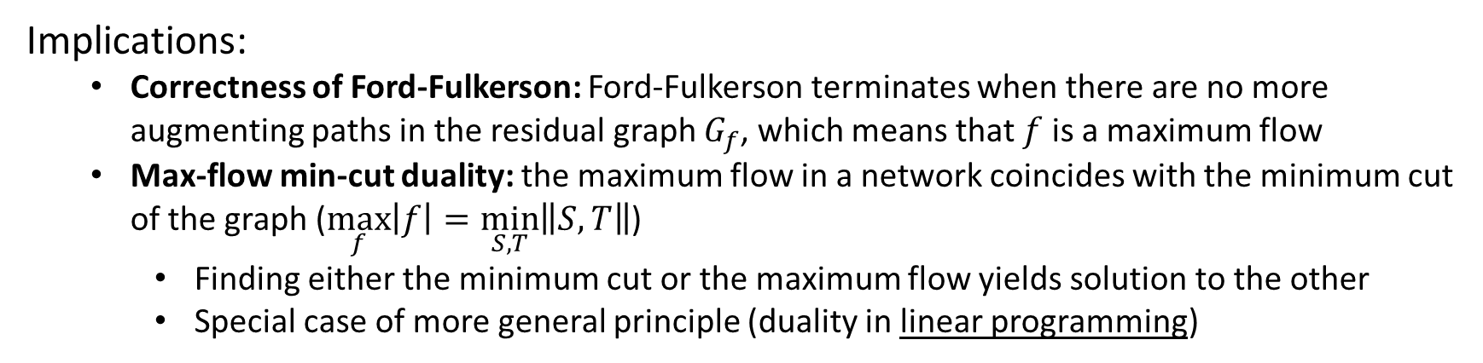
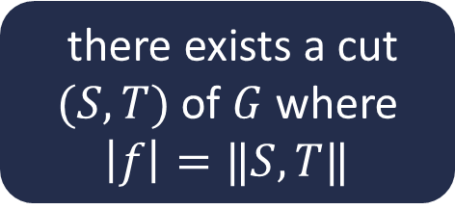
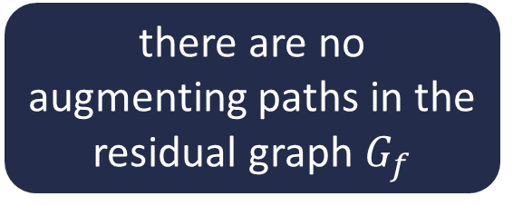
Max-Flow Min-Cut Theorem
Let $f$ be a flow in a graph $G$
$f$ is a maximum flow in $G$
there are no augmenting paths in the residual graph $G_{f}$
there exists a cut $(S,T)$ of $G$ where $\left|f\right|=‖S,T‖$
Statements are equivalent!
Implications:
Correctness of Ford-Fulkerson: Ford-Fulkerson terminates when there are no more augmenting paths in the residual graph $G_{f}$, which means that $f$ is a maximum flow
Max-flow min-cut duality: the maximum flow in a network coincides with the minimum cut of the graph ($\max_{f}\left|f\right|=\min_{S,T}\left\|S,T\right\|$)
Finding either the minimum cut or the maximum flow yields solution to the other
Special case of more general principle (duality in linear programming)

Slide 70




Max-Flow Min-Cut Duality Example
no more augmenting paths
$$S$$
2/2
2/3
1
2/3
2
2
$$s$$
0/3
$$s$$
2
3
1
0/1
1
0/2
$$t$$
2
2
$$t$$
2/2
2
3
0/3
2
0/1
2/2
1
2/3
$$T$$
1
Flow graph
Residual graph
Max flow: 4

Slide 71
Max-Flow Min-Cut Duality Example
no more augmenting paths
$$S$$
2/2
2/3
1
2/3
2
2
$$s$$
0/3
$$s$$
2
3
1
0/1
1
0/2
$$t$$
2
2
$$t$$
2/2
2
3
0/3
2
0/1
2/2
1
2/3
$$T$$
1
Flow graph
Residual graph
Max flow: 4
Min cut: 4
When there are no more augmenting paths in the graph, there is a cut whose cost matches the flow

Slide 72
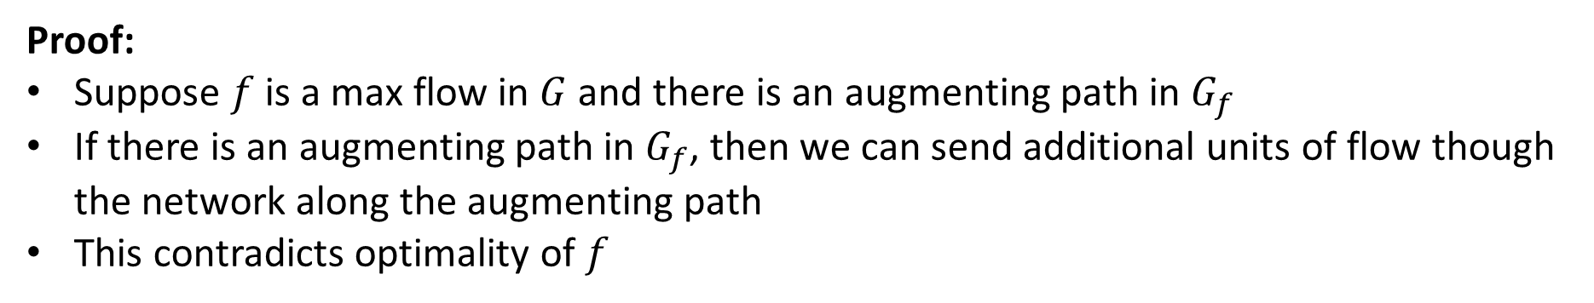
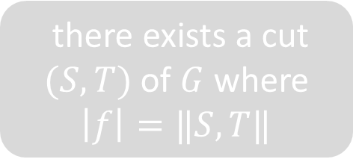
Max-Flow Min-Cut Theorem Proof
Let $f$ be a flow in a graph $G$
$f$ is a maximum flow in $G$
there are no augmenting paths in the residual graph $G_{f}$
there exists a cut $(S,T)$ of $G$ where $\left|f\right|=‖S,T‖$
Proof:
Suppose $f$ is a max flow in $G$ and there is an augmenting path in $G_{f}$
If there is an augmenting path in $G_{f}$, then we can send additional units of flow though the network along the augmenting path
This contradicts optimality of $f$

Slide 73
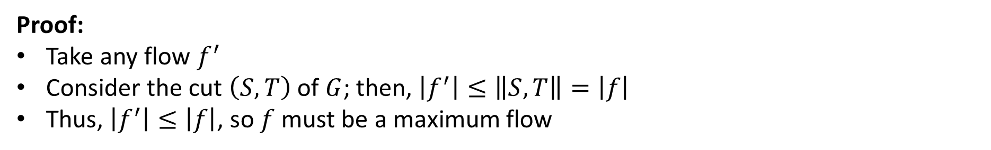
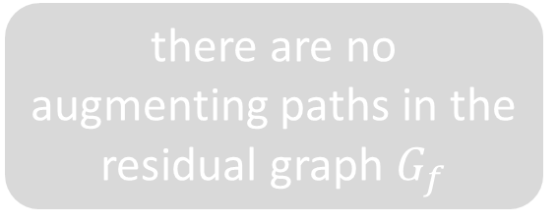
Max-Flow Min-Cut Theorem Proof
Let $f$ be a flow in a graph $G$
$f$ is a maximum flow in $G$
there are no augmenting paths in the residual graph $G_{f}$
there exists a cut $(S,T)$ of $G$ where $\left|f\right|=‖S,T‖$
Proof:
Take any flow $f^{′}$
Consider the cut $\left(S,T\right)$ of $G$; then, $\left|f^{′}\right|≤\left\|S,T\right\|=\left|f\right|$
Thus, $\left|f^{′}\right|≤\left|f\right|$, so $f$ must be a maximum flow

Slide 74
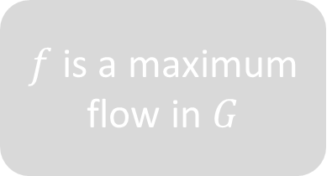
Max-Flow Min-Cut Theorem Proof
Let $f$ be a flow in a graph $G$
$f$ is a maximum flow in $G$
there are no augmenting paths in the residual graph $G_{f}$
there exists a cut $(S,T)$ of $G$ where $\left|f\right|=‖S,T‖$

Slide 75
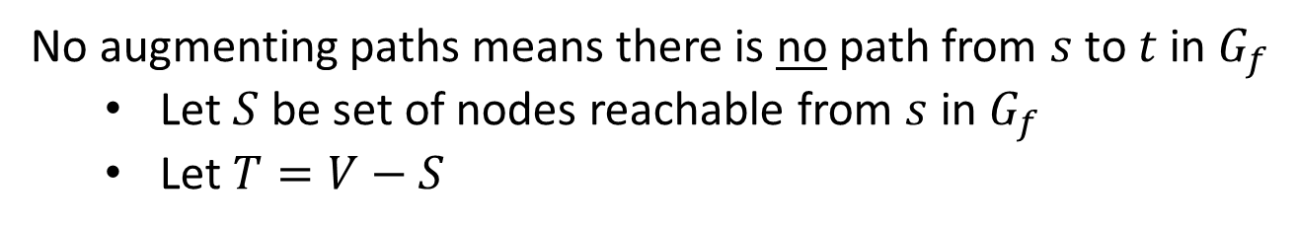
Max-Flow Min-Cut Theorem Proof
no more augmenting paths
$$S$$
2/2
2/3
1
2/3
2
2
$$s$$
0/3
$$s$$
2
3
1
0/1
1
0/2
$$t$$
2
2
$$t$$
2/2
2
3
0/3
2
0/1
2/2
1
2/3
$$T$$
1
Flow graph
Residual graph
No augmenting paths means there is no path from $s$ to $t$ in $G_{f}$
Let $S$ be set of nodes reachable from $s$ in $G_{f}$
Let $T=V−S$

Slide 76
Max-Flow Min-Cut Theorem Proof
no more augmenting paths
$$S$$
2/2
2/3
1
2/3
2
2
$$s$$
0/3
$$s$$
2
3
1
0/1
1
0/2
$$t$$
2
2
$$t$$
2/2
2
3
0/3
2
0/1
2/2
1
2/3
$$T$$
1
Claim: $\left\|S,T\right\|=\left|f\right|$
Total flow $\left|f\right|$ is amount of outgoing flow from $S$ to $T$ minus the amount of incoming flow from $T$ to $S$

Slide 77





Max-Flow Min-Cut Theorem Proof
no more augmenting paths
$$S$$
2/2
2/3
$$u$$
1
$$u$$
$$v$$
$$v$$
2
2/3
2
$$s$$
0/3
$$s$$
2
3
1
0/1
1
0/2
$$t$$
2
2
$$t$$
2/2
2
3
0/3
2
0/1
2/2
1
2/3
$$T$$
1
Claim: $\left\|S,T\right\|=\left|f\right|$
Total flow $\left|f\right|$ is amount of outgoing flow from $S$ to $T$ minus the amount of incoming flow from $T$ to $S$
Outgoing flow: Consider edge $\left(u,v\right)$ where $u∈S$ and $v∈T$
Then, $f\left(u,v\right)=c\left(u,v\right)$. Otherwise, there is a forward edge $\left(u,v\right)$ with positive weight in $G_{f}$ and $v∈S$

Slide 78





Max-Flow Min-Cut Theorem Proof
no more augmenting paths
$$S$$
2/2
2/3
$$x$$
1
$$x$$
2/3
2
2
$$s$$
0/3
$$s$$
2
3
1
0/1
1
0/2
$$t$$
2
2
$$t$$
2/2
2
3
0/3
2
0/1
2/2
1
$$y$$
$$y$$
2/3
$$T$$
1
Claim: $\left\|S,T\right\|=\left|f\right|$
Total flow $\left|f\right|$ is amount of outgoing flow from $S$ to $T$ minus the amount of incoming flow from $T$ to $S$
Outgoing flow: Consider edge $\left(u,v\right)$ where $u∈S$ and $v∈T$
Then, $f\left(u,v\right)=c\left(u,v\right)$. Otherwise, there is a forward edge $\left(u,v\right)$ with positive weight in $G_{f}$ and $v∈S$
Incoming flow: Consider edge $\left(y,x\right)$ where $y∈T$ and $x∈S$
Then, $f\left(y,x\right)=0$. Otherwise, there is a backward edge $\left(x,y\right)$ with positive weight in $G_{f}$ and $y∈S$

Slide 79





Max-Flow Min-Cut Theorem Proof
$$S$$
2/2
2/3
$$=\sum_{ u∈S,v∈T}{f\left(u,v\right)}−\sum_{y∈T,x∈S}{f\left(y,x\right)}$$
$$\left|f\right|$$
2/3
$$s$$
0/3
0/1
0/2
$$t$$
$$=\sum_{u∈S,v∈T}{c\left(u,v\right)}$$
2/2
0/3
0/1
2/2
2/3
$$T$$
$$=\left\|S,T\right\|$$
Claim: $\left\|S,T\right\|=\left|f\right|$
Total flow $\left|f\right|$ is amount of outgoing flow from $S$ to $T$ minus the amount of incoming flow from $T$ to $S$
Outgoing flow: Consider edge $\left(u,v\right)$ where $u∈S$ and $v∈T$
Then, $f\left(u,v\right)=c\left(u,v\right)$. Otherwise, there is a forward edge $\left(u,v\right)$ with positive weight in $G_{f}$ and $v∈S$
Incoming flow: Consider edge $\left(y,x\right)$ where $y∈T$ and $x∈S$
Then, $f\left(y,x\right)=0$. Otherwise, there is a backward edge $\left(x,y\right)$ with positive weight in $G_{f}$ and $y∈S$

Slide 80

Max-Flow Min-Cut Theorem
Let $f$ be a flow in a graph $G$
$f$ is a maximum flow in $G$
there are no augmenting paths in the residual graph $G_{f}$
there exists a cut $(S,T)$ of $G$ where $\left|f\right|=‖S,T‖$
Statements are equivalent!
Implications:
Correctness of Ford-Fulkerson: Ford-Fulkerson terminates when there are no more augmenting paths in the residual graph $G_{f}$, which means that $f$ is a maximum flow
Max-flow min-cut duality: the maximum flow in a network coincides with the minimum cut of the graph ($\max_{f}\left|f\right|=\min_{S,T}\left\|S,T\right\|$)

Slide 81

Other Max Flow Algorithms
Ford-Fulkerson
$Θ\left(\left|E\right|\left|f^{∗}\right|\right)$
Edmonds-Karp (Ford-Fulkerson using BFS to choose augmenting path)
$Θ({\left|E\right|}^{2}\left|V\right|)$
Push-Relabel (Tarjan)
$Θ(\left|E\right|{\left|V\right|}^{2})$
Faster Push-Relabel (also Tarjan)
$Θ({\left|V\right|}^{3})$

Slide 82
Minimum-Cost Maximum-Flow Problem
Not all paths are created equal!
2
2
5
3
1
3
2
2
$$s$$
1
1
3
1
2
$$t$$
2
7
3
1
1
2
3
3
4
A cost is associated with each unit of flow sent along an edge
Goal: Maximize flow while minimizing cost
Much harder problem!
Can solve using linear programming

