Slide 1
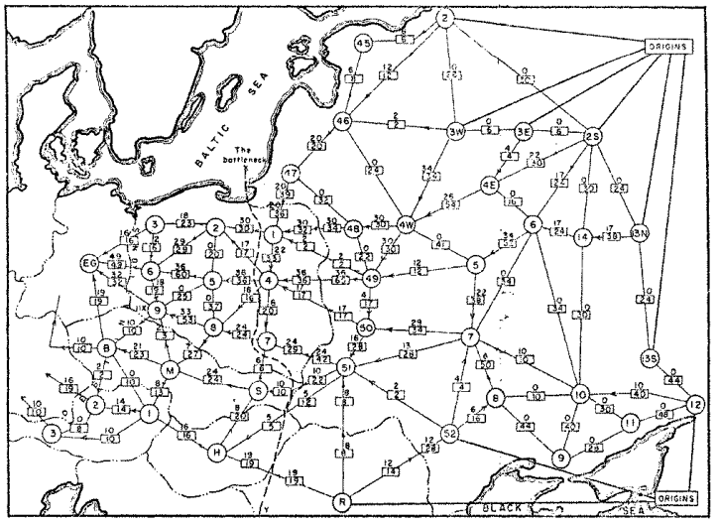
Network Flow
Question: What is the maximum throughput of the railroad network?
Railway map of Western USSR, 1955

Slide 2
Today’s Keywords
Max Flow, Min Cut
Reductions
Bipartite Matching
Vertex Cover
Independent Set
CLRS Chapter 34

Slide 3

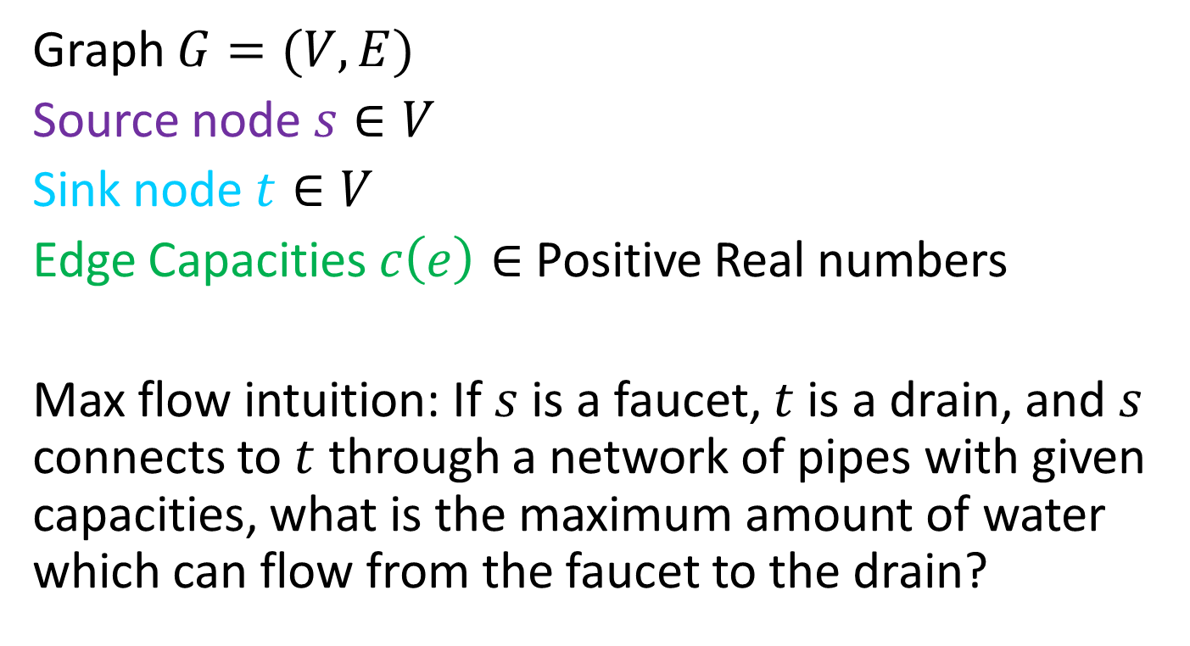

Flow Network
3
2
Graph $G=(V,E)$
Source node $s∈V$
Sink node $t∈V$
Edge Capacities $c\left(e\right)∈$ Positive Real numbers
Max flow intuition: If $s$ is a faucet, $t$ is a drain, and $s$ connects to $t$ through a network of pipes with given capacities, what is the maximum amount of water which can flow from the faucet to the drain?
3
$$s$$
3
2
$$t$$
2
1
3
1
2
3

Slide 4
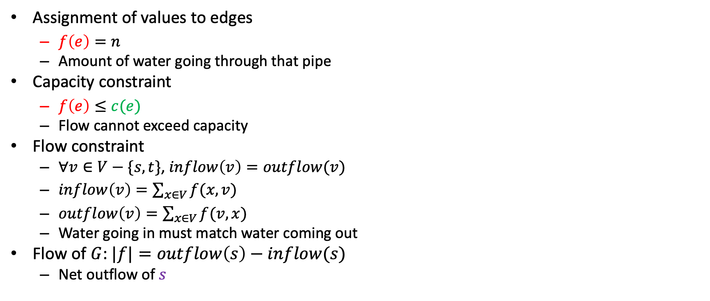


Flow
2/2
1/3
Assignment of values to edges
$f\left(e\right)=n$
Amount of water going through that pipe
Capacity constraint
$f\left(e\right)≤c(e)$
Flow cannot exceed capacity
Flow constraint
$∀v∈V−\{s,t\}$, $inflow\left(v\right)=outflow(v)$
$inflow\left(v\right)=\sum_{x∈V}{f(x,v)}$
$outflow\left(v\right)=\sum_{x∈V}{f(v,x)}$
Water going in must match water coming out
Flow of $G$: $|f|=outflow\left(s\right)−inflow(s)$
Net outflow of $s$
2/3
$$s$$
1/3
1/1
2/2
$$t$$
2/3
1/2
0/1
1/2
2/3
Flow/Capacity
3 in example above

Slide 5
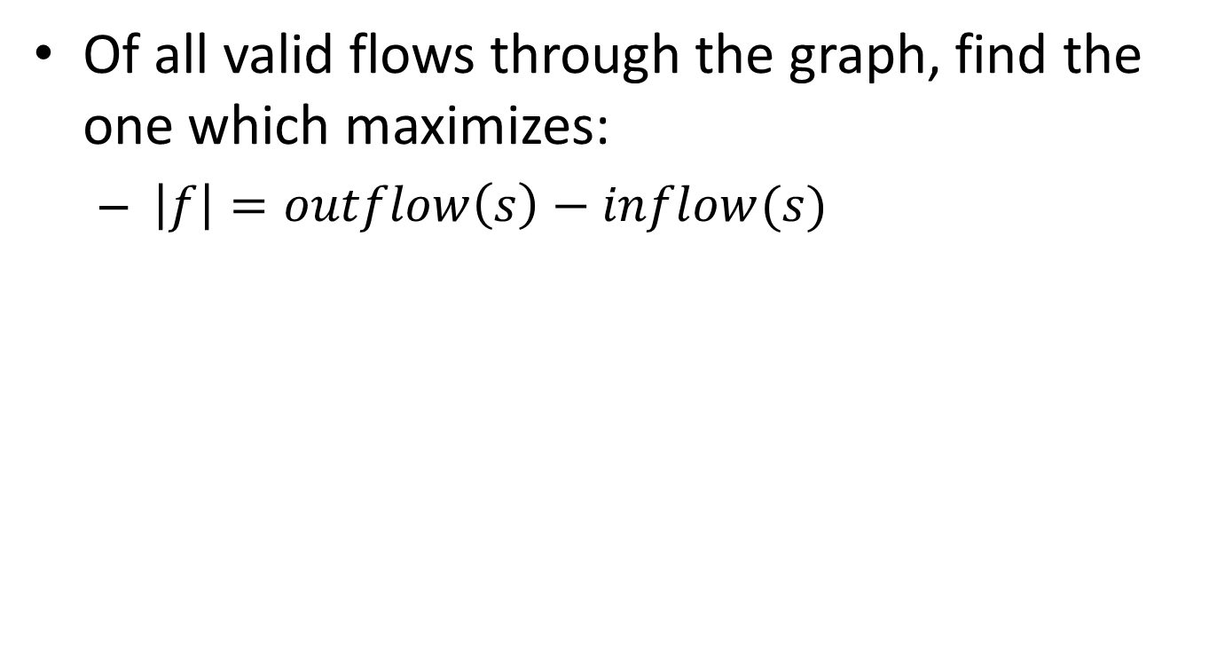
Max Flow
Of all valid flows through the graph, find the one which maximizes:
$\left|f\right|=outflow\left(s\right)−inflow(s)$

Slide 6








Residual Graph $G_{f}$
Keep track of net available flow along each edge
Forward edges: weight is equal to available flow along that edge in the flow graph
$w\left(e\right)=c\left(e\right)−f(e)$
Back edges: weight is equal to flow along that edge in the flow graph
$w\left(e\right)=f(e)$
Flow I could add
Flow I could remove
Residual Graph $G_{f}$
Flow Graph $G$
1
2
1/3
a
2/2
a
0
2
2/3
2
$$s$$
1/3
1/1
$$s$$
1
1
1/2
$$t$$
1
2/2
2/3
2
0
3
$$t$$
0
2
3
1
1
0/1
b
1/2
b
1
2/3
2

Slide 7






Ford Fulkerson: example
Residual Graph $G_{f}$
Flow Graph $G$
0/3
0/2
0
0
0/3
2
$$s$$
3
0
0/3
0/1
0/2
0/2
$$t$$
$$s$$
0
3
0/3
0
3
1
2
$$t$$
2
3
0/1
0/2
2
0/3
1
0
3
0
Add flow of 1 to this path

Slide 8
Ford Fulkerson: example
Residual Graph $G_{f}$
Flow Graph $G$
1/3
1/2
1
1
0/3
1
$$s$$
2
0
0/3
1/1
0/2
0/2
$$t$$
$$s$$
1
3
0/3
0
3
0
2
$$t$$
2
3
0/1
1/2
1
1/3
1
1
2
1
Add flow of 1 to this path

Slide 9
Ford Fulkerson: example
Residual Graph $G_{f}$
Flow Graph $G$
1/3
1/2
1
1
1/3
1
$$s$$
2
1
0/3
0/1
1/2
0/2
$$t$$
$$s$$
0
2
0/3
0
3
1
2
$$t$$
1
3
0/1
1/2
1
1/3
2
1
2
1
Add flow of 1 to this path

Slide 10
Ford Fulkerson: example
Residual Graph $G_{f}$
Flow Graph $G$
2/3
2/2
2
2
2/3
0
$$s$$
1
2
0/3
0/1
1/2
0/2
$$t$$
$$s$$
0
1
0/3
0
3
1
2
$$t$$
1
3
0/1
1/2
1
1/3
2
1
2
1

Slide 11
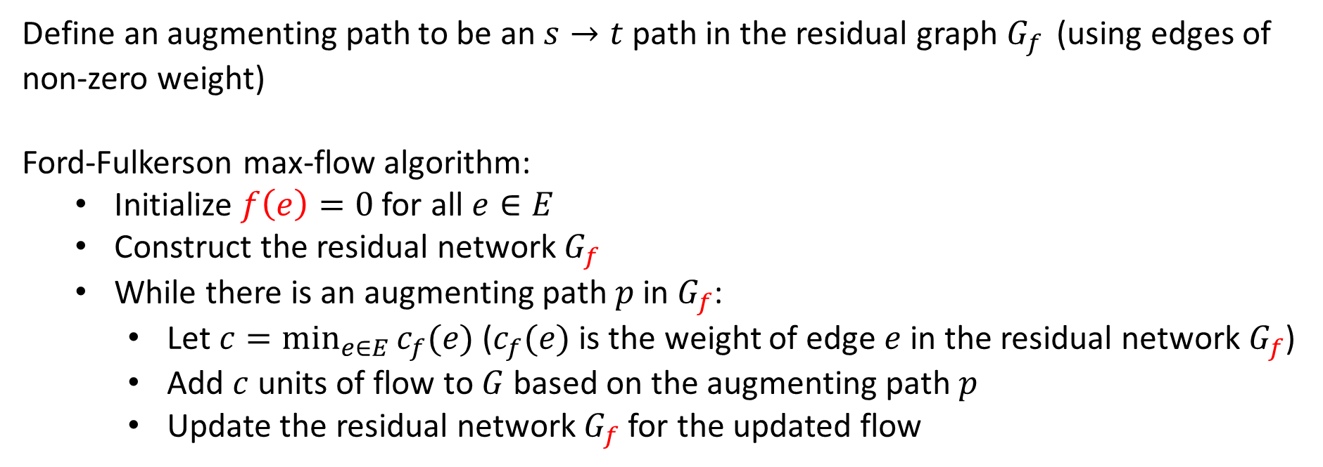
Ford-Fulkerson Running Time
Define an augmenting path to be an $s→t$ path in the residual graph $G_{f }$ (using edges of non-zero weight)
Ford-Fulkerson max-flow algorithm:
Initialize $f\left(e\right)=0$ for all $e∈E$
Construct the residual network $G_{f}$
While there is an augmenting path $p$ in $G_{f}$:
Let $c=\min_{e∈E}{c_{f}(e)}$ ($c_{f}(e)$ is the weight of edge $e$ in the residual network $G_{f}$)
Add $c$ units of flow to $G$ based on the augmenting path $p$
Update the residual network $G_{f}$ for the updated flow
Initialization: $O\left(\left|E\right|\right)$

Slide 12
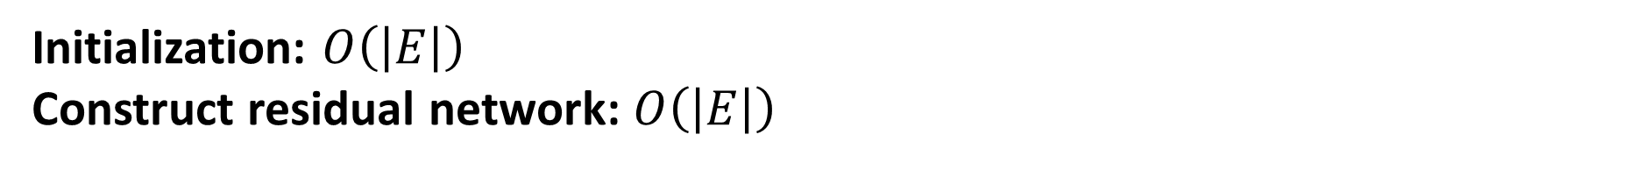
Ford-Fulkerson Running Time
Define an augmenting path to be an $s→t$ path in the residual graph $G_{f }$ (using edges of non-zero weight)
Ford-Fulkerson max-flow algorithm:
Initialize $f\left(e\right)=0$ for all $e∈E$
Construct the residual network $G_{f}$
While there is an augmenting path $p$ in $G_{f}$:
Let $c=\min_{e∈E}{c_{f}(e)}$ ($c_{f}(e)$ is the weight of edge $e$ in the residual network $G_{f}$)
Add $c$ units of flow to $G$ based on the augmenting path $p$
Update the residual network $G_{f}$ for the updated flow
Initialization: $O\left(\left|E\right|\right)$
Construct residual network: $O\left(\left|E\right|\right)$

Slide 13
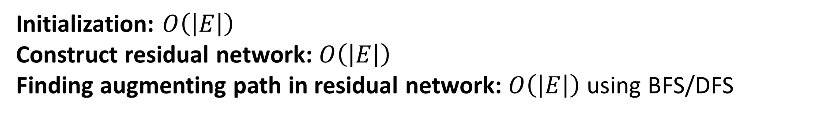
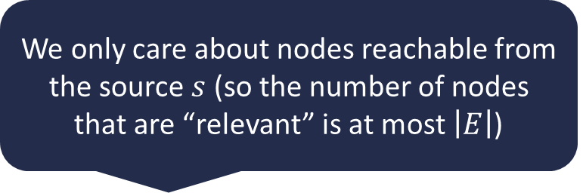
Ford-Fulkerson Running Time
Define an augmenting path to be an $s→t$ path in the residual graph $G_{f }$ (using edges of non-zero weight)
Ford-Fulkerson max-flow algorithm:
Initialize $f\left(e\right)=0$ for all $e∈E$
Construct the residual network $G_{f}$
While there is an augmenting path $p$ in $G_{f}$:
Let $c=\min_{e∈E}{c_{f}(e)}$ ($c_{f}(e)$ is the weight of edge $e$ in the residual network $G_{f}$)
Add $c$ units of flow to $G$ based on the augmenting path $p$
Update the residual network $G_{f}$ for the updated flow
We only care about nodes reachable from the source $s$ (so the number of nodes that are “relevant” is at most $\left|E\right|$)
Initialization: $O\left(\left|E\right|\right)$
Construct residual network: $O\left(\left|E\right|\right)$
Finding augmenting path in residual network: $O\left(\left|E\right|\right)$ using BFS/DFS

Slide 14
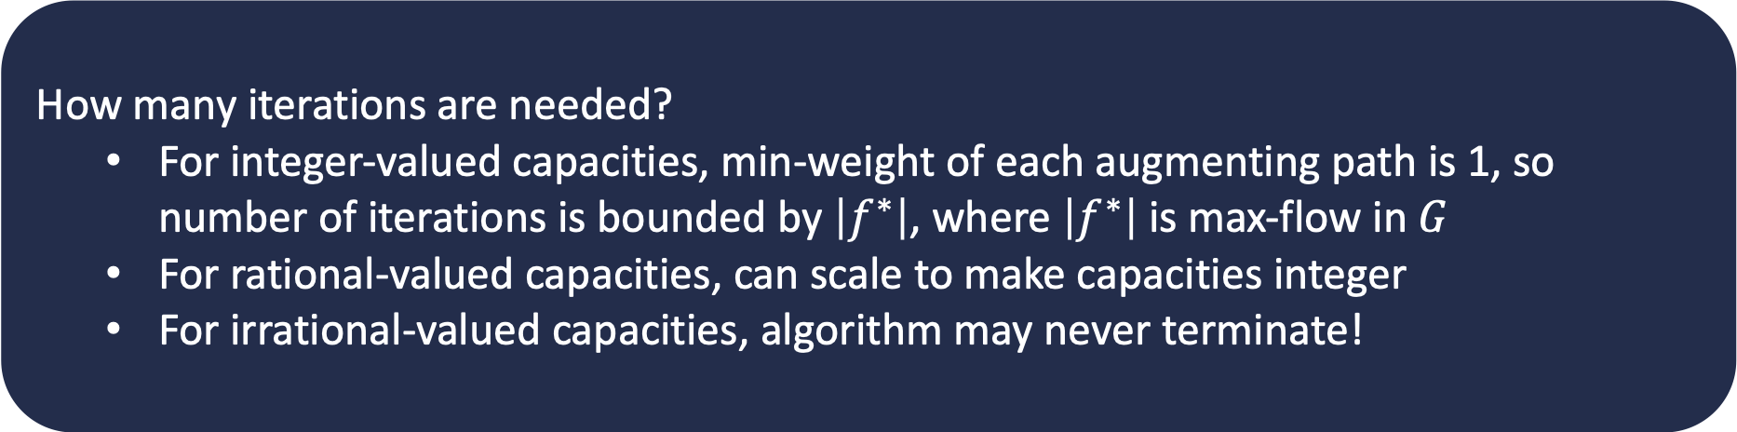
Ford-Fulkerson Running Time
Define an augmenting path to be an $s→t$ path in the residual graph $G_{f }$ (using edges of non-zero weight)
Ford-Fulkerson max-flow algorithm:
Initialize $f\left(e\right)=0$ for all $e∈E$
Construct the residual network $G_{f}$
While there is an augmenting path $p$ in $G_{f}$:
Let $c=\min_{e∈E}{c_{f}(e)}$ ($c_{f}(e)$ is the weight of edge $e$ in the residual network $G_{f}$)
Add $c$ units of flow to $G$ based on the augmenting path $p$
Update the residual network $G_{f}$ for the updated flow
How many iterations are needed?
For integer-valued capacities, min-weight of each augmenting path is 1, so number of iterations is bounded by $\left|f^{∗}\right|$, where $\left|f^{∗}\right|$ is max-flow in $G$
For rational-valued capacities, can scale to make capacities integer
For irrational-valued capacities, algorithm may never terminate!
Initialization: $O\left(\left|E\right|\right)$
Construct residual network: $O\left(\left|E\right|\right)$
Finding augmenting path in residual network: $O\left(\left|E\right|\right)$ using BFS/DFS

Slide 15

Ford-Fulkerson Running Time
Define an augmenting path to be an $s→t$ path in the residual graph $G_{f }$ (using edges of non-zero weight)
Ford-Fulkerson max-flow algorithm:
Initialize $f\left(e\right)=0$ for all $e∈E$
Construct the residual network $G_{f}$
While there is an augmenting path $p$ in $G_{f}$:
Let $c=\min_{e∈E}{c_{f}(e)}$ ($c_{f}(e)$ is the weight of edge $e$ in the residual network $G_{f}$)
Add $c$ units of flow to $G$ based on the augmenting path $p$
Update the residual network $G_{f}$ for the updated flow
For graphs with integer capacities, running time of Ford-Fulkerson is
$$O\left(\left|f^{∗}\right|⋅\left|E\right|\right)$$
Highly undesirable if $\left|f^{∗}\right|≫|E|$ (e.g., graph is small, but capacities are $≈2^{32}$)
As described, algorithm is not polynomial-time!
Initialization: $O\left(\left|E\right|\right)$
Construct residual network: $O\left(\left|E\right|\right)$
Finding augmenting path in residual network: $O\left(\left|E\right|\right)$ using BFS/DFS

Slide 16




Worst-Case Ford-Fulkerson
0/100
0/100
100
100
$$s$$
0/1
$$t$$
$$s$$
1
$$t$$
0/100
0/100
100
100

Slide 17
Worst-Case Ford-Fulkerson
Increase flow by 1 unit
0/100
0/100
100
100
$$s$$
0/1
$$t$$
$$s$$
1
$$t$$
0/100
0/100
100
100

Slide 18
Worst-Case Ford-Fulkerson
Increase flow by 1 unit
1/100
0/100
100
100
$$s$$
1/1
$$t$$
$$s$$
1
$$t$$
0/100
1/100
100
100

Slide 19
Worst-Case Ford-Fulkerson
1/100
0/100
99
100
1
$$s$$
1/1
$$t$$
$$s$$
1
$$t$$
1
0/100
1/100
100
99

Slide 20
Worst-Case Ford-Fulkerson
Increase flow by 1 unit
1/100
0/100
99
100
1
$$s$$
1/1
$$t$$
$$s$$
1
$$t$$
1
0/100
1/100
100
99

Slide 21
Worst-Case Ford-Fulkerson
Increase flow by 1 unit
1/100
1/100
99
100
1
$$s$$
0/1
$$t$$
$$s$$
1
$$t$$
1
1/100
1/100
100
99

Slide 22
Worst-Case Ford-Fulkerson
1/100
1/100
99
99
1
1
$$s$$
0/1
$$t$$
$$s$$
1
$$t$$
1
1
1/100
1/100
99
99

Slide 23
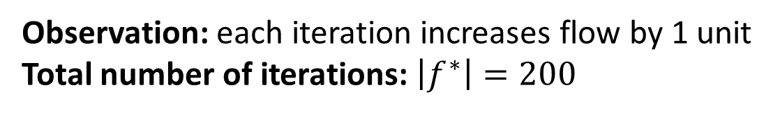
Worst-Case Ford-Fulkerson
1/100
1/100
99
99
1
1
$$s$$
0/1
$$t$$
$$s$$
1
$$t$$
1
1
1/100
1/100
99
99
Observation: each iteration increases flow by 1 unit
Total number of iterations: $\left|f^{∗}\right|=200$

Slide 24
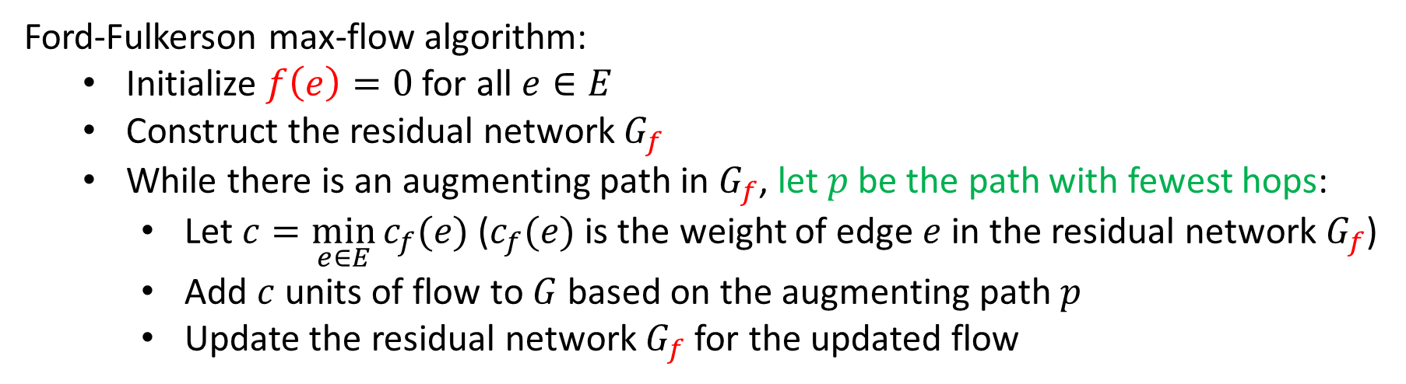

Can We Avoid this?
Edmonds-Karp Algorithm: choose augmenting path with fewest hops
Running time: $Θ\left(\min\left(\left|E\right|\left|f^{∗}\right|, \left|V\right|{\left|E\right|}^{2}\right)\right)=O\left(\left|V\right|{\left|E\right|}^{2}\right)$
How to find this?
Use breadth-first search (BFS)!
Edmonds-Karp = Ford-Fulkerson using BFS to find augmenting path
Ford-Fulkerson max-flow algorithm:
Initialize $f\left(e\right)=0$ for all $e∈E$
Construct the residual network $G_{f}$
While there is an augmenting path in $G_{f}$, let $p$ be the path with fewest hops:
Let $c=\min_{e∈E}{c_{f}(e)}$ ($c_{f}(e)$ is the weight of edge $e$ in the residual network $G_{f}$)
Add $c$ units of flow to $G$ based on the augmenting path $p$
Update the residual network $G_{f}$ for the updated flow
Proof: See CLRS (Chapter 26.2)

Slide 25
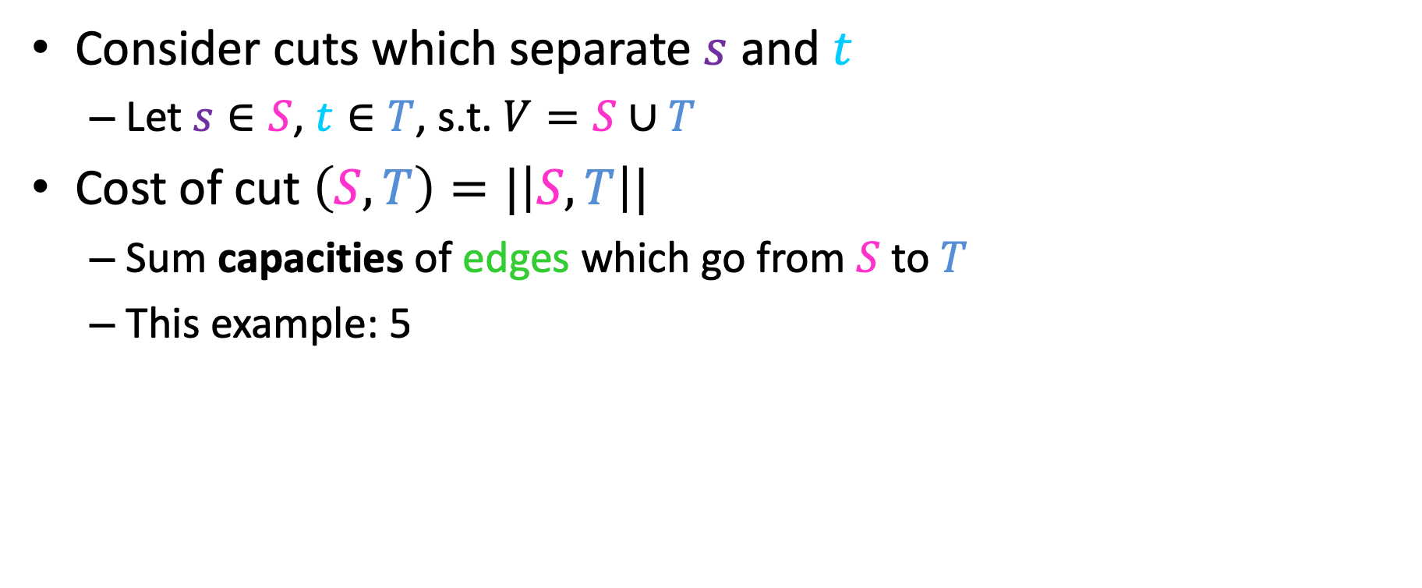



Showing Correctness of Ford-Fulkerson
Consider cuts which separate $s$ and $t$
Let $s∈S$, $t∈T$, s.t. $V=S∪T$
Cost of cut $\left(S,T\right)=|\left|S,T\right||$
Sum capacities of edges which go from $S$ to $T$
This example: 5
$$S$$
2
3
$$T$$
3
$$s$$
3
2
$$t$$
2
1
3
1
2
3

Slide 26
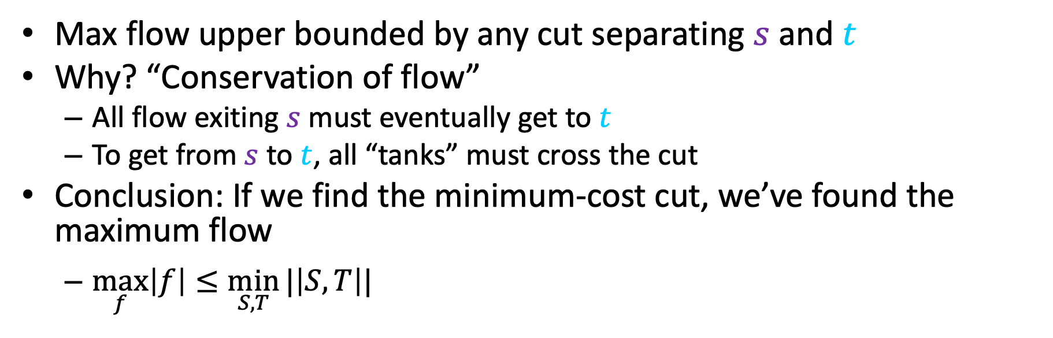

Maxflow$≤$MinCut
Max flow upper bounded by any cut separating $s$ and $t$
Why? “Conservation of flow”
All flow exiting $s$ must eventually get to $t$
To get from $s$ to $t$, all “tanks” must cross the cut
Conclusion: If we find the minimum-cost cut, we’ve found the maximum flow
$\max_{f}\left|f\right|≤\min_{S,T}{|\left|S,T\right||}$
$$S$$
2
3
$$T$$
3
$$s$$
3
2
$$t$$
2
1
3
1
2
3

Slide 27
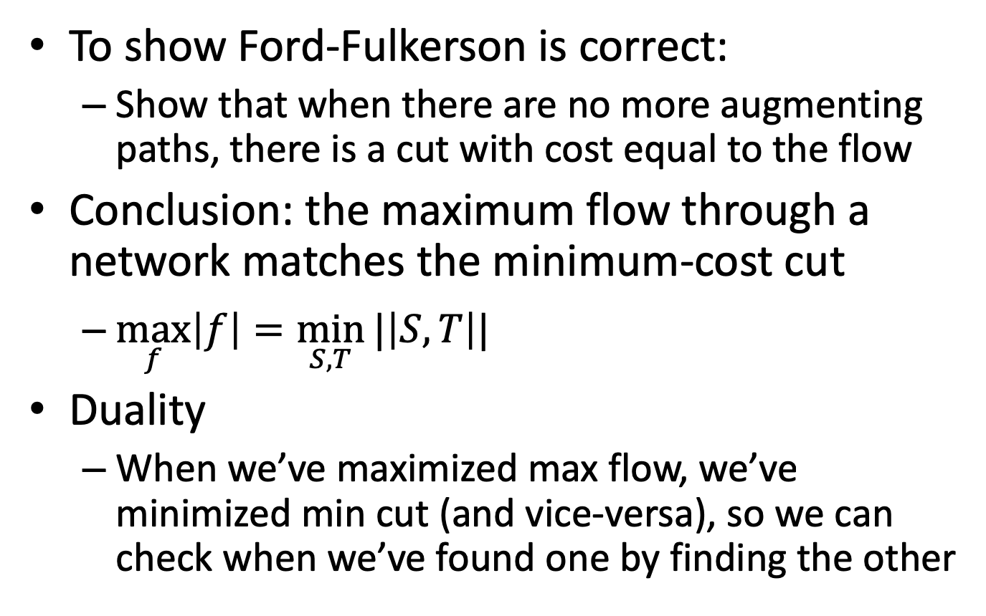
Maxflow/Mincut Theorem
To show Ford-Fulkerson is correct:
Show that when there are no more augmenting paths, there is a cut with cost equal to the flow
Conclusion: the maximum flow through a network matches the minimum-cost cut
$\max_{f}\left|f\right|=\min_{S,T}{|\left|S,T\right||}$
Duality
When we’ve maximized max flow, we’ve minimized min cut (and vice-versa), so we can check when we’ve found one by finding the other

Slide 28






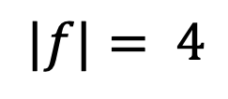
Example: Maxflow/Mincut
Flow Graph $G$
Residual Graph $G_{f}$
2
2
2/3
2/2
0
2
2/3
1
$$s$$
0/3
1/1
$$s$$
1
1
1/2
$$t$$
0
2/2
2/3
3
0
3
$$t$$
0
2
3
0
2
0/1
2/2
0
3/3
$$|f|= 4$$
3
No Augmenting Paths
$$\left|\left|S,T\right|\right|=4$$
Idea: When there are no more augmenting paths, there exists a cut in the graph with cost matching the flow
28

Slide 29

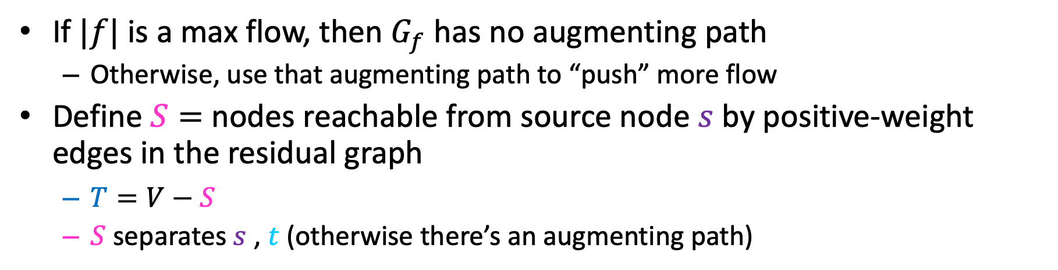
Proof: Maxflow/Mincut Theorem
If $|f|$ is a max flow, then $G_{f}$ has no augmenting path
Otherwise, use that augmenting path to “push” more flow
Define $S=$ nodes reachable from source node $s$ by positive-weight edges in the residual graph
$T=V−S$
$S$ separates $s$ , $t$ (otherwise there’s an augmenting path)
Residual Graph $G_{f}$
Flow Graph $G$
2
2
2/2
0
2
2/3
1
2/3
$$s$$
1
1
$$s$$
0/3
1/1
0
3
0
3
$$t$$
2/2
1/2
$$t$$
0
2
2/3
0
3
2
0/1
2/2
0
3/3
3

Slide 30
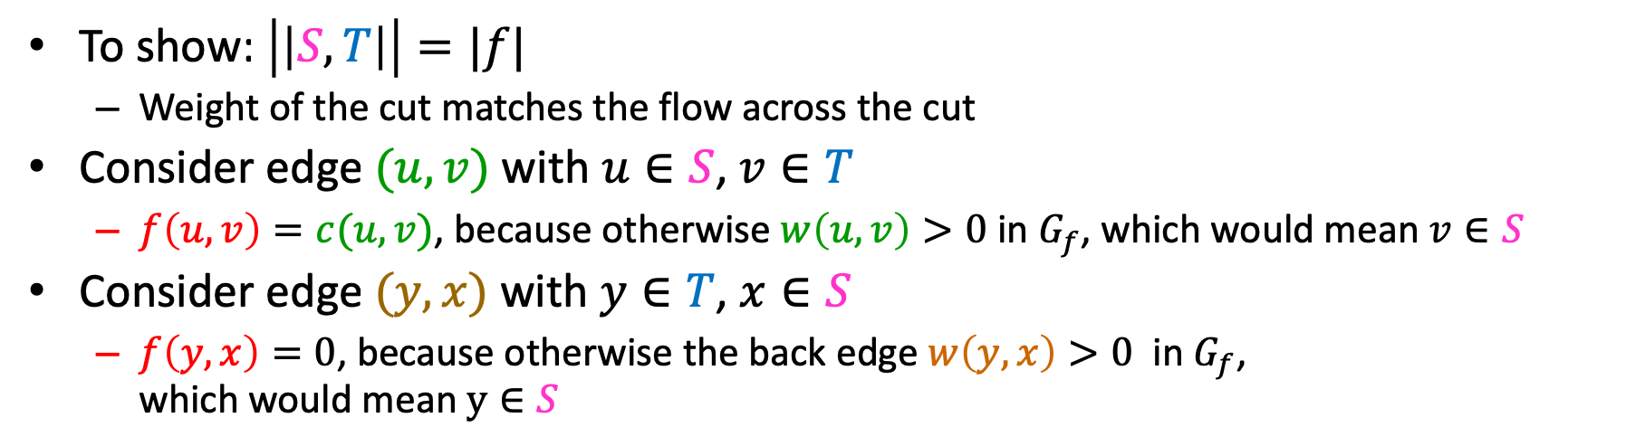
Proof: Maxflow/Mincut Theorem
To show: $\left|\left|S,T\right|\right|=|f|$
Weight of the cut matches the flow across the cut
Consider edge $(u,v)$ with $u∈S$, $v∈T$
$f\left(u,v\right)=c(u,v)$, because otherwise $w\left(u,v\right)>0$ in $G_{f}$, which would mean $v∈S$
Consider edge $(y,x)$ with $y∈T$, $x∈S$
$f\left(y,x\right)=0$, because otherwise the back edge $w\left(y,x\right)>0$ in $G_{f}$, which would mean $y∈S$
Residual Graph $G_{f}$
Flow Graph $G$
2
2
2/2
0
2
2/3
1
2/3
$$s$$
1
1
$$s$$
0/3
1/1
0
3
0
3
$$t$$
2/2
1/2
$$t$$
0
2
2/3
3
0
2
0/1
2/2
0
3/3
3

Slide 31
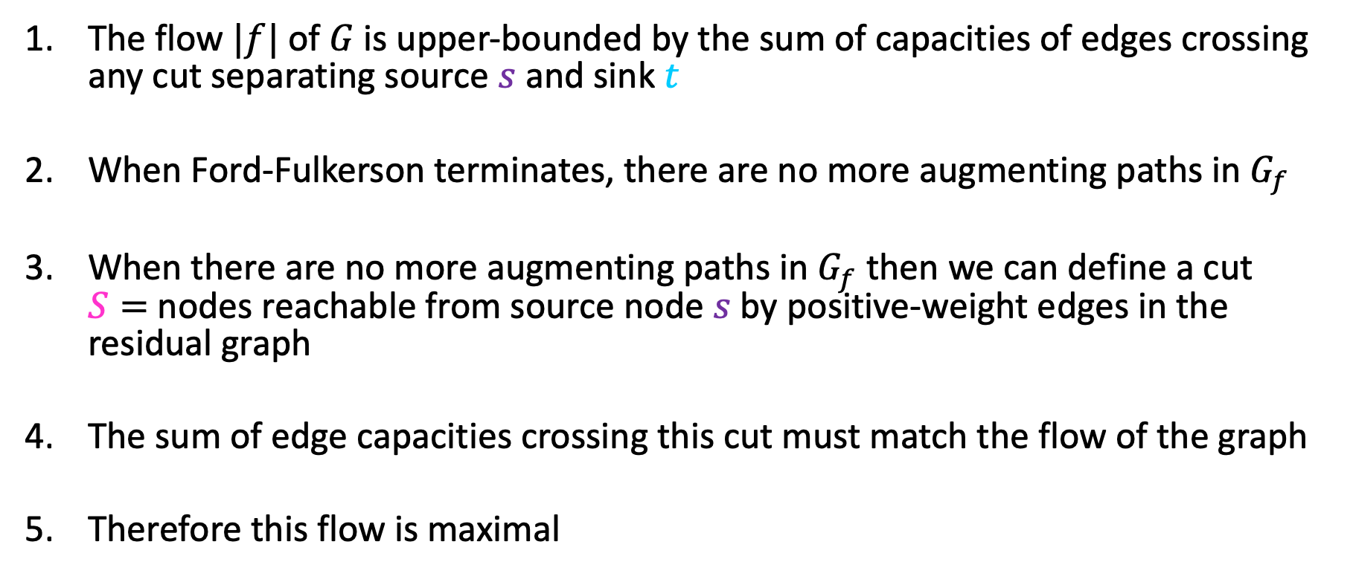
Proof Summary
The flow $|f|$ of $G$ is upper-bounded by the sum of capacities of edges crossing any cut separating source $s$ and sink $t$
When Ford-Fulkerson terminates, there are no more augmenting paths in $G_{f}$
When there are no more augmenting paths in $G_{f}$ then we can define a cut $S=$ nodes reachable from source node $s$ by positive-weight edges in the residual graph
The sum of edge capacities crossing this cut must match the flow of the graph
Therefore this flow is maximal

Slide 32
Divide and Conquer*
Divide:
Break the problem into multiple subproblems, each smaller instances of the original
Conquer:
If the suproblems are “large”:
Solve each subproblem recursively
If the subproblems are “small”:
Solve them directly (base case)
Combine:
Merge together solutions to subproblems
*CLRS Chapter 4

Slide 33
Dynamic Programming
Requires Optimal Substructure
Solution to larger problem contains the solutions to smaller ones
Idea:
Identify recursive structure of the problem
Select a good order for solving subproblems
Usually smallest problem first

Slide 34
Greedy Algorithms
Require Optimal Substructure
Solution to larger problem contains the solution to a smaller one
Only one subproblem to consider!
Idea:
Identify a greedy choice property
How to make a choice guaranteed to be included in some optimal solution
Repeatedly apply the choice property until no subproblems remain

Slide 35
So far
Divide and Conquer, Dynamic Programming, Greedy
Take an instance of Problem A, relate it to smaller instances of Problem A
Next:
Take an instance of Problem A, relate it to an instance of Problem B

Slide 36
Roadmap: Where We’re Going and Why
Reductions between problems
Why? Can be a practical way of solving a new problem
Also: A proof about one problem’s complexity can be applied to another
Formal definition of a reduction
Examples
Bipartite graphs, matching
Vertex cover and independent set

Slide 37
Using One Solution to Solve Something Else
Sometimes we can solve a “new” problem using a solution to another problem
We need to “re-cast” the “new” problem as an instance of the other problem
We may need to relate how the answer found for the other problem gives the answer for the “new” problem
Some examples coming in this lecture:
We’ll see how to solve edge-disjoint path problem. Use that to solve vertex-disjoint path problem.
We know how to find max network flow. Use that to solve bi-partite matching.

Slide 38

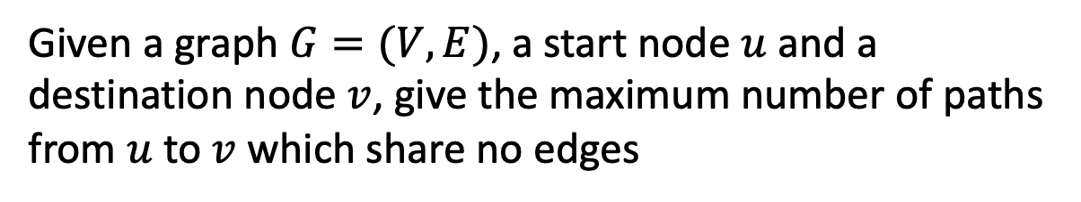

Edge-Disjoint Paths
Given a graph $G=(V,E)$, a start node $u$ and a destination node $v$, give the maximum number of paths from $u$ to $v$ which share no edges
g
Note this is an optimization problem.
$$u$$
h
f
$$v$$
e
b
c
a

Slide 39
Edge-Disjoint Paths
Given a graph $G=(V,E)$, a start node $u$ and a destination node $v$, give the maximum number of paths from $u$ to $v$ which share no edges
Set of edge-disjoint paths of size 3
(the red, blue, magenta paths)
$$u$$
g
Is this the max number?
h
f
$$v$$
e
b
c
a

Slide 40


Edge-Disjoint Paths
Given a graph $G=(V,E)$, a start node $u$ and a destination node $v$, give the maximum number of paths from $u$ to $v$ which share no edges
g
Set of edge-disjoint paths of size 4
$$u$$
Is this the max number?
h
f
$$v$$
e
b
c
a

Slide 41

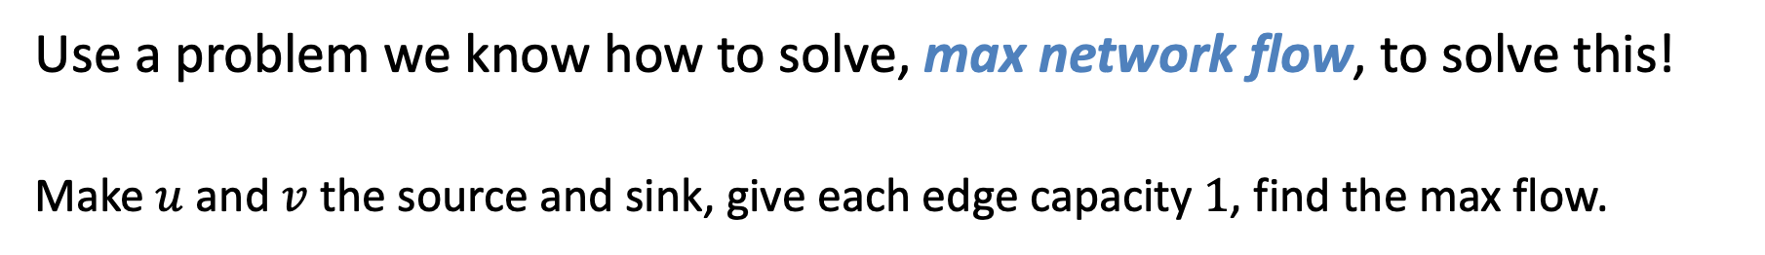

Edge-Disjoint Paths Algorithm
Use a problem we know how to solve, max network flow, to solve this!
Make $u$ and $v$ the source and sink, give each edge capacity $1$, find the max flow.
1/1
$$s$$
g
Set of edge-disjoint paths of size 4
1/1
0/1
1/1
Max flow = 4
h
1/1
1/1
1/1
f
1/1
0/1
Why does this work? We need to be able to make a valid argument that it always does.
1/1
$$t$$
e
b
0/1
1/1
1/1
c
0/1
a
0/1

Slide 42
What’s the situation?
Given an input I₁ for the max network flow problem (graph G with edge capacities), we can find the max flow for that input
Given an input I₂ for edge-disjoint path problem, we can:
Convert that input I₂ to make a valid input I₁ for network flow problem, by using same graph G but adding capacity=1 for each edge
Solve max network flow problem for I₁ and get result R₁
Use R₁ to give the solution R₂ for edge-disjoint path for input I₂
In this case, |f| = the number of paths
Next, let’s solve another problem using our new edge-disjoint path solution

Slide 43
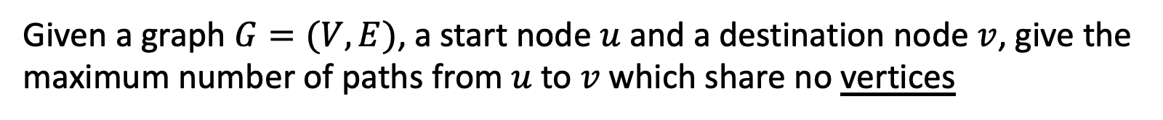
Vertex-Disjoint Paths
Given a graph $G=(V,E)$, a start node $u$ and a destination node $v$, give the maximum number of paths from $u$ to $v$ which share no vertices
$$u$$
g
h
f
$$v$$
e
b
c
a

Slide 44
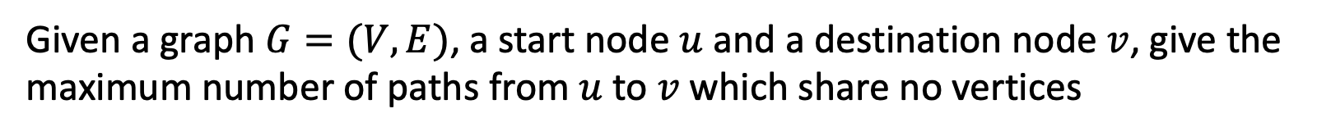
Vertex-Disjoint Paths
Given a graph $G=(V,E)$, a start node $u$ and a destination node $v$, give the maximum number of paths from $u$ to $v$ which share no vertices
This shows 3 edge-disjoint paths. Note these aren’t vertex-disjoint paths!
$$u$$
g
h
f
$$v$$
e
b
c
a

Slide 45


Vertex-Disjoint Paths Algorithm
Idea: Convert an instance of the vertex-disjoint paths problem into an instance of edge-disjoint paths
Make two copies of each node, one connected to incoming edges, the other to outgoing edges
Compute Edge-Disjoint Paths on new graph
$$u$$
g
Restricts to 1 edge
g in
g out
h
f
Why does this work? We need to be able to make a valid argument that it always does.
$$v$$
e
b
c
a

Slide 46
What’s the situation now?
Given an input I₁ for the max network flow problem (graph G with edge capacities), we can find max flow for that input
Given an input I₂ for edge-disjoint path problem, we can:
Convert that input I₂ to make a valid input I₁ for network flow problem, and solve that to find number of edge-disjoint paths
Given an input I₃ for vertex-disjoint path problem, we can:
Convert that input I₃ to make a valid input I₂ for edge-disjoint path problem
See above! Convert I₂ to I₁ and solve max network flow problem
This chain of “problem conversions” finds lets us solve vertex-disjoint path problem
Time complexity? Cost of solving max network flow plus two conversions

Slide 47
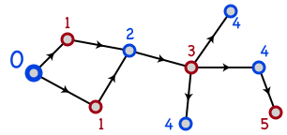
Bipartite Graphs
A graph is bipartite if node-set V can be split into sets X and Y such that every edge has one end in X and one end in Y
X and Y could be colored red and blue
Or Boolean true/false
How to determine if G is bipartite?
The numbers and arrows on edges may give you a clue….
BFS or DFS, and label nodes by levels in tree. Non-tree edge to node with same label means NOT bipartite.

Slide 48
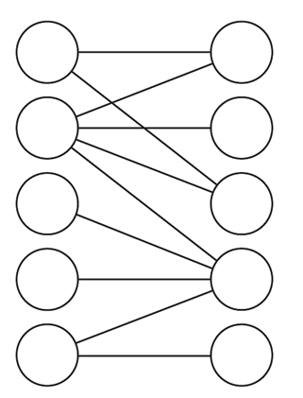
Notes and assumptions
We assume the graph is connected
Otherwise we will only look at each connected component individually
A triangle cannot be bipartite
In fact, any graph with an odd length cycle cannot be bipartite

Slide 49
Bipartite Determination Algorithm
Pick a starting vertex, color it red
Color all adjacent nodes blue
And all nodes adjacent to that red
Etc.
If you ever need to color an already red-node to be blue (or vice versa), then the graph is not bipartite
Does this algorithm sound familiar?

Slide 50

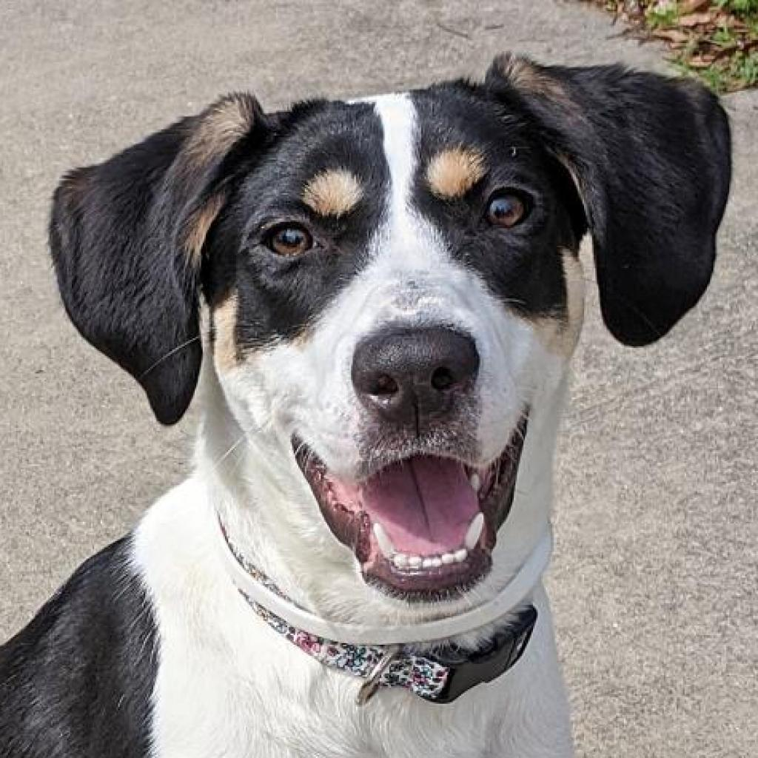





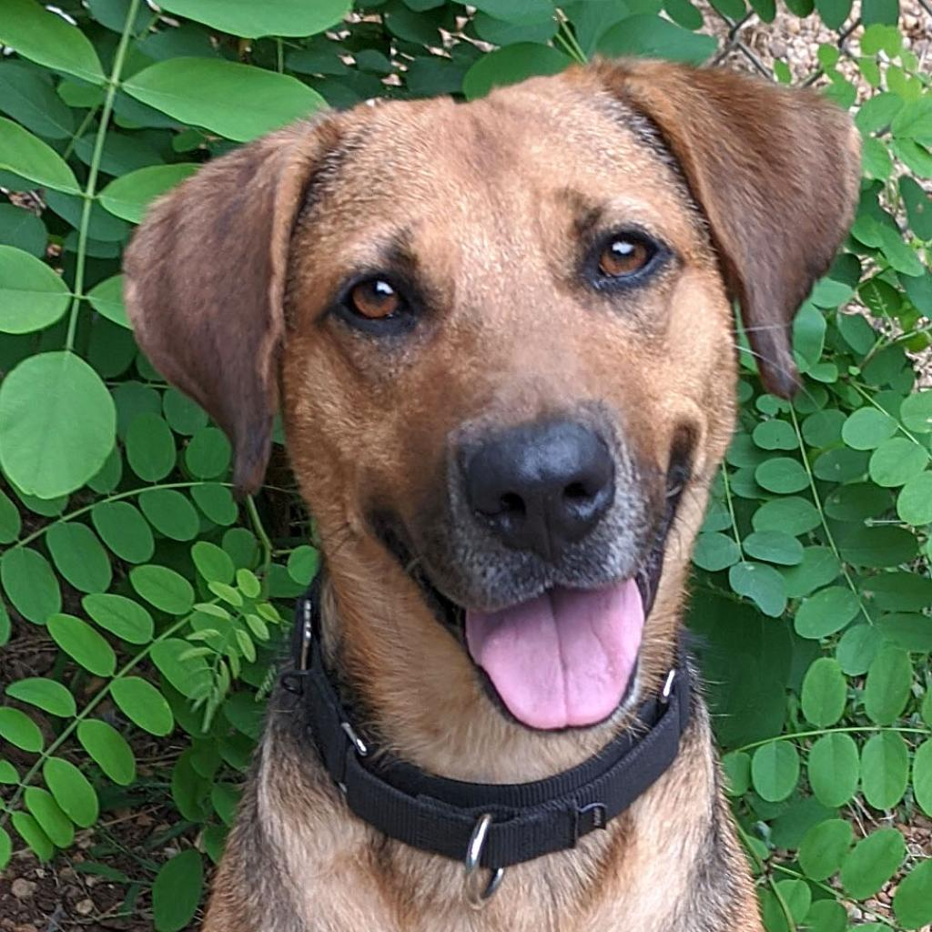
Maximum Bipartite Matching
Dog Lovers
Adoptable Dogs

Slide 51
Maximum Bipartite Matching
Dog Lovers
Dogs
Is this the best possible? The largest possible set of edges?

Slide 52
Maximum Bipartite Matching
Dog Lovers
Dogs
Better! In fact, the maximum possible! How can we tell?
A perfect bipartite match:
Equal-sized left and right subsets, and all nodes have a matching edge

Slide 53
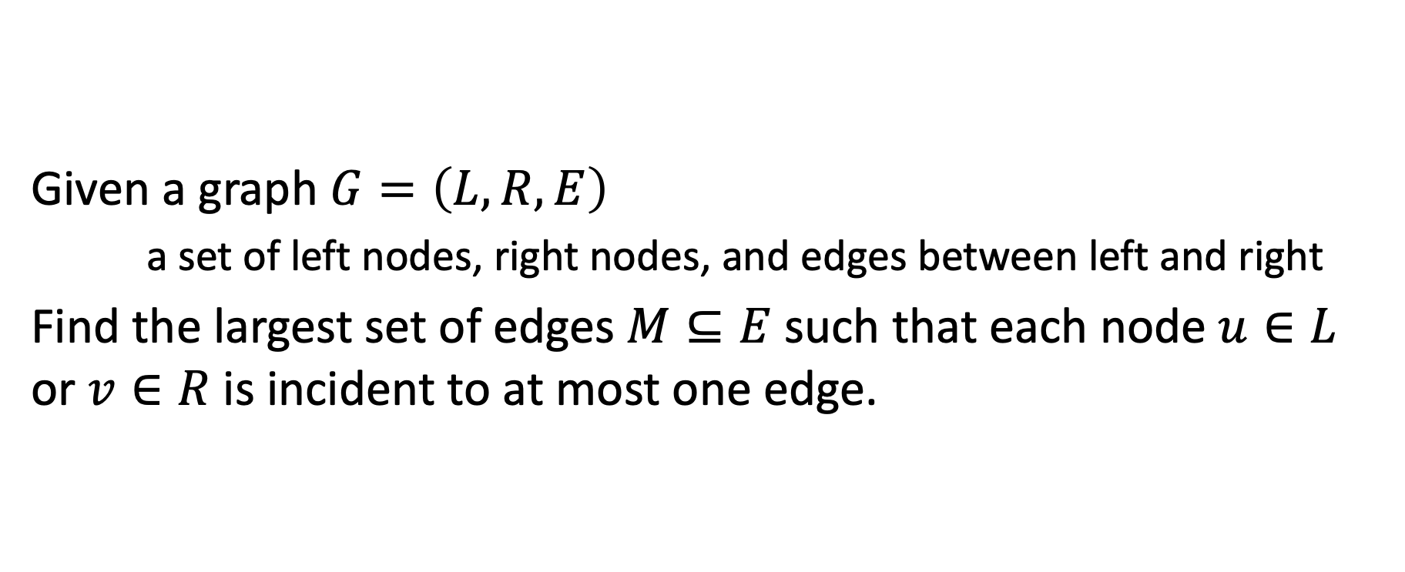
Maximum Bipartite Matching
Given a graph $G=\left(L,R,E\right)$
a set of left nodes, right nodes, and edges between left and right
Find the largest set of edges $M⊆E$ such that each node $u∈L$ or $v∈R$ is incident to at most one edge.

Slide 54
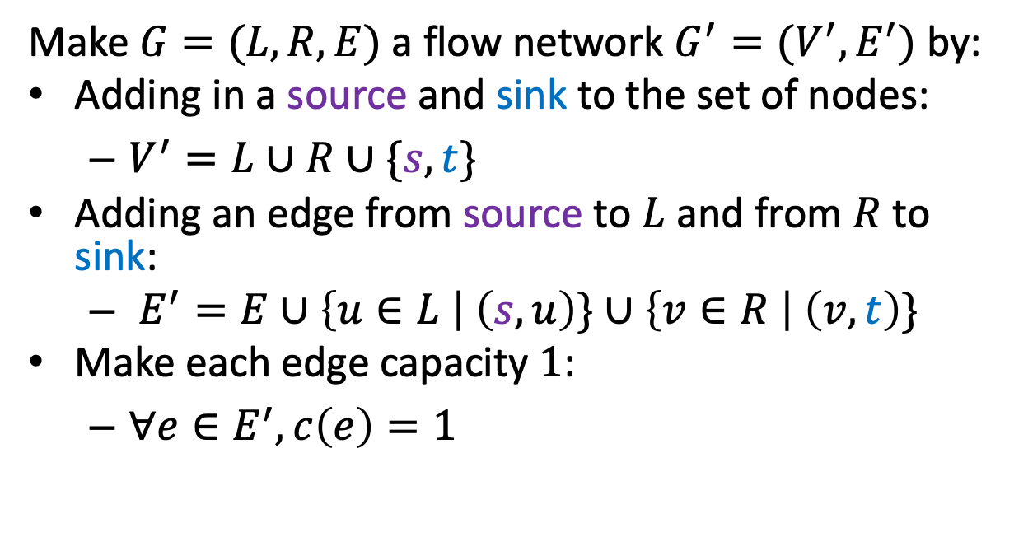


Maximum Bipartite Matching Using Max Flow
Make $G=(L,R,E)$ a flow network $G^{′}=(V^{′},E^{′})$ by:
Adding in a source and sink to the set of nodes:
$V^{′}=L∪R∪\{s,t\}$
Adding an edge from source to $L$ and from $R$ to sink:
$E^{′}=E∪\left\{u∈L \right| \left(s,u\right)\}∪\left\{v∈R \right| \left(v,t\right)\}$
Make each edge capacity $1$:
$∀e∈E^{′}, c\left(e\right)=1$
1
1
1
1
1
1
$$s$$
1
1
1
1
$$t$$
1
1
1
1
1
1
1

Slide 55


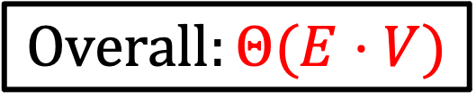





Maximum Bipartite Matching Using Max Flow
Make $G$ into $G′$
Compute Max Flow on $G′$
Return $M$ as all “middle” edges with flow 1
$$Θ(L+R)$$
$$Θ(E⋅V)$$
$$\left|f\right|≤L$$
$$Θ(L+R)$$
0/1
$$Overall:Θ(E⋅V)$$
1/1
0/1
1/1
1/1
1/1
$$s$$
1/1
0/1
1/1
0/1
$$t$$
1/1
1/1
1/1
1/1
1/1
1/1
0/1

Slide 56
Why does this work?
Each node on the left can be in at most one matching
This is enforced by the edge of capacity one leading into it
Likewise for each node on the right
The bottleneck will be how it flows across the bipartite “barrier”

Slide 57
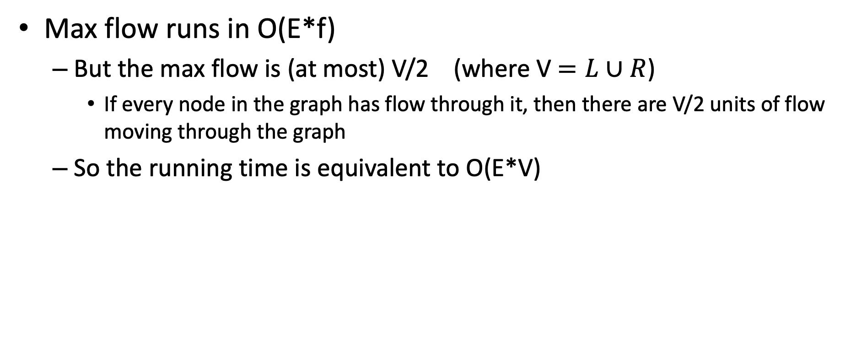
Running time
Max flow runs in O(E*f)
But the max flow is (at most) V/2 (where V $=L∪R$)
If every node in the graph has flow through it, then there are V/2 units of flow moving through the graph
So the running time is equivalent to O(E*V)

