Slide 1
Using DFS for Topological Sorting and Strongly Connected Components
CS 4102: Algorithms
Spring 2022
Robbie Hott and Tom Horton

Slide 2
Topological Sorting
Readings: CLRS 22.4

Slide 3
Topological Sort
Given a directed acyclic graph, construct a linear ordering of the vertices such that if there is an edge from u to v, then u appears before v in the ordering.
One valid topological sort is:
V1 V6 V8 V3 V2 V7 V4 V5

Slide 4
Topological Sort
What are allowable orderings I can take all these CS classes?
Note there are many possible orderings
Unlike sorting a list

Slide 5
Getting Dressed
Underwear
Socks
Watch
Pants
Shoes
Shirt
Belt
Tie
Jacket

Slide 6
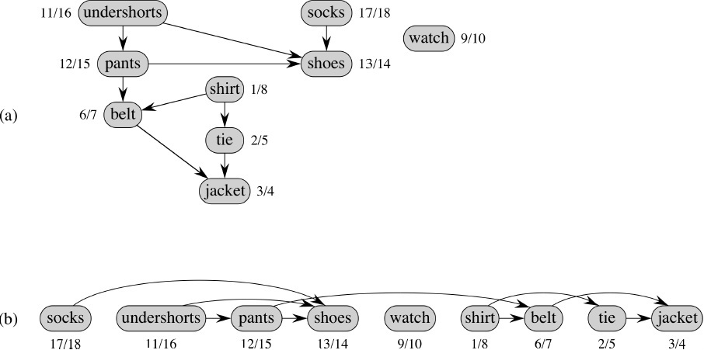
We Can Use DFS and Finish Times
Topologically sorted vertices appear in reverse order of their finish times!
This is the same graph with a different layout.

Slide 7
Topological Sort Algorithm
Strategy: modify the two DFS functions so that they order nodes by finish-time in reverse order. This slide: modified version of DFS “Sweep”.
DFS_sweep(G)
0 toposort-list = [ ] // empty list
1 for each vertex u in G.V
2 u.color = WHITE
3 u.π = NIL
4 time = 0
5 for each vertex u in G.V
6 if u.color == WHITE // if unseen
DFS-VISIT(G, u) // explore paths out of u
8 // toposort-list contains the result

Slide 8
Topological Sort Algorithm
DFS-VISIT(G, u) // modified to do topological sort
1 time = time + 1 // white vertex u has just been discovered
2 u.d = time // discovery time of u
3 u.color = GRAY // mark as seen
4 for each v in G.Adj[u] // explore edge (u, v)
5 if v.color == WHITE // if unseen
6 v.π = u
7 DFS-VISIT(G, v) // explore paths out of v (i.e., go “deeper”)
8 u.color = BLACK // u is finished
9 time = time + 1
10 u.f = time // finish time of u
11 toposort-list.prepend(u)

Slide 9
Forward vs. Reverse
Topological sort is a type of sort
Implies an ordering
Can sort backwards, of course
Forward topological order
If edge vw in graph, then topo[v] < topo[w]
Reverse topological order
If edge vw in graph, then topo[v] > topo[w]
And, every directed graph has a transpose, which means… (see next slide)

Slide 10
What’s an Edge Mean?
What does our graph model?
Edge uv means do u first, then v. Or, …
Edge uv means task u depends on v (i.e. v must be done first)
The latter is called a dependency graph
“forward in time” vs. “depend on this one”
Big deal? No, we can order vertices in reverse topological order if needed
Underwear
Underwear
Shoes
Shoes
Pants
Pants

Slide 11
Strongly Connected Components in a Digraph
Readings: CLRS 22.5, but you can ignore the proof-y parts

Slide 12
Strongly Connected Components (SCCs)
In a digraph, Strongly Connected Components (SCCs) are subgraphs where all vertices in each SCC are reachable from one another
Thus vertices in an SCC are on a directed cycle
Any vertex not on a directed cycle is an SCC all by itself
Common need: decompose a digraph into its SCCs
Perhaps then operate on each, combine results based on connections between SCCs

Slide 13
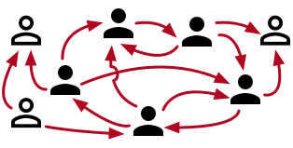
Real-world Example: Social Networks
Model a social network of users
Directed edge u->v means u follows v
We want to identify a group of users who follow each other
Maybe not directly
OK if it’s indirect, i.e. if there’s a path connecting any pair in the group
In this example, the group of solid-colored users is an SCC
Note: if all pairs had to follow each other, we call this a clique

Slide 14
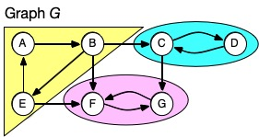
SCC Example
Example: digraph below has 3 SCCs
Note here each SCC has a cycle. (Possible to have a single-node SCC.)
Note connections to other SCCs, but no path leaves a SCC and comes back
Note there’s a unique set of SCCs for a given digraph

Slide 15
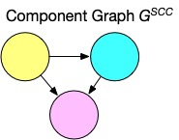
Component Graph
Sometimes for a problem it’s useful to consider digraph G’s component graph, G^{SCC}
It’s like we ”collapse” each SCC into one node
Might need a topological ordering between SCCs

Slide 16
How to Decompose Digraph into SCCs
Several algorithms do this using DFS
We’ll use CLRS’s choice (by Kosaraju and Sharir)
Algorithm works as follows:
Call DFS-sweep(G) to find finishing times u.f for each vertex u in G.
Compute G^{T}, the transpose of digraph G.
(Reminder: transpose means same nodes, edges reversed.)
Call DFS-sweep(G^{T}) but do the recursive calls on nodes in the order of decreasing u.f from Step 1. (Start with the vertex with largest finish time in G’s DFS tree,…)
The DFS forest produced in Step 3 is the set of SCCs

Slide 17
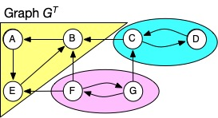
Why Do We Care about the Transpose?
If we call DFS on a node in an SCC, it will visit all nodes in that SCC
But it could leave the SCC and find other nodes ☹
Could we prevent that somehow?
Note that a digraph and its transpose have the same SCCs
Maybe we can use the fact that edge-directions are reversed in G^{T} to stop DFS from leaving an SCC?
But this depends on the order you choose vertices to do DFS-sweep() in G^{T}

Slide 18
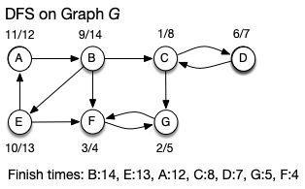
Why Do We Care About Finish Times?
Our algorithm first finds DFS finish times in G
Then calls recursive DFS on transpose G^{T} from vertex with largest finish time (here, B)
Reversed edges in G^{T} stop it visiting nodes in other SCCs

Slide 19
Why Do We Care About Finish Times?
After recursive DFS on transpose G^{T} finds SCC containing B, next DFS will start from C
Nodes in previously found SCC(s) have been visited
Reversed edges in G^{T} stop it visiting nodes in SCCs yet to be found

Slide 20
Ties to Topological Sorting
Formal proof of correctness in CLRS, but hopefully from previous slides you’re convinced it works!
Note how the use of finish times makes this seem like topological sort. And it is, if you think of topological ordering for G^{SCC}
Cycles in G, but no cycles in G^{SCC} so we could sort that
Topological sort controls the order we do things, and DFS finds all the reachable nodes in an SCC

Slide 21
Final Thoughts
There are many interesting problems involving digraphs and DAGs
They can model real-world situations
Dependencies, network flows, …
DFS is often a valuable strategy to tackle such problems
For DAGs, not interested in back-edges, since DAGs are acyclic
Ordering, reachability from DFS can be useful

