Slide 1
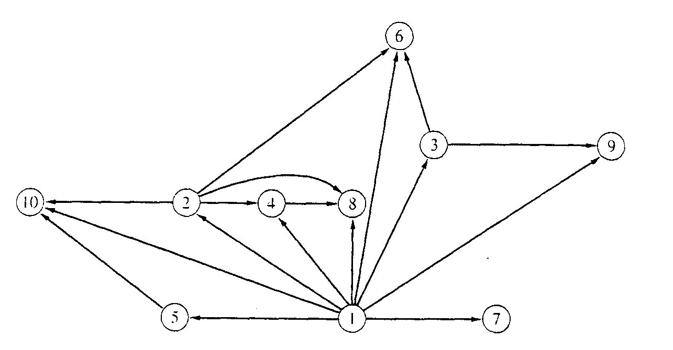
CS4102 Algorithms Spring 2022
Warm up
If the “nodes” here represent whole numbers, when is there a connection from value i to value j ?

Slide 2
Graphs – Basic Review, BFS, and Intro. to DFS
Tom Horton, Robbie Hott
CLRS Chapter 22.1 and 22.2

Slide 3
Definition: Directed graph
Directed Graph
A directed graph, or digraph, is a pair
G = (V, E)
where V is a set whose elements are called vertices, and
E is a set of ordered pairs of elements of V.
Vertices are often also called nodes.
Elements of E are called edges, or directed edges, or arcs.
For directed edge (v, w) in E, v is its tail and w its head;
(v, w) is represented in the diagrams as the arrow, v -> w.
In text we often simply write vw.
vw is said to be incident upon the vertices v and w

Slide 4
Definition: Undirected graph
Undirected Graph
A undirected graph is a pair
G = (V, E)
where V is a set whose elements are called vertices, and
E is a set of unordered pairs of distinct elements of V.
Vertices are often also called nodes.
Elements of E are called edges, or undirected edges.
Each edge may be considered as a subset of V containing two elements,
{v, w} denotes an undirected edge
In diagrams this edge is the line v---w.
In text we simple write vw, or wv
vw is said to be incident upon the vertices v and w

Slide 5
Terms You Should Know
Edge Weights: A graphs can be
Weighted or not weighted
Every edge has a numeric weight value. (Weights can be reals, integers, etc.)
Weight often represent things like cost, length, distance, capacity,…
Often indicated by wt(vw) or W(vw) for edge vw, or wt(e) for edge e (or sometimes e.wt)
Directed or undirected graphs can be weighted or unweighted
Degree of a vertex: how many adjacent vertices
Digraph: in-degree (num. of incoming edges) vs. out-degree
Can an edge connect a vertex to itself?
Undirected graphs: Normally an edge can’t connect a vertex to itself
If so, we call this a multigraph and these are parallel edges
Directed graph (digraph): an edge may connect a vertex to itself

Slide 6
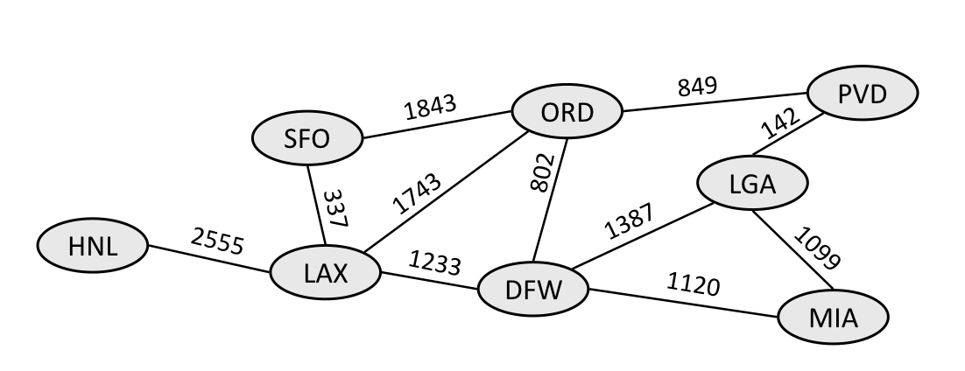
Formal Definition: Weighted Graph
A weighted graph is a triple (V, E, W)
where (V, E) is a graph (directed or undirected) and
W is a function from E into R, the reals (or integers or rational numbers).
For an edge e, W(e) is called the weight of e.
Image from Stanford’s cs106b course website

Slide 7
Terms You Should Know or Learn Now
Size of graph? Two measures:
Number of nodes: usually ‘V’ (some people use n)
Note: we really mean |V|, size of set V. But we drop the | | here.
Number of edges: usually ‘E’ (some people use m)
Dense graph: many edges
Maximally dense?
Undirected: each node connects to all others, so E = V(V-1)/2 Called a complete graph
Directed: E = V(V-1) why?
Sparse graph: fewer edges
Could be zero edges…

Slide 8
Terms You Should Know or Learn Now
Path and simple path
One vertex is reachable from another vertex
”Simple” means path contains an edge at most once
A connected graph
undirected graph, where each vertex is reachable from all others
A strongly connected digraph:
direction affects what this means!
node u may be reachable from v, but not v from u
Strongly connected means both directions
If an undirected graph is not connected, then connected subgraphs are called connected components

Slide 9
Terms You Should Know or Learn Now
Cycle
Directed graph: non-empty path with same starting and ending node
An edge may appear more than once (but why?)
Simple cycle: no node repeated except start and end
Undirected graph: same idea
If an edge appears more than once (I.e. non-simple) then we traverse it in the same direction
Acyclic: no-cycles
A connected, acyclic undirected graph: free tree
If we specify a root, it’s a rooted tree
Acyclic but not connected? an undirected forest
Directed acyclic graph: a DAG

Slide 10
Self-test: Understand these Terms?
Subgraph
Symmetric digraph
complete graph
Adjacency relation
Path, simple path, reachable
Connected, Strongly Connected
Cycle, simple cycle
acyclic
undirected forest
free tree, undirected tree
rooted tree
Connected component

Slide 11
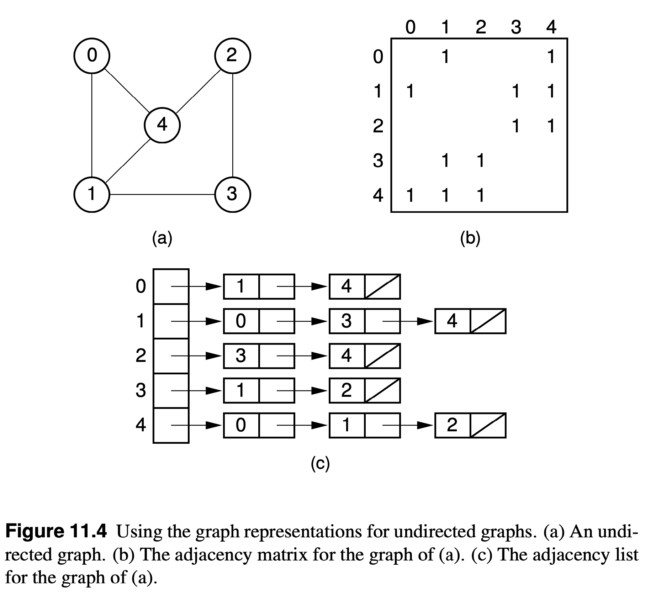
Data Structures for Undirected Graphs
Adjacency Matrix: A[u][v] is 1 if edge (u,v) exists. Note symmetrical around diagonal. Could just store info in one half of matrix.
Adjacency List: Note each edge (u,v) has an edge-node on u’s list and also v’s list.
Image of diagrams from https://people.cs.vt.edu/~shaffer/Book/

Slide 12
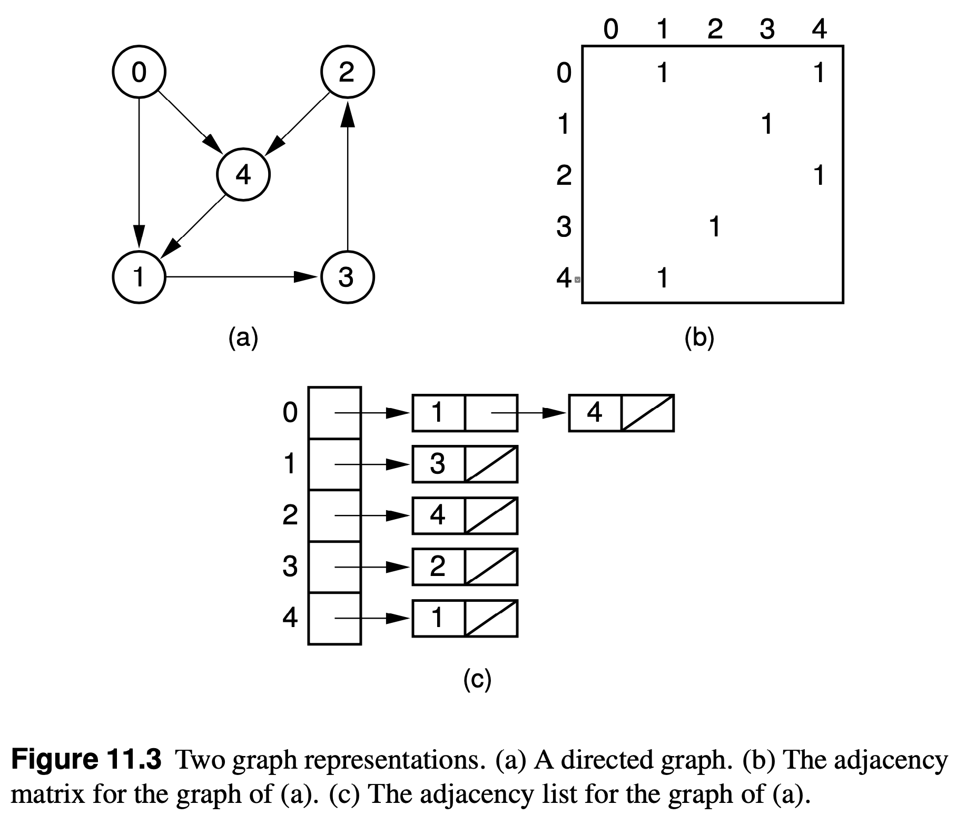
Data Structures for Digraphs
Adjacency Matrix: Not symmetrical around diagonal for digraph.
Adjacency List: Note each directed edge (u,v) has an edge-node on just one vertex’s list.
Image of diagrams from https://people.cs.vt.edu/~shaffer/Book/

Slide 13
Data Structures for Weighted Graphs
Adjacency Matrix: Store weight (u,v) in matrix cell. Use 0 or negative value if edge not in graph.
Images are of unweighted graphs.
How would we store weights?
Adjacency List: Add a field to the the edge node object to store the weight.
Image of diagrams from https://people.cs.vt.edu/~shaffer/Book/

Slide 14
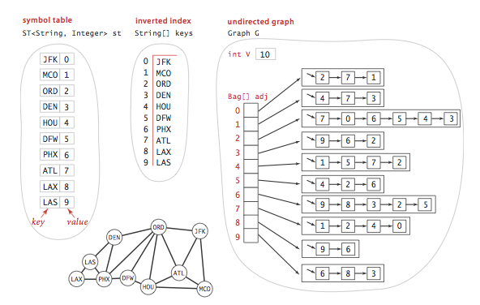
Identifying Vertices as Strings
Vertices may be identified with strings not integers.
(1) Could use an adjacency map instead of an adjacency list, and also store strings in edge-nodes
(2) Programmers often have an index and/or lookup table to convert between int’s and string IDs for vertices. Understand the example here?
There are other ways to do this. Use your programming skills!
Image from https://algs4.cs.princeton.edu/home/

Slide 15
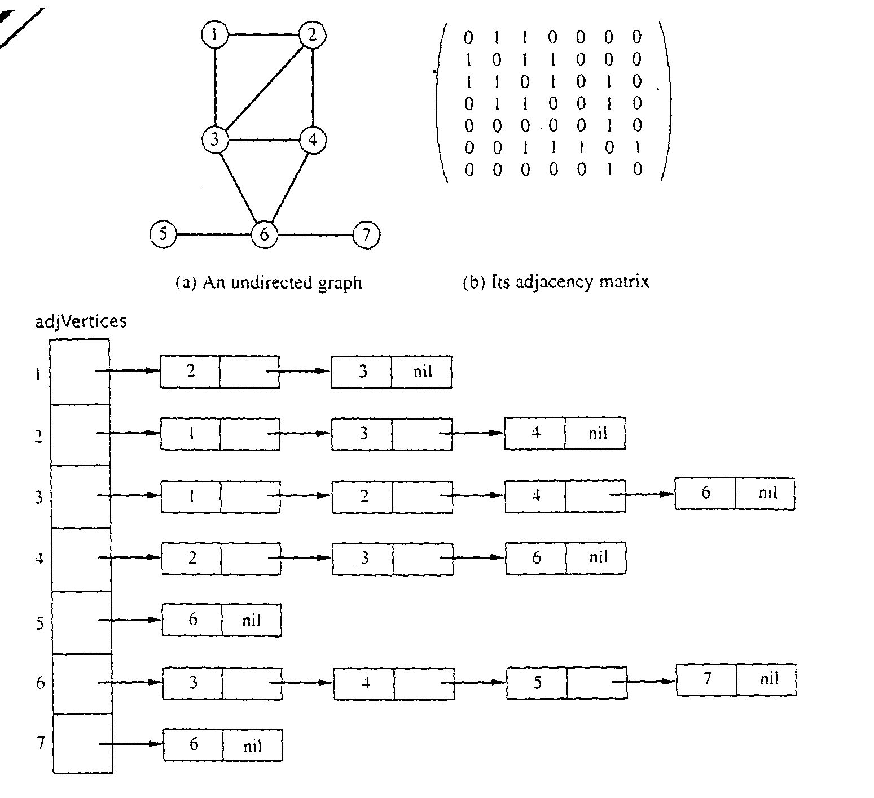
Graph Representations using Data Structures
Adjacency Matrix Representation
Let G = (V,E), n = |V|, m = |E|, V = {v1, v2, …, vn)
G can be represented by an n × n matrix

Slide 16
Array of Adjacency Lists Representation

Slide 17
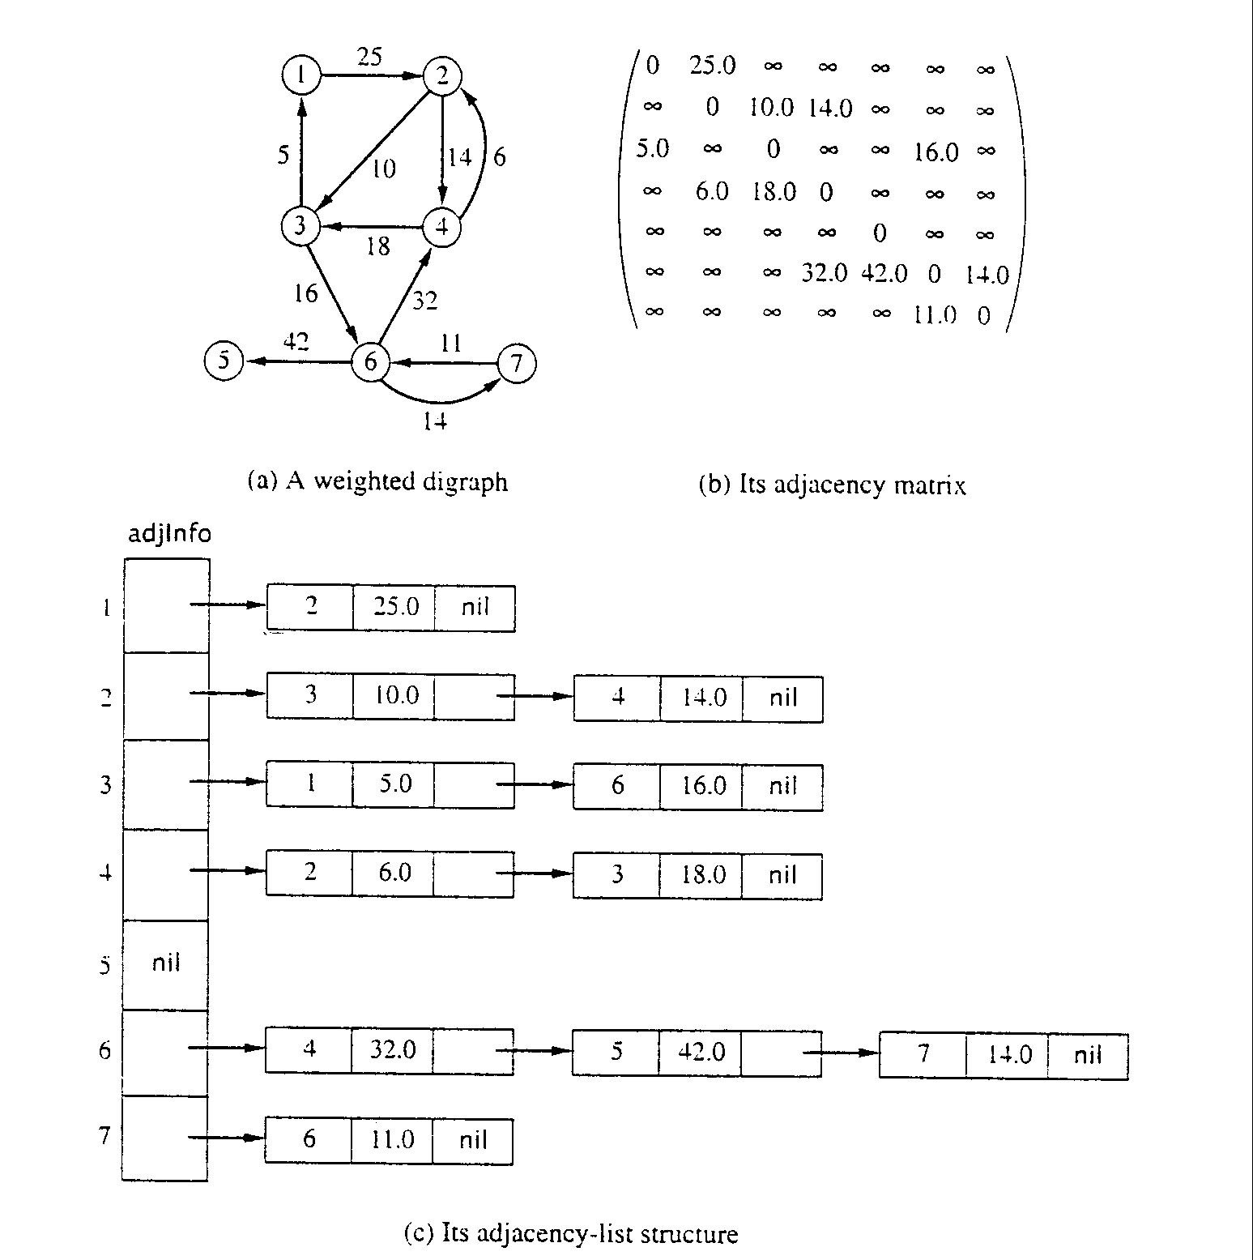
Adjacency Matrix for weight digraph

Slide 18
Array of Adjacency Lists Representation
from -> to, weight

Slide 19
Breadth-First Search

Slide 20
Traversing Graphs
“Traversing” means processing each vertex edge in some organized fashion by following edges between vertices
We speak of visiting a vertex. Might do something while there.
Recall traversal of binary trees:
Several strategies: In-order, pre-order, post-order
Traversal strategy implies an order of visits
We used recursion to describe and implement these
Graphs can be used to model interesting, complex relationships
Often traversal used just to process the set of vertices or edges
Sometimes traversal can identify interesting properties of the graph
Sometimes traversal (perhaps modified, enhanced) can answer interesting questions about the problem-instance that the graph models

Slide 21
BFS: Overall Strategy
Breadth-first search’s strategy
Choose a starting vertex
Vertices are visited in order of increasing distance from the starting vertex
For starting vertex, distance d = 0
Examine all edges leading from vertices (at distance d) to adjacent vertices (at distance d+1)
Then, examine all edges leading from vertices at distance d+1 to distance d+2, and so on,
Until no new vertex is discovered

Slide 22
BFS: Specific Input/Output
Input:
A graph G
single start vertex s
Output:
Distance from s to each node in G (distance = number of edges)
Breadth-First Tree of G with root s
Important: The paths in this BFS tree represent the shortest paths from s to each node in G
But edge weight’s (if any) not used, so “short” is in terms of number of edges in path

Slide 23
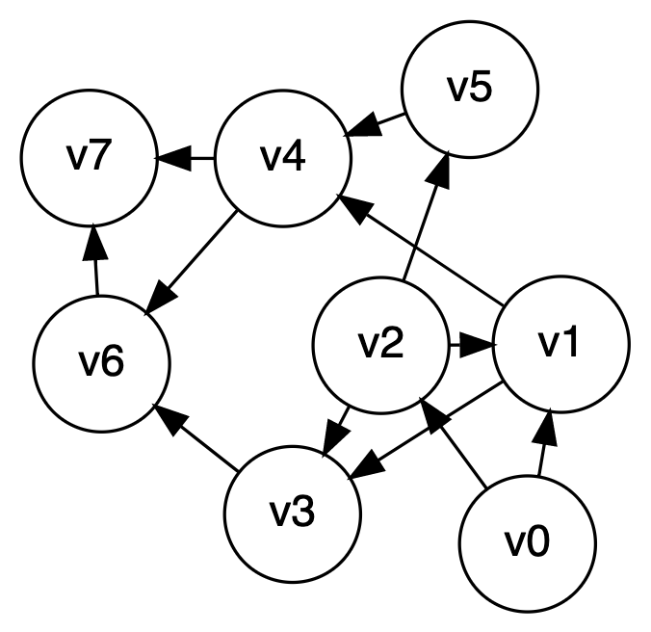
Breadth-first search, quick example
Let’s start at V0

Slide 24
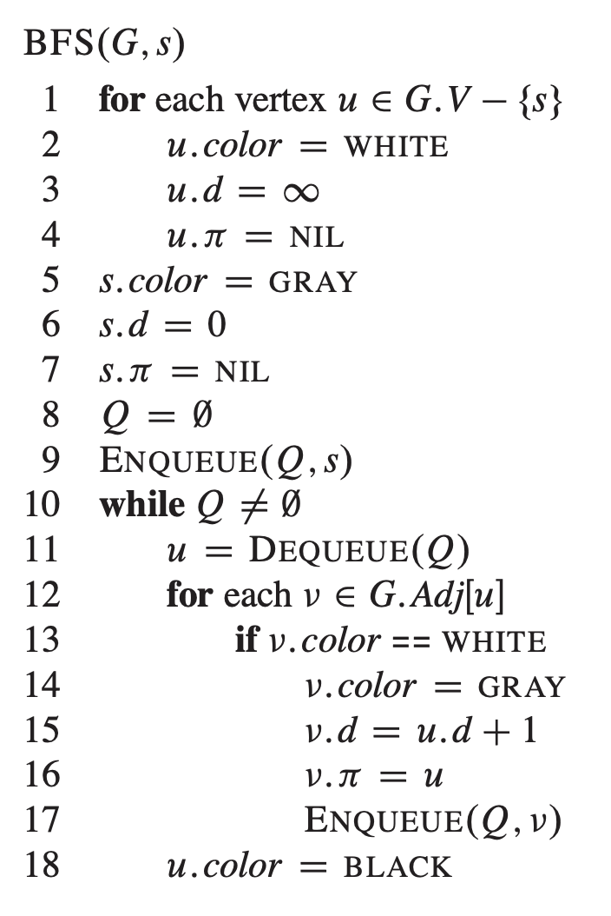
Breadth-first search implementation
From CLRS
Vertices here have some properties:
color = white/gray/black
d = distance from start node
pi = parent in tree, i.e. v.pi is vertex by which v was connected to BFS tree
Color meanings here:
White: haven’t seen this vertex yet
Gray: vertex has been seen and added to the queue for processing later
Black: vertex has been removed from queue and its neighbors seen and added to the queue

Slide 25
Breadth-first search: Analysis
For a digraph having V vertices and E edges
Each edge is processed once in the while loop for a cost of θ(E)
Each vertex is put into the queue once and removed from the queue and processed once, for a cost θ(V)
Total time-complexity: θ(V+E)
For graph algorithm’s this is called “linear”
Space complexity: extra space is used for color array and queue, so θ(V)

Slide 26
BFS Can be Useful
Not all vertices are necessarily reachable from a selected starting vertex
E.g. for an undirected graph that’s not connected
Could you use BFS to test if an undirected graph is connected? Count connected components?
Earlier we said: The paths in this BFS tree represent the shortest paths from s to each node in G
The path in the tree from start vertex s to any vertex v contains the minimum number of edges of any path from s to v
BFS is the choice for “shortest path” problems where distance is in terms of edges or connections, and not edge-weights
Next let’s make an argument to justify this property of BFS.

Slide 27
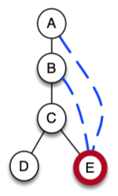
Informal Argument on BFS Trees
Assume there exists a vertex v with distance v.d from the BFS tree, but there’s a path P2 with length < v.d from s to v
Let p be the vertex that would be v’s “parent” on this shorter path
Our example: For shorter path A-E, p would be A
For the other shorter path A-B-E, p would be B
Vertex p is closer to start node than v.pi
But wait! When BFS processes p, it would add unvisited vertex v to queue and assign v’s parent v.pi to be p and v.d to be p.d+1.
If the path P2 is shorter than the path in the BFS tree, then v would have been attached to the tree at the same level as v.pi or higher
BFS adds a vertex to the tree as “early” as possible, as soon as it sees an edge connection

Slide 28
DFS
CLRS Section 22.3 on DFS

Slide 29
Readings
CLRS:
Section 22.3 on DFS
Later/eventually:
Section 22.4 on Topological Sort
Section 22.5 on Strongly Connected Components

Slide 30
DFS: the Strategy in Words
Depth-first search: Strategy
Go as deep as can visiting un-visited nodes
Choose any un-visited vertex when you have a choice
When stuck at a dead-end, backtrack as little as possible
Back up to where you could go to another unvisited vertex
Then continue to go on from that point
Eventually you’ll return to where you started
Reach all vertices? Maybe, maybe not

Slide 31
Observations about the DFS Strategy
Note: we must keep track of what nodes we’ve visited
DFS traverses a subset of E (the set of edges)
Creates a tree, rooted at the starting point: the Depth-first Search Tree (DFS tree)
Each node in the DFS tree has a distance from the start. (We often don’t care about this, but we could.)
At any point, all nodes are either:
Un-discovered
Finished (you backed up from it), or
Discovered (i.e. visited) but not finished
On the path from the current node back to the root
We might back up to it
(Later we’ll call these states: white, black and gray respectively)

Slide 32
DFS Strategy 1: Use a stack
Maintain a Stack (Let’s call it S)
Start at some node ‘s’ (push ‘s’ to S and mark as visited)
While S not empty
Pop a node ‘n’ from S
Process ‘n’ if necessary (depending on problem you are solving)
For each non-visited neighbor of ‘n’
Mark neighbor as visited
Push neighbor onto S
Repeat
Sound familiar? Same as BFS but uses stack instead of queue!
Or we can implement recursively (see next slide)

Slide 33
DFS Strategy #2
Use a recursive function to “visit” each node
Need a non-recursive function to initialize and make first call
Before we look at this code… Important!
Best to think of DFS is a strategy as well as a single, particular bit of pseudo-code
We often add things to DFS code to solve problems
Code shown next is very minimal
We can use a DFS-based approach to solve many problems.
It’s kind of the ”Swiss Army Knife” of graph algorithms! ☺

Slide 34
DFS Strategy 2: Recursion
def dfs(graph, start): //Main loop, inits and call on one start node
visited = {}
dfs_visit(graph, start, visited)
def dfs_visit(graph, curnode, visited): //sometimes called dfs_recurse()
visited[curnode] = True
alist = graph.get_adjlist(curnode) //get the neighbors of curnode
for v in alist:
if v not in visited:
print(" dfs traversing edge:", curnode, v)
dfs_visit(graph, v, visited)
# end for-all adjacent vertices
return

Slide 35
depth-first search, example
Let’s start at V0

Slide 36
DFS to Process all Vertices in a Graph
Purpose: do all required initializations, then call dfs_visit() as many times as needed to visit all nodes.
May create a DFS forest.
Can be used to count connected components
Could remember which nodes are in each connected component
CLRS text calls this version dfs() but it’s really doing >1 DFS each from a different start node
def dfs_sweep(graph, start):
visited = {}
# loop repeats DFS on every unvisited node
for v in graph:
if v not in visited:
dfs_visit(graph, v, visited)

Slide 37
Using DFS to Find if a Graphic is Acyclic
Does a graph have a cycle?
DFS is great for this
But, slightly harder if graph is undirected
Use DFS tree: classify edges and nodes as you process them
Nodes:
White: unvisited
Black: done with it, backed up from it (never to return)
Gray: Have reached it; exploring its adjacent nodes; but not done with it

Slide 38
CLRS’s DFS Algorithm (non-recursive part)
DFS_sweep(G)
1 for each vertex u in G.V
2 u.color = WHITE
3 u.π = NIL
4 time = 0
5 for each vertex u in G.V
6 if u.color == WHITE // if unseen
7 DFS-VISIT(G, u) // explore paths out of u
// CLRS calls this just dfs()

Slide 39
CLRS’s DFS Algorithm (recursive part)
// sometimes called this dfs_recurse()
DFS-VISIT(G, u)
1 time = time + 1 // white vertex u has just been discovered
2 u.d = time // discovery time of u
3 u.color = GRAY // mark as seen
4 for each v in G.Adj[u] // explore edge (u, v)
5 if v.color == WHITE // if unseen
6 v.π = u
7 DFS-VISIT(G, v) // explore paths out of v (i.e., go “deeper”)
8 u.color = BLACK // u is finished
9 time = time + 1
10 u.f = time // finish time of u

Slide 40
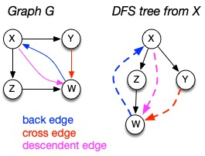
Depth-first search tree
As DFS traverses a digraph, edges classified as:
tree edge, back edge, descendant edge, or cross edge
If graph undirected, do we have all 4 types?

Slide 41
Using Non-Tree Edges to Identify Cycles
From the previous graph, note that:
Back edges (indicates a cycle)
dfs_visit() sees a vertex that is gray
This back edge goes back up the DFS tree to a vertex that is on the path from the current node to the root
Cross Edges and Descendant Edges (not cycles)
dfs_visit() sees a vertex that is black
Descendant edge: connects current node to a descendant in the DFS tree
Cross edge: connects current node to a node in another subtree – not a descendant of current node

Slide 42
Non-tree Edges in DFS
Question 1: Finding back edges for an undirected graph is not quite this simple:
The parent node of the current node is gray
Not a cycle, is it? It’s the same edge you just traversed
Question: how would you modify our code to recognize this?
Question 2:
In digraph, how could you modify the code to distinguish cross edges from descendant edges?
Need to record the “time” at which a node was discovered (set to “gray”) and finished (set to “black”)
Also, have a “time counter”, say, ctr
Set d[v] = ctr++ as discovery time
Set f[v] = ctr++ as finish time

Slide 43
Time Complexity of DFS
For a digraph having V vertices and E edges
Each edge is processed once in the while loop of dfs_visit() for a cost of θ(E)
Think about adjacency list data structure.
Traverse each list exactly once. (Never back up)
There are a total of 2*E nodes in all the lists
The non-recursive dfs_sweep() algorithm will do θ(V) work even if there are no edges in the graph
Thus over all time-complexity is θ(V+E)
Remember: this means the larger of the two values
Note: This is considered “linear” for graphs since there are two size parameters for graphs.
Extra space is used for color array.
Space complexity is θ(V)

Slide 44
depth-first search, example
Let’s start at V0

Slide 45
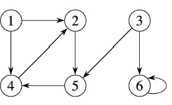
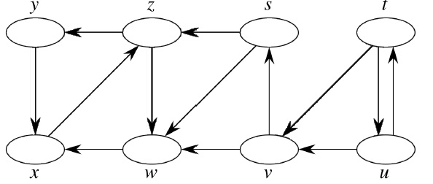
DFS Examples
Source vertex: 1
Source vertex: s

Slide 46
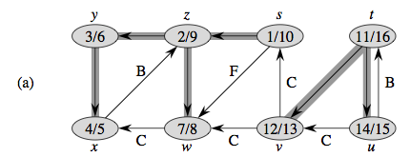
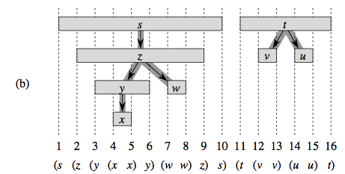
Properties of DFS Search, DFS Trees
“Parentheses Structure”. See pp. 606-609

Slide 47
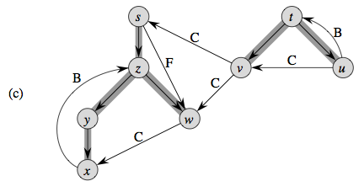
Properties of DFS Search, DFS Trees
Edge Classification. See pp. 606-609

