Slide 1
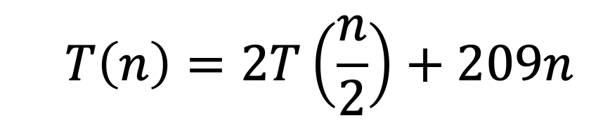
CS4102 Algorithms Spring 2022
Warm Up
What is the asymptotic run time of MergeSort if its recurrence is
$$T\left(n\right)=2T\left(\frac{n}{2}\right)+209n$$

Slide 2
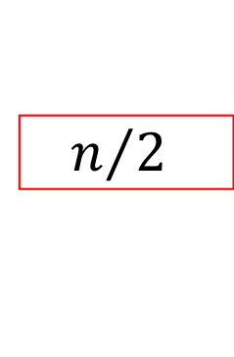

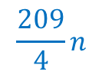
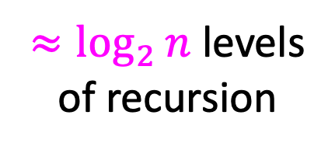


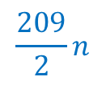
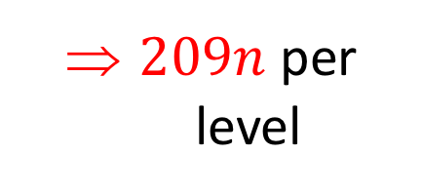
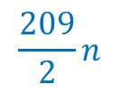
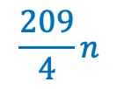


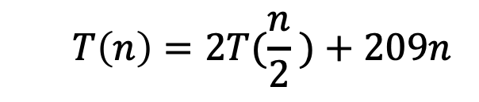

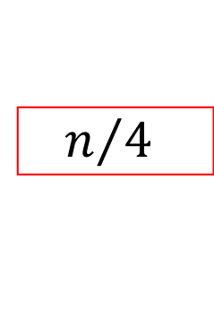
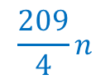



Tree Method
$$T\left(n\right)=2T(\frac{n}{2} )+209n$$
$$209n$$
$$n$$
$209n$ per level
$$n/2$$
$$\frac{209}{2}n$$
$$n/2$$
$$\frac{209}{2}n$$
$$\frac{209}{4}n$$
$$\frac{209}{4}n$$
$$\frac{209}{4}n$$
$$\frac{209}{4}n$$
${≈log}_{2}{n}$ levels
of recursion
$$n/4$$
$$n/4$$
$$n/4$$
$$n/4$$
…
…
…
…
…
$$1$$
$$1$$
$$1$$
$$1$$
$$1$$
$$1$$
$$1$$
$$1$$
$$1$$
$$T\left(n\right)=209n\sum_{i=0}^{\log{n}}{1}=209n\log_{2}{n}$$

Slide 3
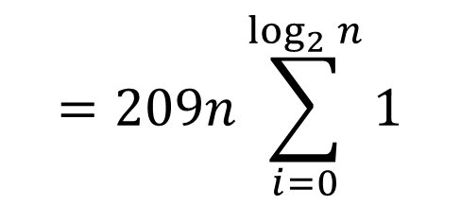






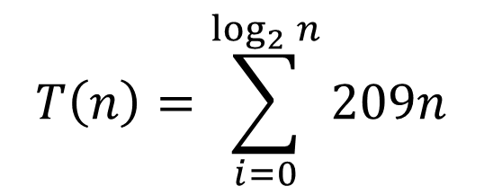

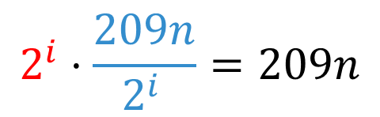


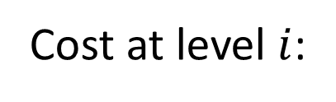


Tree Method
$$T\left(n\right)=2T\left(n/2\right)+209n$$
Number of subproblems
Cost of subproblem
What is the cost?
$$1$$
$$209n$$
$$2^{i}⋅\frac{209n}{2^{i }}=209n$$
Cost at level $i$:
$$2$$
$$209n/2$$
$$4$$
$$209n/4$$
$$T\left(n\right)=\sum_{i=0}^{\log_{2}{n}}{209n}$$
Total cost:
$$=209n\sum_{i=0}^{\log_{2}{n}}{1}$$
$$2^{k}$$
$$209n/2^{k}$$
$$=n\log_{2}{n}$$
$$=Θ\left(n\log{n}\right)$$

Slide 4



Multiplication
Want to multiply large numbers together
What makes a “good” algorithm?
How do we measure input size?
What do we “count” for run time?
$$4 1 0 2$$
$n$-digit numbers
$$× 1 8 1 9$$

Slide 5
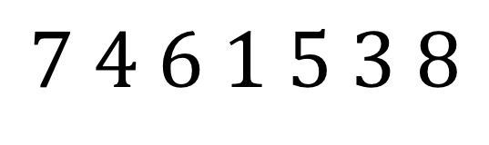

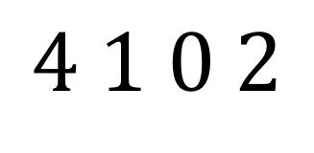

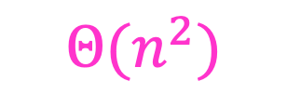
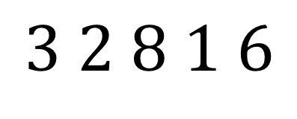

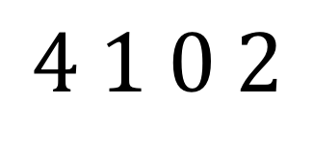
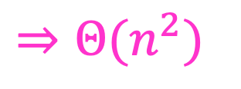

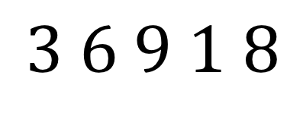
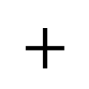

“Schoolbook” Method
Can we do better?
How many total multiplications?
$$4 1 0 2$$
$n$-digit numbers
$$× 1 8 1 9$$
$$3 6 9 1 8$$
$n$ mults
What about cost of additions?
$$4 1 0 2$$
$n$ mults
$n$ levels
$Θ(n^{2})$
$$3 2 8 1 6$$
$n$ mults
$⇒Θ(n^{2})$
$$+$$
$$4 1 0 2$$
$n$ mults
$$7 4 6 1 5 3 8$$

Slide 6
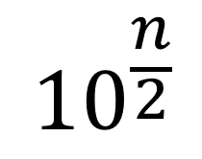



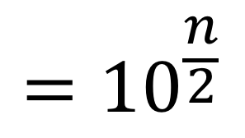

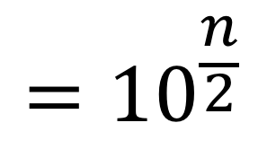

Divide and Conquer method
1. Break into smaller subproblems
$$={10}^{\frac{n}{2}}$$
$$4 1 0 2$$
a
+
b
a
b
$$={10}^{\frac{n}{2}}$$
$$× 1 8 1 9$$
+
c
d
c
d
$${10}^{n}$$
( )
+
a
$$×$$
c
$${10}^{\frac{n}{2}}$$
( )
+
a
$$×$$
d
+
b
$$×$$
c
( )
b
$$×$$
d

Slide 7
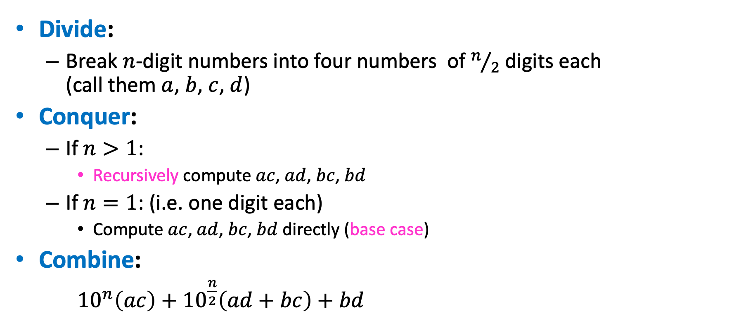
Divide and Conquer Multiplication
Divide:
Break $n$-digit numbers into four numbers of $n/2$ digits each (call them $a$, $b$, $c$, $d$)
Conquer:
If $n>1$:
Recursively compute $ac$, $ad$, $bc$, $bd$
If $n=1$: (i.e. one digit each)
Compute $ac$, $ad$, $bc$, $bd$ directly (base case)
Combine:
${10}^{n}\left(ac\right)+{10}^{\frac{n}{2}}\left(ad+bc\right)+bd$

Slide 8
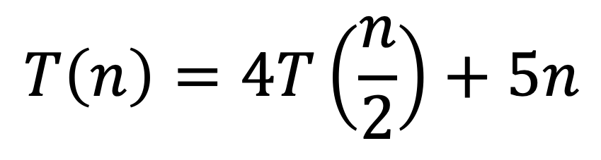
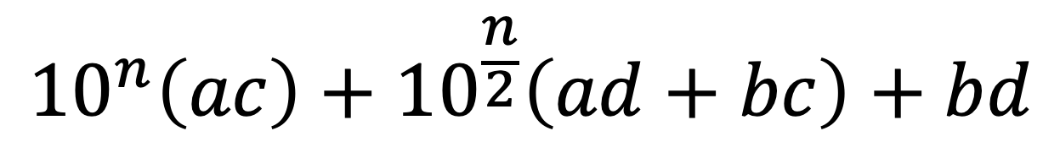
Divide and Conquer method
2. Use recurrence relation to express recursive running time
$${10}^{n}\left(ac\right)+{10}^{\frac{n}{2}}\left(ad+bc\right)+bd$$
Recursively solve
$$T\left(n\right)=4T\left(\frac{n}{2}\right)+5n$$

Slide 9







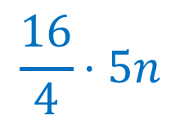

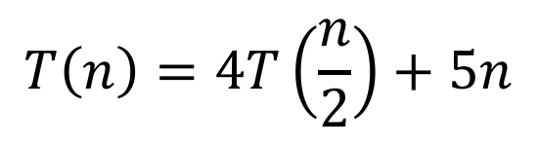













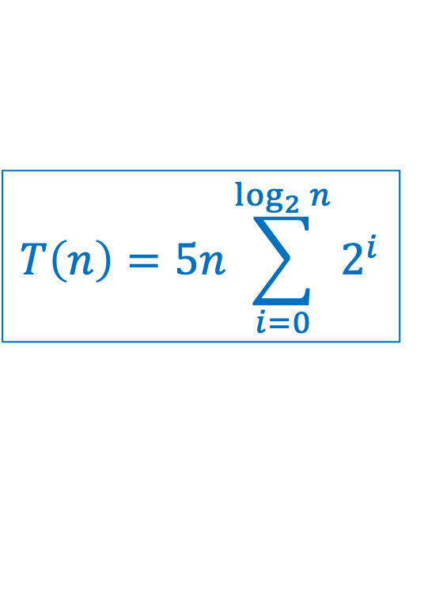























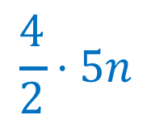

Divide and Conquer method
$$T\left(n\right)=5n\sum_{i=0}^{\log_{2}{n}}{2^{i}}$$
3. Use asymptotic notation to simplify
$$T\left(n\right)=4T\left(\frac{n}{2}\right)+5n$$
$$n$$
$$5n$$
$$5n$$
$$\frac{n}{2}$$
$$\frac{5n}{2}$$
$$\frac{n}{2}$$
$$\frac{5n}{2}$$
$$\frac{n}{2}$$
$$\frac{5n}{2}$$
$$\frac{n}{2}$$
$$\frac{5n}{2}$$
$$\frac{4}{2}⋅5n$$
$$\frac{n}{4}$$
$$\frac{n}{4}$$
$$\frac{n}{4}$$
$$\frac{n}{4}$$
…
$$\frac{n}{4}$$
$$\frac{n}{4}$$
$$\frac{n}{4}$$
$$\frac{n}{4}$$
$$\frac{16}{4}⋅5n$$
$$\frac{5n}{4}$$
$$\frac{5n}{4}$$
$$\frac{5n}{4}$$
$$\frac{5n}{4}$$
$$\frac{5n}{4}$$
$$\frac{5n}{4}$$
$$\frac{5n}{4}$$
$$\frac{5n}{4}$$
…
…
…
…
…
…
…
…
…
…
$$5$$
$$5$$
$$5$$
$$5$$
$$5$$
$$5$$
$$5$$
$$2^{\log_{2}{n}}⋅5n$$
$$5$$
$$5$$
$$5$$
$$5$$
$$5$$
$$5$$
$$5$$
$$1$$
$$1$$
$$1$$
$$1$$
$$1$$
$$1$$
$$1$$
$$1$$
$$1$$
$$1$$
$$1$$
$$1$$
$$1$$
$$1$$

Slide 10
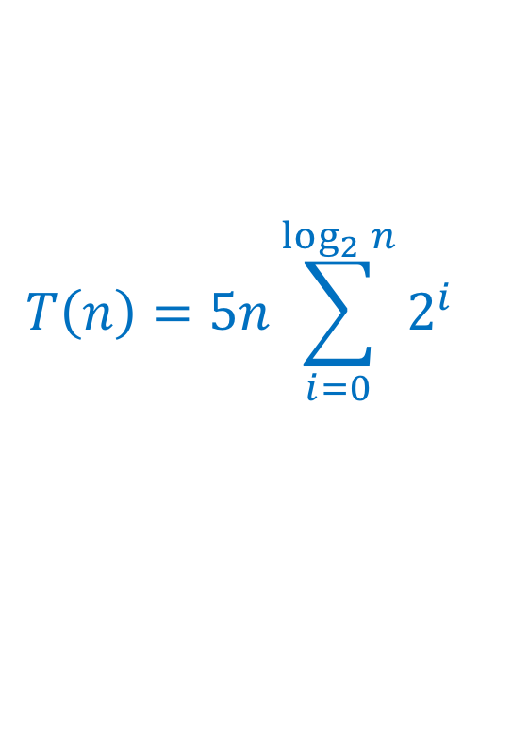
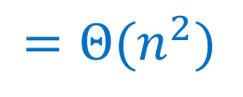
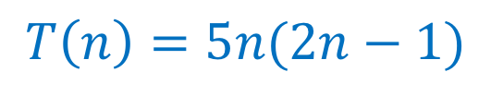
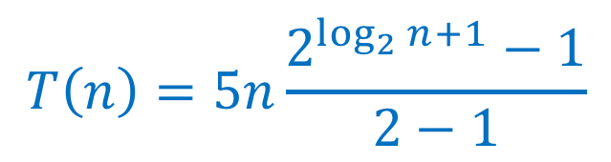
Divide and Conquer method
3. Use asymptotic notation to simplify
$$T\left(n\right)=4T\left(\frac{n}{2}\right)+5n$$
$$T\left(n\right)=5n\sum_{i=0}^{\log_{2}{n}}{2^{i}}$$
$$T\left(n\right)=5n\frac{2^{\log_{2}{n}+1}−1}{2−1}$$
$$T\left(n\right)=5n(2n−1)$$
$$=Θ(n^{2})$$

Slide 11
Karatsuba Multiplication
1. Break into smaller subproblems
$$={10}^{\frac{n}{2}}$$
$$4 1 0 2$$
a
+
b
a
b
$$={10}^{\frac{n}{2}}$$
$$× 1 8 1 9$$
+
c
d
c
d
$${10}^{n}$$
( )
+
a
$$×$$
c
$${10}^{\frac{n}{2}}$$
( )
+
a
$$×$$
d
+
b
$$×$$
c
( )
b
$$×$$
d

Slide 12
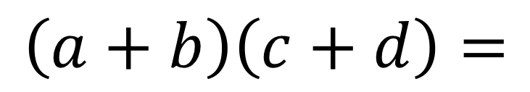
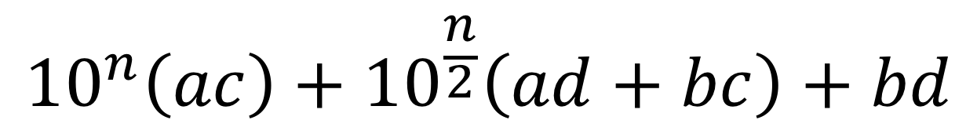

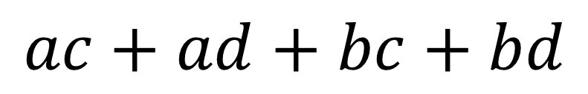
Karatsuba
a
b
$$×$$
c
d
$${10}^{n}\left(ac\right)+{10}^{\frac{n}{2}}\left(ad+bc\right)+bd$$
Can’t avoid these
This can be simplified
$$\left(a+b\right)\left(c+d\right)=$$
$$ac+ad+bc+bd$$
$$ad+bc=\left(a+b\right)\left(c+d\right)−ac−bd$$
Two multiplications
One multiplication

Slide 13
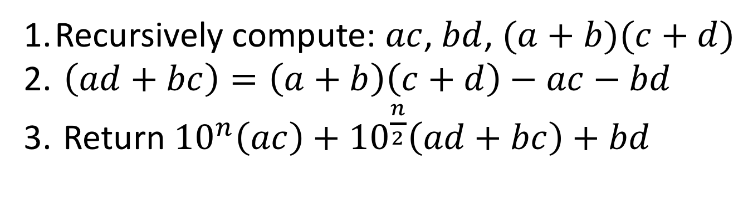

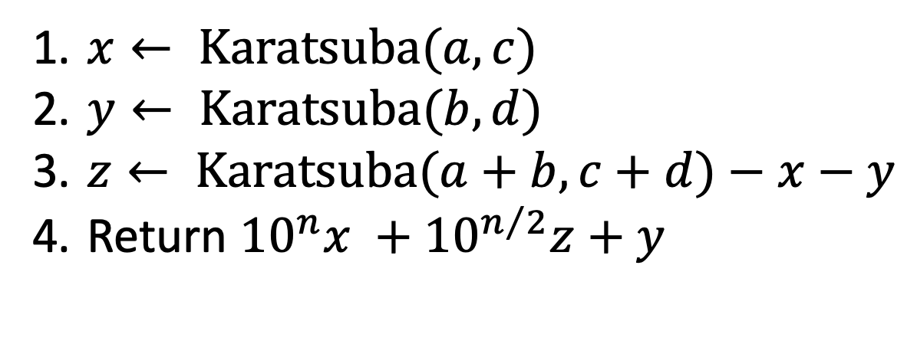
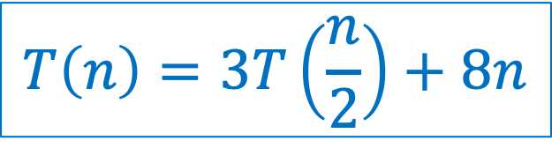
Karatsuba Algorithm
a
b
$$×$$
c
d
Recursively compute: $ac$, $bd$, $(a+b)(c+d)$
$\left(ad+bc\right)=\left(a+b\right)\left(c+d\right)−ac−bd$
Return ${10}^{n}\left(ac\right)+{10}^{\frac{n}{2}}\left(ad+bc\right)+bd$
Pseudo-code
$$T\left(n\right)=3T\left(\frac{n}{2}\right)+8n$$
$x← Karatsuba(a,c)$
$y← Karatsuba(b,d)$
$z← Karatsuba(a+b,c+d)−x−y$
Return ${10}^{n}x +{10}^{n/2}z+y$

Slide 14
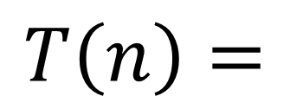
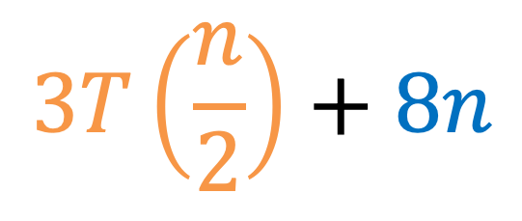



Karatsuba Multiplication
2. Use recurrence relation to express recursive running time
a
b
$$×$$
c
d
$${10}^{n}\left(ac\right)+{10}^{n/2}\left(\left(a+b\right)\left(c+d\right)−ac−bd\right)+bd$$
Recursively solve
$$3T\left(\frac{n}{2}\right)+8n$$
$$T\left(n\right)=$$
Need to compute $3$ multiplications, each of size $n/2$: $ac$, $bd$, $(a+b)(c+d)$
2 shifts and 6 additions on $n$-digit values

Slide 15





















Karatsuba
$$T\left(n\right)=8n\sum_{i=0}^{\log_{2}{n}}{{(3/2)}^{i}}$$
3. Use asymptotic notation to simplify
$$T\left(n\right)=3T\left(\frac{n}{2}\right)+8n$$
$$n$$
$$8n$$
$$8n⋅1$$
$$\frac{n}{2}$$
$$\frac{8n}{2}$$
$$\frac{n}{2}$$
$$\frac{8n}{2}$$
$$\frac{n}{2}$$
$$\frac{8n}{2}$$
$$8n⋅\frac{3}{2}$$
$$\frac{n}{4}$$
$$\frac{n}{4}$$
$$\frac{n}{4}$$
…
$$\frac{n}{4}$$
$$\frac{n}{4}$$
$$\frac{n}{4}$$
$$8n⋅\frac{9}{4}$$
$$\frac{8n}{4}$$
$$\frac{8n}{4}$$
$$\frac{8n}{4}$$
$$\frac{8n}{4}$$
$$\frac{8n}{4}$$
$$\frac{8n}{4}$$
…
…
…
…
…
…
…
$$8n⋅\frac{3^{\log_{2}{n}}}{2^{\log_{2}{n}}}$$
…
$$8$$
$$8$$
$$8$$
$$8$$
$$8$$
$$8$$
$$8$$
$$8$$
$$8$$
$$8$$
$$1$$
$$1$$
$$1$$
$$1$$
$$1$$
$$1$$
$$1$$
$$1$$
$$1$$
$$1$$

Slide 16





Karatsuba
3. Use asymptotic notation to simplify
$$T\left(n\right)=3T\left(\frac{n}{2}\right)+8n$$
$$T\left(n\right)=8n\sum_{i=0}^{\log_{2}{n}}{{\left(3/2\right)}^{i}}$$
$$T\left(n\right)=8n\frac{{\left(3/2\right)}^{\log_{2}{n}+1}−1}{3/2−1}$$
Math, math, and more math…(see lecture supplement)
$$T\left(n\right)=24\left(n^{\log_{2}{3}}\right)−16n$$
$$=Θ(n^{\log_{2}{3}})$$
$$≈Θ(n^{1.585})$$

Slide 17



$$n^{2}$$
$$n^{1.585}$$

Slide 18




Recurrence Solving Techniques
Four methods for solving recurrences
Unrolling: expand the recurrence
Tree: get a picture of recursion
Guess/Check: Substitution by guessing the solution and using induction to prove
“Cookbook”: Use magic (a.k.a. Master Theorem)
?

Slide 19



Induction (review)
Goal: $∀k∈ℕ, P(k)$ holds
Base case(s): $P\left(1\right)$ holds
Technically, called strong induction
Hypothesis: $∀x≤x_{0}, P\left(x\right)$ holds
Inductive step: show $P\left(1\right),…,P\left(x_{0}\right)⇒P\left(x_{0}+1\right)$

Slide 20

Guess and Check Intuition
Show: $T\left(n\right)∈O(g\left(n\right))$
Consider: $g_{∗}\left(n\right)=c⋅g(n)$ for some constant $c$, i.e. pick $g_{∗}\left(n\right)∈O(g\left(n\right))$
Goal: show $∃n_{0}$such that $∀n>n_{0},T\left(n\right)≤g_{∗}(n)$
(definition of big-O)
Technique: Induction
Base cases:
show $T\left(1\right)≤g_{∗}\left(1\right), T\left(2\right)≤g_{∗}\left(2\right),…$ for a small number of cases (may need additional base cases)
Hypothesis:
$∀n≤x_{0}, T\left(n\right)≤g_{∗}(n)$
Inductive step:
Show $T\left(x_{0}+1\right)≤g_{∗}\left(x_{0}+1\right)$
Need to ensure that in inductive step, can either appeal to a base case or to the inductive hypothesis

Slide 21



Karatsuba Guess and Check (Loose)
$$T\left(n\right)=3 T\left(\frac{n}{2}\right)+8n$$
Goal: $T\left(n\right)≤3000 n^{1.6}=O(n^{1.6})$
Base cases: $T\left(1\right)=8≤3000$
$T\left(2\right)=3\left(8\right)+16=40≤3000⋅2^{1.6}$
… up to some small $k$
Hypothesis: $∀n≤x_{0}, T\left(n\right)≤3000n^{1.6}$
Inductive step: Show that $T\left(x_{0}+1\right)≤3000{\left(x_{0}+1\right)}^{1.6}$

Slide 22
Karatsuba Guess and Check (Loose)

Slide 23



Mergesort Guess and Check
$$T\left(n\right)=2 T\left(\frac{n}{2}\right)+n$$
Goal: $T\left(n\right)≤n\log_{2}{n} =O(n\log_{2}{n})$
Base cases: $T\left(1\right)=0$
$T\left(2\right)=2≤2\log_{2}{2}$
… up to some small $k$
Hypothesis: $∀n≤x_{0} T\left(n\right)≤n\log_{2}{n}$
Inductive step: $T\left(x_{0}+1\right)≤\left(x_{0}+1\right)\log_{2}{(x_{0}+1)}$
Math, math, and more math…(on board, see lecture supplemental)

Slide 24
Mergesort Guess and Check

Slide 25

Karatsuba Guess and Check
$$T\left(n\right)=3T\left(\frac{n}{2}\right)+8n$$
Goal: $T\left(n\right)≤{24n}^{\log_{2}{3}}−16n=O(n^{\log_{2}{3}})$
Base cases: by inspection, holds for small $n$ (at home)
Hypothesis: $∀n≤x_{0}, T\left(n\right)≤24n^{\log_{2}{3}}−16n$
Inductive step: $T\left(x_{0}+1\right)≤{24(x_{0}+1)}^{\log_{2}{3}}−16(x_{0}+1)$
Math, math, and more math…(on board, see lecture supplemental)

Slide 26
Karatsuba Guess and Check

Slide 27

What if we leave out the $−16n$?
$$T\left(n\right)=3T\left(\frac{n}{2}\right)+8n$$
Goal: $T\left(n\right)≤{24n}^{\log_{2}{3}}−16n=O(n^{\log_{2}{3}})$
Base cases: by inspection, holds for small $n$ (at home)
Hypothesis: $∀n≤x_{0}, T\left(n\right)≤{24n}^{\log_{2}{3}}−16n$
Inductive step: $T\left(x_{0}+1\right)≤{24(x_{0}+1)}^{\log_{2}{3}}−16(x_{0}+1)$
What we wanted: $T\left(x_{0}+1\right)≤{24(x_{0}+1)}^{\log_{2}{3}}$
Induction failed!
What we got: $T\left(x_{0}+1\right)≤{24(x_{0}+1)}^{\log_{2}{3}}+8(x_{0}+1)$

Slide 28
Recurrence Solving Techniques
Four methods for solving recurrences
Unrolling: expand the recurrence
Tree: get a picture of recursion
Guess/Check: Substitution by guessing the solution and using induction to prove
“Cookbook”: Use magic (a.k.a. Master Theorem)
?

Slide 29

Observation
Divide: $D(n)$ time
Conquer: recurse on small problems, size $s$
Combine: $C(n)$ time
Recurrence:
$$T\left(n\right)=D\left(n\right)+\sum{T(s)}+C(n)$$
Many D&C recurrences are of the form:
$T\left(n\right)=aT\left(\frac{n}{b}\right)+f\left(n\right),$ where $f\left(n\right)=D\left(n\right)+C(n)$

Slide 30

Remember…
MergeSort: $T\left(n\right)=2 T\left(\frac{n}{2}\right)+n$
D&C Multiplication: $T\left(n\right)=4T\left(\frac{n}{2}\right)+5n$
Karatsuba: $T\left(n\right)=3T\left(\frac{n}{2}\right)+8n$

Slide 31

































General
$$T\left(n\right)=\sum_{i=0}^{\log_{b}{n}}{a^{i}f\left(\frac{n}{b^{i}}\right)}$$
$$T\left(n\right)=aT\left(\frac{n}{b}\right)+f(n)$$
$$n$$
$$f(n)$$
$$f\left(n\right)$$
$$\frac{n}{b}$$
$$\frac{n}{b}$$
…
$$\frac{n}{b}$$
$$af\left(\frac{n}{b}\right)$$
$$f\left(\frac{n}{b}\right)$$
$$f\left(\frac{n}{b}\right)$$
$$f\left(\frac{n}{b}\right)$$
$$\frac{n}{b^{2}}$$
$$\frac{n}{b^{2}}$$
…
$$\frac{n}{b^{2}}$$
…
$$\frac{n}{b^{2}}$$
$$a^{2}f\left(\frac{n}{b^{2}}\right)$$
$$f\left(\frac{n}{b^{2}}\right)$$
…
$$f\left(\frac{n}{b^{2}}\right)$$
$$f\left(\frac{n}{b^{2}}\right)$$
$$f\left(\frac{n}{b^{2}}\right)$$
…
…
…
…
…
…
…
…
$$f(1)$$
$$f(1)$$
$$f(1)$$
$$f(1)$$
$$f(1)$$
$$f(1)$$
$$f(1)$$
$$1$$
$$1$$
$$1$$
$$1$$
$$a^{\log_{b}{n}}f(1)$$
$$1$$
$$1$$
$$1$$

Slide 32

3 Cases
$$L=\log_{b}{n}$$
$$T\left(n\right)=f\left(n\right)+af\left(\frac{n}{b}\right)+a^{2}f\left(\frac{n}{b^{2}}\right)+a^{3}f\left(\frac{n}{b^{3}}\right)+…+a^{L}f(\frac{n}{b^{L}})$$
Case 1:
Most work happens at the leaves
Case 2:
Work happens consistently throughout
Case 3:
Most work happens at top of tree

Slide 33


Master Theorem
$$T\left(n\right)=aT\left(\frac{n}{b}\right)+f(n)$$
Case 1: if $f\left(n\right)∈O(n^{\log_{b}{a} −ε})$ for some constant $ε>0$, then $T\left(n\right)∈Θ\left(n^{\log_{b}{a}}\right)$
Case 2: if $f\left(n\right)∈Θ(n^{\log_{b}{a}})$, then $T\left(n\right)∈Θ(n^{\log_{b}{a}}\log{n})$
Case 3: if $f\left(n\right)∈Ω(n^{\log_{b}{a+ε}})$ for some constant $ε>0$, and if $af\left(\frac{n}{b}\right)≤cf(n)$ for some constant $c<1$ and all sufficiently large $n$, then $T\left(n\right)∈Θ(f\left(n\right))$

Slide 34




Master Theorem Example 1
$$T\left(n\right)=aT\left(\frac{n}{b}\right)+f(n)$$
Case 1: if $f\left(n\right)=O(n^{\log_{b}{a} −ε})$ for some constant $ε>0$, then $T\left(n\right)=Θ(n^{\log_{b}{a}})$
Case 2: if $f\left(n\right)=Θ(n^{\log_{b}{a}})$, then $T\left(n\right)=Θ(n^{\log_{b}{a}}\log{n})$
Case 3: if $f\left(n\right)=Ω(n^{\log_{b}{a+ε}})$ for some constant $ε>0$, and if $af\left(\frac{n}{b}\right)≤cf(n)$ for some constant $c<1$ and all sufficiently large $n$, then $T\left(n\right)=Θ(f\left(n\right))$
$$T\left(n\right)=2T\left(\frac{n}{2}\right)+n$$
Case 2
$$Θ\left(n^{\log_{2}{2}}\log{n}\right)=Θ(n\log{n})$$

Slide 35























Tree method
$$T\left(n\right)=2T\left(\frac{n}{2} \right)+n$$
$$n$$
$$n$$
$$n$$
$$n/2$$
$$n/2$$
$$n$$
$$n/2$$
$$+$$
$$n/2$$
$$\log_{2}⁡n$$
$$n/4$$
$$n/4$$
$$n/4$$
$$n/4$$
$$+$$
$$n/4$$
$$n/4$$
$$+$$
$$n/4$$
$$n/4$$
$$n$$
$$+$$
…
…
…
…
$$1$$
…
$$1$$
$$1$$
$$1$$
$$1$$
$$1$$
$$n$$
$$1$$
$$+$$
$$1$$
$$+$$
$$1$$
$$+$$
$$1$$
$$+$$
$$1$$
$$+$$
$$1$$

Slide 36



Master Theorem Example 2
$$T\left(n\right)=aT\left(\frac{n}{b}\right)+f(n)$$
Case 1: if $f\left(n\right)=O(n^{\log_{b}{a} −ε})$ for some constant $ε>0$, then $T\left(n\right)=Θ(n^{\log_{b}{a}})$
Case 2: if $f\left(n\right)=Θ(n^{\log_{b}{a}})$, then $T\left(n\right)=Θ(n^{\log_{b}{a}}\log{n})$
Case 3: if $f\left(n\right)=Ω(n^{\log_{b}{a+ε}})$ for some constant $ε>0$, and if $af\left(\frac{n}{b}\right)≤cf(n)$ for some constant $c<1$ and all sufficiently large $n$, then $T\left(n\right)=Θ(f\left(n\right))$
$$T\left(n\right)=4T\left(\frac{n}{2}\right)+5n$$
Case 1
$$Θ\left(n^{\log_{2}{4}}\right)=Θ(n^{2})$$

Slide 37





Tree method
$$T\left(n\right)=4T\left(\frac{n}{2}\right)+5n$$
$$n$$
$$5n$$
$$5n$$
$$\frac{n}{2}$$
$$\frac{5n}{2}$$
$$\frac{n}{2}$$
$$\frac{5n}{2}$$
$$\frac{n}{2}$$
$$\frac{5n}{2}$$
$$\frac{n}{2}$$
$$\frac{5n}{2}$$
$$\frac{4}{2}⋅5n$$
$$\frac{n}{4}$$
$$\frac{n}{4}$$
$$\frac{n}{4}$$
$$\frac{n}{4}$$
…
$$\frac{n}{4}$$
$$\frac{n}{4}$$
$$\frac{n}{4}$$
$$\frac{n}{4}$$
$$\frac{16}{4}⋅5n$$
$$\frac{5n}{4}$$
$$\frac{5n}{4}$$
$$\frac{5n}{4}$$
$$\frac{5n}{4}$$
$$\frac{5n}{4}$$
$$\frac{5n}{4}$$
$$\frac{5n}{4}$$
$$\frac{5n}{4}$$
…
…
…
…
…
…
…
…
…
…
$$5$$
$$5$$
$$5$$
$$5$$
$$5$$
$$5$$
$$5$$
$$2^{\log_{2}{n}}⋅5n$$
$$5$$
$$5$$
$$5$$
$$5$$
$$5$$
$$5$$
$$5$$
$$1$$
$$1$$
$$1$$
$$1$$
$$1$$
$$1$$
$$1$$
$$1$$
$$1$$
$$1$$
$$1$$
$$1$$
$$1$$
$$1$$

Slide 38


Master Theorem Example 3
$$T\left(n\right)=aT\left(\frac{n}{b}\right)+f(n)$$
Case 1: if $f\left(n\right)=O(n^{\log_{b}{a} −ε})$ for some constant $ε>0$, then $T\left(n\right)=Θ(n^{\log_{b}{a}})$
Case 2: if $f\left(n\right)=Θ(n^{\log_{b}{a}})$, then $T\left(n\right)=Θ(n^{\log_{b}{a}}\log{n})$
Case 3: if $f\left(n\right)=Ω(n^{\log_{b}{a+ε}})$ for some constant $ε>0$, and if $af\left(\frac{n}{b}\right)≤cf(n)$ for some constant $c<1$ and all sufficiently large $n$, then $T\left(n\right)=Θ(f\left(n\right))$
$$T\left(n\right)=3T\left(\frac{n}{2}\right)+8n$$
Case 1
$$Θ\left(n^{\log_{2}{3}}\right)≈Θ(n^{1.5})$$

Slide 39





Karatsuba
$$T\left(n\right)=3T\left(\frac{n}{2}\right)+8n$$
$$n$$
$$8n$$
$$8⋅1n$$
$$\frac{n}{2}$$
$$\frac{8n}{2}$$
$$\frac{n}{2}$$
$$\frac{8n}{2}$$
$$\frac{n}{2}$$
$$\frac{8n}{2}$$
$$\frac{8}{2}⋅3n$$
$$\frac{n}{4}$$
$$\frac{n}{4}$$
$$\frac{n}{4}$$
…
$$\frac{n}{4}$$
$$\frac{n}{4}$$
$$\frac{n}{4}$$
$$\frac{8}{4}⋅9n$$
$$\frac{8n}{4}$$
$$\frac{8n}{4}$$
$$\frac{8n}{4}$$
$$\frac{8n}{4}$$
$$\frac{8n}{4}$$
$$\frac{8n}{4}$$
…
…
…
…
…
…
…
$$\frac{8}{2^{\log_{2}{n}}}⋅3^{\log_{2}{n}}n$$
…
$$8$$
$$8$$
$$8$$
$$8$$
$$8$$
$$8$$
$$8$$
$$8$$
$$8$$
$$8$$
$$1$$
$$1$$
$$1$$
$$1$$
$$1$$
$$1$$
$$1$$
$$1$$
$$1$$
$$1$$

Slide 40


Master Theorem Example 4
$$T\left(n\right)=aT\left(\frac{n}{b}\right)+f(n)$$
Case 1: if $f\left(n\right)=O(n^{\log_{b}{a} −ε})$ for some constant $ε>0$, then $T\left(n\right)=Θ(n^{\log_{b}{a}})$
Case 2: if $f\left(n\right)=Θ(n^{\log_{b}{a}})$, then $T\left(n\right)=Θ(n^{\log_{b}{a}}\log{n})$
Case 3: if $f\left(n\right)=Ω(n^{\log_{b}{a+ε}})$ for some constant $ε>0$, and if $af\left(\frac{n}{b}\right)≤cf(n)$ for some constant $c<1$ and all sufficiently large $n$, then $T\left(n\right)=Θ(f\left(n\right))$
$$T\left(n\right)=2T\left(\frac{n}{2}\right)+15n^{3}$$
Case 3
$$Θ\left(n^{3}\right)$$

Slide 41















Tree method
$$T\left(n\right)=2T\left(\frac{n}{2} \right)+15n^{3}$$
$$15n^{3}$$
$$15n^{3}$$
$$n$$
$$\frac{15n^{3}}{4}$$
$$15{\left(\frac{n}{2}\right)}^{3}$$
$$15{\left(\frac{n}{2}\right)}^{3}$$
$$n/2$$
$$+$$
$$n/2$$
$$15{\left(\frac{n}{4}\right)}^{3}$$
$$15{\left(\frac{n}{4}\right)}^{3}$$
$$15{\left(\frac{n}{4}\right)}^{3}$$
$$15{\left(\frac{n}{4}\right)}^{3}$$
$$\log_{2}⁡n$$
$$\frac{15n^{3}}{16}$$
$$n/4$$
$$+$$
$$n/4$$
$$+$$
$$n/4$$
$$+$$
$$n/4$$
…
…
…
…
$$15$$
…
$$15$$
$$15$$
$$15$$
$$15$$
$$15$$
$$1$$
$$+$$
$$1$$
$$+$$
$$1$$
$$+$$
$$1$$
$$+$$
$$1$$
$$+$$
$$1$$
$$15\log_{2}{n}$$

