Slide 1
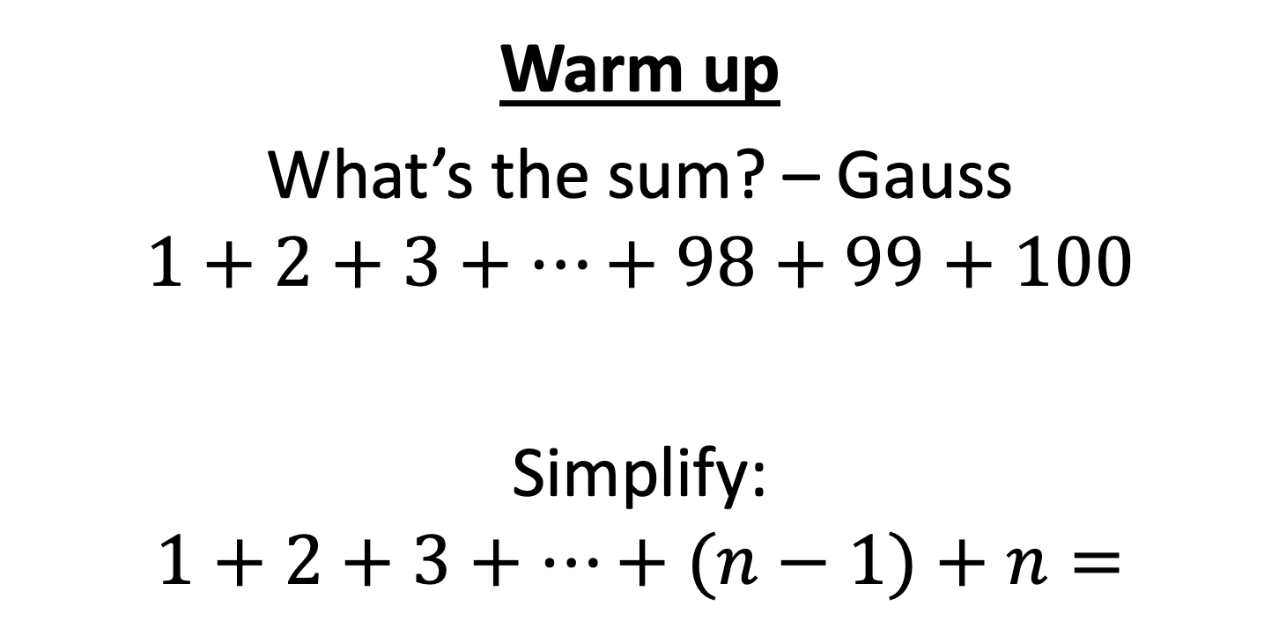
CS4102 Algorithms Spring 2022
Warm up
What’s the sum? – Gauss
$$1+2+3+…+98+99+100$$
Simplify:
$$1+2+3+…+(n−1)+n=$$

Slide 2



$$\frac{n\left(n+1\right)}{2}$$
$$1+2+3+…+(n−1)+n=$$
$$n$$
$$n+1$$

Slide 3
Announcements
Homework 1A Basic is out!
Prof. Hott’s Office hours
Mondays 3-5pm (4-5pm primarily 4102)
Fridays 12-2pm (1-2pm primarily 4102)
Horton’s office hours: See course website
Policy change: max size of collaboration groups is 4 total

Slide 4
Topics in first part of this slide-deck:
Some of this material is from CLRS, Chapter 2
Goals for this lecture:
Review the sorting problem and some “basic” algorithms, while using this to review (or introduce) some principles of algorithm analysis
Topics:
The sorting problem
Insertion Sort
Including a lower-bounds proof
Mergesort
Including an overview of Divide and Conquer
Solving recurrences: tree method and the unrolling method

Slide 5
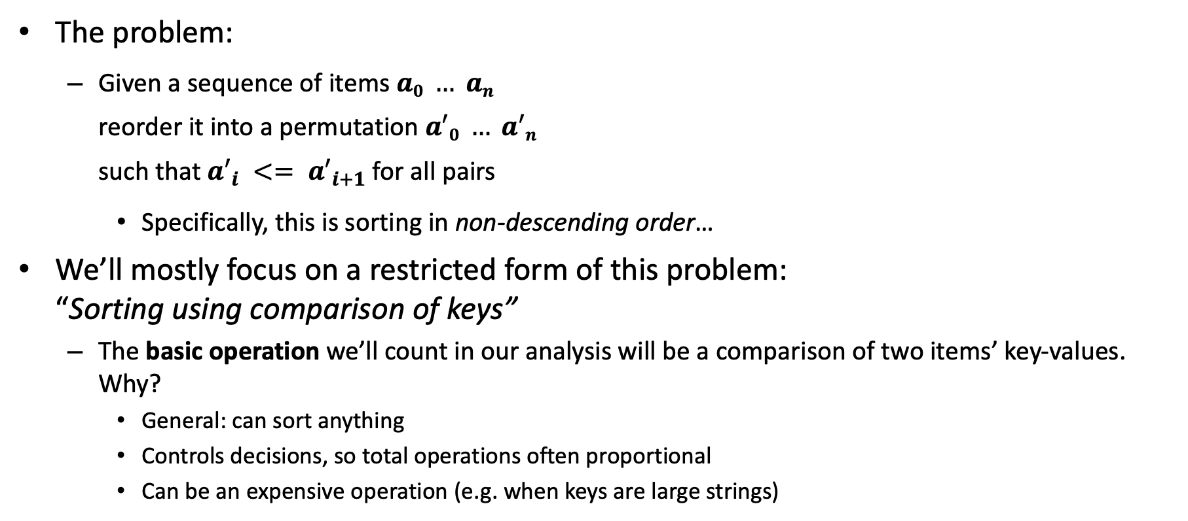
Sorting a Sequence: Defining the Problem
The problem:
Given a sequence of items $a0 … an$ reorder it into a permutation $a′0 … a′n$ such that $a′_{i} <= {a′}_{i+1}$for all pairs
Specifically, this is sorting in non-descending order…
We’ll mostly focus on a restricted form of this problem: “Sorting using comparison of keys”
The basic operation we’ll count in our analysis will be a comparison of two items’ key-values. Why?
General: can sort anything
Controls decisions, so total operations often proportional
Can be an expensive operation (e.g. when keys are large strings)

Slide 6
Some Observations
We assume non-descending order for simplicity
Our analysis results apply for other orderings
You know a comparison-function can be used in practice (e.g. Java’s Comparable interface)
In analyzing a problem and algorithms that solve it, sometimes it’s important to define assumptions like what we’re counting, i.e. the basic operation here
Example: binary search is an optimal algorithm for searching using key comparisons, but hashing can be faster in practice.
Swapping items is often expensive
We can apply same techniques to count swapping, as a separate analysis

Slide 7
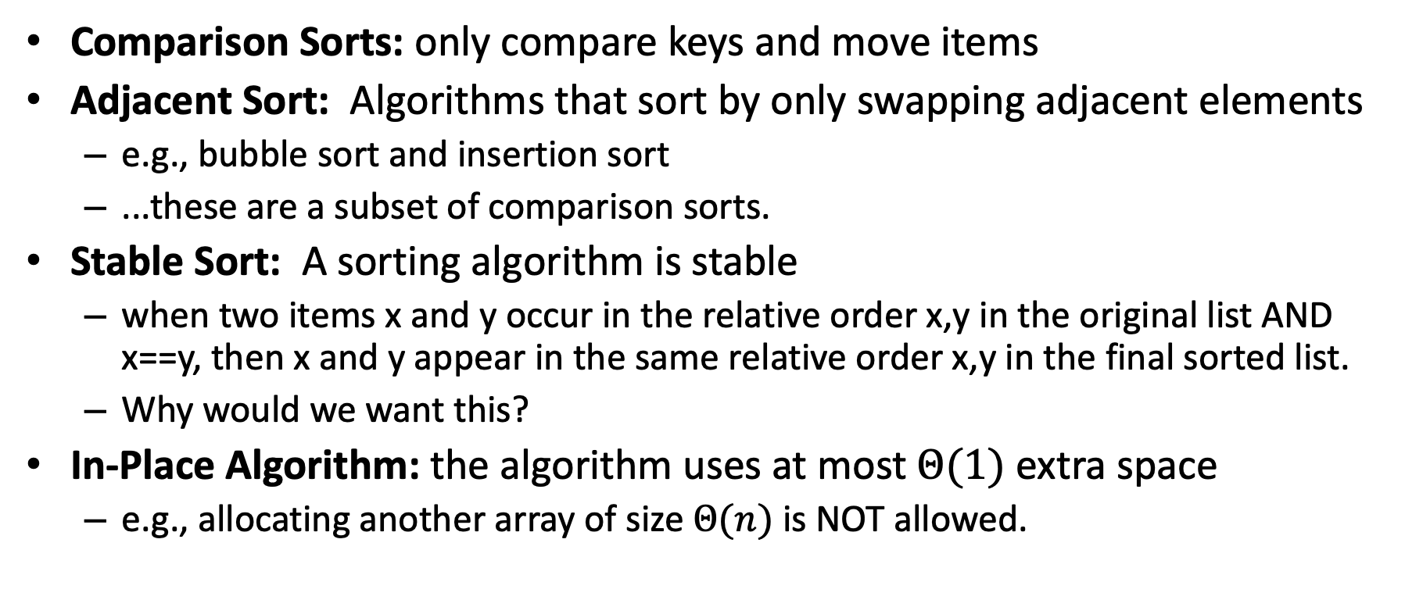
Sorting: More Terminology
Comparison Sorts: only compare keys and move items
Adjacent Sort: Algorithms that sort by only swapping adjacent elements
e.g., bubble sort and insertion sort
...these are a subset of comparison sorts.
Stable Sort: A sorting algorithm is stable
when two items x and y occur in the relative order x,y in the original list AND x==y, then x and y appear in the same relative order x,y in the final sorted list.
Why would we want this?
In-Place Algorithm: the algorithm uses at most$Θ(1)$extra space
e.g., allocating another array of size $Θ(n)$ is NOT allowed.

Slide 8
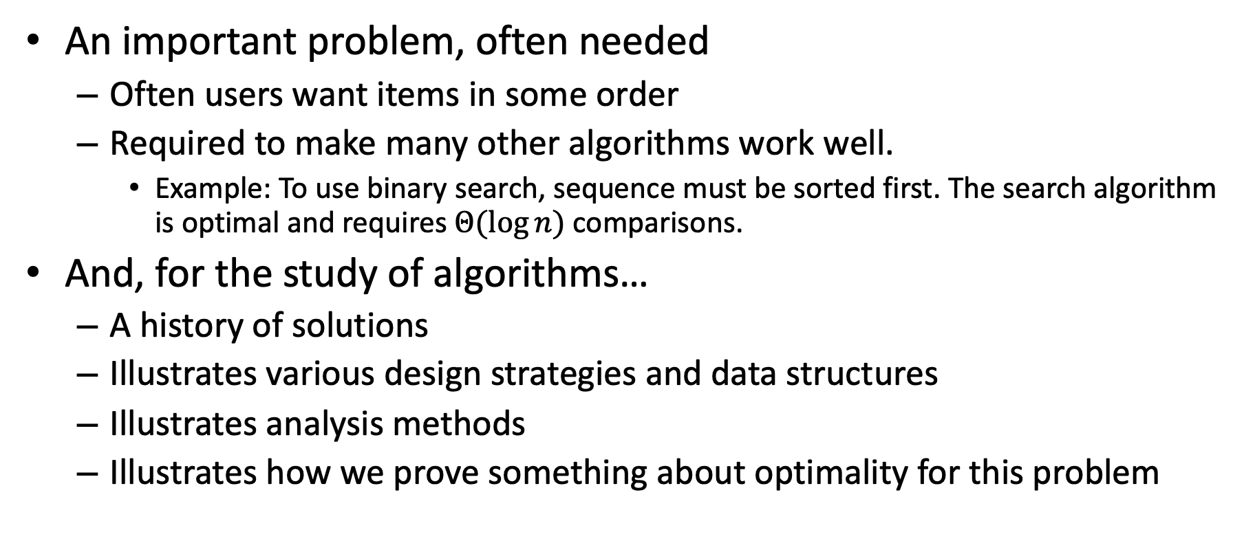
Why Do We Study Sorting?
An important problem, often needed
Often users want items in some order
Required to make many other algorithms work well.
Example: To use binary search, sequence must be sorted first. The search algorithm is optimal and requires $Θ(log⁡n)$comparisons.
And, for the study of algorithms…
A history of solutions
Illustrates various design strategies and data structures
Illustrates analysis methods
Illustrates how we prove something about optimality for this problem

Slide 9
Insertion Sort
Idea: Maintain a sorted list prefix, extend that prefix by “inserting” the next element
Sorted Prefix
3
5
7
8
10
12
9
2
4
6
1
11
3
5
7
8
10
9
12
2
4
6
1
11
3
5
7
8
9
10
12
2
4
6
1
11
Sorted Prefix
3
5
7
8
9
10
12
2
4
6
1
11

Slide 10
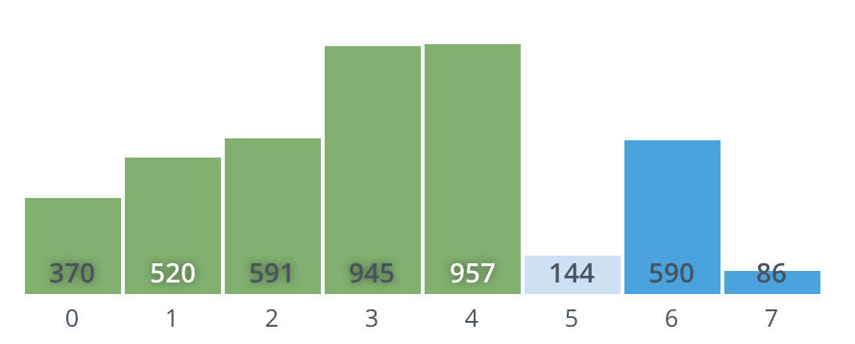
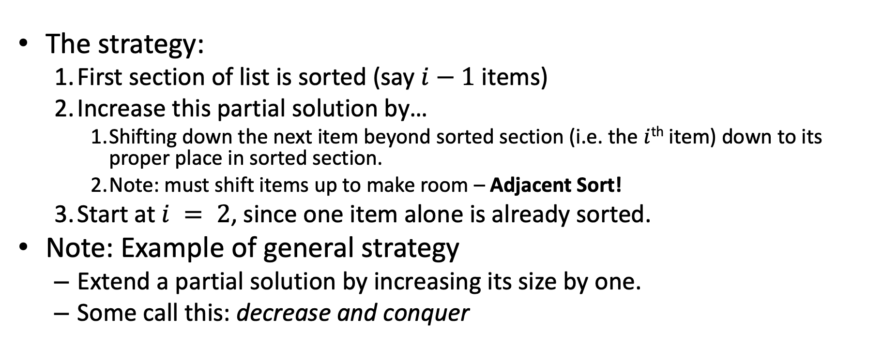
Insertion Sort
The strategy:
First section of list is sorted (say $i−1$ items)
Increase this partial solution by…
Shifting down the next item beyond sorted section (i.e. the $i$^{th} item) down to its proper place in sorted section.
Note: must shift items up to make room – Adjacent Sort!
Start at $i = 2$, since one item alone is already sorted.
Note: Example of general strategy
Extend a partial solution by increasing its size by one.
Some call this: decrease and conquer

Slide 11
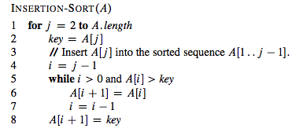
Insertion Sort: Pseudocode
Note: CLRS pseudocode indexes
lists from 1, not from 0.

Slide 12
An Aside: Proving it right with Loop Invariants
An important technique to prove algorithm correctness. (See CLRS or even Wikipedia.)
Properties that hold true at these points:
Prior to first iteration (initialization)
If true before an iteration, then true after that iteration (maintenance)
When loop ends, properties still hold and tell us something useful about correctness (termination)
Loop invariant for Insertion Sort:
For the for-loop governed by index j, the values A[1..j-1] are the elements originally stored in the sub-list but in sorted order

Slide 13
Properties of Insertion Sort
We could have talked about bubble sort, selection sort,…
Why are we focusing on Insertion Sort?
Easy to code
In-place
What’s it like if the list is sorted?
Or almost sorted?
Fine for small inputs. Why?
Is it stable? Why?

Slide 14
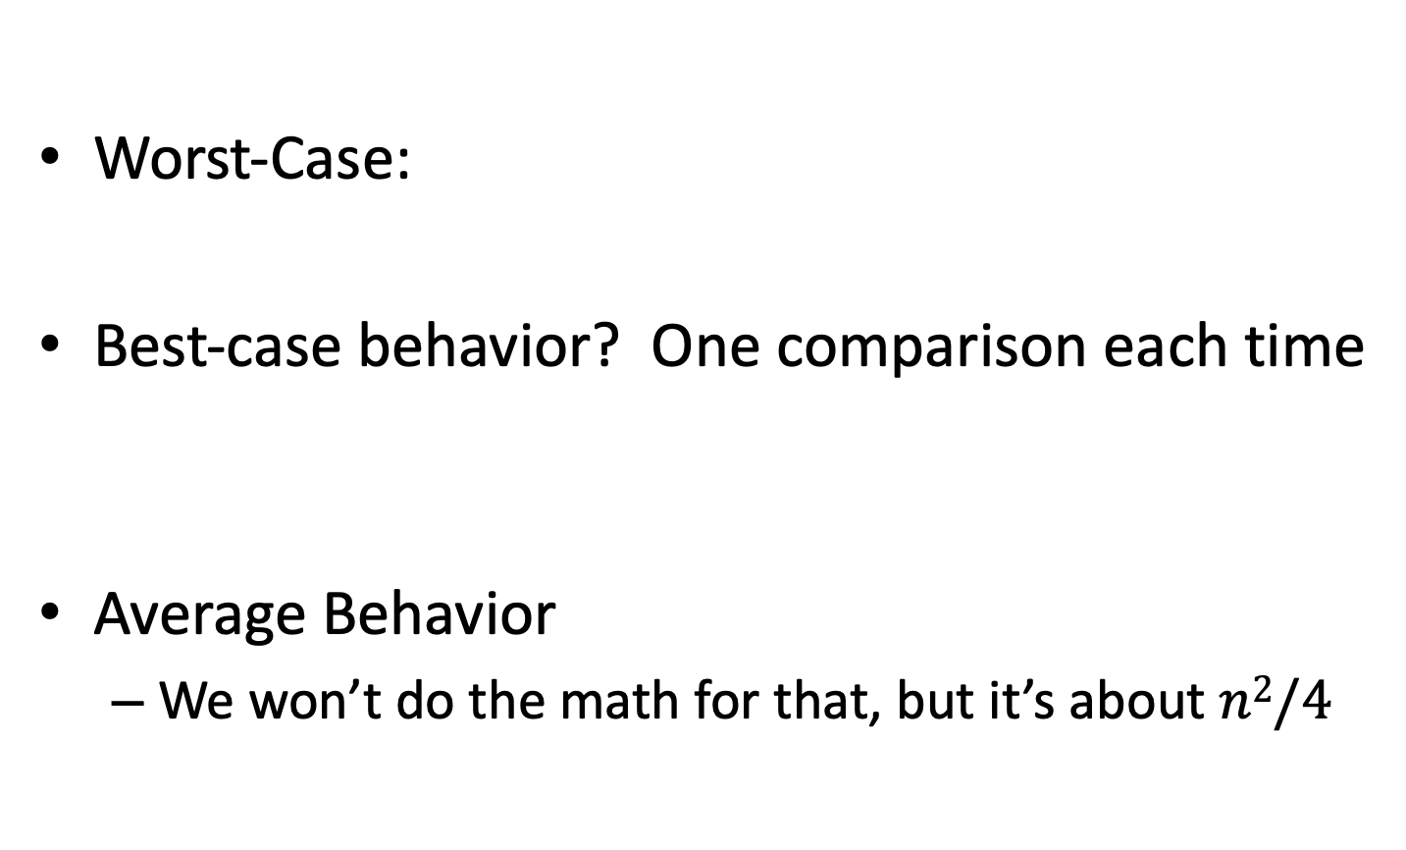
Insertion Sort: Analysis
Worst-Case:
Best-case behavior? One comparison each time
Average Behavior
We won’t do the math for that, but it’s about $n2/4$

Slide 15
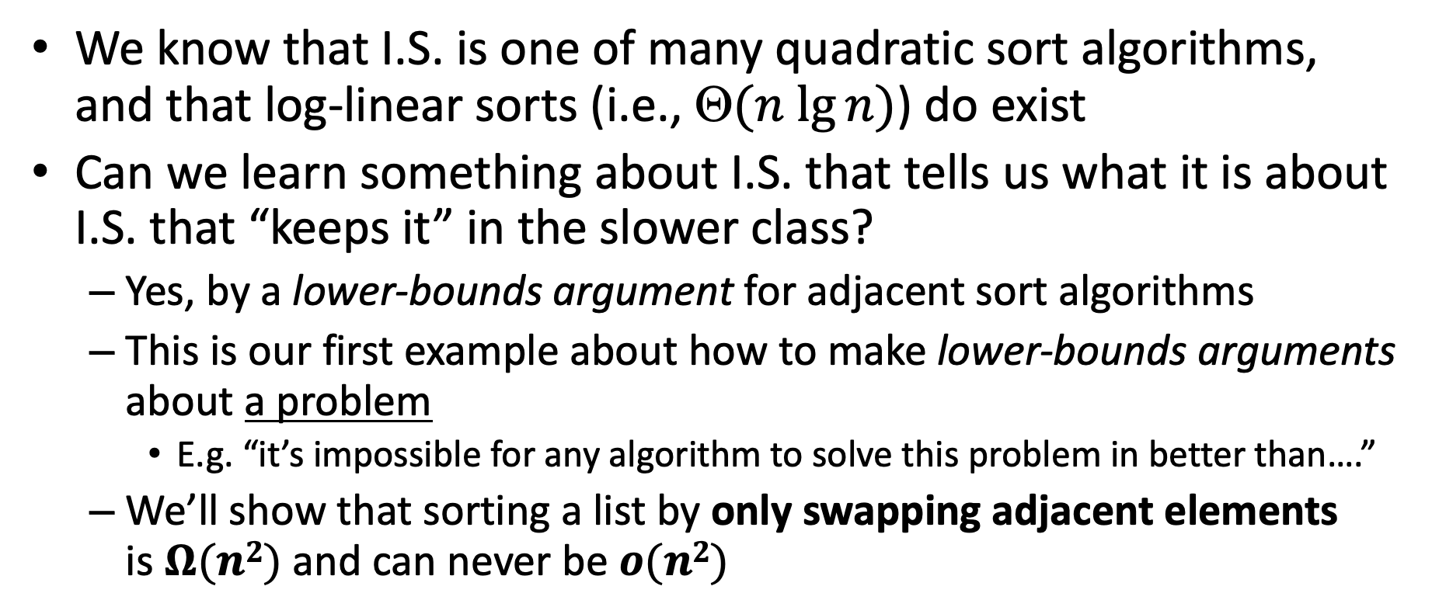
Insertion Sort: Best of a breed?
We know that I.S. is one of many quadratic sort algorithms, and that log-linear sorts (i.e., $(n lg⁡n)$) do exist
Can we learn something about I.S. that tells us what it is about I.S. that “keeps it” in the slower class?
Yes, by a lower-bounds argument for adjacent sort algorithms
This is our first example about how to make lower-bounds arguments about a problem
E.g. “it’s impossible for any algorithm to solve this problem in better than….”
We’ll show that sorting a list by only swapping adjacent elements is $Ω(n2)$ and can never be $o(n2)$

Slide 16
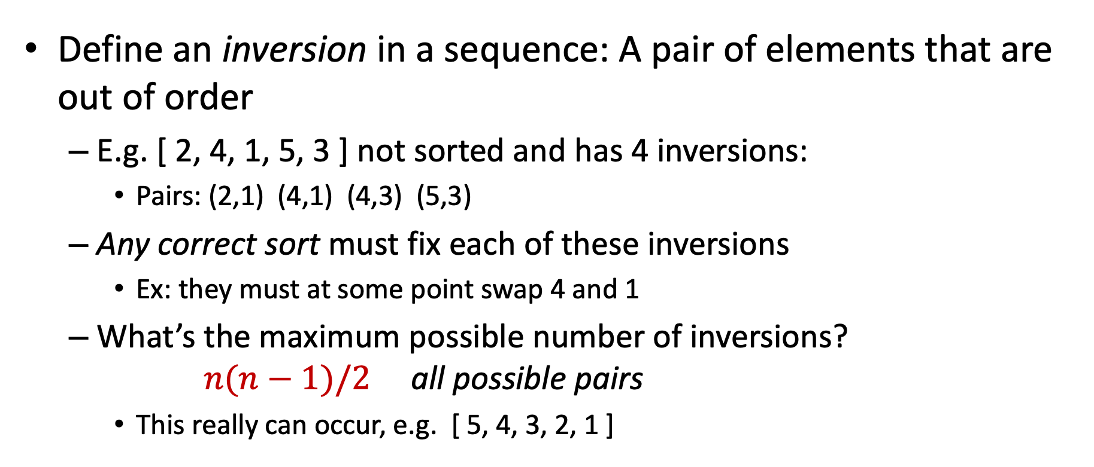
Removing Inversions
Define an inversion in a sequence: A pair of elements that are out of order
E.g. [ 2, 4, 1, 5, 3 ] not sorted and has 4 inversions:
Pairs: (2,1) (4,1) (4,3) (5,3)
Any correct sort must fix each of these inversions
Ex: they must at some point swap 4 and 1
What’s the maximum possible number of inversions? $n(n−1)/2$ all possible pairs
This really can occur, e.g. [ 5, 4, 3, 2, 1 ]

Slide 17
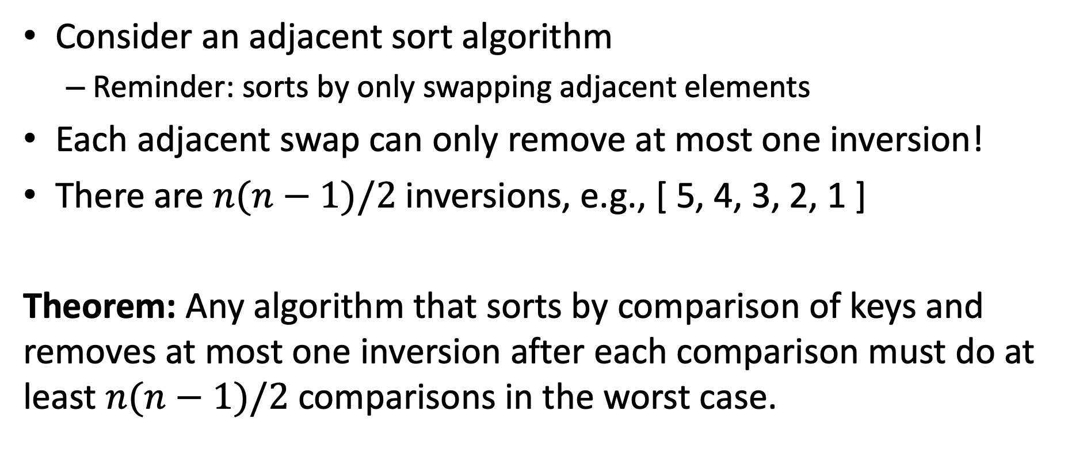
Removing Inversions – Lower Bound
Consider an adjacent sort algorithm
Reminder: sorts by only swapping adjacent elements
Each adjacent swap can only remove at most one inversion!
There are $n(n−1)/2$inversions, e.g., [ 5, 4, 3, 2, 1 ]
Theorem: Any algorithm that sorts by comparison of keys and removes at most one inversion after each comparison must do at least $n(n−1)/2$comparisons in the worst case.

Slide 18
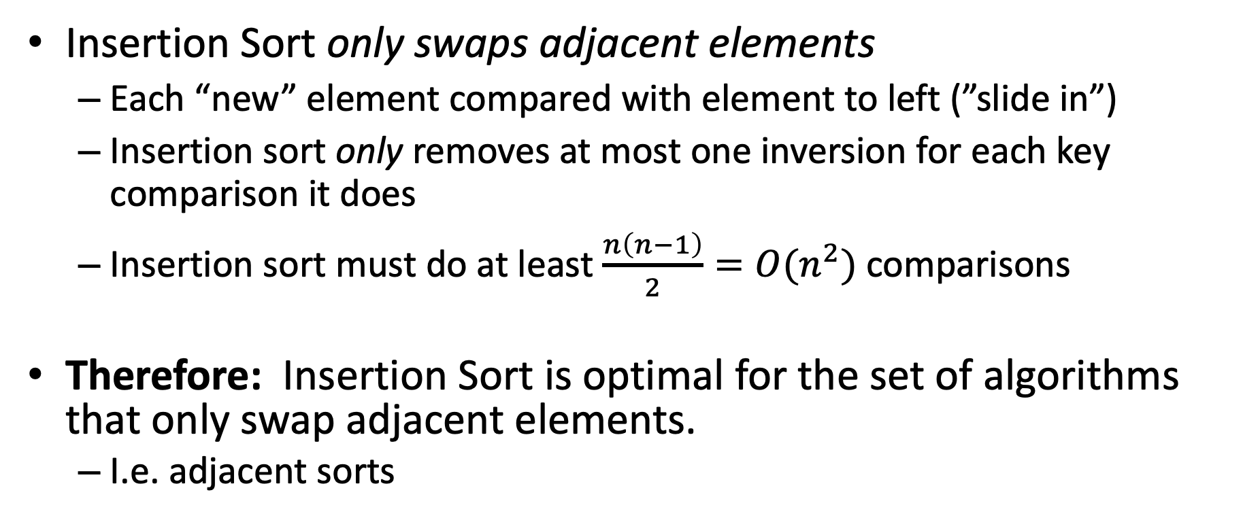
Lower Bound and Insertion Sort
Insertion Sort only swaps adjacent elements
Each “new” element compared with element to left (”slide in”)
Insertion sort only removes at most one inversion for each key comparison it does
Insertion sort must do at least $\frac{n\left(n−1\right)}{2}=O(n^{2})$comparisons
Therefore: Insertion Sort is optimal for the set of algorithms that only swap adjacent elements.
I.e. adjacent sorts

Slide 19
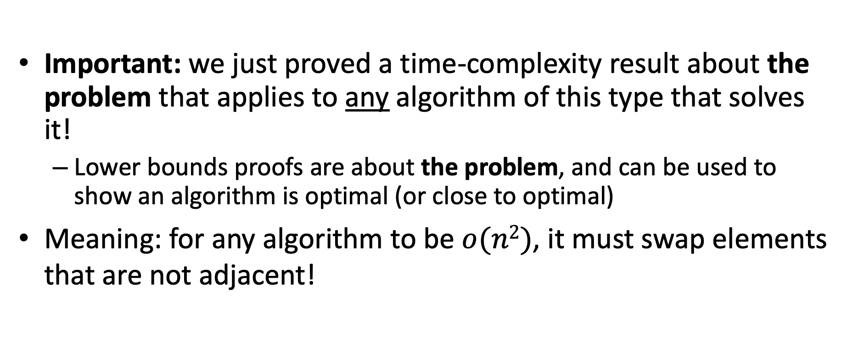
Lower Bound is General
Important: we just proved a time-complexity result about the problem that applies to any algorithm of this type that solves it!
Lower bounds proofs are about the problem, and can be used to show an algorithm is optimal (or close to optimal)
Meaning: for any algorithm to be $o(n2)$, it must swap elements that are not adjacent!

Slide 20
Mergesort Overview
General and practical sorting algorithm
Good example of a divide-and-conquer algorithm
Recursion leads to a more efficient solution in the worst-case than adjacent sorts
It’s o(n²) or Θ(n lg n) to be more precise

Slide 21
Divide and Conquer
[CLRS Chapter 4]
Divide:
Break the problem into multiple subproblems, each smaller instances of the original
Conquer:
If the suproblems are “large”:
Solve each subproblem recursively
If the subproblems are “small”:
Solve them directly (base case)
Combine:
Merge solutions to subproblems to obtain solution for original problem
When is this an effective strategy?

Slide 22
Generic Divide and Conquer Solution
def myDCalgo(problem):
if baseCase(problem):
solution = solve(problem) #brute force if necessary
return solution
subproblems = Divide(problem)
for sub in subproblems:
subsolutions.append(myDCalgo(sub))
solution = Combine(subsolutions)
return solution

Slide 23
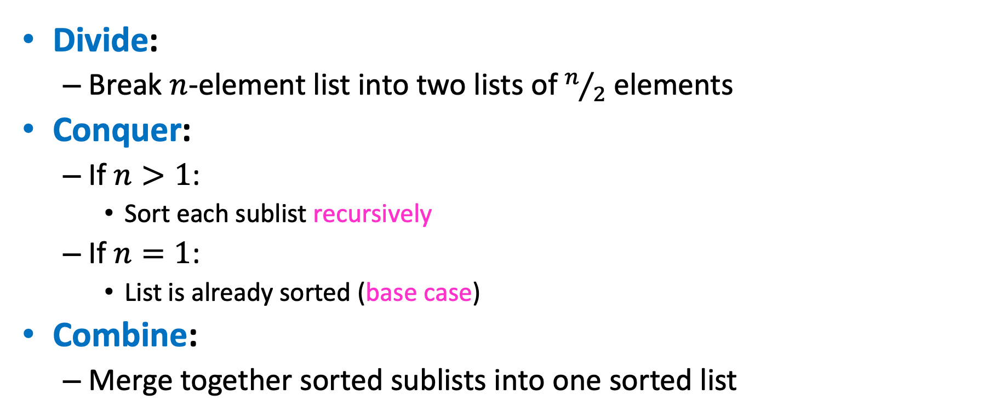
Merge Sort: Divide and Conquer Sorting
Divide:
Break $n$-element list into two lists of $n/2$ elements
Conquer:
If $n>1$:
Sort each sublist recursively
If $n=1$:
List is already sorted (base case)
Combine:
Merge together sorted sublists into one sorted list

Slide 24
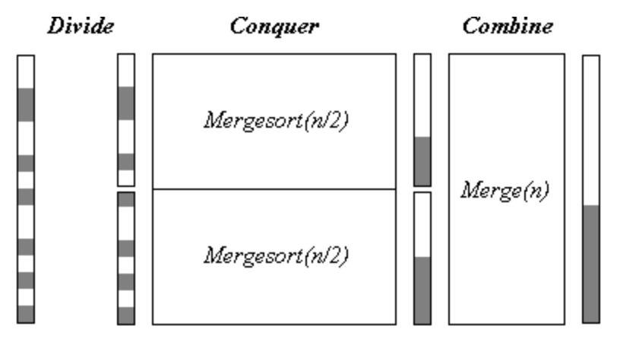
A Visualization
Note: in this visualization, think of the gray regions being larger values that should get sorted to the end (the bottom).

Slide 25
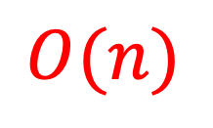
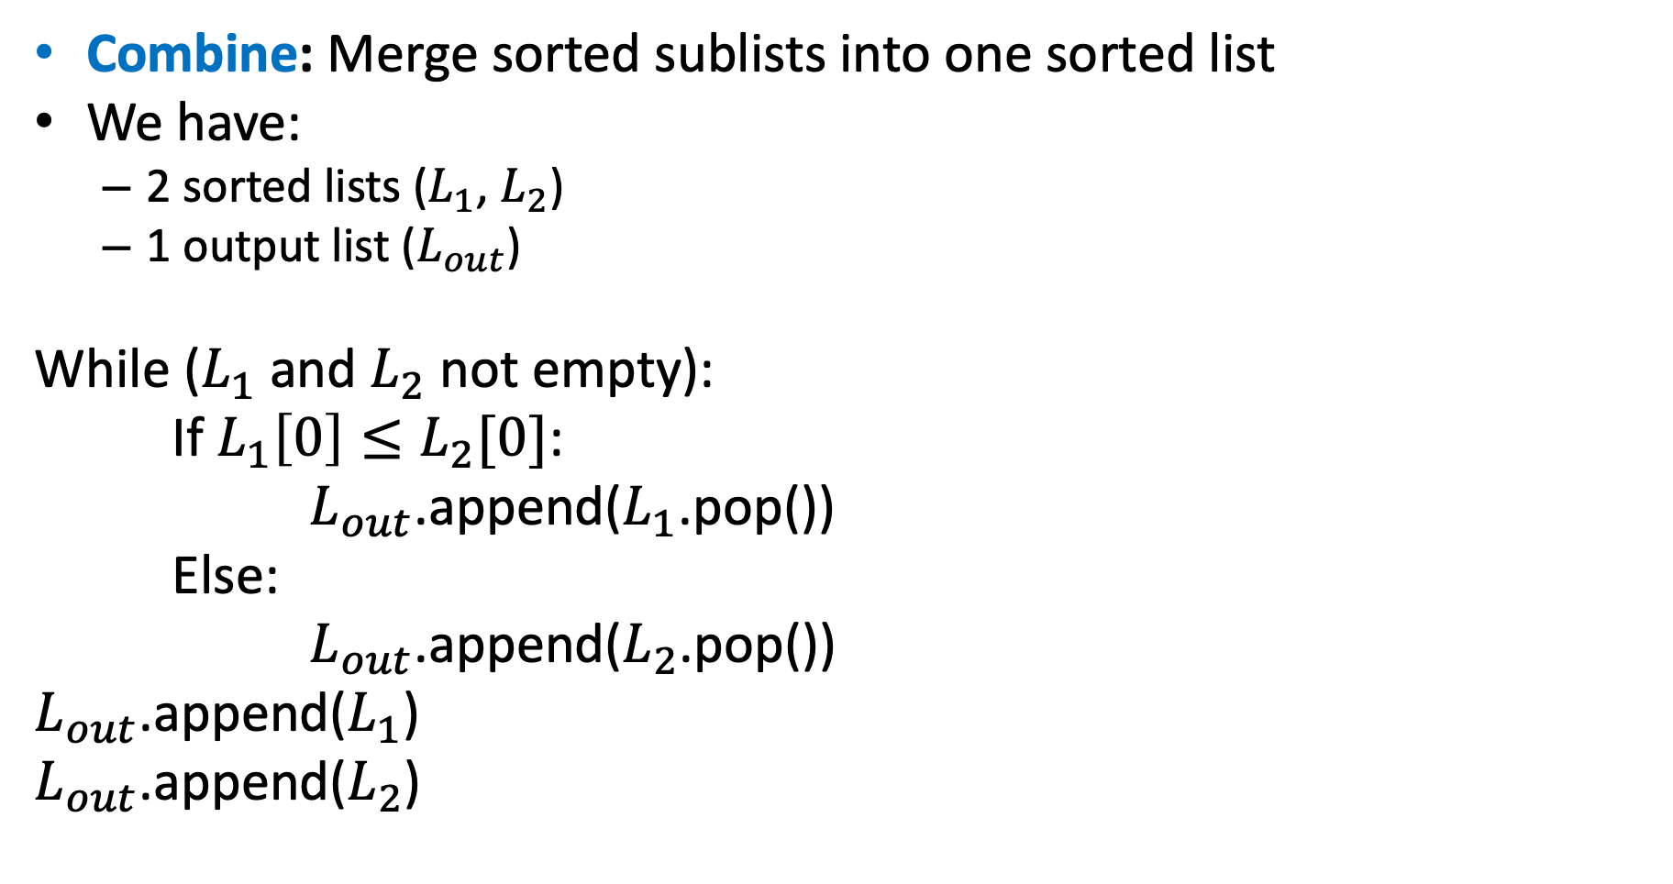
Merge
Combine: Merge sorted sublists into one sorted list
We have:
2 sorted lists ($L_{1}$, $L_{2}$)
1 output list ($L_{out}$)
While ($L_{1}$ and $L_{2}$ not empty):
If $L_{1}\left[0\right]≤L_{2}[0]$:
$L_{out}$.append($L_{1}$.pop())
Else:
$L_{out}$.append($L_{2}$.pop())
$L_{out}$.append($L_{1}$)
$L_{out}$.append($L_{2}$)
$$O(n)$$

Slide 26
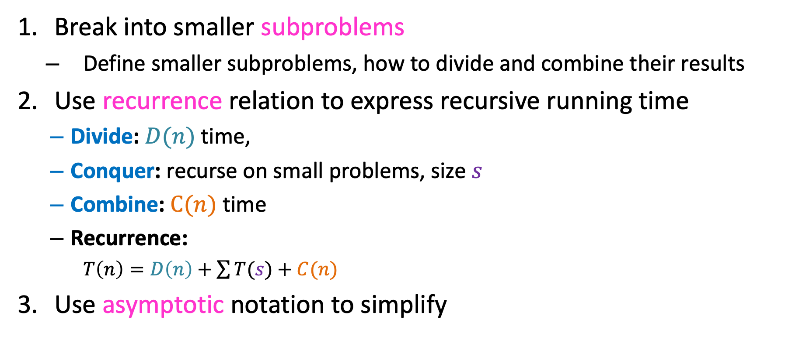
Analyzing Divide and Conquer
Break into smaller subproblems
Define smaller subproblems, how to divide and combine their results
Use recurrence relation to express recursive running time
Divide: $D(n)$ time,
Conquer: recurse on small problems, size $s$
Combine: $C(n)$ time
Recurrence:
$T\left(n\right)=D\left(n\right)+\sum{T(s)}+C(n)$
Use asymptotic notation to simplify

Slide 27
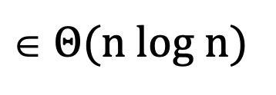
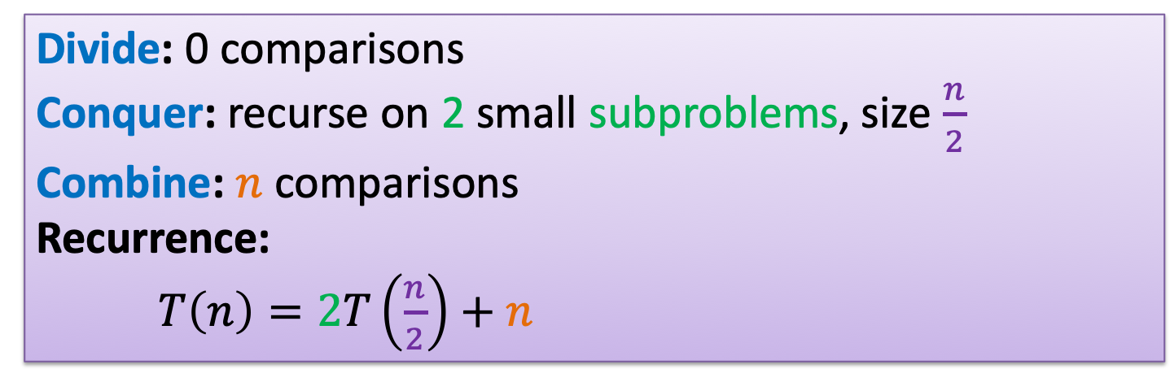
Analyzing Merge Sort
Break into smaller subproblems
Use recurrence relation to express recursive running time
Use asymptotic notation to simplify
Divide: 0 comparisons
Conquer: recurse on 2 small subproblems, size $\frac{n}{2}$
Combine: $n$ comparisons
Recurrence:
$T\left(n\right)=2T\left(\frac{n}{2}\right)+n$
$\text{}$ Θ(n log n)
Let’s see why!

Slide 28



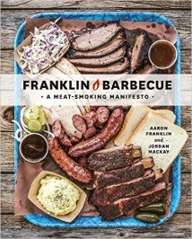
Recurrence Solving Techniques
Four methods for solving recurrences
Unrolling: expand the recurrence
Tree: get a picture of recursion
Guess/Check: Substitution by guessing the solution and using induction to prove
“Cookbook”: Use magic (a.k.a. Master Theorem)
?

Slide 29
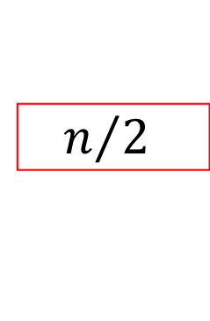


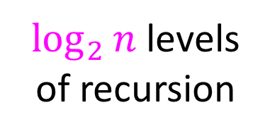




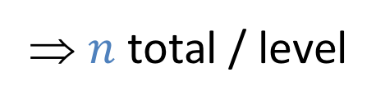


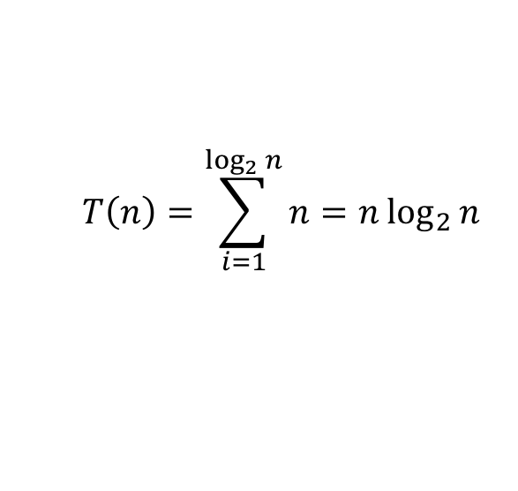
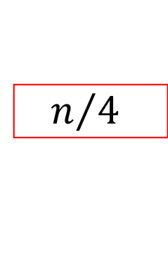
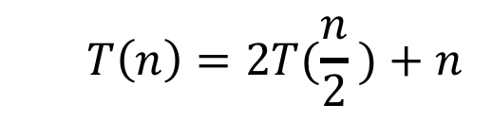








Tree method
$$T\left(n\right)=2T(\frac{n}{2} )+n$$
$$n$$
$$n$$
⇒ $n$ total / level
$$n/2$$
$$\frac{n}{2}$$
$$n/2$$
$$\frac{n}{2}$$
$$\frac{n}{4}$$
$$\frac{n}{4}$$
$$\frac{n}{4}$$
$$\frac{n}{4}$$
$\log_{2}⁡n$ levels
of recursion
$$n/4$$
$$n/4$$
$$n/4$$
$$n/4$$
…
…
…
…
…
$$1$$
$$1$$
$$1$$
$$1$$
$$1$$
$$1$$
$$1$$
$$1$$
$$1$$
$$1$$
$$1$$
$$1$$
$$T\left(n\right)=\sum_{i=1}^{\log_{2}{n}}{n}=n\log_{2}{n}$$

Slide 30
Unrolling
The strategy:
Replace the recursive calculation for the smaller value with what you get if you “plug in” the smaller value into the original recurrence
Repeat and describe the general pattern
Use the base case to find how many repetitions
Finally plug in base case value and simplify
Let’s do this for Mergesort’s recurrence!

Slide 31
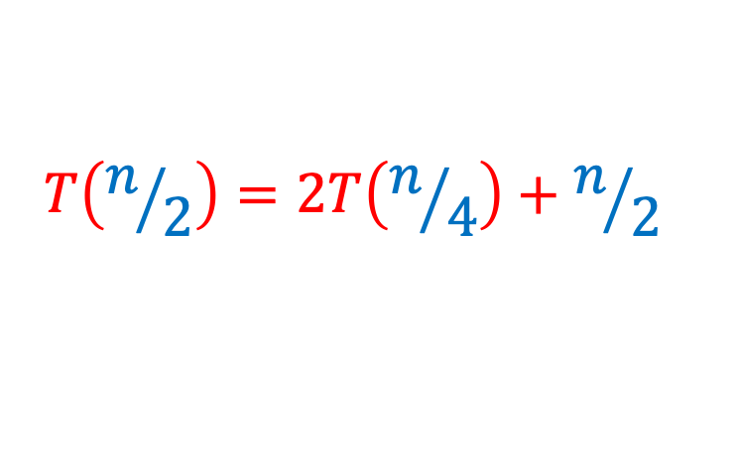
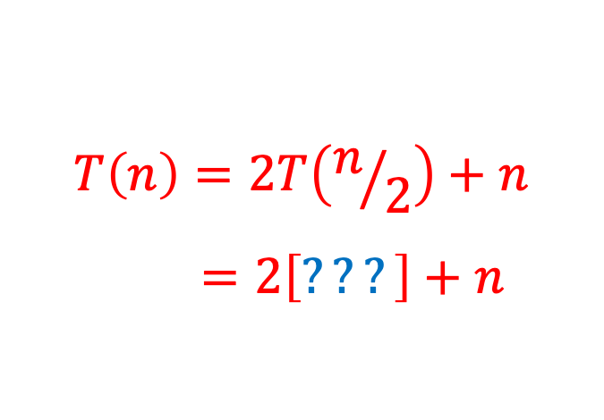
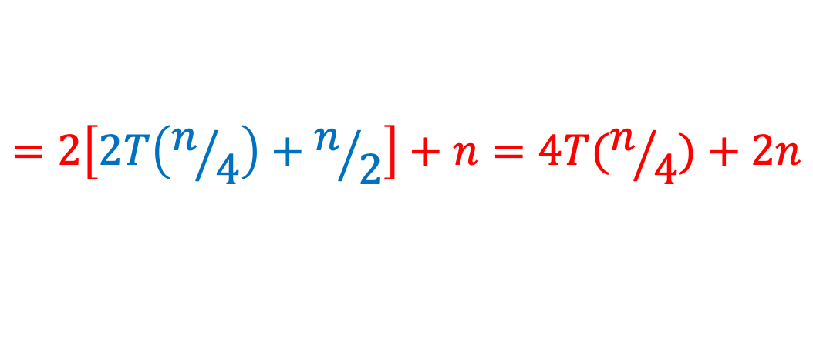
Unrolling, Step 1
Replace the recursive calculation for the smaller value with what you get if you “plug in” the smaller value into the original recurrence
$$T\left(n\right)=2T\left(n/2\right)+n$$
$$=2\left[???\right]+n$$
$$T\left(n/2\right)=2T\left(n/4\right)+n/2$$
$$=2\left[2T\left(n/4\right)+n/2\right]+n=4T(n/4)+2n$$

Slide 32
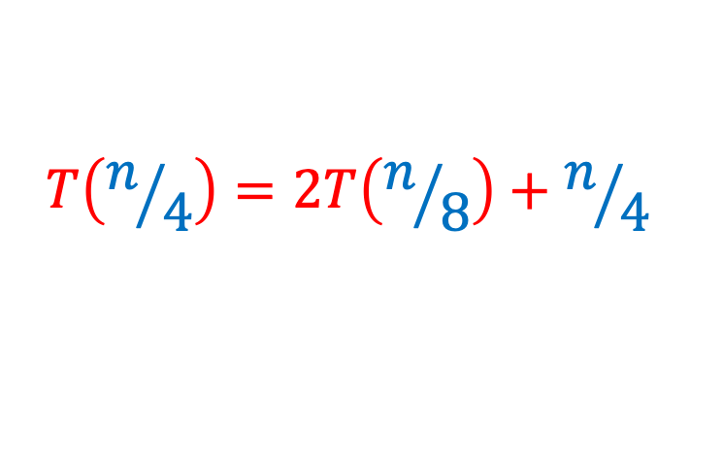
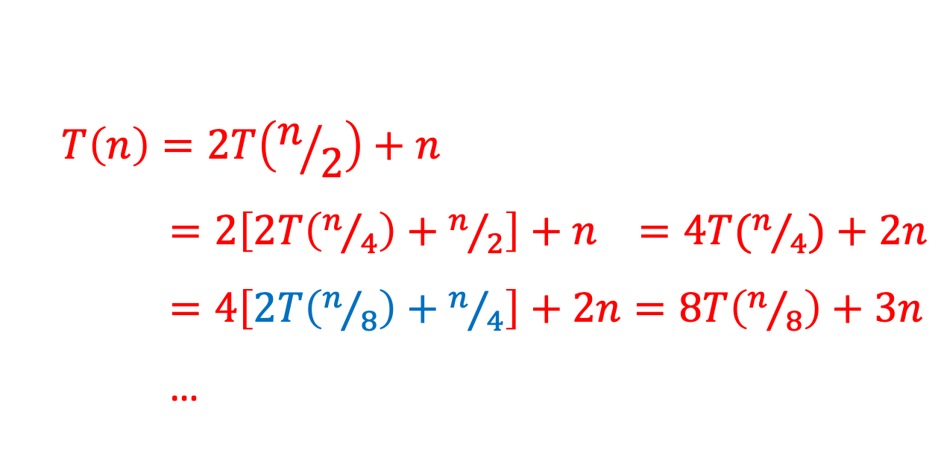
Unrolling, Step 2: Repeating
Replace the recursive calculation for the smaller value with what you get if you “plug in” the smaller value into the original recurrence
Repeat and describe the general pattern
$$T\left(n\right)=2T\left(n/2\right)+n$$
$=2\left[2T\left(n/4\right)+n/2\right]+n =4T(n/4)+2n$
$=4\left[2T\left(n/8\right)+n/4\right]+2n=8T\left(n/8\right)+3n$
…
$$T\left(n/4\right)=2T\left(n/8\right)+n/4$$

Slide 33


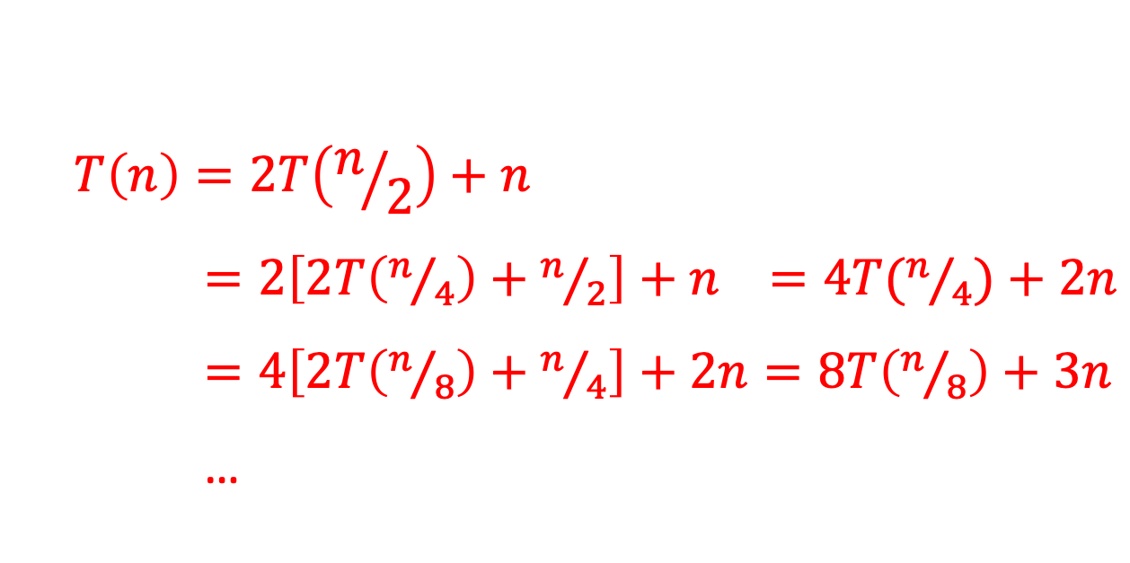



Unrolling, Step 2: General Pattern
Replace the recursive calculation for the smaller value with what you get if you “plug in” the smaller value into the original recurrence
Repeat and describe the general pattern
Let $i$count repetitions
$$T\left(n\right)=2T\left(n/2\right)+n$$
$=2\left[2T\left(n/4\right)+n/2\right]+n =4T(n/4)+2n$
$=4\left[2T\left(n/8\right)+n/4\right]+2n=8T\left(n/8\right)+3n$
…
$$i=1$$
$$i=2$$
$$i=3$$
$$=2i T\left(n/{2i}\right)+i n$$

Slide 34

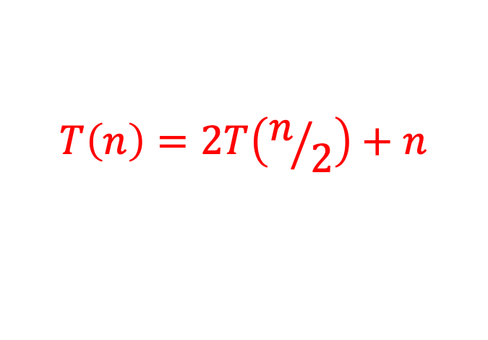
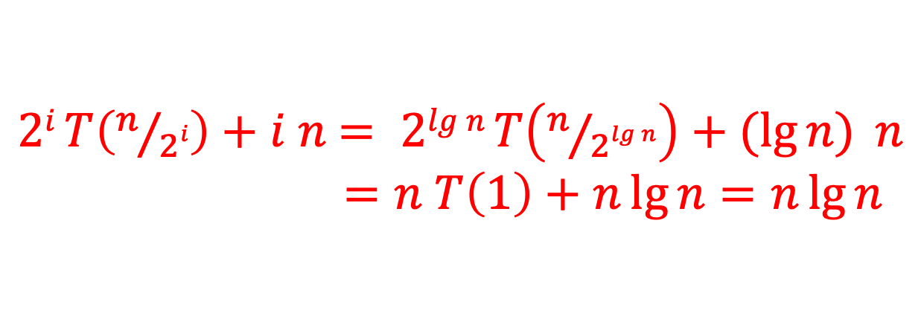
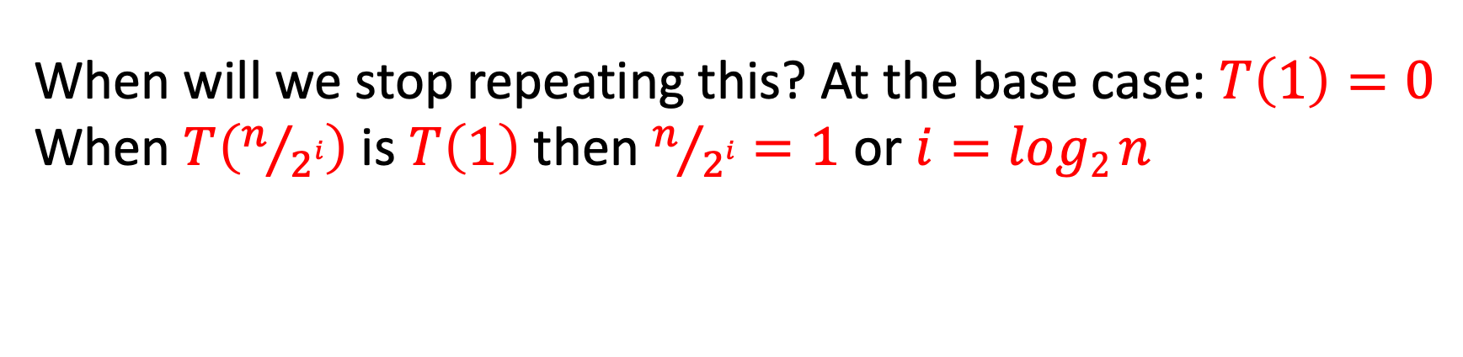

Unrolling, Steps 3 and 4: General Pattern
Use the base case to find how many repetitions
Finally plug in base case value and simplify
$$T\left(n\right)=2T\left(n/2\right)+n$$
$$=2i T\left(n/{2i}\right)+i n$$
Let $i$count repetitions
When will we stop repeating this? At the base case: $T\left(1\right)=0$
When $T\left(n/{2i}\right)$ is $T\left(1\right)$ then $n/{2i}=1$ or $i=log2 n$
$2i T\left(n/{2i}\right)+i n$ $= 2lg n T\left(n/{2lg n}\right)+(\lg{n)} n$ $=n T\left(1\right)+n\lg{n=n\lg{n}}$
We have the closed form
of the recurrence!

Slide 35
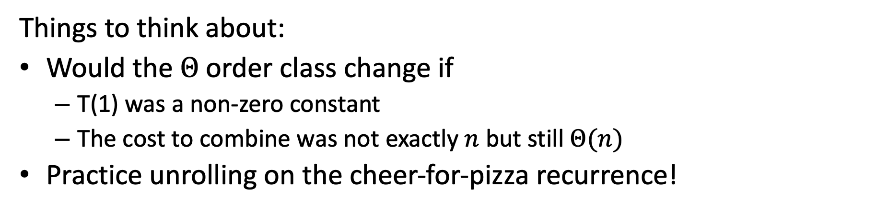

Conclusion
Using the unrolling technique, we’ve found the closed form for:
Mergesort’s Recurrence:
$T\left(1\right)=0, T\left(n\right)=2T\left(\frac{n}{2}\right)+n=n log n$
Mergesort is a log-linear sort, Θ(n log n)
Things to think about:
Would the Θ order class change if
T(1) was a non-zero constant
The cost to combine was not exactly $n$ but still Θ($n$)
Practice unrolling on the cheer-for-pizza recurrence!

Slide 36
Where we are: We’ve used sorting to…
See again how to apply ideas of counting operations
For insertion sort, we’ve discussed: worst, average, best case
See two different strategies for the same problem
Insertion sort: “decrease and conquer”
Mergesort: divide and conquer
Introduced some new concepts: in-place, stable
Prove a lower-bound that shows
One class of algorithms has a lower bound of Ω(n²)
To do better, must remove >1 inversion for each comparison
Methods for solving recurrences
Seen the tree method
Learned the unrolling method

