Slide 1
WebGL Connelly Barnes CS 4810: Graphics Acknowledgement: Content from tutorials by NeHe Productions, Giles Thomas, Johannes Raida

Slide 2
What is WebGL?
A JavaScript API for rendering 2D/3D graphics.
Based on OpenGL ES (Embedded Systems) 2.0
Programmable pipeline only (shaders)
No fixed-function pipeline (no glTranslate, glColor, glLight, …)
But these are emulated by libraries such as glMatrix and Three.js

Slide 3
Resources
Three.js examples and documentation
NeHe OpenGL tutorials
WebGL tutorial by Giles Thomas, from http://learningwebgl.com/
Three.js WebGL tutorial by Johannes Raida: http://www.johannes-raida.de/tutorials.htm
Microsoft WebGL reference manual
Mozilla WebGL reference
GLSL reference (”OpenGL Shading Language”)

Slide 4
Setup Stage
Do the following at command line: git clone https://github.com/uva-graphics/webgl.git cd webgl python -m SimpleHTTPServer
Point a Web browser to http://localhost:8000/
Alternative on cloud9 (Web-based Linux): run only the git clone line, then right click the html files in the webgl repository and choose Preview.

Slide 5
Basics
<html><head> <script type="text/javascript">
function webGLStart() { var canvas = document.getElementById("cvs");
gl = canvas.getContext("webgl-test");
gl.clearColor(0, 0, 0, 1);
…
}
</script> </head>
<body onload="webGLStart();">
<canvas id="cvs" width="500" height="500"> </canvas>

Slide 6
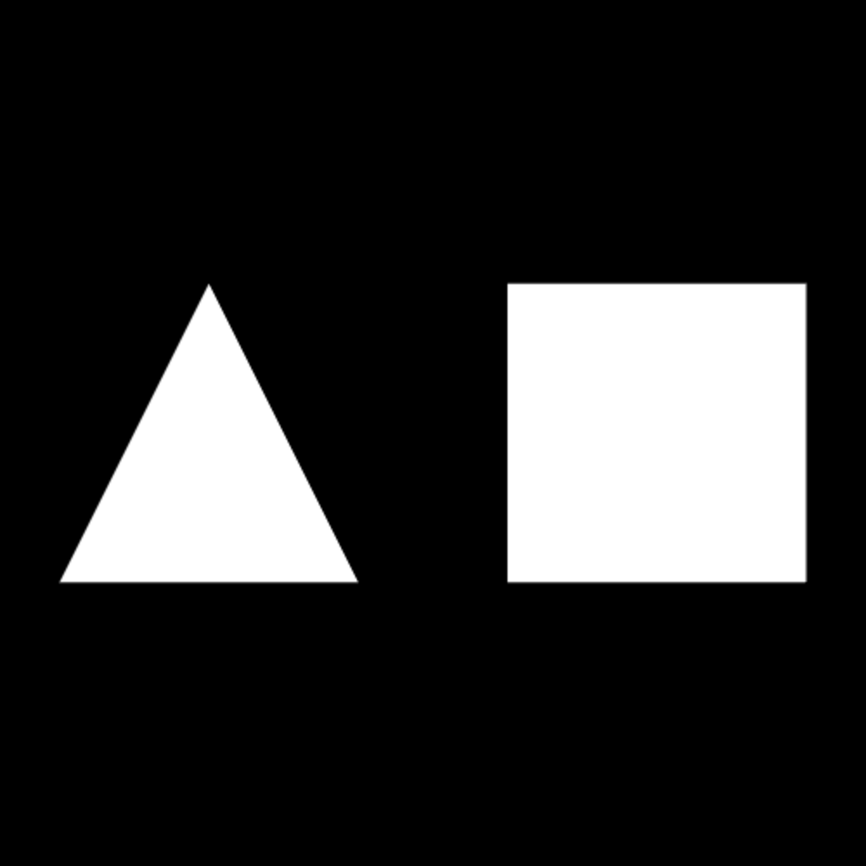
Lesson 1: Triangle and Quad

Slide 7
Lesson 1: Triangle and Quad (WebGL)
Local Web server links: WebGL lesson 1 (also, view source)
Web links: WebGL lesson 1 (also, view source)

Slide 8
Lesson 1: Triangle and Quad (WebGL)
Uses the glMatrix library:
<script type="text/javascript” src="glMatrix-0.9.5.min.js"></script>

Slide 9
Lesson 1: Triangle and Quad (WebGL)
Creates a fragment shader. This determines the RGBA colors of fragments (pixels).
<script id="shader-fs”
type="x-shader/x-fragment">
precision mediump float;
void main(void) {
gl_FragColor = vec4(1.0, 1.0, 1.0, 1.0);
}
</script>

Slide 10
Lesson 1: Triangle and Quad (WebGL)
Creates a vertex shader. This transforms model coordinates to screen coordinates.
<script id="shader-vs" type="x-shader/x-vertex">
attribute vec3 aVertexPosition;
uniform mat4 uMVMatrix;
uniform mat4 uPMatrix;
void main(void) {
gl_Position = uPMatrix * uMVMatrix * vec4(aVertexPosition, 1.0);
}
</script>

Slide 11
Lesson 1: Triangle and Quad (WebGL)
Multiply by “modelview” matrix (model to world)
Multiply by “perspective” matrix (world to screen)
<script id="shader-vs" type="x-shader/x-vertex">
attribute vec3 aVertexPosition;
uniform mat4 uMVMatrix;
uniform mat4 uPMatrix;
void main(void) {
gl_Position = uPMatrix * uMVMatrix * vec4(aVertexPosition, 1.0);
}
</script>

Slide 12
Lesson 1: Triangle and Quad (WebGL)
“Uniform” variables are global arguments to the shader that do not change with vertex/fragment.
<script id="shader-vs" type="x-shader/x-vertex">
attribute vec3 aVertexPosition;
uniform mat4 uMVMatrix;
uniform mat4 uPMatrix;
void main(void) {
gl_Position = uPMatrix * uMVMatrix * vec4(aVertexPosition, 1.0);
}
</script>

Slide 13
Lesson 1: Triangle and Quad (WebGL)
Initialize gl context from canvas.
<script type="text/javascript">
var gl;
function initGL(canvas) {
try {
gl = canvas.getContext("experimental-webgl");
gl.viewportWidth = canvas.width;
gl.viewportHeight = canvas.height;
} catch (e) {
}
if (!gl) {
alert("Could not initialise WebGL, sorry :-(");
}
}

Slide 14
Lesson 1: Triangle and Quad (WebGL)
Generic function for getting shaders.
function getShader(gl, id) {
var shaderScript = document.getElementById(id);
if (!shaderScript) {
return null;
}
... }

Slide 15
Lesson 1: Triangle and Quad (WebGL)
Initialize shaders and set up their uniform vars.
var shaderProgram;
function initShaders() {
var fragmentShader = getShader(gl, "shader-fs");
var vertexShader = getShader(gl, "shader-vs");
shaderProgram = gl.createProgram();
gl.attachShader(shaderProgram, vertexShader);
gl.attachShader(shaderProgram, fragmentShader);
gl.linkProgram(shaderProgram);
if (!gl.getProgramParameter(shaderProgram, gl.LINK_STATUS)) {
alert("Could not initialise shaders");
}
gl.useProgram(shaderProgram);
shaderProgram.vertexPositionAttribute = gl.getAttribLocation(shaderProgram, "aVertexPosition");
gl.enableVertexAttribArray(shaderProgram.vertexPositionAttribute);
shaderProgram.pMatrixUniform = gl.getUniformLocation(shaderProgram, "uPMatrix");
shaderProgram.mvMatrixUniform = gl.getUniformLocation(shaderProgram, "uMVMatrix");
}

Slide 16
Lesson 1: Triangle and Quad (WebGL)
Set modelview and perspective matrix from global variables.
var mvMatrix = mat4.create();
var pMatrix = mat4.create();
function setMatrixUniforms() {
gl.uniformMatrix4fv(shaderProgram.pMatrixUniform,
false, pMatrix);
gl.uniformMatrix4fv(shaderProgram.mvMatrixUniform,
false, mvMatrix);
}

Slide 17
Lesson 1: Triangle and Quad (WebGL)
Build triangle and quadrilateral in buffers.
var triangleVertexPositionBuffer;
var squareVertexPositionBuffer;
function initBuffers() {
triangleVertexPositionBuffer = gl.createBuffer();
gl.bindBuffer(gl.ARRAY_BUFFER,
triangleVertexPositionBuffer);
var vertices = [
0.0, 1.0, 0.0,
-1.0, -1.0, 0.0,
1.0, -1.0, 0.0
];
gl.bufferData(gl.ARRAY_BUFFER, new Float32Array(vertices), gl.STATIC_DRAW);
triangleVertexPositionBuffer.itemSize = 3;
triangleVertexPositionBuffer.numItems = 3;
squareVertexPositionBuffer = gl.createBuffer();
gl.bindBuffer(gl.ARRAY_BUFFER, squareVertexPositionBuffer);
vertices = [
1.0, 1.0, 0.0,
-1.0, 1.0, 0.0,
1.0, -1.0, 0.0,
-1.0, -1.0, 0.0
];
gl.bufferData(gl.ARRAY_BUFFER, new Float32Array(vertices), gl.STATIC_DRAW);
squareVertexPositionBuffer.itemSize = 3;
squareVertexPositionBuffer.numItems = 4;
}

Slide 18
Lesson 1: Triangle and Quad (WebGL)
Build triangle and quadrilateral in buffers.
squareVertexPositionBuffer = gl.createBuffer();
gl.bindBuffer(gl.ARRAY_BUFFER, squareVertexPositionBuffer);
vertices = [
1.0, 1.0, 0.0,
-1.0, 1.0, 0.0,
1.0, -1.0, 0.0,
-1.0, -1.0, 0.0
];
gl.bufferData(gl.ARRAY_BUFFER, new Float32Array(vertices), gl.STATIC_DRAW);
squareVertexPositionBuffer.itemSize = 3;
squareVertexPositionBuffer.numItems = 4;
}

Slide 19
Lesson 1: Triangle and Quad (WebGL)
Draw the scene, using glMatrix as a helper.
function drawScene() {
gl.viewport(0, 0, gl.viewportWidth, gl.viewportHeight);
gl.clear(gl.COLOR_BUFFER_BIT | gl.DEPTH_BUFFER_BIT);
mat4.perspective(45, gl.viewportWidth / gl.viewportHeight, 0.1, 100.0, pMatrix);
mat4.identity(mvMatrix);
mat4.translate(mvMatrix, [-1.5, 0.0, -7.0]);
gl.bindBuffer(gl.ARRAY_BUFFER, triangleVertexPositionBuffer);

Slide 20
Lesson 1: Triangle and Quad (WebGL)
Draw the scene, using glMatrix as a helper.
function drawScene() {
gl.viewport(0, 0, gl.viewportWidth, gl.viewportHeight);
gl.clear(gl.COLOR_BUFFER_BIT | gl.DEPTH_BUFFER_BIT);
mat4.perspective(45, gl.viewportWidth / gl.viewportHeight, 0.1, 100.0, pMatrix);
mat4.identity(mvMatrix);

Slide 21
Lesson 1: Triangle and Quad (WebGL)
Draw triangle.
mat4.translate(mvMatrix, [-1.5, 0.0, -7.0]);
gl.bindBuffer(gl.ARRAY_BUFFER, triangleVertexPositionBuffer);
gl.vertexAttribPointer(shaderProgram.vertexPositionAttribute, triangleVertexPositionBuffer.itemSize, gl.FLOAT, false, 0, 0);
setMatrixUniforms();
gl.drawArrays(gl.TRIANGLES, 0, triangleVertexPositionBuffer.numItems);

Slide 22
Lesson 1: Triangle and Quad (WebGL)
Draw quad.
mat4.translate(mvMatrix, [3.0, 0.0, 0.0]);
gl.bindBuffer(gl.ARRAY_BUFFER, squareVertexPositionBuffer);
gl.vertexAttribPointer( shaderProgram.vertexPositionAttribute, squareVertexPositionBuffer.itemSize, gl.FLOAT, false, 0, 0);
setMatrixUniforms();
gl.drawArrays(gl.TRIANGLE_STRIP, 0, squareVertexPositionBuffer.numItems);

Slide 23
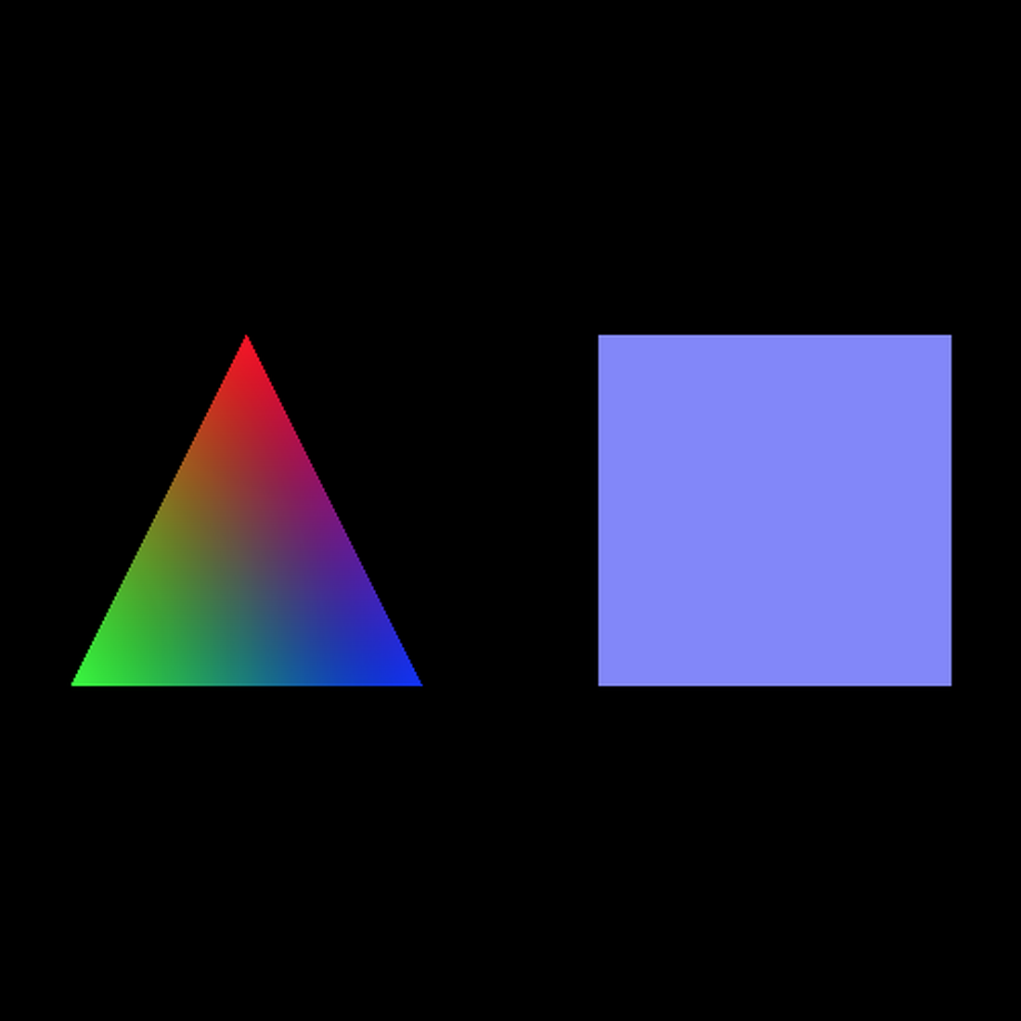
Lesson 2: Colored Triangle and Quad

Slide 24
Lesson 2: Colored Triangle and Quad
Add varying color parameter to vertex shader.
<script id="shader-vs" type="x-shader/x-vertex">
attribute vec3 aVertexPosition;
attribute vec4 aVertexColor;
uniform mat4 uMVMatrix;
uniform mat4 uPMatrix;
varying vec4 vColor;
void main(void) {
gl_Position = uPMatrix * uMVMatrix * vec4(aVertexPosition, 1.0);
vColor = aVertexColor;
}

Slide 25
Lesson 2: Colored Triangle and Quad
Make fragment shader return (interpolated) color.
<script id="shader-vs" type="x-shader/x-fragment">
precision mediump float;
varying vec4 vColor;
void main(void) {
gl_FragColor = vColor;
} </script>

Slide 26
Lesson 2: Colored Triangle and Quad
Get vertex color attribute in initShaders().
function initShaders() {
...
shaderProgram.vertexColorAttribute = gl.getAttribLocation(shaderProgram, "aVertexColor");
gl.enableVertexAttribArray(shaderProgram.vertexColorAttribute);
...
}

Slide 27
Lesson 2: Colored Triangle and Quad
Define additional global buffer variables to hold color buffers.
var triangleVertexPositionBuffer;
var triangleVertexColorBuffer; // New variable
var squareVertexPositionBuffer;
var squareVertexColorBuffer; // New variable

Slide 28
Lesson 2: Colored Triangle and Quad
Initialize color buffers in initBuffers().
function initBuffers() {
...
triangleVertexColorBuffer = gl.createBuffer();
gl.bindBuffer(gl.ARRAY_BUFFER, triangleVertexColorBuffer);
var colors = [
1.0, 0.0, 0.0, 1.0,
0.0, 1.0, 0.0, 1.0,
0.0, 0.0, 1.0, 1.0
];
gl.bufferData(gl.ARRAY_BUFFER, new Float32Array(colors), gl.STATIC_DRAW);
triangleVertexColorBuffer.itemSize = 4;
triangleVertexColorBuffer.numItems = 3;
}

Slide 29
Lesson 2: Colored Triangle and Quad
Initialize color buffers in initBuffers().
Do the same for the quad.

Slide 30
Lesson 2: Colored Triangle and Quad
Make drawScene() use the new color attributes.
function drawScene() {
...
// Before drawing triangle
gl.bindBuffer(gl.ARRAY_BUFFER, triangleVertexColorBuffer);
gl.vertexAttribPointer(shaderProgram.vertexColorAttribute, triangleVertexColorBuffer.itemSize, gl.FLOAT, false, 0, 0);
// Before drawing quad
gl.bindBuffer(gl.ARRAY_BUFFER, squareVertexColorBuffer);
gl.vertexAttribPointer(shaderProgram.vertexColorAttribute, squareVertexColorBuffer.itemSize, gl.FLOAT, false, 0, 0);
}

Slide 31
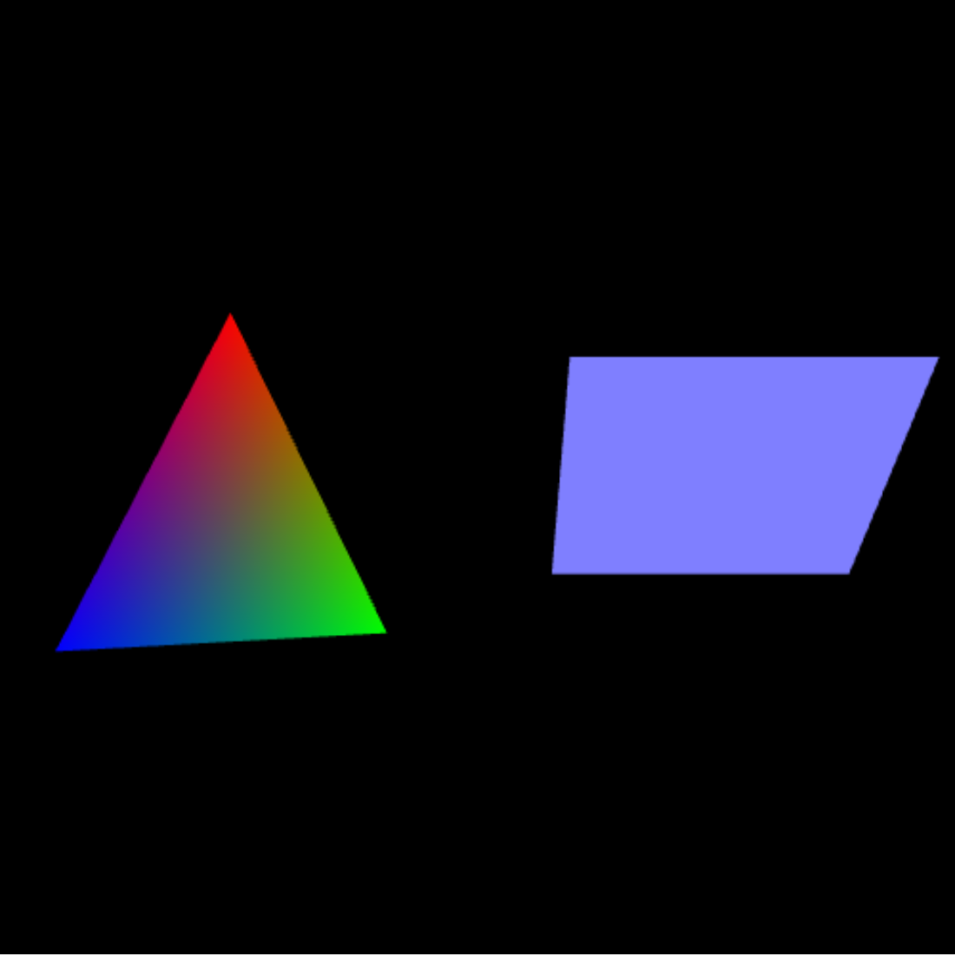
Lesson 3: Movement

Slide 32
Lesson 3: Movement
Call a function that “repaints” a new frame.
function webGLStart() {
...
tick();
}

Slide 33
Lesson 3: Movement
Repaint the new frame.
function tick() {
requestAnimFrame(tick); // Uses Google webgl-utils.js to // register tick as “repaint” callback
drawScene();
animate();
}

Slide 34
Lesson 3: Movement
Declare global rotation variables.
var rTri = 0;
var rSquare = 0;

Slide 35
Lesson 3: Movement
Advance rotation variables in animate().
var lastTime = 0;
function animate() {
var timeNow = new Date().getTime();
if (lastTime != 0) {
var elapsed = timeNow - lastTime;
rTri += (90 * elapsed) / 1000.0;
rSquare += (75 * elapsed) / 1000.0;
}
lastTime = timeNow;
}

Slide 36
Lesson 3: Movement
In drawScene(), rotate triangle/quad.
function drawScene() {
...
mvPushMatrix();
mat4.rotate(mvMatrix, degToRad(rSquare), [1, 0, 0]);
// Draw triangle
mvPopMatrix();
...
}

Slide 37
Lesson 3: Movement
Helper functions to handle our own matrix stack:
var mvMatrix = mat4.create();
var mvMatrixStack = [];
var pMatrix = mat4.create();
function mvPushMatrix() {
var copy = mat4.create();
mat4.set(mvMatrix, copy);
mvMatrixStack.push(copy);
}
function mvPopMatrix() {
if (mvMatrixStack.length == 0) {
throw "Invalid popMatrix!";
}
mvMatrix = mvMatrixStack.pop();
}

Slide 38
Class Activity: Fragment Shader Hacking
Open http://localhost:8000/webgl/lesson03.html
Edit the fragment shader on lines 23-24 of lesson03.html to create an interesting animated color pattern of your choice. You can get started by uncommenting the “dancing colors” line: gl_FragColor = vColor + cos(vPosition*10.0) + tan(vPosition) + cos(currentTime/100.0); // Uncomment to make dancing colors!

Slide 39
More Exciting WebGL Samples
http://webglsamples.org/

Slide 40
Lesson 1 in Three.js

Slide 41
Lesson 1: Triangle and Quad (Three.js)
Local Web server links: Three.js lesson 1 (also, view source)
Web links: Three.js lesson 1 (also, view source)

Slide 42
Lesson 01
Declare scene and camera, init, and render.
var scene; // Global scene object
var camera; // Global camera object
initializeScene();
renderScene();

Slide 43
Lesson 01
Set up the renderer.
function initializeScene() {
if (Detector.webgl){
renderer = new THREE.WebGLRenderer({antialias:true});
} else {
renderer = new THREE.CanvasRenderer();
}
renderer.setClearColor(0x000000, 1); // Opaque black
canvasWidth = window.innerWidth; // Viewport size
canvasHeight = window.innerHeight;
renderer.setSize(canvasWidth, canvasHeight);
document.getElementById("WebGLCanvas"). appendChild(renderer.domElement);

Slide 44
Lesson 01
Create scene and add camera.
scene = new THREE.Scene();
// Set camera field of view, aspect // ratio, near, far clipping plane
camera = new THREE.PerspectiveCamera(45, canvasWidth / canvasHeight, 1, 100);
camera.position.set(0, 0, 10);
camera.lookAt(scene.position);
scene.add(camera);

Slide 45
Lesson 01
Create triangle geometry.
var triangleGeometry = new THREE.Geometry();
triangleGeometry.vertices.push(new THREE.Vector3( 0.0, 1.0, 0.0));
triangleGeometry.vertices.push(new THREE.Vector3(-1.0, -1.0, 0.0));
triangleGeometry.vertices.push(new THREE.Vector3( 1.0, -1.0, 0.0));
triangleGeometry.faces.push(new THREE.Face3(0, 1, 2));

Slide 46
Lesson 01
Create material.
var triangleMaterial = new THREE.MeshBasicMaterial({
color:0xFFFFFF,
side:THREE.DoubleSide // Render front and back-facing polys
});

Slide 47
Lesson 01
Combine geometry and material into mesh.
var triangleMesh = new THREE.Mesh(triangleGeometry, triangleMaterial);
triangleMesh.position.set(-1.5, 0.0, 4.0);
scene.add(triangleMesh);

Slide 48
Lesson 01
Similar for the square.
But, build square geometry out of 2 triangles.
var squareGeometry = new THREE.Geometry();
squareGeometry.vertices.push(new THREE.Vector3(-1.0, 1.0, 0.0));
squareGeometry.vertices.push(new THREE.Vector3( 1.0, 1.0, 0.0));
squareGeometry.vertices.push(new THREE.Vector3( 1.0, -1.0, 0.0));
squareGeometry.vertices.push(new THREE.Vector3(-1.0, -1.0, 0.0));
squareGeometry.faces.push( new THREE.Face3(0, 1, 2));
squareGeometry.faces.push( new THREE.Face3(0, 2, 3));

Slide 49
Lesson 01
Similar for the square.
But, build square geometry out of 2 triangles.
var squareGeometry = new THREE.Geometry();
squareGeometry.vertices.push(new THREE.Vector3(-1.0, 1.0, 0.0));
squareGeometry.vertices.push(new THREE.Vector3( 1.0, 1.0, 0.0));
squareGeometry.vertices.push(new THREE.Vector3( 1.0, -1.0, 0.0));
squareGeometry.vertices.push(new THREE.Vector3(-1.0, -1.0, 0.0));
squareGeometry.faces.push( new THREE.Face3(0, 1, 2));
squareGeometry.faces.push( new THREE.Face3(0, 2, 3));

Slide 50
Lesson 2: Color (Three.js)

Slide 51
Lesson 02
Set vertex colors.
Q: What is this doing at the lower WebGL layer?
triangleGeometry.faces[0].vertexColors[0] = new THREE.Color(0xFF0000);
triangleGeometry.faces[0].vertexColors[1] = new THREE.Color(0x00FF00);
triangleGeometry.faces[0].vertexColors[2] = new THREE.Color(0x0000FF);
var triangleMaterial = new THREE.MeshBasicMaterial({
vertexColors:THREE.VertexColors,
side:THREE.DoubleSide
});

Slide 52
Lesson 3: Movement

Slide 53
Lesson 03
Call animateScene(), which calls renderScene().
// Call animateScene() instead of renderScene.
animateScene();
function animateScene(){
triangleMesh.rotation.y += 0.1;
squareMesh.rotation.x -= 0.075; // Register animation callback
requestAnimationFrame(animateScene);
renderScene();
}

Slide 54
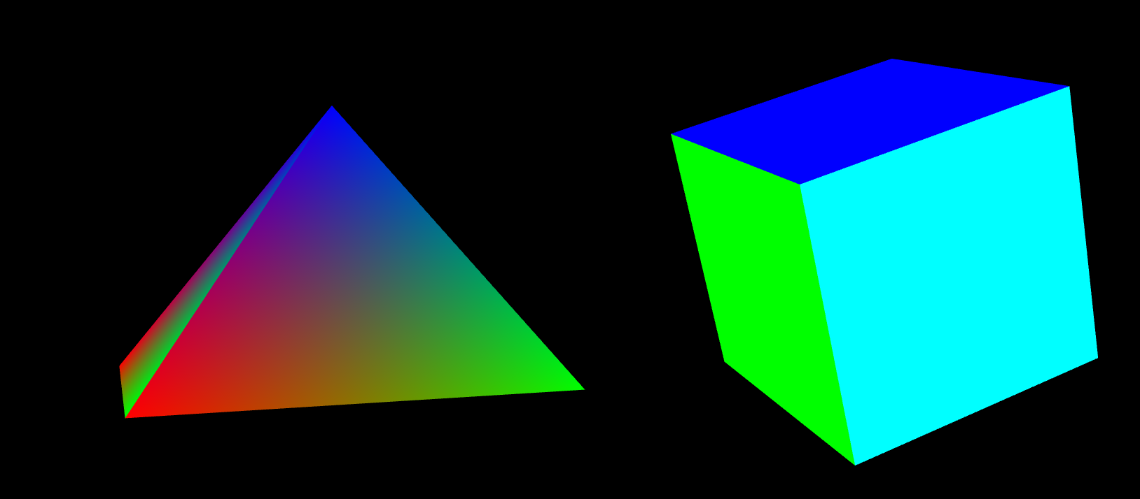
Lesson 4: 3D Shapes

Slide 55
Lesson 04
Q: How could we build the pyramid and cube?

Slide 56
Lesson 04: Pyramid
function initializeScene() {
...
var pyramidGeometry = new THREE.CylinderGeometry( 0, 1.5, 1.5, 4, false);
// top and bottom radius, height, segments
for(i = 0; i < pyramidGeometry.faces.length; i++) {
pyramidGeometry.faces[i].vertexColors[0] = new THREE.Color(0xFF0000);
pyramidGeometry.faces[i].vertexColors[1] = new THREE.Color(0x00FF00);
pyramidGeometry.faces[i].vertexColors[2] = new THREE.Color(0x0000FF);
}
...

Slide 57
Lesson 04: Box
var boxGeometry = new THREE.BoxGeometry(1.5, 1.5, 1.5); // Size
var boxMaterials = [
new THREE.MeshBasicMaterial({color:0xFF0000}),
new THREE.MeshBasicMaterial({color:0x00FF00}),
new THREE.MeshBasicMaterial({color:0x0000FF}),
new THREE.MeshBasicMaterial({color:0xFFFF00}),
new THREE.MeshBasicMaterial({color:0x00FFFF}),
new THREE.MeshBasicMaterial({color:0xFFFFFF})
];
...

Slide 58
Lesson 04: Box
// Use different material on every face
var boxMaterial = new THREE.MeshFaceMaterial(boxMaterials);
// Create a mesh from geometry and material.
boxMesh = new THREE.Mesh(boxGeometry, boxMaterial);
boxMesh.position.set(1.5, 0.0, 4.0);
scene.add(boxMesh);

Slide 59
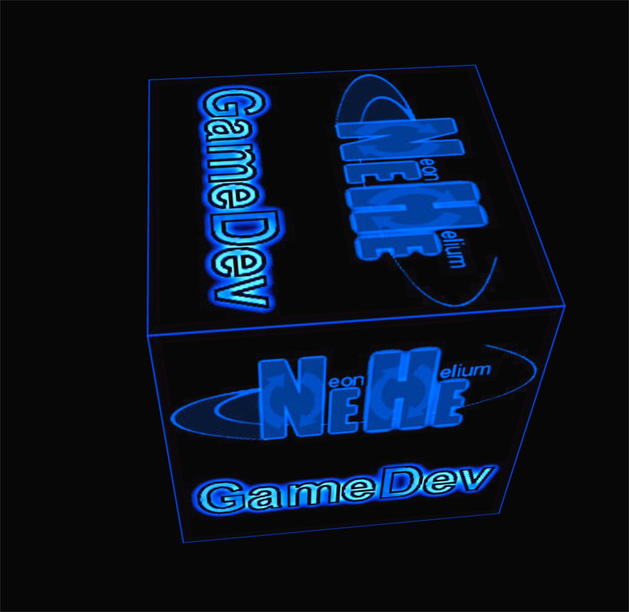
Lesson 5: Texture

Slide 60
Lesson 05: Texture
var boxGeometry = new THREE.BoxGeometry(2.0, 2.0, 2.0);
var neheTexture = new THREE.ImageUtils.loadTexture("NeHe.jpg");
var boxMaterial = new THREE.MeshBasicMaterial({
map:neheTexture,
side:THREE.DoubleSide });
boxMesh = new THREE.Mesh(boxGeometry, boxMaterial);
boxMesh.position.set(0.0, 0.0, 4.0);
scene.add(boxMesh);

Slide 61
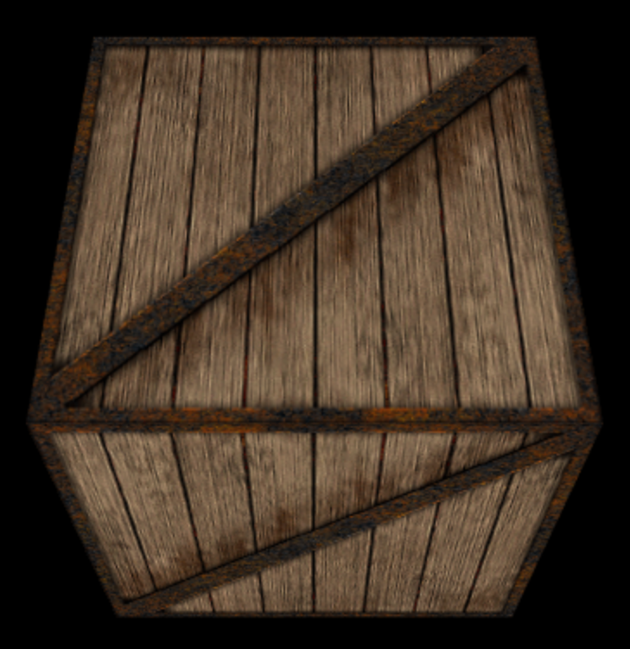
Lesson 6: Keyboard, Lighting

Slide 62
Lesson 06: Keyboard, Lighting
// Lambertian (lit) textured material model var boxMaterial = new THREE.MeshLambertMaterial({
map:crateTexture,
side:THREE.DoubleSide
});
// Build a box the same as before
boxMesh = new THREE.Mesh(boxGeometry,
boxMaterial);
boxMesh.position.set(camera.position.x, camera.position.y, camera.position.z);
scene.add(boxMesh);

Slide 63
Lesson 06: Keyboard, Lighting
// Ambient light, given color and intensity
var ambientLight = new THREE.AmbientLight(0x101010, 1.0);
scene.add(ambientLight);
// Directional light, given color, intensity
directionalLight = new THREE.DirectionalLight(0xffffff, 1.0);
directionalLight.position.set(0.0, 0.0, 1.0);
scene.add(directionalLight);

Slide 64
Lesson 06: Keyboard, Lighting
Install keyboard event callback at the end of initializeScene():
document.addEventListener("keydown", onDocumentKeyDown, false);

Slide 65
Lesson 06: Keyboard, Lighting
Keyboard handler
if(keyCode == 70) { // ASCII code for F
switch(textureFilter){
case 0:
crateTexture.minFilter = THREE.NearestFilter;
crateTexture.magFilter = THREE.NearestFilter;
textureFilter = 1; break;
...
};
crateTexture.needsUpdate = true;

Slide 66
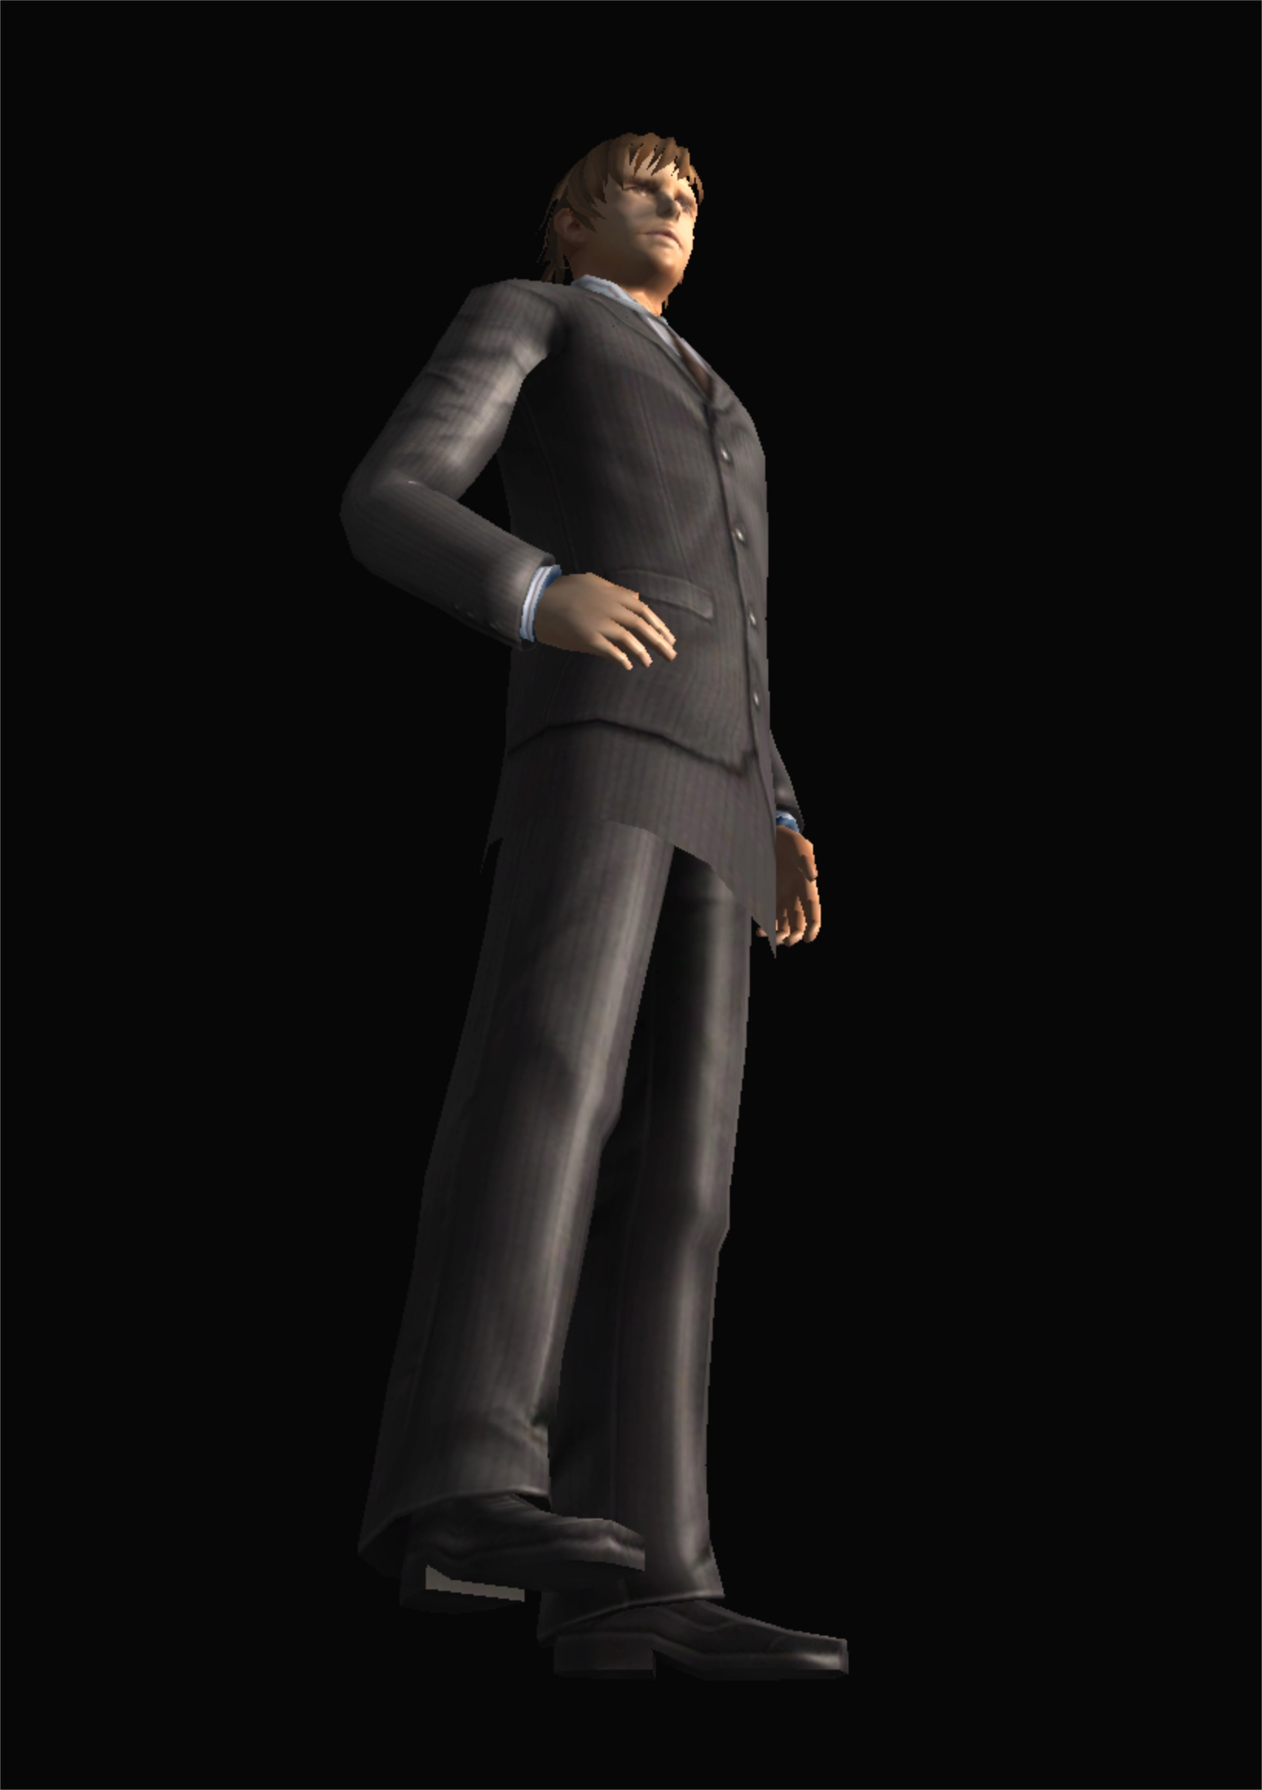
Three.js Examples: OBJ/MTL Loader
OBJ / MTL Loader Example on local server

Slide 67
Model Loader: Scene Code
scene = new THREE.Scene();
var ambient = new THREE.AmbientLight(0x444444);
scene.add(ambient);
var directionalLight = new THREE.DirectionalLight(0xffeedd);
directionalLight.position.set( 0, 0, 1).normalize();
scene.add(directionalLight);

Slide 68
Model Loader: Progress Indicator
var onProgress = function ( xhr ) {
if (xhr.lengthComputable ) {
var percentComplete = xhr.loaded / xhr.total * 100;
console.log( Math.round(percentComplete, 2) + '% downloaded' );
}
};
var onError = function ( xhr ) {
};
THREE.Loader.Handlers.add( /\.dds$/i, new THREE.DDSLoader() );

Slide 69
Model Loader: Load Model
var loader = new THREE.OBJMTLLoader();
loader.load('obj/male02/male02.obj’, 'obj/male02/male02_dds.mtl’,
function (object) {
object.position.y = - 80;
scene.add(object);
}, onProgress, onError);

Slide 70
Lesson 1: Triangle and Quad (Three.js)
Three.js

Slide 71
Three.js Mesh Loader
Simple tutorial three.js

Slide 72
Model Loader: Where to Get Models
Can download OBJ format from some 3D model repositories, e.g.
https://sketchfab.com/download
http://tf3dm.com/3d-models/textures/1/obj
See also other websites:
https://3dwarehouse.sketchup.com/?hl=en
https://www.thingiverse.com/
Can convert to OBJ format using MeshLab

